Slide 1
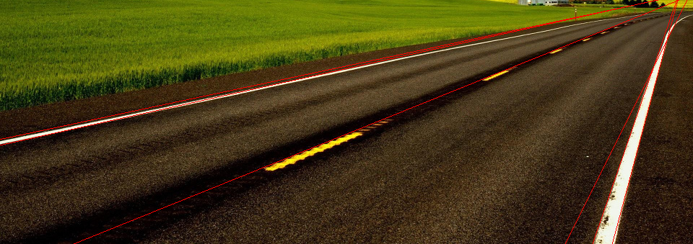

HOUGH-TRANSFORM WITH CUDA
PARALLEL COMPUTING
PRESENTATION 2015-02-03
Parallel Computing
Christian Mielers – Phil Yannick Schrör

Slide 2


Goal: Detection of Edges
Input image
Visualization of the result
PARALLEL COMPUTING CHRISTIAN MIELERS - PHIL YANNICK SCHRÖR | BOCHUM | 3rd OF FEBRUARY 2015

Slide 3
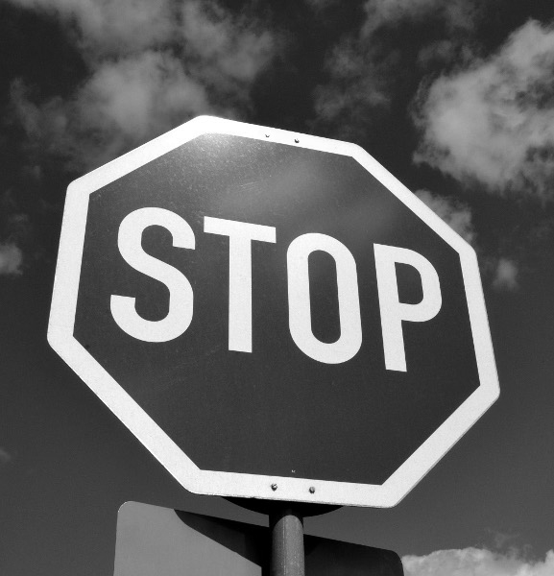
Convert to Gray Scale
Color image
Gray scale image
PARALLEL COMPUTING CHRISTIAN MIELERS - PHIL YANNICK SCHRÖR | BOCHUM | 3rd OF FEBRUARY 2015

Slide 4
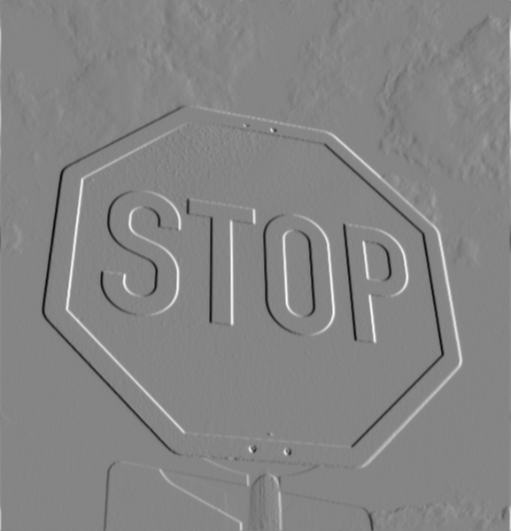
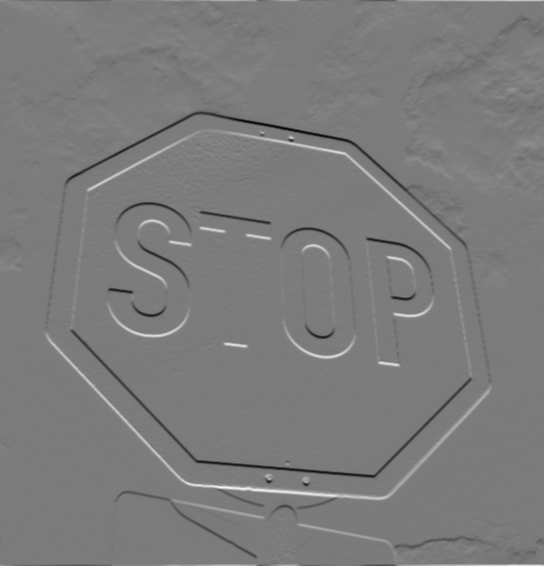
Detect Contours
Convolve with vertical Sobel filter
Convolve with horizontal Sobel filter
PARALLEL COMPUTING CHRISTIAN MIELERS - PHIL YANNICK SCHRÖR | BOCHUM | 3rd OF FEBRUARY 2015

Slide 5
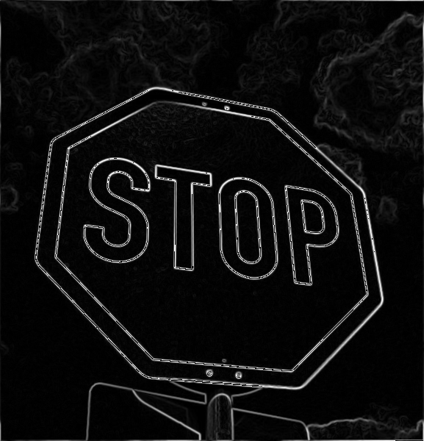
Gradient strength
Combination of Sobel X and Sobel Y convolution results
Compute gradient strength at each position via
Gradient strength
PARALLEL COMPUTING CHRISTIAN MIELERS - PHIL YANNICK SCHRÖR | BOCHUM | 3rd OF FEBRUARY 2015

Slide 6

Binarization
Gradient strength
Binary image
PARALLEL COMPUTING CHRISTIAN MIELERS - PHIL YANNICK SCHRÖR | BOCHUM | 3rd OF FEBRUARY 2015

Slide 7
Hough parameterization
x
θ
y
r
Hough transform Prameterization with θ and r
PARALLEL COMPUTING CHRISTIAN MIELERS - PHIL YANNICK SCHRÖR | BOCHUM | 3rd OF FEBRUARY 2015

Slide 8
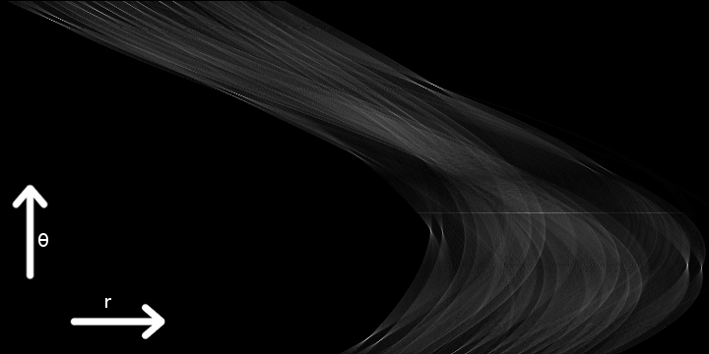
Vote for lines
Accumulator Array – rotated counter clockwise by 90°, scaled to fit
PARALLEL COMPUTING CHRISTIAN MIELERS - PHIL YANNICK SCHRÖR | BOCHUM | 3rd OF FEBRUARY 2015

Slide 9
Extraction of strongest lines
Isolate local maxima
  force minimal distance
  exclude borders
Sort by intensity
Choose k strongest lines
Visualization of 16 strongest lines
PARALLEL COMPUTING CHRISTIAN MIELERS - PHIL YANNICK SCHRÖR | BOCHUM | 3rd OF FEBRUARY 2015

Slide 10
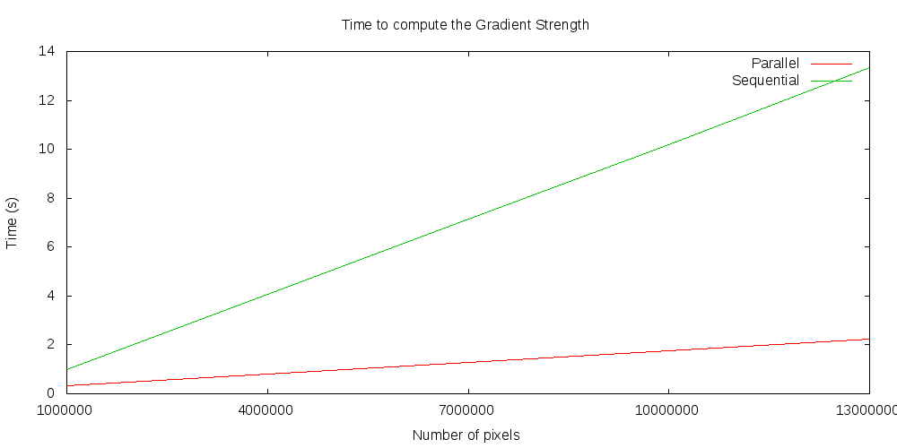
Time to compute the Gradient Strength
Time to compute the Gradient Strength
PARALLEL COMPUTING CHRISTIAN MIELERS - PHIL YANNICK SCHRÖR | BOCHUM | 3rd OF FEBRUARY 2015

Slide 11
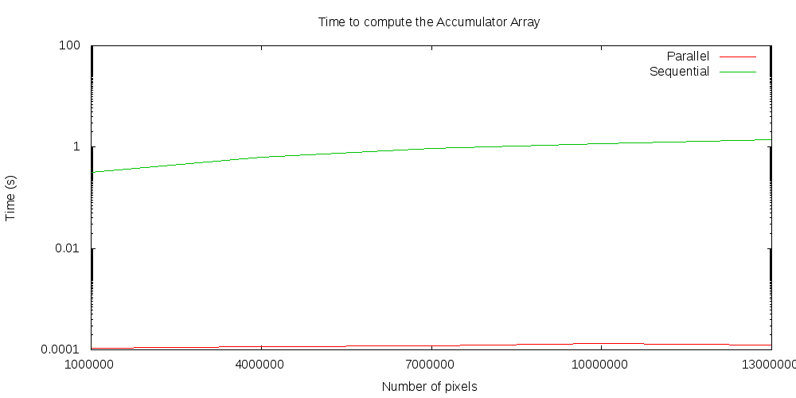
Time to compute Accumulator Array
Time to compute the Accumulator Array
PARALLEL COMPUTING CHRISTIAN MIELERS - PHIL YANNICK SCHRÖR | BOCHUM | 3rd OF FEBRUARY 2015

Slide 12
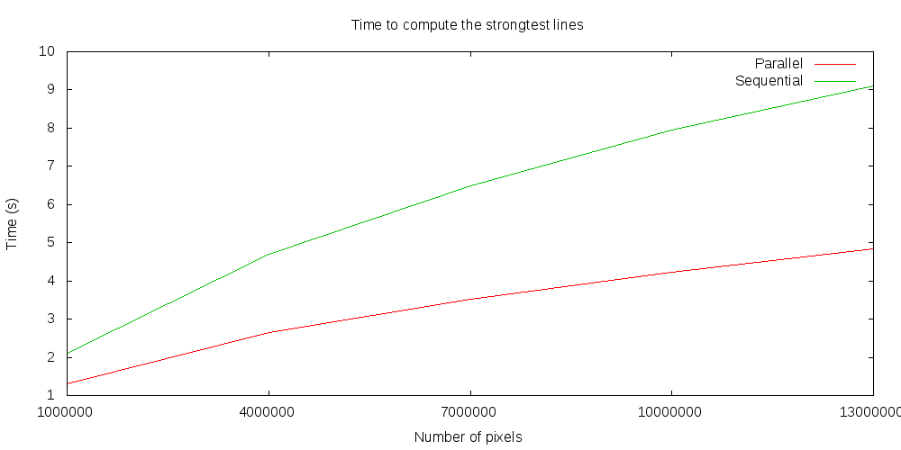
Time to extract strongest lines
Time to extract the strongest lines
PARALLEL COMPUTING CHRISTIAN MIELERS - PHIL YANNICK SCHRÖR | BOCHUM | 3rd OF FEBRUARY 2015

Slide 13
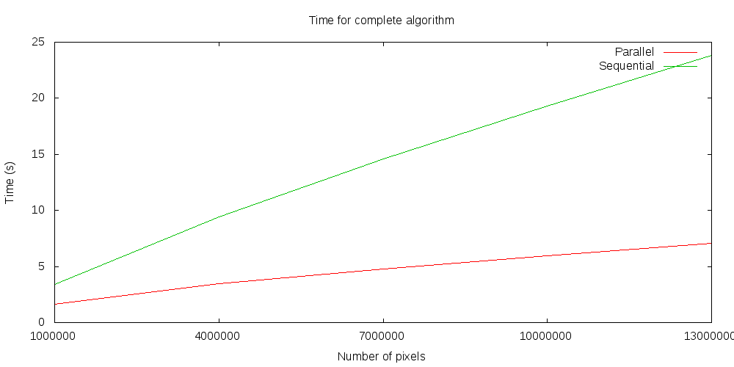
Total time
Time for complete algorithm
PARALLEL COMPUTING CHRISTIAN MIELERS - PHIL YANNICK SCHRÖR | BOCHUM | 3rd OF FEBRUARY 2015

Slide 14

Any Questions?
PARALLEL COMPUTING CHRISTIAN MIELERS - PHIL YANNICK SCHRÖR | BOCHUM | 3rd OF FEBRUARY 2015

Slide 15
ANGEWANDTE INFORMATIK
TUTORIUM
22.10.2013
Studiengang Angewandte Informatik
Christian Mielers

Slide 16
Headline
PARALLEL COMPUTING CHRISTIAN MIELERS - PHIL YANNICK SCHRÖR | BOCHUM | 3rd OF FEBRUARY 2015

Slide 17
Headline
Bildunterschrift Sitat und dore ipsum
PARALLEL COMPUTING CHRISTIAN MIELERS - PHIL YANNICK SCHRÖR | BOCHUM | 3rd OF FEBRUARY 2015

Slide 18
Headline
Bildunterschrift Sitat und dore ipsum
Bildunterschrift Sitat und dore ipsum
PARALLEL COMPUTING CHRISTIAN MIELERS - PHIL YANNICK SCHRÖR | BOCHUM | 3rd OF FEBRUARY 2015

Slide 19
Headline
Bildunterschrift Sitat und dore ipsum
PARALLEL COMPUTING CHRISTIAN MIELERS - PHIL YANNICK SCHRÖR | BOCHUM | 3rd OF FEBRUARY 2015

