Slide 1


Slide 2

Uses augmented reality to aid with the initial alignment of highly directional microwave antennas
Built using the Wikitude SDK
Indicates direction of transmitting antenna along with:
Expected SNR
Elevation angle for optimal signal
Distance, frequency, gain etc. of transmitting antenna
Map view of antenna locations

Slide 3
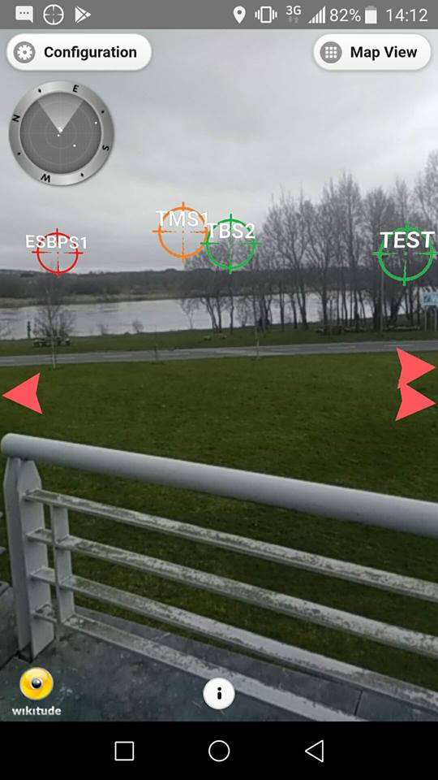
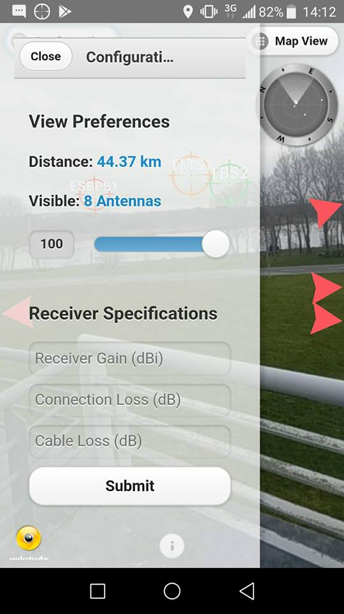
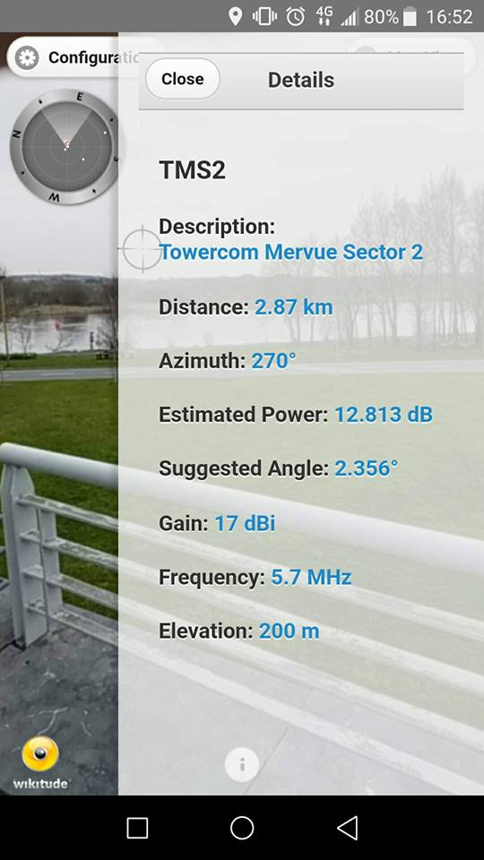
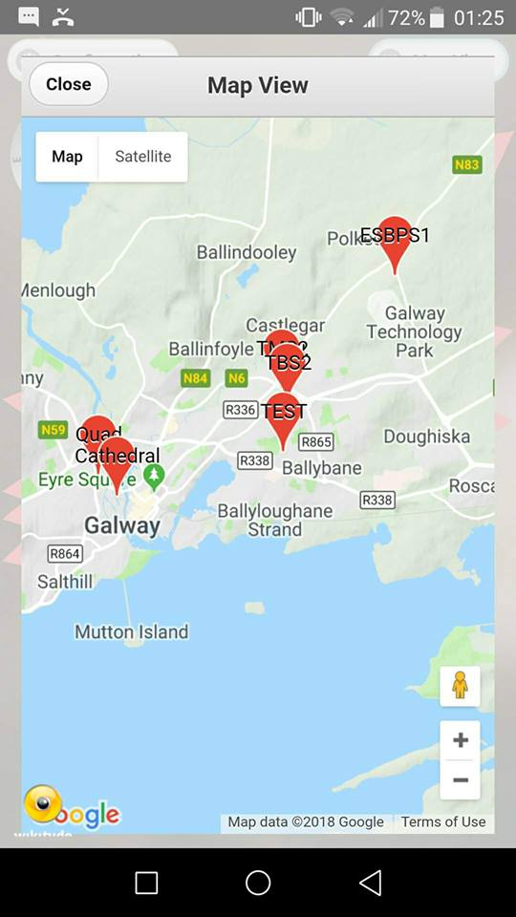
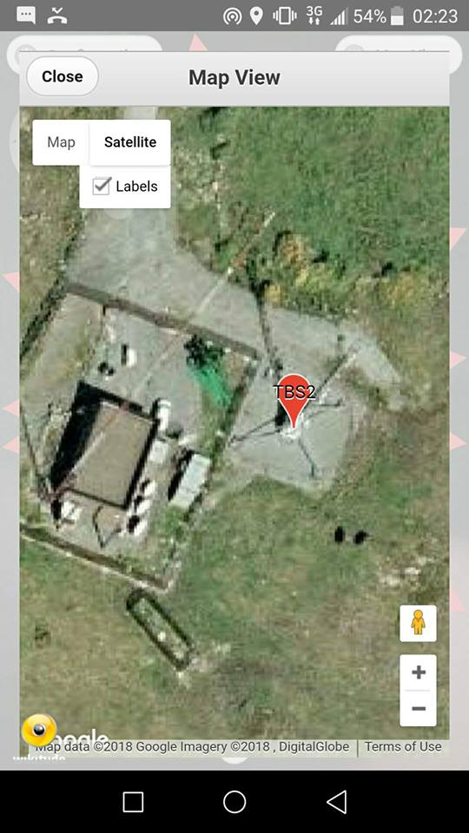
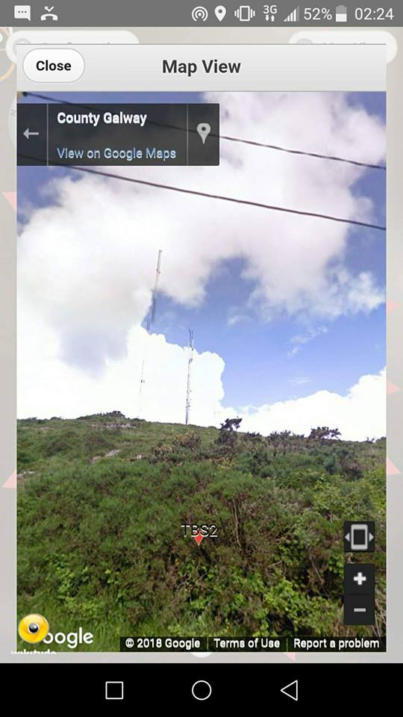
Features Include:
Easy form of user input to accurately estimate expected SNR
Sector filtering based on azimuth & user’s location
Antenna filtering based on distance
Marker categorization based on expected SNR
Map View including satellite & street view
Indicators to direct users to available Satellites
Radar to aid users in finding desired antennas
Server-side GUI to manage antenna locations and properties

