Slide 1
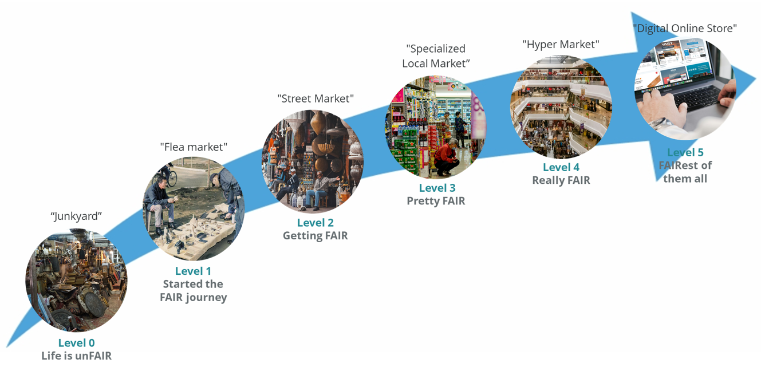
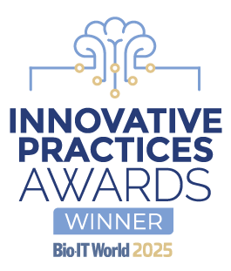

FAIR Maturity and Business Value
fairmm.pistoiaalliance.org
CC BY 4.0 ​​
Data exchange across functions enables more and better quality AI training data sets for LLM. It facilitates insight generation (e.g., competitive intelligence, market access, clinical development) by humans and machines. Interoperability enables data-set integration. Facilitated regulatory compliance and auditing.
Ability to exchange and augment data sets across organizations. Cross-organizational insight generation. AI trusted actionability significantly increase. Increased cost-effectiveness of FAIR infrastructure investments via cost-sharing across organizations. Secondary reuse of data emerges . Real-world evidence data-mining and improved patient outcomes. Enhanced drug development efficacy, drug repurposing, and overall reduced time-to-market are expected. Level 5 represents the emerges a truly data centric ecosystem with interoperable and reusable data across organizations.
Department-level data reuse and insight generation; increased effectiveness and efficiency of data resources available in the organization. Reuse of data reduces procurement costs and the need for data generation.
Speed, cost-effectiveness, and machine automation increase. Use-cases for machine-findable and interpretable data start becoming possible. Data access quantification and qualification (license, costs) reduce barriers to access. Being decoupled from applications, data increases its applicability, further reducing the need for new data creation or acquisition.
Speed and cost are the main benefits. Humans can more efficiently locate important data assets; for example, researchers take much less time to find data. There is also a reduction in redundant data collection. Data is recognised as a Strategic Asset.
Application Centric Business Value, classically, we see desktop integration of disparate data systems. Data is a “tactical asset”.
Status QUO
BEST PRACTICE
ASPIRATIONAL

