Slide 1
Statistical Distribution
Fatemeh Riahi
BCIT
Notes:
Page r

Slide 2
Statistics and Data Science
“A data scientist is someone who knows more
statistics than a computer scientist and more
computer science than a statistician.”
- Josh Blumenstock (Univ. of Washington)

Slide 3
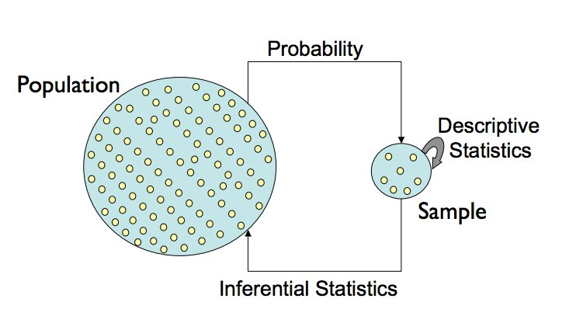
The Central Dogma of Statistics
Notes:
from the lecture slides at www.gs.washington.edu/academics/courses/akey/56008/lecture/lecture2.pdf
🧠 The big idea
This diagram summarizes the entire logic of statistics in one loop.
It shows how we move between populations and samples, using two key processes:
Probability (top arrow)
Inference (bottom arrow)
This is called the Central Dogma of Statistics because almost everything in statistics — from simple averages to deep learning — builds on this flow.
🔁 Step-by-step explanation
1️⃣ Population → Sample (via Probability)
The population is the entire set of things we care about (e.g., all voters, all trees in BC, all patients in a study).
But we can’t observe or measure everyone — it’s too large.
So we use probability to model how a sample is drawn from that population.
Example: randomly selecting 1,000 voters from all voters in Canada.
🎯 Goal: ensure the sample is representative, so we can trust it.
2️⃣ Sample → Descriptive Statistics
Once we have the sample, we calculate descriptive statistics — things like:
Mean, median, standard deviation
Graphs, histograms, boxplots
These describe what we actually observed in the sample.
Example: “The average income in our sample is $60,000.”
🎯 Goal: summarize the data we have.
3️⃣ Sample → Population (via Inference)
Using inferential statistics, we go backward from the sample to the population.
We estimate unknown population characteristics (parameters) and quantify uncertainty.
Example: “We estimate that the average income in the population is $60,000 ± $3,000.”
🎯 Goal: make conclusions about the population from limited data.
4️⃣ Population → Sample (closing the loop)
In theory, the population model (via probability) generates samples.
In practice, we reverse engineer this:
We observe a sample and try to guess what kind of population model produced it.
That’s why the loop connects probability (forward thinking) and inference (backward reasoning).

Slide 4
Statistical Data Distributions
Every observed random variable has a particular frequency/probability distribution.
Some distributions occur often in practice/theory:
The Binomial Distribution
The Normal Distribution
The Poisson Distribution
The Power Law Distribution

Slide 5
Significance of Classical Distributions
Classical probability distributions arise often in practice, so look out for them.
Closed-form formulas and special statistical tests often exist for particular distributions.
However, your observed data does not necessarily come from a particular distribution just because the shape looks similar.

Slide 6

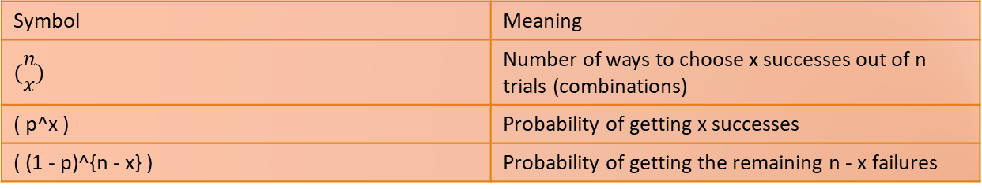
Binomial Distributions
Experiments consist of n identical, independent trials which have two possible outcomes, with probabilities p and (1-p) like heads or tails.
The observed season batting averages of a p=0.300 hitter were drawn from a binomial distribution.
Symbol | Meaning
$$(\begin{matrix}n \\ x\end{matrix})$$ | Number of ways to choose x successes out of n trials (combinations)
( p^x ) | Probability of getting x successes
( (1 - p)^{n - x} ) | Probability of getting the remaining n - x failures
Notes:
The binomial distribution describes the number of successes in a fixed number of independent trials, each with the same probability of success.
It’s used when you repeat an experiment multiple times — like flipping a coin, rolling a die, or a baseball player taking swings — and count how many times you get a certain outcome (like a hit, head, or success).
⚙️ The setup
We have:
n: number of trials (e.g., 100 swings, 10 coin flips)
p: probability of success on each trial (e.g., 0.3 chance of getting a hit)
X: number of successes (how many hits)

Slide 7
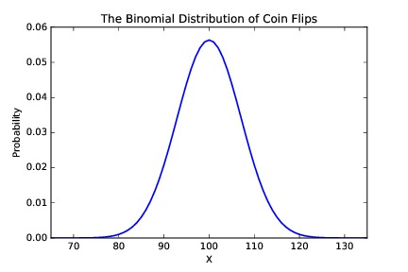
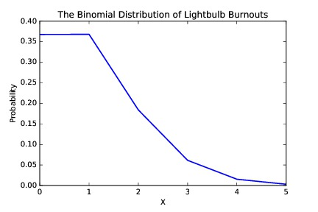
Properties of Binomial Distributions
Discrete, but bell (or half-bell) shaped
Lightbulb burnouts: p=0.001 n=1000
Coin flips: p=0.5 n=200
The distribution is a function of n and p.
Notes:
⚙️ The big idea
The binomial distribution depends on two parameters:
n: the number of trials
p: the probability of success on each trial
Different combinations of n and p produce very different shapes — even though the same formula defines them.
💬 “The binomial distribution’s shape and spread depend entirely on how likely success is, and how many chances you get.”
🎯 Key property
It’s discrete (counts only whole numbers), but its shape can vary:
Symmetric like a bell curve (when p≈0.5p \approx 0.5p≈0.5)
Skewed (when ppp is very small or very large)
🪙 Example 1: Coin flips
n=200, p=0.5
Each trial has two outcomes: heads or tails.
Here, the probability of success (0.5) is balanced.
With many trials (200), the binomial distribution becomes almost symmetric and bell-shaped, centered around np=100.
This looks like a Normal (Gaussian) curve because of the Central Limit Theorem:
“When you repeat a fair random process many times, the sum (or count) tends to form a bell curve.”
✅ Interpretation:
Most outcomes are near 100 heads, but very few near 70 or 130.

Slide 8

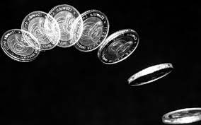

Variance of the Binomial Distribution
The closed form is:
The mode, mean, and median is np for integers.
The probability of getting exactly n/2 heads is O(1/sqrt{n}), so it is actually quite low.

Slide 9
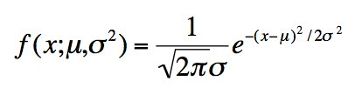
The Normal Distribution
The bell-shaped distribution of height, IQ, etc.
Completely parameterized by mean and standard deviation:
Not all bell-shaped distributions are normal but it is generally a reasonable start.
whenever you want to calculate the probability density of a continuous variable that follows (or approximately follows) a normal distribution.
For example:
If X∼N(100,15^2) (IQ scores),
and you want to know how likely someone with IQ = 130 is,
Region | Approx. % of data
μ ± 1σ | 68%
μ ± 2σ | 95%
μ ± 3σ | 99.7%
Notes:
The normal distribution — also called the Gaussian distribution — is one of the most important and commonly used probability distributions in statistics.
It’s the classic “bell curve”, symmetric around the mean, where most observations cluster near the center and fewer occur at the extremes.
📊 2️⃣ Real-world examples
Many natural and human-made measurements follow (or approximately follow) a normal distribution:
Heights of people
IQ scores
Measurement errors in experiments
Blood pressure, exam scores, or machine tolerances
💬 “Whenever you have many small, independent factors adding up, the result tends to be approximately normal.”
This is why it appears so frequently in practice — a direct result of the Central Limit Theorem.
⚙️ 3️⃣ The formula
the mean (center) — shifts the curve left or right
σ\sigmaσ: the standard deviation — controls the spread or width of the bell

Slide 10
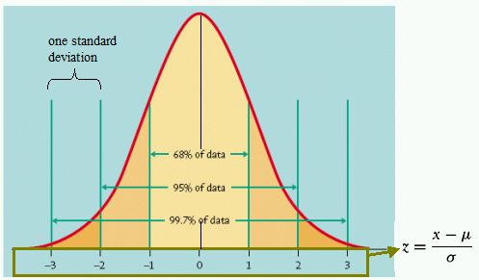
Interpreting the Normal Distribution
Tight bounds on probability follow for Z-scores from normally distributed random variables:
IQ is normally distributed, with mean 100 and standard deviation 15.
Thus about 2.5% of people have IQs above 130.

Slide 11
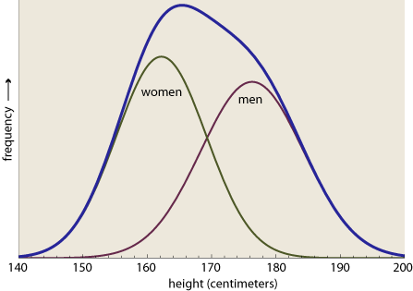
What’s not Normal?
Not all bell-shaped distributions are normal (i.e. stock returns are log normal with fat tails).
Mixtures of normal distributions are not normal, like full population heights.
Statistical tests exist to establish whether data is drawn from a normal distribution, but populations are generally mixtures of multiple distributions: height, weight, IQ

Slide 12

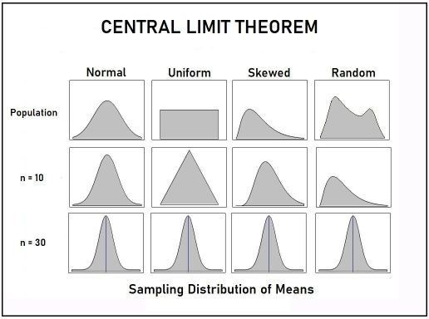
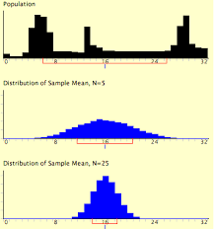
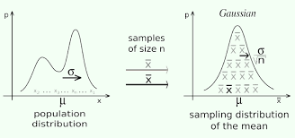
The Central Limit Theorem
The mean of n independent samples from any distribution converges to the normal distribution
If the population distribution has mean and SD , the mean distribution of n samples has mean and SD
Notes:
⚙️ 1️⃣ The Big Idea
The Central Limit Theorem (CLT) is one of the most important results in statistics.
It explains why the normal distribution shows up so often — even when the original data are not normal.
💬 “No matter what your data look like, if you take enough averages, those averages will look normal.”
🧩 2️⃣ The setup
You have:
A population (of any shape: skewed, uniform, random, etc.)
Population mean = μ\muμ
Population standard deviation = σ\sigmaσ
Now, you take many samples, each of size nnn, and calculate their sample means Xˉ\bar{X}Xˉ.
📈 3️⃣ What the theorem says
As nnn (sample size) gets larger:
The distribution of the sample means becomes approximately normal,
even if the original population is not normal.
The mean of those sample means = μ\muμ (same as the population mean)
The standard deviation of the sample means =
Standard Error=σn\text{Standard Error} = \frac{\sigma}{\sqrt{n}}Standard Error=n​σ​
💬 “The more data you average, the more stable and predictable that average becomes.”

Slide 13

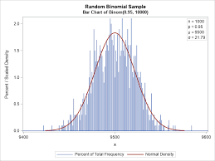
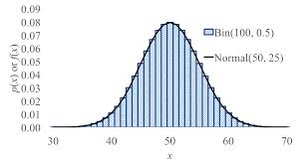
The Binomial Distribution is Normal
The number of heads in n tosses is the sum of n independent samples of a 0-1 random variable with mean p and
Thus the average number of heads is approximated by the normal distribution.
Head count Z-scores are normal
Notes:
The binomial distribution counts the number of “successes” (like heads in coin flips) across n independent trials with probability p of success per trial.
When the number of trials nnn is large, this binomial distribution becomes approximately normal.
💬 “A binomial distribution is just the sum of many little 0–1 random variables — and sums of many random variables tend to look normal.”
This is a direct application of the Central Limit Theorem.

Slide 14

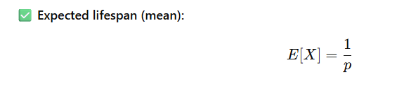
Lifespan/Geometric Distributions
If your chance of surviving any given day is probability p, what is your lifespan distribution?
A lifespan of n days means dying for the first time on day n, so
Lightbulb life spans are better modeled with such a distribution, not dead bulbs per 1000 hours.
Notes:
The idea
The geometric distribution models the number of trials needed to get the first success (or first failure).
In this context, “success” means the event happens — e.g., a lightbulb burns out, or a person dies.
So the question is:
“If you have a constant chance p of dying (or failing) each day,
what’s the probability that you survive until day n−1 and die on day n?”
The probability formula
here’s what each term means:
P^n-1 probability of surviving for n−1
(you didn’t fail yet — success each previous day)
(1−p): probability of failing (dying/burning out) on the nth day
So this gives the chance that the first failure happens on day n.

Slide 15
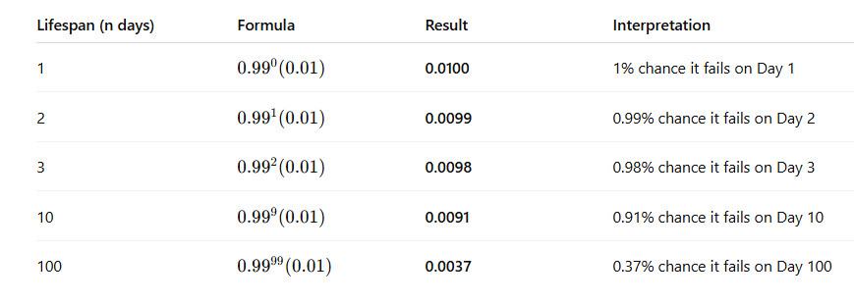

Example
Scenario
You have a factory that makes LED lightbulbs.
Each bulb has a 1% chance (p = 0.01) of burning out on any given day.
The bulbs are tested daily, and we want to find:
“What is the probability that a bulb lasts for a certain number of days before it burns out for the first time?”
What’s the expected lifespan?
The mean (expected number of days until burnout) is:

Slide 16


The Poisson Distribution
The Poisson distribution measures the frequency of intervals between rare events.
Instead of event probability p, it is parameterized by mean mu, equivalent because
The Poisson distribution is Normal with
Notes:
The Poisson distribution models how many times a rare event occurs in a fixed interval of time, space, or area.
It’s perfect for describing counts of infrequent events — like:
Number of accidents per week
Number of emails received per hour
Number of typing errors on a page
Number of bacteria in a petri dish

Slide 17
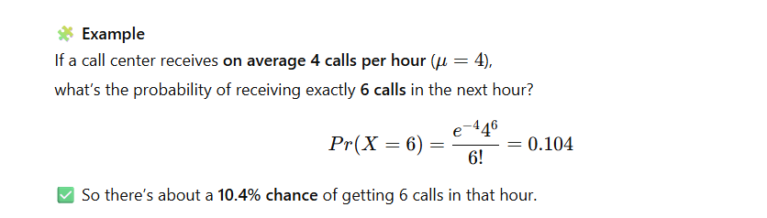
Example

Slide 18
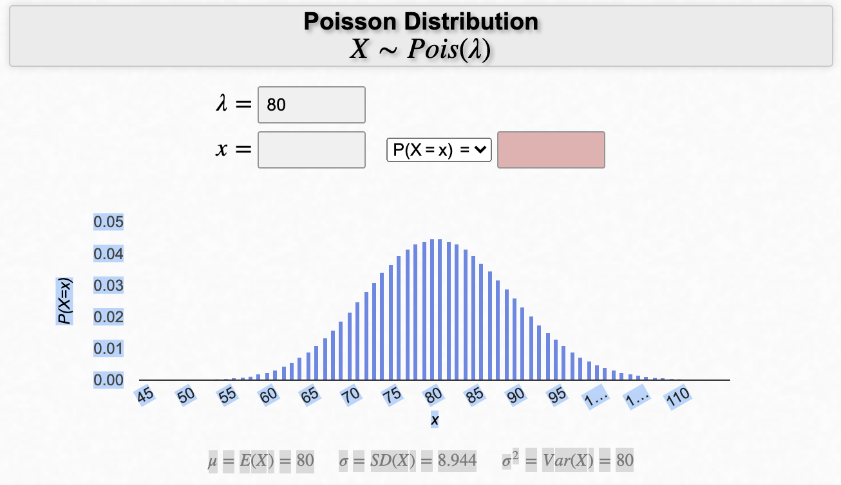
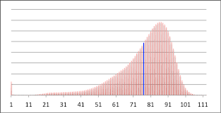

Distribution of Human Lifespans
From an average lifespan = 80, the Poisson distribution looks kind of reasonable.
But is the probability of dying each day constant over all ages?

Slide 19
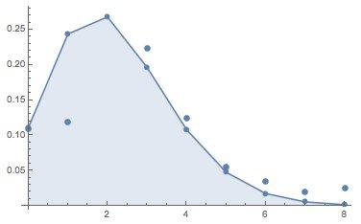
Distribution of Kids per Family
The average U.S. family has 2.2 kids, but how are they distributed?
If families repeatedly decide whether to have any more children with fixed probability p we get a Poisson distribution:
x (children) | P(X=x) | Approx. % of families
0 | 0.11 | 11% (no children)
1 | 0.24 | 24%
2 | 0.26 | 26%
3 | 0.19 | 19%
4 | 0.10 | 10%
5+ | <0.07 | Less than 7%
Notes:
🧠 1️⃣ The question being asked
We know the average number of children per U.S. family is about 2.2,
but averages alone don’t tell the full story.
💬 “If the average is 2.2, does that mean every family has two or three kids? Of course not — the real question is: how are family sizes distributed?”
That’s where the Poisson distribution can help.
⚙️ 2️⃣ Why Poisson makes sense here
The Poisson distribution models the number of events (like births) that occur over a fixed interval,
when:
Each event happens independently,
There’s a constant average rate λ\lambdaλ,
And the probability of two events happening “at once” is very small.
If we think of “having a child” as a rare event that happens independently over a couple’s childbearing years,
then the number of kids per family can be modeled by a Poisson distribution.

Slide 20
Power Law Distributions
Power laws are defined p(x) = c x^{-a}, for exponent a and normalization constant c.
They do not cluster around a mean like a normal distribution, instead having very large values rarely but consistently.
They define 80-20 rules: 20% of the X get 80% of the Y.
Notes:
“Most of the time in statistics, we deal with normal distributions —
where values cluster around a mean: most people are average height,
a few are shorter or taller, but not drastically so.”
“Power laws are the opposite: they describe systems where a few values are extremely large, and most are small — but those extreme values happen consistently enough to shape the system.”
Here, α\alphaα (alpha) controls how fast probabilities drop off —
larger α means fewer large values.
The constant ccc just makes sure everything adds up to 1

Slide 21
City Population Yield Power Laws
The average big US city has population 165,719. Even with a huge standard deviation of 410,730, the biggest city under a normal distribution should be Indianapolis (780K).
New York city had 8,008,278 people in the 2000 census.
Power laws arise when the rich get richer.

Slide 22
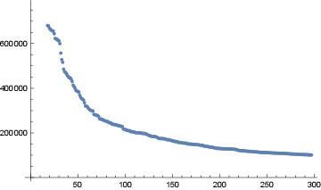
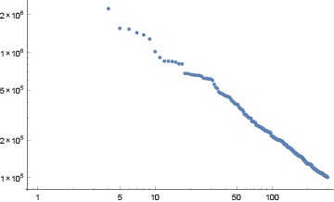
Linear and Log-Log Plots for City Pop
Straight lines on log-log plots say power law.
The biggest values are out of scale on linear plots.

Slide 23
Wealth Yields Power Laws
1 Bill Gates has $80 billion.
5 Hyperbillionaries have $40 billion each.
25 SuperBillionaries have $20 billion each.
125 MultiBillionaries have $10 billion each.
625 Billionaries have $5 billion each.
Power law: as you multiply the value by x, you divide the number of people by y.

Slide 24

Definitions of Power Laws
For a power law distributed variable X,
The constant c is unimportant: for a given a this constant c ensures the probability sums to 1.
Doubling x (to 2x) reduces the probability by a factor of 2^a, so larger values keep getting rarer at steady, non-decreasing rate.

Slide 25
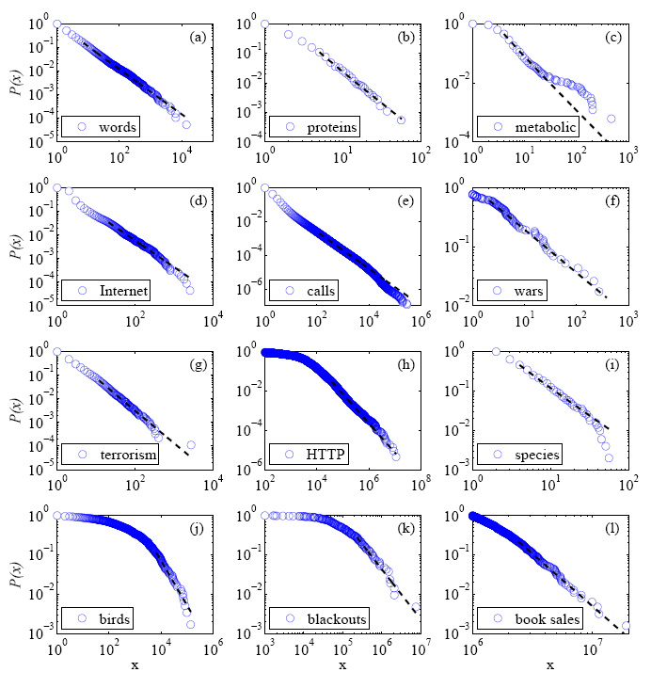
Many Distributions are Power Laws
Internet sites with x inlinks.
Frequency of earthquakes at x on the Richter scale
Words used with a relative frequency of x
Wars which kill x people
Power laws show as straight lines on log value, log frequency plots.

Slide 26
Resources
I would like to thank Dr. Steven S. Skiena, Dr. Christian Kästner, and Chip Huyen for the valuable resources they have provided through their coursework in machine learning and data science. Their materials have been instrumental in shaping my teaching in these areas.
The Data Science Design Manual, Steven S. Skiena
Learning From Data, by Yaser S. Abu-Mostafa, Malik Magdon-Ismail, Hsuan-Tien Lin
Machine Learning in Production: From Models to Products by Christian Kästner
Designing Machine Learning Systems, Chip Huyen

