Slide 1
Scores Ranking and Statistical Distribution
Fatemeh Riahi
BCIT
Notes:
Page r

Slide 2







Scores and Rankings
Scoring functions are measures that reduce multi-dimensional data to a single value, to highlight some particular property.
Rankings order items, usually by sorting scores.

Slide 3
Assigning Grades
Course grades get assigned by scoring functions. Observe that grading systems have:
Degrees of arbitrariness: each teacher differs.
Lack of validation data: there is no right grade.
General robustness: students tend to get similar grades in all their classes anyway.
Calling scores statistics lends them more dignity.

Slide 4
Scoring vs. Regression
The critical issue in designing scoring functions is that there is no gold standard/right answer.
Machine learning techniques like linear regression can learn a scoring function from features if you had training data, which generally you don’t.
Google’s ranking algorithms train on click data.

Slide 5
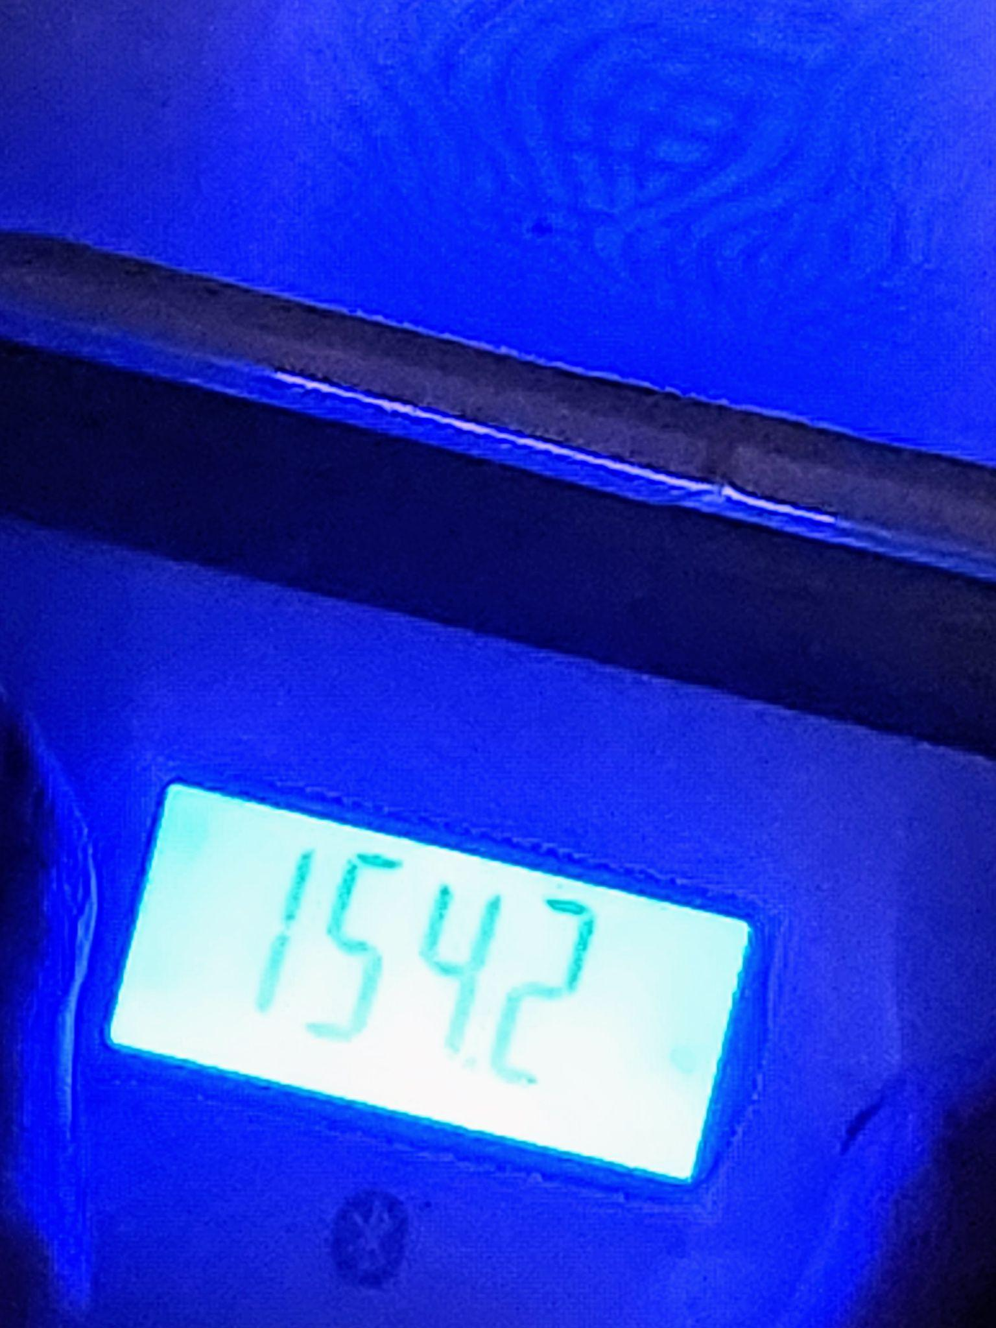


The Body-Mass Index (BMI)
BMI is a score designed to capture whether your weight is under control:
Mass is in kg and height in meters
Underweight: below 18.5
Normal: 18.5 to 25
Overweight: 25 to 30
Obese: over 30

Slide 6
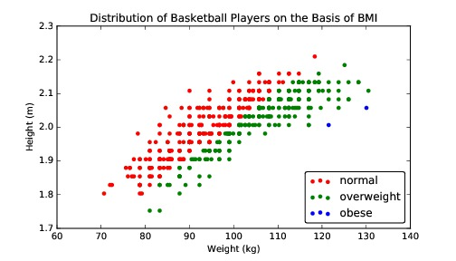
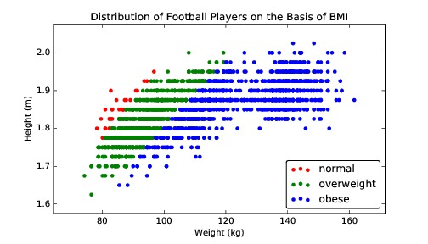
BMI: Pro Basketball and US Football
BMI is easy to interpret, and correlates with body fat. Mass should scale with the square (or cube) of height.
Notes:
1. What this slide is about
The slide compares the relationship between height, weight, and BMI for professional basketball and football players.
It helps us see how different sports have different body compositions — even when using the same BMI formula.
2. What is BMI?
BMI (Body Mass Index) = weight (kg) / height (m)²
It’s a simple way to estimate body fat and categorize people as normal, overweight, or obese.
It assumes that as a person’s height increases, their mass should grow roughly with the square of height (or sometimes even the cube, depending on the body type).
3. Understanding the plots
Both graphs show Height (m) on the Y-axis and Weight (kg) on the X-axis.
Each dot represents one player.
Colors:
🔴 Red = normal BMI
🟢 Green = overweight
🔵 Blue = obese
4. Basketball vs. Football
Basketball players (left chart):
Tend to be taller (1.9–2.2 m) and relatively leaner.
Most are in the normal or slightly overweight BMI range.
You see fewer “obese” dots because muscle and height balance out.
Football players (right chart):
Are generally shorter (1.7–1.9 m) but heavier.
Many fall in the overweight or obese BMI categories.
This doesn’t mean they’re unhealthy — they often have more muscle mass, which BMI doesn’t distinguish from fat.
5. Key takeaway
BMI is simple but imperfect.
It works well for general population estimates but not for athletes with a lot of muscle.
The graphs highlight that context matters — a football player and a basketball player with the same BMI may have very different body compositions.

Slide 7
Student Transcript Performance?
Propose a statistic to map a student’s grade transcript at BCIT to a single numerical score such that better performance gets a higher score?
Notes:
“Map a student’s transcript to one number where higher = better performance.”
🧩 Key idea
There isn’t a single “right” score. You must choose what you value (consistency? difficulty? improvement?) and design a formula that reflects that—just like BMI and Flesch.
Candidate scoring functions (with what they reward & drawbacks)
Simple GPA (credit-weighted mean)
Drawbacks: treats all courses as equally hard; ignores improvement trend.
Difficulty-weighted GPA
Values: tougher, higher-level courses.
Drawbacks: picking weights is subjective; may disadvantage students early on.
Recency-weighted GPA (improvement matters)
Drawbacks: can underplay earlier strong terms.
Robust GPA (trimmed mean)
Drop the lowest and highest 10% of course grades (by credits), then average.
Values: consistency; less sensitive to one anomaly.
Drawbacks: throws away data; needs enough courses to be fair.
Excellence with consistency (mean – variance penalty)
Drawbacks: penalizes risk-taking (e.g., hard electives).
Cohort-relative score (z-GPA)
Drawbacks: needs cohort stats; can be sensitive to small groups.
Quick example to illustrate (say aloud)
“Imagine two students both at 80% average. One took mostly 1st-year courses; the other took 3rd-year heavy courses and improved from 72% to 88%. Simple GPA says they’re equal. A difficulty-weighted or recency-weighted score would rank the second student higher. Different scoring choices → different rankings.”

Slide 8
Gold Standards and Proxies
Gold standards are labels or answers we trust to be correct, reflecting the scoring goal.
Proxies are available quantities correlated with what we want to measure.
Your GPA or SAT/GRE is a proxy for how you should do in my class.
Notes:
🥇 Gold Standard
A gold standard is the true, trusted, or ideal answer — the one we wish we had for every case.
It represents ground truth — the correct outcome we’d use to judge or train a model.
Example:
In medical testing → a biopsy result is the gold standard for diagnosing cancer.
In grading → your final instructor-assigned grade is the gold standard for how well you did.
🧩 Proxy
A proxy is a substitute measurement — something easier to get that is correlated with what we truly care about.
We use proxies when the gold standard is hard, slow, or expensive to obtain.
Example:
A blood pressure reading is a proxy for heart health.
GPA, SAT, or GRE is a proxy for predicting academic success — they’re not perfect, but they’re correlated.
⚖️ Why this matters
In data science, we often can’t measure what we really want.
So we use proxies instead — but we must remember they’re approximations, not the truth.
Example:
If we want to measure student understanding, using quiz grades might be a proxy — but they can be influenced by stress or test design.
💡 Simple analogy
Think of it like trying to estimate a person’s fitness:
The gold standard = full medical evaluation + endurance test.
The proxy = number of steps on your smartwatch.
The proxy is helpful — but it can be fooled (e.g., shaking your wrist adds “fake steps”).
🧭 In short
Gold standard = What we wish we could measure directly (truth).
Proxy = What we actually measure (easier, cheaper, but imperfect).
The closer the proxy tracks the gold standard, the better your scoring function.

Slide 9
Scoring vs. Machine Learning
When you have a gold standard, you can train a regression function to accurately predict things.
When all you have are proxies, all you can do is evaluate your scoring function.
“Weapons of Math Destruction” happen when you confuse proxies for gold standards: e.g. student test scores for teaching quality.
Notes:
🧩 Connecting to the previous slide
We just talked about gold standards (true answers) and proxies (approximate signals).
This slide shows why that difference matters — especially when using data for prediction or evaluation.
⚙️ When you have a gold standard
If you know the true answer, you can train a machine learning model to predict it.
For example:
If you have many medical images labeled “cancer” vs. “no cancer” by doctors (the gold standard),
→ you can train a regression or neural network model to predict new cases accurately.
Machine learning thrives on accurate labels — the closer your labels are to truth, the better your predictions.
📉 When you only have proxies
If you don’t have true answers, you can’t train a predictive model properly.
You can only make a scoring function — a rule that tries to approximate what matters.
Example:
You don’t know true “student potential,” but you can compute a score (like GPA, test results, or attendance).
You can then evaluate how well that score correlates with future success — but it’s not truly predictive.
⚠️ The danger: confusing proxies with gold standards
The book Weapons of Math Destruction (by Cathy O’Neil) warns about this exact mistake.
When people treat proxies (like test scores, credit scores, or performance ratings) as truth,
→ it leads to unfair and harmful decisions.
Example:
Schools may judge teacher quality by student test scores,
even though test results are influenced by many external factors (resources, background, stress, etc.).

Slide 10
Scores vs. Rankings
Which is more interpretable depends on:
Will the numbers be presented in isolation?
University A ranks 111th of 351 teams RPI=39.18
What is the distribution of scores?
How much better is #1 than #2?
Do you care about the middle or extremes?
Small changes in score can cause big rank diffs
Notes:
Both scores and rankings summarize performance — but they emphasize different things and can lead to different interpretations.
🧩 1. Scores give magnitude — Rankings give order
A score tells how well something did, numerically.
Example: “University A’s RPI score is 39.18.”
A ranking tells relative position among others.
Example: “University A is ranked 111th of 351.”
Both describe performance — but scores show the amount of difference, while ranks only show who’s ahead.
🔍 2. What makes interpretation tricky
a. Will the numbers be presented in isolation?
If you only show the rank (e.g., “111th”), it’s hard to know whether that’s good or bad.
The same rank might mean very different things depending on how close everyone’s scores are.
→ You need context — score distribution, scale, and total number of items.
b. What is the distribution of scores?
Suppose the top 50 teams are all tightly clustered (e.g., 39.5 vs 39.2 vs 39.1).
Then a tiny difference in score can cause a big jump in rank.
Rankings exaggerate small differences when the data are dense.
c. Do you care about the middle or the extremes?
Rankings highlight extremes (who’s #1, who’s last).
Scores can better represent overall spread or average performance.
For example:
If you’re hiring, you might care about how much better someone is (score).
If you’re running a contest, you might only care about who’s best (rank).
📊 Example
University A has an RPI score of 39.18, ranking 111th out of 351.
If the top schools have scores 39.50–39.10, then:
University A’s score difference from the top is tiny (0.32),
But its rank difference is huge (60+ spots).
That’s why scores are continuous and rankings are discrete — rankings may distort perception.

Slide 11
Recognizing Good Scoring Functions
Easily computable
Easily understandable
Monotonic interpretation of variables
Produces satisfying results on outliers
Use systematically normalized variables
Notes:
🟠 1. Easily computable
The function should be simple to calculate with available data.
Example: BMI = weight / height² is easy to compute — no fancy tools required.
If a score takes too much time or data to compute, it’s not practical for widespread use.
💬 “A perfect formula is useless if no one can actually compute it.”
🟠 2. Easily understandable
People should be able to interpret the score — know what higher or lower values mean.
Example: Reading ease scores (like Flesch–Kincaid) directly map to grade levels.
If a score feels mysterious (like a black box algorithm), users may distrust or misuse it.
💬 “Transparency builds trust — people should grasp what the number represents.”
🟠 3. Monotonic interpretation of variables
When one input increases, the score should change in a consistent and logical direction.
Example: In a “credit score,” higher income should never lower your score.
This ensures predictable behavior and helps detect bugs or bias.
💬 “If studying more sometimes makes your grade worse, something’s wrong with the formula!”
🟠 4. Produces satisfying results on outliers
A good scoring function shouldn’t behave strangely on extreme values.
For example, if a function gives absurdly high or low scores for rare cases, it’s not robust.
Designers should test with extreme examples to ensure reasonable outputs.
💬 “Your formula shouldn’t collapse when you meet an outlier.”
🟠 5. Uses systematically normalized variables
Inputs should be on comparable scales, so no single variable dominates unfairly.
Example: if you mix “years of experience (0–40)” with “satisfaction rating (1–5)” without scaling, the first will overwhelm the score.
Normalizing (e.g., z-scores or 0–1 scaling) keeps each factor balanced.
💬 “Always compare apples to apples — not apples to elephants.”

Slide 12
Advanced Ranking Techniques
Linear combinations of normalized values generally yield reasonable scores, but other techniques include:
Elo rankings
Merging rank orderings
Directed graph orderings
PageRank
Technique | Core Idea | Example Use
Elo | Pairwise competition & probability updates | Sports, games
Merging ranks | Combining multiple ranking lists | Voting, meta-search
Graph orderings | Use directional relationships | Tournaments, citations
PageRank | Importance through network links | Web search, influence detection
Notes:
Up to now, we’ve discussed simple scoring functions — things like weighted averages or linear combinations of normalized variables (e.g., GPA, BMI, WAR).
Those are great for assigning a score when each item is independent.
But sometimes, ranking depends on pairwise comparisons or networks of relationships — not just raw scores.
That’s where advanced ranking techniques come in.

Slide 13
Binary Comparisons
Rankings are often formed by analyzing series of binary comparisons:
Team A beats team B
Expert votes for A instead of B
Student choses university A over B
Vote counts fail to pick the best when different teams face different levels of competition.
Notes:
🧠 Core idea
Rankings can often be built not from absolute scores, but from pairwise (binary) comparisons — comparing two items at a time.
A binary comparison simply means:
“Between A and B, which one is better?”
These comparisons are the foundation of many ranking systems.
🟠 Examples of binary comparisons
Sports: Team A beats Team B.
→ A is “preferred” over B.
Expert judgments: A movie critic rates film A higher than film B.
→ A > B in quality.
Choices: A student picks University A over University B.
→ We infer A is more desirable (for that student).
Each individual decision gives us a small piece of ranking information.
⚙️ How rankings emerge
When you collect many such binary comparisons across multiple entities,
you can build a ranking network showing overall preferences.
Example:
A > B, B > C, A > C → clear order (A best, then B, then C).
But sometimes results are inconsistent:
A beats B, B beats C, but C beats A → circular preferences (no clear winner).
That’s where more advanced ranking methods (like Elo or PageRank) become valuable — they can handle complex or uneven matchups.
⚠️ Limitation: “Vote counts fail”
The line in red highlights a critical problem:
“Vote counts fail to pick the best when different teams face different levels of competition.”
Simple win counts assume every matchup is equally difficult — but in reality:
Some teams play against very strong opponents,
Others only face weak ones.
So, just counting wins (or votes) gives a biased ranking.
Example:
Team A: 3 wins, all against top teams.
Team B: 5 wins, all against weak teams.
→ Raw counts say B > A, but Elo or PageRank-style methods would recognize A’s wins as more impressive.
💡 Takeaway
Binary comparisons form the basis of many ranking systems.
But raw counts (like total wins or votes) are too naive.
Smarter ranking systems weigh who you beat, not just how many you beat.
💬 Example to tell students:
“Imagine you’re ranking students based on who beats whom in chess.
If Kimia beats Kaveh (a top player), that should count more than beating a beginner — otherwise, rankings would reward easy matches.”

Slide 14
Elo Rankings
After starting equally ranked, scores are then adjusted to reflect the surprise of each match.
S is the actual score (-1,1) for A, with mu the expected score from the previous r(A) and r(B).
Parameter k modulates the maximum possible swing in any one match.
Notes:
🧠 Concept Overview
The Elo ranking system is used to rate competitors (like chess players, teams, or video game players) based on their match outcomes.
It updates each player’s rating after every match, reflecting how surprising the result was.
If you beat someone much stronger than you, your rating goes up more.
If you lose to someone much weaker, your rating goes down more.
⚙️ How it works (step by step)
Start equally ranked:
Everyone begins with the same base score (e.g., 1500 in chess).
Play a match:
Player A plays Player B. The actual result for A is:
SA=1 if A wins
SA=0A loses
SA=0.5 if it’s a draw
Compute the expected outcome (based on current ratings):
The expected probability that A beats B is:
The formula in the slide, This means:
If A and B have equal ratings → each expected to win 50% of the time.
If A is much higher rated → expected to win most of the time.
Update A’s rating:
r′(A)=the surprise factor (actual minus expected outcome)
k = how sensitive the system is (higher k means ratings move faster)
🔍 Interpretation
If A wins unexpectedly (A beats a higher-rated player):
​−μA​ large → big jump in rating.
If A loses as expected (A loses to a much stronger player):
→ SA=​ small → small drop.
If A loses an upset (A was supposed to win but didn’t):
→ SA=0S_A = 0SA​=0, μA\mu_AμA​ large → large negative swing.
⚖️ Example
Let’s say:

Slide 15
What is the Expected Match Score?
If P(A>B) estimates the probability that A beats B, then:
If the ranking system is meaningful, this probability should be a function of the difference between the scores r(A) and r(B).

Slide 16
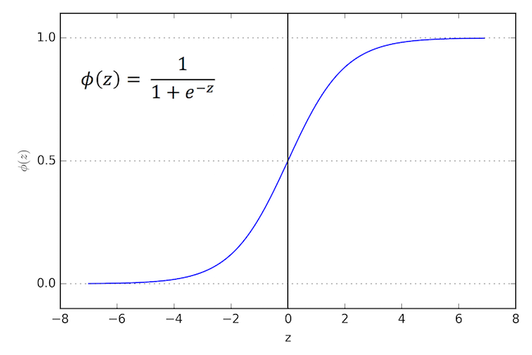
The Logit Function
We need a function f(x) that takes x and yields a probability:
f(0) = ½
f(infty) = 1
f(-infty) = 0
Notes:
⚙️ Why do we need this function?
In Elo ranking (and in many other models), we often want to convert a difference in scores between two players into a probability that one player wins.
For example, if Player A’s rating is much higher than Player B’s, we want a function that outputs a high probability (close to 1) that A wins — but never exactly 1.
So, we need a function that:
Takes any real number xxx (the rating difference)
Outputs a number between 0 and 1 (a valid probability)
🎯 The required behavior
We want:
f(0)=12f(0) = \frac{1}{2}f(0)=21​ → equal players have a 50% chance to win
f(∞)=1f(\infty) = 1f(∞)=1 → infinitely stronger player always wins
f(−∞)=0f(-\infty) = 0f(−∞)=0 → infinitely weaker player always loses
This means the function should smoothly increase from 0 → 1 as xxx increases.

Slide 17
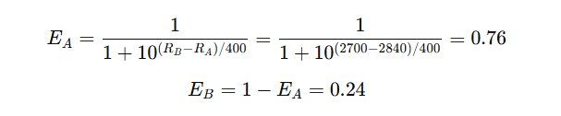
Elo Chess Ranking Example
Player | Initial Rating
Magnus Carlsen (A) | 2840
Hikaru Nakamura (B) | 2700
Compute the expected score
Magnus is expected to win 76% of the time, Hikaru only 24%.

Slide 18

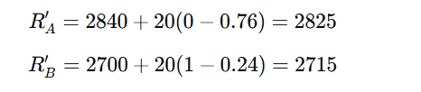
Elo Chess Ranking Example
Actual Match outcome
Magnus loses to Hikaru.
Update Ratings (K = 20)
Player | New Rating | Change
Magnus Carlsen | 2825 | ↓ –15
Hikaru Nakamura | 2715 | ↑ +15

Slide 19
Merging Rankings / Votes
Consider determining the winner of a multiparty election where each voter ranks the candidates in order of preference.
1. BCIT 2. MIT 3. Illinois 4. ….
Equivalently, consider merging rankings independently drawn on different features.

Slide 20

Borda’s Method
By assigning an increasing score per position, the resulting point total ranks the items:
Four voters, each ranking five items.
Notes:
⚙️ What it is
Borda’s Method is a way to combine multiple rankings (like votes or preferences) into a single overall ranking.
Instead of just counting first-place votes (like in a simple majority system),
Borda’s Method gives points to each position — so every ranking matters, not just the top choice.
📋 How it works
Suppose there are n items (e.g., candidates, teams, universities).
A 1st-place rank gets n–1 points
A 2nd-place rank gets n–2 points
…and so on, down to 0 points for the last place.
Each voter (or rater) ranks all items.
You add up the points from all voters for each item.
The item with the lowest total score (or highest, depending on convention) wins or ranks first.

Slide 21
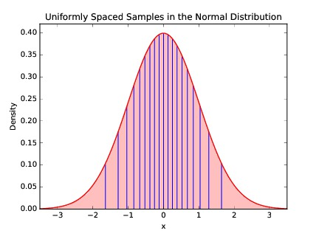
Weights for Borda’s Method
Linear position weights make sense when we have equal confidence across all positions.
But we presumably trust our distinctions among the best/worst more than the middle elements, suggesting normally distributed weights.
Notes:
🧠 Recap: What we’ve done so far
In Borda’s Method, each position in a ranking gets a linear weight —
for example, if there are 5 items, you assign:
1st = 4 points
2nd = 3 points
3rd = 2 points
4th = 1 point
5th = 0 points
That’s linear weighting — every rank difference counts equally.
⚙️ When does linear weighting make sense?
Linear weights assume we have equal confidence in our distinctions between all ranks.
In other words:
The difference between 1st and 2nd is treated the same as between 4th and 5th.
We’re equally sure about all positions.
That’s reasonable in some cases — like if each rank is based on objective scores (e.g., exam results, times, or averages).
🧩 But what if we’re not equally confident?
In many real ranking situations (like voting or subjective ratings),
we tend to:
Care more about who’s at the top or bottom
Be less confident about the middle positions
Example:
You probably feel very certain who your favorite or least favorite movie is —
but not as sure about which movie should be ranked 3rd vs 4th.
📈 So what’s the alternative?
We can assign nonlinear weights, emphasizing the extremes.
A normal (bell-shaped) distribution can model this intuition:
Large differences in weight near the top and bottom ranks
Smaller differences between the middle ranks
This is what the slide’s bell curve (normal distribution) represents.
💬 Interpretation of the graph
The x-axis: rank positions (from worst to best)
The y-axis: how much weight or “confidence” we give to that rank difference
The shape (bell curve) shows that:
At the extremes (best/worst), small changes in rank matter a lot
In the middle, small changes in rank matter less
So, the weights follow a normal curve rather than a straight line.
🧮 Example
If 5 items are ranked, linear weights might be:
[4, 3, 2, 1, 0]
But with normally distributed weights, they might look like:
[5, 3, 2.5, 3, 5] (more emphasis on top and bottom)
(Or equivalently, in normalized form: [1.0, 0.7, 0.5, 0.7, 1.0])

Slide 22
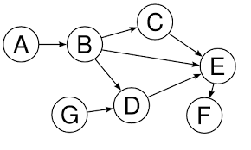
Directed Graph Orderings
Treating the vote (A>B) as an edge (A,B) yields a directed graph.
If there are no inconsistencies, we get a directed acyclic graph (DAG).
Topologically sorting this DAG gives a reasonable order, like
ABCGDEF or GABCDEF
Notes:
⚙️ What’s happening here
When we have many pairwise comparisons (like “A beats B,” “B beats C,” etc.), we can represent them as a directed graph:
Each node = an item (team, player, candidate)
Each directed edge (A → B) = “A is preferred over B”
This is a visual way to organize preferences or rankings.
🧩 Step 1: Build the graph
Each comparison creates a directed edge:
“A > B” becomes an arrow from A → B
“C > E” becomes an arrow from C → E
If you collect enough of these, you get a network of preferences — like the diagram on the slide.
⚙️ Step 2: Check for consistency
If no cycles exist (no circular preferences like A > B > C > A),
the graph is called a Directed Acyclic Graph (DAG).
That’s important because:
A DAG represents a consistent ordering of preferences.
It means there’s no contradiction in who beats whom.
If cycles do exist (like A beats B, B beats C, C beats A),
the ranking is inconsistent, and we may need extra methods (like Elo or PageRank) to resolve ties or contradictions.
🧮 Step 3: Topological sort
A topological sort is an algorithm that arranges nodes of a DAG in a linear order that respects all edges — meaning if A → B, then A always appears before B.
That order becomes your ranking.
For example:
If the graph edges are:
A → B, B → C, C → E, D → E, E → F, G → D, B → D
Then possible valid topological orders are:
A B C G D E F
G A B C D E F
Both preserve the “beats” relationships in the graph.
💬 Intuitive example
Think of this like ranking chess players:
If A beat B and B beat C, then A should come before C.
But if G never played A, we can still place G based on others it beat.
The resulting order gives a consistent global ranking based on all pairwise match outcomes.
⚖️ Why this method is useful
It gives a logical global order when data is consistent.
It’s transparent — you can trace why one item ranks above another.
It’s the foundation for ranking algorithms in sports, web search, and recommendation systems.

Slide 23
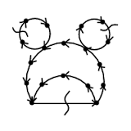
Ranking General Digraphs
For general directed graphs, we seek the order minimizing the number of ``wrong way’’ edges.
Cutting the minimum number of edges to leave a DAG is NP-complete.
But reasonable heuristics start by sorting by the difference between in/out degree.
Player | Wins (out-degree) | Losses (in-degree) | Score
A | 4 | 1 | +3
B | 3 | 2 | +1
C | 2 | 3 | –1
D | 1 | 4 | –3
Notes:
Starting point — when preferences have cycles
In the previous slide, we assumed that the directed graph of preferences (A > B, B > C, etc.) had no cycles — it was a DAG (Directed Acyclic Graph).
That allowed us to do a clean topological sort and get a clear ranking.
But in real data — like sports results, votes, or user preferences — cycles often appear:
A beats B,
B beats C,
and C beats A.
That creates a cycle, meaning there’s no perfect linear ranking that satisfies all comparisons.
🕸️ The problem
When cycles exist, we call it a general directed graph (not a DAG).
Our goal is to still find a best possible order that:
Minimizes the number of “wrong-way” edges
— edges that point backward in our final ranking.
In other words, we want an order that breaks as few rules as possible.
⚠️ The challenge
Finding the minimum number of edges to remove to make the graph acyclic (a DAG)
is an NP-complete problem — meaning it’s computationally very hard, especially as the number of items grows.
There’s no known efficient (polynomial-time) algorithm to guarantee the best solution for large graphs.
🧩 Heuristic (good-enough) approach
Because the exact solution is intractable, we use heuristics — practical shortcuts that work well in most cases.
One simple and effective heuristic:
Sort nodes by the difference between their out-degree and in-degree.
Out-degree: number of wins (edges going out)
In-degree: number of losses (edges coming in)
So, players or items that “beat” many others but are rarely beaten will appear higher in the ranking.
score(node)=out-degree−in-degree\text{score}(node) = \text{out-degree} - \text{in-degree}score(node)=out-degree−in-degree This creates a reasonable ordering, even if cycles exist.

Slide 24


PageRank
PageRank(v,G) corresponds to the probability that a random walk on G ends up at vertex v.
The basic formula is:
This recursive formula defines an iterative algorithm, which quickly converges in practice.
Symbol | Meaning
v | The page (node) we’re computing PageRank for
(u,v) in E | An edge from page ( u ) to page ( v )
PR_{j-1}(u) | PageRank of ( u ) from the previous iteration
(out-degree}(u) | Number of outgoing links from ( u )

Slide 25
How it works
Start by giving all pages an equal score (e.g., 1/N).
In each iteration, update each page’s score using the formula.
  Pages receive fractional contributions from the pages that link to them.
Repeat until the scores stop changing much (the algorithm converges).
After convergence, the scores represent the steady-state probabilities of the random walk.

Slide 26
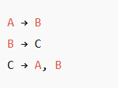

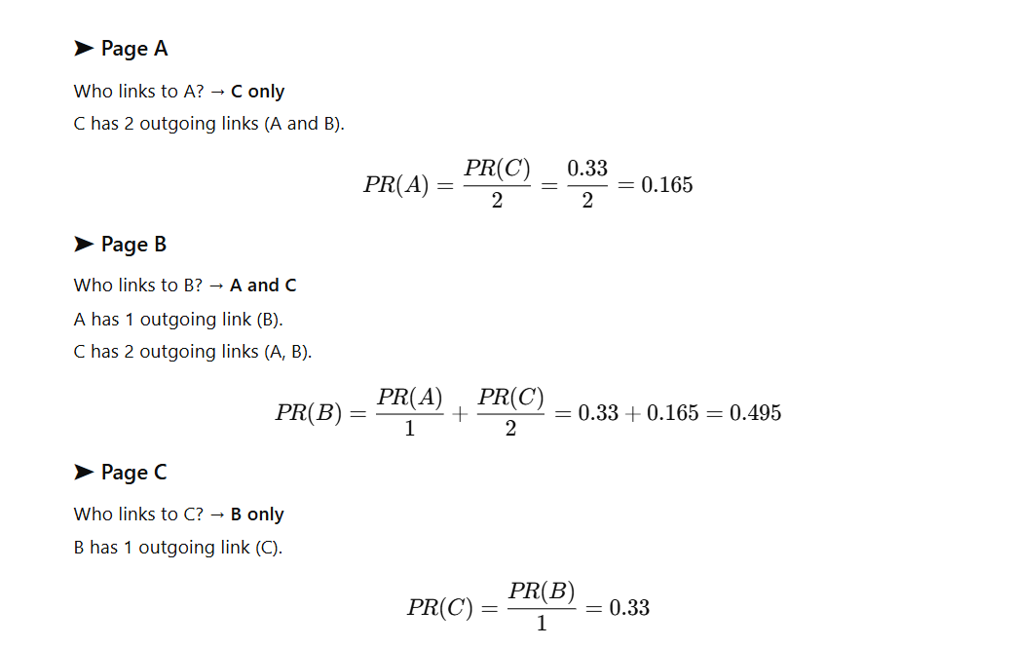
Page Rank example
Suppose you have three pages
Step 1

Slide 27
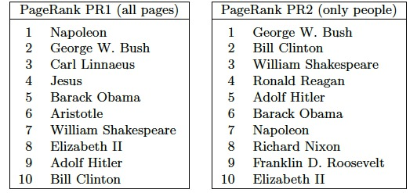
If All Roads Lead to Rome...
… then Rome must be an important place.
PageRank is a good feature to measure centrality or importance of vertices, like Wikipedia pages:
Notes:
🧠 The idea behind the title
This slide uses the famous saying — “All roads lead to Rome” — as a metaphor for PageRank.
If every road (or link) connects to a place, that place must be important.
Similarly, in a network (like the web, Wikipedia, or social connections),
a node that many others point to — especially from other important nodes — is central and influential.
That’s exactly what PageRank measures:
How important a node is, based on who connects to it.
🧩 Interpretation of results
In PR1 (all pages), names like Napoleon, Jesus, Aristotle appear —
because they’re connected to a wide range of historical and conceptual pages (wars, philosophy, religion, etc.).
In PR2 (people only), modern political figures dominate —
because contemporary people are heavily cross-linked (e.g., U.S. presidents link to one another’s pages).
It reflects how PageRank captures link-based influence,
not moral judgment or fame, but structural connectedness.

Slide 28

PageRank in Practice
Design decisions in PageRank include:
Editing the graph to remove irrelevant vertices/edges (spam).
Removing outdegree zero vertices.
Allowing random jumps: the damping factor.
PageRank is less important to Google today than popularly supposed.

Slide 29
Arrow’s Impossibility Theorem
There is no ranking system that satisfies all desirable properties:
The system should be complete: given A and B it must pick one or say equal preference.
The system must be transitive, meaning that if A>B and B>C then A>C.
If every voter prefers A to B, then A wins over B.
Preferences cannot depend only on one dictator.
The preference of A to B should be independent of preferences for all other candidates.
Voter | Red | Green | Blue
X | 1 | 2 | 3
Y | 2 | 3 | 1
Z | 3 | 1 | 2
Red beats Green, Green beat Blue, Blue beats Red

Slide 30
Resources
I would like to thank Dr. Steven S. Skiena, Dr. Christian Kästner, and Chip Huyen for the valuable resources they have provided through their coursework in machine learning and data science. Their materials have been instrumental in shaping my teaching in these areas.
The Data Science Design Manual, Steven S. Skiena
Learning From Data, by Yaser S. Abu-Mostafa, Malik Magdon-Ismail, Hsuan-Tien Lin
Machine Learning in Production: From Models to Products by Christian Kästner
Designing Machine Learning Systems, Chip Huyen

