Slide 1
Statistical Significance
Fatemeh Riahi

Slide 2
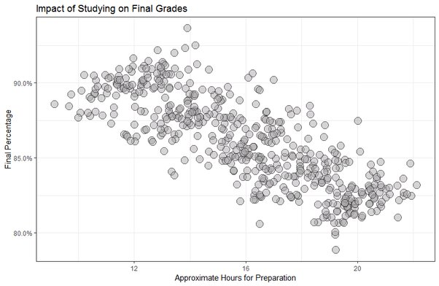
Study Time vs. Exam Grades
Survey result from classes at a high school (r=-0.798)
What’s going on here?

Slide 3
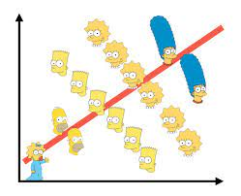
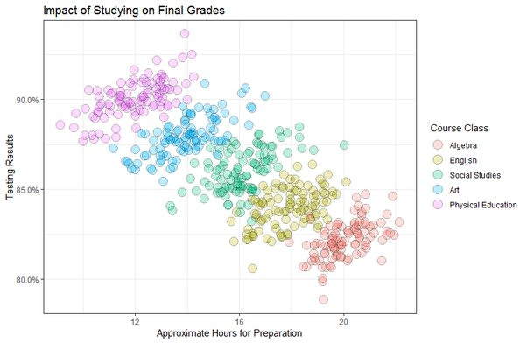
Simpson’s Paradox
Simpson's Paradox is a statistical phenomenon where an association between two variables in a population emerges, disappears or reverses when the population is divided into subpopulations.
Notes:
The scatter plot shows the impact of studying hours on final grades.
Each color represents a different course (Algebra, English, etc.).
If you look at all points combined, it seems that more hours of study = lower grades — a negative trend.
But within each course (each color), the trend is positive — more study time actually improves grades.
“When we pool all the data, it looks like studying more makes grades worse. But when we split it by course, studying more actually helps. That’s Simpson’s Paradox — the overall trend reverses when we look at the subgroups.”
Why It’s Called Simpson’s Paradox (or Simpson’s Effect)
The phenomenon was first described by Edward H. Simpson, a British statistician, in 1951 in a paper titled “The Interpretation of Interaction in Contingency Tables.”
He noticed that the relationship (association) between two variables can change direction when a third variable is taken into account.
Because of this surprising reversal, it was called a paradox — it seems to contradict logic at first glance.
Sometimes, researchers call it “Simpson’s Effect” instead of “Paradox” because it’s

Slide 4
Talking to Statisticians
Statisticians are primarily concerned with whether observations on data are significant.
Data miners are primarily concerned with whether their observations are interesting.

Slide 5
When is an Observation Meaningful?
Computational analysis readily finds patterns and correlations in large data sets.
But when is a pattern significant?
Sufficiently strong correlations on large data sets may seem ``obviously’’ significant, but often the effects are more subtle.

Slide 6
Medical Statistics
Evaluating the efficacy of drug treatments is a classically difficult problem.
Drug A cured 19 of 34 patients. Drug B cured 14 of 21 patients. Is B better than A?
FDA approval of new drugs rests on such trials/analysis, and can add/subtract billions from the value of drug companies.

Slide 7
Why We Need Hypothesis Testing
Question:
How do we know if an observed pattern in data is real or just random noise?
Why we test hypotheses
  Real-world data always contains random variation.
  We need a way to decide whether an observed difference or correlation is statistically meaningful.
Hypothesis testing provides a structured decision process.
Example:
“A new teaching method raises average scores from 75 to 80 Is it really better, or did we just
get lucky with this sample?”
Key idea:
We can never be 100% certain, but we can measure how unlikely such a result would be if nothing actually changed.

Slide 8
Null and Alternative Hypotheses
Null Hypothesis (H₀):
There is no real effect — any difference is due to chance.
Example: μ₁ = μ₂
Alternative Hypothesis (H₁ or Hₐ):
There is a real effect or difference.
Example: μ₁ ≠ μ₂
Use data to decide whether to reject H₀ in favor of H₁.
We never “prove” H₁ —
We just find evidence strong enough that H₀ is unlikely.

Slide 9
The p-Value: Measuring Significance
What is the p-value?
The p-value is the probability of getting a result as extreme as, or more extreme than the one observed, if the null hypothesis (H₀) were true.
Why we use it
It tells us how surprising our result is under H₀.
Smaller p-values → stronger evidence against H₀.
Conventionally:
  p < 0.05 → statistically significant
  p < 0.01 → highly significant

Slide 10
Comparing Population Means
The T-test evaluates whether the population means of two samples are different.
Sample the IQs of 20 men and 20 women. Is one group smarter on average?
Certainly the sample means will differ, but is this difference significant?

Slide 11
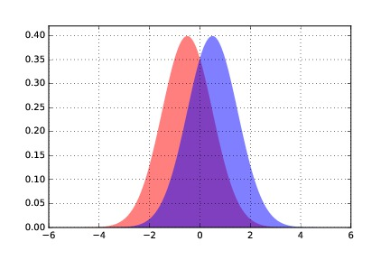

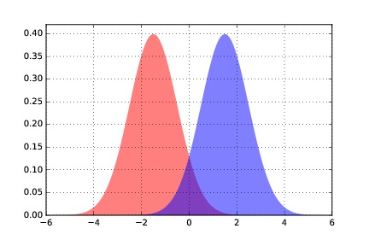
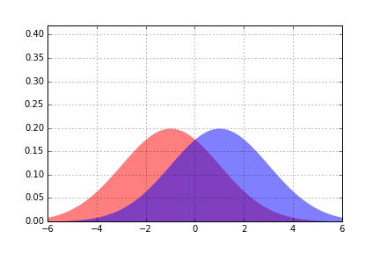
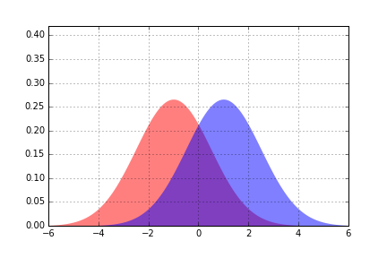

Differences in Distributions
It becomes easier to distinguish two distributions as the means move apart...
... or the variance decreases:

Slide 12
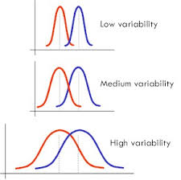


The T-Test
Two means differ significantly if:
The mean difference is relatively large
The standard deviations are small enough
The samples are large enough
Welch’s t-statistic is:
where s^2 is the sample variance.
Significance is looked up in a table.
Degree of Freedom:
The degrees of freedom represent the amount of information we have to estimate variability.
For two independent samples:
Notes:
“We often want to know: are these two groups really different, or could the difference be just due to random chance?”
Example:
“Say we test two teaching methods. Group A has an average score of 85, Group B has 82. Is that 3-point difference real, or just random noise?”
“The t-test compares the difference between two means while accounting for how much variation there is inside each group.”
If the difference between the means is large, and
The spread (variability) within groups is small,
Then we’re more confident the difference is real, not random.
That’s what the bullets on your slide summarize nicely:
Mean difference is large → more signal
Standard deviations small → less noise
Sample sizes large → more confidence
The formula is
“It’s basically a signal-to-noise ratio.
The numerator (top) is the difference in means — our signal.
The denominator (bottom) is the combined uncertainty — the noise.”
S^2 are the sample variances.
N1 and n2​ adjust for how much data we have — larger samples mean smaller uncertainty.
Degrees of freedom (df):
The degrees of freedom represent the amount of information we have to estimate variability.
For two independent samples:
Smaller sample sizes → fewer degrees of freedom → wider tails in the t-distribution.

Slide 13
Example
Scenario
You want to know if a new studying technique improves exam performance.
You test it on two small groups of students:
State the Hypotheses
H₀: No difference in mean scores (μ₁ = μ₂)
H₁: There is a difference (μ₁ ≠ μ₂)
Group | Sample Size (n) | Mean (x̄) | Standard Deviation (s)
Traditional | 10 | 75 | 5
New Technique | 10 | 80 | 4
Notes:
Example: Comparing Two Small Samples
(s)Traditional10755New Technique10804

Slide 14
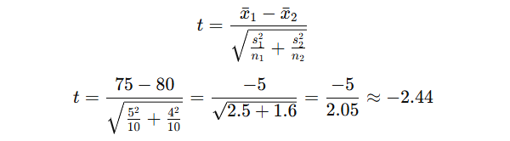

Compute the Test Statistic (Welch’s t)
We can ignore the sign and use t = 2.44
because we’ll compare absolute values.
Find the Degrees of Freedom (approximation)

Slide 15
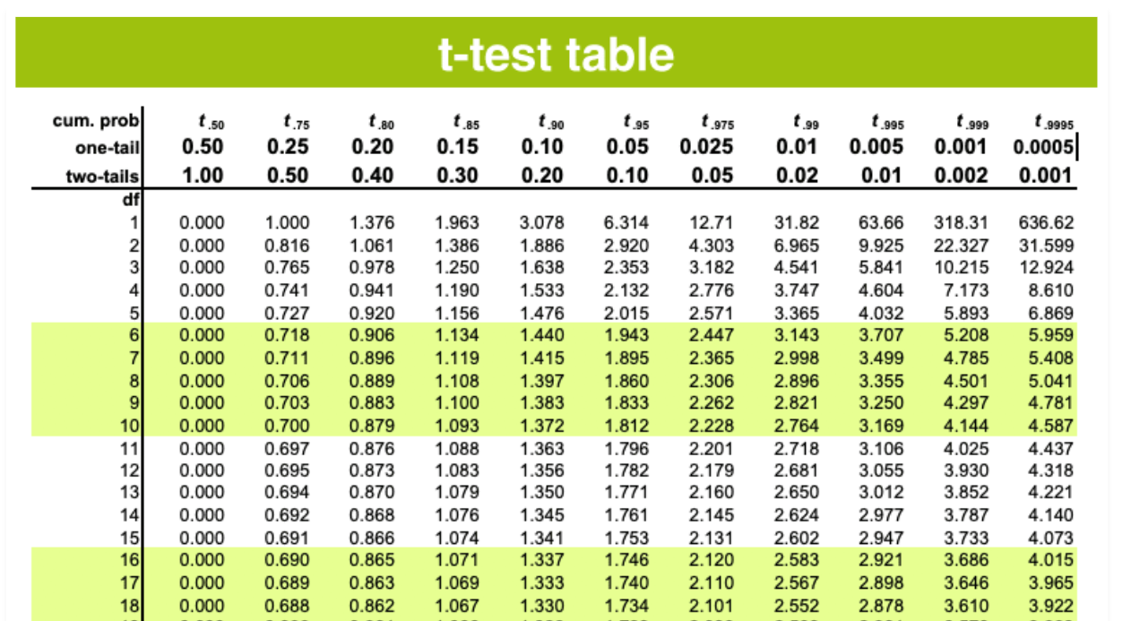
Look up the t-critical value
“Now open a t-distribution table and find the critical t value for
df = 18 and significance level α = 0.05 (two-tailed).”
t₀.₀₅(18) ≈ 2.10
Since 2.44 > 2.10,
the difference is significant at
the 0.05 level.
The new technique improved
test scores enough that the
difference is unlikely due to
random variation.”
Notes:
“

Slide 16
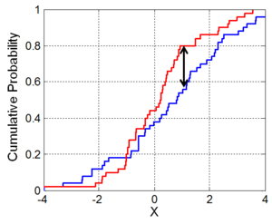

The Kolmogorov-Smirnov Test
This test measures whether two samples are drawn from same distribution by the maximum difference in their cdf.
The distributions differ if:
and
at a significance of alpha.
Notes:
“The KS test answers one question:
Do these two samples seem to come from the same overall distribution?”
It doesn’t assume the distributions are normal — that’s what makes it non-parametric and powerful.
Example to give students:
“Imagine you have two sets of test scores — one from last year and one from this year. You want to know if students’ performance changed overall, not just the mean, but the whole distribution.”
The KS test compares the two empirical CDFs (cumulative distribution functions) of your samples.
F1,n(x) : proportion of sample 1 values ≤ x
F2,n′(x) : proportion of sample 2 values ≤ x
Interpretation:
“We slide across all possible x-values and measure the largest vertical distance between the two CDF curves.
That biggest gap — the black arrow in the figure — is the KS statistic.”
c(α) is a constant that depends on the significance level (α) — e.g., 0.05.
If the computed DDD exceeds this threshold, we reject the null hypothesis (that both samples come from the same distribution).
Point at the red and blue lines:
Red = empirical CDF of sample 1
Blue = empirical CDF of sample 2
The black vertical line shows the maximum distance (D-value).
“If that distance is large, the samples likely come from different distributions.
If they mostly overlap, they’re probably from the same one.”

Slide 17
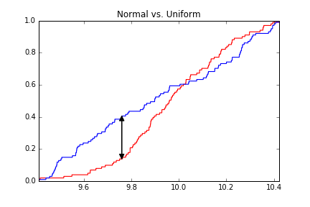
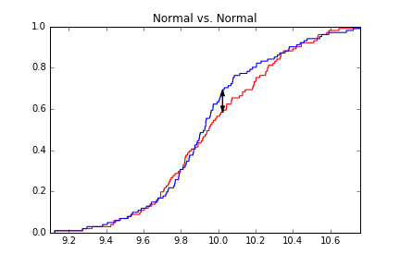
Normality Testing
We can perform the KS-test where one distribution is sampled from the theoretical distribution:

Slide 18
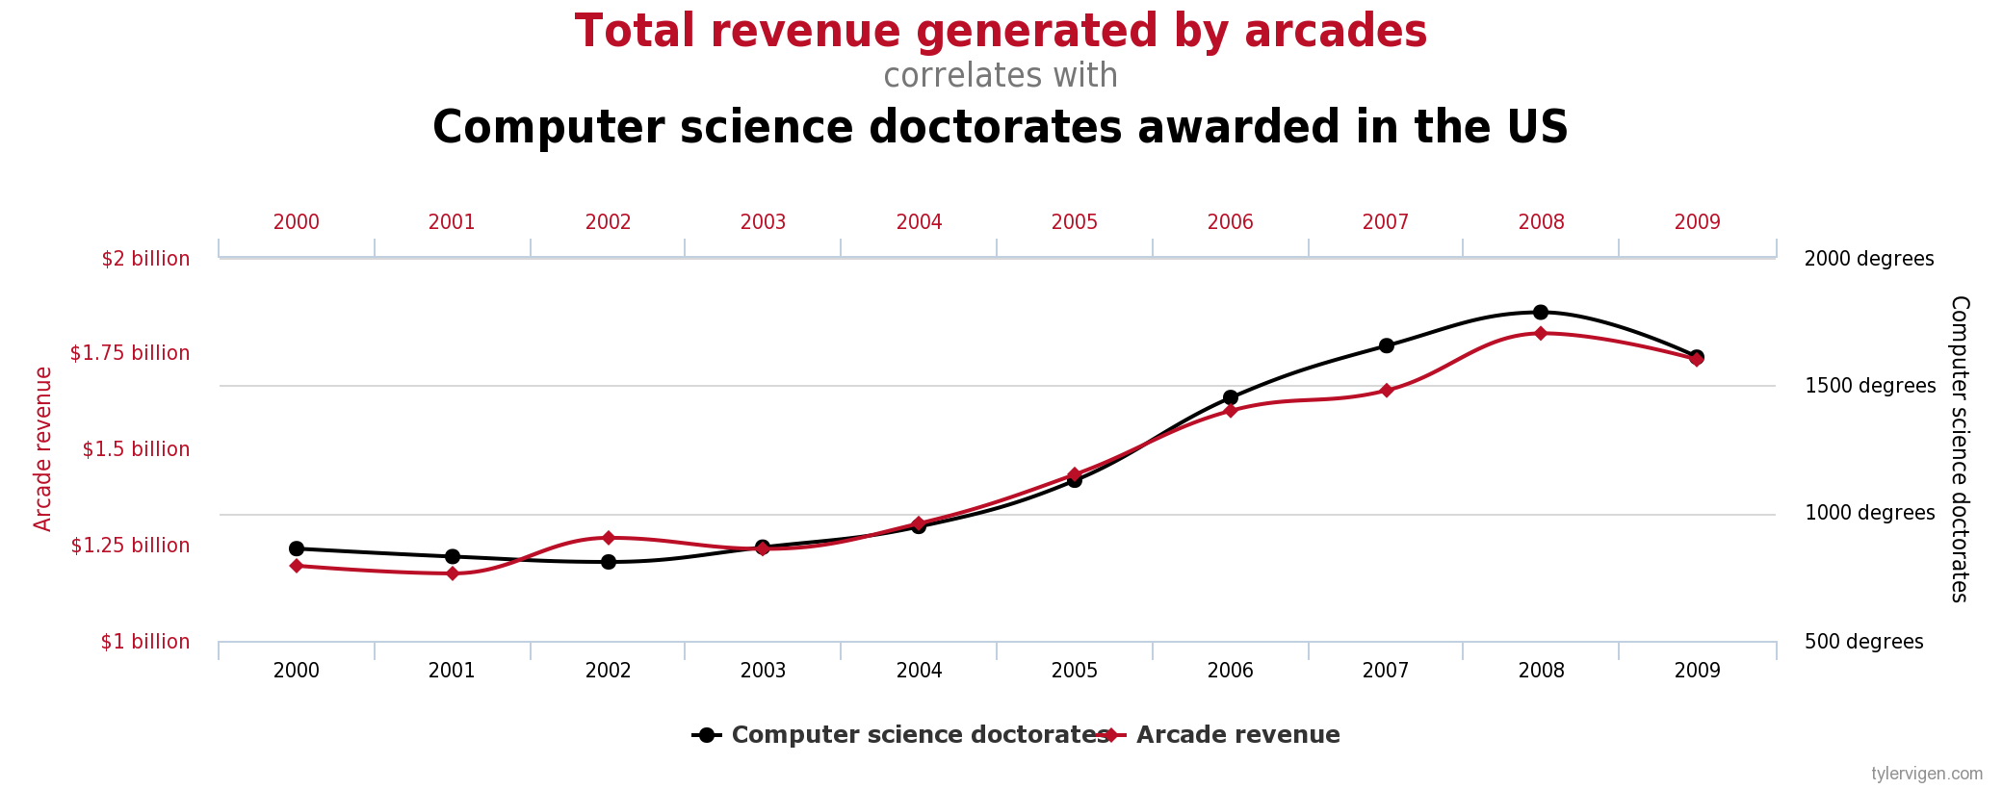

The Bonferroni Correction
A statistical significance of 0.05 means there is a probability 1/20 this result came by chance.
Thus fishing expeditions which test millions of hypotheses must be held to higher standards!
In testing n hypotheses, one must rise to a level of to be considered significant at the level of alpha.

Slide 19
The Significance of Significance
For large enough sample sizes, extremely small differences can register as highly significant.
Significance measures the confidence there is a difference between distributions, not the effect size or importance/magnitude of the difference.
Notes:
Who has more fingers men or women.
If the difference is on a large enough magnitude that I should care about it.

Slide 20

Measures of Effect Size
Pearson correlation coefficient: small effects start at 0.2, medium effects at 0.5, large effects at 0.8
Percentage of overlap between distributions: small effects ≈ 85% overlap (very similar), medium ≈ 67%, large ≈ 53% (more distinct distributions)
Cohen’s d : small >0.2, medium > 0.5, large > 0.8
Notes:
d=0.2d = 0.2d=0.2: the means differ by 0.2 of a standard deviation → small effect
d=0.5d = 0.5d=0.5: half a standard deviation → medium
d=0.8d = 0.8d=0.8: almost a full standard deviation → large
Example:
“If men and women differ in height by 0.8 standard deviations, that’s a large effect — you can easily see it in data.”

Slide 21
Why Significance Tests Can Work
Statistical tests seem particularly opaque (e.g. look up numbers from table), but come from ideas like:
Probabilities of samples drawn from distributions with given mean and std. dev.
Bayes theorem converts Pr(data|distribution) to Pr(distribution|data)

Slide 22
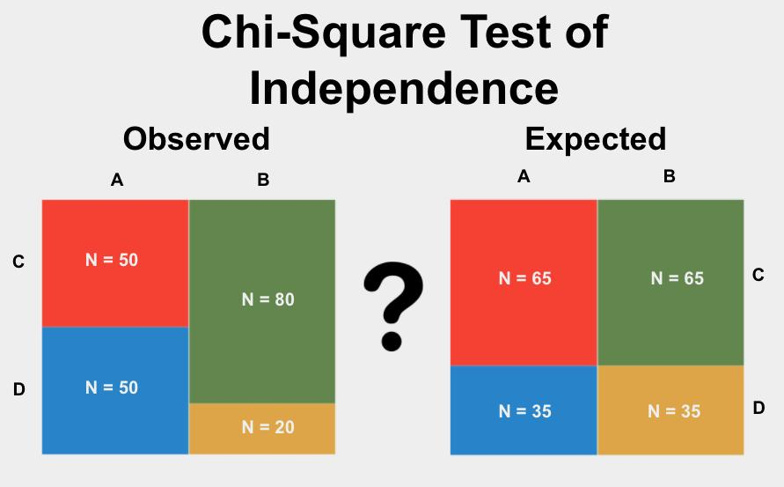
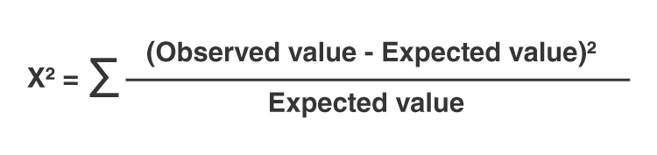
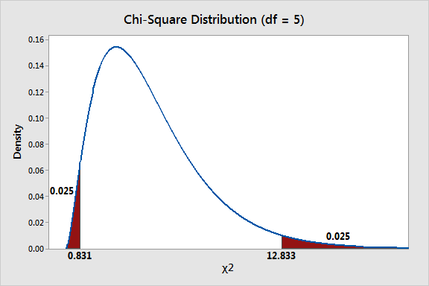
Do Categories Really Matter?
The Simpson’s paradox example rested on students studying gym like they do algebra.
Chi squared tests establishes if different population labels exhibit the same distribution.

Slide 23
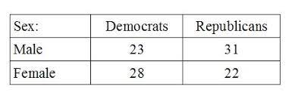
The Chi Square Test
Given categorical variable observations from two populations, are the populations different?
1- Build a contingency table:
2- Compute test statistic:
3- Evaluate against distribution.

Slide 24
Issues with Chi Square Test
Degrees of Freedom: more categories, higher expected sum of rations: use correct table.
Counts instead of fractions: 100% easy to get with n=1. Demand >10 counts per cell.
Significance level: is 0.05 the threshold?
Sampling: Assumes statistically random, independent samples.

Slide 25
Bootstrapping P-values
Traditional statistical tests evaluate whether two samples came from the same distribution.
Many have subtleties (e.g. one- vs. two-sided tests, distributional assumptions, etc.)
Permutation tests allow a more general, more computationally idiot-proof way to establish significance.
Why it’s useful
No assumption about normality or equal variance
Works for almost any statistic (mean, median, correlation, etc.)
Easy to implement computationally
Gives an intuitive view of “how rare” the observed result is
Notes:
“Traditional tests like the t-test assume the data follows certain shapes — like normal distributions — and use formulas to estimate probabilities.
But in real data, those assumptions often don’t hold.”
What bootstrapping does
“Bootstrapping skips the formulas and uses the computer to simulate what randomness looks like.”
Simple idea:
Treat your sample as if it were the entire population.
Randomly resample (with replacement) from it thousands of times.
Each resample gives you a new estimate of your statistic (e.g., mean difference).
The variation across these simulated results shows what random chance alone would produce.
What permutation testing does
“Permutation tests go one step further — instead of resampling within groups, we shuffle group labels to test the null hypothesis directly.”
Example:
You have Group A (mean = 75) and Group B (mean = 80).
If there’s no real difference, group labels shouldn’t matter.
Shuffle all scores randomly between groups many times, compute the mean difference each time, and see how often you get a difference as large as the observed one.
That frequency ≈ the p-value.

Slide 26
Permutation Tests
If your hypothesis is true, then randomly shuffled data sets should not look like real data.
The ranking of the real test statistic among the shuffled test statistics gives a p-value.
You need statistic on your model you believe is interesting, e.g. correlation, std. error, or size.

Slide 27
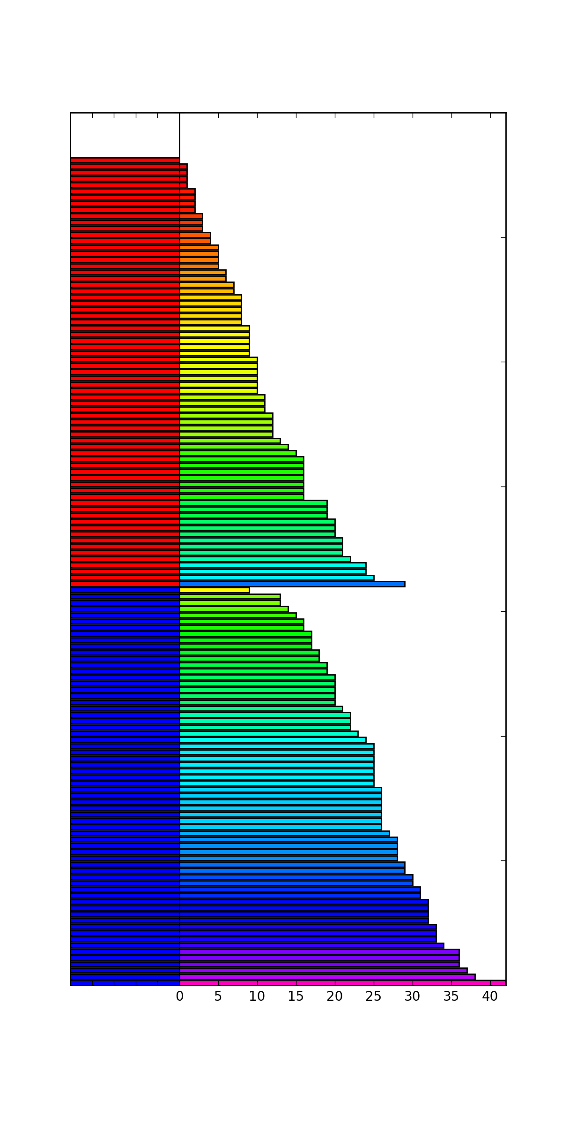
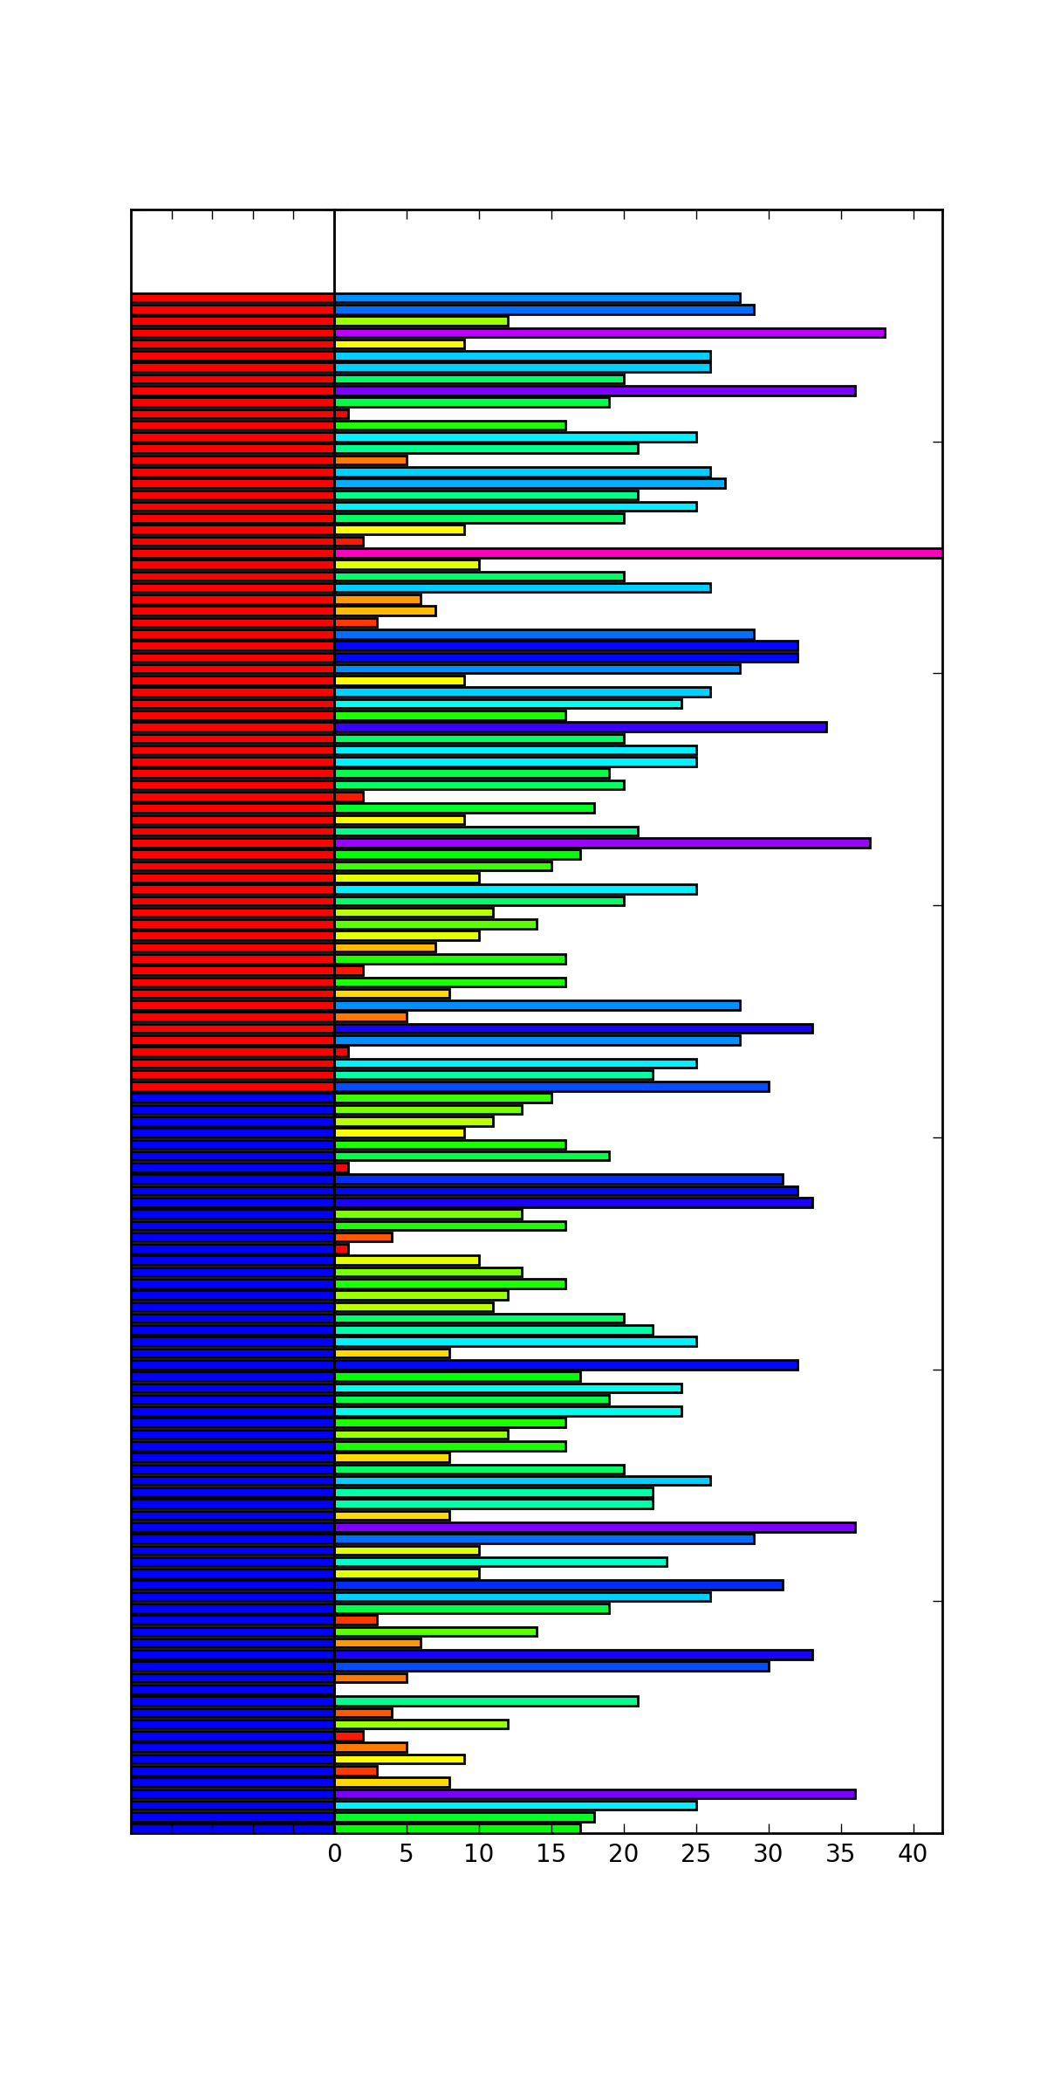
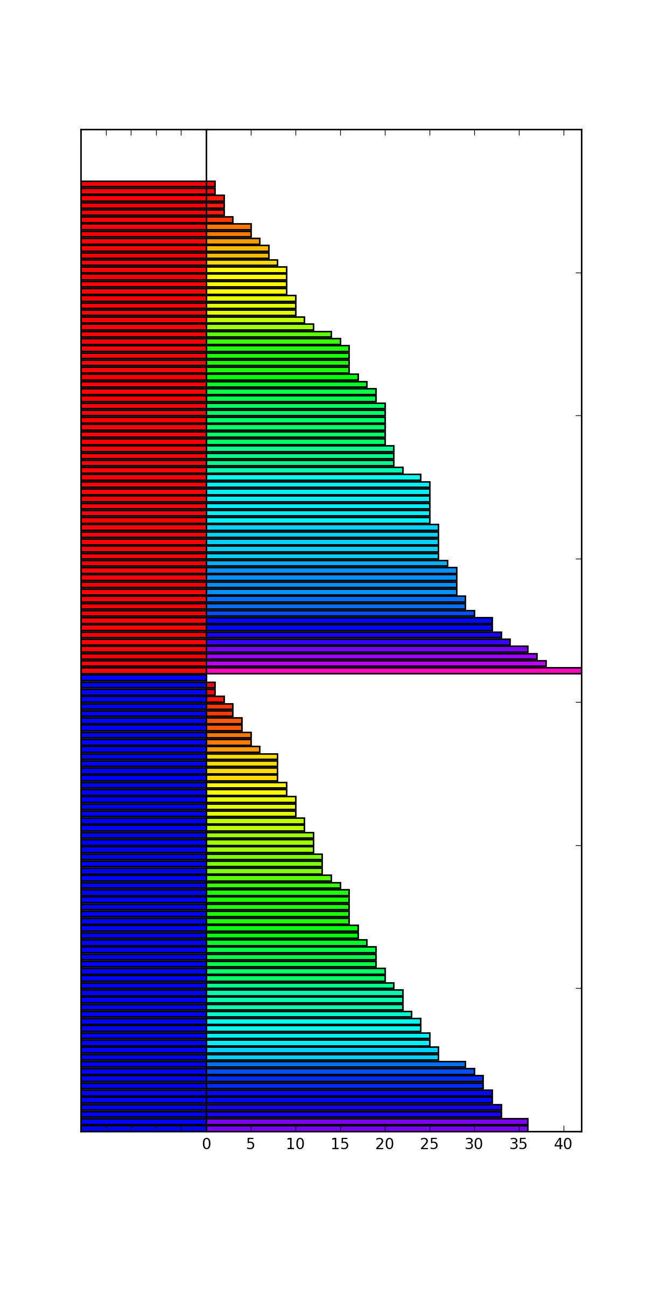
Permutation Test (Gender Relevant?)
Heights here coded by bar length and color
The random permutation (c/r) shows less height difference by gender than the original data (l).

Slide 28
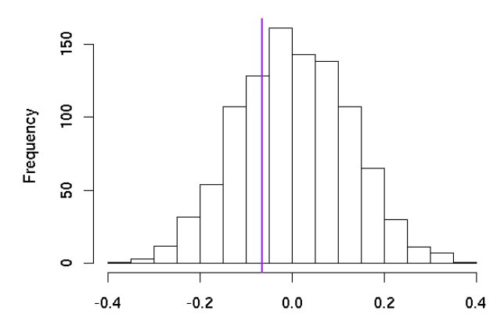
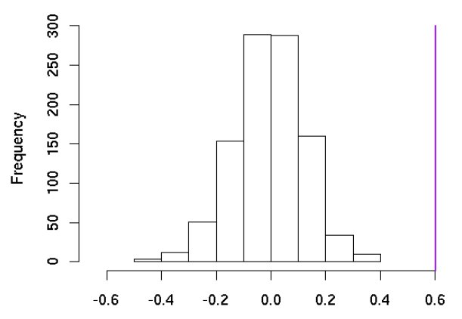
Significance of a Permutation Test
The rank of the real data among the random permutations determines significance:

Slide 29
Performing Permutation Tests
The more permutations you try (at least 1000), the more impressive your significance can be.
Typically we permute the values of fields across records or time-points within a record. Keep comparisons apples-to-apples.
If your model shows decent performance trained on random data, you have a problem.

Slide 30
Permutation Test Caveat!
Permutation tests give you the probability of your data given your hypothesis.
This is not the same as the probability of your hypothesis given your data, which is the traditional goal of significance testing.

Slide 31


Constructing Random Permutations
Constructing truly random permutations is surprisingly subtle. Which algorithm is right?
or:

Slide 32
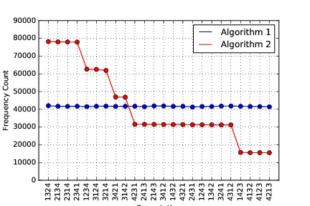
Yes, there is a difference
Experiments constructing 1 million random permutations shows that algorithm 1 is uniform, but algorithm 2 is not.
st. dev. 1 = 166.1
st. dev. 2 = 20,932.9

Slide 33
Why is it Uniform?
The first algorithm picks a random choice for the first position, then leaves it alone and recurs. It generates random permutations.
The second algorithm gives subsequent elements a better chance to end up first. The distribution is not uniform.
Moral: Random generation can be very subtle.

Slide 34
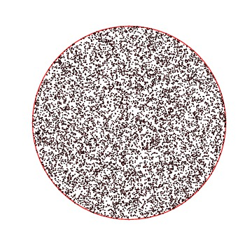
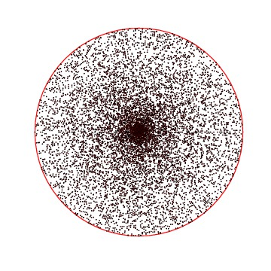
Sampling from Distributions
A common task is repeatedly drawing random samples from a given probability distribution.
Give me an algorithm to draw uniformly random points from a circle:
The problem is more subtle than it looks.

Slide 35
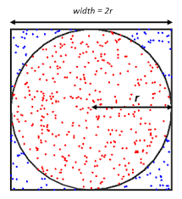
Drawing Points from a Circle
Each point in a circle is described by a radius r and angle a, but drawing them uniformly at random picks too many points near the center.
The inner half circle is smaller than the outer half!
Independently sampling x and y give points uniform in the box, so discarding those outside the circle leaves a uniform distribution.

Slide 36
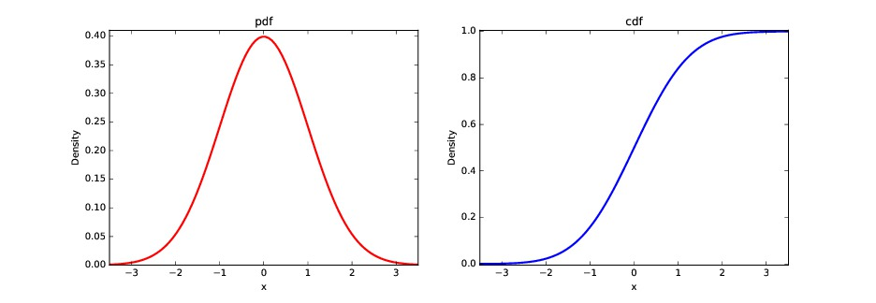
Sampling in One Dimension
To sample from any probability distribution, convert it to its cumulative distribution (cdf).
Selecting a probability p in [0,1] now maps to a value in the cdf:

Slide 37
Resources
I would like to thank Dr. Steven S. Skiena, Dr. Christian Kästner, and Chip Huyen for the valuable resources they have provided through their coursework in machine learning and data science. Their materials have been instrumental in shaping my teaching in these areas.
The Data Science Design Manual, Steven S. Skiena
Learning From Data, by Yaser S. Abu-Mostafa, Malik Magdon-Ismail, Hsuan-Tien Lin
Machine Learning in Production: From Models to Products by Christian Kästner
Designing Machine Learning Systems, Chip Huyen

