Slide 1
Introduction
Fatemeh Riahi
BCIT

Slide 2





My introduction
Who am I?
  24 years student!
  Software Engineer/ Data Scientist/ Team Lead

Slide 3
Your Introduction!
Your (preferred) name
In 1-2 sentences, your data science background and goals (e.g., coursework, internships, work experience)
In 1-2 sentences, your software engineering background, if any, and goals (e.g., coursework, internships, work experience)
One topic you are particularly interested in learning during this course?

Slide 4
What is Data Science?
Like any emerging field, it isn’t well defined, but incorporates elements of:
Exploratory Data Analysis and Visualization
Machine Learning and Statistics
High-Performance Computing technologies for dealing with scale.
Notes:
At the intersection of

Slide 5
Why Data Science?
New technology makes it possible to capture vast amounts of logging / sensor data.
Computing advances make it possible to analyze data on ever increasing scales.
Prominent role models (Google, Moneyball, hedge funds, Nate Silver, ...) have proven the power of modern data analytics.
Notes:
The buzzword is generative AI but 6-7 years ago it was data science
Hedge fund managers use data analysis to analyze the movement of stocks data

Slide 6
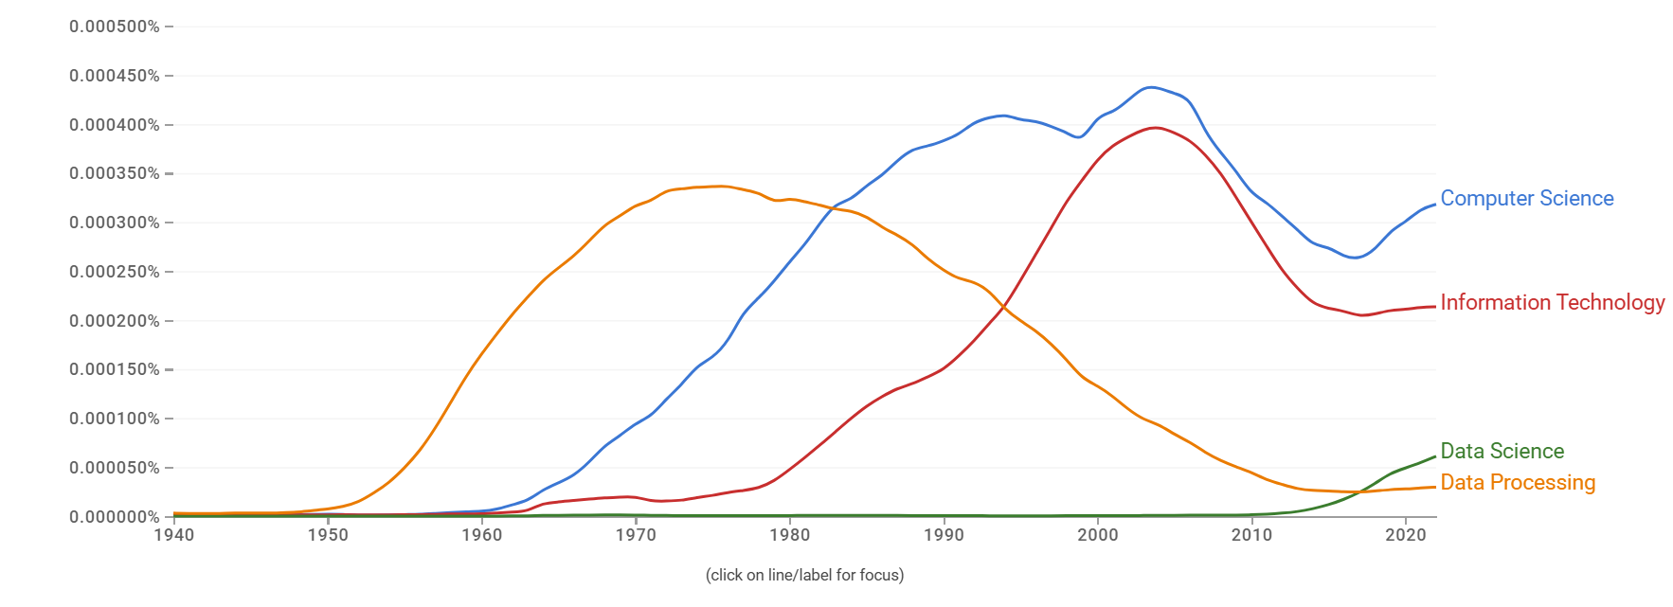
Data is not new to computing
Notes:
“This slide is reminding us that data is not something brand new in computing—it has been there since the beginning.”
: “Every computing system, from punch cards to cloud platforms, has always been about processing and storing data.”
x-axis (1900–2000s): “This is the timeline. We’re looking at how different terms or fields have been used over the years.”
y-axis (percentages): “This shows the frequency of these terms in published materials—basically, how often people talked about them.”
Blue (Data Processing): “Before the term ‘Computer Science’ was popular, people used the term ‘Data Processing.’ This was common in the 1950s–70s, when businesses were automating payroll, inventory, and accounting.”
Red (Computer Science): “As the field matured, around the 1970s and 80s, ‘Computer Science’ took off as the academic discipline.”
Green (Information Technology): “In the 1980s and 90s, as computers spread into offices and organizations, the term ‘Information Technology’ became more common.”
Orange (Data Science): “And more recently, in the 2000s, we see the rise of ‘Data Science’ as a distinct area—though the core idea, working with data, is not new.”
“So, when we say ‘Data Science,’ it sounds modern, but it’s really the continuation of a long tradition—data processing, IT, computer science—just with new tools and scale.”
“Why do you think ‘Data Processing’ declined while ‘Data Science’ rose?”
“Can you think of examples of ‘data processing’ today that haven’t changed much since the 1960s?” (e.g., payroll systems, banking transactions).
“What’s the difference between IT and Data Science?”
Q1: Why do you think “Data Processing” declined while “Data Science” rose?
Answer:
The term data processing was mainly about routine, structured tasks (e.g., payroll, billing, census data).
Over time, computers became more powerful and businesses demanded more than just processing—they wanted insights, predictions, and decisions.
That shift from processing data → analyzing and learning from data led to the rise of Data Science.
So the decline isn’t because data stopped being important, but because the scope expanded.
Q2: Can you think of examples of “data processing” today that haven’t changed much since the 1960s?
Answer:
Payroll systems – calculating salaries, deductions, and taxes every month.
Banking transactions – debit/credit updates, balance checks, and account statements.
Inventory management – tracking stock levels in warehouses.
These systems have modern technology now, but the underlying idea—input, process, output—remains the same.
Q3: What’s the difference between IT and Data Science?
Answer:
IT (Information Technology): Focuses on managing and maintaining computing infrastructure—networks, databases, servers, security, software deployment. It’s about making sure systems work reliably.
Data Science: Focuses on extracting knowledge and insights from data. This includes statistics, machine learning, predictive modeling, and visualization.
In short:
IT = keeping the data and systems running.
Data Science = using the data to answer questions and make predictions.

Slide 7
Data Science is not Machine Learning
Our primary goal here is to learn to think about data: understanding, cleaning, visualization -- not just building models.
We will not be doing deep learning/Gen AI.
We will be doing some applied machine learning, but this is not a machine learning course.

Slide 8
My experience with data
Premier league data to find the expectational players.
DNS data to find DNS tunneling.
DNS data of IoT devices to find anomalous behaviours.
Community Question answering data.
Startup company focused on CRMs.
This drives what I will teach here.

Slide 9
Course Project
This will be a small group project, where each team takes on a particular forecasting challenge and builds a predictive model.
Each team will start from scratch, including finding/constructing the relevant data sets.
Each team will choose from a list of 5-7 possible projects, released in a month or so.

Slide 10
Course ChatGPT policy
ChatGPT can do amazing-looking data science things, particularly using Code Interpreter.
You can use this and related tools provided you cite (#BEGIN[ChatGPT GPT-4]) giving prompts.
I look forward to learning what you can and cannot do with these tools.

Slide 11
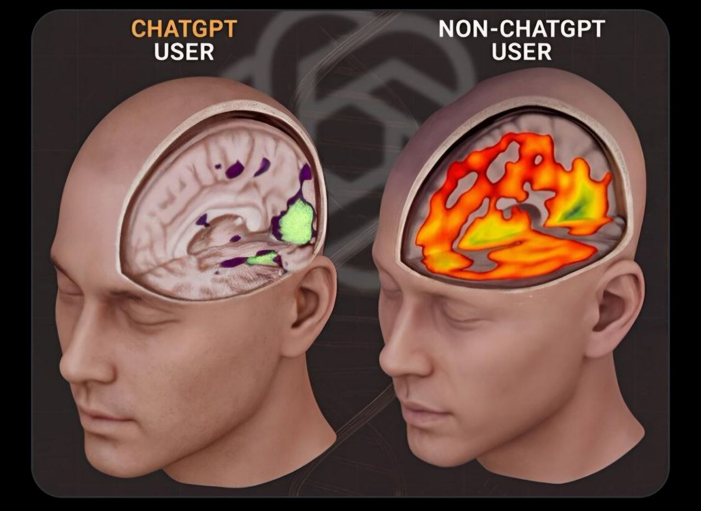
Use it before you lose it!
MIT researchers studied essay writing over 4 months using ChatGPT, Google Search, or no tools. ChatGPT users showed lower brain connectivity, weaker recall of their own writing, and less sense of ownership.
The key lesson is not “AI is bad,” but: students should use AI to support thinking, not replace it.
https://arxiv.org/pdf/2506.08872

Slide 12
Generative AI and Data Science
GenAI is eating the world, including certain aspects of what I think of Data Science.
That said, my focus is generally how to think correctly about mid-scale data analysis, to get the right understanding on important tasks.
We will somewhat discuss and use but not build GenAI models.

Slide 13
Academic Grading
Criteria | % | Comments
Assignments | 15 | (1) Python data manipulation (5%), (2) experimental analysis (5%), and (3) machine learning (5%) (total 15% of course grade)
Labs and quizzes | 15 | 8 labs, and 10 quizzes
Code Walk | 10 | Each student is required to complete two code walkthroughs over the semester. During each walkthrough, the student will explain and discuss their lab work. The specific lab to be reviewed will be selected randomly.
Project | 20 | Project proposal (5% of grade), Final project report (15% of grade)
Midterm | 20 | Paper based
Final | 20 | Paper based

Slide 14
Assignments
Series of 3 small to medium sized individual assignments
Engage with practical challenges
Reason about tradeoffs and justify your decisions
Integrate models and explanations into end-user products
Written reports, a little modeling, some coding

Slide 15
Labs
Introducing various tools, or a hands-on experience on what we have learned that week.
About 1h of work, low stakes, you may have to show your work to me.

Slide 16
Quiz
One quiz per session, consisting of 6 questions.
3 questions will be based on the previous lecture, which you are expected to review.
3 questions will be based on the current lecture material, before we cover it in class.
Reading material will be provided at the beginning of each week so you can review it in advance and prepare for the quiz.

Slide 17
Group project
Student Choose their team with some interventions form me!
Teams stay together for project throughout semester.
There will be a Peer review for the group project

Slide 18
Prerequisites
Some machine learning experience required
Basic understanding of data science process, incl. data cleaning, feature engineering, using ML libraries
High level understanding of machine-learning approaches
  Supervised learning
  Regression, decision trees, neural networks
  Accuracy, recall, precision, ROC curve
Ideally, some experience with notebooks, sklearn, or other frameworks
Basic programming and command-line skills will be needed
No further software-engineering knowledge required
Teamwork experience in product team is useful but not required
No required exposure to requirements, software testing, software design, continuous integration, containers, process management, etc.
  If you are familiar with these, there will be some redundancy – sorry!

Slide 19
Academic honesty
In a nutshell: do not copy from other students, do not lie, do not share or publicly release your solutions
In group work, be honest about contributions of team members, do not cover for others
Collaboration okay on labs, but not quizzes, individual assignments or exams
If you feel overwhelmed or stressed, please come and talk to use (see course outline for other support opportunities)

Slide 20
Case Study: Music Generation

Slide 21
Context: Music Generation Research
Lam, Max WY, et al. "Efficient neural music generation." Advances in Neural Information Processing Systems 36 (2024).
Recent progress in music generation has been remarkably advanced by the state-of-the-art MusicLM, which comprises a hierarchy of three LMs, respectively, for semantic, coarse acoustic, and fine acoustic modelings. Yet, sampling with the MusicLM requires processing through these LMs one by one to obtain the fine-grained acoustic tokens, making it computationally expensive and prohibitive for a real-time generation. Efficient music generation with a quality on par with MusicLM remains a significant challenge.In this paper, we present MeLoDy (M for music; L for LM; D for diffusion), an LM-guided diffusion model that generates music audios of state-of-the-art quality meanwhile reducing 95.7% to 99.6% forward passes in MusicLM, respectively, for sampling 10s to 30s music. MeLoDy inherits the highest-level LM from MusicLM for semantic modeling, and applies a novel dual-path diffusion (DPD) model and an audio VAE-GAN to efficiently decode the conditioning semantic tokens into waveform. DPD is proposed to simultaneously model the coarse and fine acoustics by incorporating the semantic information into segments of latents effectively via cross-attention at each denoising step. Our experimental results suggest the superiority of MeLoDy, not only in its practical advantages on sampling speed and infinitely continuable generation, but also in its state-of-the-art musicality, audio quality, and text correlation. Our samples are available at https://Efficient-MeLoDy.github.io/.

Slide 22
The Startup Idea
You just completed a research thesis as part of your Master’s/PhD degree about making deep learning for generative AI more energy efficient
Your recent project was using music generation as a case study. You showed 30% energy improvements with similar quality of generated music on benchmark prompts.
Two friends are excited about the application of music generation.
Idea: Let’s commercialize the idea and sell it to end users or music producers.

Slide 23
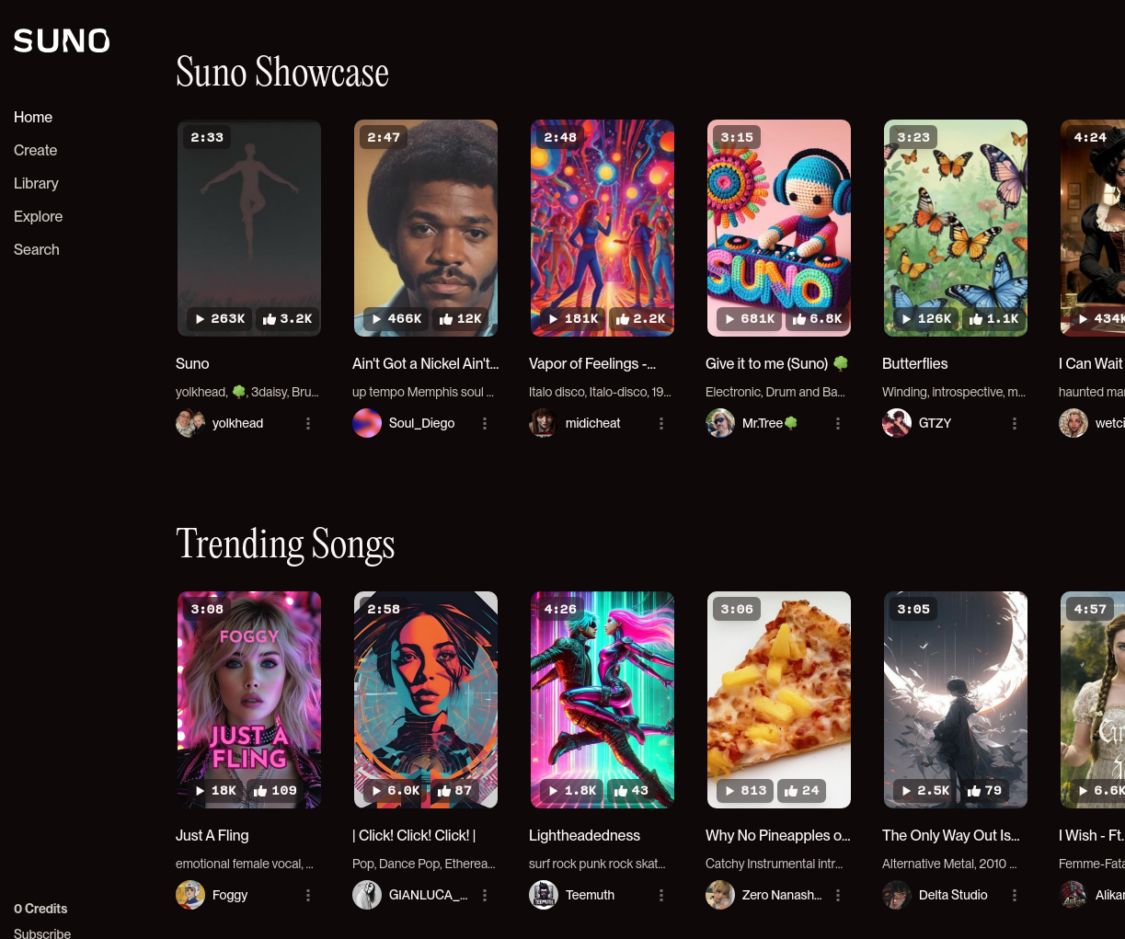

Slide 24
Breakout: Likely challenges in building commercial product?
As a group, think about challenges that the team will likely face when turning their research into a product:
One machine-learning challenge
One engineering challenge in building the product
One challenge from operating and updating the product
One team or management challenge
One business challenge
One safety or ethics challenge
Notes:
1. Machine-learning challenges
Generalization: Model trained on benchmark prompts might not perform well on real-world, diverse user prompts.
Evaluation: Hard to measure “good music” objectively; accuracy metrics may not reflect user satisfaction.
Bias in training data: Over-representation of some genres or cultures could make outputs feel repetitive or unfair.
Scalability: Handling longer music pieces (minutes vs. 10–30 seconds) without losing coherence.
2. Engineering challenges in building the product
Latency: Users expect near real-time generation; slow models will frustrate them.
Infrastructure cost: GPU/TPU costs are high, and scaling to thousands of users is expensive.
Integration: Making ML models work smoothly with front-end apps (web, mobile).
Reliability: Avoiding crashes or silent failures during generation.
3. Challenges from operating and updating the product
Continuous updates: New model versions may break compatibility or lower quality unexpectedly.
Monitoring: Detecting when generation quality drops in production.
User feedback loop: Collecting enough useful feedback without overwhelming users.
High availability: System must stay online 24/7; downtime means lost users.
4. Team or management challenges
Interdisciplinary collaboration: Need ML researchers, software engineers, product designers, and business people to work together.
Prioritization: Balancing research improvements vs. customer-facing features.
Scaling team: Growing from 3 people to 20+ requires new structures, roles, and leadership.
Burnout risk: Startups often move fast; without good management, team morale can collapse.
5. Business challenges
Monetization: How do you make money—subscriptions, per-song pricing, licensing to artists?
Competition: Products like Suno or OpenAI’s Jukebox are already in the market.
Legal risks: Music copyrights and intellectual property concerns—generated outputs could resemble real songs.
Market adoption: Convincing users to trust AI-generated music vs. human-created.
6. Safety or ethics challenges
Copyright infringement: Generated songs might copy melodies or lyrics too closely.
Offensive content: Users may try to generate inappropriate or harmful lyrics/music.
Misuse: Fake songs mimicking real artists could be used for scams or misinformation.
Fairness & cultural respect: Avoid over-representing Western genres at the expense of others; respect cultural diversity.
Data privacy: If user prompts or uploaded examples are stored, they must be protected.

Slide 25
Examples for discussion
What does correctness or accuracy really mean? What accuracy do customers care about?
How can we see how well we are doing in practice? How much feedback are customers going to give us before they leave?
Can we estimate how good our generated music is? How are we doing for different customers or different genres?
How to present results to the customers?
When customers complain about poor output, how to prioritize and what to do?
What are unacceptable mistakes and how can they be avoided? Is there a safety risk?
Can we cope with an influx of customers?
Will responding to the same prompt twice produce the same result? Does it matter?
How can we debug and fix problems? How quickly?
Notes:
Customer Facing issues. .
What does correctness or accuracy really mean? What accuracy do customers care about?
Correctness in ML-generated music isn’t about “true/false,” it’s about meeting user expectations (does the music sound good, fit the prompt, or feel coherent?).
Customers care more about perceived quality (pleasantness, creativity, fit for purpose) than technical accuracy.
2. How can we see how well we are doing in practice? How much feedback are customers going to give us before they leave?
Track metrics: listening duration, number of downloads/shares, repeat usage.
Collect explicit ratings (stars, thumbs up/down), but assume feedback will be sparse—most customers won’t report issues, they’ll just leave.
So combine implicit signals (engagement) with explicit ratings.
3. Can we estimate how good our generated music is? How are we doing for different customers or different genres?
Use automatic metrics (audio similarity, diversity scores, etc.).
Complement with user studies or crowd-sourced evaluations.
Break results down by genre, user segment, and use case to see if performance varies (e.g., great for classical but weak for jazz).
4. How to present results to the customers?
Provide multiple options (not just one track). Let customers pick their favorite.
Use clear labels (e.g., “fast tempo,” “calm mood”) to give customers control.
Keep the interface simple—avoid technical jargon.
5. When customers complain about poor output, how to prioritize and what to do?
Prioritize complaints that are severe (offensive, broken audio) or common (recurring issues across many users).
Respond quickly with workarounds (e.g., let them regenerate).
Feed complaints back into the training/evaluation loop.
6. What are unacceptable mistakes and how can they be avoided? Is there a safety risk?
Unacceptable mistakes: offensive lyrics, copyright violations, extremely poor quality output.
Safety risks: if music is used commercially, copyright/legal liability is critical.
Mitigation: filter training data, moderate outputs, and enforce quality control before release.
7. Can we cope with an influx of customers?
Requires scalable infrastructure (cloud services, autoscaling servers, caching).
If not planned, latency and quality may drop.
Use load testing and resource monitoring to ensure stability.
8. Will responding to the same prompt twice produce the same result? Does it matter?
Likely not (due to randomness in generation).
Sometimes variation is a feature (fresh creativity).
But for professional users, consistency may matter → provide an option to fix random seeds for reproducibility.
9. How can we debug and fix problems? How quickly?
Use logging and monitoring to capture failures.
Build debug tools to replay inputs and outputs.
Have a process for hotfixes (quickly roll back or retrain).
Aim for rapid iteration, since waiting weeks to fix issues loses trust.

Slide 26
Examples for discussion 2
With more customers, generation is taking longer and longer – what can we do?
Generation sometimes crashes. What to do?
How do we achieve high availability?
How can we see that everything is going fine and page somebody if it is not?
We improve our model but somehow system behavior degrades… Why?
Tensorflow update; does our infrastructure still work?
Once somewhat successful, how to handle large amounts of data per day?
Buy more machines or move to the cloud?
Models are continuously improved. When to deploy? Can we roll back?
Can we offer live music generation as an app? As a web service?
Can we get better the longer a user interacts with us? Will this benefit the next song they generate as well?
Notes:
technical/operational issues (latency, crashes, scaling, model updates).
1. With more customers, generation is taking longer and longer – what can we do?
Optimize model inference (quantization, pruning, batching).
Scale horizontally: add more servers/GPUs.
Cache results for popular prompts.
Use a load balancer to distribute requests.
2. Generation sometimes crashes. What to do?
Add monitoring & error logging.
Implement retries with backoff.
Graceful fallback (e.g., offer pre-generated music samples if live gen fails).
3. How do we achieve high availability?
Deploy across multiple regions or cloud zones.
Use auto-scaling and redundancy.
Health checks with automatic failover.
4. How can we see that everything is going fine and page somebody if it is not?
Real-time monitoring dashboards (Prometheus, Grafana).
Alerting systems (PagerDuty, OpsGenie).
Define service-level indicators (SLIs): latency, error rates, throughput.
5. We improve our model but somehow system behavior degrades… Why?
Model regressions: accuracy improved on benchmarks but worsened on real traffic.
Distribution shift: new data doesn’t match training data.
Hidden resource costs: new model is slower or needs more memory.
6. TensorFlow update; does our infrastructure still work?
Versioning & compatibility testing before rollout.
Continuous integration pipelines that run regression tests.
Containerization (Docker) to isolate environments.
7. Once somewhat successful, how to handle large amounts of data per day?
Build pipelines for ingestion, cleaning, and storage.
Use distributed data systems (Hadoop, Spark, BigQuery).
Archive old/rarely used data for cost efficiency.
8. Buy more machines or move to the cloud?
Cloud: flexible scaling, but higher long-term costs.
On-prem: cheaper at scale, but requires upfront investment and maintenance.
Likely hybrid approach: start cloud, move heavy workloads on-prem later.
9. Models are continuously improved. When to deploy? Can we roll back?
Use A/B testing or canary deployments.
Keep older versions ready → easy rollback.
Automate deployment with CI/CD pipelines.
10. Can we offer live music generation as an app? As a web service?
Web service: more control, easier updates, runs on powerful servers.
Mobile app: convenient, but harder to run big models locally (may need on-device lite versions).
Hybrid: lightweight app with cloud backend.
11. Can we get better the longer a user interacts with us? Will this benefit the next song they generate as well?
Yes, with personalization: learn user preferences (genres, tempo, instruments).
Use feedback (ratings, skips) to fine-tune recommendations.
But balance privacy & ethics—don’t overcollect user data.
✅ Teaching Tip: You could frame these as real DevOps & MLops challenges: scaling, monitoring, deployment, continuous learning. The answers show how data science meets software engineering in practice.

Slide 27
Examples for discussion 3
How many genres can be supported? Do we have the server capacity?
Can and should we learn from customer data?
How can we debug problems files we are not allowed to see?
Any chance we might leak private data?
Can competitors or bad actors attack our system?
Notes:
Long term and ethnical issues
How many genres can be supported? Do we have the server capacity?
Capacity = traffic × (avg song sec / real-time factor). Example framing: if your model renders at 0.25× real-time (4 sec compute per 1 sec audio), a 30-sec clip costs ~120 sec GPU. Multiply by concurrent users to size GPUs.
Start with a tiered catalog (10–20 top genres + “other”). Add long-tail genres as you scale.
Cache and reuse popular prompts/styles; pre-generate showcases to cut live load.
SLOs: e.g., P50 latency < 20 s, P95 < 60 s for a 30-sec clip; plan capacity to keep those.
Can and should we learn from customer data?
Yes, with consent and minimization.
Default analytics: implicit signals (play time, skips, likes).
Opt-in for explicit ratings and prompt reuse for improvement.
For personalization, store per-user preferences (genres/tempos/instruments) not raw audio/lyrics when possible.
Use privacy-preserving learning where feasible: on-device embedding updates, federated analytics, differential privacy on aggregates.
Clear opt-out + data retention limits.
How can we debug problem files we are not allowed to see?
Log non-content telemetry: model version, seeds, latency, GPU mem, CPU/GPU utilization, errors, and content fingerprints (e.g., MinHash of mel-spectrograms) instead of audio.
Collect objective audio stats only (loudness, clipping %, silence %, spectral centroid/roll-off).
Provide a privacy box: users can share the exact file into a secure quarantine with legal consent; otherwise devs debug using deterministic replay (prompt + seed + model version).
Ship a self-test bundle so support can reproduce locally without user data.
Any chance we might leak private data?
Risks: logging prompts/lyrics verbatim, training on user uploads without consent, model memorization of rare data, URLs in metadata.
Mitigations:
PII scrubbing of prompts/metadata before logs.
No user uploads in training unless explicit, revocable consent; keep a consented corpus separate.
Membership-inference hardening (regularization, DP where applicable).
Red-team prompts for leakage; automated output filters for names/IDs.
Can competitors or bad actors attack our system?
Abuse vectors: prompt injection to create infringing/offensive content, model theft via high-volume querying, data poisoning (if you learn from uploads), DDoS, credential stuffing, scraping of outputs, copyright traps.
Controls:
Rate limits, auth, WAF/CDN, per-IP/ASN throttling, bot detection.
Safety filters pre/post-generation; block disallowed prompts; watermark outputs.
Canaries/honeypots to detect scraping; TOS + automated enforcement.
Signed requests from clients; RBAC in admin tools; audit logs.
If doing continual learning, require curated, scanned data only (malware/audio stego checks).
Quick framing you can say aloud
“Breadth we support is bounded by training data and GPU minutes. Specificity lives in controls, not in a million genres.”
“We learn from consented signals, never from private uploads by default.”
“We debug with metrics and fingerprints, not people’s audio.”
“We design for failure: rate limit, monitor, canary, and roll back.”

Slide 28
Development Teams

Slide 29
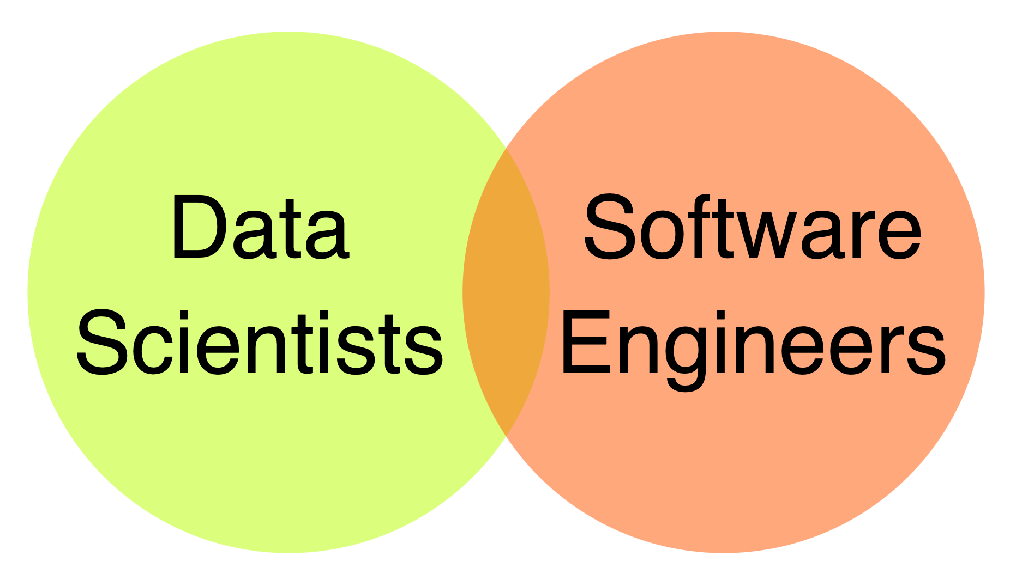
and Data engineers + Domain specialists + Operators + Business team + Project managers + Designers, UI Experts + Safety, security specialists + Lawyers + Social Scientists + …

Slide 30
Data scientist Software engineer
Often fixed dataset for training and evaluation
Focused on accuracy
Prototyping, often Jupyter notebooks or similar
Expert in modeling techniques and feature engineering
Model size, updateability, implementation stability typically does not matter
Builds a product
Concerned about performance, stability, release time
Identify quality through customer satisfaction
Must scale solution, handle large amounts of data
Detect and handle mistakes, preferably automatically
Maintain, evolve, and extend the product over long periods
Consider requirements for security, safety, fairness
Notes:
We need to make interdisciplinary teams

Slide 31

Likely collaboration challenges?
Notes:
1. Different Goals and Priorities
Data scientists focus on model performance (accuracy, precision, recall, novelty, etc.).
Software engineers focus on reliability, scalability, maintainability, and speed of deployment.
Example: A data scientist may want to try a large, complex model that gets 1% more accuracy, while an engineer worries it will double inference time and crash production.
2. Different Tools and Environments
Data scientists often work in Python notebooks, Jupyter, or R with ad-hoc scripts.
Engineers use production-grade frameworks, CI/CD pipelines, containerization, and strict coding standards.
The handoff (moving from experiment to production) often fails because the code is not production-ready.
3. Communication Gaps
Data scientists speak in terms of statistical metrics and research papers.
Engineers speak in terms of APIs, latency, memory limits, and deployment constraints.
Without translation, teams misunderstand priorities (e.g., “high accuracy” doesn’t mean “usable in real time”).
4. Iteration Speed vs. Stability
Data scientists like fast iteration: tweak parameters, retrain, experiment.
Engineers like stable versions: freeze a model, test it thoroughly, and roll it out in production.
Tension arises when scientists push too many changes too quickly, or engineers resist updates.
5. Data & Infrastructure Needs
Data scientists may request huge datasets, GPUs, or cloud resources to train models.
Engineers need to control costs and manage infrastructure.
This can cause friction when resource allocation isn’t aligned with company priorities.
6. Ownership & Accountability
If a model fails in production (e.g., poor predictions, biased outputs), who is responsible?
Data scientists might say, “The model was fine; maybe the system wasn’t configured properly.”
Engineers might say, “The system was fine; the model just didn’t generalize well.”
Lack of clear ownership slows down debugging and problem-solving.

Slide 32
What might Software Engineers and Data Scientists focus on?
Notes:
Software Engineers might focus on:
Scalability & performance
Can the system handle thousands of simultaneous song requests?
Optimize latency so songs generate quickly.
Reliability & uptime
Monitoring, logging, auto-scaling, error recovery.
Product infrastructure
Building the web app, APIs, user accounts, payment systems.
Security & privacy
Protect user data, prevent abuse (e.g., bots, malicious prompts).
Deployment & DevOps
Smooth CI/CD pipelines, version control, and rollbacks.
Data Scientists might focus on:
Model quality
How good does the generated music sound? Does it follow the prompt?
Evaluation metrics
Define quality measures: coherence, diversity, user satisfaction.
Personalization
Learn from user behavior to tailor music (genres, moods, instruments).
Experimentation
A/B testing model variants, fine-tuning prompts, exploring architectures.
Bias & coverage
Does the system work equally well across genres, cultures, and languages?
Overlap (where they collaborate)
User experience: SEs care about performance, DSs about quality—both must align.
Feedback loops: SEs build the logging systems, DSs analyze the data.
Deployment of new models: DSs design them, SEs integrate them safely.

Slide 33
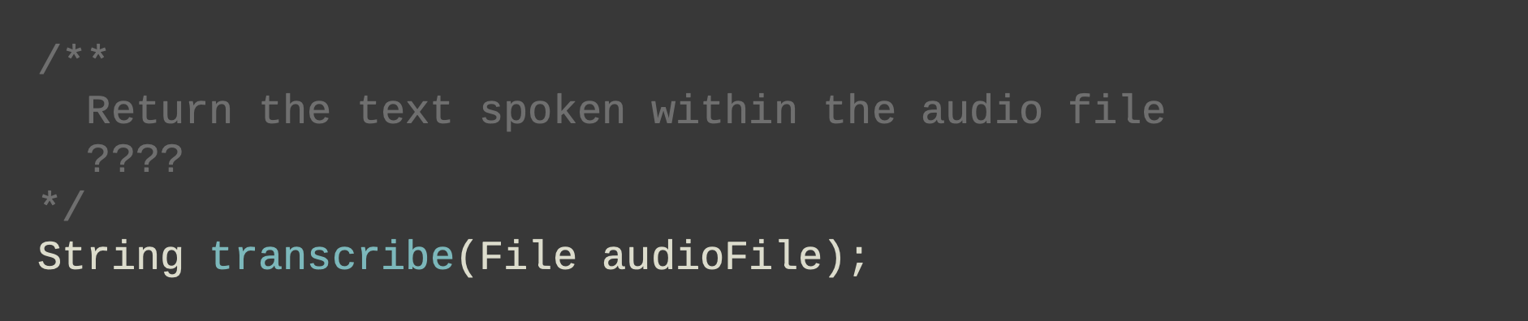
What makes software with ML challenging?
Traditional SE: specify what to do & how to test
MLs are usually black boxes (maybe justified, for their complexity…)
Even if you put specs in, e.g., LLM prompts, unclear if they will follow
Notes:
1. Traditional Software Engineering (SE)
In regular software:
You specify exactly what to do (inputs → outputs).
You write tests to check if the program behaves correctly.
Example: If you code add(2,3), you know it must return 5. Testing is straightforward.
2. Machine Learning (ML) is different
ML models are often black boxes:
Even if you know the inputs, it’s hard to predict exactly what output will come out.
This is partly justified, because ML solves very complex problems (like speech recognition, image classification, or natural language understanding).
3. The “specification” challenge
In ML, even if you provide specifications or instructions (like a function signature or an LLM prompt), you can’t guarantee the system will behave exactly as intended.
Example shown in the slide:
/** * Return the text spoken within the audio file */ String transcribe(File audioFile);
In traditional SE, you’d expect this function to always work consistently.
In ML, results may vary depending on background noise, accents, or unseen data.
: “In traditional SE, testing is like checking a calculator. In ML, testing is like checking a student — sometimes they get it right, sometimes they misunderstand, and you can’t always predict when.”
Key challenges:
Lack of determinism.
Hard to write exhaustive test cases.
Model drift (performance can degrade over time).

Slide 34
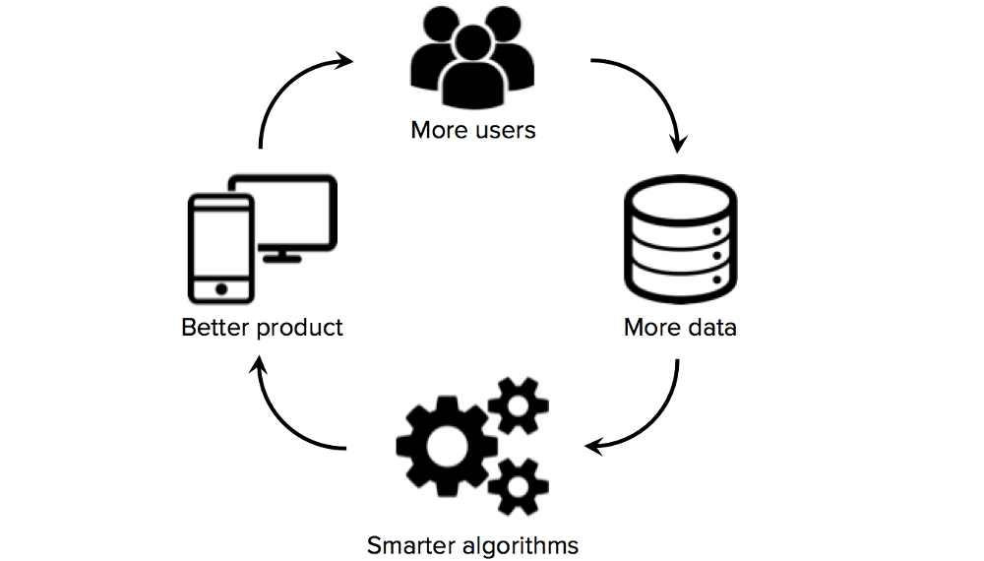
Data Focused and Scalable
MLs get the “specs” from data; Larger the better
Deductive reasoning (applying logic rules) to Inductive Reasoning (generalizing from observation)
Cause scalability issues
Notes:
1. Specs come from data
Traditional software: you write the rules explicitly.
Machine learning: the “rules” (or specifications) are learned from data.
Say: “The larger and more diverse the dataset, the better the model tends to perform.”
Example: A speech recognition system improves if it’s trained on many accents and noise conditions.
2. Deductive vs. Inductive reasoning
Deductive reasoning (traditional SE): Apply logic rules directly. (e.g., If password == correctPassword, then grant access).
Inductive reasoning (ML): Generalize from examples. (e.g., Given thousands of voice samples, the model learns patterns to recognize words).
Say: “ML flips the problem: instead of coding the rules, we code a system that learns rules from examples.”
3. Scalability issues
ML loves more data, but that comes with challenges:
Storage and computation → handling massive datasets.
Training time → scaling models across GPUs/TPUs.
System complexity → pipelines, monitoring, updating models.
4. The data flywheel (diagram explanation)
Walk students through the cycle on the right:
More users interact with your product.
They generate more data.
More data → enables smarter algorithms.
Smarter algorithms → deliver a better product.
Better product → attracts more users … and the cycle repeats.
This explains why companies like Google, Amazon, and TikTok scale so fast—more users → more data → stronger models → even more users.
👉 Teaching tip: You can ask students:
“What are examples of products where this data flywheel effect is very obvious?”
Expected answers: TikTok recommendations, Netflix, Spotify, YouTube, Google Search.

Slide 35

ML Models Make Mistakes
…Often in unexpected ways
  What happened: During a live-streamed match featuring Inverness Caledonian Thistle in Scotland, an AI-powered camera designed to track the ball repeatedly focused on the linesman’s bald head instead—and not the actual soccer ball.
Hard to foresee and capture because no spec
What does it mean to be correct? Can only evaluate whether it works well enough (on average) on some test data!
https://www.youtube.com/watch?v=SPbTKfu0zUY
Notes:
1. The funny but real-world example
Story: “During a soccer match in Scotland, an AI-powered camera was supposed to follow the ball. Instead, it kept zooming in on the linesman’s bald head—mistaking it for the ball.”
This is a great, memorable example of ML failure because:
The model learned from patterns in the data (round object, moving, shiny).
It had no deeper “understanding” of soccer.
2. Why this happens
ML doesn’t follow explicit rules like traditional software.
Instead, it generalizes from training data, so it can make mistakes in situations it wasn’t trained for.
These errors are often hard to foresee because there’s no detailed specification for “ball-ness” or “head-ness.”
3. The deeper challenge
Ask: “What does it even mean for the system to be ‘correct’?”
In traditional software: correctness = matches the spec.
In ML: correctness is statistical → the model only needs to be right most of the time on average, according to test data.
4. Teaching takeaway
Say: “ML failures are not bugs in the usual sense. They’re unexpected behaviors that come from the limits of the data and the generalization process.”
Important point for future engineers: you can’t test every possible scenario—so robustness, monitoring, and diverse training data are critical.

Slide 36
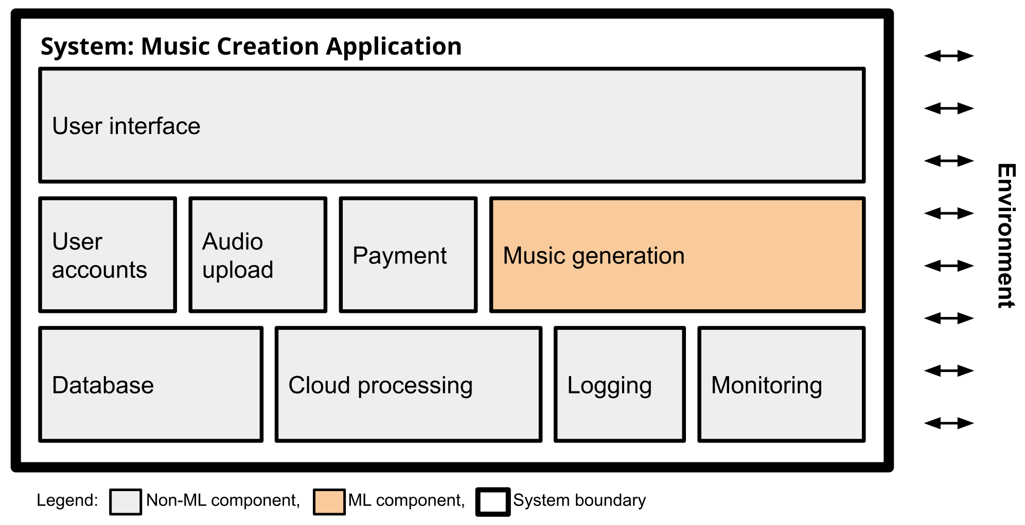
Interaction with the environment
Our system must be able to tolerate some incorrect predictions, and be aware of how it might influence the world…
Notes:
Say: “This diagram represents a music creation application. Notice that ML is just one part of the whole system.”
Highlight: most of the system is non-ML components — user interface, accounts, payment, database, cloud, monitoring.
2. The ML component
The music generation block (highlighted) is the ML piece.
It interacts with many other modules: user uploads, database, cloud processing, and ultimately with the outside world (the environment).
Say: “The ML part doesn’t live in isolation. Its outputs influence how users experience the system.”
3. Why this is challenging
ML predictions are not always 100% correct.
Example: A generated song might sound poor, inappropriate, or unexpected.
The system must be designed to:
Tolerate errors (e.g., give users a retry button, let them regenerate music).
Monitor outputs to detect when something goes wrong.
Log results to improve models in the future.
4. Environment interaction
The arrows show the system’s connection with the environment:
Users give input (e.g., a prompt for music).
The system processes and outputs music.
If the ML model fails, the environment (users, business reputation) feels the consequences.
5. Teaching takeaway
Say: “When we build software with ML, we can’t just focus on the model. We must think about the system around it: logging, monitoring, error handling, and user experience. Otherwise, one wrong prediction could ruin the whole product.”

Slide 37
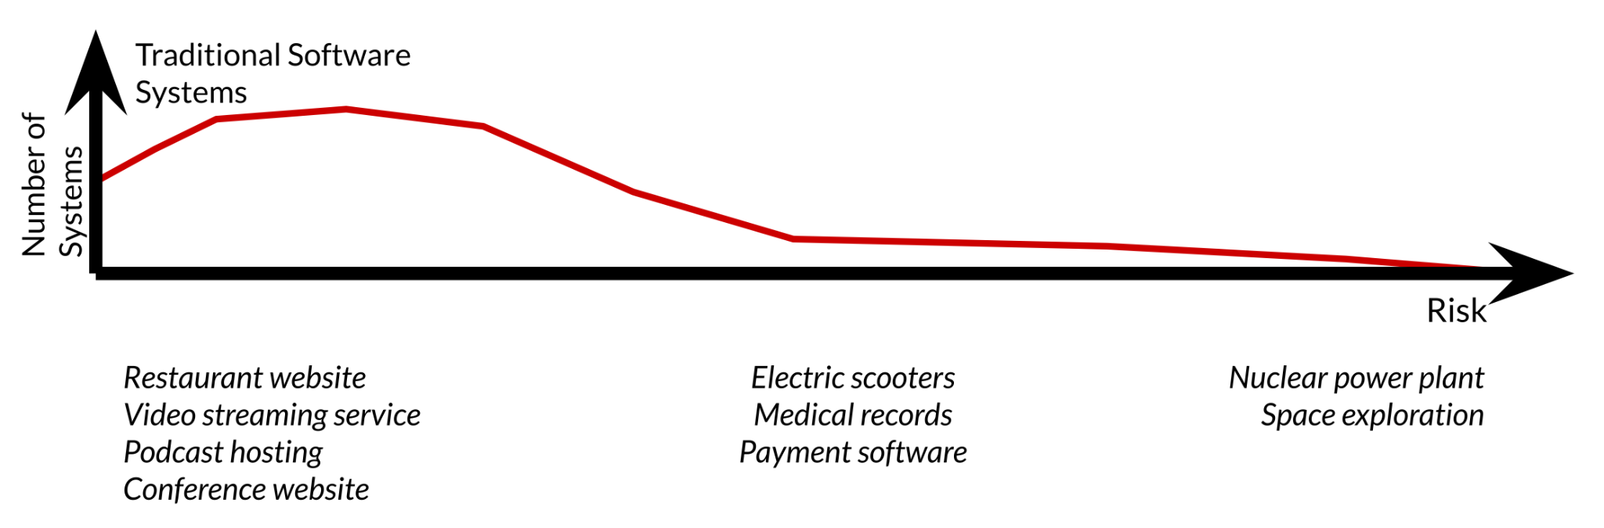
Complexity
Notes:
Slide 1 – Complexity in Traditional Software
The x-axis = risk (how dangerous if something goes wrong).
The y-axis = number of systems (how many types of systems exist at that level).
Most traditional systems are low-to-medium risk (restaurant websites, video streaming, conference websites).
Fewer systems exist at the high-risk end (nuclear power plants, space exploration).
Say: “Traditional software spans a spectrum, but most of what we see daily—apps, websites—falls into low-risk, even if they’re complex.”
Slide 2 – Complexity in Software with ML Components
Now, a second curve (blue) shows ML-enabled systems.
These appear in different parts of the risk spectrum:
Lower risk examples: Game AI, traffic planning, photo filters.
Medium risk examples: Photo search, social media feeds, smart homes, automated transcription.
High risk examples: Autonomous vehicles, predictive policing, deepfakes.
Say: “ML shifts complexity and risk into new domains. Some of these systems influence society directly—like predictive policing or deepfakes—so the risks are social and ethical, not just technical.”
Teaching Takeaways
Traditional software risk is often tied to safety-critical infrastructure (e.g., power plants).
ML software risk can emerge in everyday products (e.g., biased recommendations, misinformation) even if the technical system isn’t “safety critical.”
Both curves overlap in the middle: you can build ML into relatively safe products (photo filters) or very high-risk ones (autonomous vehicles).

Slide 38
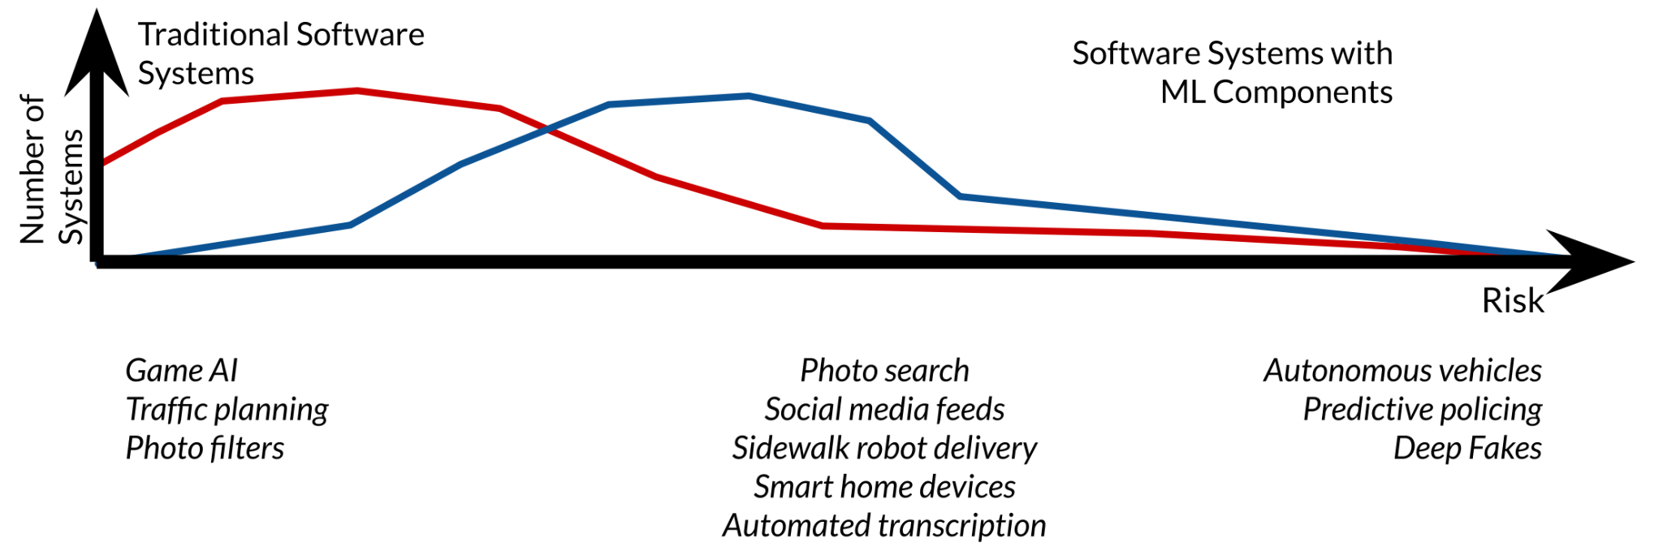
Complexity
Notes:
Mistakes here can affect privacy, safety, information exposure, or user experience.

Slide 39
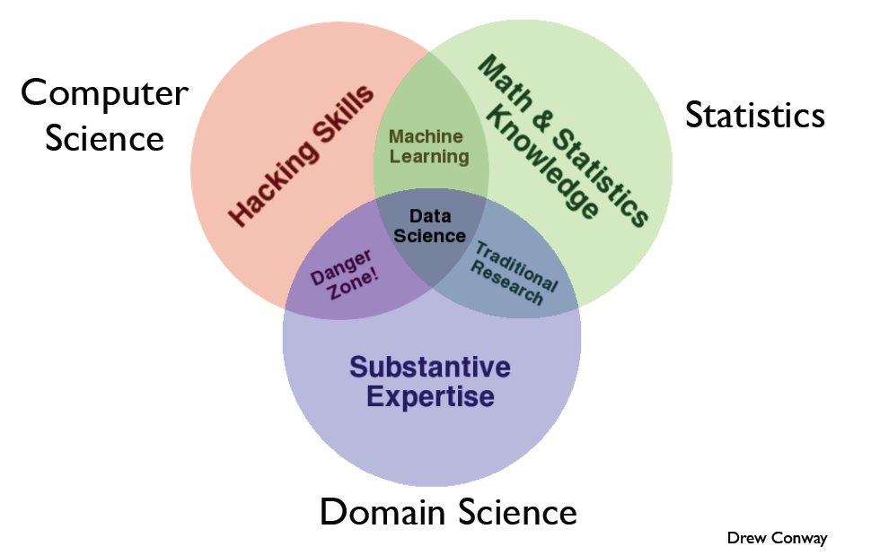
Skill Sets for Data Science
Notes:
Start with the three circles
Computer Science / Hacking Skills (red circle):
Practical programming ability—writing code, working with databases, manipulating large datasets, building prototypes.
Math & Statistics Knowledge (green circle):
Understanding probability, statistics, linear algebra, optimization—tools to build and evaluate models.
Domain/Business Expertise (purple circle):
Knowing the specific field you’re applying data science to (e.g., healthcare, finance, retail). This helps interpret data in a meaningful way.
2. Explain the overlaps
Computer Science + Math & Stats → Machine Learning
If you know how to code and understand math, you can build machine learning models—but you may not know how to apply them correctly without domain expertise.
Math & Stats + Domain Expertise → Traditional Research
This is what statisticians or domain researchers do: applying statistical methods to study specific questions.
Computer Science + Domain Expertise → Danger Zone!
You can write code and know the business problem, but without statistical grounding, you may make unreliable or misleading conclusions (e.g., mistaking correlation for causation).
3. The Center: Data Science
When all three skills overlap, you get a data scientist:
Can code and manage data (hacking skills).
Knows the math to build and evaluate models.
Understands the business/domain to ask the right questions and interpret results correctly.
“Being a data scientist is not about being the best programmer, statistician, or domain expert. It’s about being good enough in all three areas to connect them together.”
“If you’re too strong in one area and missing another, you may end up in the danger zone.”

Slide 40
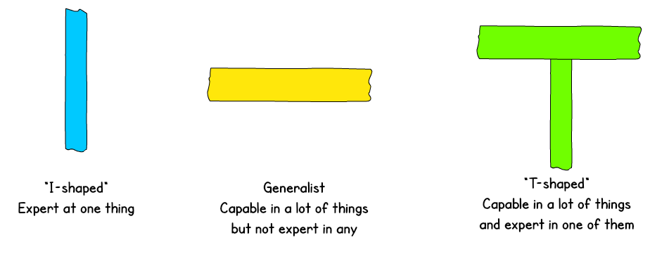
T-Shaped People
Broad-range generalist + Deep expertise
Figure: Jason Yip. Why T-shaped people?. 2018
Notes:
1. Start with the “I-shaped” person (blue bar)
Say: “An I-shaped person is a specialist. They have deep expertise in one area, but not much beyond it.”
Example: A brilliant statistician who knows advanced probability theory but can’t code or communicate results well.
Strength: Very deep knowledge.
Weakness: Hard to collaborate outside their niche.
2. The Generalist (yellow bar)
Say: “A generalist has broad knowledge across many areas but no deep expertise in any one of them.”
Example: Someone who can code a bit, do some stats, design basic UI, and write reports—but not at an expert level.
Strength: Flexibility, can help with many tasks.
Weakness: Shallow in all areas, not the go-to expert.
3. The T-shaped person (green T)
Say: “A T-shaped person combines both: they are broadly capable across different areas, but also have one deep area of expertise.”
Example: A data scientist who understands software engineering and domain knowledge broadly, but is an expert in machine learning.
Strength: Great collaborators—they can talk across disciplines and provide expert contributions.
Weakness: Takes time to build this balance.
4. Why it matters in Data Science teams
Data science is interdisciplinary (math, programming, domain knowledge).
Teams work best when members are T-shaped: each has their specialty (deep expertise), but also enough breadth to understand and work with others.
This reduces silos, improves collaboration, and makes projects more resilient.
“As future professionals, aim to become T-shaped. Have a specialty that makes you valuable, but also learn enough of the surrounding fields so you can collaborate and adapt.”

Slide 41
T-Shaped People
Broad-range generalist + Deep expertise
Example:
Basic skills of software engineering, business, distributed computing, and communication
Deep skills in deep neural networks (technique) and medical systems (domain)

Slide 42
Latest Buzzword: π-Shaped People
π
Notes:
Say: “We’ve just talked about T-shaped people — they have broad general knowledge and deep expertise in one area.”
Then: “But the latest buzzword is π-shaped people. Instead of one area of depth, they have two.”
2. What π-shaped people are
The horizontal bar (across the top of π) → broad skills across many disciplines, like communication, teamwork, and general technical knowledge.
The two vertical bars → two deep areas of expertise.
Example: A person who is deeply skilled in machine learning and software engineering, with general knowledge in product design, statistics, and business.
3. Why they’re valuable
They can bridge multiple disciplines.
They make teams more resilient—if one problem requires ML expertise and another needs engineering depth, the same person can contribute.
They’re especially valuable in startups and interdisciplinary research, where crossing boundaries is essential.
4. Comparison
I-shaped → only one specialty, little breadth.
T-shaped → breadth + one deep specialty.
π-shaped → breadth + two deep specialties.
5. Teaching Tip
You can ask your students:
“If you were to become π-shaped, which two deep skills would you want to combine?”
Example answers: Data Science + Business, ML + Cloud Engineering, Cybersecurity + AI.

Slide 43
Appreciating Data
Computer Scientists do not naturally appreciate data: it’s just stuff to run through a program.
The usual way to test algorithm performance is to run the implementation on “random data”.
But interesting data sets are a scarce resource, which requires hard work and imagination to obtain.

Slide 44
Computer vs. Real Scientists (1)
Scientists strive to understand the complicated and messy natural world, while computer scientists build their own clean and organized virtual worlds. Thus:
Nothing is ever completely true or false in science, while everything is either true or false in Computer Science / Mathematics.

Slide 45
Computer vs. Real Scientists (2)
Scientists are data-driven, while computer scientists are algorithm-driven.
Scientists obsess about discovering things, which computer scientists invent rather than discover.
Scientists are comfortable with the idea that data has errors; computer scientists are not.

Slide 46
Genius vs. Wisdom
Software developers are hired to produce code.
Data Scientists are hired to produce insights.
Genius shows in finding the right answer!!!
Wisdom shows in avoiding the wrong answers.
Data science (like most things) benefits more from wisdom than from genius.

Slide 47
Developing Wisdom
Wisdom comes from experience.
Wisdom comes from general knowledge.
Wisdom comes from listening to others.
Wisdom comes from humility, observing how often you have been wrong and why/how.
I seek pass on wisdom, through my experience on the difficulty of making good predictions.
Notes:
1. Set the context
Say: “So far, we’ve talked about skills and knowledge. But being a good scientist or engineer is not just about skills—it’s also about wisdom.”
Emphasize that wisdom is about judgment, reflection, and learning from mistakes.
2. Go through the bullet points
Wisdom comes from experience:
We gain wisdom by doing—working on projects, making predictions, failing, and improving.
Wisdom comes from general knowledge:
The broader your exposure (history, psychology, ethics), the more perspective you have to make good decisions.
Wisdom comes from listening to others:
Collaborating, taking feedback, and learning from mentors expands your understanding beyond your own viewpoint.
Wisdom comes from humility:
Acknowledge when you’re wrong. Reflect on why and how. This self-correction builds better judgment.
3. Tie it back to Data Science & ML
Say: “In machine learning, predictions are often wrong. The key is not to avoid mistakes, but to learn from them systematically—through monitoring, evaluation, and iteration.”
Add: “Just as wisdom in life comes from humility and reflection, building robust ML systems requires humility: we must accept uncertainty, be aware of limitations, and design with care.”

Slide 48
Developing Curiosity
The good data scientist develops a curiosity about the domain/application they are working in.
They talk shop with the people whose data they are working on.
Notes:
1. Curiosity about the domain
Say: “A good data scientist isn’t just crunching numbers—they want to understand the problem deeply.”
Example: If you’re analyzing healthcare data, you should be curious about how hospitals operate, what doctors care about, and what patients need.
Teaching point: “Without domain curiosity, you risk building models that are technically good but practically useless.”
2. Talking with stakeholders
Say: “Data scientists must spend time talking to the people behind the data.”
Example: If you’re analyzing customer transactions, talk to sales or marketing teams to understand customer behavior.
This bridges the gap between numbers and real-world meaning.
3. Broader perspective
Say: “Reading widely—whether it’s newspapers, blogs, or reports—helps you connect your work to the world.”
Example: If you know about current events (like inflation, climate change, or new technologies), you can ask better questions and interpret data more wisely.
4. Teaching takeaway
Curiosity drives better models, but also better questions.
Say: “Being a good data scientist is not only about answering questions with data—it’s also about asking the right questions in the first place.”

Slide 49
Asking Good Questions
Software developers are not encouraged to ask questions, but data scientists are:
What exciting things might you be able to learn from a given data set?
What things do you/your people really want to know?
What data sets might get you there?
Notes:
. Walk through the guiding questions
What exciting things might you be able to learn from a given dataset?
Example: From Netflix viewing data, can we learn not just what people watch, but why they stop watching?
What things do you/your people really want to know?
Example: A hospital doesn’t just want numbers—they want to know which patients are at high risk and need extra care.
What datasets might get you there?
Example: To study traffic congestion, you might need both GPS data and weather reports.
3. Teaching takeaway
Say: “A good data scientist doesn’t jump straight into modeling. They pause and ask: what is the real question here, and what data do I need to answer it?”
Add: “Bad questions lead to irrelevant models, no matter how advanced your algorithms are.”
4. Interactive element
Ask students:
“If I gave you access to all the data from Spotify, what’s one question you’d want to ask?”
Expected answers: Which songs go viral? What makes people skip songs? Can we predict a listener’s mood?

Slide 50
Let’s Practice Asking Questions!
Who, What, Where, When, and Why on the following datasets:
Baseball-reference.com
International Movie Database (IMBb)
Google ngrams
NYC taxi cab records
Notes:
1. Explain the activity
Say: “As data scientists, our first job is to ask the right questions. Let’s practice by taking real datasets and brainstorming good questions.”
Emphasize: “Notice we’re not yet building models—we’re learning to frame problems.”
2. Go through examples for each dataset
Baseball-reference.com
Who: Who are the most consistent hitters across decades?
What: What factors most influence a player’s career length?
Where: Where do most top players come from (geographic trends)?
When: When do players peak in performance?
Why: Why do certain positions have longer careers?
International Movie Database (IMDb)
Who: Who are the most frequently collaborating actors or directors?
What: What genres are gaining or losing popularity over time?
Where: Where are most highly rated movies produced?
When: When did box office revenue patterns change (e.g., pre/post streaming)?
Why: Why do certain movies succeed critically but fail commercially?
Google Ngrams
Who: Who are the most cited historical figures over time?
What: What words/phrases suddenly spike in usage?
Where: Where do linguistic shifts originate (English, French, Chinese)?
When: When did terms like “artificial intelligence” become popular?
Why: Why do some words fade out while others stay common?
NYC Taxi Cab Records
Who: Who are the most frequent riders (business vs. leisure patterns)?
What: What times of day have the highest demand?
Where: Where are the most common pickup and drop-off points?
When: When do traffic patterns change most (holidays, storms)?
Why: Why do fares vary so much in similar trips?

Slide 51
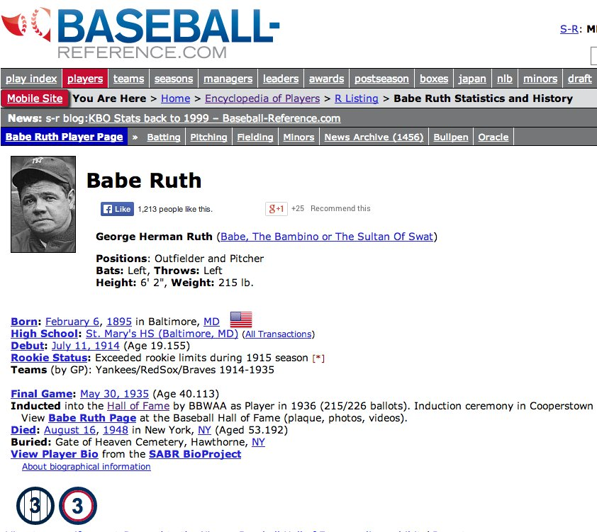
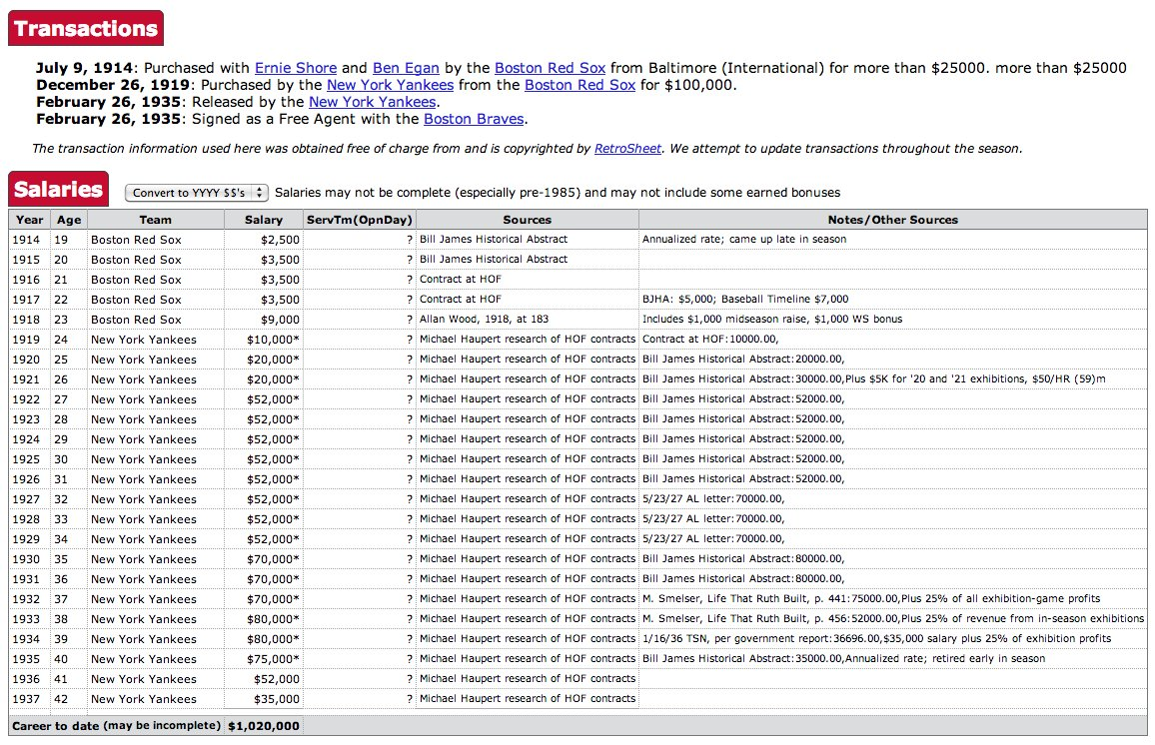
Baseball-Reference.com: biosketch
Notes:
1. Point out what the dataset contains
Personal info: name, birth date, physical stats, career highlights.
Career events: transactions between teams, debut and final game, Hall of Fame induction.
Financial data: year-by-year salary, total career earnings.
Sources: where the information came from.
2. Link back to data science skills
Say: “This is not just sports trivia—it’s structured data we can analyze.”
Example: Each player has dozens of attributes: performance stats, financial records, and career trajectory. That makes it a perfect dataset for asking good questions.
3. Show possible questions
Using the Who, What, Where, When, Why framework from the previous slide:
Who earned the highest salaries in baseball history?
What is the relationship between performance stats and salary increases?
Where did the most Hall of Famers come from?
When do salaries peak during a player’s career?
Why were certain players paid more despite similar performance?
4. Teaching takeaway
Say: “The value of this biosketch is not just in the individual story of Babe Ruth, but in how we can compare across many players to see larger patterns.”
Add: “In data science, we always look for ways to move from single cases → to generalizable insights.”

Slide 52
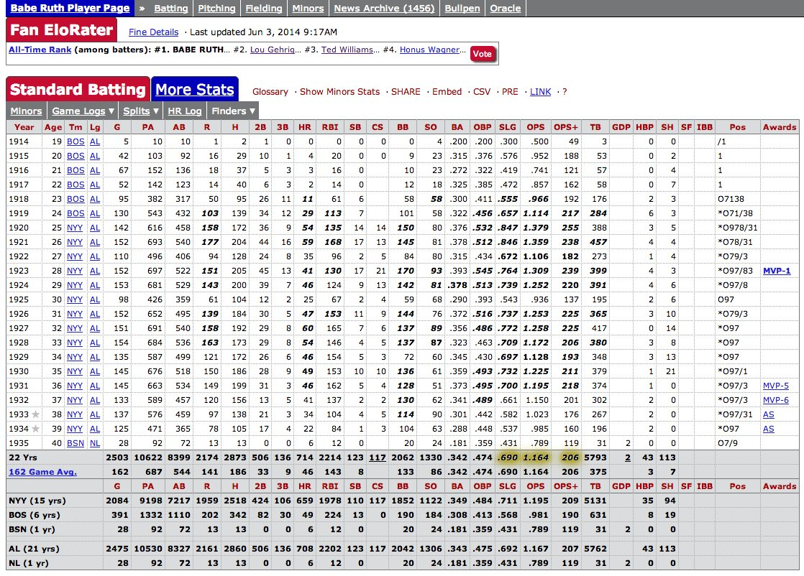
Statistical Record of Play
Summary statistics of each years batting, pitching, and fielding record, with teams and awards.
Notes:
1. What the dataset contains
Each row = one season.
Columns = detailed batting statistics (games played, hits, home runs, runs batted in, walks, strikeouts, batting average, etc.).
Also includes team, league, awards, and season totals.
2. Why it’s interesting for data science
It’s a time series dataset: you can analyze performance across years.
It’s multivariate: multiple features (e.g., batting average, home runs, strikeouts) can be compared.
It has labels/awards: MVP, All-Star, Hall of Fame → good for classification or correlation analysis.
3. Example data science questions
Trends over time:
How did Babe Ruth’s batting average change with age?
When did he peak as a player?
Comparisons:
Did his performance justify his salary at each stage?
How do his stats compare to other players of his era?
Predictions:
Based on his first 5 years, could we have predicted his career trajectory?
Anomalies:
Were there any “outlier” seasons where his stats deviated sharply?
4. Teaching takeaway
Say: “Sports statistics are a gold mine for data science. They’re structured, complete, and often span decades—perfect for practicing time series analysis, regression, prediction, and visualization.”
Add: “This is also a good reminder: the techniques we use in sports data can apply to other fields like finance, healthcare, and education.”

Slide 53
Baseball Questions
How to best measure individual player’s skill, value or performance?
How fair do trades between teams work out?
What is the trajectory of player’s performances as they mature and age?
To what extent does batting performance correlate with the position played?
Notes:
1. How to best measure individual player’s skill, value, or performance?
Say: “Baseball has dozens of stats—batting average, on-base percentage, slugging, home runs. Which one is the best measure of player value?”
This opens discussion about feature selection in data science—deciding what metric really captures what you care about.
2. How fair do trades between teams work out?
Example: Babe Ruth’s famous trade from the Red Sox to the Yankees.
Question: Did both teams benefit? Or did one side “win” the trade?
This ties to causal inference: measuring outcomes not just in raw numbers, but in terms of long-term value.
3. What is the trajectory of players’ performances as they mature and age?
Performance is not static—it improves, peaks, and declines.
This invites time series analysis and predictive modeling.
Example: Can we model when most players peak? How early performance predicts longevity?
4. To what extent does batting performance correlate with the position played?
Certain positions (e.g., pitchers vs. outfielders) have different batting expectations.
Say: “If we separate batting stats by position, do we see clear patterns? Are shortstops weaker hitters than outfielders, on average?”
This is an example of segmentation and correlation analysis.
5. Teaching takeaway
Say: “Notice that these questions are not just about baseball—they’re about data science thinking. They force us to ask: What metrics matter? How do we measure fairness? How do we handle time series? How do we segment data by categories?”

Slide 54
Demographic Questions
Do left-handed people have shorter lifespans than right-handers?
How often do people return to where they were born?
Do player salaries reflect past, present, or future performance?
Are heights and weights increasing in the population?
Notes:
1. Do left-handed people have shorter lifespans than right-handers?
Say: “This is a classic kind of demographic question—looking for differences between groups.”
In baseball data, you can compare left-handed vs. right-handed players on career length or health outcomes.
Broader lesson: This is about group comparison analysis.
2. How often do people return to where they were born?
With birthplace and deathplace (or retirement place) data, you can study migration patterns.
Say: “Are players more likely to settle back near their hometowns, or do they stay in the cities where they played?”
Broader lesson: This reflects geographic/demographic mobility studies.
3. Do player salaries reflect past, present, or future performance?
Great example of causality and time dependence.
Say: “Are teams paying for what a player has already done, what they’re doing right now, or what they’re expected to do in the future?”
Broader lesson: This connects to lagged features and predictive modeling.
4. Are heights and weights increasing in the population?
With long-term player records, you can track physical changes over decades.
Say: “For example, are modern players taller and heavier than players from Babe Ruth’s time?”
Broader lesson: This is about longitudinal trend analysis.
Teaching takeaway
Emphasize: “These questions show how demographic information—things like handedness, birthplaces, physical stats, and salaries—can be analyzed to uncover trends and insights. The key is to link demographics to outcomes.”
How many people go back to their country after their studies
Gender is a big bias in the basebasl data

Slide 55
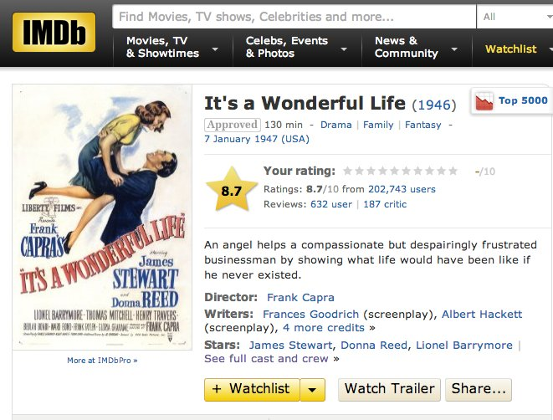
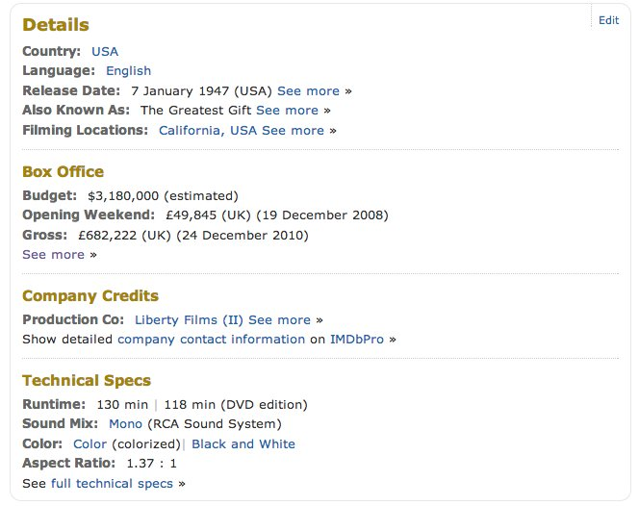
IMDb: Movie Data

Slide 56
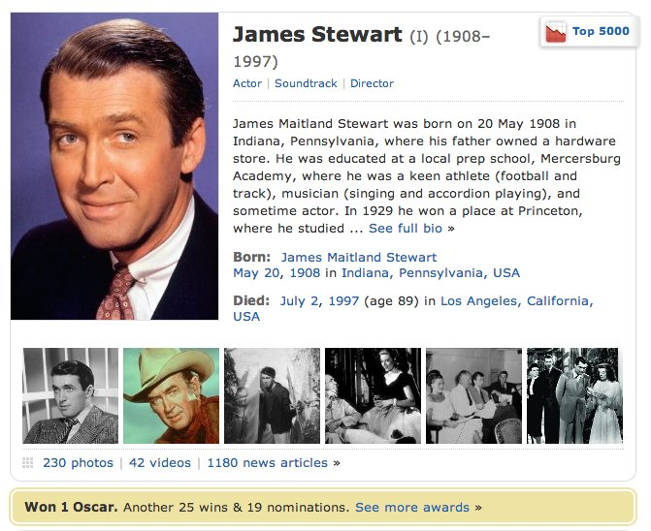
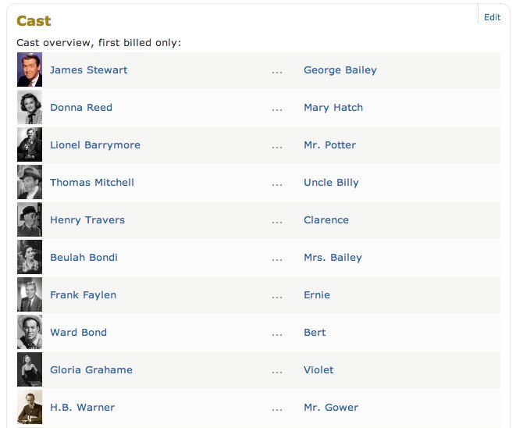
IMDb: Actor Data

Slide 57
Movie Questions
Can we predict how well people will like a movie? What about its gross?
What does the social network of actors look like? (Six degrees of Kevin Bacon)
What is the age distribution of actors and actresses in film?
Do stars live longer or shorter lives than the bit players or public?
Notes:
Slide 1 – IMDb Actor Data
The slide shows James Stewart’s IMDb profile with:
Biographical info (birth, death, education, achievements).
Career highlights (movies, awards).
Cast lists (co-actors and roles).
Say: “This is a structured dataset: each actor has biographical, career, and network data (who they worked with). That means we can ask not just about individual actors, but about patterns across the film industry.”
Slide 2 – Movie Questions
1. Can we predict how well people will like a movie? What about its gross?
Use features like cast, director, genre, budget, release date.
This ties to predictive modeling & regression/classification.
2. What does the social network of actors look like?
Example: the “Six Degrees of Kevin Bacon” game.
Build a graph network: actors are nodes, co-starring in a film creates edges.
Useful for graph analysis and studying influence/collaboration.
3. What is the age distribution of actors and actresses in film?
Compare age distributions across decades, genres, or leading vs. supporting roles.
This is a demographic analysis question.
4. Do stars live longer or shorter lives than the bit players or public?
Compare survival statistics for lead actors vs. supporting actors vs. general population.
Brings in statistical comparison and hypothesis testing.

Slide 58
Google Ngrams
Presents an annual time series of the frequency of every “popular” word/phrase with 1 to 5 words occurs in scanned books.
`Popular’ means appears >40 times in total.
Google has scanned about 15% of all books ever published, making this resource quite comprehensive.
Notes:
1. What Google Ngrams is
Say: “Google Ngrams is a dataset built from books that Google has scanned—about 15% of all books ever published.”
It presents an annual time series showing how often words or short phrases (1–5 words) appear in books.
Only words/phrases that appear at least 40 times are included (to filter out noise).
2. Why it’s useful
It lets us track language and cultural trends over time.
Example: How often words like computer, democracy, or climate change appear in books.
It’s essentially a way to “quantify culture.”
3. Example questions
Trends: How has the use of “artificial intelligence” grown since 1950?
Comparisons: Which was used more often over time: “freedom” or “equality”?
Events: Did mentions of “war” spike during the 1940s?
Shifts: When did “email” surpass “letter” in popularity?
4. Teaching takeaway
Say: “Google Ngrams is an example of a dataset that isn’t numbers in a table, but still allows quantitative analysis.”
Emphasize: “Data science is about asking questions and finding patterns—whether the data is stock prices, sports stats, or words in books.”

Slide 59
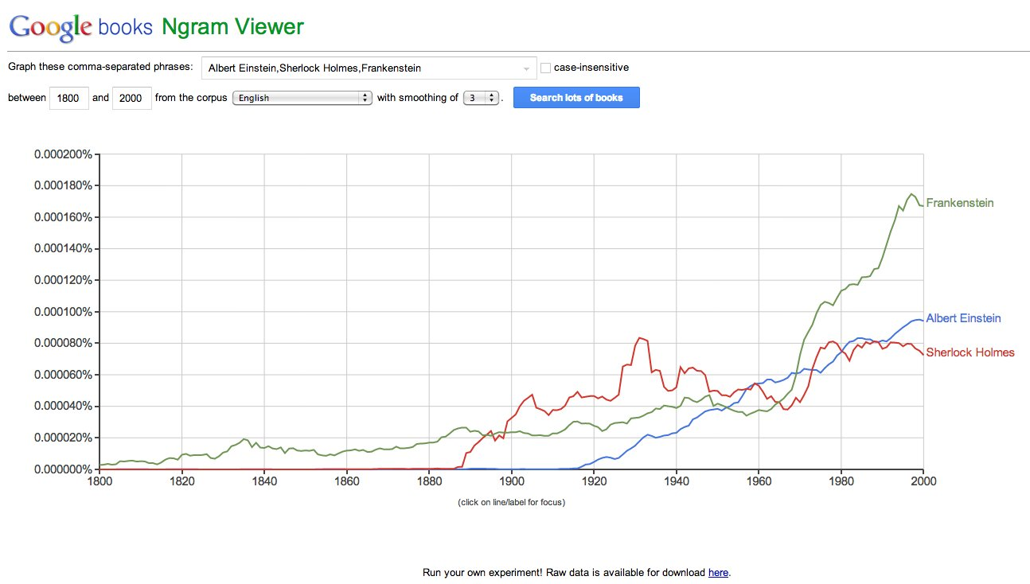
Google Ngram Viewer
Notes:
How the Viewer Works
Say: “The Ngram Viewer lets us enter words or phrases and see how often they appeared in books across time.”
The graph here tracks usage between 1800–2000, showing relative frequency of each term in Google’s scanned book corpus.
Important detail: The y-axis is normalized—it shows percentage of all words, not raw counts.
2. Interpreting the Graph
Frankenstein (green):
Spikes in the 19th century (after Mary Shelley’s book in 1818).
Keeps rising through the 20th century, reflecting the novel’s cultural legacy and film adaptations.
Sherlock Holmes (red):
Appears later, starting in the late 19th century.
Peaks in the early 20th century with Conan Doyle’s stories, then stabilizes.
Albert Einstein (blue):
Appears only in the 20th century.
Peaks mid-century, aligning with his prominence in physics and global culture.
3. Why This Is Useful
Say: “This shows how Ngrams let us connect literary data with history and culture. We can see the cultural footprint of fictional characters vs. real scientists.”
Emphasize: “It’s a powerful way to visualize how ideas, people, and stories rise and fall in popularity.”
4. Teaching Activity
Ask students: “What other terms might show interesting trends? For example: democracy vs. freedom, or email vs. letter.”
Have them predict the trend first, then test with Ngram Viewer.
How are the words creeping into each other
How much cursing has changed.

Slide 60
Ngram Questions
How has the amount of cursing changed over time?
What is the lifespan of fame and technologies? Is it increasing/decreasing?
How often do new words emerge? Do they stay in common usage?
What words are associated with other words, i.e. can you build a language model?
Notes:
1. How has the amount of cursing changed over time?
Say: “We could look at how often swear words appear in published books over the last 200 years.”
This raises interesting cultural and social questions—are people writing more openly now than before?
2. What is the lifespan of fame and technologies? Is it increasing or decreasing?
Example: Compare mentions of famous people (like “Albert Einstein”) or technologies (“steam engine” vs. “electricity” vs. “internet”).
Ask: “Does fame last longer today than in the past? Do technologies fade faster?”
This ties into trend analysis and cultural memory.
3. How often do new words emerge? Do they stay in common usage?
Say: “We can track new words like ‘selfie’ or ‘blockchain’ to see if they’re just fads or lasting additions to the language.”
This is about innovation in language and adoption curves.
4. What words are associated with other words (language modeling)?
Example: Look at word pairs like “artificial” → “intelligence” or “climate” → “change.”
Ask: “What kinds of contexts do words appear in, and how do associations shift over time?”
This is essentially the foundation of modern NLP—learning word embeddings and co-occurrence patterns.
Teaching Takeaway
Say: “Ngrams isn’t just about words—it’s a tool to study culture, society, and language itself. With the right questions, we can move from word counts to deep insights about history.”

Slide 61
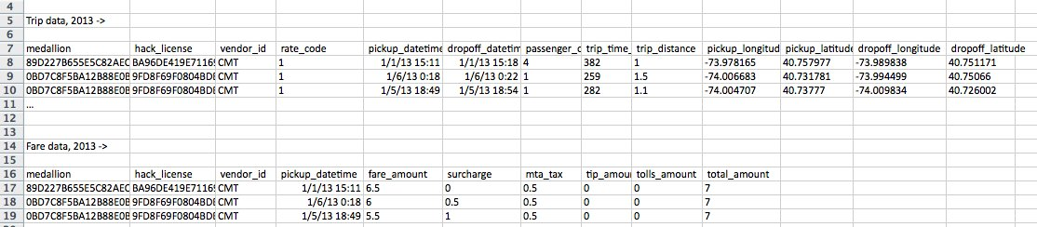
NYC Taxi Cab Data
Gives driver/owner, pickup/dropoff location, and fare data for every taxi trip taken.
Data obtained from NYC via Freedom of Information Act Request (FOA)
Notes:
1. What the dataset contains
Each row represents a single taxi trip in New York City.
Key variables:
Driver/owner IDs (medallion, hack license, vendor ID).
Trip details: pickup & dropoff times, locations (lat/long), trip distance, trip duration.
Fare details: fare amount, surcharge, taxes, tips, tolls, total fare.
Say: “This dataset essentially captures the economic and geographic footprint of taxi transportation in NYC.”
2. Why it’s interesting
It’s large-scale: millions of trips across years.
It’s multi-dimensional: combines geography, time, economics, and human behavior.
It’s a great dataset for exploring urban analytics, demand forecasting, and mobility studies.
3. Example questions
Demand & supply:
What are the busiest pickup/dropoff locations?
What times of day have the highest demand?
Fares & tips:
Do tips correlate with trip distance, duration, or time of day?
How do surcharges (like night or rush hour pricing) affect total fares?
Geographic analysis:
Which neighborhoods are most connected by taxis?
Can we cluster trips into common routes?
Operational questions:
How much revenue does an average taxi driver make in a day?
What’s the distribution of trip lengths (short vs. long rides)?
4. Teaching takeaway
Say: “This dataset shows how raw transactional data—like taxi rides—can reveal broader patterns about human behavior, economics, and city infrastructure.”
Emphasize: “It’s not just about taxis. The same techniques apply to analyzing Uber trips, food deliveries, or even hospital visits.”

Slide 62
Taxicab Questions
How much do drivers make each night?
How far do they travel?
How much slower is traffic during rush hour?
Where are people traveling to/from at different times of the day?
Do faster drivers get tipped better?
Where should drivers go to pick up their next fare?
Notes:
1. How much do drivers make each night?
Using fare_amount + tips + surcharges, group by driver and date.
Can answer: “What’s the average nightly income? How does it vary by weekday/weekend?”
Data science angle: aggregation & time-based grouping.
2. How far do they travel?
Use trip_distance across all trips.
Can compare: average trip length vs. total miles driven per day.
Data science angle: distribution analysis.
3. How much slower is traffic during rush hour?
Compare trip_time / trip_distance at rush hour vs. off-peak.
Can also check seasonal or weather effects.
Data science angle: time-of-day patterns, hypothesis testing.
4. Where are people traveling to/from at different times of the day?
Use pickup/dropoff latitude and longitude.
Morning → more pickups in residential areas, drop-offs downtown.
Evening → reverse.
Data science angle: spatial analysis, clustering, heatmaps.
5. Do faster drivers get tipped better?
Compare average speed (distance/time) with tip percentage.
Question: “Do riders reward efficiency, or penalize reckless driving?”
Data science angle: correlation analysis.
6. Where should drivers go to pick up their next fare?
Analyze pickup hotspots by time of day.
Suggest optimal locations for idle drivers.
Data science angle: predictive modeling, recommendation systems.
Teaching takeaway
Say: “Notice how all these questions combine raw trip data with real-world behavior: economics, geography, and human decision-making.”
Add: “The best data science projects don’t stop at describing the past—they also guide future action, like where to find the next passenger.”

Slide 63
Resources
I would like to thank Dr. Steven S. Skiena, Dr. Christian Kästner, and Chip Huyen for the valuable resources they have provided through their coursework in machine learning and data science. Their materials have been instrumental in shaping my teaching in these areas.
The Data Science Design Manual, Steven S. Skiena
Learning From Data, by Yaser S. Abu-Mostafa, Malik Magdon-Ismail, Hsuan-Tien Lin
Machine Learning in Production: From Models to Products by Christian Kästner
Designing Machine Learning Systems, Chip Huyen

