Slide 1
Mathematical Preliminaries
Fatemeh riahi
bcit

Slide 2

Probability
Probability theory provides a formal framework for reasoning about the likelihood of events.
The probability p(s) of an outcome s satisfies:
0 <= p(s) <= 1
These basic properties are often violated in casual use of “probability” in data science.
Notes:
In data science, models may produce scores that people casually call probabilities, even though those scores don’t satisfy these rules. The sentence is warning you to check before interpreting a score as a probability.
Cat: 0.8
Dog: 0.6
Bird: 0.2
Someone might say, “There’s an 80% probability it’s a cat, 60% it’s a dog, and 20% it’s a bird.”

Slide 3
Probability vs. Statistics
Probability deals with predicting the likelihood of future events, while statistics analyzes the frequency of past events.
Probability is theoretical branch of mathematics on the consequences of definitions, while statistics is applied mathematics trying to make sense of real-world observations.

Slide 4
Compound Events and Independence
Suppose half my students are female (event A) Half my students are above median (event B).
What is the probability a student is both A & B?
Events A and B are independent iff
Independence (zero correlation) is good to simplify calculations but bad for prediction.
Notes:
Why Independence Makes Prediction Harder
Independence means no relationship.
If two events are independent, knowing one doesn’t help you predict the other.
Example:
Imagine you’re trying to predict if a student is above the median.
If “student is female” is independent of performance, then knowing gender gives you zero extra information.
You can’t make your prediction better — you’re basically still guessing with 50/50 chance.
Contrast with dependence (helpful for prediction):
Suppose female students actually score higher on average (not independent).
Then, knowing a student is female increases your chance of predicting they are above the median.
Here, the dependence gives you useful predictive power.

Slide 5


Conditional Probability
The conditional probability P(A|B) is defined:
Conditional probabilities get interesting only when events are not independent, otherwise:
Notes:
A intersection B

Slide 6

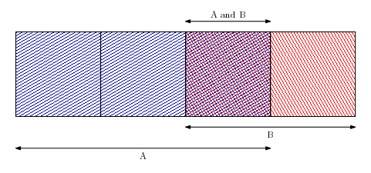
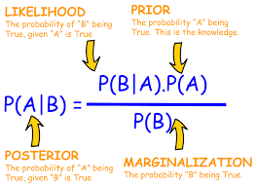
Bayes Theorem
Bayes theorem lets us update our likelihood estimate of A in response to knowledge of B:
Notes:
Updating the belief based o the evidence.
P(covid|fever)=p(fever|covid)*p(covid)/p(fever)
P(B/A)=1/3
P(A)=3/4
P(B)=1/2

Slide 7
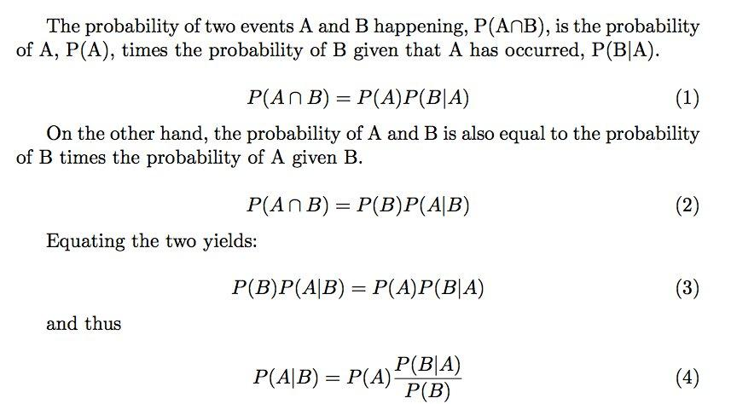
Proof of Bayes Theorem
Notes:
Updating the belief based o the evidence.

Slide 8
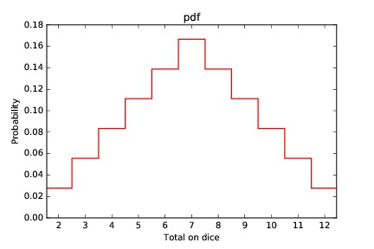
Distributions of Random Variables
Random variables are numerical functions where values come with probabilities.
Probability density functions (pdfs) represent RVs, essentially as histograms.
Here V is the sum of two dice.
Notes:
Result of a coin toss is a random variable or resule of dice roll.

Slide 9

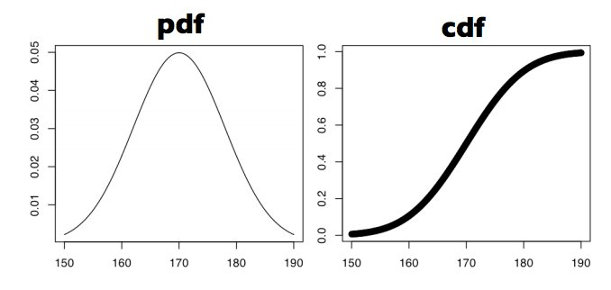
Probability/Cumulative Distributions
The cdf is the running sum of the pdf:
The pdf and cdf contain exactly the same information, one being the integral / derivative of the other.

Slide 10
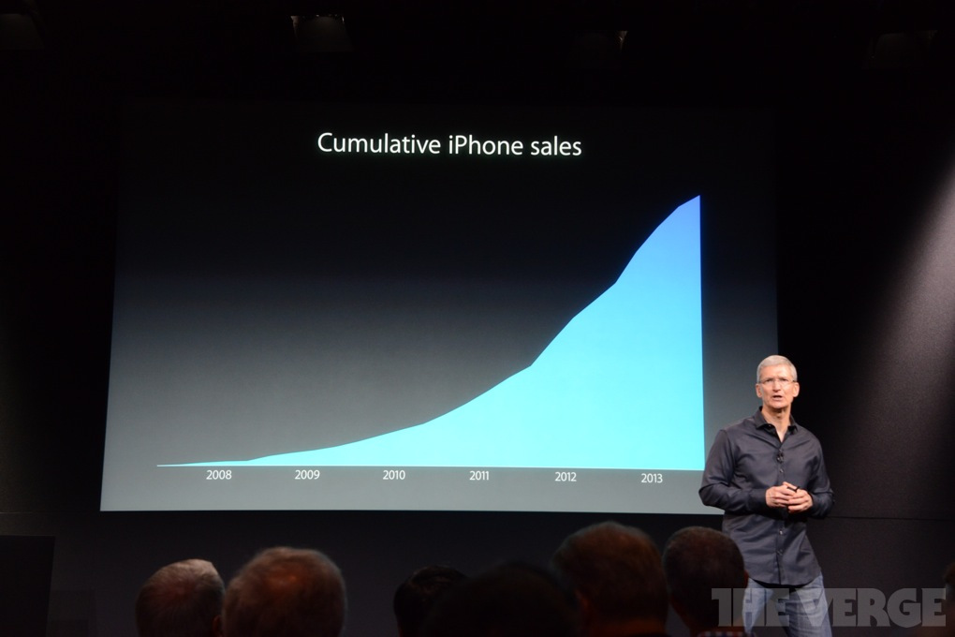
Visualizing Cumulative Distributions
Apple iPhone sales have been exploding, right?

Slide 11
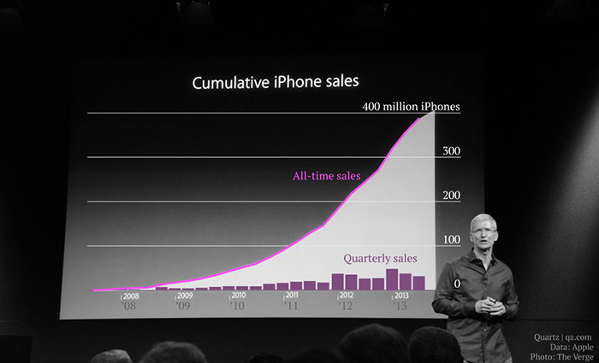
How explosive is that growth, really?
Cumulative distributions present a misleading
view of growth rate.
The incremental change is the derivative of this function, which is hard to visualize
Notes:
a cumulative graph can look dramatically “explosive” even when the actual rate of growth is much less dramatic.
The graph on the right shows cumulative iPhone sales. Every quarter’s sales are added to all previous sales, so the total can only go up. Because of that, the purple cumulative line naturally becomes steep and can give the impression that sales are accelerating enormously.
But if you want to know how fast iPhone sales are actually growing at a particular time, you should look at the incremental change—for example, how many iPhones were sold each quarter. Those are the bars at the bottom.
Mathematically, if the cumulative sales are $F\left(t\right)$, then the sales rate is roughly the derivative:
$$\text{Sales rate}=F^{′}\left(t\right)$$
So the slope of the cumulative line tells us the current rate of sales.
For example, imagine cumulative sales are:
Year
Total phones sold
201050 million
2011100 million
2012180 million
2013260 million
The cumulative numbers look huge: 50 → 100 → 180 → 260.
But the yearly incremental sales are:
$$50, 50, 80, 80$$
So from 2012 to 2013, the cumulative total increased a lot, but the rate of sales did not accelerate at all; it stayed at 80 million per year.
That is what the title “How explosive is that growth, really?” is questioning.
A good sentence to tell your students would be:
“Don't confuse a rapidly increasing cumulative total with a rapidly increasing growth rate. To understand the growth rate, look at the slope—or derivative—of the cumulative curve.”
And one additional distinction is useful: positive slope = growth, while an increasingly steep slope = accelerating growth. A cumulative graph may rise steeply without its growth rate itself increasing.

Slide 12
Descriptive Statistics
Descriptive statistics provides ways to capture the properties of a given data set / sample.
Central tendency measures describe the center around the data is distributed.
Variation or variability measures describe data spread, i.e. how far the measurements lie from the center.

Slide 13

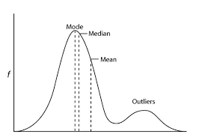
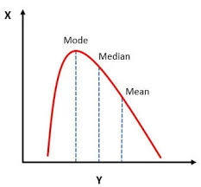
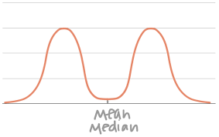
Centrality Measure: Mean
To calculate the mean, sum values and divide by number of observations:
Mean is meaningful for symmetric distributions without outliers.
Notes:
When mean works well:
Data is symmetric (balanced left and right, like a bell curve).
There are no extreme outliers.
When mean can mislead:
Outliers pull the mean away.
Example: Salaries:
Four people earn $50k, one earns $5 million.
Mean salary = about $1 million → but that doesn’t represent most people!
Skewed data (not symmetric):
Example: Test scores where most are low but a few are very high → mean is higher than the “typical” score.
Multi-peaks (bimodal distribution):
Example: Heights of a class with both children and adults. The mean is somewhere in between, but almost nobody has that height. The camel shape
👉 Key takeaway:
Mean is powerful and widely used.
But always check the shape of the data. Sometimes median or mode gives a better picture.
Mode is where the density function is at highest.
Median is where cdf is at 0.5

Slide 14

Other Centrality Measures
The median represents the middle value.
The geometric mean is the nth root of the product of n values:
The geometric mean is always <= arithmetic mean, and more sensitive to values near zero.
Geometric means make sense with ratios:
1/2 and 2/1 should average to 1.
Notes:
Nth root
Other Centrality Measures (Simplified)
1. Median
The middle value when numbers are sorted.
Example: Scores = [50, 60, 70, 90, 100] → Median = 70.
Why useful? Median isn’t affected by extreme outliers.
Example: If one student scored 1000, the median would still be 70, while the mean would shoot up.
2. Geometric Mean
GM=a1⋅a2⋅…⋅annGM = \sqrt[n]{a_1 \cdot a_2 \cdot \ldots \cdot a_n}GM=na1​⋅a2​⋅…⋅an​​ Instead of adding and dividing (like the mean), we multiply numbers and then take the nth root.
Example: For values 4 and 9:
GM=4⋅9=36=6GM = \sqrt{4 \cdot 9} = \sqrt{36} = 6GM=4⋅9​=36​=6
Always ≤ arithmetic mean.
How to make geometric mean useless?
How to make Arithmetic mean useless?
When does geometric mean make sense?
Especially useful for ratios, percentages, or rates of growth.
Example: A stock grows by +50% one year and then shrinks by –50% the next.
Arithmetic mean says: (50% – 50%) / 2 = 0% (looks like no change).
Geometric mean correctly shows the net effect: you actually lost money!
Another example: Ratios like 1/2 and 2/1.
Arithmetic mean = (0.5 + 2) / 2 = 1.25
Geometric mean = √(0.5 × 2) = √1 = 1 ✅ (which feels more “balanced”).
👉 Key takeaway for students:
Median = good when data has outliers or skew.
Geometric mean = good when dealing with growth rates or ratios.
Would you like me to also make a table comparing mean, median, and geometric mean (with pros, cons, and examples) so students can see the differences side-by-side?
Absolutely 👍 — here are some clear, student-friendly examples that show why geometric mean works well for ratios:
Example 1: Ratios (1/2 and 2/1)
Suppose two measurements are ratios: 12=0.5\tfrac{1}{2} = 0.521​=0.5 and 21=2\tfrac{2}{1} = 212​=2.
Arithmetic mean:
0.5+22=1.25\frac{0.5 + 2}{2} = 1.2520.5+2​=1.25 This feels too high, because 0.5 and 2 are opposites (they should balance out).
Geometric mean:
0.5×2=1=1\sqrt{0.5 \times 2} = \sqrt{1} = 10.5×2​=1​=1 ✅ Much more natural — the “average ratio” should be 1.
Example 2: Growth Rates (Stock Prices)
Year 1: stock grows by +50% → multiply by 1.5.
Year 2: stock shrinks by –50% → multiply by 0.5.
After 2 years:
1×1.5×0.5=0.751 \times 1.5 \times 0.5 = 0.751×1.5×0.5=0.75 So you actually lost 25% overall.
Arithmetic mean would say: (50% – 50%) / 2 = 0% → no change (misleading!).
Geometric mean:
1.5×0.5=0.75≈0.866\sqrt{1.5 \times 0.5} = \sqrt{0.75} \approx 0.8661.5×0.5​=0.75​≈0.866 → This corresponds to an average –13.4% per year, which is correct.
Example 3: Ratios in Speed
You drive the same distance twice:
First half at 60 km/h.
Second half at 120 km/h.
Arithmetic mean of speeds = (60 + 120) / 2 = 90 km/h. ❌ Wrong.
Correct average speed (harmonic mean, but geometric mean also helps here for ratios):
60×120=7200≈84.85 km/h\sqrt{60 \times 120} = \sqrt{7200} \approx 84.85 \, \text{km/h}60×120​=7200​≈84.85km/h ✅ Closer to the true average.

Slide 15
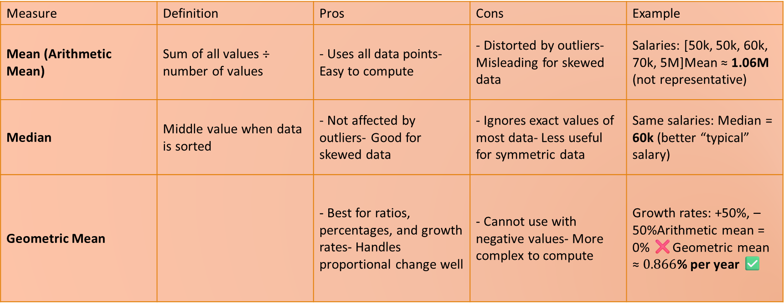
Which Measure is Best?
Measure | Definition | Pros | Cons | Example
Mean (Arithmetic Mean) | Sum of all values ÷ number of values | - Uses all data points- Easy to compute | - Distorted by outliers- Misleading for skewed data | Salaries: [50k, 50k, 60k, 70k, 5M]Mean ≈ 1.06M (not representative)
Median | Middle value when data is sorted | - Not affected by outliers- Good for skewed data | - Ignores exact values of most data- Less useful for symmetric data | Same salaries: Median = 60k (better “typical” salary)
Geometric Mean |  | - Best for ratios, percentages, and growth rates- Handles proportional change well | - Cannot use with negative values- More complex to compute | Growth rates: +50%, –50%Arithmetic mean = 0% ❌Geometric mean ≈ $0.866$% per year ✅
Notes:
Mean is meaningful for symmetric distributions without outliers: e.g. height and weight.
Median is better for skewed distributions or data with outliers: e.g. wealth and income.
Bill Gates adds $250 to the mean per capita wealth but nothing to the median.
Then we subtract 1 to convert that average growth factor into an average growth rate:
\[ 0.866-1=-0.134=-13.4\% \]
Imagine you start with $100:
Year 1: +50% → $100 × 1.5 = $150
Year 2: −50% → $150 × 0.5 = $75
You end with less than you started, even though the arithmetic mean is:
\[ \frac{50\% + (-50\%)}{2}=0\% \]
That calculation is correct, but it doesn’t describe your compounded growth. The 50% loss applies to the larger amount of $150.
The geometric mean finds the constant yearly rate that would also turn $100 into $75 over two years:
\[ r=\sqrt{1.5\times0.5}-1 =\sqrt{0.75}-1 \approx -13.4\% \]
So gaining 50% and then losing 50% has the same final result as losing about 13.4% each year for two years.
10:58 AM

Slide 16
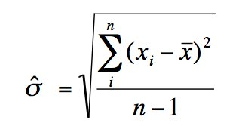
Variance Metric: Standard Deviation
Standard deviation (SD) measures how spread out the data is around the mean.
Variance is just the square root of the standard deviation.
Do we divide by n or n-1?
  The population SD divides by n, the sample SD by n-1, but for large n, n ~ (n-1) so it doesn’t really matter.
Notes:
Why divide by n or n−1?
Population standard deviation (when you have all the data) → divide by n.
Sample standard deviation (when using a sample to estimate the population) → divide by n–1.
This correction is called Bessel’s correction, and it makes the estimate less biased.
Why do we divide by (n–1) instead of n?
When we use a sample (a subset of the population), the sample mean xˉ is already “pulled” toward the data we observed.
This makes the spread (variance) look a little smaller than it really is in the full population.
Dividing by n−1 instead of n corrects this underestimation → it gives us an unbiased estimator of the true population variance.
Example: Tiny Population
Population = {2, 4, 6}
Population mean = 4
Population variance =~2.67
Case 1: Sample of size 2, divide by n
Pick sample {2, 4}:
Sample mean = 3
Variance (divide by 2): 1 This underestimates the true variance (2.67).
Case 2: Sample of size 2, divide by n–1
Same sample {2, 4}:
Variance (divide by 1):
2 Much closer to the population variance (2.67).
Samlple size of 1, vatiation becomes zero which is not correct

Slide 17
Interpreting Variance (Stock Market)
It is hard to measure “signal to noise” ratio, cause much of what you see is just variance.
Consider measuring the relative “skill” of different stock market investors.
Because performance has high variance, it is difficult to determine how much of the observed difference is due to skill versus luck.
Notes:
Understanding variance helps because it tells you how much variation you should expect from noise alone.
Suppose two fund managers have the same true skill. Even then, their yearly returns will not be identical because of random market movements. If the variance of returns is large, their results may differ a lot just by chance.
For example:
True skill difference: maybe only 1%
Typical random fluctuation: maybe ±15%
Then seeing one manager outperform another by 5% in one year is not very convincing, because 5% is small compared with the amount of randomness we normally expect.
But imagine instead that random fluctuation is only ±1%, and one manager repeatedly beats another by 5%. Now that difference is much harder to explain as noise, so it looks more like a real signal.
So variance gives you a baseline for noise:
$$\text{Is the observed difference large compared with normal random variation?}$$
That is the key question.
A simple way to think of it is:
$$\text{Signal−to−noise}≈\frac{\text{difference we care about}}{\text{typical random variation}}$$
If variance is high, the denominator is large → signal is harder to detect.
If variance is low, the denominator is small → real differences stand out more clearly.
So variance does not itself tell you “this part is signal and this part is noise.” It tells you how noisy the environment is, which lets you judge whether an observed pattern is unusually large or could easily have happened by chance.

Slide 18
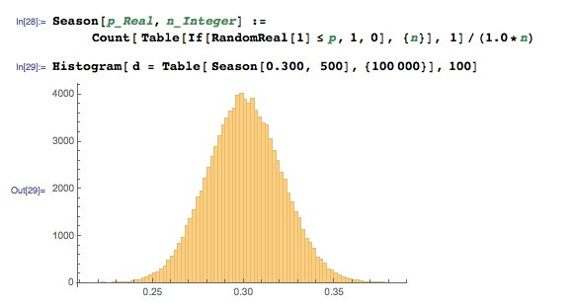
Interpreting Variance (Batting Avg)
In baseball, 0.300 hitters (30% success rate) represent consistency over 500 at-bats/season.
But simulations show a real 0.300 hitter has a 11% chance of hitting 0.275 or below.
They also have a 11% chance of hitting 0.325 or above.
Good or bad season, or lucky/unlucky?
Notes:
Little variance when walking
The slide is showing that a player’s results can change because of chance, even when their underlying ability stays the same.
Interpreting Variance (Batting Average)
In baseball, a .300 hitter means the player gets a hit 30% of the time.
Over a season with 500 at-bats, you might expect them to be very consistent around .300.
But due to variance (random chance):
Even a true .300 hitter has a 10% chance of finishing at .275 or below.
They also have a 10% chance of finishing at .325 or above.
So what does this mean?
A player’s batting average in one season could look much better or worse than their true ability.
A “good” or “bad” season may actually be more about luck than skill.
Key Question for Students:
👉 When we see someone hitting .325 — is that a sign of real skill improvement, or just random variation?
Analogy for clarity:
It’s like flipping a coin 500 times.
The true probability is 50%, but you might get 48% heads or 52% heads just by chance.
The same happens with batting averages.

Slide 19
Interpreting Variance (Many Models)
We will typically develop several models for each challenge, from very simple to complex.
Some difference in performance will be explained by simple variance: which training/evaluation pairs were selected, how well parameters were optimized, etc.
A small performance improvement (e.g., 0.5% better accuracy) might just be noise.
In such cases, it’s often better to choose the simpler model → easier to interpret, faster to run, less risk of overfitting.
Notes:
A small performance improvement (e.g., 0.5% better accuracy) might just be noise.
In such cases, it’s often better to choose the simpler model → easier to interpret, faster to run, less risk of overfitting.

Slide 20

Variance Reduction Methods
Although walking to class is slower than taking the bus, arrival times have lower variance.
Repeating an experiment multiple times reduces variance (k-fold cross validation).
Proper random and deterministic sampling
Eliminating outlier values (if justifiable) reduces variance.
Notes:
Variance Reduction Methods
Walking vs. Bus Analogy
Walking to class may be slower than the bus, but it’s more predictable (low variance in arrival time).
The bus is faster on average, but delays and traffic cause high variance.
Ways to reduce variance in experiments and models:
Repeat the experiment multiple times
Example: k-fold cross validation in machine learning averages results over several splits, reducing variance.
Use proper random or deterministic sampling
Ensures fair representation of data instead of depending on one lucky/unlucky sample.
Remove outliers (when justified)
Extreme values can inflate variance.
Example: A typo in test scores (someone entered 1000 instead of 100) should be removed.

Slide 21
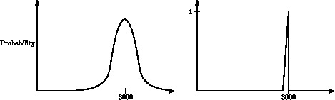
The Printer Cartridge Life Distribution
Distributions with the same mean can look very different.
But together, the mean and standard deviation fairly well characterize any distribution.
Notes:
The Printer Cartridge Life Distribution
Same mean, different shapes:
Two printer cartridges may both last an average of 3000 pages, but their reliability can look very different.
Example:
Wide distribution (left graph):
Some cartridges fail early (2000 pages), some last much longer (4000+).
Mean = 3000, but performance is unpredictable (high variance).
Narrow distribution (right graph):
Most cartridges last very close to 3000 pages.
Mean = 3000, but performance is consistent (low variance).
Key Point:
The mean tells us the average lifespan.
The standard deviation tells us how consistent or spread out that lifespan is.
Together, mean + standard deviation give a good picture of the distribution.

Slide 22

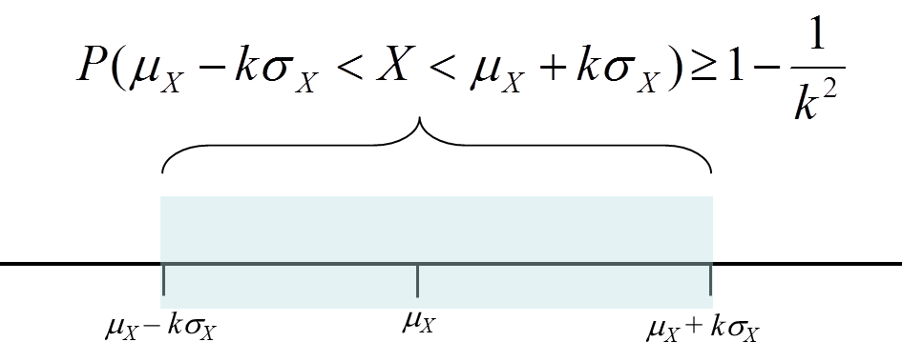
Chebyshev’s inequality: Parameterizing Distributions
Regardless of how data is distributed, at least ( ) th of the mass must lie within k sigma of the mean.
Thus at least 75% must lie within two sigma of the mean (at most 25% > two sigma away).
Even tighter bounds apply for normal distributions.

Slide 23
Resources
I would like to thank Dr. Steven S. Skiena, Dr. Christian Kästner, and Chip Huyen for the valuable resources they have provided through their coursework in machine learning and data science. Their materials have been instrumental in shaping my teaching in these areas.
The Data Science Design Manual, Steven S. Skiena
Learning From Data, by Yaser S. Abu-Mostafa, Malik Magdon-Ismail, Hsuan-Tien Lin
Machine Learning in Production: From Models to Products by Christian Kästner
Designing Machine Learning Systems, Chip Huyen

