Slide 1
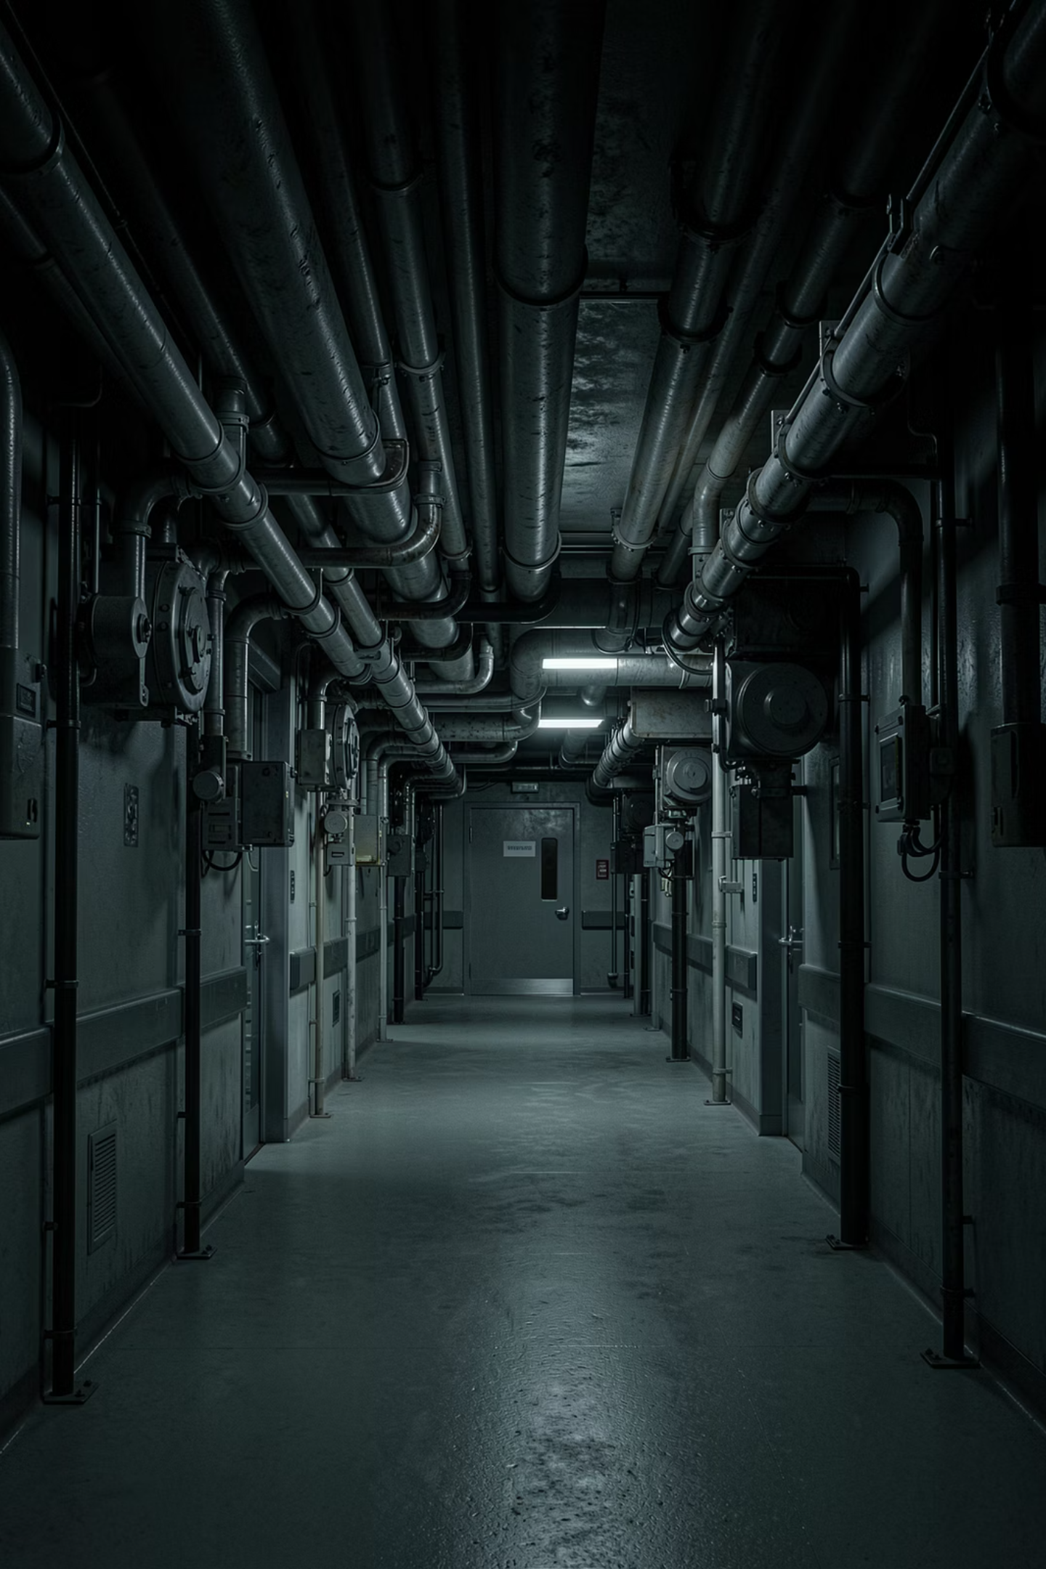
Orphan X
AI-Powered MEP Systems Auditor
Finding the pipes that kill patients.
Team
Chris France · Ignacio Benito Soto · Oskar Lindström · Petra O'Sullivan
Event
Autodesk DevCon 2026 — Dynamo Day Hackathon, Amsterdam

Slide 2

Dead Legs Kill People
Dead-end pipe branches where water stagnates breed Legionella bacteria. Legionnaires' disease kills 1 in 10 hospitalized patients (CDC). ASHRAE Standard 188 mandates dead leg elimination in every healthcare facility — yet most dead legs are only found after someone gets sick.
🦠 The Pathogen
⚠️ The Regulation
Stagnant water in dead-end pipe branches creates ideal conditions for Legionella to multiply to lethal concentrations.
ASHRAE Standard 188 requires dead leg elimination in healthcare facilities. NFPA 13 and IPC 901.2 set additional code requirements.
🕐 The Human Limit
📐 The Scale
A mechanical engineer takes 3 full days to manually audit one hospital MEP model — and still misses things.
18,000 elements across 1,100 systems in a single hospital model. No human can check every pipe.
Most dead legs are found AFTER someone gets sick. That is the problem Orphan X was built to solve.

Slide 3
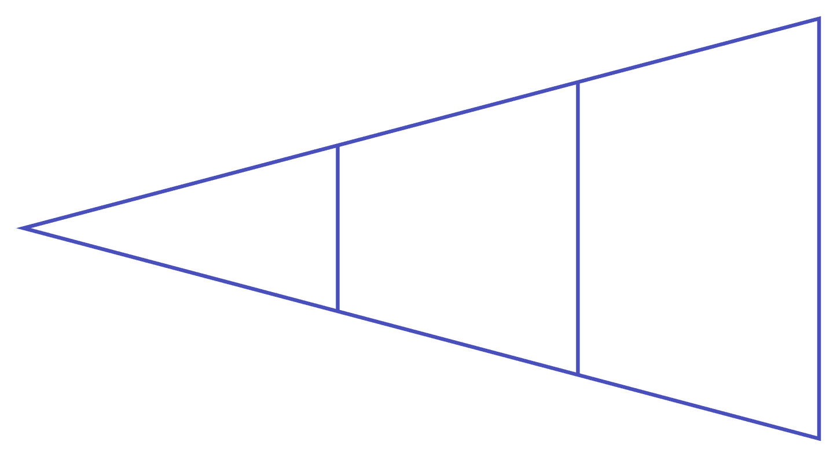

One Script. One Click. 120 Seconds.
Orphan X connects Revit directly to Claude AI through a custom MCP server — transforming a 3-day manual audit into a fully automated, AI-powered safety sweep.
🔍 EXTRACT
Scans all MEP systems and builds element-to-system index using reverse lookup (Revit 2026 fix).
🧠 ANALYZE
Revit Model
Local + Claude API
Dynamo Python
AI traces pipe topology — finds dead legs per ASHRAE 188, code violations per NFPA 13 and IPC 901.2, and all safety risks.
🎨 VISUALIZE
Color-codes every flagged element by severity in the live 3D model.
🔴 RED
🟠 ORANGE FUTURE
Patient Safety Critical
Code Violation
🟡 YELLOW FUTURE
🩵 CYAN FUTURE
Major Risk
Minor Issue
1,119
18K
120s
Systems Analyzed
Elements Checked
Total Audit Time
Every MEP system in the model, fully indexed and traced.
Every pipe, fitting, and terminal — no exceptions.
From blank model to fully color-coded safety report.
The AI is swappable — Claude today, Ollama or any local LLM tomorrow. The MCP standard means any AI client can connect.

Slide 4
Watch It Work
No complex setup. No special tooling. Just a single Python Script node dropped into Dynamo — and the model lights up.
1
2
Paste the Script
Click Run
Single Python Script node in Dynamo. One paste.
One click triggers the full pipeline — extract, analyze, visualize.
3
4
Wait 120 Seconds
The Model Lights Up
The AI reads every pipe across all 1,119 systems.
Every flagged element color-coded live in the 3D view.
Floor 2 — Domestic Hot Water System: Dead leg flagged as Critical Patient Safety with ASHRAE 188 violation reference. RED pipes are the ones that could kill patients.
The Watch node output shows everything: systems found, orphans detected, AI findings with severity levels and exact code references. One paste. One click. One view.

Slide 5
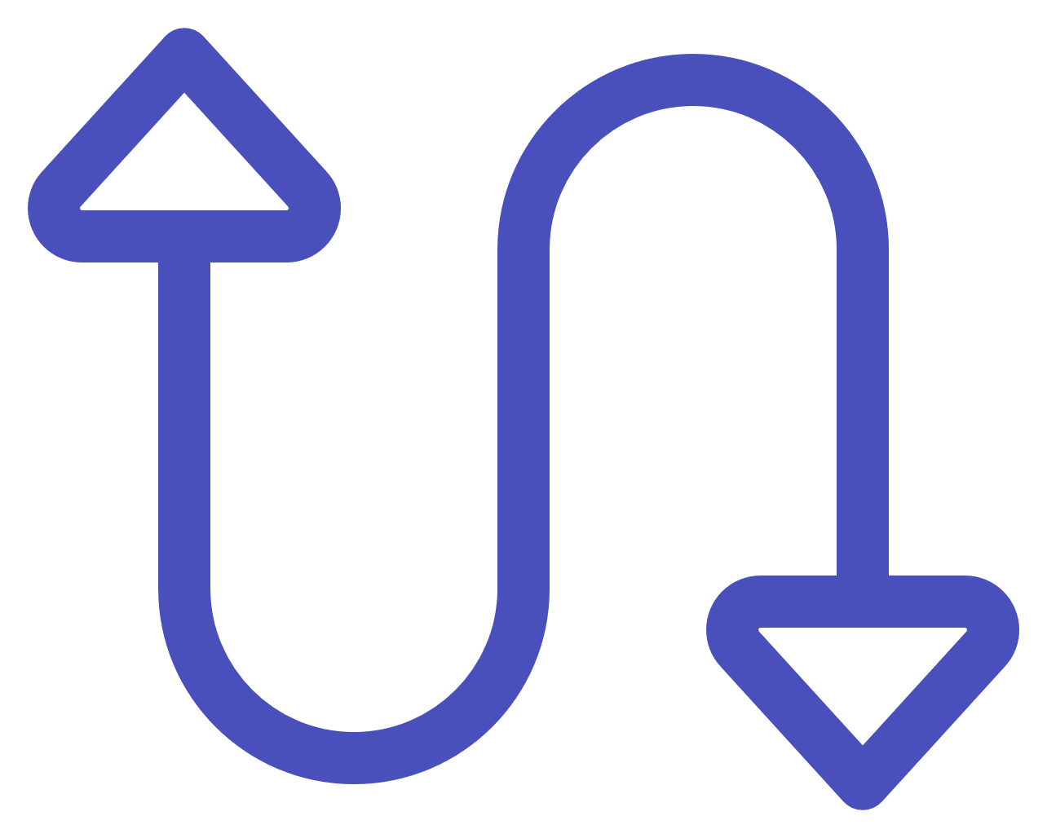
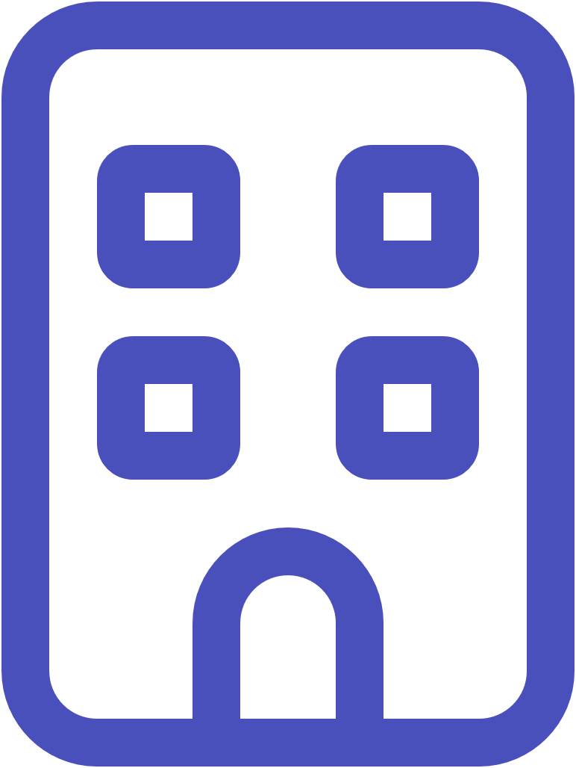
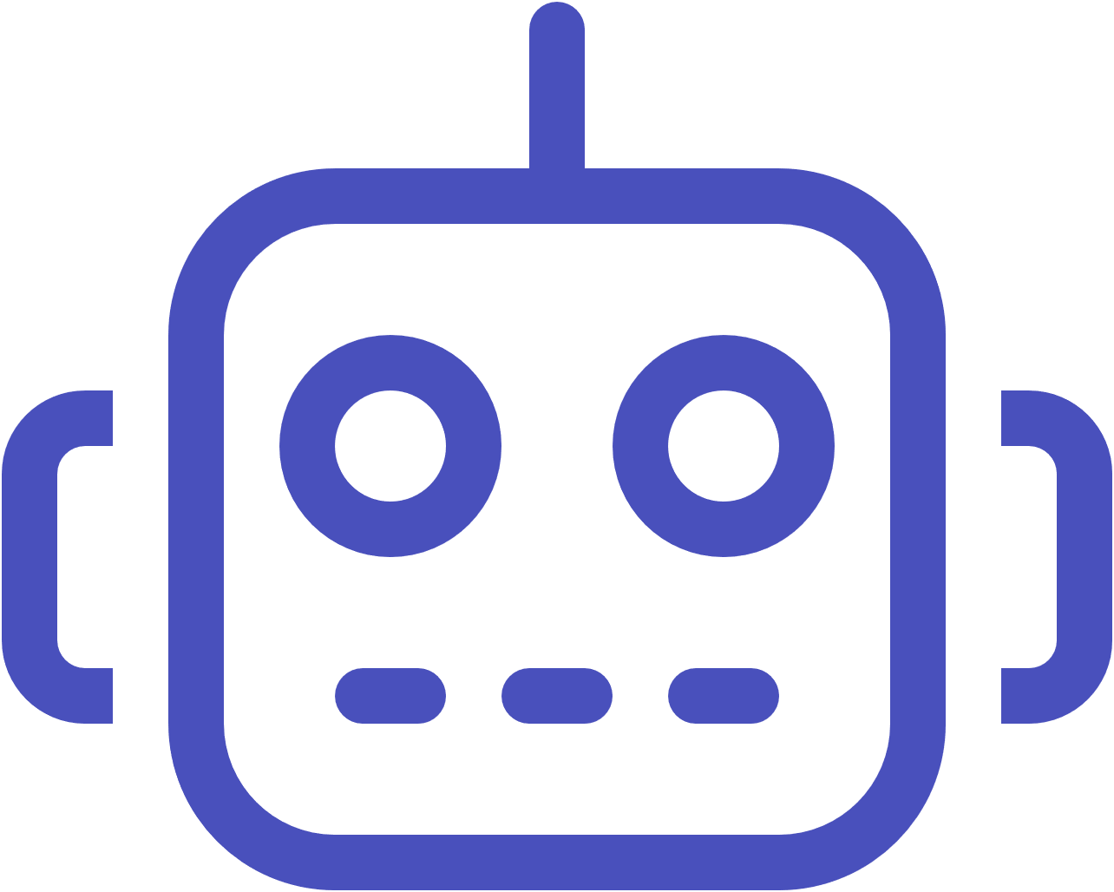

3 Days Becomes 120 Seconds
Today — Without Orphan X
Tomorrow — With Orphan X
⏳ Manual audit takes 3 full days per hospital model
⚡ AI audit in 120 seconds, every time
🙈 Engineers miss things — fatigue, scale, complexity
🔎 Finds what humans miss — every pipe, every floor
💀 Dead legs found after patients get sick
🛡️ Dead legs caught before anyone gets sick
The Road Ahead
Swap Any LLM
Any MEP Model
AI Never Tires
Ollama, vLLM, local models — the MCP standard means any AI client can connect. No vendor lock-in.
Hospitals, labs, commercial buildings — if it's in Revit, Orphan X can audit it.
The AI does not get tired. The AI does not skip floors. The AI reads every pipe.
The AI does not get tired. The AI does not skip floors. The AI reads every pipe. — That is the promise of Orphan X.

