Slide 1
Understanding Non-Epileptic Attack Disorder (NEAD)
Dr Mary King, Clinical Psychologist
mary.king2@srft.nhs.uk
Chris Gaskell, Trainee Clinical Psychologist
Christopher.gaskell@srft.nhs.uk

Slide 2
Disclaimers
Potentially distressing area.
Videos and images.
Notes:
Chris – preamble/ warning re. triggers
Distressing Area:
- It's possible that people may find discussion of these services or patient groups as emotionally charged areas. I think they are. People are free to do whatever they need to do during this presentation. If you need to tune out at any point that's fine.
Images/Videos:
We are using a range of images and videos in this presentation. Most of them are taken from YouTube or Google Images.
Some of the videos that I show are of people in distress. I personally think that its worth showing them. I think the videos are worth seeing. I'll try to give you all a heads up of when they are going to happen and what they are of. so that you can choose for yourself if you want to see them.
One video we are going to share is of a patient who very kindly volunteered to come and share some of his experiences of NEAD. This is going to be shown a little later on. It is unlikely that you are going to recognise or know this person but it is perfectly possible. If you do know him – let us know straight away or turn it off until the video is over.

Slide 3
Plan
What is NEAD?
What happens?
Why does it happen?
Acute management
Case examples

Slide 4
What would you do?
You are called to an incident in a shopping centre. The report is of someone experiencing a sudden collapse. You arrive to find a man, approximately 50 years old, on the floor making jerking movements with his arms and legs. His eyes are closed and he is not responding to your questions.
Q: What would you do?

Slide 5
Have you heard of NEAD?

Slide 6
Clearing up confusion
Like many conditions, there are multiple terms used to describe the same experience.
Some of the terms that you may have heard:
Non-epileptic attacks (NEAs)
Psychogenic seizures
Psychogenic non-epileptic seizures (PNES)
Dissociative seizures
Conversion disorder
Functional seizures
Psychological seizures
Pseudo-seizures
We refer to these events as: “episodes”
We refer to the condition as Non-epileptic Attack Disorder (NEAD)
Notes:
Chris –

Slide 7
What is NEAD?
A functional neurological disorder (FND)
Neurological symptoms that cannot be accounted for by physical damage to the nervous system (DSM-5; Stone, 2013).

Slide 8
How is it diagnosed?
Diagnosis is made by a Neurologist or Neuropsychiatrist based on:
Clinical history
Videos
Objective signs
Subjective experience
EEG (electroencephalogram)
ECG (electrocardiogram)
Videotelemetry
Notes:
MARY
A NEAD diagnosis is made from certain signs and symptoms that a neurologist/ neuropsychiatrist can recognise. It is not made because doctors are “giving up” or “have run out of tests”.
Diagnosis can take a long time, I think the average is a few years, during this time people often undergo lots of investigations, are misdiagnosed with epilepsy and prescribed a variety of medications that will not address the problem but can cause unpleasant side effects
The difficult journey towards getting a final diagnosis of NEAD can make it hard to accept the diagnosis – having been treated for epilepsy and investigated for such a long time – people often wonder whether the diagnosis is made because the doctors have run out of ideas

Slide 9
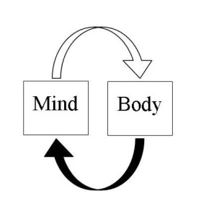
NEAD and the Mind-Body Link
Psychological experiences (e.g. our thoughts and emotions) affect the body ALL THE TIME.
Sudden shock = heart beats faster
Embarrassment = face goes red
Upset = eyes produce tears
It is normal for changes to happen in the body without a medical cause or disease
(e.g. tears when we feel sad are not caused by a disease; it is the mind-body link).
NEAD also happens through this Mind-Body link.
The cause is not medical but the impact on the body is real.

Slide 10
What is NEAD?
People with NEAD experience episodes of temporary loss of control and/ or awareness
Symptoms can affect: | Examples:
Movement | Shaking Difficulty controlling movement Falls
Senses | Changes to hearing, sight, taste, smell or touch Feeling numb
Awareness/ thinking skills | Feeling confused Distant Disorientated Blacking out
Notes:
Different people experience different symptoms
- NEAD symptoms are not always the same
- Symptoms may change over time

Slide 11
Videos of NEAD episodes
Warning

Slide 12
Epilepsy and NEAD – what’s the difference?
 | Symptoms | Cause | Management
Epilepsy | Movement Senses Awareness | Abnormal activity in the brain | Medical interventions
NEAD | Movement Senses Awareness | Physical and emotional stress | Psychological interventions
Notes:
MARY
- NEAD is often mistaken for epilepsy because the symptoms can look and feel very similar.
- Many people have both epilep.sy and NEAD and have difficulty telling them apart

Slide 13
Epilepsy and NEAD – what’s the difference?
NOT TO BE CONFUSED WITH
Malingering | Deliberately manufacturing symptoms for material gain e.g. Money
Factitious disorder | Deliberately manufacturing symptoms for emotional gain e.g. Attention
* Do not mistake NEAD symptoms for factitious/malingering just because it doesn’t fit with what you know of epileptic seizures
Notes:
Mary
Because NEAD can sometimes look like but not quite fit with what is expected during epileptic seizures, it is not uncommon for healthcare professionals to mistakenly assume that the symptoms are “put on” or that the person is “pretending”.
But just because someone does not have epilepsy, does not mean that they are “putting it on” or “pretending” or deliberately manufacturing symptoms as is the case with diagnoses of malingering or factitious disorder
People with NEAD are experiencing genuine symptoms that they are not able to control.

Slide 14
How common is NEAD?
Approximately…
20,000 people in the UK have this diagnosis – but there are likely to be many more.
1 out of every 5 people referred to a first seizure clinic go on to have a diagnosis of NEAD.
NEAD accounts for up to 50% of patients brought to hospital with suspected ‘status epilepticus’.
(Howell, Owen, Chadwick, 1989; Kotsoupoulos et al., 2003, Rawlings, Brown & Reuber, 2017)
Notes:
NEAD is not uncommon. It is likely that most people working in the National Health Service will come into contact with someone with this diagnosis at some point in their careers.
Episodes vary in duration from a seconds to hours or even days. Because they are often a lot longer than epileptic seizures, they can be mistaken for status epilepticus (single seizure lasting more than five minutes or two or more seizures within a five-minute period without the person returning to normal between them. If either of these things happen, the person needs urgent treatment to stop the status before it causes long-term damage.
NEAD – no internal damage, no matter how long the episode goes on for
POLL

Slide 15
What does NEAD feel like?
“I feel really spaced out. Like I’m not really there. I try to move but I am like a snail. I try to talk but it’s like my tongue is stuck”
“It feels like I am falling, although my body is still it feels like it is being thrown around. My arms and legs are tensed and cramped up. I can see and hear but I can’t move. It’s so scary”
Notes:
MARY

Slide 16
What does NEAD feel like?
“I feel like I am ‘tripping’ without taking nothing. I am in another world short term, and I feel confused, dazed, disorientated and its scary. My head and brain feels like a tin of broken biscuits. I am different and feel weird. Luckily these episodes don’t last long, but they happen ‘out of the blue’, when you least expect it.
Understanding of my environment is lost, and my body changes with my eyes spinning and poor-coordination and my listening is affected. I feel stupid during these episodes and I wonder do people notice or think I am acting or faking it for attention?”
Notes:
- NEAD episodes vary considerably, I asked some of my clients to describe what their episodes feel like…

Slide 17
What does NEAD feel like?
“I feel really spaced out. Like I’m not really there. I try to move but I am like a snail. I try to talk but it’s like my tongue is stuck”
“It feels like I am falling, although my body is still it feels like it is being thrown around. My arms and legs are tensed and cramped up. I can see and hear but I can’t move. It’s so scary”

Slide 18
What does NEAD feel like?
“I really can’t get up and cannot speak, if I kick out it is not because I am being aggressive, it’s because my body can’t help it”

Slide 19
What is happening?

Slide 20
What is happening during a NEAD episode?
The fight/flight/freeze response - evolutionary based fear response that is adaptive for survival
Freezing is one of the main defensive threat reactions across species
(Roelofs, 2017; Rockliffe-Fidler & Mark Willis, 2018)
Notes:
Our current/ best understanding of NEAD is …
Sympathetic nervous system drives the fight/ flight response, but this response can be overriden by the parasympathetic ‘freeze’/ shut down response in the face of escape being impossible

Slide 21
Fight/ Flight/ Freeze in action
https://www.youtube.com/watch?v=lAtW7nJUcRA
(Rockliffe-Fidler & Willis, 2018)
WARNING
Notes:
Possibly distressing footage showing an impala being captured by a leopard
Timing - 8 seconds – for being held down by leopard
- 2.59 for NEAD
“The video begins with an impala whose fight/flight response was insufficient, lying in the jaws of a leopard and having apparently been killed. Some baboons then disturb the leopard, which leaves the lifeless impala behind.
However, after several seconds, the impala shows signs of life; it begins to breathe deeply and eventually sits up on its forelegs. Following this, it
shakes in a manner reminiscent of ‘seizures’ that patients experience. The impala then stands up and runs away.
The impala’s sympathetically driven flight response was overridden by parasympathetic freeze in the face of escape being impossible. It is thought that we evolved this mechanism because it is advantageous to surviving the threat of predators which are generally not interested in eating prey that is already dead or is demonstrating symptoms that indicate it is unwell. Another advantage is being numb to pain.

Slide 22
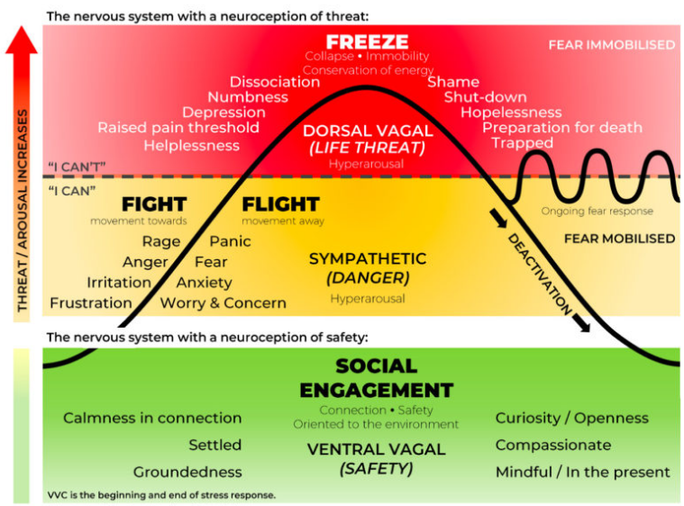
Polyvagal Theory
Notes:
Our current/ best understanding of the mechanism by which NEAD happens is provided by accounts of the autonomic nervous system (e.g. The ‘autonomic defence strategy’ (Schauer & Elbert, 2010) and Stephen Porges’ polyvagal theory)
The autonomic nervous system (ANS) is the branch of the nervous system that functions without awareness. It involves the unconscious regulation of basic operations within the body—for example, heart rate, digestion, salivation, blood pressure, sweat and so on…
The autonomic nervous system has two components:
The sympathetic nervous system functions like the accelerator in a car. It triggers the fight-or-flight response, providing the body with a burst of energy so that it can respond to perceived dangers.
The parasympathetic nervous system acts like a brake. It promotes the "rest and digest" response that calms the body down after the danger has passed. And in the case where the danger persists, the parasympathetic can override the sympathetic fight- flight response activating the freeze response causing immobilisation – the shutting down of mind/ body processes. Freezing is one of the main defensive threat reactions across species (Roelofs, 2017; Rockliffe-Fidler & Mark Willis, 2018)
NEAD is considered to be an example of the freeze response.

Slide 23



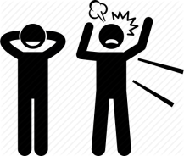
Traffic lights – Green (rest/digest)
Body sensations
Feel strong and at ease
Breathing is comfortable
Muscles relax
Heart rate slower
In control of body movements
Feel relaxed
Thinking
Can learn new information
Aware of the “here and now”
Can shift attention
Able to make decisions
Thinking clearly, clarity
Imagination, creativity
Behaviour
Seek connection with other people
Engage in valued activities
More willing to try new things
Can sleep easily at night
Emotions
Curious, even about challenges
Courageous
Connected
Experience emotions without getting stuck
Compassionate
Confident
Notes:
Traffic light nervous system
At any given time, we can be in one of 3 zones: green, amber or red
When we are in the green zone, our heart rate is relatively stable, breathing relatively steady, we are able to focus our attention and to do the things that matter to us. This is where we want to be the majority of the time.
“Whenever a person is confronted with a stressful event, the brain goes into ‘fight or flight’ mode, releasing chemicals, which prepares the body to either fight or run away. This was useful to humans in the days when if you didn’t react instantly to something, you could be eaten! These days, the brain still reacts in the same way even if the perceived danger is not actually a threat. For people living in stressful circumstances, this ‘fight or flight’ mode is switched on constantly which means they will be especially sensitive to things like sudden noises, flashing lights or an argument with their boss or spouse.” http://www.nonepilepticattackdisorder.org.uk/non-epileptic-attack-disorder/

Slide 24
Traffic lights – Amber (fight/flight)
Body sensations
Feel tense
Heart rate speeds up
Fast/ shallow breathing
Throat tightens
‘Butterflies’
Feeling hot
Nausea/ feeling sick
Urination
Change in appetite
Dry mouth
Difficulty sleeping
Digestive changes
Headaches
Pain
Sweating, shaking
Changes to bowel movements
Behaviour
Avoidance of: situations, places, activities…
Doing a lot of things at once - quickly
Stick to set routines/ familiar places
Rely on outside things to relax (e.g. alcohol, smoking, food)
Emotions
Anger/ frustration/ short temper
Bossed around by emotions
Feel unsafe/ overwhelmed
Anxiety/ panic/ nervous
Agitation/ difficulty being still/ keeping really busy
Thinking
Mental focus narrows
Racing thoughts
Hypervigilance/ increased alertness
Difficulty planning and remembering
Notes:
When the nervous system detects a threat (/is under stress?), it goes into the amber zone. This is when the nervous system prepares the mind/ body for fight or flight. Signs that you are in the amber zone include…
Each of these processes use energy. If your nervous system is in the amber zone for too long, it will use up lots of energy.
Eventually, the nervous system will go into the Red zone in order to save energy. It is almost like going into standby mode. Things that you might notice are…
NEAD episodes happen when you have been in the amber zone for a sustained period and are temporarily moving into the red zone.
Everyone’s NEAD episodes are different, which means that you may experience other changes that are not on this list.
“Whenever a person is confronted with a stressful event, the brain goes into ‘fight or flight’ mode, releasing chemicals, which prepares the body to either fight or run away. This was useful to humans in the days when if you didn’t react instantly to something, you could be eaten! These days, the brain still reacts in the same way even if the perceived danger is not actually a threat. For people living in stressful circumstances, this ‘fight or flight’ mode is switched on constantly which means they will be especially sensitive to things like sudden noises, flashing lights or an argument with their boss or spouse.” http://www.nonepilepticattackdisorder.org.uk/non-epileptic-attack-disorder/

Slide 25
Traffic lights – Red (freeze)
Body sensations
Feel weak
Numbness
Slow, shallow breathing
Exhaustion
Muscles rigid/ stiff
Shaking
Collapse/ fall
Emotions
Feel numb
Low mood
Lack of motivation
Can’t connect with other people
Sense of hopelessness
Behaviour
Sleeping a lot
Inactive
Reduced/ slow movement
Difficulty controlling movement
Thinking
Dizziness/ blank
Feeling distant or “spaced out”
Changes to vision/ hearing
Disorientation/ confusion
No memory or awareness of actions
Blackout/ unresponsive
Notes:
Eventually, the nervous system will go into the Red zone in order to save energy. It is almost like going into standby mode. Things that you might notice are…
Clarify NEAD is in the Red Zone
Panic attacks happen in the Amber Zone
Can use traffic lights when working with anyone! – Can be really helpful way to guide therapy. If someone is in the green zone, it might be a good time to do more cognitively demanding therapeutic tasks (e.g. taking a history, formulating), if they are in the amber zone – that’s an opportunity to practice strategies that help to reduce arousal (e.g. abdominal breathing), if they are in the red zone – focus will be on warming up (e.g. going for a walk).
We can use the traffic lights ourselves – noticing our tell-tale signs of being in the amber zone helps to guide behaviour (e.g. my tell-tale signs are difficulty sleeping and heart-pounding).
Everyone’s NEAD episodes are different, which means that you may experience other changes that are not on this list.
Introducing clients to the traffic lights is particularly helpful for people who do not recognise thoughts and feelings. They can notice behaviours and bodily sensations that gives us helpful information about their experience that we can work with.
Understanding that there is something ‘real and biological’ going on helps to make people feel believed and that their symptoms are being taken seriously.
My hope is that this will give you something practical that you might also find helpful when working with people with a range of difficulties.

Slide 26
Interview with J
Consent was obtained to share this interview for learning purposes.
Please respect confidentiality by not talking about the person in this video outside of this teaching session.

Slide 27
Why is it happening?

Slide 28
What can cause a person to go into/ stay in the amber zone?
Physical stress in the body
Examples: injury, illness, pain…
Difficult past experiences
Examples: situations that have felt threatening, loss of a loved one…
Current stressful situations
Examples: relating to finances, relationships, difficulty meeting responsibilities, loss of independence…
Emotional stress
Examples: worries about the future, difficult memories…
* These are general factors which may or may not be relevant for you
For many people, it is not one big thing that has caused them to go into and stay in the amber zone.
It is often a combination of factors.
Notes:
MARY
NEAD can happen to anyone but usually happens in people who have been or are going through some really difficult experiences. This includes experiences that cause physical stress (e.g. injury or illness) as well as emotional stress (e.g. worries about the future, relationship difficulties or coping with uncomfortable memories).

Slide 29
Role of traumatic past events
Why do some people develop NEAD but not others?
The role of trauma
A traumatic event = an incident that causes physical, emotional or psychological harm.
Can be single event or many unpleasant/threatening incidents
Could be recent or a long time ago
FACT: It is common for people with NEAD to have experienced some form of trauma
BUT: Many people with NEAD have NOT experienced a traumatic event/s.
Notes:
MARY

Slide 30
Why do some people develop NEAD but not others?
Although many people with NEAD can identify things that have happened/ are happening in their lives that contribute to a build-up of stress, many people do not.
The reasons why an individual develops NEAD is not always obvious at first, because everyone’s lives are different.
Notes:
MARY
Often people with NEAD have been in the ‘amber zone’ for such a long time that it has become so ‘normal’ that they don’t notice it
Psychological therapy for the management of NEAD involves working together to identify and understand the reasons why a person spends too much time in the amber/ red zones. We then support a person to learn new ways to manage difficult thoughts, feelings and responses to difficult experiences.

Slide 31
Acute management of NEAD

Slide 32
Interview with C
Consent was obtained to share this interview for learning purposes.
Please respect confidentiality by not talking about the person in this video outside of this teaching session.

Slide 33
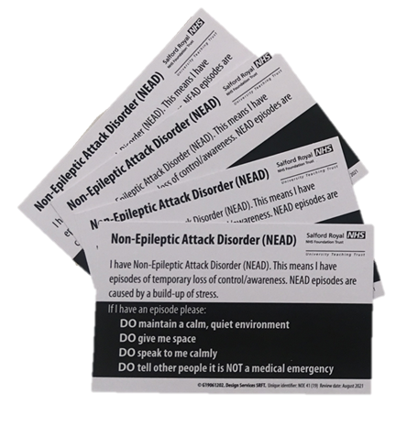
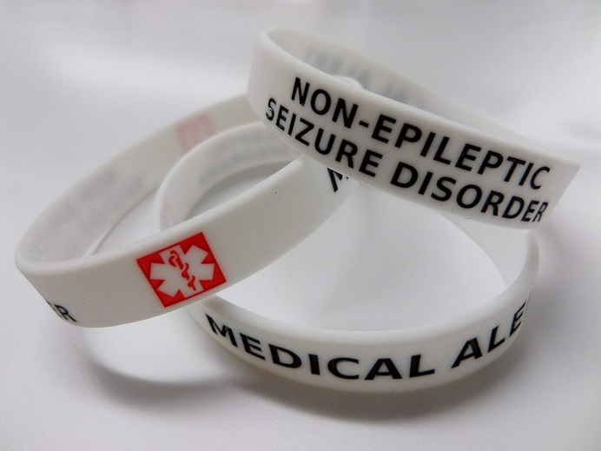
Is this NEAD?
Salford Royal NEAD service guidance letter
Friends/ family members
Salford Royal NEAD guidance cards
Medical alert bracelets
* Do not attempt to make a differential diagnosis. If information about the diagnosis is not available, follow epilepsy guidelines.
Notes:
MARY TO PRESENT
- We do not expect or recommend that you attempt to make a differential diagnosis when you are responding to a callout.
People with NEAD, particularly those who come through our service, often carry a NEAD guidance card or guidance letter (pass round examples). Some people wear alert bracelets or necklaces or have a screensaver on their phone.
Friends/ family members/ carers who are with the person may also be able to provide information about the person’s diagnosis.

Slide 34
Common concerns about NEAD
The changes that are experienced before, during and after episodes are caused by the fight/ flight/ freeze response
These changes might look and feel uncomfortable/ unpleasant but are not causing immediate harm:
Brain activity remains the same
Having an episode is not caused by and does not cause internal damage.
Notes:
MARY
NEAD episodes can be very distressing for the person experiencing it as well as the people around them.
Even those who are familiar with the diagnosis can be concerned that the symptoms are causing damage to a person.
The episodes are however caused by the fight/flight/freeze response and do not cause and are not caused by internal damage to the brain and nervous system

Slide 35
Common concerns about NEAD
Risk of injury
NEAD episodes do not cause internal damage
Risk of injury from falls during episodes is low
(number of injuries VS total number of episodes)
Duration of episodes
Episodes can last seconds, minutes, hours or even days.
Even if the episode lasts a long time (or longer than usual), it is still not causing internal damage
The episode will pass naturally without need for medical intervention
Symptom variation
Many people experience episodes that feel very different to one another
It is normal for episodes to change over time
Notes:
MARY
Although people can sustain injuries during episodes, for most people the number of injuries they experience is very low in comparison with number of episodes
Injuries requiring medical attention are not common – this is thought to be because the parts of the brain associated with instinctive and unconscious protective processes is still online

Slide 36
Do’s and Don’ts
DO Maintain a calm, quiet environment
DO Give me space
DO Speak to me calmly
DO Tell other people it is NOT a medical emergency
Notes:
Mary
People need a calm quiet environment in which to come round in.
* If have both epilepsy and NEAD – treat as you would for epilepsy

Slide 37
Do’s and Don’ts
Do NOT give me medication
Do NOT touch me (unless to protect my head)
Do NOT crowd or stand over me
Do NOT let there be more than one person nearby
Do NOT try to bring me “out of it”
Do NOT restrain me
Do NOT time the episode
Do NOT take me to hospital, unless I have a significant injury that needs immediate medical attention
Notes:
Evidence shows us that taking someone to hospital and/ or providing medical interventions tends to make it worse – episodes carry on for longer or someone comes in and out of the episode
Making sure that a person is in a safe, calm, quite environment and then do as little as possible
Even if you decide to take someone to hospital, this guidance can still be followed.
If you do take a person to hospital, make sure that you tell healthcare professionals at the emergency department about the person’s diagnosis. This is really important or else it is likely that they will receive medical treatment that is not appropriate and could make the symptoms worse.

Slide 38
Recovery
After an episode people can often experience:
confusion
fatigue
difficult thoughts and emotions
difficulty remembering
difficulty controlling movements
aches, pains, tension
Notes:
MARY

Slide 39
Recovery
DO Help to re-orientate
(e.g. by telling the person where they are, who they are with, what is happening)
DO Offer water
DO Encourage to notice what can they can see/ hear
(e.g. count the number of circles/ red things)
DO Maintain a calm environment
DO Encourage to focus on taking slow, deep breaths
DO Find out if there is someone who can help them to get home/ to a safe place?
DO Provide support to friends/ family
Notes:
MARY
- If have both epilepsy and NEAD – treat as you would for epilepsy

Slide 40
Recovery
Do NOT try to lift the person up or try to get them moving before they are ready
Do NOT ask lots of questions
Notes:
MARY
- Doing these things even if bringing someone to hospital

Slide 41
How we talk about NEAD matters
Communication has a significant impact on:
Patient satisfaction
Acceptance of the diagnosis
Frequency/ severity of symptoms
Future engagement with healthcare services
(Hall-Patch et al., 2010; McKenzie, Russell, Pelosi & Duncan, 2010)
Notes:
MARY
Many people feel disbelieved and not taken seriously by healthcare professionals when they are given a diagnosis of NEAD. This can lead patients to look elsewhere for a diagnosis and seek 2nd opinions and further investigations. This consumes more resources and further delays the patient in starting appropriate treatment and prolong symptoms.
Frequency/ severity of symptoms – Hall-patch et al found that when neurologists used the standardised protocol for communication – significant improvement in frequency of episodes – 63% of participants reported a greater than 50% reduction in episodes 3 months later.

Slide 42
How we talk about NEAD matters
“We know your symptoms are real”
“We do not think your symptoms are “all in your head””
“We know that you are not pretending”
“We know that this is not your fault”
“NEAD is a well-recognised condition”
“It’s like having a software problem in your brain rather than a hardware problem”(Stone)
Notes:
MARY
Just as with any person who is in need of care, it is important to be mindful of how you talk to and about a person with NEAD. Even if a person is unresponsive, evidence suggests that many people are able to hear during the episodes. What we say does matter.
Make it clear that you know that the symptoms are real, emphasise that the person has a condition that is recognised and can be managed

Slide 43
Things to avoid saying
“You are (just) stressed”
“You do not have…”
“It’s nothing to worry about”
“You can control this”
“Stop doing this”
Notes:
MARY TO PRESENT?
Try to avoid language that dismisses or trivialises symptoms. We know that the person is not in control and that the episodes are distressing and have a serious and significant impact on people’s lives.
Do not over-emphasise the diagnoses that the person does not have as this can make a person feel as though they are being dismissed

Slide 44
Questions?

Slide 45
Further information
http://www.manchesterneurosciences.com/departments/neuropsychology/nead
http://neurosymptoms.org/
https://www.fndaction.org.uk/non-epileptic-attack-disorder/
http://www.nonepilepticattacks.info/
https://www.youtube.com/watch?v=MA1EYAg9y5k&feature=youtu.be
https://www.youtube.com/watch?v=w4obwKD8JLU
https://www.fndsociety.org/fnd-education

Slide 46
References
Brown, R. J., & Reuber, M. (2016). Towards an integrative theory of psychogenic non-epileptic seizures (PNES). Clinical Psychology Review, 47, 55–70. doi: 10.1016/j.cpr.2016.06.003
Hall-Patch, L., Brown, R., House, A., Howlett, S., Kemp, S., Lawton, G., Mayor, R., Smith P., & Reuber, M. (2010). Acceptability and effectiveness of a strategy for the communication of the diagnosis of psychogenic nonepileptic seizures. Epilepsia, 51(1), 70–78. doi: 10.1111/j.1528-1167.2009.02099.x
Howell, S.J.L., Owen, K. & Chadwick, D.W. (1989). Pseudostatus Epilepticus. (1989). The Lancet, 334(8661), 485. doi: 10.1016/s0140-6736(89)92094-1
Kotsopoulos, I. A., Krom, M. C. D., Kessels, F. G., Lodder, J., Troost, J., Twellaar, M., … Knottnerus, A. J. (2003). The diagnosis of epileptic and non-epileptic seizures. Epilepsy Research, 57(1), 59–67. doi: 10.1016/j.eplepsyres.2003.10.014
Mckenzie, P., Oto, M., Russell, A., Pelosi, A., & Duncan, R. (2009). Early outcomes and predictors in 260 patients with psychogenic nonepileptic attacks. Neurology, 74(1), 64–69. doi: 10.1212/wnl.0b013e3181c7da6a
Porges, S. W. (2009). The polyvagal theory: New insights into adaptive reactions of the autonomic nervous system. Cleveland Clinic Journal of Medicine, 76(Suppl_2). doi: 10.3949/ccjm.76.s2.17
Rawlings, G. H., Brown, I., & Reuber, M. (2017). Deconstructing stigma in psychogenic nonepileptic seizures: An exploratory study. Epilepsy & Behavior, 74, 167–172. doi: 10.1016/j.yebeh.2017.06.014
Rockliffe-Fidler, C., & Willis, M. (2019). Explaining dissociative seizures: a neuropsychological perspective. Practical Neurology, 19(3), 259–263. doi: 10.1136/practneurol-2018-002100
Roelofs, K. (2017). Freeze for action: neurobiological mechanisms in animal and human freezing. Philosophical Transactions of the Royal Society B: Biological Sciences, 372(1718), 20160206. doi: 10.1098/rstb.2016.0206
Stone, J., Carson, A. & Hallett, M. (2016). Explanation as treatment for functional neurologic disorders. Handbook of clinical neurology, 139(3), 543-553.

