Slide 1

Neurorehabilitation for Children
after Brain Injury
Dr Chris Gaskell
Clinical Neuropsychologist
Contribution to slides by:
Suzanna Anthony
Occupational Therapist

Slide 2

What to Expect
What to Expect
Introduction & Hopes
What is brain injury:
What is it?
Causes of brain injury
What is the impact?
The neuropsychological aspects
Community rehabilitation
Your questions:
Notes:
General overview. Or rather a loose framework for us to work through. If things come up during the teaching that you want to know about then ask.
Hope and expectations – what do people expect or hope to get out of this.

Slide 3
What is brain injury?
Notes:
Invitation to staff to bring forward what they already know?
The chances are…. that you might already have personal or professional experience of working with someone with a brain injury.
Previous experience/teaching around supporting people with brain injury?

Slide 4
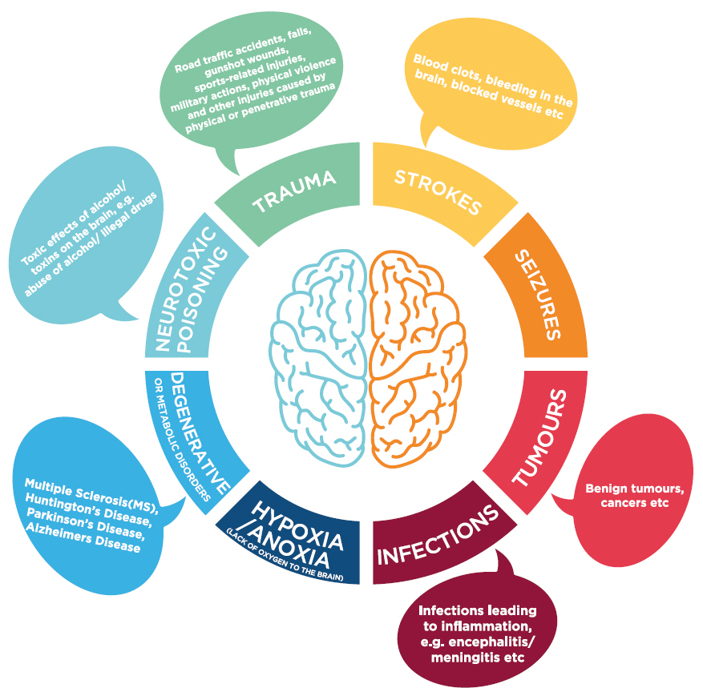
Causes of Brain Injury
Notes:
Lots of different causes of ABI
Vincent sustained extradural and subdural haematoma and subarachnoid haemorrhage with an extensive skull fracture and bruising across his body. He required a decompressive craniotomy and has some post-operative cerebrospinal fluid leakage with low potassium levels. Vincent has made a good physical recovery but there continue to be behavioural and cognitive concerns. He remains under the care of Sheffield Children’s Hospital with reviews from the neurodisability and neuropsychology teams. He has had NHS physiotherapy and occupational therapy but has now been discharged.
Injuries can be focal or diffuse
Causes include;
Traumatic brain injury (falls, car accidents, sports)
Infections such as meningitis or encephalitis
Childhood stroke
Hypoxic-ischaemic events (drowning, seizures or cardiac complications)
Tumours and surgery

Slide 5
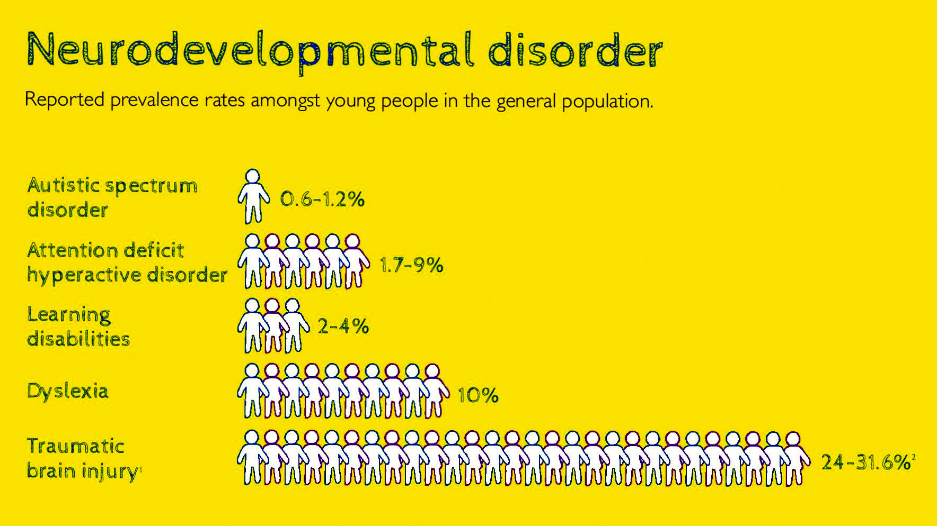
Notes:
It would be good to look at the REF for this.

Slide 6
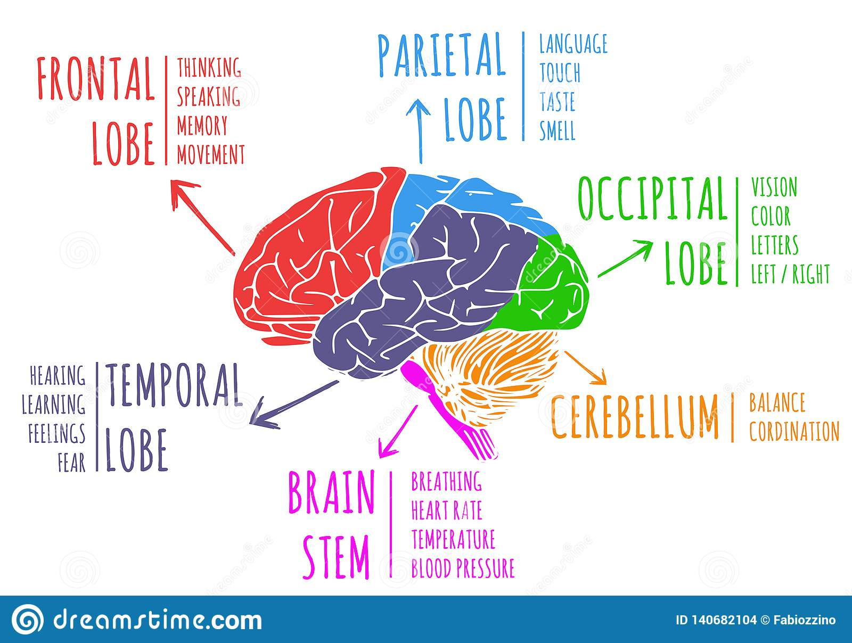
Parts of the brain
Notes:
Brain abnormalities:
Alcohol metaphor

Slide 7
Impact of brain injury?

Slide 8
Primary difficulties resulting from brain injury
Education
Missed learning due to hospitalisation.
Not reaching ARE.
Masking of difficulties
Academic potential may not be reached
Independence
Over-reliance on adults.
Loss of skills.
Retention of new learning.
Lack of confidence.
Social skills and relationships
Emotional
Self esteem
Frustration
Anxiety
Emotional dysregulation
Social
Difficulties unrecognized (invisible difficulty).
Visible difference.
Skills for making and managing relationships
Vulnerability
Difficulty with behaviour
Problems with thinking skills
Memory (short term, long term, working memory).
Executive functions (more later).
Paying attention.
Lack of insight.
Word finding difficulties.
Visual problems
Empathy and understanding others’ POV
Physical & Medical
Hearing Impairment
Fine motor problems: poor handwriting
Gross motor problems: mobility, balance, co-ordination.

Slide 9
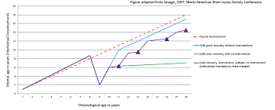
Developmental trajectory and outcomes
Neuropsychological (executive processes) difficulties are also associated with difficulties in:
Academic attainment - maths, literacy
Emotion regulation – high prevalence of depression/anxiety
Behavioural regulation – high prevalence of aggression/conduct
Social communication
Social participation – Family burden/stress
Future independence in adulthood, future employment, risk of crime, risk of substance use, risk of mental health difficulties etc
Around 50% of offenders report to have a previous ABI. Could be as high as 70%
Suicide risk peaks 5-7 years post-injury.
Notes:
Figure is useless
Check REF and change photo. Savage2007, North American Brain Injury. Is actually information from conference proceedings.
Green – Natural plateau
Blue – Right support and intervention
Purple =

Slide 10
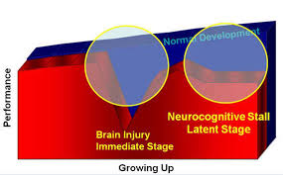
Plasticity vs. Vulnerability
‘Derails’ normal development as the brain continues to mature in the context of an injury.
Deficits can emerge over time, as different cognitive functions come online
(e.g., executive functions associated with the frontal lobes continue to develop into early adulthood).
Notes:
Read up on plasticity vs. vulnerability.
So the injury can affect the cognitive abilities that were had pre-injury…
But they can also affect your ability to pick up new cognitive abilities.

Slide 11
Long term - Impact on life
School attendance and engagement:
60% do poorly at school (Sariaslan et al, 2016)
Exclusions/ alternative provision
Criminal justice system (Williams et al, 2010 & 15)
Jobs, qualifications and future welfare:
Less likely to progress to future study/work.
80% more likely to receive disability benefits and 60% welfare benefits (Sariaslan et al., 2016).
More likely to be homeless (e.g., 48% in Leeds had a history of ABI; Disabilities Trust, 2010).
Mental Health:
overrepresentation of psychiatric conditions (Li & Liu, 2013)
Similar levels of mental health difficulties as CYP referred to CAMHS (Gracey & Watson, 2014)
Social Adjustment, isolation & relationships:
Many people with ABI report poor quality of life (Anderson et al, 2010)
Poorer social adjustment, participation and greater social problems (Anderson et al, 2014)
Notes:
Might be helpful to look at soe

Slide 12
Neuropsychological changes

Slide 13
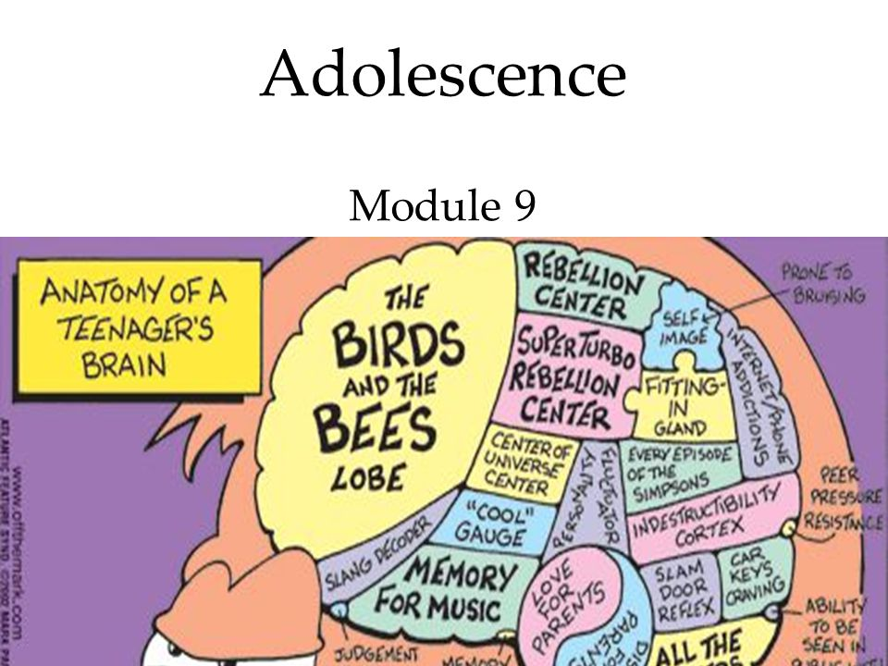
What are neuropsychological difficulties?
There is a large, diverse range of thinking skills/processes that we all have.
Many of these thinking skills can be grouped (called domains).
Cognitive Groups
Memory
Language
Perception
Proprioception
Attention
Intelligence
Interoception
Executive functioning
Notes:
You have to notice (attend) to something in your environment to remember it
How do you alter your arousal/attention levels?
You have to interact with your environment in some way (Motor skills and sensory information)
What difference does language make? We have to label our experience in some way

Slide 14
EF is an umbrella term to describe a group of processes that contribute to the execution of purposeful and goal directed behavior. A bit like an executive in a company supervising complex and novel tasks.
Working Memory
Being able to hold information mind and manipulate it purposefully.
Required for: Arithmetic, holding multiple instructions
Regulation
Being able to monitor and manage emotions and behaviour.
Required for: Managing social demands and school pressures (essentially everything)
Planning
Being able to plan a series of steps to complete a task and employ effective strategies.
Required for: Project work, large self-directed tasks
Executive Functioning
Set Shifting
Being able to adjust to new thinking when old thinking is not successful.
Required for: Problem solving
Inhibition
Being able to resits urges and impulses.
Required for: interpersonal skills, tasks requiring careful consideration, appropriate behaviour, prolonged concentration
Self Monitoring
Being able to observe own performance to guide subsequent behaviour.
Required for: Problem solving

Slide 15
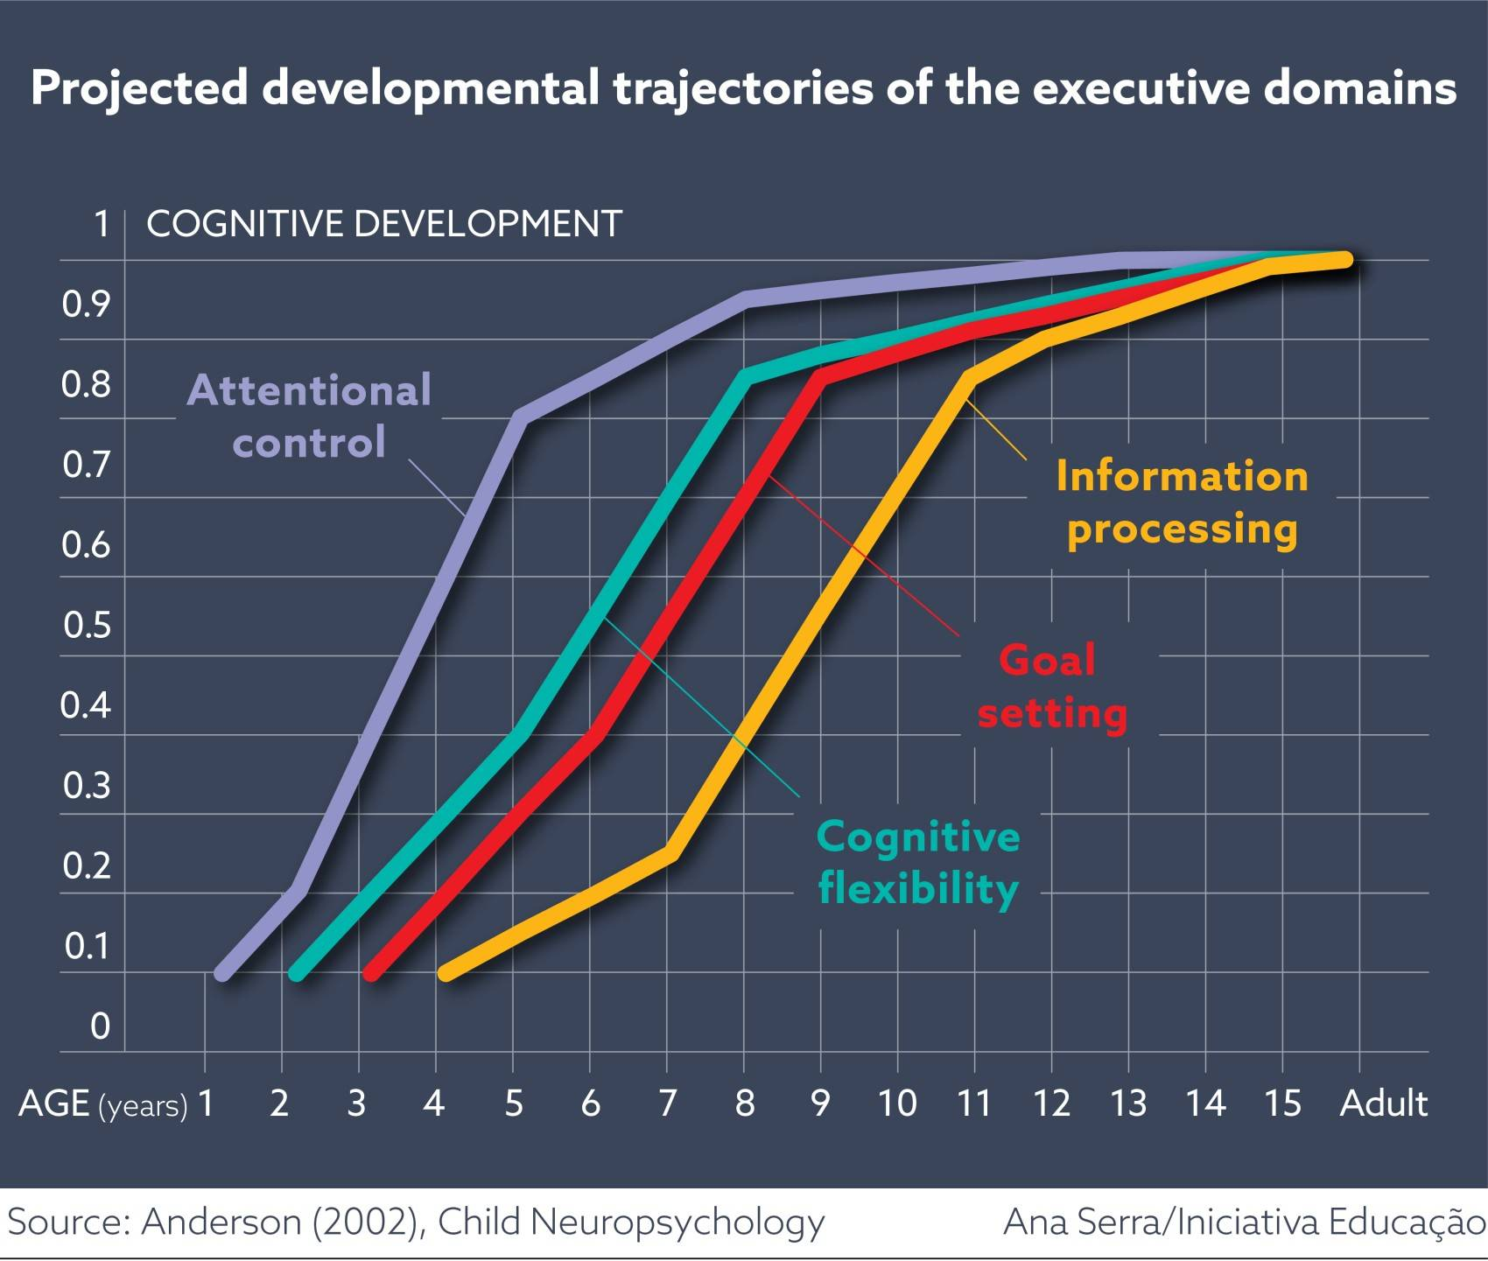
Executive Functioning
Particularly vulnerable to injury
Develop throughout childhood and adolescence
Two main areas:
Ventrolateral cortex: emotional and behavioural regulation
Dorsolateral cortex: working memory, planning, organisation
Notes:
Anderson2002 Child Neuropsychology check REF

Slide 16

What might be signs of EF difficulty?
Forgets to complete ad-hoc homework task.
Difficulty with complex/novel work that requires planning and switching tasks.
Difficulty staying on task (particularly uninteresting tasks).
Poor time management.
Impulsive behavior and difficulty regulating emotions.
When stuck on a problem unable to think of alternative solutions.
Regular difficulty with peers.
Not able to utilize feedback.
Highly repetitive behaviors.
Difficulty with motivation and self-direction.

Slide 17
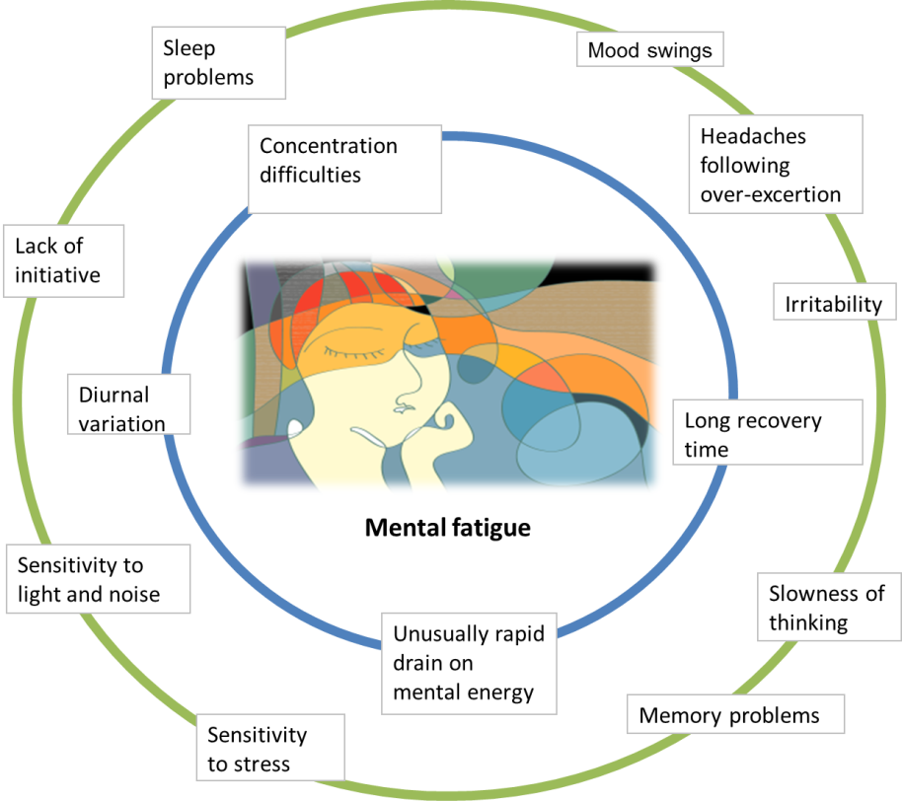
Difficulties with Fatigue
Fatigue is different to being tired.
It can be physical and mental fatigue and impacts upon cognitive functioning.
Fatigue needs to be managed by:
Taking regular breaks, either physical or mental rest.
Not overloading with information.
Embedding breaks into the daily routine.
Understanding triggers for fatigue

Slide 18
Neuro-Rehabilitation
Notes:
Invitation to staff to bring forward what they already know?
The chances are…. that you might already have personal or professional experience of working with someone with a brain injury.
Previous experience/teaching around supporting people with brain injury?

Slide 19

Ask children what they want (McCarron et al, 2019)
Mapping of rehabilitation goals onto function revealed;
52% Activities & participation (e.g., family, peers, school, self-care independent living, relationships)
28% Body function goals (e.g., mental and sensory functions).
20% Environment goals (e.g., Support and attitudes, relationships)
Goals distribution:

Slide 20
Holistic approach
Rehabilitation psychology: Goal = optimising wellbeing and meaningful participation for individuals with disabilities in daily living (Dunn Ehde & Wegener, 2016)
Occupational therapy: Identifying impairments on everyday, functional activities and working to help children overcome their difficulties and regain independence.
How do we do this?
Neuropsychological intervention: cognitive, behavioural, social, emotional applications.
OT intervention: to introduce strategies/ adaptations to everyday activities, including education.
Ecological rehab integrated into daily routines – appropriate to age and stage of brain development (e.g., Braga, 2016).
Within the meaningful setting of the family (shape relationships).
Empower families with knowledge.
Realistic expectations: short and long-term goals that are relevant to the specific child.
Focus on potential and successes, not losses.
Work between community, school and home: promoting consistent rehabilitation wherever possible.
Plan for the future (prognosis for abilities > employment and social integration)
Notes:
Ecological rehab = exampled getting V to school on the bus.

Slide 21

Education after Brain Injury
Schools are a crucial part to rehabilitation however limited training provided for teachers about ABI: unsure how to support despite having skills and experience.
Student can find it hard to process information.
They find the curriculum demands very tiring.
May have no idea where to start, especially if lots of instructions.
Working without frequent prompts and guidance is difficult.
May appear to not be trying - don’t use ‘obvious’ strategies such as turning to the page before.
May have limited ability to draw on prior knowledge.
Can be very literal and need very clear expectations.
May be reluctant to ask for help and keen to be like their peers.
Social and emotional issues become more apparent in teenage years.
Inappropriate behaviour:
Impulsivity and lack of control - may be labelled as ‘naughty’/’challenging’ when they have reduced control or are acting out of distress or lack of understanding
Lack of initiation or empathy may be seen as ‘lazy’ or thoughtless

Slide 22
Keep in touch: chris@indigoneuro.co.uk
More information:
The Child Brain Injury Trust: www.childbraininjurytrust.org.uk
The Children’s Trust for Children with Brain Injury: http://www.braininjuryhub.co.uk/
The Brain Injury Association of America: www.biausa.org/brain-injury-children.htm
Headway: www.headway.org.uk
Key References & Links

