Slide 1
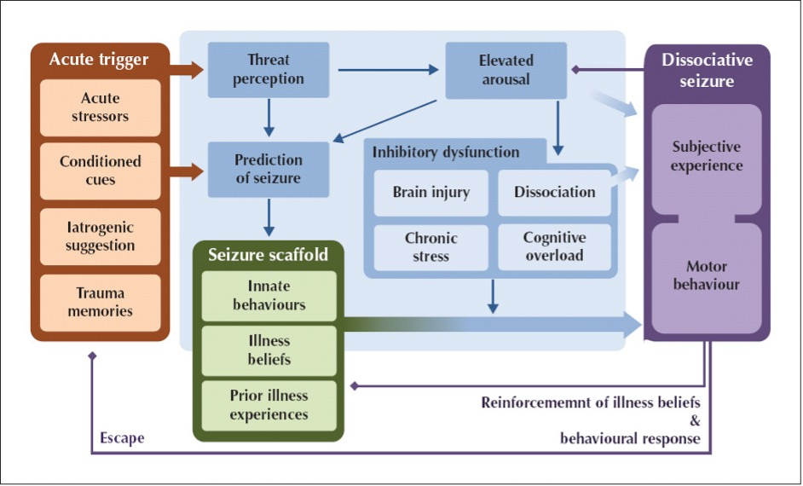

Slide 2
Increased Arousal
Seizure Triggers
Functional Seizure
Threat Perception
Confrontation
Inhibitory Dysfunction
Loss of awareness
Worries about money
Prediction of Seizure
Not eating
Being over worked
Convulsive shaking
Illness
Post seizure fatigue
Unmet Emotional Needs
Dissociation
Seizure Scaffold
Family member with epilepsy
Panic attacks as teenager
Gradually reinforced scaffold & beliefs
Belief Physical symptoms = Seizure

Slide 3
Regulation Strategies (e.g., breathing, grounding)
Increased Arousal
Noticing / interoception.
Emotion tolerance
Seizure Triggers
Promoting adaptive behaviors.
Recognition of unmet emotional needs.
Functional Seizure
Threat Perception
Acute Management
and Recovery Planning
Confrontation
Inhibitory Dysfunction
Loss of awareness
Worries about money
Prediction of Seizure
Not eating
Being over worked
Convulsive shaking
Illness
Post seizure fatigue
Unmet Emotional Needs
Dissociation
Seizure Scaffold
Family member with epilepsy
Panic attacks as teenager
Gradually reinforced scaffold & beliefs
Cognitive restructuring
for catastrophic thoughts.
Belief Physical symptoms = Seizure
Longer form psychotherapy

