Slide 1
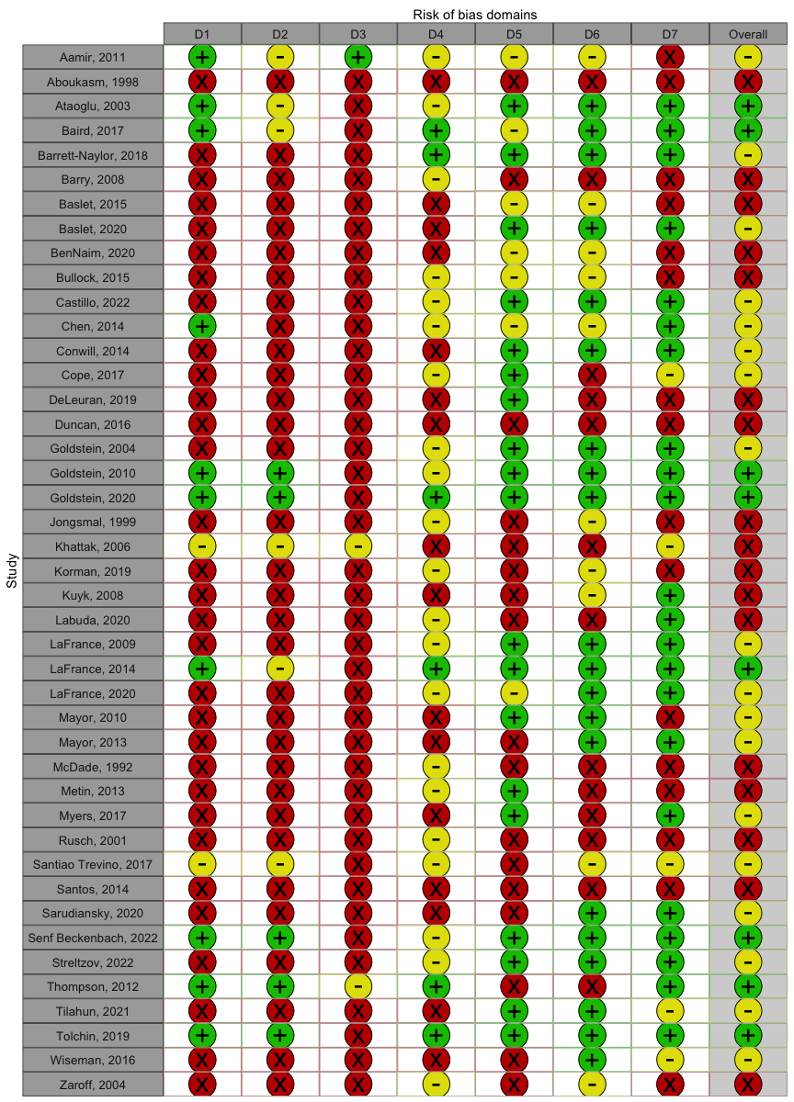
Risk of Bias Domains
Studies included in the Systematic Review
Notes. D1 = Random sequence generation; D2 = Allocation concealement; D3 = Blinding of participants; D4 = Blinding of outcome assessment; D5 = Incomplete outcome data; D6 = Selective reporting; D6 = Other sources of bias.

