Slide 1


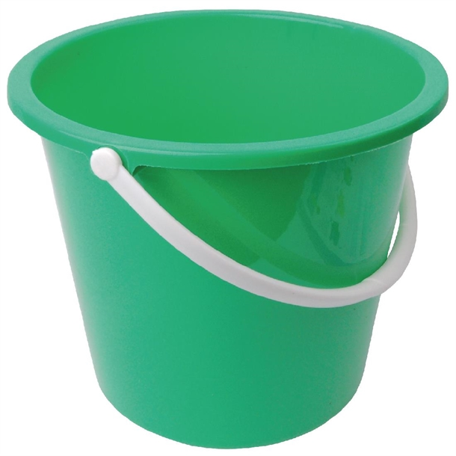
Depression Measures
Anxiety Measures
Other Measures

