Slide 1
THE ORIGINS OF WORLD WAR ONE
Lobj: to conclude our investigation into the causes of World War One

Slide 2
Checklist and highlighter
Letters to parents

Slide 3
The World changed in 1871
1871 = war between France & Prussia (soon to be Germany)
Alsace & Lorraine, part of France, became part of a new German Empire.
The arrival of this ‘new Germany’ destabilised international relations.
It was an economic & military powerhouse – and frightened others

Slide 4
Beliefs
Germany, like many other countries believed in:
Nationalism – believe in your country, no matter if they are right or wrong
Imperialism – my nation has the right to conquer other lands – Empire.
Militarism – it was important for countries to have strong, well-prepared fighting forces

Slide 5
WELTPOLITIK
Kaiser of Germany = Wilhelm II
Germany was strong with a huge army – but they felt they weren’t taken seriously as they had no Empire
Kaiser wanted this ‘place in the sun’ – and would use an aggressive foreign policy to get it

Slide 6
WELTPOLITIK 2
The Kaiser wanted Germany to be a huge trading Nation – need an Empire (esp Africa)
Wanted to be like Britain (Empire =1/5 of the World)
These policies spread fear into GB, France & Russia
Kaiser gave an interview to the DailyTelegraph – said the English were ‘mad’ and that the German ‘disliked’ them

Slide 7
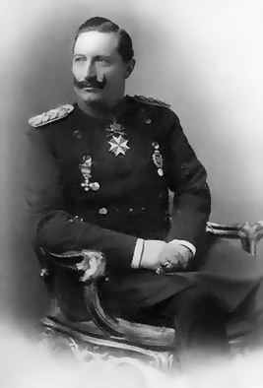
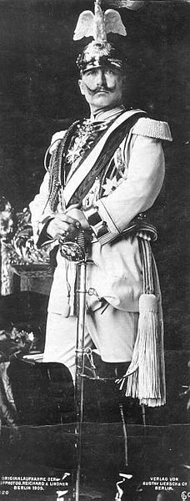

Slide 8
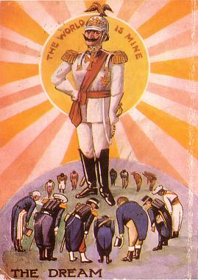

Slide 9
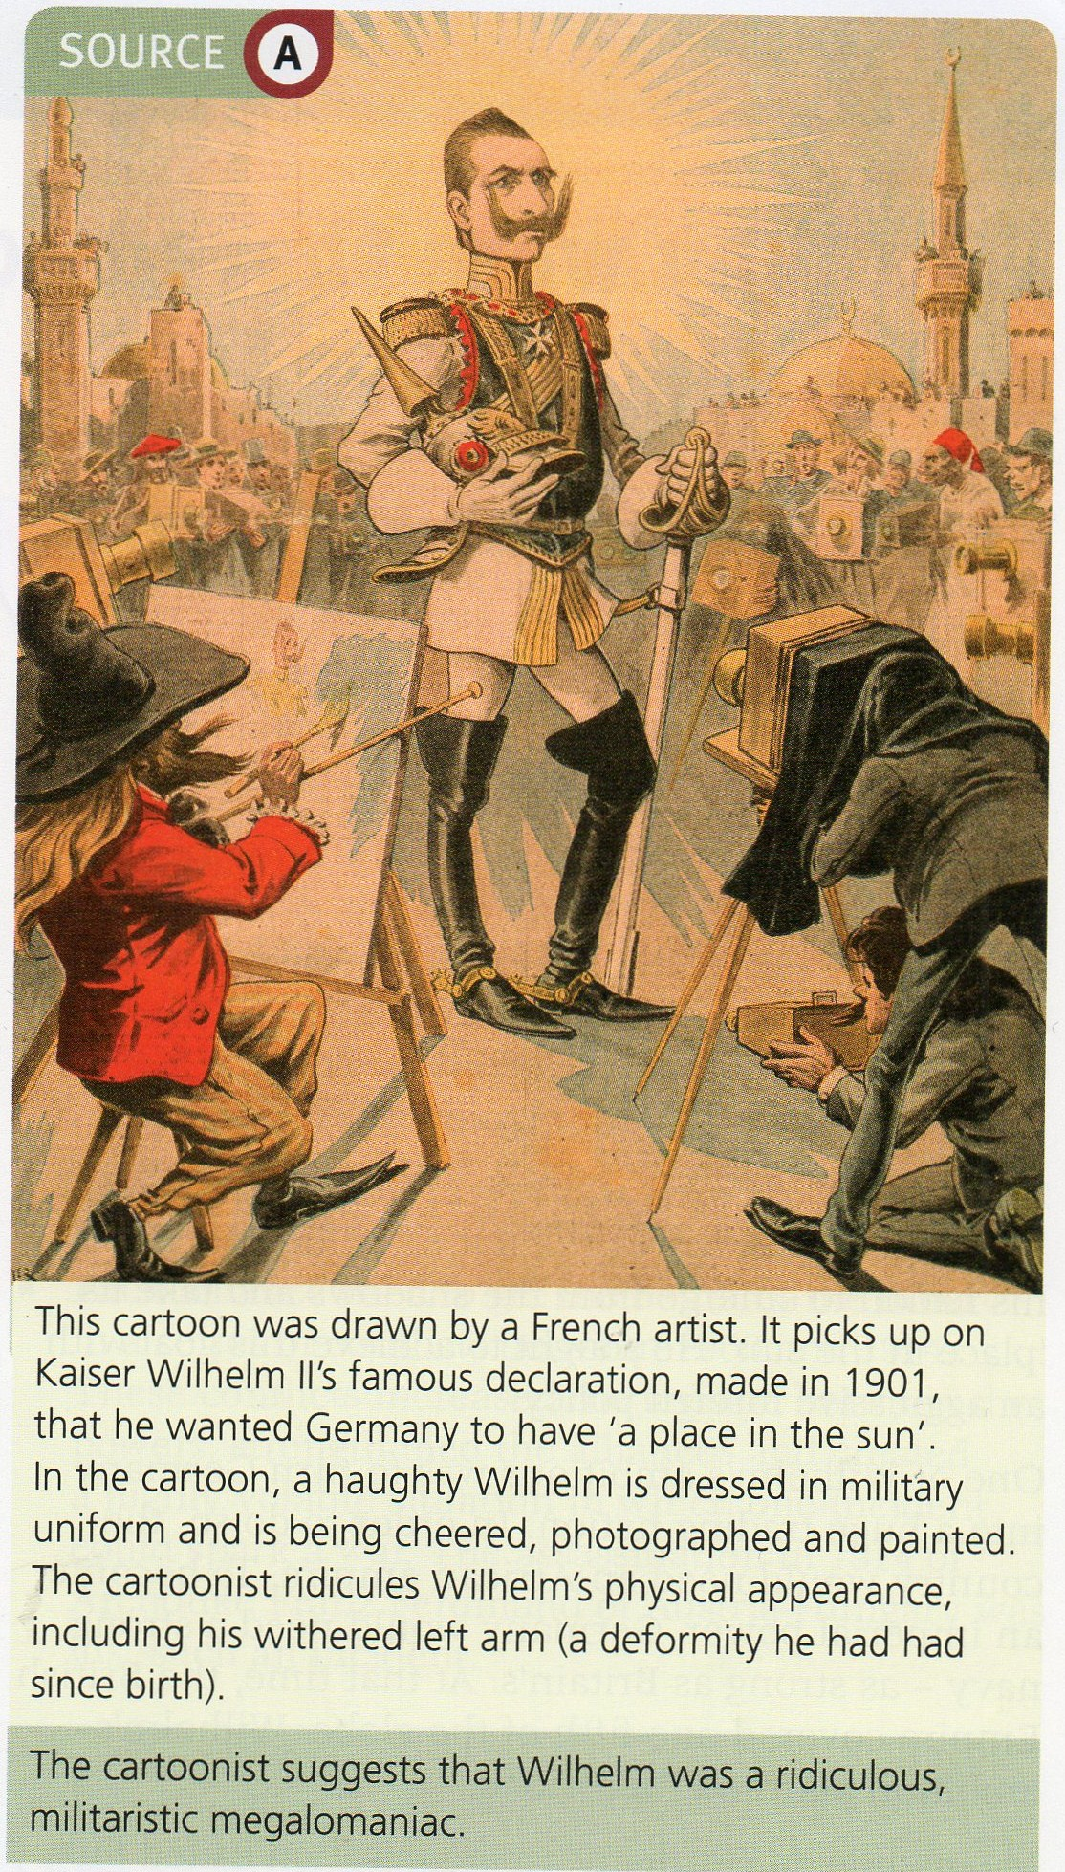

Slide 11
Pan-German league & Mitteleuropa
This was a strong state that would include all the German speakers (Germanic Race)
Be dominated by Germany itself.

Slide 12
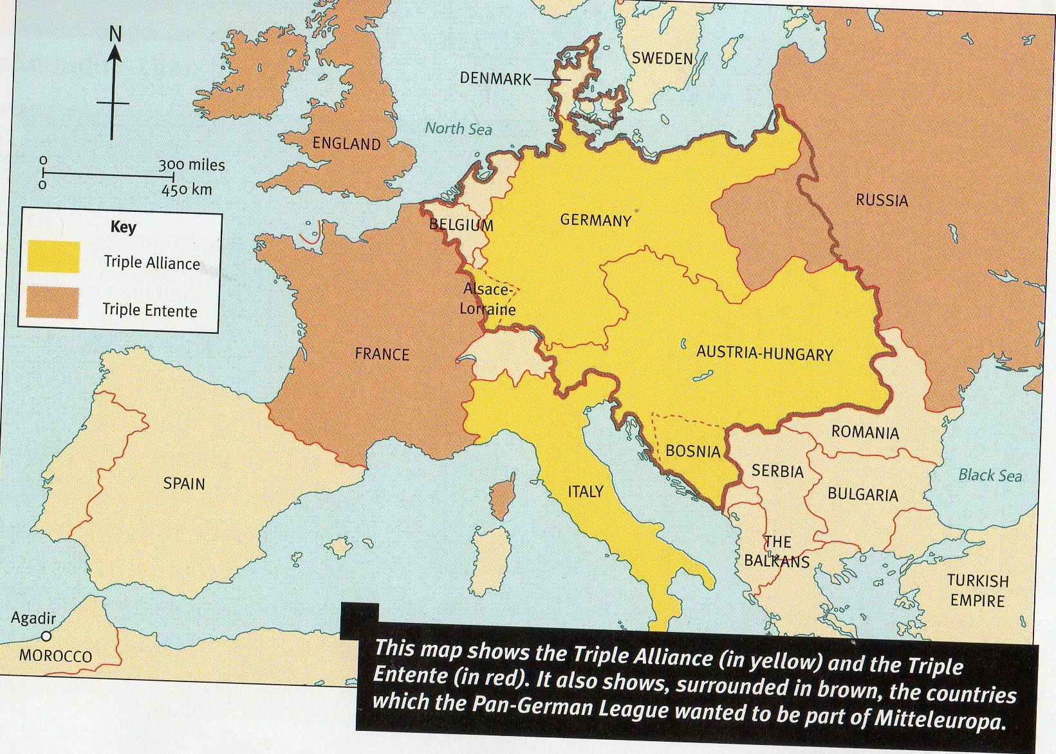

Slide 13
WW1 – who was to blame?
Serbia? – rejected Austria’s ultimatum and encouraged the assassinated Franz Ferdinand
Austria-Hungary? – manipulated the situation to invade Serbia.
Russia? – mobilised troops against A-H knowing it would provoke Germany
Germany? – blamed for wanting a war – did not accept that Russian troops would only attack A-H not them; Schlieffen Plan
GB ? – for the Naval race & getting involved in a war on a technicality (Belgium)

