Slide 2
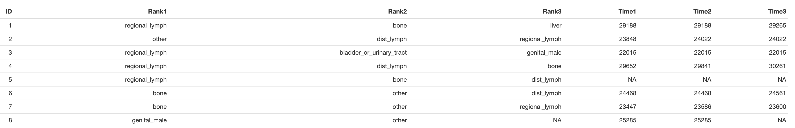

The problem
Problem: We (clinics) mostly REACT upon metastases
time in days; birth
1st metastatic site
2nd metastatic site
3rd metastatic site
We are mainly acting in a REACTIVE way
We want a PRO-active way

Slide 3
Is the metastatic seeding pattern (timely) random
Goal: Do we have appropriate stastics to infer the metastatic seeding pattern
Organ 4
Organ 2
Organ 3
Primary cancer
Organ 1
I will not touch on metastatic colonization properites
I will not talk about genetics

Slide 4
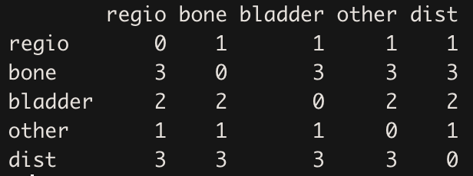
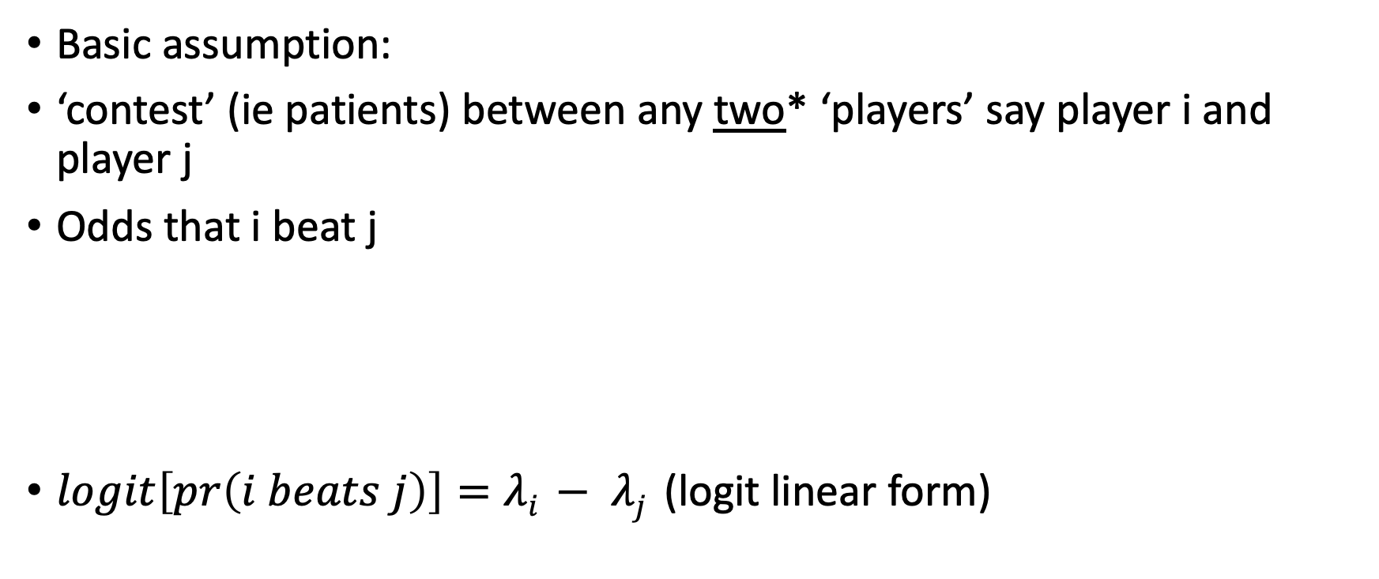
BradleyTerry model and some extensions
Methods: Do we have appropriate stastics to infer the metastatic seeding pattern
Basic assumption:
‘contest’ (ie patients) between any two* ‘players’ say player i and player j
Odds that i beat j
$logit\left[pr\left(i beats j\right)\right]=λi − λj$ (logit linear form)
*will be important later
Cohort of 10 patients; 5 unique organ sites

Slide 5
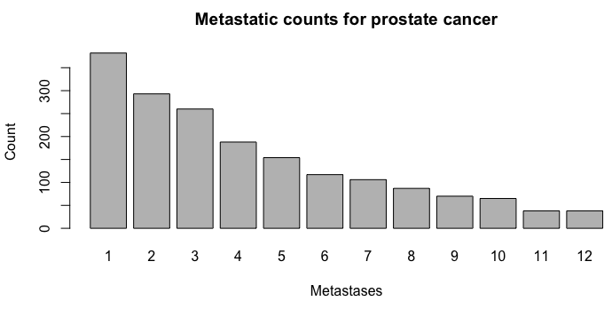
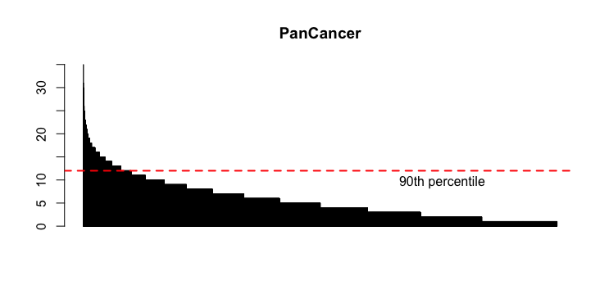
Prostate cancer dataset
I used prostate as starting point since there is a lot of literature on metastatic dissemation from primary prostate cancer

Slide 6
Results I: Bone(s) are among the first organ(s) were metastatic lesions are detected
Rank 1
Rank ∈ {1 … 12}
First metastatic site:

Slide 7
The highest likelihood to detect the first metastatic site is at regional_lymph node, other or bone (cannot be discriminated)
Results II: Qualitative inference reflects the exploratory pattern seen before
ns
significant (at 0.05)
reference
group

Slide 8
Results III: We can only create a ‘single-end’ tree; assessing the likelihood of first occurrence
Bone
other
Proportional to evidence of support
(model coefficients; BT model)
‘time-branch’
uniform across all
organ sites
RegioalLN
Length of line could indicate time measure
primary prostate cancer
Distal LN
Lymph
Kidney
AdrenalG
BiliaryTR
breast

Slide 9
Limitations
Reference group needed for statistical inference
Ties (two organ sites at the same time) are not supported
Qualitative measure (time agnostic)
BradleyTerry model propose a point estimate in time
BT model estimates recapitualte ‘simple’ observations
Straightforward in interpretation

Slide 10
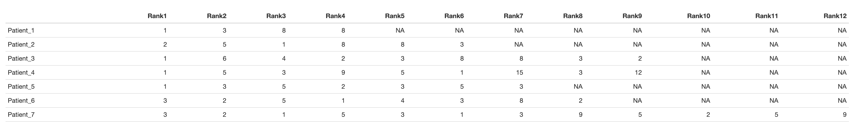
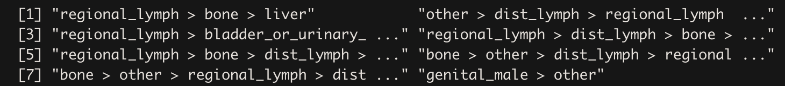
PlackettLuce model for modelling rankings data
Methods II: Rankings data, in which each observation is an ordering of a set of items (consumer studies, etc.)
early
later

Slide 11
comparision
Methods III: ML estimation
PlacketLuce model:
Ties are allowed
Partial or complete ranking
The Bradley-Terry model for datasets involving paired comparisons has wide uptake in the R community.
However, existing functionality1 is restricted to paired comparisons.
The canonical problem is to consider n players who compete against one another;
the basic inference problem is to estimate numbers p = (p1, . . . , pn), pi > 0, P pi = 1
which correspond to player “strengths”. Information about the pi may be obtained from
the results of paired comparisons between the players.
hyperdirichlet distribution

Slide 12
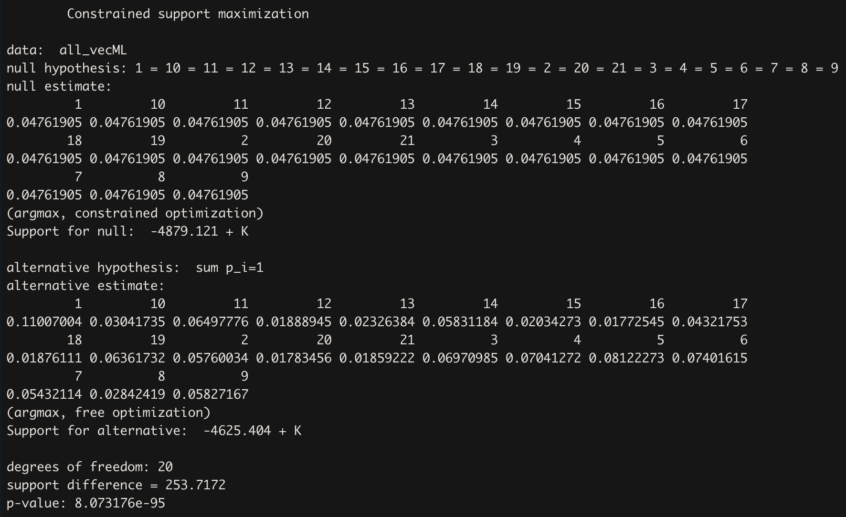
Relative strength parameters are evaluated
Hypothesis testing:
Equality of strength:
specifically:
H0:p1=p2=⋯=pn=1n.
ML sums up to 1; relative ‘strength’ to each other

Slide 13
Hypothesis 2: p1⩾max(p2,…,p6)
H1: p₁ > 1/n
H2: p₁ > max {p2, . . . p_{n}}
H3: p5 + p6 > 1 3
H4: max {p5, p6} > min {p1, p2, p3, p4}

Slide 14
Again:
Qualitative measure
Statistical inference limited
No reference group needed
Partial ranking possible
Inferences limited (H0, HA, etc.)

Slide 15
Time
Currently the models are time agnostic. Does a longer disease monitoring automatically mean that more metastatic sites are diagnosed?
Since we only working with the ‘first’ site – there is no time measure!

