Slide 1
(qualitatively) time metastatic seeding
01/11/2022

Slide 2
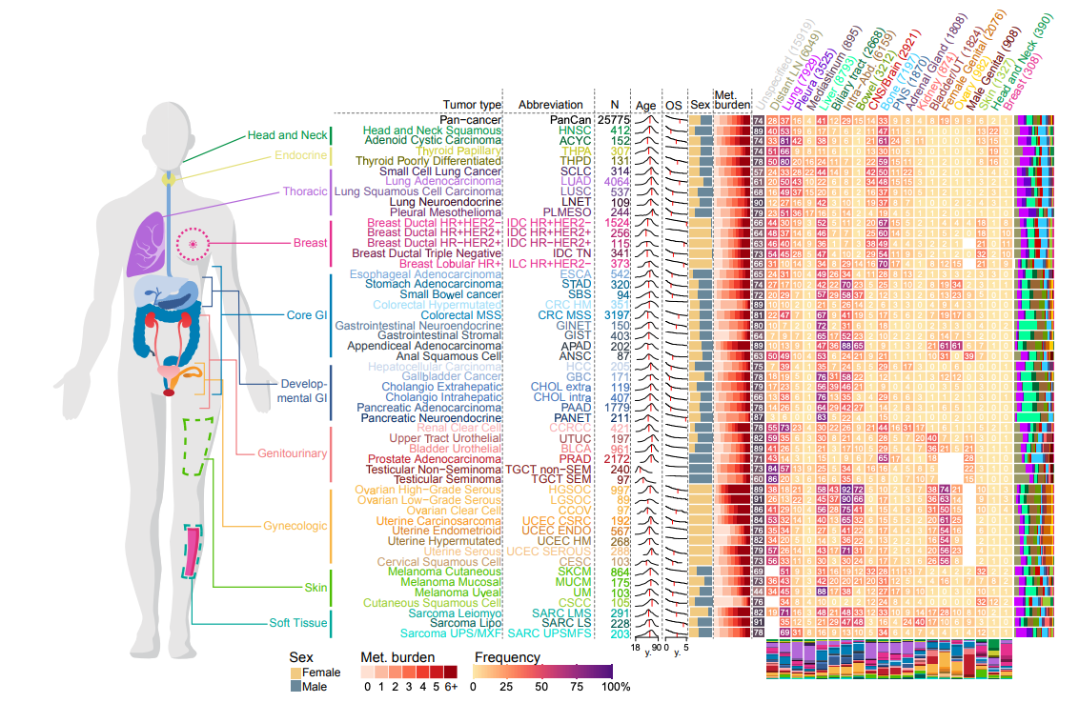
Data: Nguyen, B. et al. supplemental table 2

Slide 3
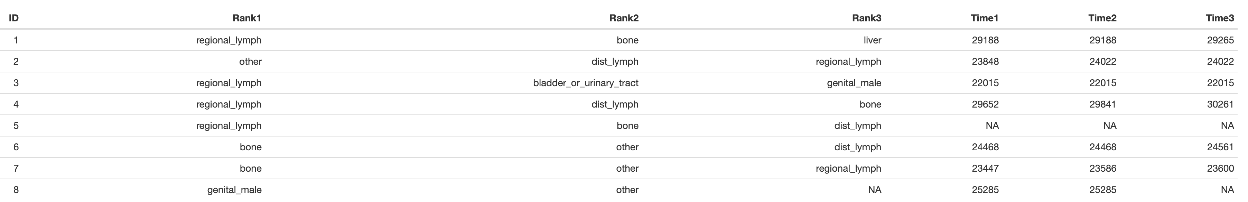

Pure observation occlude dissemination pattern
84% of patients show more than one metastasis
time in days; birth
1st metastatic site
2nd metastatic site
3rd metastatic site

Slide 4
Is the metastatic seeding pattern (timely) random?
Problem AND Goal: We (clinics) mostly REACT upon metastases. Is there a PRO-active approach?
Organ 4
Organ 2
Organ 3
Primary cancer
Organ 1

Slide 5
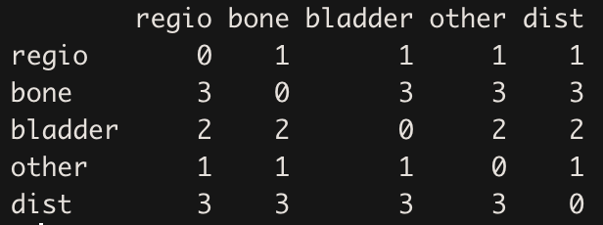
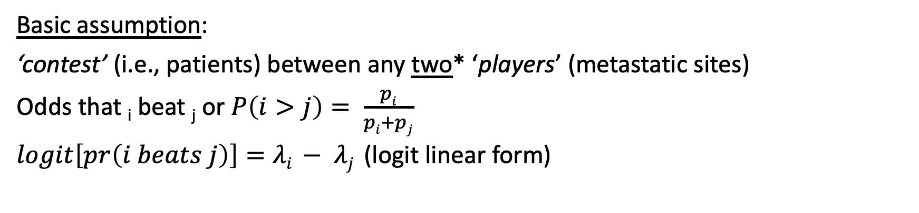
The BradleyTerry probability model; predict the outcome of a paired comparision
Methods I: Do we have appropriate stastics to infer the metastatic seeding pattern
Basic assumption:
‘contest’ (i.e., patients) between any two* ‘players’ (metastatic sites)
Odds that _{i} beat _{j} or $P\left(i>j\right)= \frac{pi}{pi+pj}$
$logit\left[pr\left(i beats j\right)\right]=λi − λj$ (logit linear form)
Example:
Cohort of n=10
Total of 5 metastaic sites
(regio, bone, bladder, etc.)
Regional_LN were found once (patient) as the first organ populated; hence regio ‘won’ against the other 4 sites
Bone metastases were found first in 3 patients; hence bone ‘won’ against the other 4 sites, 3 times
*will be important later

Slide 6
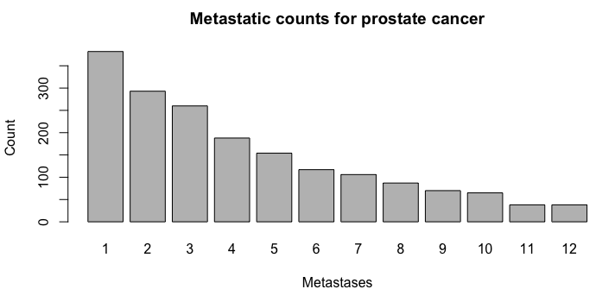
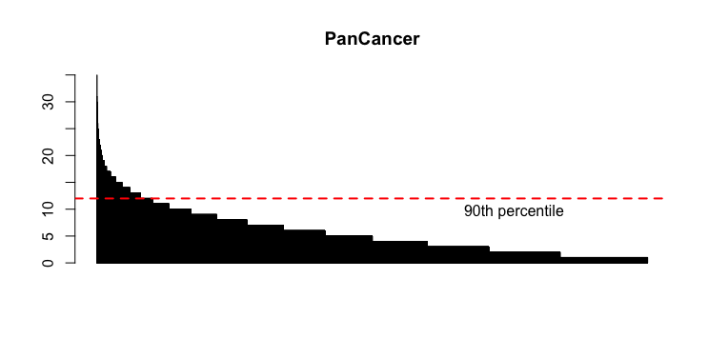
90% of patients show ≤ 12 metastatic sites
I used prostate since there is a lot of literature on metastatic dissemation patterns

Slide 7
Bone(s) are among the first organ(s) were metastatic lesions are detected
Result I: Rank 1 = first site detected; we could do the same thing for every ’rank’
Rank 1
Rank ∈ {1 … 12}

Slide 8
There is strong statistical evidence that bone and ‘other’ are the first organ sites were metastasis are found
Results II: Qualitative inference reflects the exploratory pattern seen before
ns
significant (at 0.05)
reference
group

Slide 9
Results III: We can only create a ‘single-end’ tree; assessing the likelihood of first occurrence
Bone
other
Proportional to evidence of support
(model coefficients; BT model)
‘time-branch’
uniform across all
organ sites
RegioalLN
Length of line could indicate time measure
primary prostate cancer
Distal LN
Lymph
Kidney
AdrenalG
BiliaryTR
breast

Slide 10
Limitations
Reference group needed for statistical inference
Ties (two organ sites at the same time) are not supported
Qualitative measure (time agnostic)
BradleyTerry model propose a point estimate in time (i.e., Rank1)
BT model estimates recapitualte ‘simple’ observations
Straightforward in interpretation

Slide 11
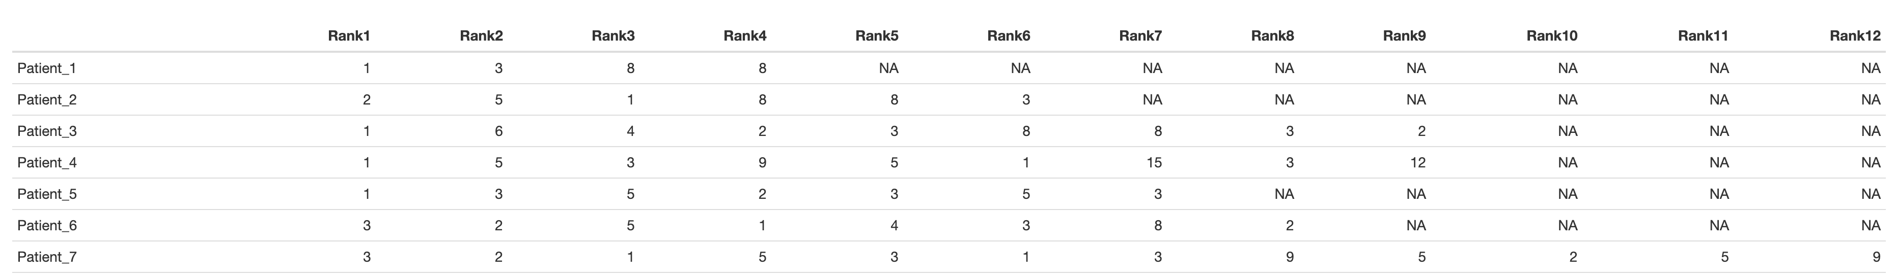
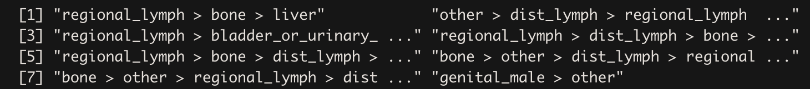
PlackettLuce model for modelling rankings data
Methods II: Rankings data, in which each observation is an ordering of a set of items (consumer studies, etc.)
early
later

Slide 12
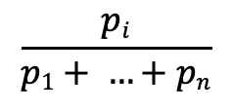
Generalization of the BradleyTerry model - PlackettLuce
Methods III: I deployed the hyper2 R package for support
Competiror _{i} winning in a filed of _{j} = 1, …, n
$$\frac{pi}{p1+ …+pn}$$
eg
6 competitors
$bone ≻liver ≻regional_LN≻lung ≻other ≻pleura$
Estimate the ‘strength’ for every p_{i} where i ∈ {bone, liver, regional_LN, lung, other, pleura) via a
ML estimation using dirichlet distributions

Slide 13
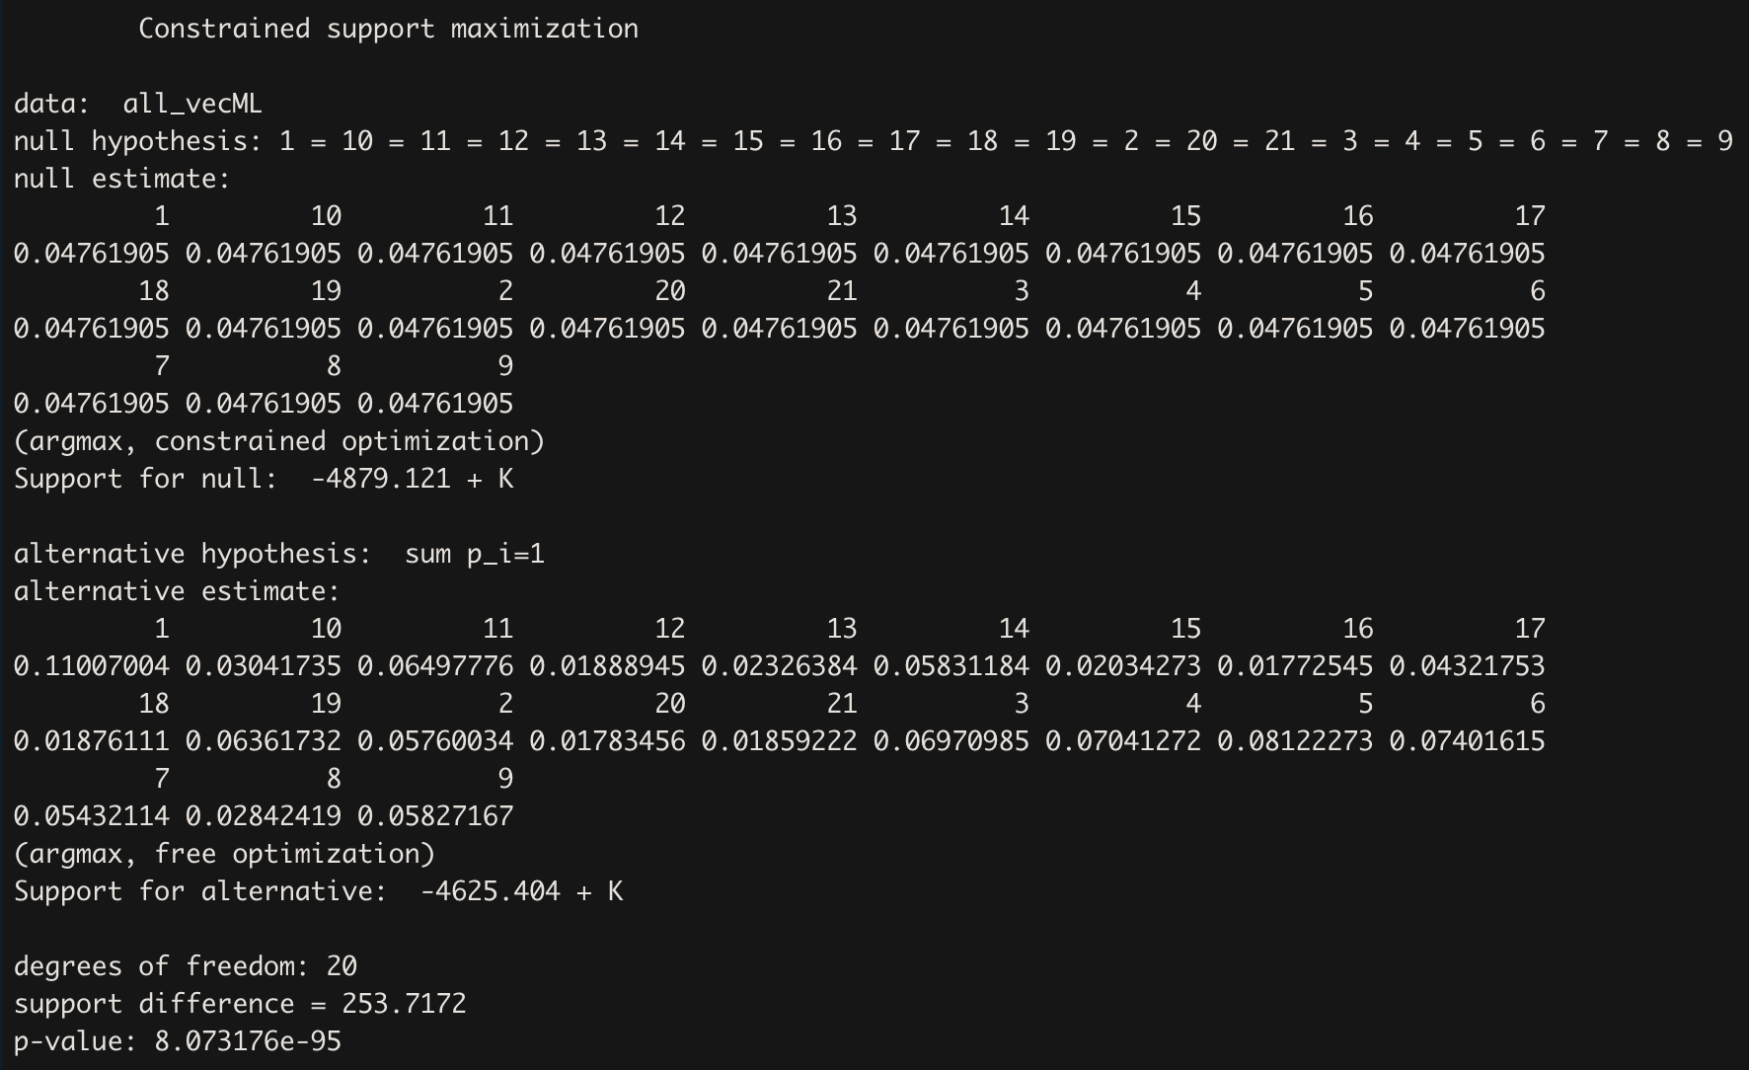
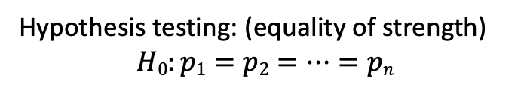
The likelihood for metastases detection at regional_LN are highest
Results IV: Note that statistical inferences are not possible with this approach (currently)
Hypothesis testing: (equality of strength)
$$H0:p1=p2=…=pn$$

Slide 14
Summary
Model follows intuition
no reference group needed
considers comprehensive ranking (rather than BT)
Qualitative measure
Statistical inference limited

Slide 15
Discussion: Site by Site OR comprehensively assessing the data
Organ site 1
Organ site 2
Organ site 3
Organ 4
Organ 2
Organ 4
Organ 2
Organ 4
Organ 2
Organ 3
Organ 3
Organ 3
Primary cancer
Primary cancer
Primary cancer
Organ 1
Organ 1
Organ 1
Every metastatic lesion is independent; BT model for 1st 2nd, 3rd occurrence
Thickness: eg ML estimates of p_{i}
Primary cancer
Organ 1
Organ 2
Organ 3
Organ 4
Length: eg duration from 1st to 2nd, etc
PlackettLuce to establish a ML (strength) relationship among the full dataset

Slide 17
Time
Currently the models are time agnostic. Does a longer disease monitoring automatically mean that more metastatic sites are diagnosed?

