Slide 1
Follow-up on Y-chromosomes

Slide 2
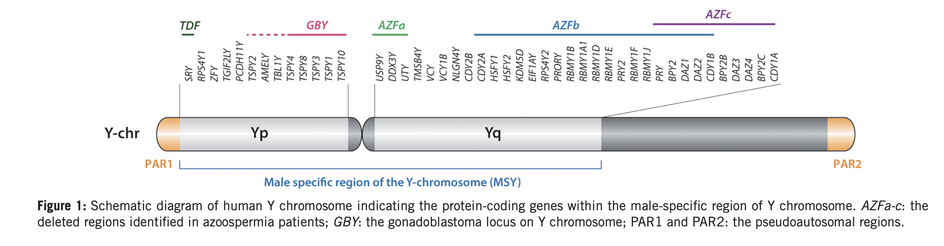
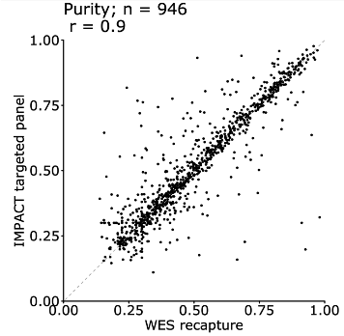
A) Technical aspects
A1) FacetsY (algorithm): remove PAR2 (~ 59 Mb) seq. reads coming from the Yp arm.
Background: We call Y-chromosome loss on the basis of the ‘50%-rule’. FacetsY fits segments which span all loci covered by seq. reads. Since the vast majority of the Yp is not informative and seq. reads are anyway sparse, we exclude PAR2 regions, since derived-fitted segments appear doubtful.
A2) Purity-estimation disparities between MSK-IMPACT and WES-recapture are independent of each other.
Background: The overall purity concordance between the two methods is high. However, there are some cancer samples which display obvious disagreement (Figure, right bottom). Take a look into those samples (~ 5) and decipher whether there is an association with WGD.

Slide 3
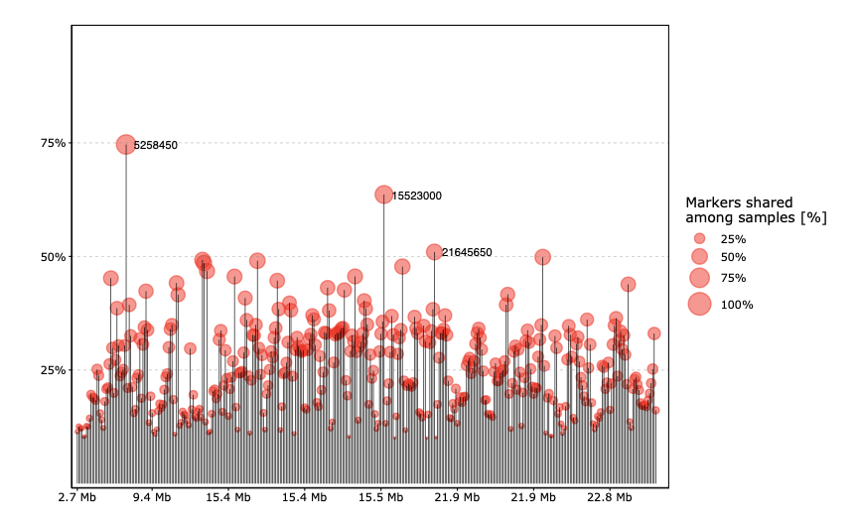
B) Y loss aspects
B1) There is no unique segment/probe/locus (marker) specifically enriched in the Y chromosome loss cases in solid tumor tissue.
Background: an identification of specific loci which are associated with Y chromosome loss could make the seq. resolution coming from either MSK-IMPACT OR MSK-WES recapture obsolete. Moreover, it could serve as independent measurement in assessing this particular genomic biomarker (e.g. if locus X is deleted (PCR) there is a Y% likelihood that the Y chromosome is equally lost). Notably https://www.nature.com/articles/ng.3821#Sec8
Position 5,258,450 (PCDH11Y) is covered by most of the cancer
samples analysed (74.6%). There are only two additional
positions which are covered in more than 50% of the samples
investigated. Note that this is a holistic visualization of the
cohort (n=12,405 samples). Position 15,523,000 falls within
UTY (homologue to KDM6A on chromosome X).
Coverage among cohort
Y chromosome coordinates

Slide 4
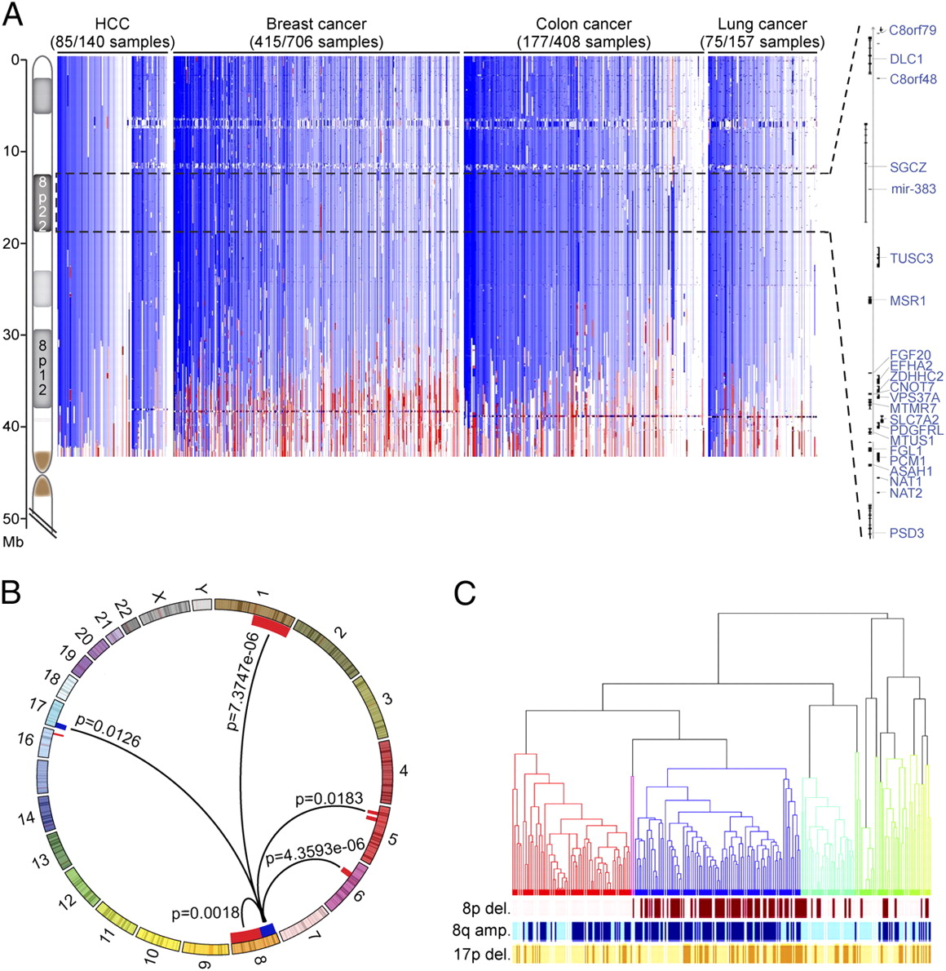
Genomic complexity is, in part, the result of cancer, rather than the cause (hypothesis)
B2) There is no notable SCNA (ranging from small to whole chromosomes) event associated with Y chromosome loss.
Background: We know that FGA as a global measure of genome instability is associated with a higher chance of observing a Y chromosome loss in solid cancer tissue. However, whether this coincide by chance is largely unexplored. We aim to find a stringent co-occurrence pattern between any SCNA and Y chromosome loss.
SCNA: Gene-level, Chromsome-arm level??
Unequal distribution through Panel Data
https://www.pnas.org/content/109/21/8212

Slide 5
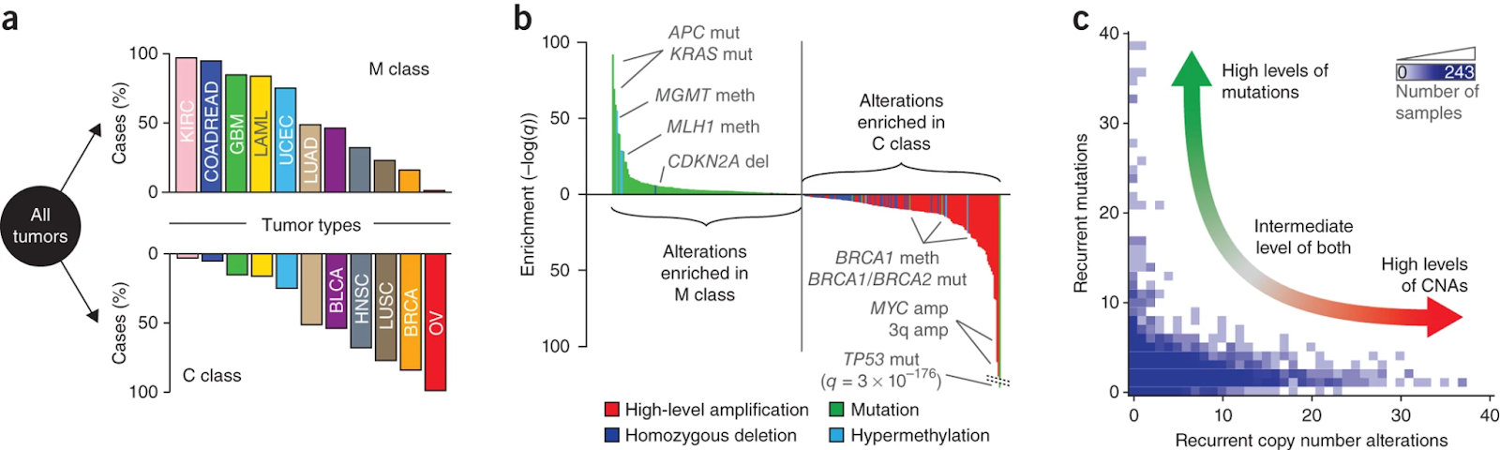
C) Lineage specific aspects
C1) The selection for Y chromosome loss is cancer type independent.
Background: Y chromosome loss rates vastly differ across different cancer types (range: 12 - 58%). Moreover, we observe several cancer types where the selection rate for Y chromosome loss vastly differs between primary or metastatic samples. At this stage we can exclusively speculate about the genomic background
https://www.nature.com/articles/ng.2762#MOESM75

Slide 6
Tumor suppressive function of KDM6A?
C3) KDM6A protects against bladder cancer in females
Background: KDM6A is a lysine demethylase located on the X chromosome. One particular study (Kaneko and Li, Sci. Adv. 2018; 4: eaar5598) claims that KDM6A acts as a sex-specific tumor suppressor (Ubiquitination and Chromatin modification). KO of mouse Kdm6a reduces expression of Cdkn1a and Perp, canonical gene targets of the tumor suppressor p53. Consistently, loss of Kdm6a increases BCa risk in female mice, and mutations or reduced expression of human KDM6A predicts poor prognosis of female BCa patients.
C4) KDM6A (Chr. X) AND UTY (Chr. Y) inactivation are required to achieve adverse effects in males with bladder cancer
Background: UTY is a homologous gene of KDM6A residing on chromosome Y. We claim that either one of the homologous genes can rescue the deleterious effect of inactivation of its counterpart.

Slide 7
D) Cancer biology aspects
D1) KDM6A regulates p53 signaling
Background: See above. Reduced/missing KDM6A lead to reduced expression of CDKN1A (G1 arrest, quiescence) and PERP (apoptosis) which are direct targets of TP53. CDKN1A (p21) is a direct target of p53 which, upon activation, keeps cells at a quiescent state and hence hinder the propagation of deleterious genetic material (https://www.nature.com/articles/nrc3711).
D2) Male patients with Klinefelter syndrome (> 1X) show prolonged OS
Background: The genotype of Klinefelter syndrome mimics a female genetic setup. As the argument above highlights - females are less likely to develop bladder cancer - we would expect that male patients, even with an Y chromosome loss, show an equal survival curve than females.

Slide 8
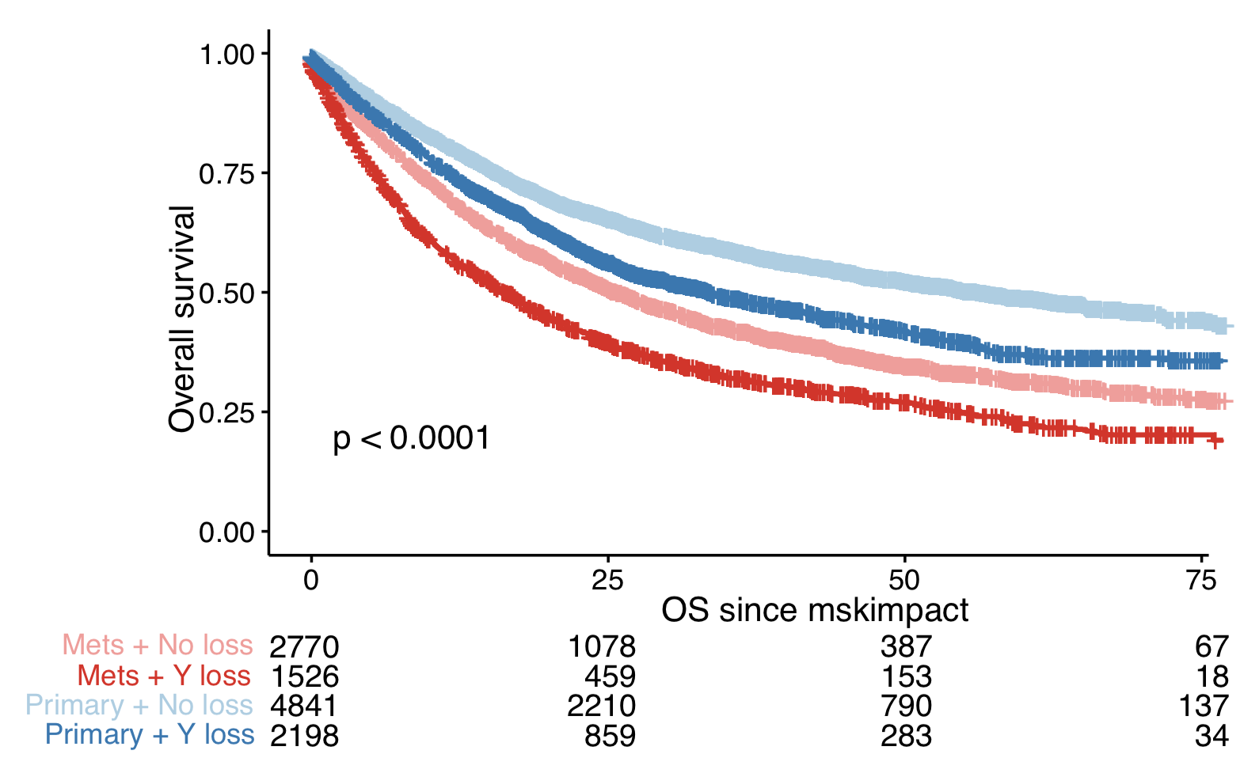
E) Methodological and statistical aspects
E1) Logistic regression. The model formulation (either: Gene ~ ChrY [...] or: ChrY ~ Gene [...]) does not influence the conclusions.
Background: Compare these two models and assess the accuracy of both via i) Goodness of fit and ii) deviance check. Moreover, elaborate on this topic and create a running vignette which can be shared with all lab members (especially Francisco’s concern)
E3) How does an unequal sample size (i.e. unequal contribution of different cancer types in OS analysis) influence the overall Kaplan-Meier curve?

Slide 9
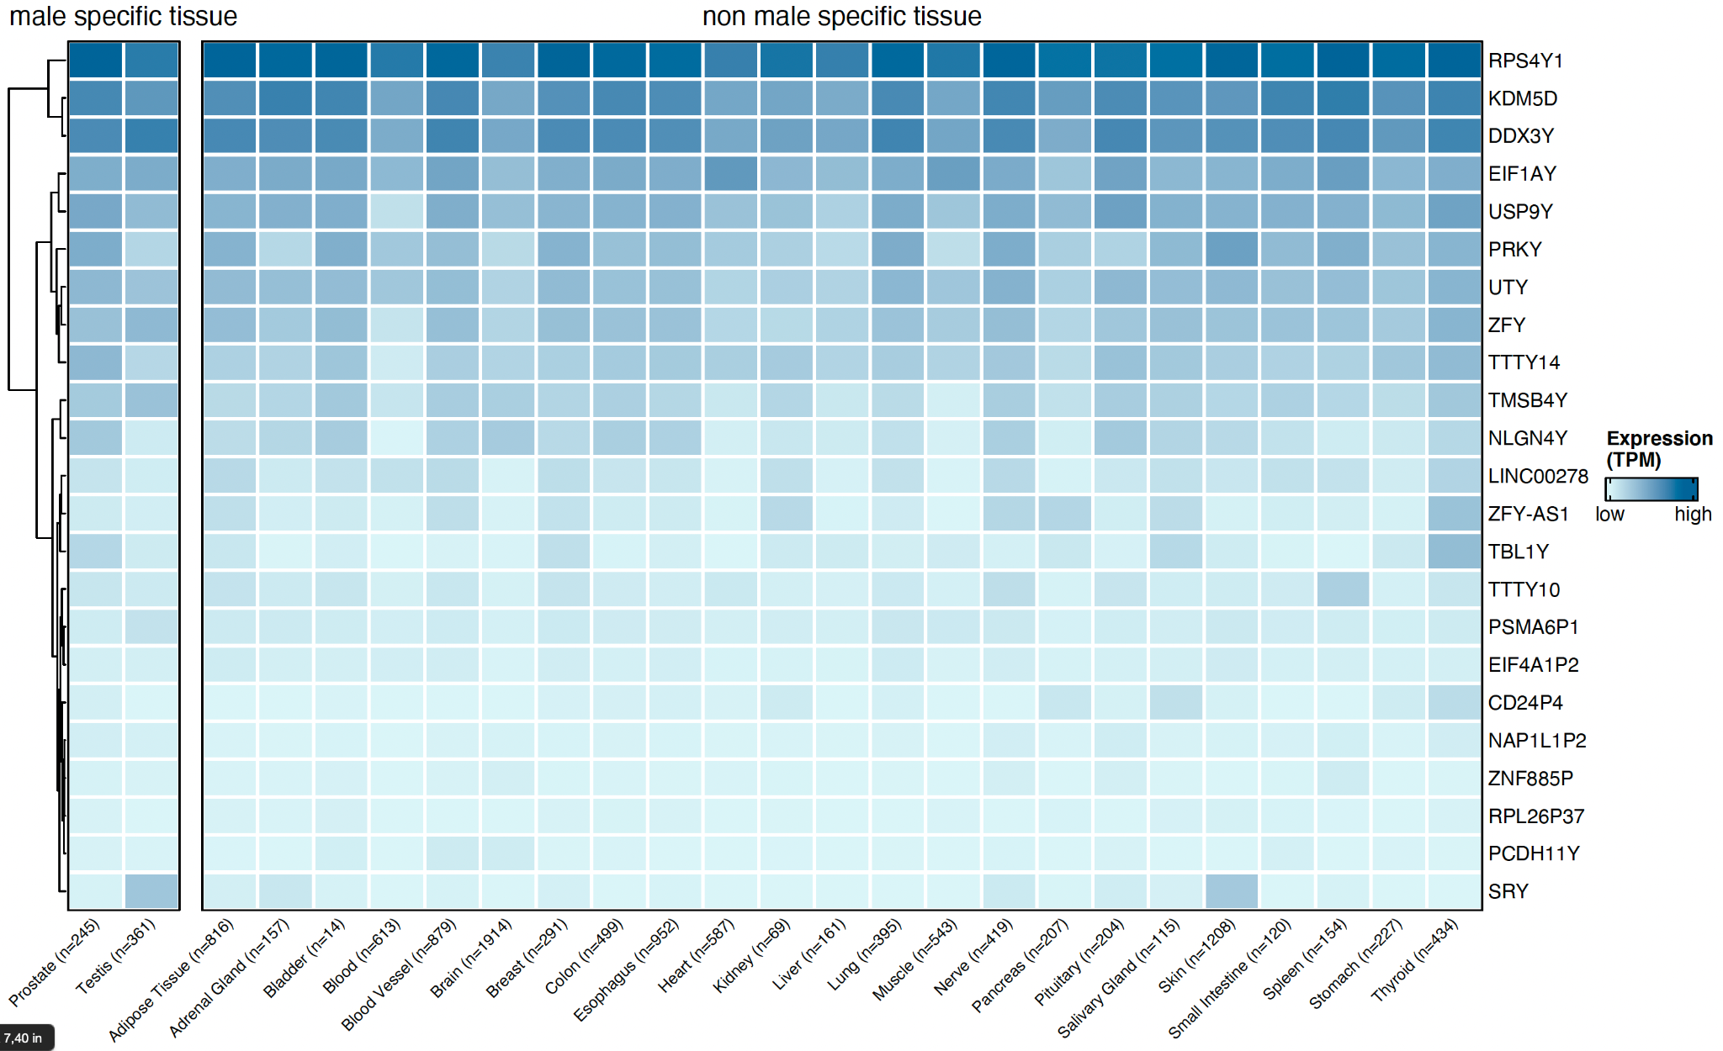
Reducing the number of genes?

