Slide 1
Project Architecture
Team: EncoreLite

Slide 2
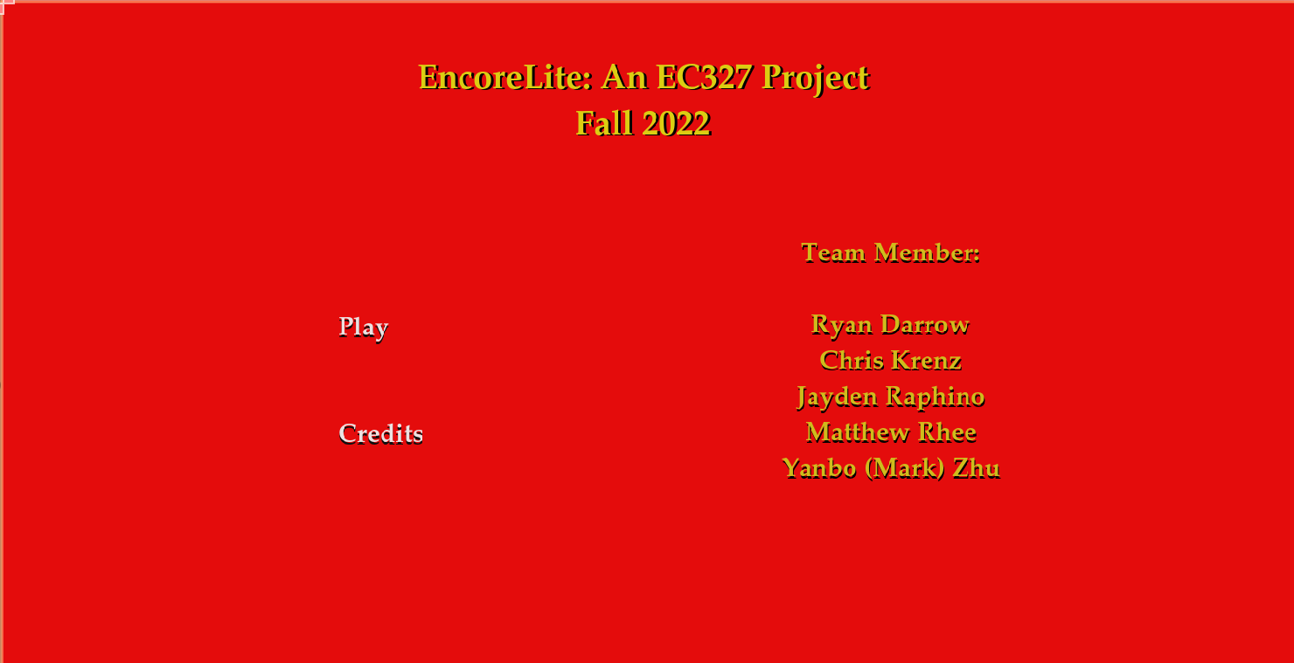
Title Screen: The Visuals
There are two interactive buttons here:
Play: Brings up the Slot Machine scene.
Credits: Brings up the Credits scene

Slide 3
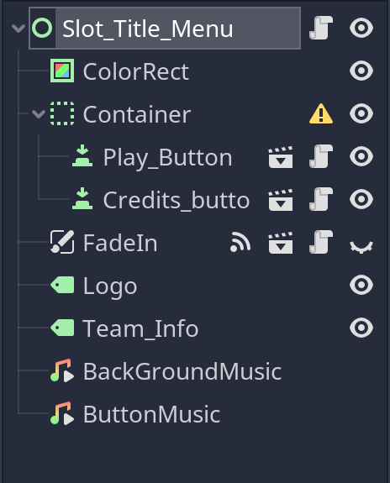
Title Screen: Behind the Scene Structures
Slot_Title_Menu: Holds the main script of the screen, which contains the appropriate functions to call either the Play Button, Credits Button, or FadeIn function.
Container: Object used to hold the Play Button and Credits Button Scripts
FadeIn: A link to the FadeIn.gd script, which is needed so the Slot_Title_Menu can call the FadeIn function when changing scenes

Slide 4
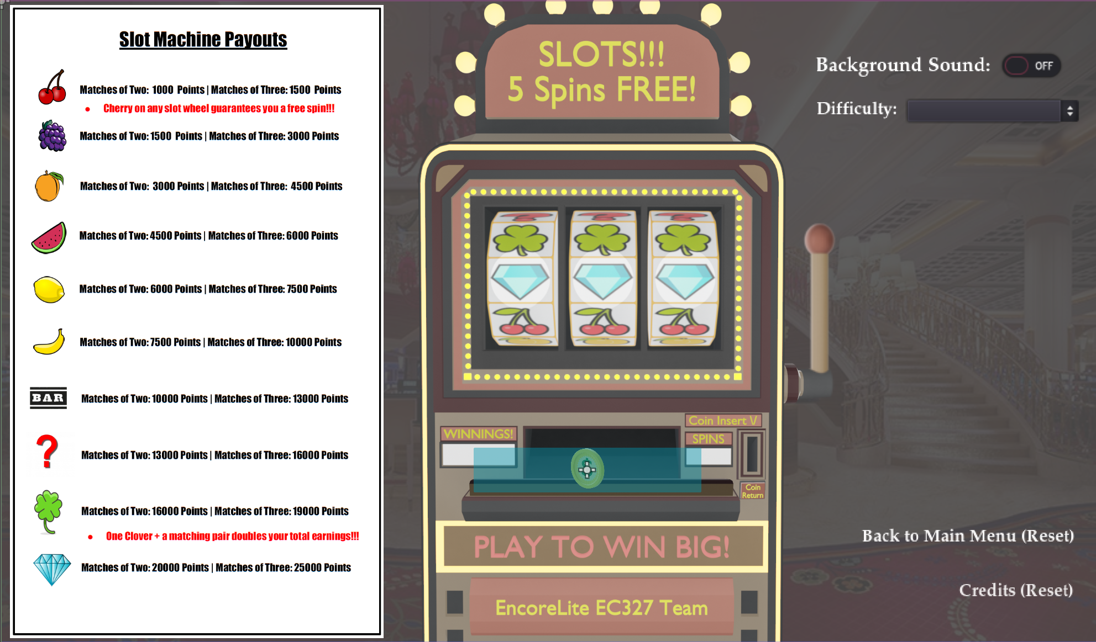
Slot Machine Screen: The Visuals
Interactive lever the User can pull down
Interactive Coins the User can insert into the Slot Machine
Toggle Button to turn on/off background music
Dropdown menu to select Difficulty
Buttons to return to Main Menu and go to Credits. Both reset the game

Slide 5
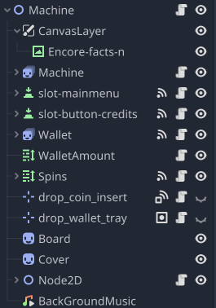
Slot Machine Screen: Behind the Scenes Overview
Once the player selects play scene, it automatically changed to the slot machine.
It does following jobs:
1.Creates the background, payouts pictures, slot machine and return to menu and credits options
2. Setup Machine, wallet, and coin’s Node2D
3. Plays background music and playing sound effect

Slide 6
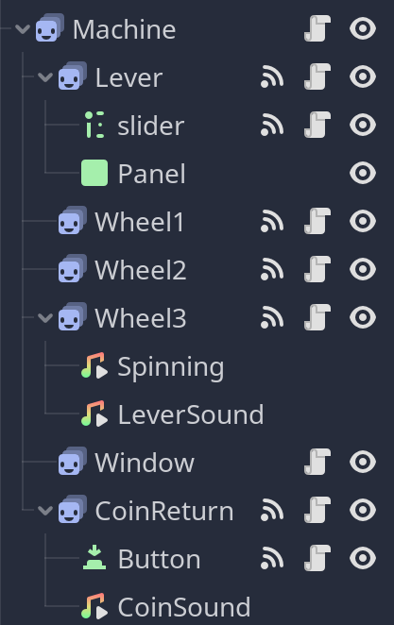
Slot Machine Screen – Machine:
Contains the Machine script, which initializes the other functions associated with overall machine logic (Lever, Wheels 1-3)
Lever: Controls the movement of the lever down. When pulled, sends a signal to the wheels to begin spinning
Wheel(1-3): When it begins spinning, a random number between 0-9 is generated. This result is stored, then the results for all three wheels are sent to the Wallet to calculate winnings

Slide 7
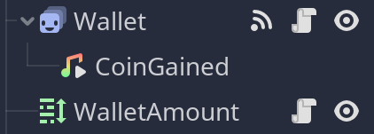
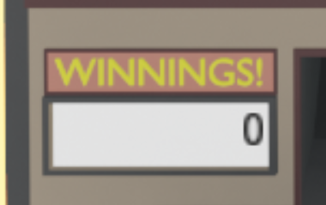
Slot Machine Screen – Wallet:
Background:
Used to hold the value of the User winnings
Receives the values of the 3 wheel spin result variables, then uses a dictionary to determine the appropriate payout.
After updating the variable for winnings, the visual display is updated to reflect the changes
User Visual

Slide 8
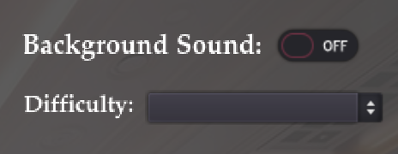
Slot Machine Screen – Sound Toggle and Difficulty Selection:
Toggle menu that has ON/OFF for the background music. Turning it on calls the BackgroundMusic.play() function.
When a dropdown is selected, it sends a signal to the machine to change the variable “difficulty” used by the wheels to generate the range of possible random numbers used.

Slide 9
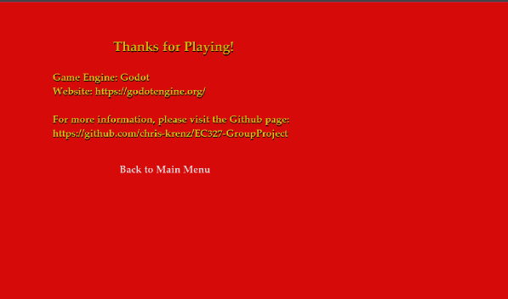
Credit menu:
Back to Main Menu buttons calls function to change to Title Screen

Slide 10
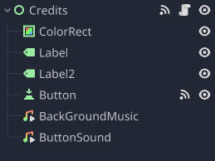
Once the player selects credit scene, it will automatically change to credit page.
It does following jobs:
Creates the background, credit text, and return to menu options
Setup a button to be used for returning to menu.
Plays background music and playing sound effect

Slide 11
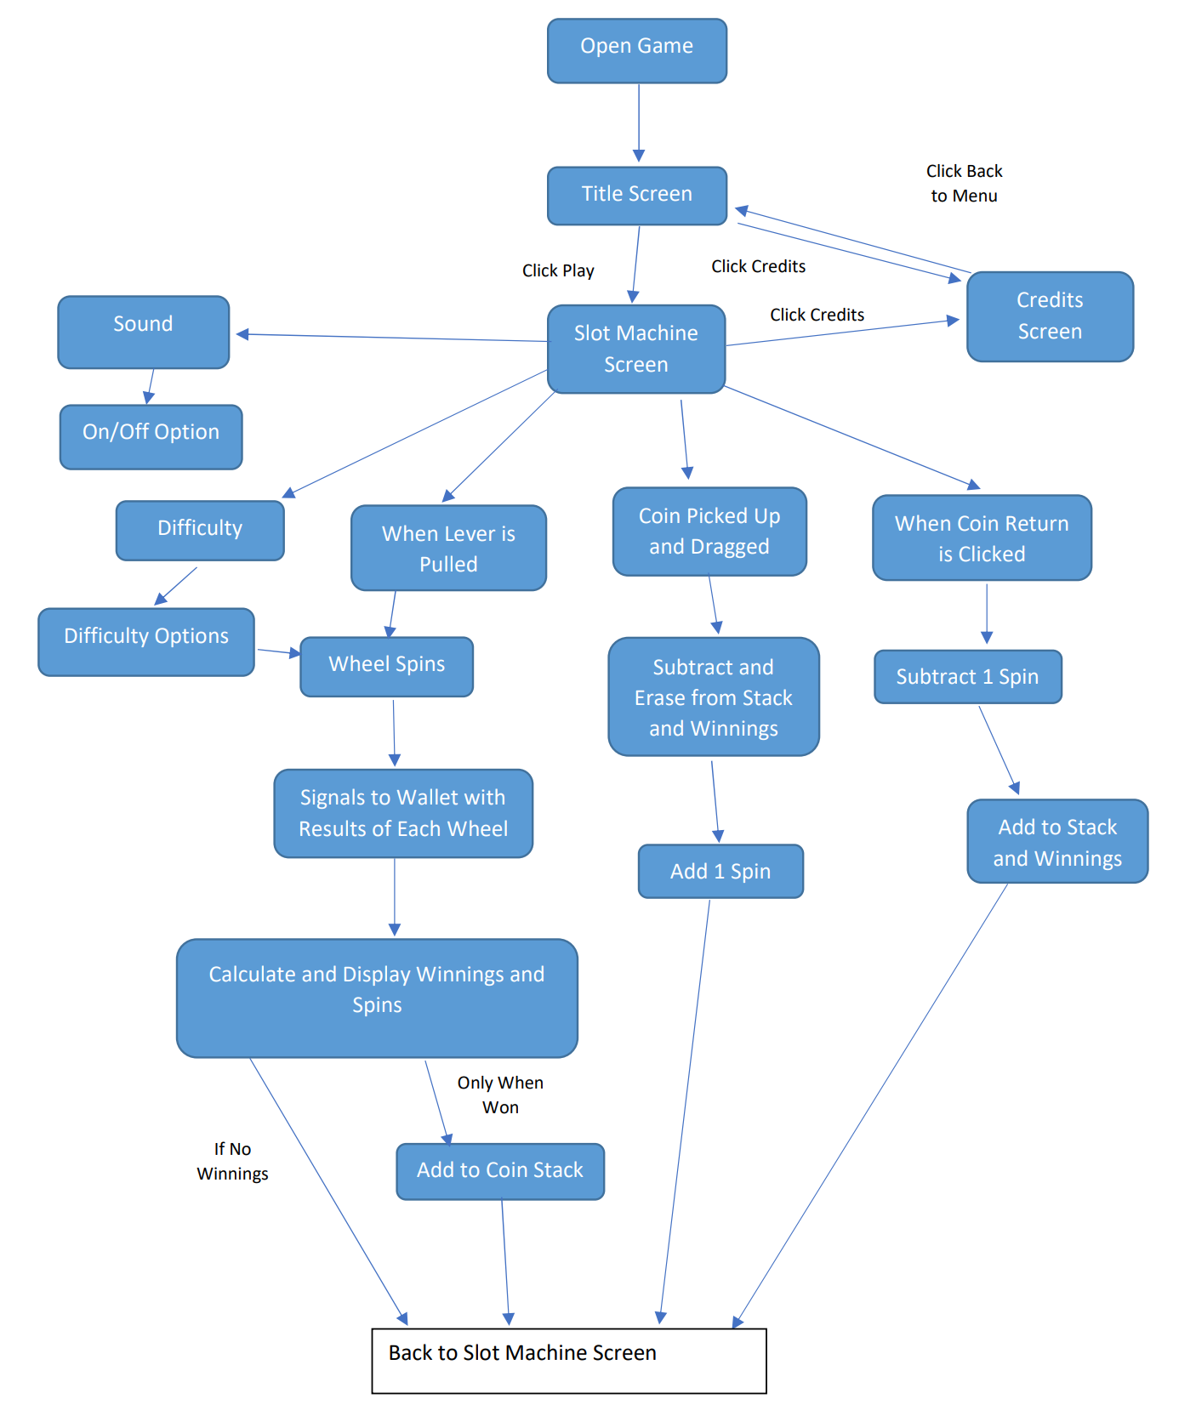
Control Flow:

