Slide 1
Volumetric Fog
Chris Kwakman

Slide 2
The Problem:
We must find a way to determine how perceived light interacts with fog.
Fog density may vary i.e. due to height attenuation and noise.
Cannot use simple depth-based attenuation to mimic simple fog of uniform density.
Fog must be able modifiable to artistic preference.

Slide 3
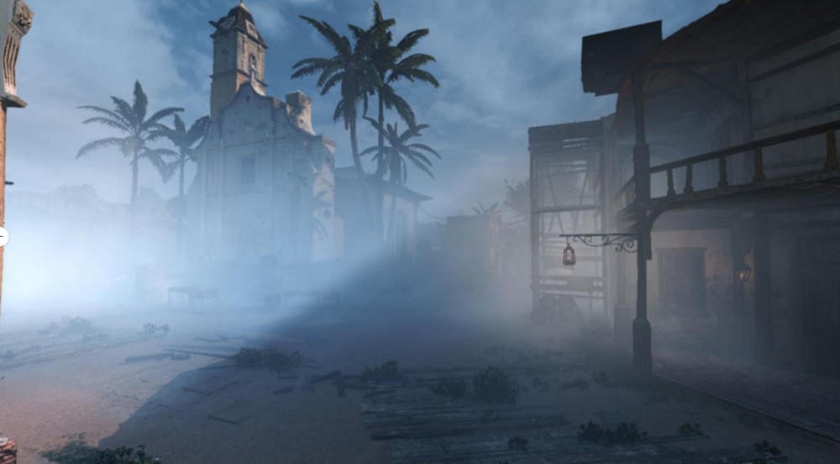
Solution: Volumetric Fog

Slide 4
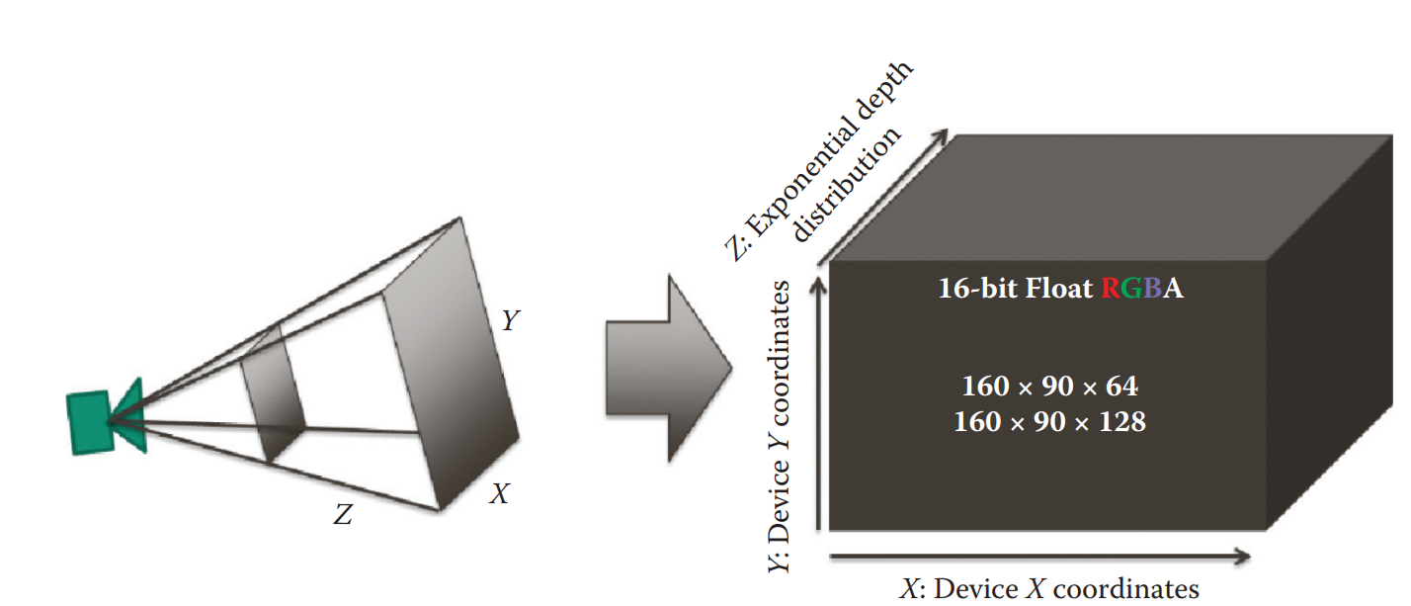
Volumetric Fog
Computed in three phases:
Density Pass
Compute fog density
In-scattering Pass
Compute how light bounces towards camera from light sources
Accumulation Pass
Quantify how much light bounces towards camera.
Compute in space contained in camera frustum.
We sample a grid of points in frustum space.
This means we need 3D volumetric textures, one for each pass.

Slide 5
Density Pass
Determine density of fog in frustum space.
Transform eye space position into 3D fog texture UV coordinates.
Fog density can vary in world space due to many factors.
Height attenuation (fog particles are heavier than air)
Perlin noise (variation of density in world space)
Can change over time as well
Other gameplay elements
I.e. wind, fog repulsion elements, etc…
Only required step in this pass is that desired fog density value must be multiplied by slice depth of sampled position in eye space.

Slide 6
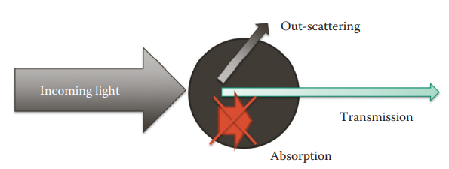
In-scattering Pass
Compute the quantity of light scattered in direction of camera for every source of light.
Affected by three factors:
Phase Anisotropy
Scattering Coefficient
Absorption Coefficient

Slide 7
Accumulation Pass
Combine the previous two steps

