Slide 1

Modeling Home Prices Using A Multiple Linear Regression Model
Chris Machado

Slide 2

Introduction
How much is a home worth?
Using historical data, it is possible to predict what a house will sell for.
I will show you how I built a linear regression model that made 100 predictions with 84% accuracy to include:
Obtaining the data and examining its quality
Repairing reformatting the data as needed
Identifying correlations from previous sales
Parameters for constructing several prototype models
Testing the prototypes using from real records
*Please add slides as required.

Slide 3
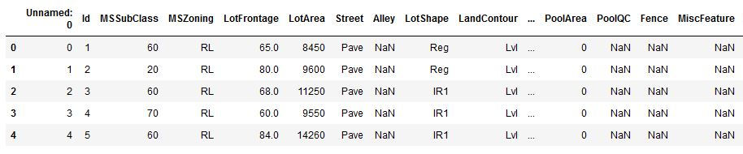
The Data
The dataset was provided by Dr. John Williams
Contained records of Boston home sales from 2006 to 2010
Two files to both train and test the model
100 records in each file
75 data points for each home sold
*Please add slides as required.

Slide 4
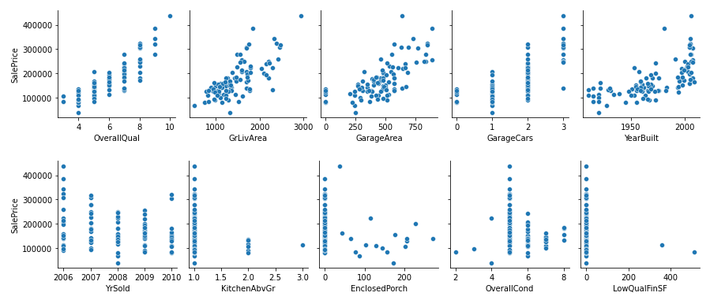
Data Exploration
Identify home features that correlate to the sale price
Correlated variables show a linear relationship when compared to price
Overall quality, size, and year built show distinct correlation
Negatively correlated variables show downward trends in sale price
Year sold shows negative correlation
Kitchen, enclosed porch, and low quality finish show downward trends, but lack data points to be conclusive

Slide 5
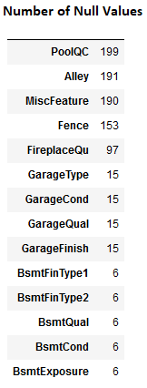
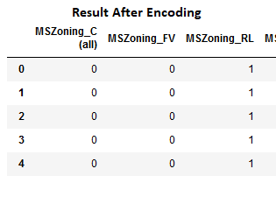
Data Preparation
The Categorical Data
Identify missing or null values
Too many missing for pool, alley, and misc – delete these columns
Fill the rest with “NA” to indicate not applicable
Qualitative data must be converted into numbers for model processing
Done through process of encoding
Result is additional columns with 1’s and 0’s representing qualitative features

Slide 6
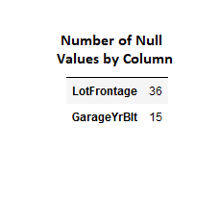
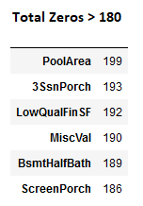
Data Preparation
The Numerical Data
Identify missing or null values
Fill in lot frontage missing data with average value in dataset
Assume 15 lots don’t have garages
A value of 0 for year built would heavily skew the data
Use the dataset minimum (1900)
Excessive zeros indicate lack of data
Use 10% as threshold (180 of 200)
Delete columns not meeting threshold

Slide 7
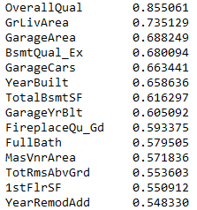
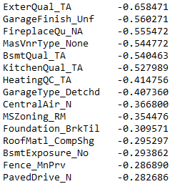
Correlation
Correlation coefficients measure how much a feature affects sale price
Good indication which variables add skill to a model
Range is from -1 to 1
Correlated
to Sale Price
Inversely Correlated
to Sale Price
Values closer to 1 represent strong correlation
Values closer to -1 represent strong inverse (or negative) correlation
Values closer to 0 indicate no correlation

Slide 8
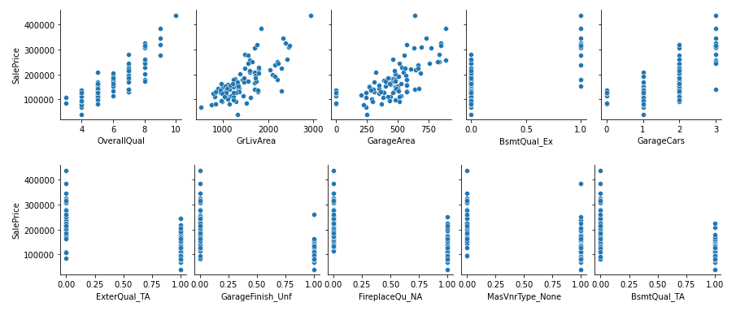
Correlation
Encoding categorical data provides additional variables might otherwise be overlooked
Excellent basement quality is reflected in the price
Downward trends are clear evidence of inverse correlation in the descriptive data

Slide 9

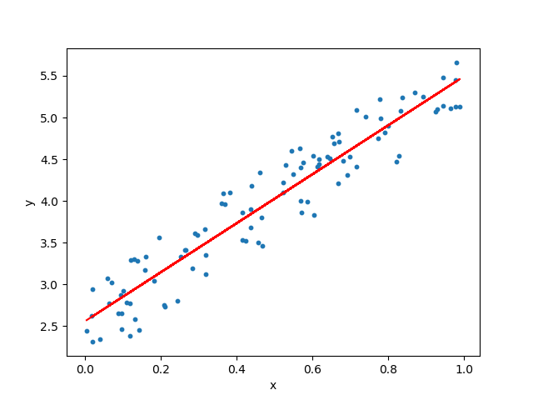
Project Description
Why Multiple Linear Regression?
Variables identified show a linear trends
There is a single dependent variable (sale price)
Multiple independent variables (home features)

Slide 10
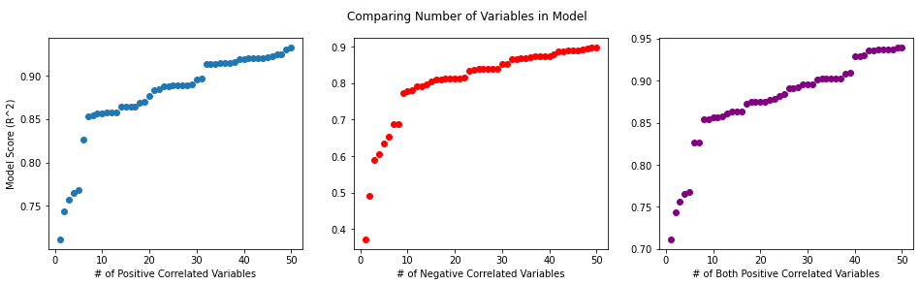
Analysis and Results
Experiment by adding correlated variables to model and measure performance
Largest skill gains observed with addition of first 7-10
Marginal improvement beyond 10 variables
Certain features add more skill than those with similar correlation coefficients

Slide 11
Analysis and Results
Four Prototypes
Model 1: The top 15 correlated variables
Model 2: The top 15 correlated when absolute value of negative correlated are considered
Model 1
OverallQual
GrLivArea
GarageArea
BsmtQual_Ex
GarageCars
YearBuilt
TotalBsmtSF
GarageYrBlt
FireplaceQu_Gd
FullBath
MasVnrArea
TotRmsAbvGrd
1stFlrSF
YearRemodAdd
ExterQual_Gd
Model 2
OverallQual
GrLivArea
GarageArea
BsmtQual_Ex
GarageCars
YearBuilt
ExterQual_TA
TotalBsmtSF
GarageYrBlt
FireplaceQu_Gd
FullBath
MasVnrArea
GarageFinish_Unf
FireplaceQu_NA
TotRmsAbvGrd

Slide 12
Analysis and Results
Model 3: 7 most correlated, 7 most inversely correlated, and the addition of no central air observing a marked improvement when added previously
Model 4: Variation of model 3, removed number of car garages, then added brick face masonry veneer and good exterior quality noting change in model improvement previously analyzed
Model 3
OverallQual
GrLivArea
GarageArea
BsmtQual_Ex
GarageCars
YearBuilt
TotalBsmtSF
ExterQual_TA
GarageFinish_Unf
FireplaceQu_NA
MasVnrType_None
BsmtQual_TA
KitchenQual_TA
HeatingQC_TA
CentralAir_N
Model 4
OverallQual
GrLivArea
GarageArea
BsmtQual_Ex
MasVnrType_BrkFace
YearBuilt
TotalBsmtSF
ExterQual_TA
GarageFinish_Unf
FireplaceQu_NA
MasVnrType_None
BsmtQual_TA
KitchenQual_TA
HeatingQC_TA
CentralAir_N
ExterQual_Gd

Slide 13
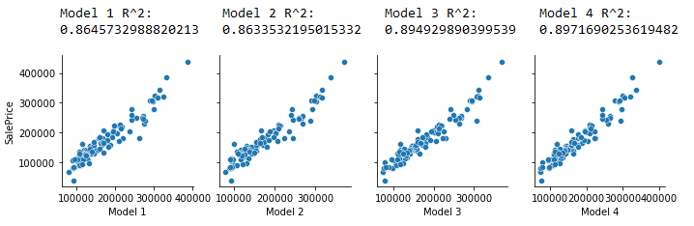
Analysis and Results
R^2 is a measure of the proportion of all independent variables have on the sale price as a percentage
All models indicate good performance above 86%
Models 3 and 4 indicate 3% better accuracy
Plotted predictions all show tightly grouped linear repationships

Slide 14
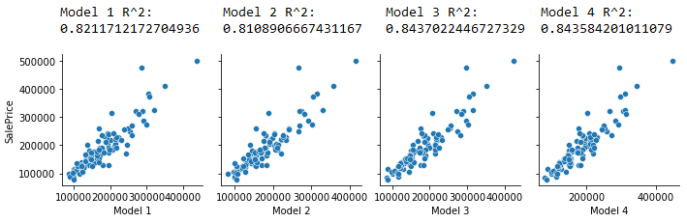
Verification
Subject each model to the test dataset
Overall performance not as good as estimated, but all models still show decent skill above 81%
As expected, models 3 and 4 perform similarly and better than 1 or 2 with 2-3% better accuracy
Plotted predictions all show definitive linear relationships but observe a bit more variance

Slide 15

Conclusion
Model 3 selected as winner with 84% accuracy
and only 15 variables
This proves a predictive model can be built using historical data
Preparing the dataset was essential for revealing qualitative data correlating to sale price
Identifying linearly correlated variables was critical for model design
Linear regression techniques are applicable in this application since we are only concerned with one dependent variable (sale price)

Slide 16
References
Agarwal, Animesh. “Linear Regression using Python.” Medium. (2018) https://towardsdatascience.com/linear-regression-using-python-b136c91bf0a2
Dean, Andy. “Sold Home For Sale Real Estate Sign and Beautiful New House.” Andy Dean Photography – fotolia. https://www.ctinsider.com/realestate/article/Bridgeport-New-Haven-housing-markets-cooling-17312154.php
LaMorte, Wayne. “The Role Of Probability – Central Limit Theorem.” Boston University of Public Health. (2016). https://sphweb.bumc.bu.edu/otlt/mph-modules/bs/bs704_probability/BS704_Probability12.html
Lane, Dennis. “Prices are higher and houses for sale are fewer.” Dennis Lane/Getty Images. https://www.businessinsider.com/how-much-you-have-offer-buy-house-above-asking-price-2021-3
McKinney, Wess and Kluyver, Thomas. “Pandas: Powerful Python Data Analysis Toolkit.” Version 1.4.3. The Pandas Development Team. (2022). https://pandas.pydata.org/docs/pandas.pdf
Pedregosa, F., Varoquaux, G., Gramfort, A., Michel, V., Thirion, B., Grisel, O., Blondel, M., Prettenhofer, P., Weiss, R., Dubourg, V., Vanderplas, J., Passos, A., Cournapeau, D., Brucher, M., Perrot, M. Duchesnay, E. “Scikit-learn: Machine Learning in Python.” JMLR, Vol 12. (2011) pp. 2825-2830.
Radovanovic, Igor. “Sklearn – An Introduction Guide To Machine Learning.” Algotraining101. (2021). https://algotrading101.com/learn/sklearn-guide/

