Slide 1


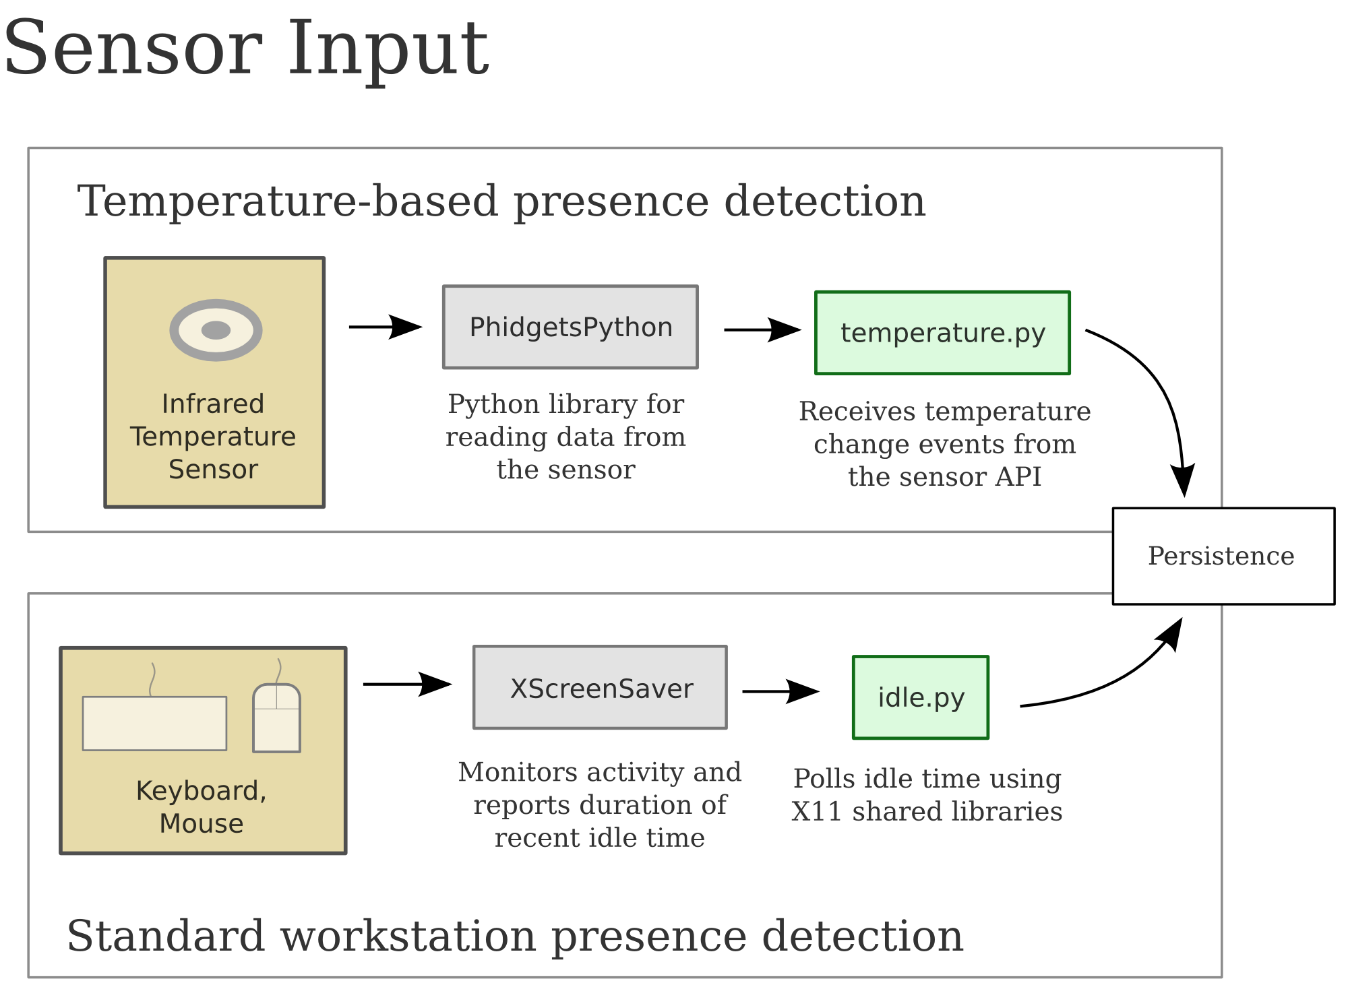
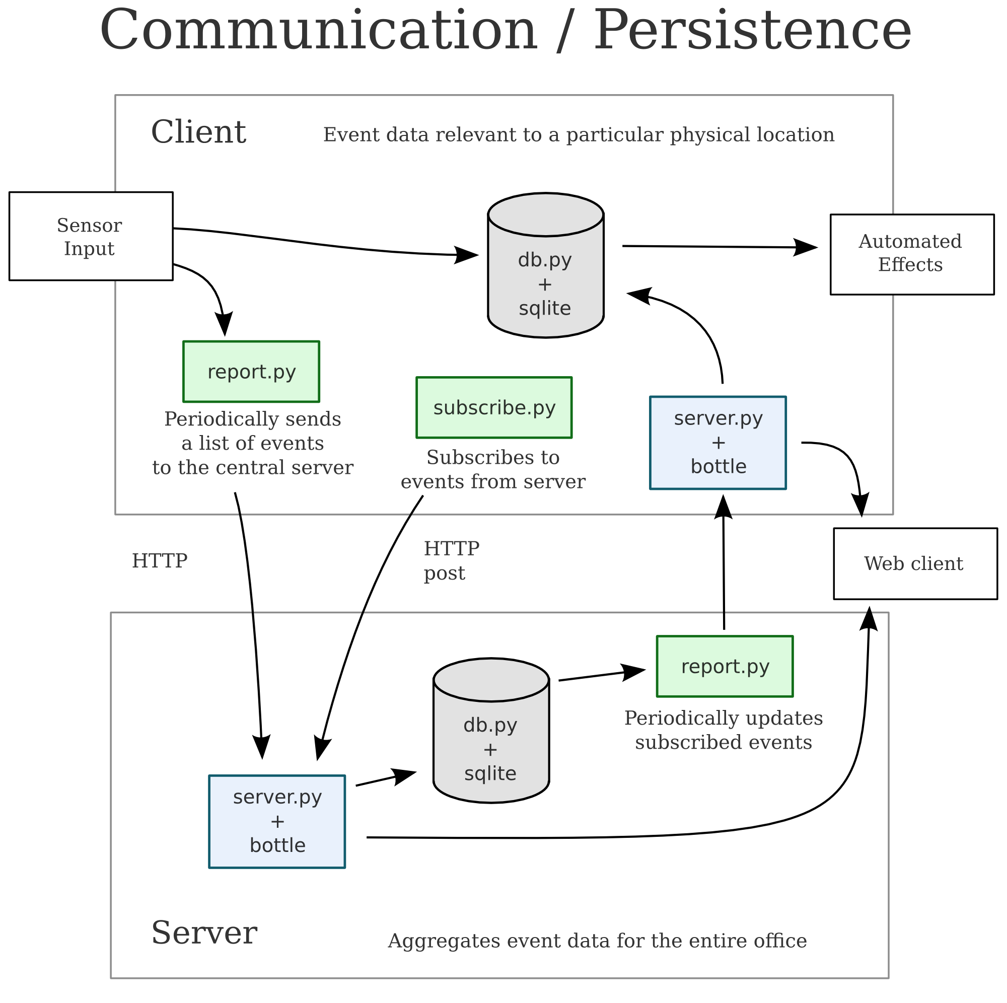
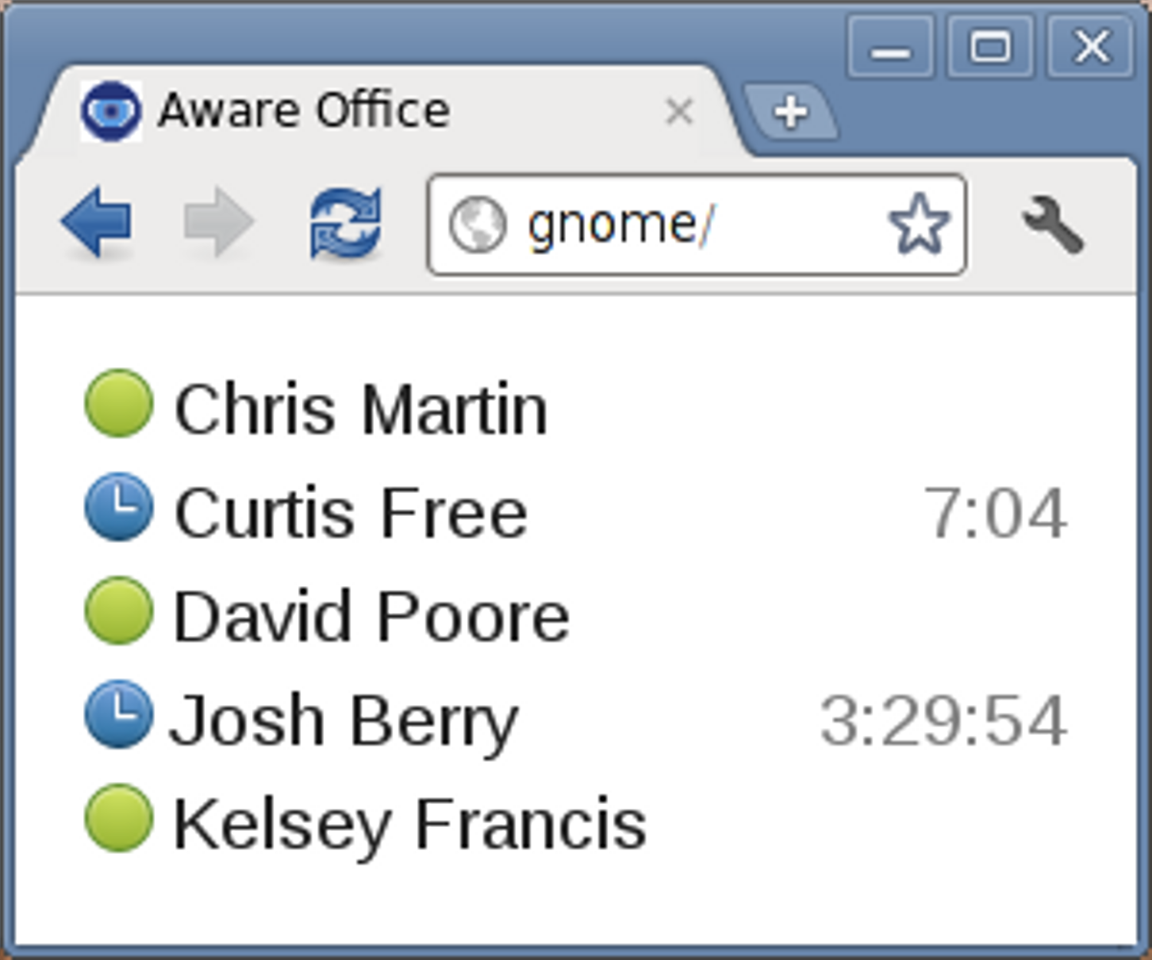
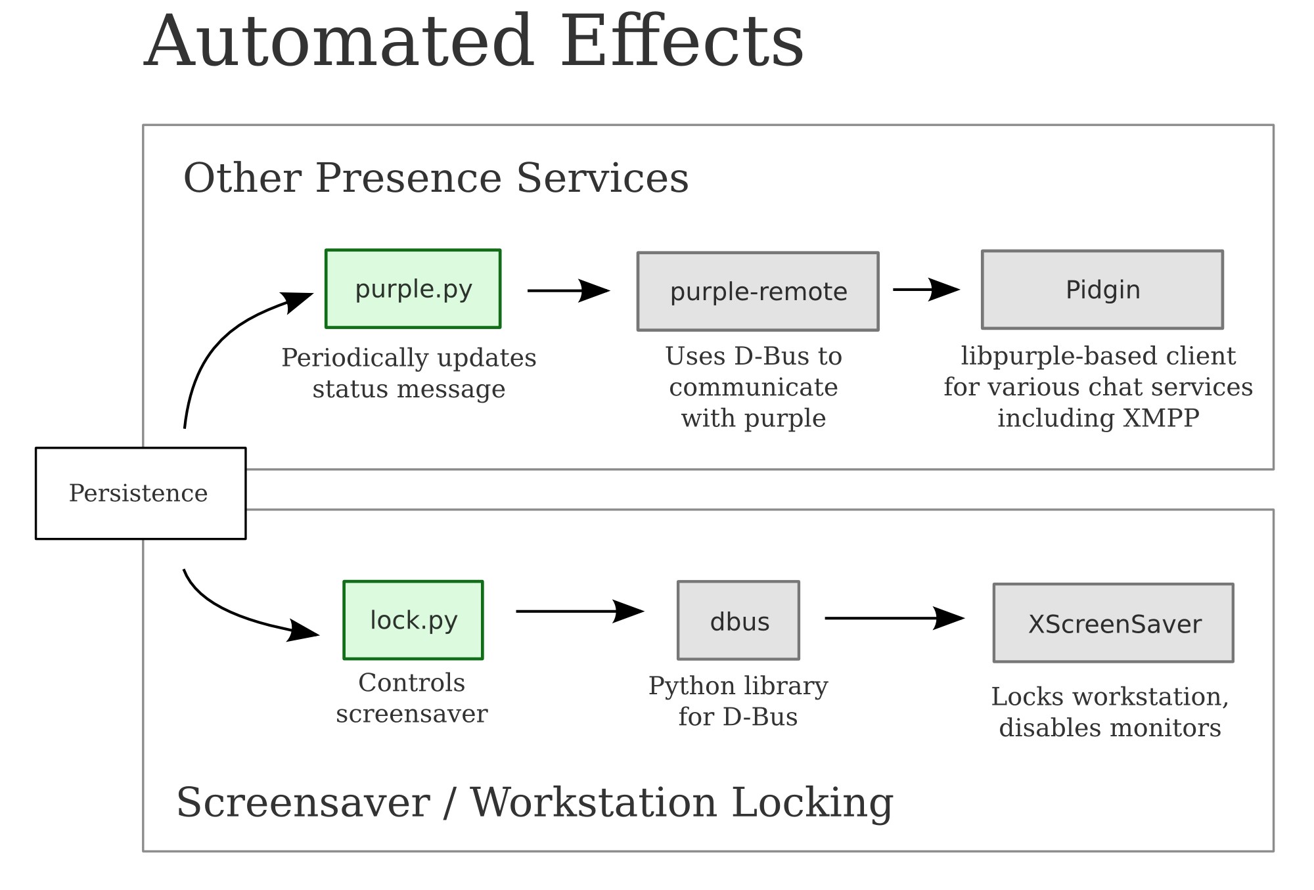
Aware Office
Make your presence known.
Overview
Architecture
Targets medium-to-large organizations
Facilitates collaboration
Boosts productivity
Promotes security
Priced at about $200 per seat
IR temperature sensor
  Phidgets Inc.
  Cost $75/ea. in bulk
  USB interface
  Python library
Keyboard/mouse
activity
Business Viability
Detect presence of personnel
Enhance presence services
Use Case: Team Agility
Install Aware Office sensor at each employee workstation
Automatically update Jabber status and lock screens
Keep screens from being locked when sitting at desk but not actively using workstation
Coworkers don't waste time walking to each others' offices to find that one one is there
Collect events in database
Standalone or paired with central server
Link multiple workstations under one identity
JSON over HTTP
Next Steps
Windows/Mac client
Address security/privacy concerns
Additional/different sensors
  Sonar
  Chair seat force
Nicer packaging for IR sensor
  Flexible mounting options
  Wireless
  On-board computer (Raspberry Pi)
    PoE
Set IM status
Lock screen
Kelsey Francis (francis@gatech.edu), Chris Martin (chris.martin@gatech.edu), David Poore (dpoore3@gatech.edu)
www.cic.gatech.edu

