Slide 1
Agile Software Project Management
Project Management
Project Planning

Slide 2
Project Management
Goals
  Software delivered within budget
  Software delivered within schedule
  Software is built according to requirements
Why?
  Well-managed projects sometimes fail
  Badly managed projects inevitably fail
  Software development process is not standardized

Slide 3
Project Manager’s Dilemma
CHEAP
GOOD
FAST
YOU CAN ONLY HAVE TWO!!!!

Slide 4
Project Managers Rectangle
Resources
Quality
FEASIBLE ZONE
Schedule
Features
Notes:
For 3911, resources are pretty set (3-5 people)
Schedule is set very firm (end of semester)
Quality is somewhat set (grading criteria)
The flexibility you have is feature set. (Scope)

Slide 5
Project Planning Process
Sommerville, 1995
  Establish the project constraints
  Make initial assessments of the project parameters
  Define project milestones and deliverables
  while project has not been completed or cancelled loop
  Draw up project schedule
  Initiate activities according to schedule
  Wait ( for a while )
  Review project progress
  Revise estimates of project parameters
  Update the project schedule
  Re-negotiate project constraints and deliverables
  if ( problems arise ) then
  Initiate technical review and possible revision
  end if
  end loop

Slide 6
So how do we do this?
Spend time understanding the problem
Estimate amount of effort required (This is hard!!)
  Number of major functions
  Difficulty of each function
Develop schedule with built in safety nets
  Increase estimates by some factor
  Have a backup plan for worst case
  Make sure schedule is realistic
Revise schedule as project understanding increases

Slide 7
Some Historical Figures (Small Projects)
Architecture/Design 10%
Detailed Design 20%
Code/Debug 25%
Unit Testing 20%
Integration 15%
System Test 10%
Not including administration, planning, documentation...

Slide 8
Scheduling
Dependencies
What has to be done before I can start this activity?
Governs sequencing

Slide 9
Scheduling
Derived from estimated level of effort required
Don’t forget testing & integration take time too
Be realistic
  Other classes
  Outside work/activities
  Eat & sleep
Build in safety nets & backup plans
Find Critical Path
Work Leveling

Slide 10
Agile Project Management
Gantt Charts and Milestone tracking replaced by:
  Product Backlog
    List of Prioritized Features
    Estimate of time required for each feature
  Sprint (Iteration) Backlog
    Plan for 1 iteration
    Work assignment
    Tracking by feature

Slide 11
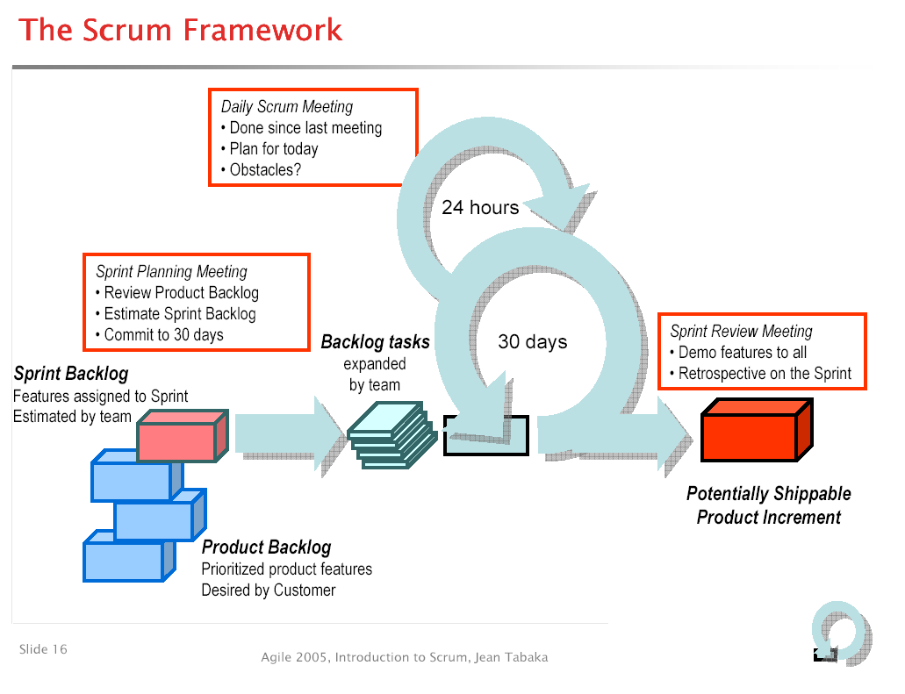
Establish
Goal of Sprint

Slide 12
Product Backlog
Transfer features from Vision to Spreadsheet
Add course requirements (presentation prep, administration)
Order by Priority – Very High, High, Medium, Low, Very Low
Estimate how long features will take to implement
Show hours remaining by Sprint

Slide 13
Product Backlog
Its not how many hours you work or project, its how many you have to go.
Task | Initial Estimate | Adjust Factor | Adjust Estimate | 1 | 2 | 3
Hide/Display burndown window | 3 | .2 | 3.6 | 3.6 | 3.6 | 0
Automatic recalculation of row/column values | 3 | .2 | 3.6 | 3.6 | 2.4 | 0
Display Product Burndown Graph | 3 | .2 | 3.6 | 3.6 | 0 | 0
Display Sprint Burndown Graph | 4 | .2 | 4.8 | 4.8 | 2.4 | 2.4
Total Remaining | 650 | 0 | 650 | 650 | 550 | 320
Product backlog shows prioritized tasks, and hours to go by sprint

Slide 14
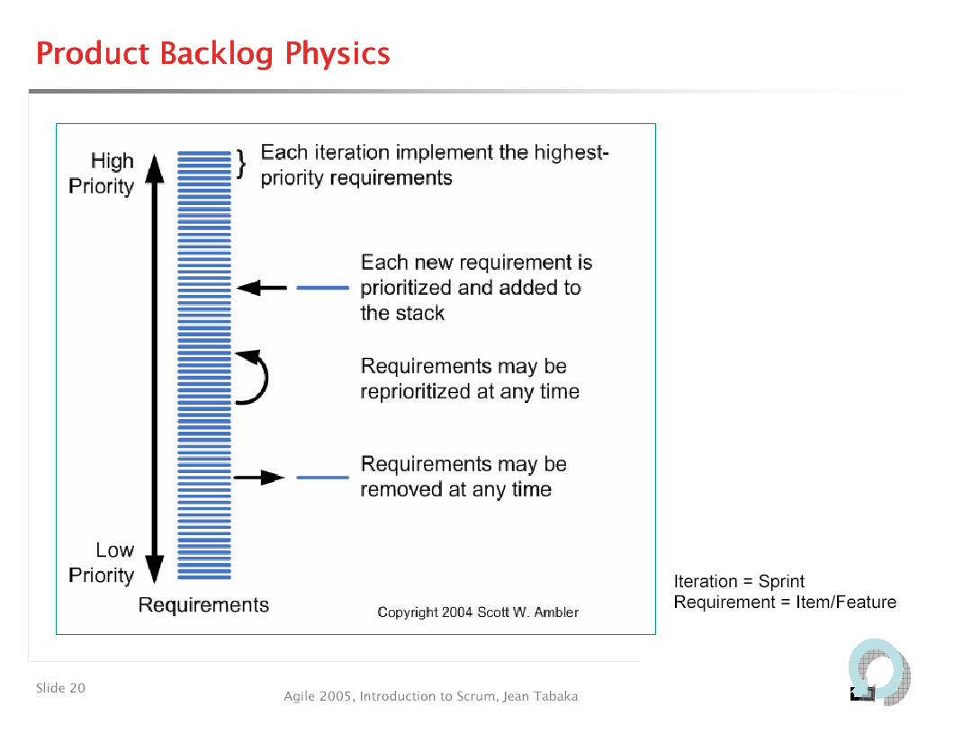

Slide 15
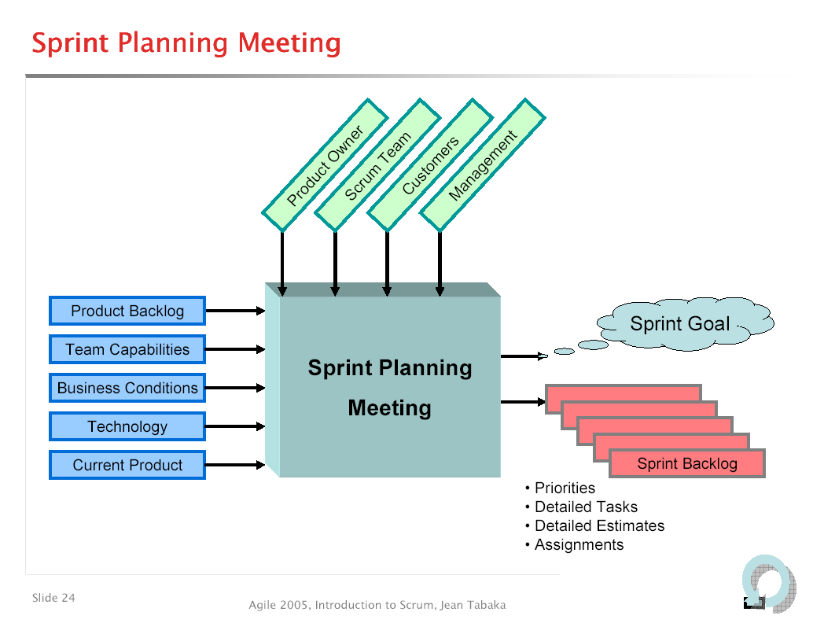

Slide 16
Sprint Backlog
Use to manage details of current Sprint (iteration)
Transfer features (task breakdown) from product backlog for just this Sprint
Assign task to specific team member (not everyone!)
Plan work by week over iteration
Track work by week over iteration

Slide 17
Sprint Backlog
Task | Responsible | Status | 1 | 2 | 3 | 4
Move Calculations out of Excel | Jim | Not Started | 10 | 10
Store PDF files in structure | Sally | In Progress | 15 | 8
Switch to JDK1.5 | Pete | Completed | 10 | 0 | 0 | 0
Install Cruise Control on Team Server | Jim | Completed | 5 | 0 | 0 | 0
LTCS Disk | Jim | In Progress | 10 | 10
Total Remaining |  |  | 450 | 300
Focus is on each persons estimate of how much work they have to go
on tasks, not how much they have done in past.
Status = Not Started, In-Progress, Completed, Canceled, Transferred

Slide 18
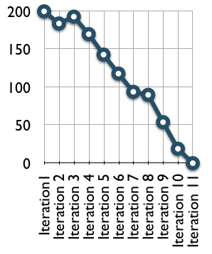
Burndown Charts
Tracks project accomplishment to completion
Provides a visual representation for project completion
Goes down when progress made, Up when estimates revised
Sharp drop usually means reduction of features.

Slide 19
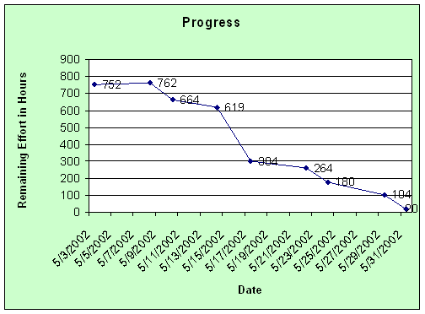
Sprint Burndown

Slide 20
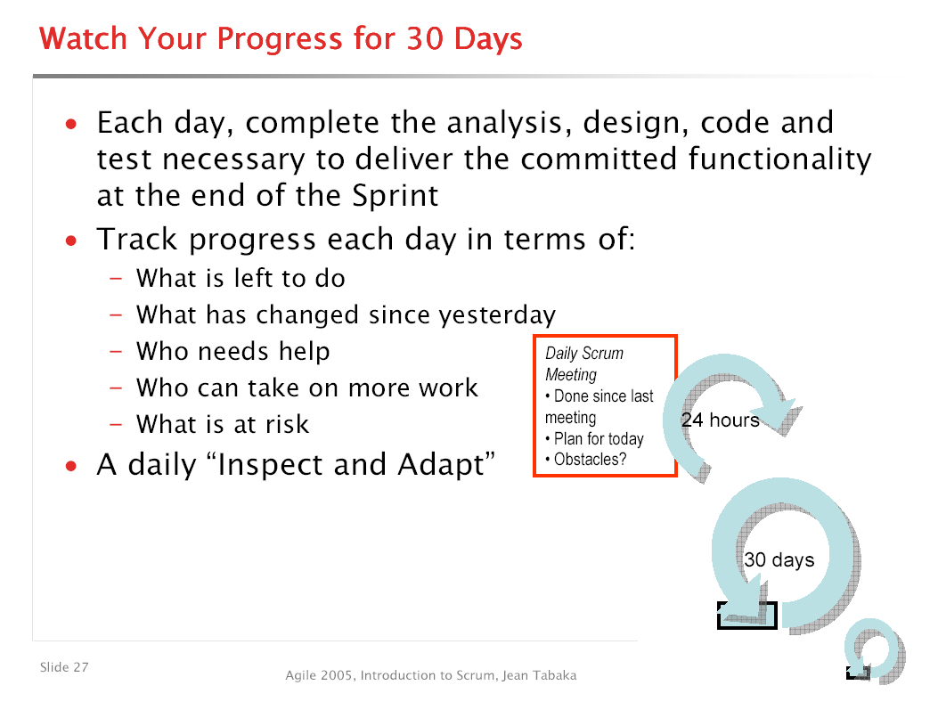

Slide 21
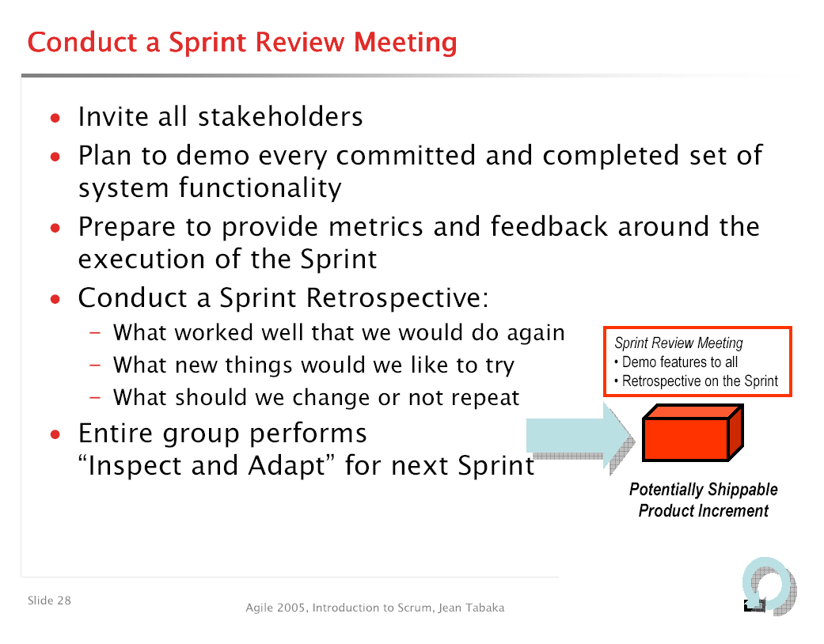

Slide 22
Sprint Length
Rules:
  No requirements changes to current sprint.
  Timebox, no change to delivery schedule
  New/Changed requirements go onto Product Backlog for next Sprint.
  Cannot slip schedule, can only remove features
  Be careful about removing too much!!! You still have to produce work.

Slide 23
Traditional PM to Backlogs
Tasks = Features
Milestones = Tracking of Sprint Backlog time period
Risk Management informal vs. formal

Slide 24
Some SCRUM Movies
http://video.google.com/videoplay?docid=4057927881115975455&q=&hl=en
http://www.youtube.com/watch?v=IyNPeTn8fpo
http://video.google.com/videoplay?docid=8795214308797356840&q=&hl=en

Slide 25
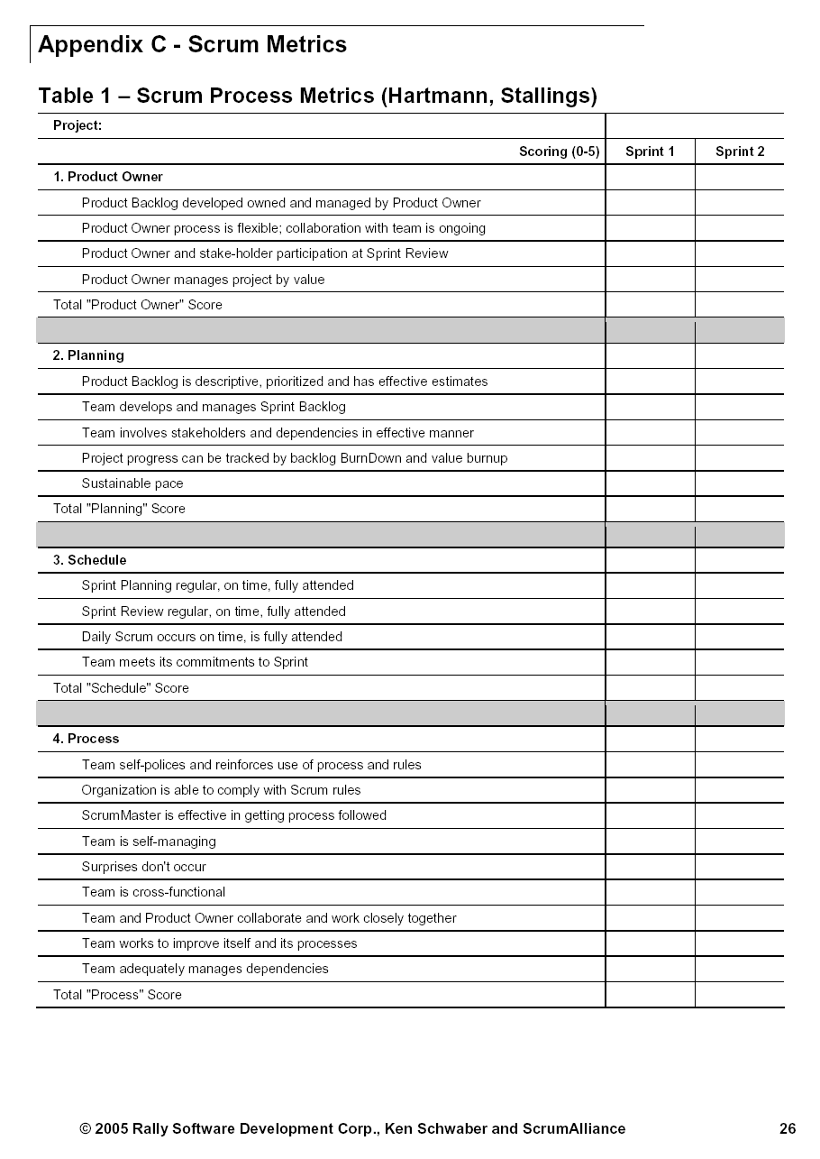

Slide 26
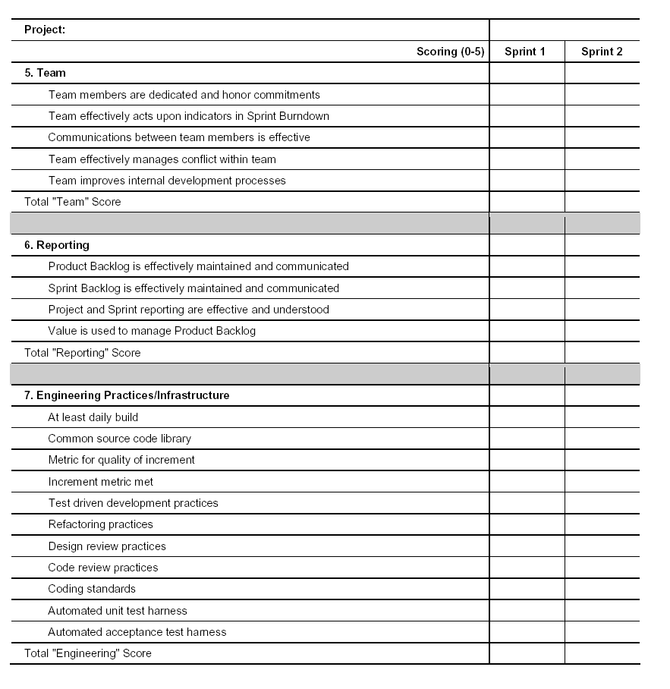

Slide 27
