Slide 1
Presentations, Project Status Reporting, and Design Reviews
CS4911

Slide 2

Agenda
Mid-Term Presentations (see webpage)
Presentation Guidelines
Sample Contents
Process Comments
Final Presentations
Design Reviews
Test Plan

Slide 3
Guidelines
Each team has 15-20 minutes for midterm, 30 mins for Sprint 2 demo/design review, 30-35 minutes for final presentations
Principle purpose of midterm is project description, design alternatives and status, and Sprint 1 demo.
Principle purpose of Sprint 2 demo is the demo and a design review
Principle purpose of final is project (Sprint 3) demo, results, and conclusions (lessons learned)
Each team member must present at least once at midterm or final presentation
Attendance at presentations mandatory, miss yours 1 letter grade (off final grade), miss others -5 pts per miss (off presentation grade)

Slide 4

Presentations
Present Positive Image
Know your audience
Develop and follow a theme (no staple together)
Open – Body - Conclusion
Careful with humor
Watch mannerisms, posture
Test your AV gear

Slide 5
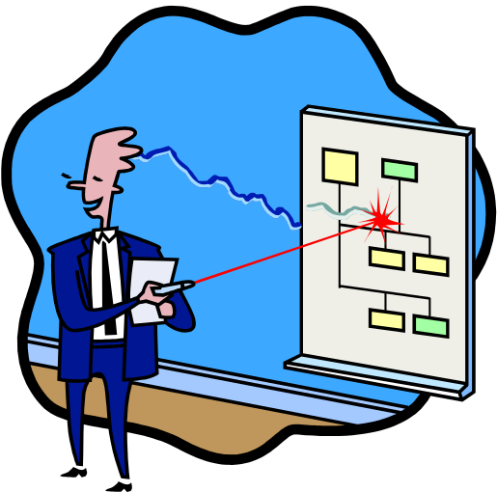
Presentations (cont’d)
Normally given by PM with support, but…
Backup slides (Anticipate Questions)
Rehearse – Stay within time limits
Leave room for questions
Be honest
Never read slides
Eye contact

Slide 6
Slides
Legibility
Images (relevant)
Avoid RANSOM notes
Avoid mixed metaphors
Check details
  Correct Spelling
  Relevant/Correct Images
  Correct Charts

Slide 7
OR
The 10/20/30 rule
  No more than 10 slides
  No more than 20 minutes
  No less than 30 pt fonts.

Slide 8
Midterm Presentation Content
(Status and Design)
Introduction of team
  Team name, customer, faculty advisor, team members, their roles
Product to be delivered (Vision)
  Customer background, product context, tangible product to be developed
  Overview of requirements
Design Alternatives, Design Selected, Rationale (Solution Approach)
Project plan (backlogs/burndown)
  Project Backlog / burndown
  Iteration 1 Backlog / burndown
Status (Backlogs/burndown)
Sprint 1 Demo (Demo)

Slide 9
A Status Report shows:
Overview of project
Planned vs. work to go (Burn Down Charts)
Other Relevant Metrics
Major Milestones Met or Missed (Burndown)
Issues
“Show Stoppers”
It is NOT a “what I did on my summer project” save that for the final presentation!

Slide 10
The Project Manager’s Cube
Schedule
Quality
Feature Set
Resources

Slide 11
Schedule (Total)
.02 to .03 Development
Planned
Actual
Projected
As of 1/15/2004
Total
Project
Current
Quarter
Hours Expended

Slide 12
Schedule (By Major Activity)
Design
Coding
Unit Test
Integration
As of 1/3/04

Slide 13
Resources (Person-Hours)
Cumulative Effort (Person Hours)
Time
Total Project
Quarter
Projected
Actual

Slide 14
Product Burndown charts
Hours To Go
1 2 3 4 5
Sprint

Slide 15
Sprint Burndown Charts
Hours To Go
1 2 3 4 5
Weeks

Slide 16
Resources (Expenditures)
Cumulative Expenditures (Dollars)
Planned
Actual
Time

Slide 17
Expenditure by Category
Salary (Base)
Overtime
Equipment
Travel
Training
Supplies
Dollars ($)

Slide 18
Features
100
Planned
Actual
Percent Complete
Reports
Security
DB Design
Feature Item

Slide 19
Defect Rate
Historical
Actual
Defects/KLOC
Time

Slide 20
Issues
Excessive Overtime Rate
Design Element 1.3 Modification
Expansion of Requirements by 25%
These should be things that are affecting your project: $, time, hours

Slide 21
Showstoppers
Issue: Main Development Server Hardware failure
Action: RAID Controller on order, expected delivery 2/12/07
Impact: DB Coding stopped for 2 weeks, Work shifted to v2 design

Slide 22
Final Presentation Content
(Design and Product)
Introduction of team
  Team name, customer, faculty advisor, team members, their roles
Product to be delivered (Introduction)
  Customer background, product context, tangible product to be developed, main design question(s)
  Overview of requirements
Burndown and Backlogs (Final Burndown)
Product actually delivered (Product Quality Eval)
  Differences from plan; reasons; design resolution
  Missing Functions, test plan results
Process strengths and weaknesses (Lesson Learned)
Final Design (Final Architecture and Design)
Demo (Sprint 3)

Slide 23
Demo at your Final Presentation
Your final presentation should include a demo of your product executing
Script it
  Know exactly what you are going to show; practice demo
Have canned data available (not actual proprietary/personal data)
Don’t let demo be first time you try a feature
Be sure your demo runs in the presentation environment

Slide 24

Presentation Conclusions
Plan Presentation Sequence
Practice (maybe in front of mirror)
Check content
Relax and be confident

Slide 25
Design Reviews
Should follow on-line checklist
Conducted at each major iteration design
For this class—Review with instructor at Sprint 2 will focus on VALIDATION section.
  Will post on Syllabus, so keep watching
  Let me know of restrictions
  Only team presenting has to come to this
  Look at criteria

