Slide 1
Technology View (poc/prototype)
Scope: Build a POC/Prototype of the Defender functionality within Mpowa’s Decarbonizer webapp.
Out of Scope: Jada AI integration
In scope but not ‘done’ for the Prototype: UX integration with Minima via Defender minidapp, Applying ML over Video streaming, Proper use of the Minima API and concepts (like layer 1 and layer 2), Event capture and store on mobile app in case of n/w outages, Real time ML integration etc
The technology landscape that will be visible over the next few slides are stitched up to enable moving towards desired outcome/states for the prototype and will change in the MVP and final product builds that will continue post the Minima competition. All discussion/text from hear on is focussing mostly on the Prototype view unless specified otherwise.
There are essentially 4 Usecases that we wanted to bring together as part of the prototype. The next slide shows the associated Sequence diagrams for these.
Minima-Defender – capture event: User/Victim recording an unfolding event: On click of an easily accessible button the Defender functionality is kicked off and it starts to record image streams for a period of 1 min (configurable). The stream of images is deposited as it builds in a S3 bucket for processing. Notification events are posted from the bucket for downstream processing by the next use case.
Minima-Defender – Apply ML model – on event capture end notification a Lambda function kicks off and calls a AWS:FaceRekognition model to work out Emotions, Facial Identification information and stores it back into an S3 bucket for the next use case
Minima-Defender – persist event in minima level 1 – on ML done event a Lambda event should fire the call out of the create token command inside the defender Minidapp
Minima-Defender – view captured events – Admin user can view the list of Defender events
Deployment landscape: The mobile app is a React application hosted on AWS, the sequence diagram lists out the various tech we use and the deployment diagram should show how it all comes together on the services and infra in AWS – we touch S3, SNS, ML:ImageRekontion, Kubernetes etc
Minima-defender android mobile app download link: https://expo.dev/artifacts/eas/rm5c8e3TSLC3HBNnX91gqe.apk
Minima-defender minidapp and commands GiI Repo: https://github.com/chris-md-git/minima.git

Slide 2
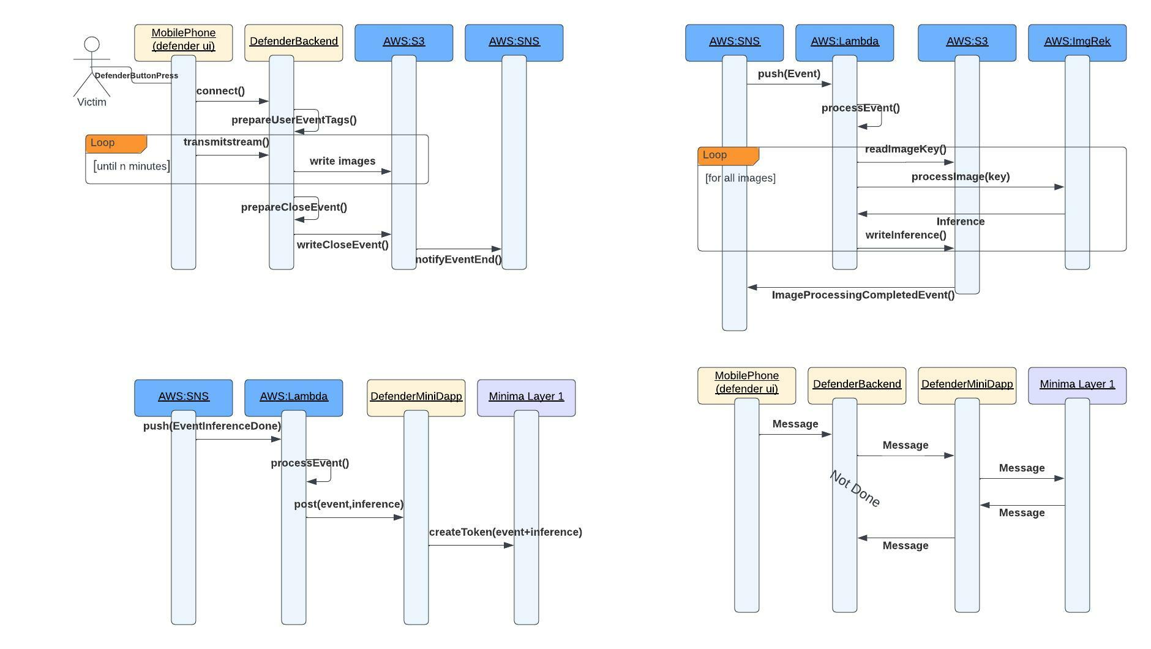
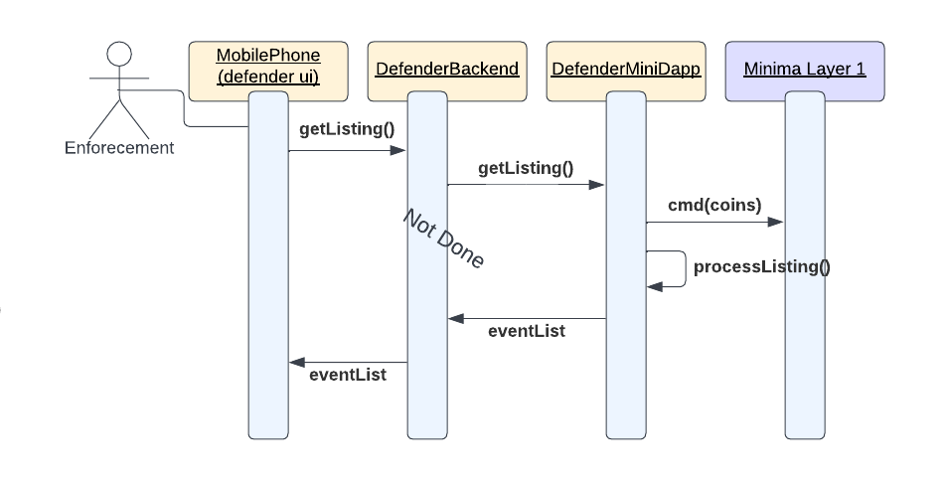

Defender POC Sequence Diagrams
Minima-Defender – capture event
Minima-Defender – Apply ML model
Minima-Defender – persist event in minima level 1
Minima-Defender – view captured events

Slide 3
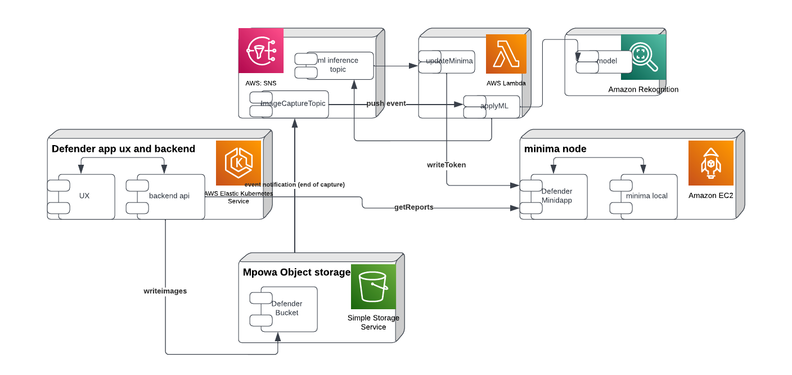
Deployment/Arch diagram

Slide 4
Defender Usecase 1 spec
Minima-Defender – capture event

Slide 5
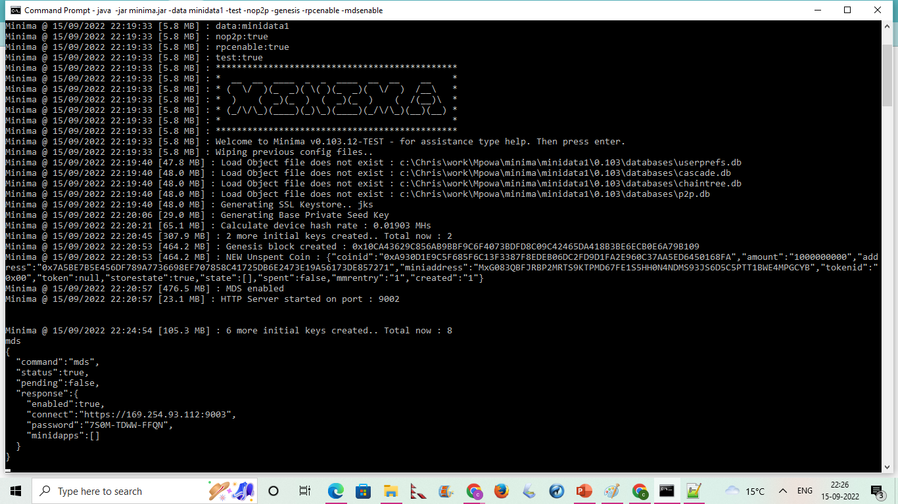

Slide 6
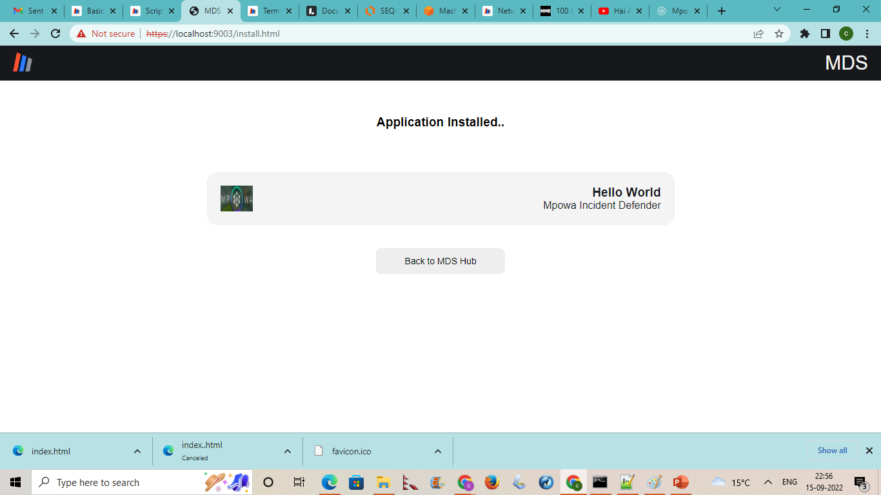

Slide 7
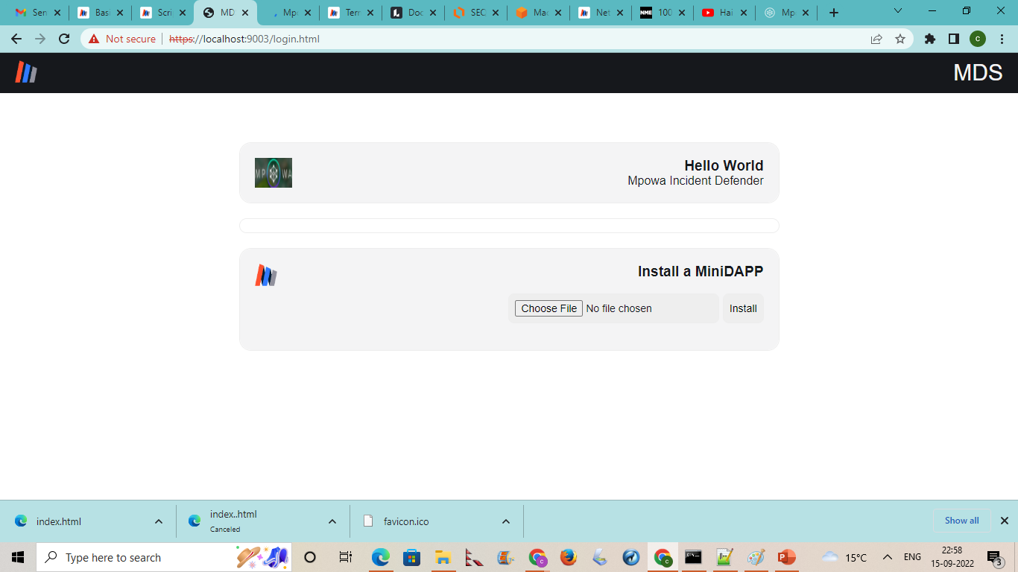

Slide 8
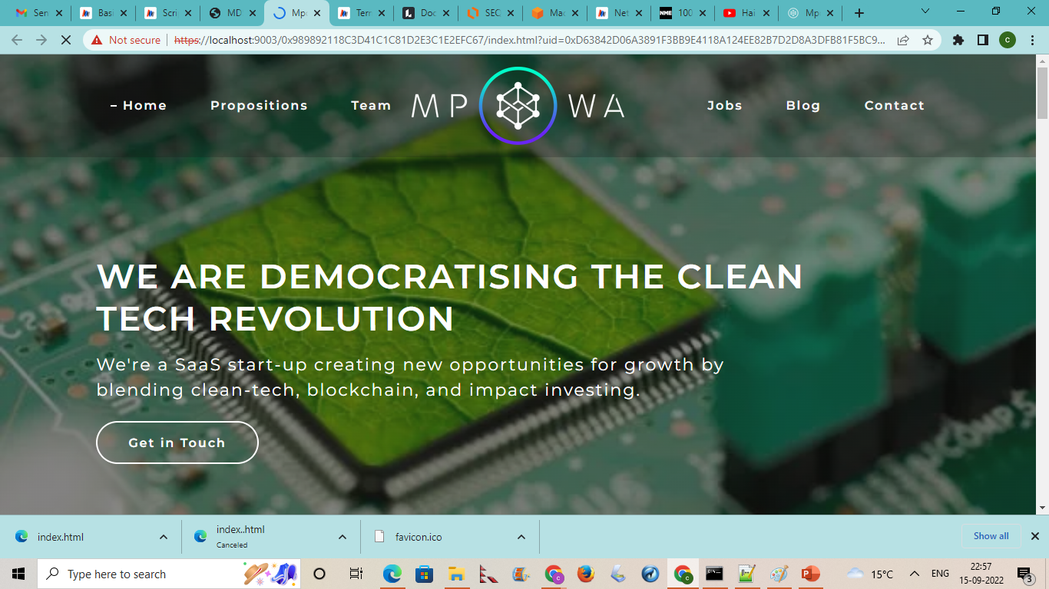

Slide 9
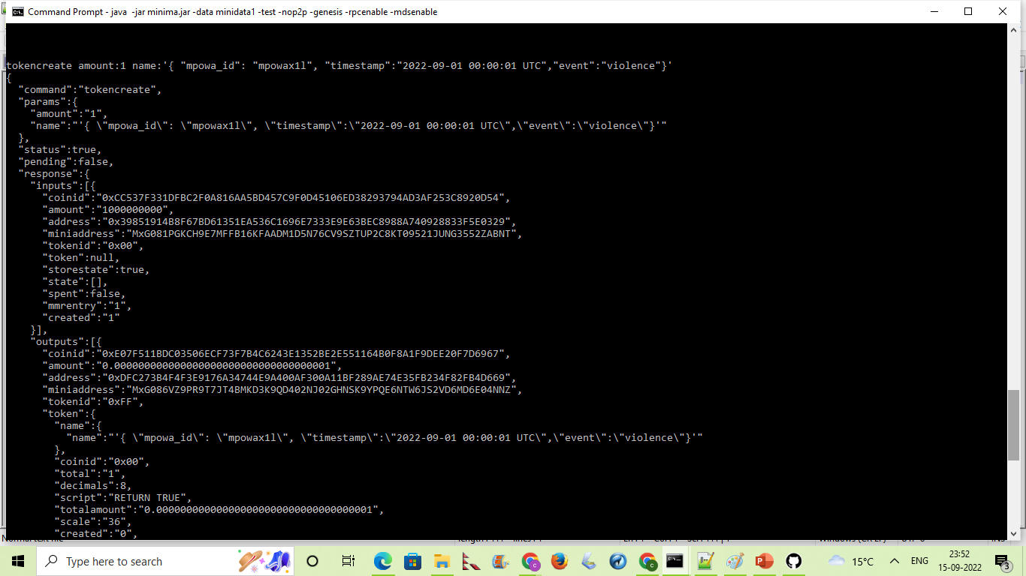

Slide 10
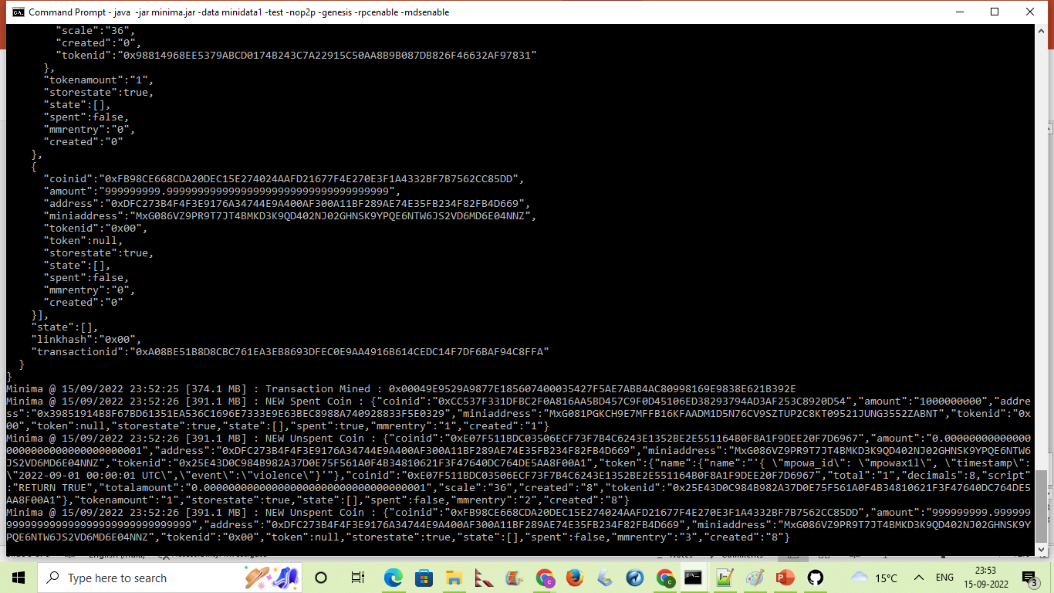

Slide 11
