Slide 1
Student Perceptions of Code-switching in ID1
Christopher Meng, WRIT101

Slide 2
So, what is this all about?
For a final research paper in WRIT101: Multilingual Writing
The rise in public discussion about how to be an anti-racist educator
My personal passion for education and belief in its significance (for good and bad)
Notes:
As you all know, this is for this course. I knew that I wanted to focus on student experiences, and to narrow the scope of my research, it felt logical to focus on ID1, which is the equivalent of Pitzer’s FYS.
This topic is also timely as there has been more discussion about how to be anti-racist educator.
I’ve always been really interested in the power of education and it’s probably a field that I see myself going into in the future in some capacity.

Slide 3


What are students’ linguistic backgrounds that they bring to ID1?
What are their perceptions of and explanations for code-switching?

Slide 4
Outline
Introduction
Literature Review
Language and Self
History of Language Oppression
Procedures/Methodology
Qualtrics
Demographic Data
Analysis
Linguistic Backgrounds
Correlations with Race, FLI, and Comfort with Academic English
Qualitative Themes
Conclusion

Slide 5

Literature Review
Here we go!

Slide 6
Language and Self
Gloria Anzaldúa, a queer feminist Chicana scholar, on linguistic terrorism
Internalized hatred of one’s language -> internalized hatred of one’s self (270)
April Baker-Bell, a professor of language literacy & education, on linguistic justice
“[linguistic racism] is so normal that it is difficult to address because it is not acknowledged as a form of racism” (16)
Notes:
The biggest thing that I’ve learned from this class is how language is so much more than a medium of communication. A conversation about language is a conversation about the student’s humanity.
That’s what allow Gloria Anzaldua… to proclaim… where…
ABB builds on that in her incisive book about linguistic justice that I would recommend
This is kind of my motivation for doing this study. I hope I can enlighten the diversity of linguistic backgrounds that students bring and explore their perceptions of ID1, an environment that quote-unquote “helps students transition to college-level writing and speaking.” To me, the word college-level signals academic English, and I’m curious what students will think if anything and how they react to it.
From my cursory literature review, there seemed to be much more research on international students linguistic experiences in college, but as we know, domestic students also face linguistic racism, tho they may interact with it differently.

Slide 7
History of Language Oppression
Language planning during American slavery
Education as a mechanism of social control
Notes:
Now I will review a very brief history of language, as without it, we cannot understand the full context that we are working within and therefore, we cannot effectively research and hopefully implement programs that get at the problem.’
From the initial years of colonization, European enslavers separated captive Africans who spoke the same language as a way to minimize rebellion
While enslaved by the planter elite, Black people were beat if they were caught trying to learn to read
From the very beginning of this country, white oppressors recognized the power of language and worked to ensure that marginalized groups would not be empowered through language
As slavery was forced to end and public education became more prominent, we see schools become a mechanism of social control, which we can still apply today
Integration can be seen as a means of socializing marginalized groups into capitalist values and positions and perpetuating their own oppression
A prominently grotesque example of this is Native American boarding schools
Washed their mouths with lye soap whenever they attempted to speak their own language
History matters. Without it, we dismiss current events as isolated incidents that aren’t rooted in oppression and don’t require action.

Slide 8
If language can be oppressive, language can also liberate possibilities for expression.
Notes:
However, I think it’s equally important to have a vision of a world that can be so we have something to work towards. Academia works in a way that often forces students to choose between access/success and their full humanity. Educators and just generally when we’re working with writers, we can facilitate student ownership over their work in such a way that allows them to elaborate on their writing in directions that energize them and feel true to them, that is not conditional on whether or not their writing or speaking is “good” enough for the classroom according to some vague and oppressive standard. We’ve read some great pieces in this class that might have exemplified this like the poem, the piece in Spanglish.

Slide 9
Procedures Methodology
The fun stuff…

Slide 10
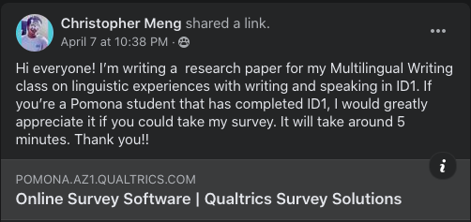
Qualtrics Survey
Sampled from Pomona students who completed ID1
Class of 2020 (1), 2021 (7), 2022 (10), 2023 (12), 2024 (20)
67 total responses
Length: ~4 minutes (1-10 minutes)
Advertised on Facebook and class group chats, the survey was open for 4 days
Open: Wednesday, April 7 (night)
Close: Saturday, April 10 (night)
What questions did I ask?
Notes:
67 responses, who answered at least some of the multiple choice or open-ended parts.
The estimated survey length is 5 minutes, and people took anywhere from 1-10 minutes.
The survey was optional and participants could skip any questions that they wished to. All participants remained anonymous.
Pres_Speak:
Pres_Write:
Help_Speak:
Help_Write:
Feedback:
Comfort:
Ling_Enviro:

Slide 11
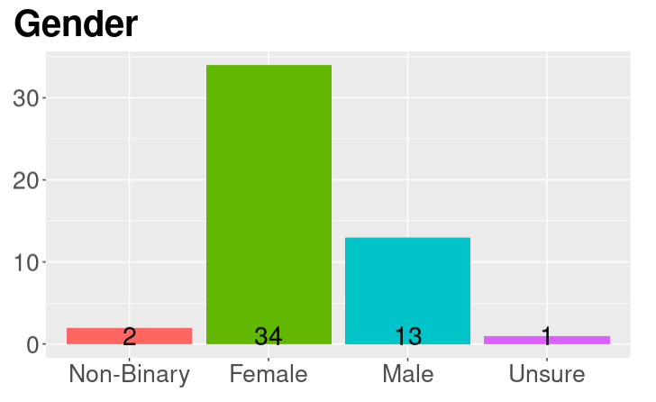
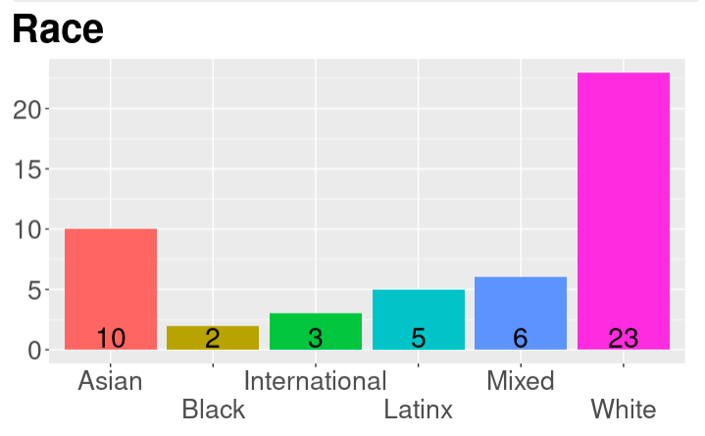
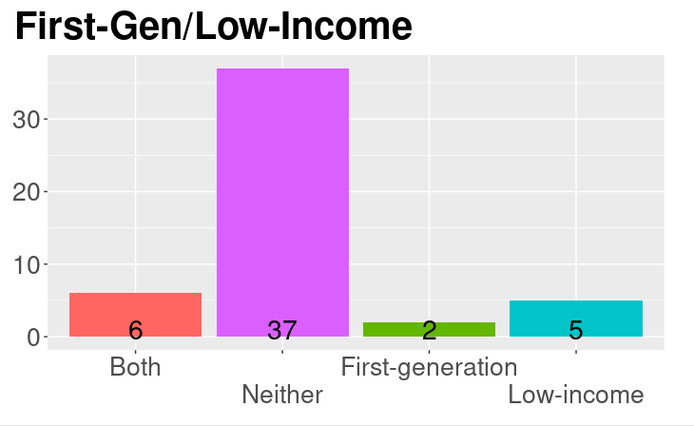
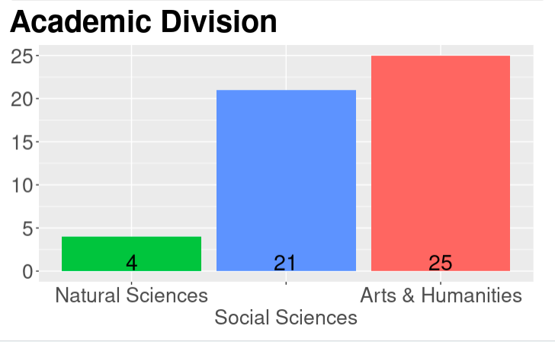
Notes:
Demographics of participants. 2/3 female. Half white. A quarter FLI, which is in about in line with the overall Pomona population.

Slide 12
Analysis
Almost there…

Slide 13

Linguistic Backgrounds: Diverse
42 responses
18 students self-identified as navigating environments with multiple languages or dialects.

Slide 14
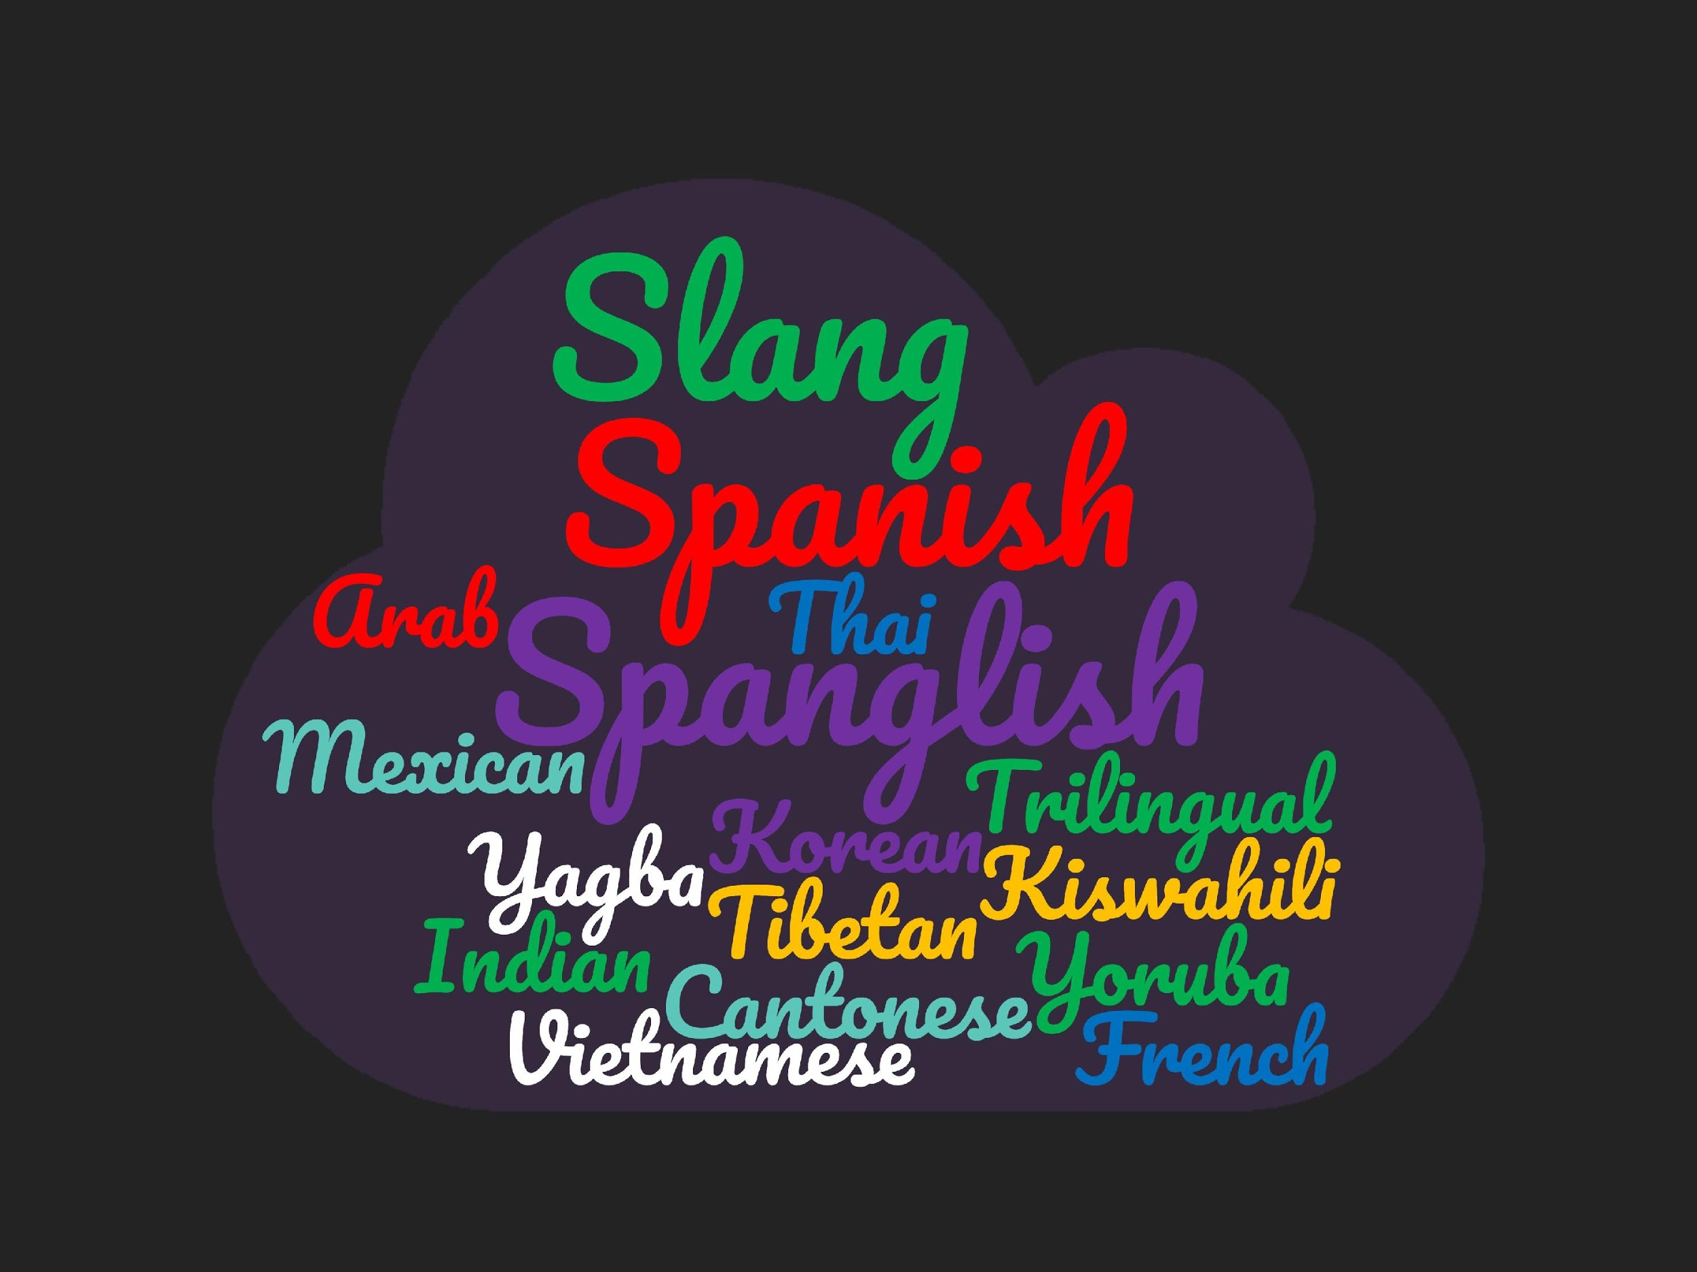
Notes:
Here you can see some of the incredible variety of words that students used to describe their linguistic identity.

Slide 15
English isn’t a monolith.
Of the 24 students who self-identified as mostly English speakers with linguistically similar home and college environments, they used a variety of descriptors that provided nuance.
“Native English”
Sign language
Academic English
Colloquialism
Informal (West Coast)
Southern
New Jersey
“No real language”
Notes:
5 people used the phrase “Native English” in some form.
1 person mentioned using sign language at hope.
There were a couple of people who talked about even using academic English at home, and one who talked about codeswitching within the home between colloquial English and academic English depending on the parent.
The transition from East Coast how jarring the informality of the West Coast was.
Codeswitching between New Jersey and Southern accents in school and home.
Even one person who said they spoke “no real languages”

Slide 16

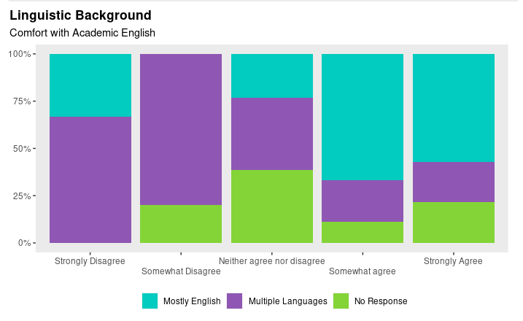
Notes:
I asked some multiple choice questions about racial identity, FLI identity, comfort with academic English, and I analyzed those three with linguistic background.
The graphs are a bit misleading because there were only 8 total responses for Strongly Disagree and Somewhat Disagree. However, of those 8, 6 of them identified speaking multiple languages or dialects. 32 people are contained within the agrees, and we see a clearly disproportionate number of Mostly English speakers in those categories.

Slide 17
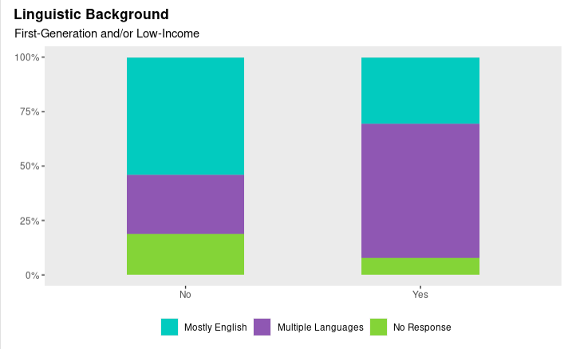
Notes:
Twice as many multiple language/dialect speakers compared to Mostly english identified as FLI, whereas twice as many Mostly English speakers did not identify as FLI.

Slide 18
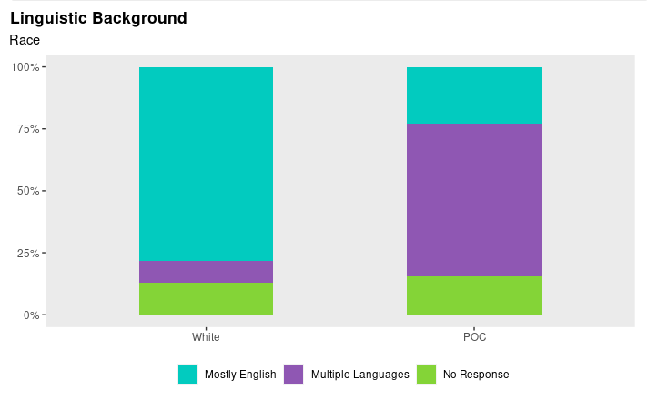
Notes:
I had 23 students who identified as white, and 26 who identified as a POC. Here we see clear differences in their linguistic backgrounds. A major weakness here was that my sample size was not big enough to capture individual ethnic group patterns, so I merged everyone into a monolithic POC category, which is bad thing to do as it erases diversity so keep that limitation in mind.

Slide 19
1. Code-switching Between Home and School
“how different academic standards and expectations are”
“get used to American accents and formalities that I havent experienced much of before”
“English was mostly the ’school’ language and Spanish was what was waiting for me outside my door”
“I developed [English] skills well throughout my K-12 education”
“The difference was so clear cut that I never had any problems switching on and off”
“Force my voice into the constraints of academic English"
"I just knew that this survey was for academic purposes, and a switch in my brain flipped"
"The way I pronounced words changed at school. So did the way I structure my sentences"
"there was a certain standard in the classroom, but I could be more casual at home"
Notes:
Analyzing some more of the themes that came forth from the open-ended responses,
Codeswitching exists. Even in my Qualtrics survey, this one person says: Read quote about even MY survey. Students were able to identify a clear switch between in and outside the classroom.

Slide 20
2. Social Context of the Classroom
"I wanted to sound smart, obviously, smarter than I would normally sound (isn’t that most of college, though?) "
“I was very conscious not to ’stir the pot’ with any statements that might be controversial.”
"it was an English class and it seemed like word choice really mattered"
"I often felt the need to use larger words that I normally wouldn’t use"
"I felt more pressure to impress my professor and my classmates. I maybe tried to use more complicated words than I usually do."
"there is definitely a pressure to phrase your thoughts in the most eloquent ways possible"
"The discussions I have in classes feel like more intense, structured versions of conversations on interesting topics I would have with my friends"
"Someone pointed out my usage of AAVE and I used it less afterwards.”
Notes:
A second theme is the social context of the classroom influencing language and codeswitching.
Things that stand out to me here: Sounding smart. Discipline-specific pressures. This AAVE quote. Didn’t quote any here, but imposter syndrome came up several times in people’s responses as interacting with how they received feedback in ID1 and how they navigated that academic environment.

Slide 21
3. It’s just how it is.
"Writing academically is a requirement of taking academic courses"
"In order to succeed in academia, it requires a more verbose vocabulary/professional written structure than casual conversation between friends."
"I think it's just a symptom of Pomona culture (or even just higher education) as a whole, rather than ID1."
"I find it normal considering it was an academic setting."
"I guess in my mind that's how it is for everyone just because that's how I've always experienced it."
Notes:
A third theme was some responses to my questions that suggested using certain kinds of language is just how college is.

Slide 22
4. Code-switching in Other Contexts
“I code switched at my public high school (don’t want to sound too smart)”
“in the writing I actually adopted a more informal tone”
“People definitely speak differently on the west coast which was jarring but that is more in terms of informal speaking”
"I kind of just let [my writing style] be as I am and [high school] teachers seemed to like it, but when I got to college professors began giving me more rules and format to follow"
Notes:
These were also some fascinating tidbits that didn’t fit into the other themes. Codeswitching the opposite way that we expect so that one doesn’t sound too smart. Speaking one way but writing another way within the same class. West Coast vs East Coast. High school vs college.

Slide 23
(Quantitative) Conclusions
Answered similarly regardless of linguistic background
Pressure to speak/write
ID1 helping future speaking/writing
Significant correlations between background of multiple languages/dialects and:
Comfort with Academic English (-)
FLI (+)
POC (+)
A commitment to anti-racist pedagogy requires education that considers language.
Possibly interesting patterns emerging for virtual vs. in-person ID1
Notes:
Regardless of linguistic background, people answered the other multiple choice questions relatively similar, and if anything, it seems like students who speak multiple languages or dialects were slightly but not significantly more likely to strongly agree with the questions about feeling pressured and ID1 helping them. However, there was a noticeable pattern outside of the scope of my original research question regarding class year: students who took ID1 virtually felt significantly more pressure to speak a certain way in class discussions, and significantly more students agreed that ID1 helped them learn how to communicate with professors. We see how closely tied language is to FLI and racial identity, so it follows that a commitment to anti-racist pedagogy requires education that at the very least considers language, or I would go further and say is linguistically-empowering and affirming.

Slide 24



(Qualitative) Conclusions
Students have incredibly diverse linguistic backgrounds.
Even within mostly “standard” English speakers, there is much variation.
Wanting to sound “smart”
Students are highly aware of their codeswitching to meet ”academic standards.”
Avoiding discomfort or controversy
Several expressed that codeswitching is just the nature of the academy.
Notes:
This was kind of my main research interest, just kind of reading about and presenting how people perceive their linguistic backgrounds, and I was not disappointed. As I said on the last side, this must be accounted for in the classroom. Perhaps it’s my positionality from my linguistic identity, but I do not hear educators and peers publicly talking about this as much, despite language being how we communicate and therefore, pervasive in our lives. Privately, I’ve heard the both positively and negatively impactful effects of language, so I hope this research bridges some of that disconnect.
From accents, to localities, to having family members in the academy, to slang and sign language.
Many students talked directly about codeswitching from inside to outside the classroom.
Explanations included social pressures to…
And that’s just how it is in academia
I want to push back on that with a sentiment from bell hooks about her conception of the classroom as a radical space of possibility. We can create change, but when we lose sight of the vision or lose hope that change can happen, we fail to realize this possibility.

Slide 25




Future Directions
Academic disciplines
Learning disabilities
Online experience
Specific practices to implement

Slide 26
References
Anzaldúa, G. (1987). Linguistic terrorism. Borderlands/la frontera: The new mestiza. Aunt Lute Books.
Baker-Bell, A. (2020). Linguistic justice: Black language, literacy, identity, and pedagogy. New York, NY & Urbana, IL: Routledge & National Council of Teachers of English.
Dumas, M. (2016). Against the dark: Antiblackness in education policy and discourse. Theory Into Practice 55, 11-19.
hooks, b. (1994). Teaching to transgress: Education as the practice of freedom.
Yong, D. (2021, Feb. 10). Colonization and slavery in the US [Class discussion]. ID048: Social Justice and Equity in STEM, Harvey Mudd College, Claremont, CA, United States.
Notes:
Here are the references I mentioned in this presentation.

