Slide 1
BeeT℞
Presented By: Darin
With: Derek
Chris
Neal

Slide 2
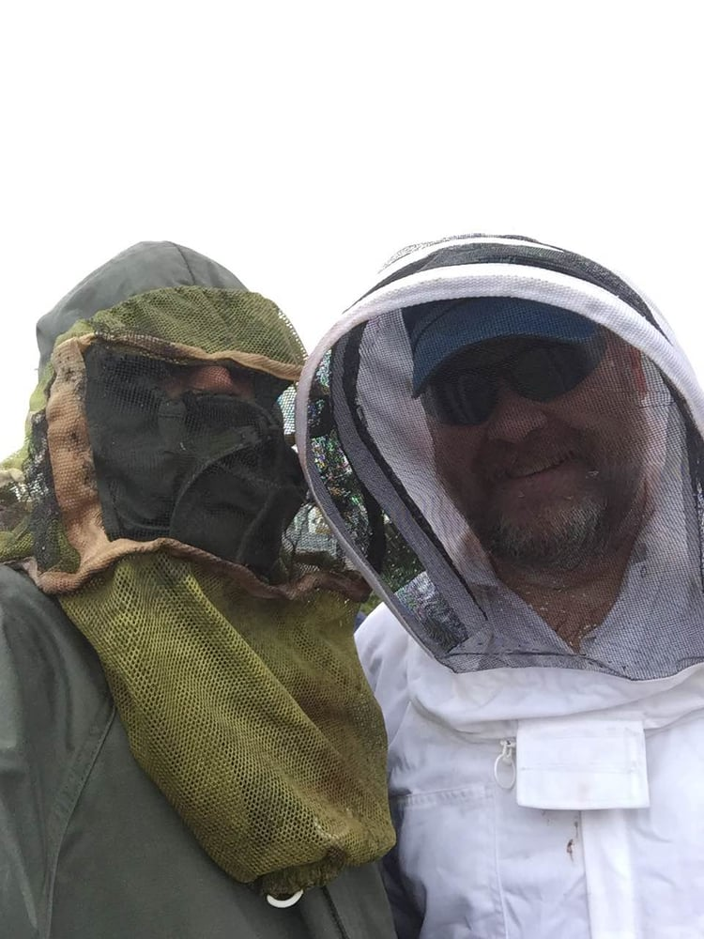
Darin: the Generational Master Bee Keeper

Slide 3
Why BeeT℞?
The Problem:
Not enough efficacy data for Congress
Clinical studies having to wait for Doctor/Patient checkups
BeeT℞ Solution:
Alexa interfaces with user to easily collect data patients provide
Much more data in much less time!

Slide 4
Our Solution
The Honey!
Exponentially MOAR DATARRRrr!

Slide 5
Stakeholders
State of Colorado in 2016 invested $13 mil for efficacy research for Cannabis
Research Grants
Medical Cannabis Activists/Lobbyists
Patients
Pharmaceutical Researchers
Market for Artesian Cannabis Honey

Slide 6
Questions?

