Slide 1
BLOCKCHAIN
Scott C.-H. Huang
Department of Electrical Engineering and Institute of Communications Engineering
National Tsing Hua University
chhuang@ee.nthu.edu.tw

Slide 2
Outlines
Introduction to Blockchain
Introduction to Bitcoin
Overview of Blockchain
Overview of Cryptocurrency
Different cryptocurrencies
Application of Blockchain
Smart Contracts

Slide 3
What is blockchain?

Slide 4
The blockchain is an incorruptible digital ledger of economic transactions that can be programmed to record not just financial transactions but virtually everything of value.
Don & Alex Tapscott, authors Blockchain Revolution (2016)

Slide 5
Blockchain & Distributed Ledgers
Blockchain
The technology behind cryptocurrencies.
Analogous to the TCP/IP Protocol that is the foundation of the internet
Blockchain are Distributed Ledgers
Ledgers are historically centralized and private
Blockchains are Decentralized or Distributed

Slide 6
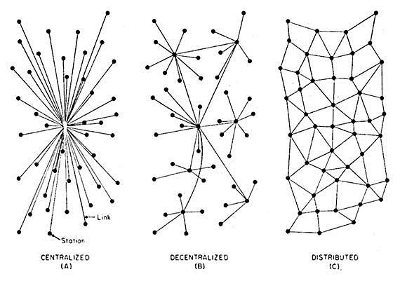

Slide 7

History of blockchain
When we talk about “Blockchain”, we will always mention …

Slide 8
BITCOIN
Real world Problem
transaction fee
barrier for currency exchange
The possible approach to solve these problems is the original idea of Bitcoin.

Slide 9
Bitcoin was firstly created according to the idea from Satoshi Nakamoto (中本聰) who published the paper named “A Peer-to-Peer Electronic Cash System” in 2009 which contained the idea of Blockchain.
Peer-to-peer network
Proof of work
Digital signatures

Slide 10

Nick Szabo
American computer scientist

Slide 11

Craig Steven Wright
Australian computer scientist and businessman.
Was the CEO of Hotwire Preemptive Intelligence Group (Hotwire PE)

Slide 12
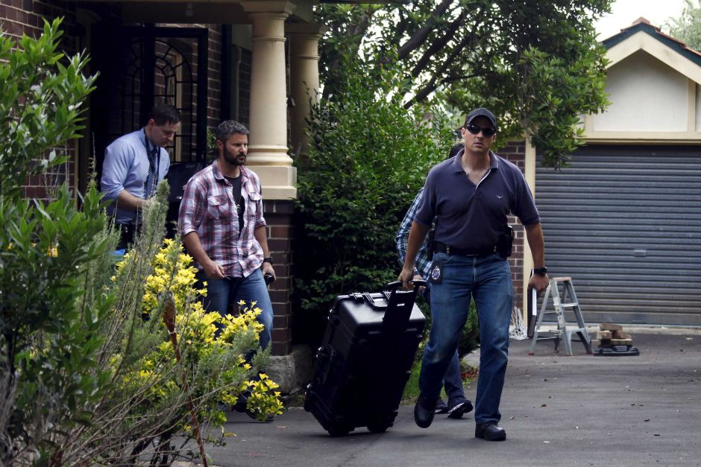

Slide 13
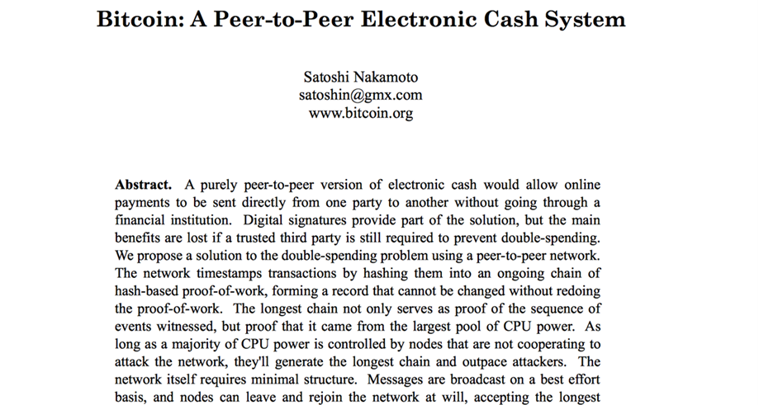
Bitcoin Whitepaper

Slide 14
Bitcoin
A digital money created to make the new payment procedure. It is used on decentralized peer-to-peer payment network. This technique required every user in this network to store the transactions (blocks) to keep the network working without a central authority (Middlemen).

Slide 15
Features of Bitcoin
Nominal transaction fee’s paid to the network
Same cost to send $.01 as $1,000,000
Consensus driven – no central authority
Counterfeit resilient
Cannot add coins arbitrarily
Cannot be double-spent

Slide 16
Blockchain Contributor

Slide 17
Who is the contributor in Blockchain network?
Users
Miners

Slide 18
What are miners doing?
Principally everybody can be a miner. Since a decentralized network has no authority to delegate this task, a cryptocurrency needs some kind of mechanism to prevent one ruling party from abusing it. Imagine someone creates thousands of peers and spreads forged transactions. The system would break immediately.
So, Satoshi set the rule that the miners need to invest some work of their computers to qualify for this task. In fact, they have to find a hash – a product of a cryptographic function – that connects the new block with its predecessor. This is called the Proof-of-Work. In Bitcoin, it is based on the SHA 256 Hash algorithm.

Slide 19
How Blockchains Work: Maintenance
The individuals who maintain and update the Blockchain are “miners,” and they are paid a reward
The Miners process transactions by:
Solving a complex mathematical problem
Sending transactions to other nodes to be verified.

Slide 20
How Blockchains Work: Hashing
When all miners agree the problem has been solved correctly, the block is added to the chain and is visible to the entire network
The unbroken Hash (seal) confirms that the block, and therefore every block before it, is legitimate

Slide 21
How Blockchains Work: Hashing (cont.)
Recall: Transactions must be validated by other network miners
Miners incentivized to add “valid” transactions via a reward; invalid transactions are rejected, and thus, no reward is given

Slide 22
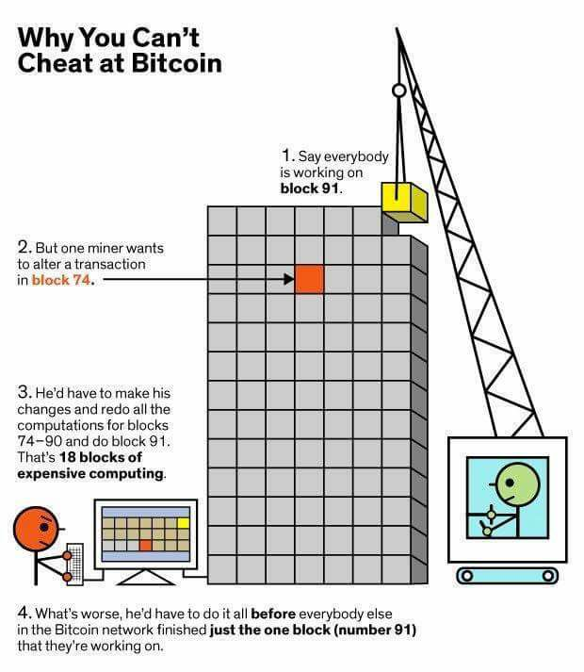

Slide 23
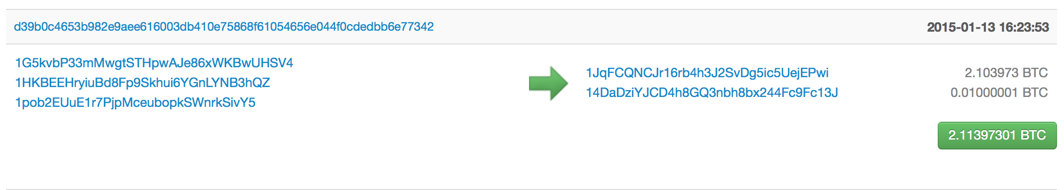
Pseudo Anonymous
Using public key cryptography, specifically Elliptic Curve Cryptography due to its key strength and shorter keys
Transactions are sent to public key “addresses”
1AjYPi8qryPCJu6xgdJuQzVnWFXLmxq9s3
1Give4dbry2pyJihnpqV6Urq2SGEhpz3K

Slide 24
Addresses are like Accounts
The wallet listens for transactions addressed to any of its public keys and in theory is the only node that is able to decrypt and accept the transfer
“Coins” are “sent” by broadcasting the transaction to the network which are verified to be viable and then added to a block
Keys can represent a MULTI-SIG address that requires a N of M private keys in order to decrypt the message

Slide 25
Public Ledger
Every viable transaction is stored in a public ledger
Transactions are placed in blocks, which are linked by SHA256 hashes.
https://blockchain.info

Slide 26
Transaction Confirmation
Having a transaction provisionally accepted into a candidate block signals that the network has verified that the inputs were viable
Every new block accepted into the chain after the transaction was accepted is considered a confirmation
Coins are not considered mature until there have been 6 confirmations (basically an hour assuming a 10 minute block cadence)
New Coins created by the mining process are not valid until about 120 confirmations
This is to assure that a node with more than 51% of the total hash-power does not pull off fraudulent transactions

Slide 27
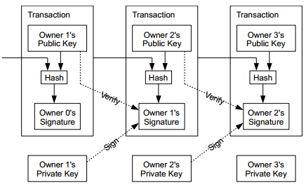

Slide 28
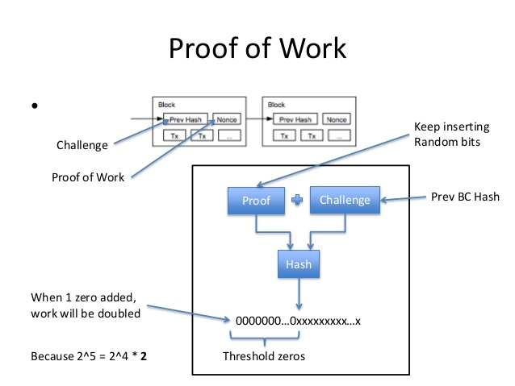

Slide 29
Transaction Properties

Slide 30
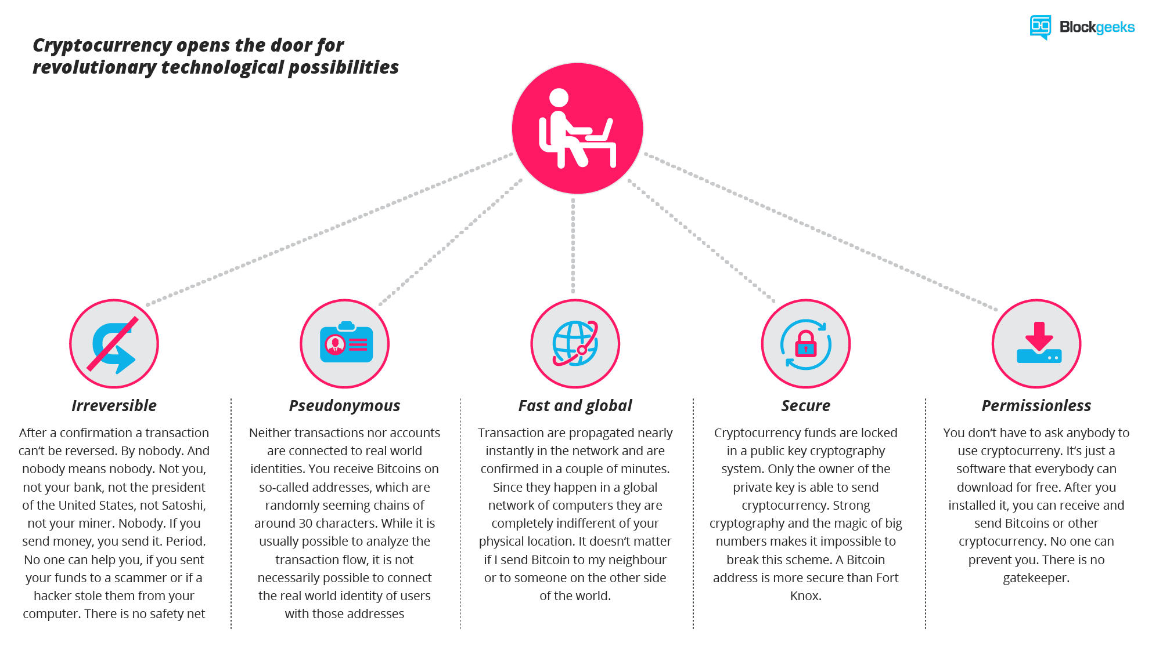
Transaction properties
Ref: https://blockgeeks.com/guides/what-is-cryptocurrency

Slide 31
Transaction properties
Irreversible: After confirmation, a transaction can‘t be reversed. By nobody. And nobody means nobody. Not you, not your bank, not the president of the United States, not Satoshi, not your miner. Nobody. If you send money, you send it. Period. No one can help you, if you sent your funds to a scammer or if a hacker stole them from your computer. There is no safety net.

Slide 32
Transaction properties
Pseudonymous: Neither transactions nor accounts are connected to real-world identities. You receive Bitcoins on so-called addresses, which are randomly seeming chains of around 30 characters. While it is usually possible to analyze the transaction flow, it is not necessarily possible to connect the real world identity of users with those addresses.

Slide 33
Transaction properties
Fast and global: Transaction are propagated nearly instantly in the network and are confirmed in a couple of minutes. Since they happen in a global network of computers they are completely indifferent of your physical location. It doesn‘t matter if I send Bitcoin to my neighbor or to someone on the other side of the world.

Slide 34
Transaction properties
Secure: Cryptocurrency funds are locked in a public key cryptography system. Only the owner of the private key can send cryptocurrency. Strong cryptography and the magic of big numbers makes it impossible to break this scheme. A Bitcoin address is more secure than Fort Knox.

Slide 35
Transaction properties
Permissionless: You don‘t have to ask anybody to use cryptocurrency. It‘s just a software that everybody can download for free. After you installed it, you can receive and send Bitcoins or other cryptocurrencies. No one can prevent you. There is no gatekeeper.

Slide 36
What is Cryptocurrency?

Slide 37
What is Cryptocurrency?
“A digital currency in which encryption techniques are used to regulate the generation of units of currency and verify the transfer of funds, operating independently of a central bank.”

Slide 38
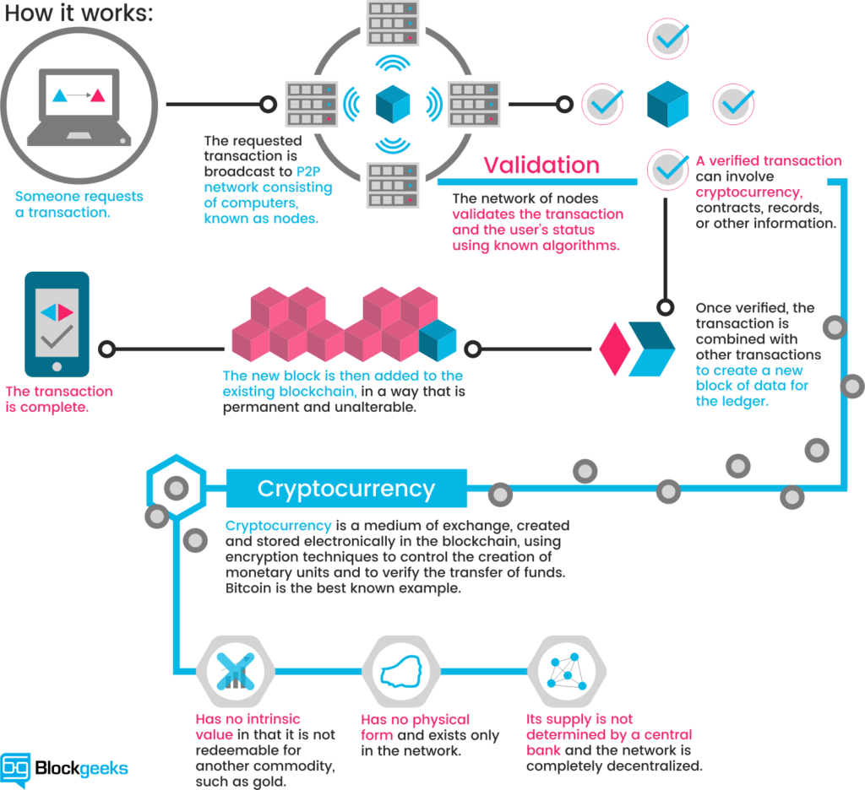
Ref: https://blockgeeks.com/guides/what-is-cryptocurrency

Slide 39
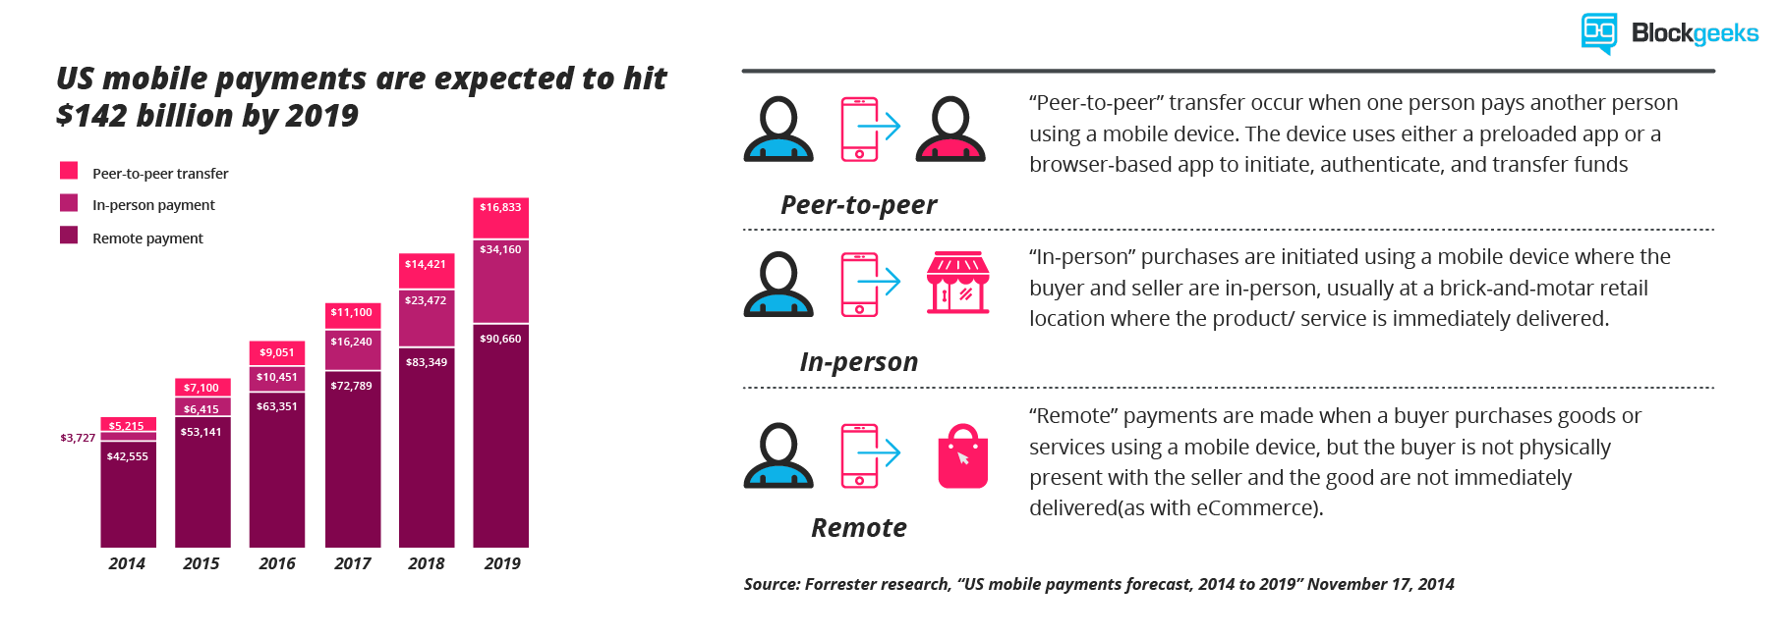
Cryptocurrencies: Dawn of a new economy
Ref: https://blockgeeks.com/guides/what-is-cryptocurrency

Slide 40
Cryptocurrencies: Dawn of a new economy
Ref: https://blockgeeks.com/guides/what-is-cryptocurrency

Slide 41
Cryptocurrencies

Slide 42
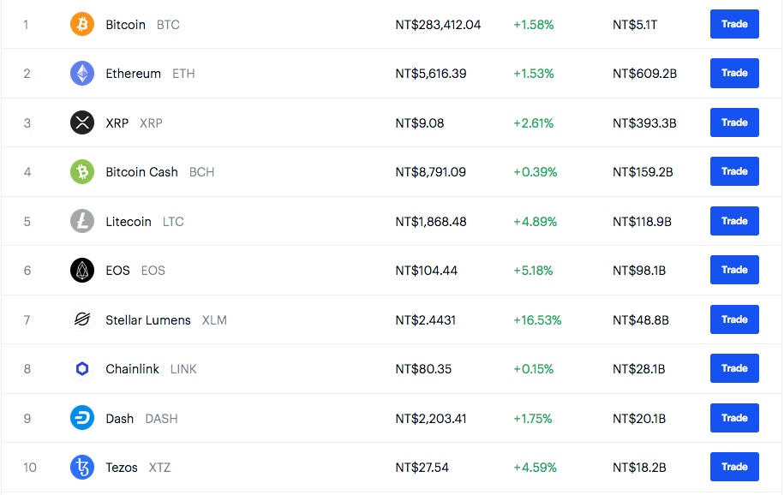
Different cryptocurrencies (updated: 2019/11/05)

Slide 43
Applications of Blockchain

Slide 44
Applications of blockchain
e-wallet
Smart contract
Database system
Traceability of agriculture and food supply chain

Slide 45
Smart Contracts
Self-automated computer programs that can carry out the terms of any contract
Mostly based on objective conditions precedent
“If, then” criteria

Slide 46
Smart Contracts (cont.)
Variables: Readily Verifiable Data
Oracles: Reliable sources
Social Security DMF
FAA Records
National Weather Service
Crowdsourcing
Voting

Slide 47
Smart Contracts (cont.)
Think: Escrow Agreements
Money held in escrow until performance is met
Once performance is validated, money released
Regulated by an unbiased party, which only seeks the objectively “right” answer, devoid of outside influence

Slide 48
Types of Cryptocurrencies and Uses

Slide 49

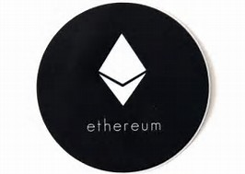

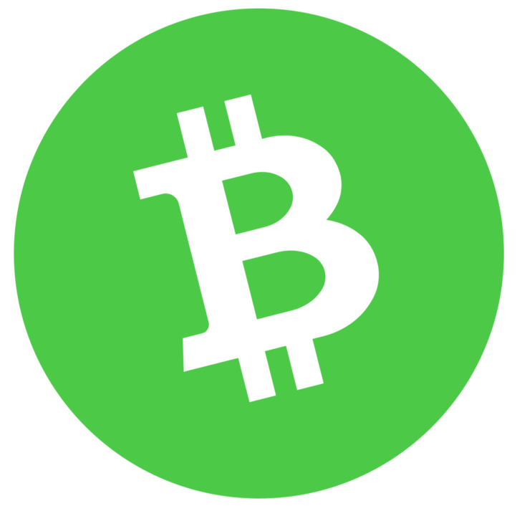
Example of Protocol Tokens
Bitcoin
Ethereum
Litecoin
Bitcoin Cash

Slide 50
Ethereum.org Turing complete contracts on a blockchain.
Contracts are the main building blocks of Ethereum.
A contract is a computer program that lives inside the distributed Ethereum network and has its own ether balance, memory and code.
Every time you send a transaction to a contract, it executes its code, which can store data, send transactions and interact with other contracts.
Contracts are maintained by the network, without any central ownership or control.
Contracts are written in languages instantly familiar to any programmer and powered by Ether, Ethereum's cryptofuel.

Slide 51
Other Blockchain Applications
Issuing Stocks and Bonds
Insurance
Land Registries
Supply Chain Integrity

Slide 52
Consensus Algorithms
Proof of Work (PoW)
Proof of Stake (PoS)
Mixed

Slide 53
Proof of Work
Miners check the validity of transactions for a fee
Wasting lots of energy
Easier to be controlled by big mining companies
Anti-ASIC cryptocurrencies

Slide 54
Proof of Stake
The idea resembles company shares
Only those with enough shares can speak in a shareholders’ meeting
The more shares you have, the more influence you have
To create a block, you need to have some shares. The more the better.

Slide 55
Coin-Age
If you possess a coin for 100 days, or you possess 100 coins for a day, you have 100 coin-age.
More coin-age means more stakes. The one with more stakes is more likely to be selected as the next block creator.
After a block was created, the possessor's coin-age will be reset to 0.
There is a limit on the number of days to be counted towards the coin-age.
Drawback: bad fluidity

Slide 56
Anti-ASIC Cryptocurrencies
Evolution of hash algorithms: SHA256 (bitcoin) -> Scrypt (LiteCoin) -> Ethash (Ethereum) -> X11 (Dash) -> X13, X15, X17, X16R…

Slide 57
Scrypt
PoW
It generates lots of pseudorandom date to be computed
It needs lots of memory
Used by Litecoin and Dogecoin
GPU is more efficient in executing Scrypt as compared with CPU
There is a shortage of strong GPU card towards the end of 2013

Slide 58
X11
PoW used in Dash
Serializing 11 different hash algorithms including
BLAKE, Blue Midnight Wish, Grøstl, JH, Keccak, Skein, Luffa, CubeHash, SHAvite-3, SIMD, ECHO (NIST hash competitors)
Needs lots of memory

