Slide 1

UVAs Traffic Control based on Multi-Access Edge Computing
 | 2018 IEEE Global Communication Conference Authors : Oussama Bekkouche, Tarik Taleb and Miloud Bagaa Abu Dhabi, United Arab Emirates, 2018, pp. 1-6. doi: 10.1109/GLOCOM.2018.8647421
Date : 2019 / 12 /30
Name : 陳文遠
StudentID : 108064535

Slide 2
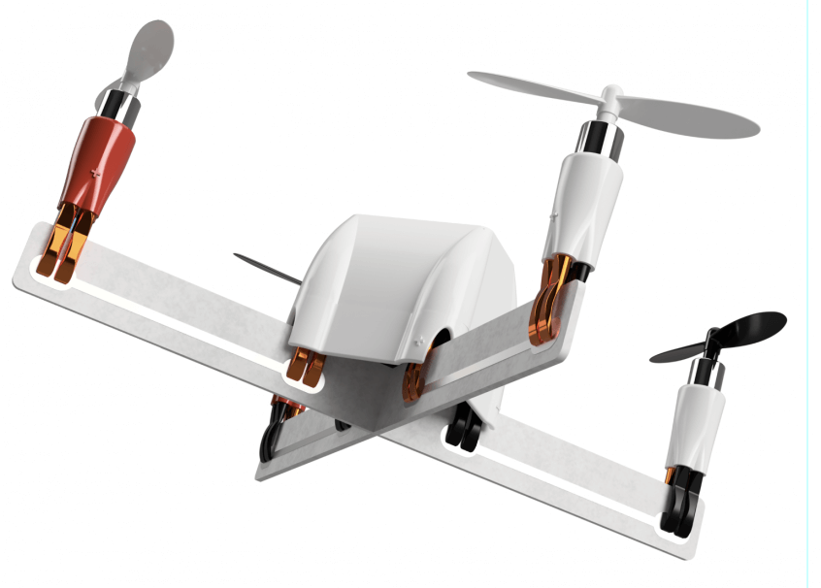
CONTENT
Introduction
Experiment
Method
Discussion

Slide 3
INTRODUCTION

Slide 4
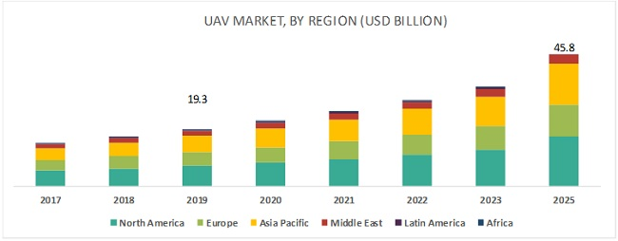
Why UAV ?
UAV is widely used.
UAV’s market is expected to reach $45.8 billion by 2025.
Military Reconnaissance
Inspection of Infrastructures
Smart Agriculture
Traffic Management
Border surveillance
Cargo delivery
1.4 trillion NTD

Slide 5
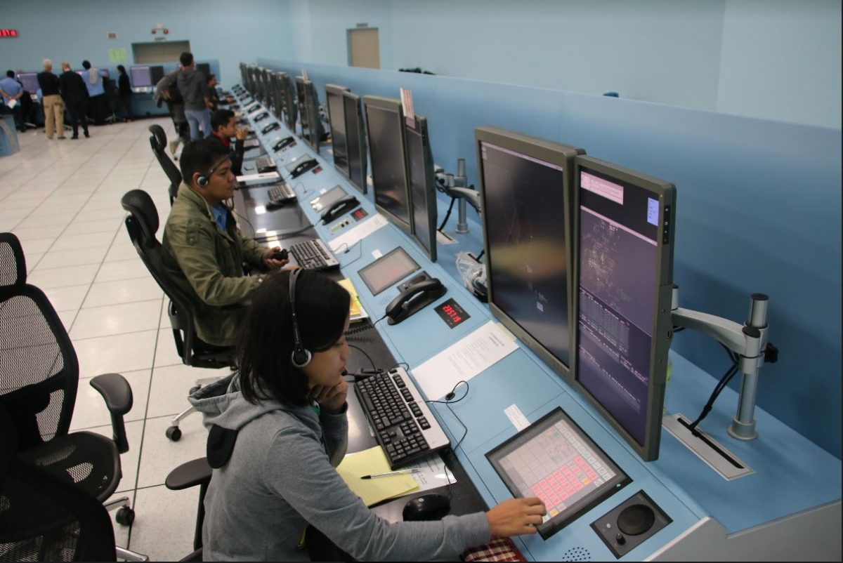
Air Traffic Management (ATM)
Each UAV is manually and individually operated (or use pre-define program).
In challenging environments, we must keep UAV stayed in Visual-Line-of-Sight of pilot.
Rely on voice communication between air traffic controllers and pilots.
That’s not designed to handle the expected high density of UAVs traffic.

Slide 6
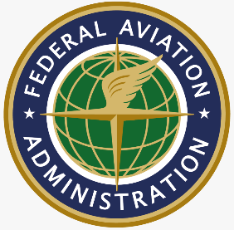

UAV Traffic Management (UTM)
Used to handle the high density of UAVs traffic.
Mitigate the risk of collision among small UAVs, flying in uncontrolled airspace.

Slide 7
UAV Traffic Management (UTM)
The following figure is an UTM system concept of operations flow chart.

Slide 8
Multi-Access Edge Computing (MEC)

Slide 9
EXPERIMENT

Slide 10
Experimentation Purpose
The UTM will control the flight plan of each UAV to ensure that it’s flying inside an allowed geo-fence.

Slide 11
Experimentation Setup

Slide 12
Experimentation Methodology

Slide 13
Result & Discussion

Slide 14
METHOD

Slide 15
MEC-Based UAVs’ Traffic Management Framework

Slide 16
DISCUSSION

Slide 17

Q & A

Slide 18
Thank you for your attention

