Slide 1
10810 COM 501000 通訊所書報討論 Seminar
鍾偉和 教授
祈忠勇 教授
邱瀞德 教授

Slide 2
評分原則 (本國學生、陸生)
本學期共15週
評分原則：
出席率評核 53 分 (每次出席3.5分)
15堂課全出席可得 53 分
額外加分 9 分 (每次出席3分)
參加通訊所主辦專題演講可做額外加分，全學期最多三次
若出席通訊所主辦專題演講，請攜帶ICE passport並給該堂課負責人簽名，期末時將統一收回加分
心得報告評核 30 分 (每次心得報告0~3分)
至少100字，7天內上傳至ilms，遲交酌扣分數
演講提問評核 25 分 (每次提問5分，一週最高5分)
點名時間為14:10~14:20
學期中會公告目前累計的分數

Slide 3
Evaluation Guidelines for International Students
There are 15 seminars in this semester.
Evaluation Guidelines:
Appearance 53 pts (Each appearance 3.5 pts)
Bonus points 9 pts (Each appearance 3 pts)
Report 30 pts (Each report 4 pts max, Maximum 30 pts)
Question 25 pts (Each question 5 pts, max 5 pts per week, Maximum 25 pts) Only counted in ICE seminars
If seminar talk in ICE is given in English, you must attend ICE seminar. If seminar talk is given in Chinese, you may attend seminars held by Institute of Information Systems and Applications (ISA). Note: The seminar of ISA is scheduled at W5W6 in Delta R105. Please get your seminar passport stamped by TA of ISA seminar.
You may also attend any visiting scholar’s talk, hosted by ICE faculty, to get bonus points. Limited 3 talks per semester.
We will do the roll call at 14:10~14:20.
Your temporal grade will be announced in the 10th week of the semester.

Slide 4
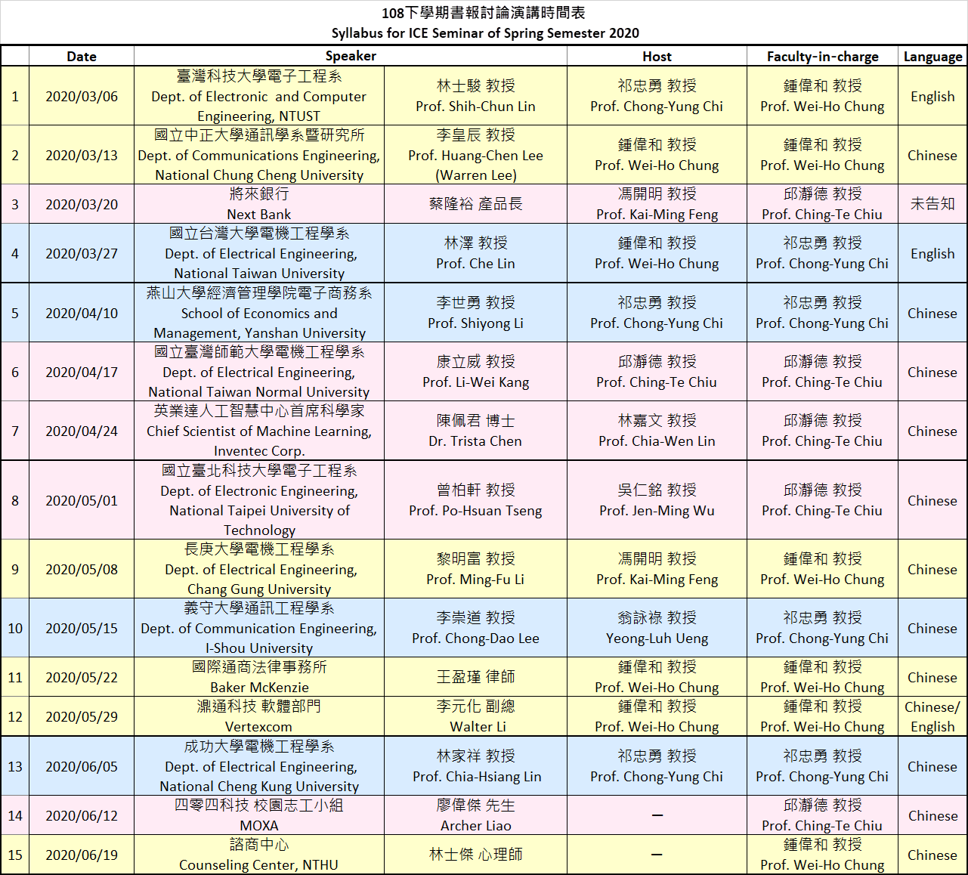
演講時程表

