Slide 1

UVAs Traffic Control based on Multi-Access Edge Computing
 | 2018 IEEE Global Communication Conference Authors : Oussama Bekkouche, Tarik Taleb and Miloud Bagaa Abu Dhabi, United Arab Emirates, 2018, pp. 1-6. doi: 10.1109/GLOCOM.2018.8647421
Date :
Name : 陳文遠
StudentID : 108064535

Slide 2
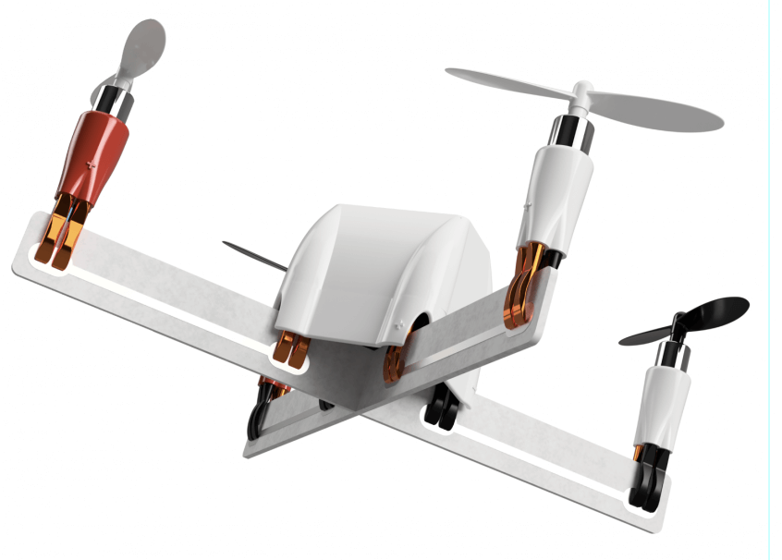
CONTENT
Introduction
Method
Result
Discussion

Slide 3
INTRODUCTION

Slide 4
Why UAV ?

Slide 5
Air Traffic Management (ATM)

Slide 7
METHOD

Slide 8
RESULT

Slide 9
DISCUSSION

Slide 10

Q & A

Slide 11
Thank you for your attention

