Slide 1
COM 5335 NETWORK SECURITY
LECTURE 1
INTRODUCTION
Scott CH Huang

Slide 2
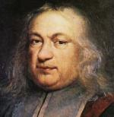
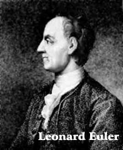
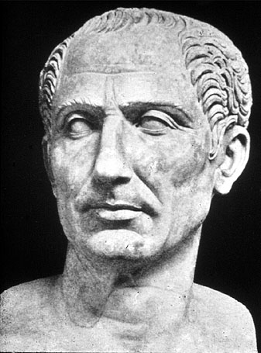
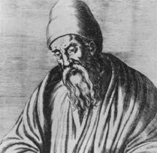

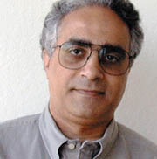

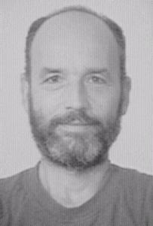
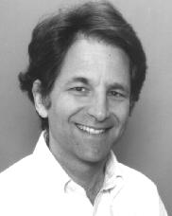

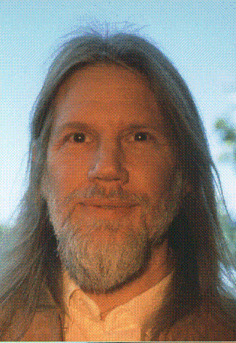
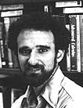

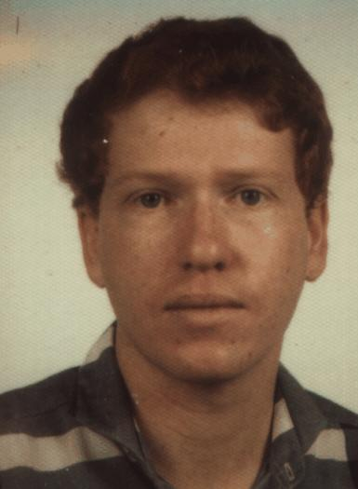
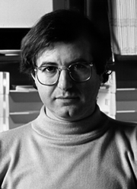
Who’s who?

Slide 3
Outline
What is Cryptography?
Steganography
Cryptography: past, present and future
Classical Cryptography
  Shift cipher
  Simple substitution cipher
  Poly-alphabetic substitution cipher
One-time pad
COM 5336 Cryptography Lecture 1

Slide 4
Outline
The American Heritage Dictionary:
  “The art or process of writing in or deciphering secret code.”
Webster:
  “The science or study the techniques of secret writing.”
More generally,
  “A science which studies how to provide communication channels with secrecy and/or authenticity properties.”
Communication channels:
  Network, hard drive, CD-ROM, etc.
COM 5336 Cryptography Lecture 1

Slide 5
Steganography
Dear George;
Greetings to all at Oxford. Many thanks for your
letter and for the summer examination package.
All Entry Forms and Fees Forms should be ready
for final dispatch to the Syndicate by Friday
20th or at the very latest, I’m told by the 21st.
Admin has improved here, thought there’s room
for improvement still, just give us all two or three
more years and we’ll really show you! Please
don’t let these wretched 16+ proposals destroy
your basic O and A pattern. Certainly this
sort of change, if implemented immediately,
would bring chaos.
Sincerely yours;
COM 5336 Cryptography Lecture 1

Slide 6
STEGANOGRAPHY (CONT’D)
Susan eats truffles. Under pressure, that helps everything before owning Major Bullwinkle.
COM 5336 Cryptography Lecture 1

Slide 7
STEGANOGRAPHY (CONT’D)
Fishing freshwater bends and saltwater coasts rewards anyone feeling stressed. Resourceful anglers usually find masterful leapers fun and admit swordfish rank overwhelming anyday.
COM 5336 Cryptography Lecture 1

Slide 8
Cryptography: Past, Present, and Future
Old days – Classical cryptography
  Essentially secret writing (encryption)
Today
  Conventional Cryptography (symmetric key)
  Public Key cryptography (asymmetric key)
  Other cryptographic algorithms and schemes
    proof of knowledge, digital signature, message authentication, secret sharing, etc.
Future
  Quantum Cryptography
COM 5336 Cryptography Lecture 1

Slide 9
Classical Cryptography: Two Main Techniques
Shift
Substitution
  Mono-alphabetic substitution
  Poly-alphabetic substitution
COM 5336 Cryptography Lecture 1

Slide 10
Shift Cipher
ABCDEFGHIJKLMNOPQRSTUVWXYZ
➔
WXYZABCDEFGHIJKLMNOPQRSTUVWXYZ
WXYZABCDEFGHIJKLMNOPQRSTUVWXYZ
WXYZABCDEFGHIJKLMNOPQRSTUVWXYZ
WXYZABCDEFGHIJKLMNOPQRSTUVWXYZ
WXYZABCDEFGHIJKLMNOPQRSTUVWXYZ
Ciphertext:
AIPGSQIXSGMXCYRMZIVWMXCSJLSRKOSRK
Plaintext:
XFMDPNFUPDJUZVOJWFSTJUZPGIPOHLPOH
WELCOMETOCITYUNIVERSITYOFHONGKONG
AIPGSQIXSGMXCYRMZIVWMXCSJLSRKOSRK
ZHOFRPHWRFLWBXQLYHUVLWBRIKRQJNRQJ
YGNEQOGVQEKVAWPKXGTUKVAQHJQPIMQPI
Total number of possible shifts = 26
…can you write a computer program to automate this cracking machine?…
COM 5336 Cryptography Lecture 1

Slide 11
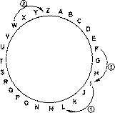
Shift Cipher
Famous shift cipher: Caesar Cipher
  Shift by 3 letters
  reputedly used by Julius Caesar (100 – 44 B.C.)
Plaintext: I CAME I SAW I CONQUERED
Ciphertext: L FDPH L VDZ L FRQTXHUHG
A shift cipher can also be described as
Encryption E_{K}(x) = x + K mod 26
Decryption D_{K}(x) = x - K mod 26
for English alphabet by setting up a correspondence
between alphabetic characters and residues modulo 26.
  K is the Key
  K=3 in Caesar Cipher
COM 5336 Cryptography Lecture 1

Slide 12
Security Strength of a Shift Cipher
Only have 26 possible shifts
Brute-force Attack : simply try each possible shift in turn
  - a.k.a. exhaustive key search
Example:
Ciphertext – mjaiamwlxsvitpegipixxivw
Trial 1 lizhzlvkwruhsodfhohwwhuv (shift backward by 1)
Trial 2 khygykujvotgrncegngvvgtu (shift backward by 2)
Trial 3 jgxfxjtiupsfombdfmfuufst (shift backward by 3)
Plaintext - ifwewishtoreplaceletters (shift backward by 4)
Hence K=4.
The major problem of shift ciphers:
  “the key space is too small against brute-force attack”
The complexity of brute-force attack is O(n).
COM 5336 Cryptography Lecture 1

Slide 13
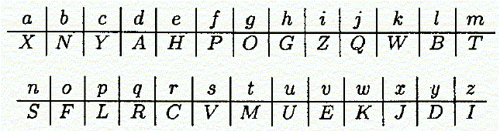
Simple Substitution
EIMBULJIWLNYANJMVLIURAHIWAI
A B C D E F G H I J K L M N O P Q R S T U V W X Y Z
A B C D E F G H I J K L M N O P Q R S T U V W X Y Z
DEPARTMENTOFCOMPUTERSCIENCE
A key is a random permutation of the alphabetic characters.
E.g.
What’s the ciphertext of “solutionsoffinalexam”?
COM 5336 Cryptography Lecture 1

Slide 14
Simple Substitution
Total number of possible permutations
26!
26! = 403,291,461,126,605,635,584,000,000 (i.e. 27 digits)
Maybe… also write a computer program to try them all exhaustively… (so-called Brute-force Attack)
Calculation: suppose we have one million 3GHz PCs can try 3 billion permutations per second, the machine will take 4263 years to try all 26! permutations.
Question: any better cracking algorithm?
COM 5336 Cryptography Lecture 1

Slide 15
Character Frequency Attack (Statistical Attack)
Brute-force attack against simple substitution becomes less efficient for large alphabet size.
However, simple substitution does not change relative letter frequencies.
Character Frequency Attack
in most languages, letters are not equally common
in English, e and t are by far the most common letters
Probability of occurrences of the 26 English letters (obtained by Beker and Piper)
letter | probability | letter | probability
A | .082 | N | .067
B | .015 | O | .075
C | .028 | P | .019
D | .043 | Q | .001
E | .127 | R | .060
F | .022 | S | .063
G | .020 | T | .091
H | .061 | U | .028
I | .070 | V | .010
J | .002 | W | .023
K | .008 | X | .001
L | .040 | Y | .020
M | .024 | Z | .001
COM 5336 Cryptography Lecture 1

Slide 16
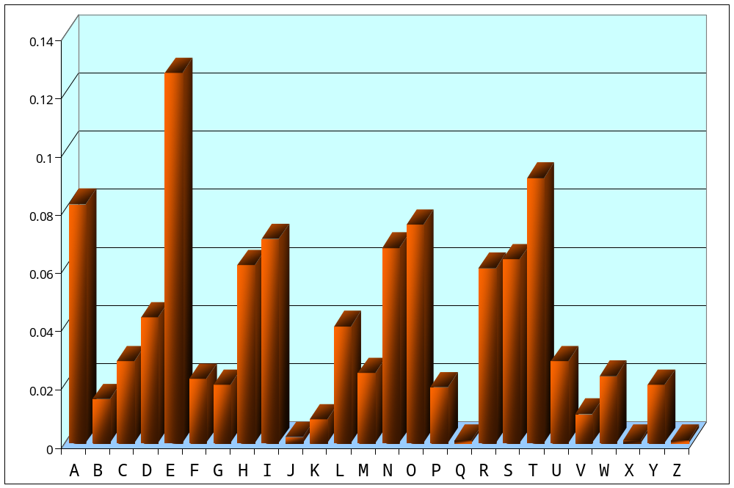
Character Frequency Attack (Statistical Attack)
May also be useful to consider sequences of two or three consecutive letters called digrams and trigrams, respectively.
e.g. common diagrams (in decreasing order): TH, HE, IN, ER, AN, RE, ED, ON, ES, ST, EN, AT, TO, NT, HA, ND, OU, EA, NG, AS, OR, …
e.g. common trigrams (in decreasing order): THE, ING, AND, HER, ERE, ENT, THA, NTH, WAS, …
COM 5336 Cryptography Lecture 1

Slide 17
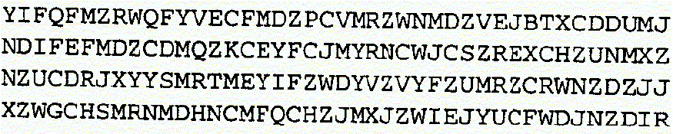
Cryptanalysis of The Substitution Cipher
May also be useful to consider sequences of two or three consecutive letters called digrams and trigrams, respectively.
e.g. common diagrams (in decreasing order): TH, HE, IN, ER, AN, RE, ED, ON, ES, ST, EN, AT, TO, NT, HA, ND, OU, EA, NG, AS, OR, …
e.g. common trigrams (in decreasing order): THE, ING, AND, HER, ERE, ENT, THA, NTH, WAS, …
Exercise: Ciphertext obtained from a substitution cipher
What’s the message?
COM 5336 Cryptography Lecture 1

Slide 18
Polyalphabetic Substitution Ciphers
In both the Shift Cipher and the Substitution Cipher, once a key is chosen, each alphabetic character is mapped to a unique alphabetic character – monoalphabetic.
  Small key space (O(n) for Shift Cipher)
  Vulnerable to statistical attacks (Substitution Cipher).
Alternative: Polyalphabetic Substitution Ciphers
  We want large key space and less vulnerable to statistical attacks
Approach: for different location or different time, same letter is to be substituted by different letter.
COM 5336 Cryptography Lecture 1

Slide 19
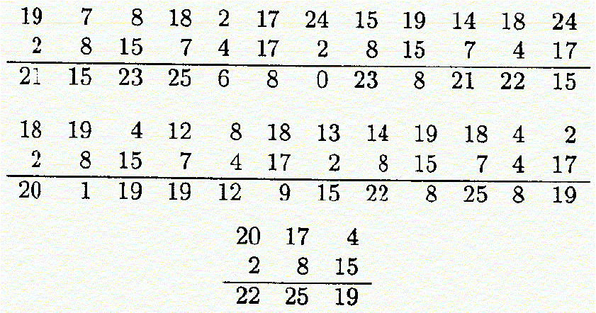
Vigenère Cipher
Invented in the 16th century
A kind of poly-alphabetic substitution cipher
Using the correspondence A ↔ 0, B ↔ 1, …, Z ↔ 25.
Keyword: CIPHER ↔ (2, 8, 15, 7, 4, 17)
Plaintext: thiscryptosystemisnotsecure
Ciphertext: VPXZGIAXIVWPUBTTMJPWIZITWZT
COM 5336 Cryptography Lecture 1

Slide 20
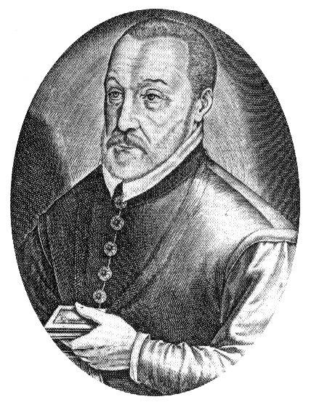
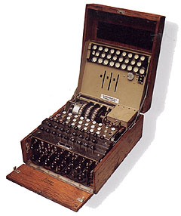
Vigenère Cipher and Enigma
Number of possible keywords of length m = 26^{m}.
Much larger than that of a simple substitution cipher.
An alphabetic character of a plaintext can be mapped to one of m possible alphabetic characters (assuming that the keyword contains m distinct characters).
In general, cryptanalysis is much more difficult for polyalphabetic than for monoalphabetic cryptosystems.
Rotor Machines
In the 1920s, various mechanical encryption devcies were invented to automate the process of encryption.
A rotor machine has a keyboard and a series of rotors, and implements a version of the Vigenère cipher.
The best-known rotor device is the Enigma, used by the Germans during World War II.
COM 5336 Cryptography Lecture 1

Slide 21
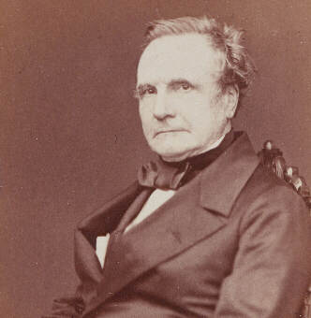
Kasiski Test (1863)
Idea: any two identical strings will be encrypted to the same ciphertext if they are km positions apart where m is the keyword length and k is a positive integer.
Two Steps of Attack:
  Find the keyword length
  Conduct statistical attack
An Example of Attack
  Look for trigrams that are identical
  Compute the distance between them, d₁, d₂, …
  Let m’ be a divisor of gcd(d₁, d₂, …)
  Write the ciphertext in a rectangular array with m’ columns, then statistical attack can be used on each column
COM 5336 Cryptography Lecture 1

Slide 22
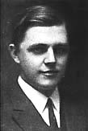
One-Time Pad
Polyalphabetic substitution with the keyword as long as the plaintext and the keyword has no statistical relationship to the plaintext.
Vernam Cipher (1918)
Works on binary string rather than letters
C_{i} = P_{i} ⊕ K_{i} , where K_{i} is chosen randomly
The only cryptographic system that can be proved to be unconditionally secure
Can be shown to be information theoretically secure.
COM 5336 Cryptography Lecture 1

Slide 23
Weakness of One-time Pad
Malleable: Provides secrecy but not authentication.
Keys must NOT be reused:
  cannot withstand Known Plaintext Attack
  depending on known information about plaintexts, Eve can make use of
  C1 ⊕ C2 = (M1 ⊕ K) ⊕ (M2 ⊕ K)
  = M1 ⊕ M2
  to figure out both messages
Generating random bits
  radioactive decay
  noisy diode
  flipping coins
COM 5336 Cryptography Lecture 1

Slide 24
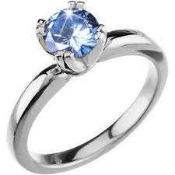
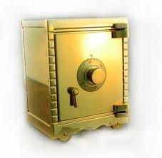
Diamond Ring and Safe
NT$100K
NT$200K
NT$100K

Slide 25
Computational Complexity
The input length of a problem is the number n of symbols used to characterize it
Complexity of a method
  Function f(n) is order O(g(n)) if
    f(n)<=c*|g(n)|, for all n>=N0, for some c
  Function f(n) is order Ω(g(n)) if
    f(n)>=c*|g(n)|, for all n>=N0, for some c
  Function f(n) is order θ (g(n)) if
    c1*|g(n)|<=f(n)<=c2*|g(n)|, for all n>=N0, for some c1 and c2
Polynomial time algorithm (P)
  solves any instance of a particular problem with input length n in time O(p(n)), where p is a polynomial

Slide 26
Computational Complexity (cont.)
Non-deterministic polynomial time algorithm (NP)
  is one for which any guess at the solution of an instance of the problem may be checked for validity in polynomial time.
NP-complete problems
  are a subclass of NP problems for which it is known that if any such problem has a polynomial time solution, then all NP problems have polynomial solutions.
Co-NP: the complements of NP problems.

Slide 27
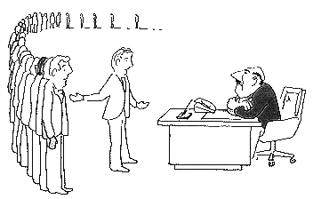
NP-Completeness
I can't find an efficient algorithm, but neither can all these famous people.

