Slide 1
COM5335 Network Security Lecture 11
Elliptic Curve Cryptography
Scott CH Huang

Slide 2
Outline
Elliptic Curve (橢圓函數)
  Basic definition
  Operations：addition & scalar
Elliptic Curve Cryptosystem
  Security considerations
    ECC vs. RSA comparison
  Implementation considerations
  Applications
Conclusions

Slide 3
Holy Roman Empire vs Elliptic Curve Cryptosystem
“The Holy Roman Empire is neither holy, nor Roman, nor an empire.”~ Voltaire
The Elliptic Curve Cryptosystem is neither related to ellipses nor itself a cryptosystem.

Slide 4
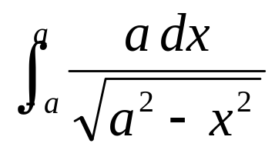
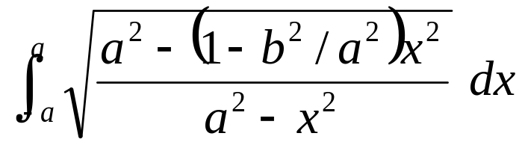
The Arc Length of an Ellipse
The arc length of a half circle
is given by the familiar integral
x²+y²=a²
-a
a
The arc length of a half ellipse
is more complicated
b
x²/a² + y²/b² = 1
-a
a

Slide 5
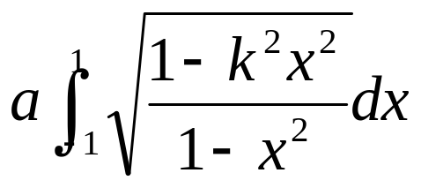
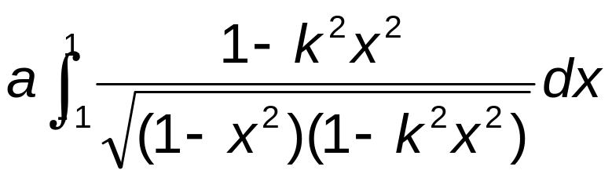
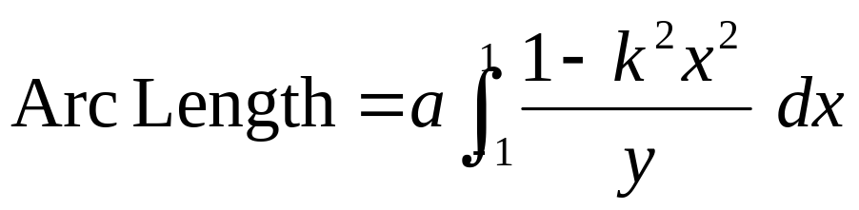
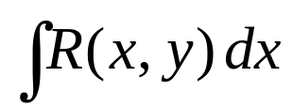
Let k² = 1 – b²/a² and change variables x → ax. Then the arc length of an ellipse is
An Elliptic Curve!
with y² = (1 – x²) (1 – k²x²) = quartic in x.
An elliptic integral is an integral , where R(x,y) is a rational function of the coordinates (x,y) on an “elliptic curve”
E : y² = f(x) = cubic or quartic in x.

Slide 6
Elliptic Curve Cryptography
ECC itself is NOT a cryptosystem
It uses EC to define a group.
We can use this group to form an Elliptic Curve Discrete Log Problem (ECDLP)
Any DLP-based system can replace its Z_{p} by the EC group

Slide 7
ECC (cont)
Thus, we can use EC on all DLP-based encryption/decryption/key exchange/signature algorithms: Diffie-Hellman, ElGamal, ElGamal signature, DSA
There are no good attacks on ECDLP now, so ECC can use very short keys.
  ECC uses 160-bit keys (cf RSA/ElGamal 1024 bits)

Slide 8
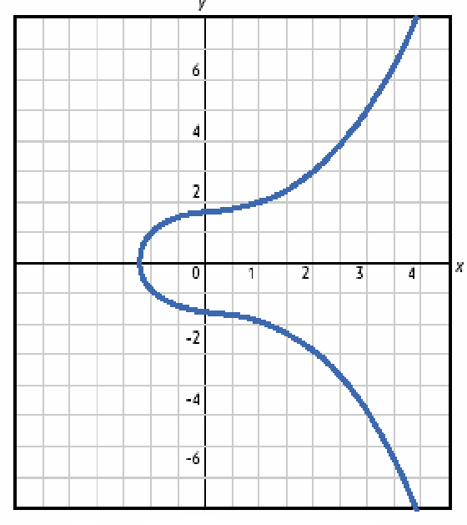
Elliptic Curves
Elliptic curves are not ellipses (the name comes from elliptic integrals)
Circle
  x² + y² = r²
Ellipsis
  a·x² + b·y² = c
Elliptic curve
  y² = x³ + a·x + b
Notes:
Graph from An intro to Elliptical Curve Cryptography at http://www.deviceforge.com/articles/AT4234154468.html, which is a reproduction of An Elliptic Curve Cryptography (ECC) Primer by Certicom.

Slide 9
Elliptic Curves Over Real Numbers
An elliptic curve over reals is the set of points (x,y) which satisfy the equation y² = x³ + a·x + b, where x, y, a, and b are real numbers
If 4·a³ + 27·b² is not 0 (i.e. x³ + a·x + b contains no repeated factors), then the elliptic curve can be used to form a group
An elliptic curve group consists of the points on the curve and a special point O (point at infinity)
Elliptic curves are additive groups
  Addition can be defined geometrically or algebraically

Slide 10
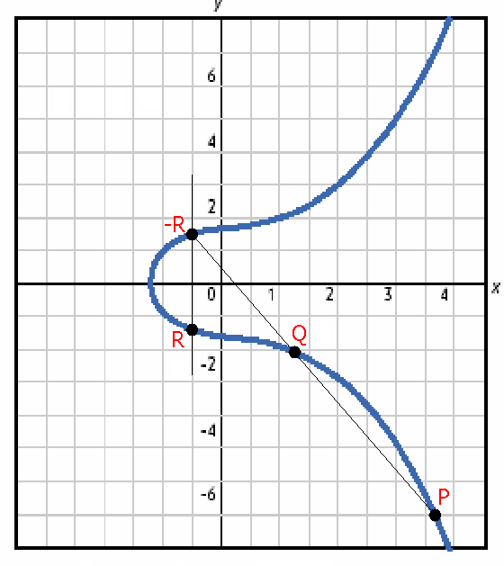
Adding Points P and Q
Draw a line that intersects distinct points P and Q
  The line will intersect a third point -R
Draw a vertical line through point -R
  The line will intersect a fourth point R
Point R is defined as the sum of points P and Q
  R = P + Q
Notes:
Shane added the points to this graph.

Slide 11
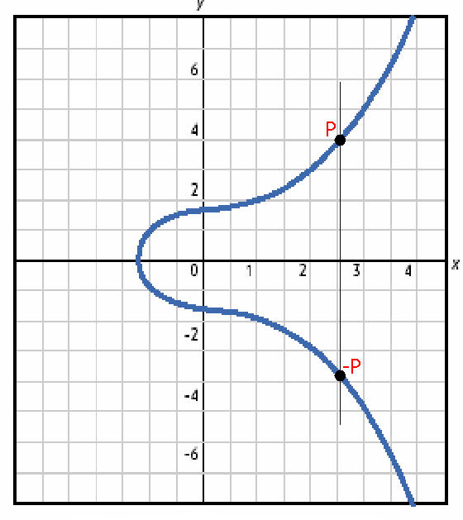
Adding Points P and -P
Draw a line that intersects points P and -P
  The line will not intersect a third point
For this reason, elliptic curves include O, a point at infinity
  P + (-P) = O
  O is the additive identity
Notes:
Shane added the points to this graph.

Slide 12
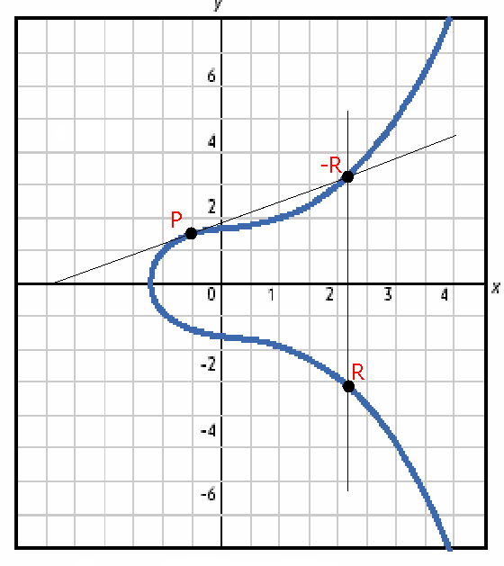
Doubling the Point P
Draw a line tangent to point P
  The line will intersect a second point -R
Draw a vertical line through point -R
  The line will intersect a third point R
Point R is defined as the summation of point P with itself
  R = 2·P
Notes:
Shane added the points to this graph.

Slide 13
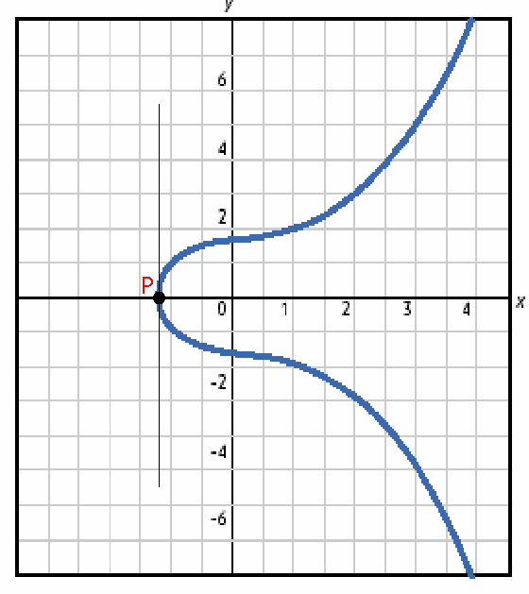
Doubling the Point P if yP = 0
Draw a line tangent to point P
  If yP = 0, the line will not intersect a second point
2·P = O when yP = 0
  3·P = P (2·P + P)
  4·P = O (2·P + 2·P)
  5·P = P (2·P + 2·P + P)
Notes:
Shane added the points to this graph.

Slide 14
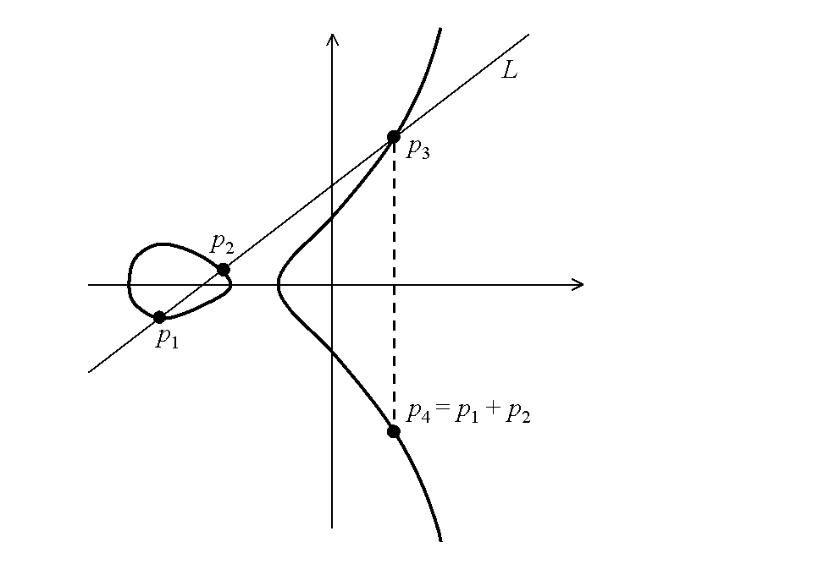
Some Elliptic Curve over Reals

Slide 15

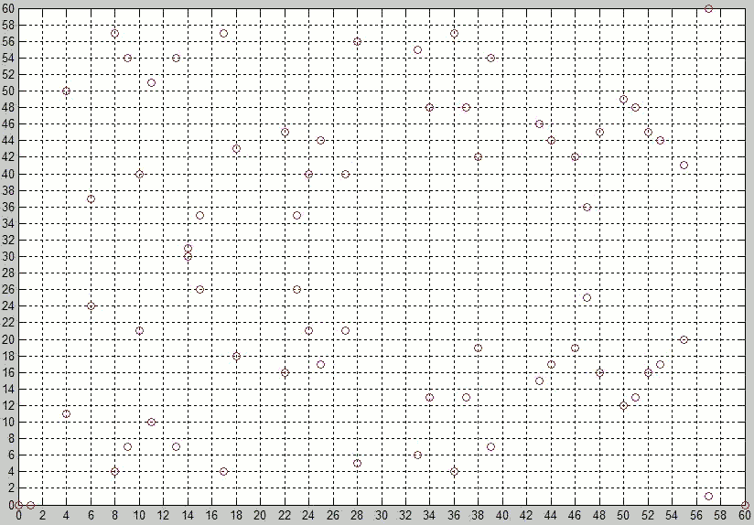
Elliptic Curves over GF(61)

Slide 16
Algebraic Approach
Addition: P=(x₁,y₁), Q=(x₂,y₂), R =(x₃,y₃) = P + Q
  λ = (y₂ - y₁) / (x₂ - x₁)
  x₃ = λ² - x₁ - x₂
  y₃ = -y₁ + λ( x₁ - x₃)
Doubling: R =(x₃,y₃) = 2P
  λ = (3x₁² + a) / (2y₁)
  x₃ = λ² - 2x₁
  y₃ = -y₁ + λ( x₁ - x₃)

Slide 17
Characteristic of a Ring
Let R be a ring. The characteristic of R, denoted by char(R), is defined to be the smallest number n such that a+…+a = 0 for all a ∈ R.
If R contains 1, then the characteristic is the smallest number n such that 1+…+1=0
If such number do not exists, then char(R) is defined to be 0.
n times
n times

Slide 18
Elliptic Curves Over Finite Fields
Calculations with real numbers are slow and rounding causes inaccuracy
Speed and accuracy are important for cryptography
Use elliptic curve groups over the finite field GF(p) (aka prime fields) or GF(2^{m}) (aka binary fields)

Slide 19
Elliptic Curves Over Finite Fields
Because it’s a finite field, a finite number of points make up the curve
  This means there is no curve anymore
  But also no more rounding
Geometric definitions of addition and doubling don’t work on these curves
Algebraic definitions still hold

Slide 20
Elliptic Curves in Weierstrass Form
y² +a₁xy+a₃y= x³ + a₂x² + a₄x + a₆
All coefficients and variables are assumed to be in a field F.
Depending on the characteristic of F, different forms of elliptic curves are used.
In particular, if the char(F)= 2, special treatment is necessary.
Fields with characteristic 3 are usually not important in applications and are often omitted.

Slide 21
Elliptic Curves over F w/ char(F)≠2,3
Elliptic curve over F : y² = x³ + ax + b,
  where x, y, a, b ∈ F.
4a³ + 27b² ≠ 0 (i.e. x³ + ax + b contains no repeated factors).
Everything is the same as the elliptic curve over reals except that there’s no curve anymore and their definitions are purely algebraic.
As usual, the elements are the (x,y) pairs satisfying the above equation along with O.

Slide 22
Algebraic Definition of Addition,Inverse, and Doubling
Inverse: P=(x₁,y₁)
  -P=(x₁,-y₁)
Addition: P=(x₁,y₁), Q=(x₂,y₂), R =(x₃,y₃) = P + Q
  λ = (y₂ - y₁) / (x₂ - x₁)
  x₃ = λ² - x₁ - x₂
  y₃ = -y₁ + λ( x₁ - x₃)
Doubling: R =(x₃,y₃) = 2P
  λ = (3x₁² + a) / (2y₁)
  x₃ = λ² - 2x₁
  y₃ = -y₁ + λ( x₁ - x₃)

Slide 23
Elliptic Curves Over F w/ char(F)=2
Usually we only consider two types of elliptic curves: zero j-invariant & nonzero j-invariant.
Zero j-invariant : y² +a₃y= x³ + a₄x + a₆, where x, y, a₃, a₄, a₆∈ F.
Nonzero j-invariant : y² +xy= x³ + a₂x² + a₆, where x, y, a₃, a₄, a₆∈ F.

Slide 24
Inverse, Addition, & Doubling of
Zero j-invariant Elliptic Curves
Zero j-invariant Elliptic Curve: y² +a₃y= x³ + a₄x + a₆
Inverse: P=(x₁,y₁)
  -P=(x₁,-y₁+a₃)
Addition: P=(x₁,y₁), Q=(x₂,y₂), R =(x₃,y₃) = P + Q
  λ = (y₁ + y₂) / (x₁ + x₂)
  x₃ = λ² + x₁ + x₂
  y₃ = λ( x₁ + x₃) + y₁ + a₃
Doubling: R =(x₃,y₃) = 2P
  λ = (x₁² + a₄) / a₃
  x₃ = λ²
  y₃ = λ( x₁ + x₃) + y₁ + a₃

Slide 25
Inverse, Addition, & Doubling of Nonzero j-invariant Elliptic Curves
Nonzero j-invariant Elliptic Curve: y² +xy= x³ + a₂x² + a₆
Inverse: P=(x₁,y₁)
  -P=(x₁,y₁+x₁)
Addition: P=(x₁,y₁), Q=(x₂,y₂), R =(x₃,y₃) = P + Q
  λ = (y₁ + y₂) / (x₁ + x₂)
  x₃ = λ² +λ+ x₁ + x₂+ a₂
  y₃ = λ( x₁ + x₃) + x₃+ y₁
Doubling: R =(x₃,y₃) = 2P
  x₃ = (a₆ /x₁²) + x₁²
  y₃ = x₁² +( x₁ + y₁/x₁) x₃+ x₃

Slide 26
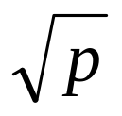
Number of Points on E(F)
#E(F): number of points on E(F).
#E(F) represents how many different pieces of information can be coded.
Hesse’s Theorem: |#E(F_{p})-(p+1)|≤2
The Weil Conjecture:
Let t=p+1-#E(F_{p}), then #E(F_{p}^{k})=p^{k}+1-α^{k}-β^{k},
where 1-tx+px²=(1-αx)(1-βx).
If the Weil Conjecture is true, then we can determine #E(F_{p}^{k}) based on #E(F_{p}).

Slide 27
Corresponding Operations of Z_{p}* and EC
Z_{p}* | E(F)
Multiplication | Addition
Exponentiation | Scalar (Multiple)

Slide 28
Correspondence between Z_{p}* and E(F) notation
Group | Z_{p}* | E(F)
Group elements | Integers {1, 2, …, p-1} | Points (x, y) on E(F)plus O
Group operation | Multiplication modulo p | Addition of points
Notation | Elements：g, h Multiplication：g•h Inverse：g⁻¹ Division： g / h Exponentiation： gª | Elements：G, H Addition：G+H Negative：-G Subtraction：G-H Multiple：aG
Discrete Logarithm Problem | Given g∈ Z_{p}* and h = gª mod p, find a | Given G∈ E(F) and H = aG, find a

Slide 29
Elliptic Curve Cryptosystem
Proposed by Neal Koblitz and V. S. Miller (independently)in 1985.They did not invent a cryptographic algorithm using ECs.
Standards：
  ANSI X9.62 — ECDSA
  ANSI X9.63 — EC Key Agreement and Transport Protocols
  IEEE P1363 standard—Standard Specifications for PKI
Hard problem：
  Elliptic curve discrete logarithm problem (ECDLP)
    Given P, Q to find k such that Q=kP

Slide 30
ECC Security Considerations
Attacks：
  Attacks on the elliptic curve discrete logarithm problem
    Naive exhaustive search
    Pohlig-Hellman algorithm
    Baby-step Giant-step algorithm：(n)^{1/2} steps
    Pollard’s rho algorithm：(πn/2)^{1/2} steps
    Parallelized Pollard’s rho algorithm：(πn)^{1/2} /2r steps
  Attacks on the hash function employed
  Other attacks
Experimental Results
The fastest so far
Parallelized Pollard’s rho algorithm：(πn)^{1/2} /2r steps
(r processors, n is the order of the point P)

Slide 31
Comparison：ECC vs. RSA
ECC |  | RSA
Key length (bits) | Breaking time (MIPS-Years) | Key length (bits) | Breaking time (MIPS-Years)
150 | 3.8 x 10¹⁰ | 512 | 3 x 10⁴
205 | 7.1 x 10¹⁸ | 768 | 2 x 10⁸
234 | 1.6 x 10²⁸ | 1024 | 3 x 10¹¹
 |  | 1280 | 1 x 10¹⁴
 |  | 1536 | 3 x 10¹⁶
 |  | 2048 | 3 x 10²⁰
Pollard rho method to attack ECDLP |  | Generalized number field sieve method to attack factorization
160

Slide 32
ECC Implementation Considerations
Security considerations
Suitability of methods available for optimizing finite field arithmetic(addition, multiplication, squaring, and inversion)
Suitability of methods available for optimizing elliptic curve arithmetic (point addition, point doubling, and scalar multiplication)
Application platform (software, hardware, or firmware)
Constraints of a particular computing environment (e.g., processor speed, storage, code size, gate count, power consumption)
Constraints of a particular communications environment (e.g., bandwidth, response time)

Slide 33
Applications
Key Exchange (Diffie Hellman)
Encryption & Decryption (ElGamal)
Digital Signature (ElGamal, DSA)
Authentication

Slide 34
EC Diffie-Hellman Key Exchange
Public info
p prime number
g g<q and is a primitive root of p
Public info
base point G
User A
User B
User A
User B
X= gª mod p
X=aG
a
X
a
X
Y= g^{b} mod p
Y=bG
b
Y
b
Y
K_{ab}=Yª mod p
=g^{ba} mod p
=
K_{ab}=X^{b} mod p
=g^{ab} mod p
K_{ab}=aY
=abG
=
K_{ab}=bX
=baG
Diffie-Hellman Key Exchange Algorithm
Key Exchange Using Elliptic Curve Cryptography

Slide 35
EC ElGamal Encryption
 | ElGamal encryption | EC ElGamal encryption
Key generation | Generate prime p. Compute a generator g for Z_{p}*. Select x, 2 ≤ x ≤ p-2 public key：(g, p, y) private key：x | Select (p, a, b, G), G ∈E(F) over prime field GF(p) such that the smallest n for nG=O is large. Select x<n public key：(p,a,b,G,n,P_{y}) private key：x
Encryption | Plaintext M Select k, 1 ≤ k ≤ p-2 | Encode plaintext as a point P_{m}. Select k< n.
Decryption | Receive C = {a, b} | Receive C = {P_{a}, P_{b}}
y = g^{x} mod p
P_{y}=xG
C={g^{k} mod p, My^{k} mod p}
C_{m} = {kG, P_{m}+kP_{y}}
M = b/a^{x} mod p
P_{m}=P_{b}- xP_{a}

Slide 36
ECDSA Signature Scheme
 | DSA | ECDSA
Key generation | Select p, q, x and q | p-1, 1≤ d < q. Select h ∈Z_{p}* and compute g = h ^{(p-1)/q} mod p until g≠1. public key：(p, q, g, y) private key：d | Select (p, a, b, G), G ∈E(F) over prime field GF(p) such that the smallest n for nG=O is large. public key：(p,a,b,G,n,P_{y}) private key：d
Signature generation | Select k, 1 ≤ k < q. s = k⁻¹( h(m) + dr) mod q | Select k, 1 ≤ k < n. s = k⁻¹( h(m) + dr) mod n
Signature verification | w = s⁻¹ mod q u₁ = h(m)w mod q u₂ = rw mod q If v = r, (r,s) passes | w = s⁻¹ mod n u₁ = h(m)w mod n u₂ = rw mod n If v = r, (r,s) passes
y = g^{d} mod p
P_{y} = dG
r = (g^{k} mod p) mod q
kG = (x₁,y₁) and r = x₁ mod n
v = (g^{u1} y^{u2} mod p) mod q
u₁G+u₂P_{y}=(x₀, y₀),
v = x₀ mod n

Slide 37
Conclusions
ECC Advantages：
Offers the highest strength-per-key-bit of any known public-key system
Offers the same level of security with smaller key sizes
Computational power
High-speed S/W and H/W implementations
Integrated circuit space is limited
  smart card, wireless devices

Slide 38
References
ECC Whitepapers
http://www.certicom.com/research/weccrypt.html
Elliptic Curves and Cryptography
Dr. Dobb’s Journal April 1997
The Elliptic Curve Digital Signature Algorithm (ECDSA)
http://www.certicom.com/pdfs/whitepapers/ecdsa.pdf
ECC Tutorial
http://www.certicom.com/resources/ecc_tutorial/ecc_tutorial.html

