Slide 1
COM 5336
Lecture 7
Other Public-Key Cryptosystems
Scott CH Huang
COM 5336 Cryptography Lecture 7

Slide 2
Outline
Rabin public-key encryption algorithm
ElGamal public-key encryption algorithm
Diffie-Hellman key exchange protocol

Slide 3
Contemporary Public-Key Cryptosystems
Based on the Factorization Problem:
  RSA, Rabin
Based on the Discrete Logarithm Problem:
  ElGamal, Elliptic Curve, DSA (signature scheme only), Diffie-Hellman (key exchange & encryption)

Slide 4

Rabin Public-Key Cryptosystem
Rabin encryption is an extremely fast operation as it only involves a single modular squaring. By comparison with RSA.
Rabin decryption is slower than encryption but is comparable in speed to RSA decryption

Slide 5
Rabin Key Generation
Generate 2 large random numbers primes p an q, each with the same size
Compute N=pq
The public key is N and the private key is p and q

Slide 6
Rabin Encryption
Rabin Encryption is nothing more than doing a SQUARE operation as follows.
  Represent the message as an integer m in the range {0,1,….,N-1}
  Ciphertext is c ≡ m²mod N

Slide 7
Rabin Decryption
Rabin Decryption is a SQROOT operation
  Find the square roots m1,m2,m3 and m4 of c mod N
  The message sent was either m1,m2,m3 or m4.

Slide 8
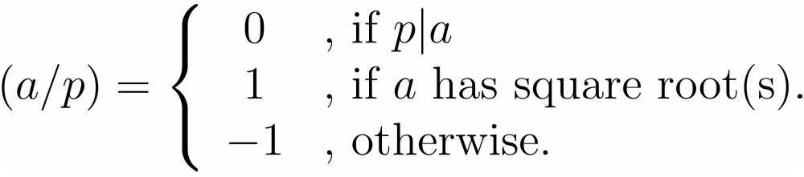
The Legendre Symbol
The Legendre symbol is a useful tool for keeping track of whether or not an integer has a sqrt mod a prime number p.
Let p be an odd prime and a an integer. The Legendre symbol (a/p) is defined as follows.

Slide 9
Facts of the Legendre Symbol
(a/p) ≡ a^{(p-1)/2} mod p
(ab/p)=(a/p)(b/p)
(Law of quadratic reciprocity) If q is an odd prime distinct from p, then
(p/q)=(q/p)(-1)^{(p-1)(q-1)/4}

Slide 10

Find SQROOT in Z_{p}
INPUT: an odd prime p & an odd integer a s.t. 0<a<p
OUTPUT: two square roots of a mod p
If (a/p)=-1, stop & return
Select b (0<b<p) with (b/p)=-1. Represent p-1=2^{s}t where t is odd.
Compute a⁻¹ mod p
c← b^{t} mod p, r ← a^{(t+1)/2} mod p
For i from 1 to s-1 do
  Compute
  If d ≡ -1 mod p, set r ← rc mod p
  c ← c² mod p
Return (r,-r)

Slide 11
Find SQROOT in Z_{p} where p≡3 mod 4
INPUT: an odd prime p where p≡3 mod 4, and square a s.t. 0<a<p
OUTPUT: two square roots of a mod p
Compute r ≡ a^{(p+1)/4} mod p
Return (r,-r)

Slide 12
Find SQROOT in Z_{p} where p≡5 mod 8
INPUT: an odd prime p where p≡5 mod 8, and square a s.t. 0<a<p
OUTPUT: two square roots of a mod p
Compute d ≡ a^{(p-1)/4} mod p
If d ≡ 1 mod p then compute r ≡ a^{(p+3)/8} mod p
If d ≡ -1 mod p then compute r ≡ 2a(4a)^{(p-5)/8} mod p
Return (r,-r)

Slide 13
Find SQROOT in Z_{n} where n=pq (p,q primes)
INPUT: n=pq & an integer a s.t. 0<a<n, a has SQROOT(s)
OUTPUT: four sqrts of a mod p
Find the two sqrts (r,-r) of a mod p
Find the two sqrts (s,-s) of a mod q
Use extended Euclid’s algorithm to find integers c,d s.t. cp+dq=1
Set x ≡ rdq+scp mod n and y ≡ rdq-scp mod n
Return (x,-x,y,-y)

Slide 14
A Problem Regarding Rabin’s Encryption Scheme
To decrypt a ciphertext, we need to compute the sqrt. However, there are 4 sqrts, how to decide which one is the plaintext???
Appropriate coding is needed to decide which one is the plaintext.
In practice, we usually take part of the plaintext and append it to the end.

Slide 15
Rabin – An Example
Key generation: Alice chooses the primes p=277, q=331, and computes N=pq=91687. Alice’s public key is N=91687 and private key is p=277 and q=331
Encryption: Suppose that the last six bits of the original messages are required to be appended prior to encryption. In order to encrypt the 10-bits message m=1001111001, Bob appends the last six bits of m to obtain 16-bits message.
m=1000111001111001 which in decimal notation is m=40569, the ciphertext is:
    C ≡ m²mod N ≡ 40569² mod 91687 ≡ 62111

Slide 16
Rabin (cont’d)
Decryption: to decrypt C, Alice computes the four sqrts of C mod N
m1=69954,m2=22033,m3=40569,m45118
  m1=1000100000010110,
  m2=101011000010001,
  m3=1001111001111001,
  m4=110001111010110
Therefore, m3 is the plaintext.

Slide 17
SQROOT Problem
SQROOT Problem
  If x² ≡ a mod N has a solution for a given composite integer N=pq (p,q primes), find a sqrt of a mod N.
FACTOR =>? SQROOT
  Use previous algorithm, we can find sqrt mod p and sqrt mod q
  Then we use extended Euclid’s algorithm to find sqrt mod N

Slide 18
SQROOT Problem
SQROOT=>? FACTOR
  Suppose A is an algorithm that solves SQROOT
  Then we generate x randomly and compute a ≡ x² mod N
  Apply A to find sqrt y
  If y=x or –x, try another x and repeat
  If not, we are done! (why?)

Slide 19
Security of Rabin
Rabin=SQROOT=Factor
Provably secure against passive adversary (cf. RSA)
Susceptible to chosen ciphertext attack similar to RSA
Many RSA attacks can be applied to Rabin

Slide 20
Finite Cyclic Groups and the Discrete Logarithm Problem
A finite group G is cyclic if it can be represented as powers of some element g in G as follows.
  G={e,g,g²,g³,…g^{n-1}}
  g is called a generator of G, and n is called the order of G.
Example: Let p=97. Then Z₉₇* is a cyclic group of order n=96. A generator of Z₉₇* is g=5. Since 5³² ≡ 35 (mod 97), log₅35 = 32 in Z₉₇*.
Let G be a finite cyclic group of order n. Let g be a generator of G, and let y ∈ G. The discrete logarithm of y to the base g, denoted log_{g}y, is the unique integer x, 0 ≤ x ≤ n-1, such that y = g^{x}.

Slide 21
Discrete Logarithm Problem
DLP in Z_{p}* : Given a prime p, a generator g of Z_{p}*, and an element y ∈ Z_{p}*, find the integer x, 0 ≤ x ≤ p-2, such that g^{x} ≡ y (mod p).
The security of many cryptographic techniques depends on the intractability of the discrete logarithm problem.
Both ElGamal encryption scheme and Diffie-Hellman key exchange are based on DLP in Z_{p}*.The Elliptic curve Cryptosystem is based on DLP in general cyclic groups.

Slide 22

ElGamal Encryption Scheme
ElGamal encryption scheme is an asymmetric key encryption algorithm
ElGamal encryption is non-deterministic, meaning that a single plaintext can be encrypted to many possible ciphertexts

Slide 23
ElGamal Key Generation
Each entity randomly choose a large prime p and picks a generator g ∈ Z_{p}*
Each entity randomly chooses an exponent x (x<p), and computes y ≡ g^{x} (mod p).
Public key = (p,g,y)
Private key= x

Slide 24
ElGamal Encryption
Suppose Bob wants to encrypt a message M (M<p) and send to Alice
Bob obtains Alice’s public key (p,g,y) and randomly picks an integer r (r<p)
Bob computes
  A ≡ g^{r} mod p
  B ≡ My^{r} mod p
Ciphertext C = (A, B).

Slide 25
ElGamal Decryption
Alice does the followings
Computes K ≡ A^{x} mod p,
M ≡ BK⁻¹ mod p

Slide 26
ElGamal - An Example
Key Generation:
  p =2357
  g = 2
  x = 1751
  y ≡ g^{x} ≡ 2¹⁷⁵¹ ≡ 1185 (mod 2357)
Public key: (p,g,y) = (2357, 2, 1185)
Private key: x = 1751

Slide 27
ElGamal
Encryption:
  say M = 2035
  Pick a random number r = 1520
  Computes
  A = g^{r} ≡ 2¹⁵²⁰ ≡ 1430 (mod 2357)
  B = My^{r} ≡ 2035 * 1185¹⁵²⁰ ≡ 697 (mod 2357)
  The ciphertext C = (A, B) = (1430, 697)
Decryption:
  Computes K ≡ A^{x} ≡ 1430¹⁷⁵¹ ≡ 2084 (mod 2357)
  M ≡ B K⁻¹ ≡ 697 * 2084⁻¹ ≡ 2035 (mod 2357)

Slide 28
Remarks on ElGamal Encryption Scheme
ElGamal encryption scheme is non-deterministic
Randomization is introduced to
  increase the effective size of the plaintext space
  i.e. one plaintext can map to a large set of possible ciphertexts
  decrease the effectiveness of chosen-plaintext attack by means of a one-to-many mapping in the encryption process
Efficiency:
  encryption requires two exponentiation operations
  exponentiation operations may be very expensive when implemented on some low-power devices. e.g. low-end PalmPilots, smart cards and sensors.
  message expansion by two-fold
Security:
  depends on the difficulty of solving DLP (more precisely, Computational Diffie-Hellman Problem).

Slide 29
Diffie-Hellman Key Exchange
A Key Exchange Protocol:
  provide a secure way for two communicating party to share a symmetric key (so called a session key)
  This session key is then used to provide privacy and authentication for subsequent message flow.
  History: problem first posed by Merkle at UC Berkeley, Diffie and Hellman came up with the protocol:
Alice
Bob
a<p
b<p
gª mod p
g^{b} mod p
Shared Session Key = g^{ab} mod p
W. Diffie, M. E. Hellman, “New directions in Cryptography”, IEEE Trans. Information Theory, IT-22, pp. 64-654, Nov 1976.

Slide 30



Man-in-the-Middle Attack
Diffie-Hellman key exchange
gª
g^{x}
g^{b}
g^{y}
Alice computes g^{ab}
Bob computes g^{xy}

Slide 31
Key Management Using Other PKC
Public-key encryption helps address key distribution problems in two aspects:
  distribution of public keys
  use of public-key encryption to distribute secret keys

Slide 32
Distribution of Public Keys
Can use the following approaches:
  Public announcement
  Publicly available directory
  Public-key authority
  Public-key certificates

Slide 33
Public Announcement
Users distribute public keys to recipients or broadcast to community at large
  eg. append PGP keys to email messages or post to news groups or email list
Major weakness is forgery
  anyone can create a key claiming to be someone else and broadcast it
    can masquerade as claimed user until forgery is discovered

Slide 34
Publicly Available Directory
Achieve greater security by registering keys with a public directory
Directory must be trusted with properties:
  contains {name,public-key} entries
  participants register securely with directory
  participants can replace key at any time
  directory is periodically published
  directory can be accessed electronically
still vulnerable to tampering or forgery

Slide 35
Public-Key Authority
Further improve security by tightening control over distribution of keys from directory
Keeps all the properties of directory
Requires users to know the public key for the directory
Users interact with directory to obtain any desired public key securely
  does require real-time access to directory when keys are needed

Slide 36
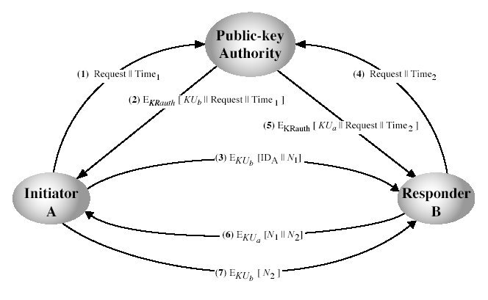
Public-Key Authority
Notes:
Stallings Fig 10.3. See text for details of steps in protocol.

Slide 37
Public-Key Certificates
Certificates allow key exchange without real-time access to public-key authority
a certificate binds identity to a public key
  usually with other info such as period of validity, rights of use etc
with all contents signed by a trusted Public-Key or Certificate Authority (CA)
can be verified by anyone who knows the public-key authorities’ public-key

Slide 38
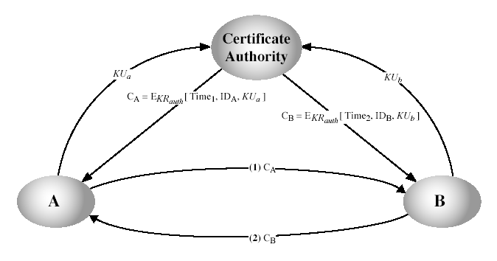
Public-Key Certificates
Notes:
Stallings Fig 10.4. See text for details of steps in protocol.

Slide 39
Distribution of Secret Keys using Public-Key
public-key cryptography can be used for secrecy or authentication
  but public-key algorithms are slow
  so usually we want to use private-key encryption to protect message contents, such as using a session key
There are several alternatives for negotiating a suitable session key

Slide 40
Simple Secret Key Distribution
proposed by Merkle in 1979
  A generates a new temporary public key pair
  A sends B the public key and their identity
  B generates a session key K sends it to A encrypted using the supplied public key
  A decrypts the session key and both use
problem is that an opponent can intercept and impersonate both halves of protocol

Slide 41
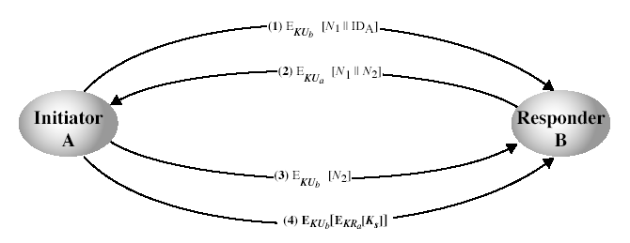
Public-Key Distribution of Secret Keys
if A and B have securely exchanged public-keys:
Notes:
Stallings Fig 10.6. See text for details of steps in protocol. Note that these steps correspond to final 3 of Fig 10.3, hence can get both secret key exchange and authentication in a single protocol.

