Slide 1

UVAs Traffic Control based on Multi-Access Edge Computing
 | 2018 IEEE Global Communication Conference Authors : Oussama Bekkouche, Tarik Taleb and Miloud Bagaa Abu Dhabi, United Arab Emirates, 2018, pp. 1-6. doi: 10.1109/GLOCOM.2018.8647421
Date : 2019 / 12 /30
Name : 陳文遠
StudentID : 108064535

Slide 2
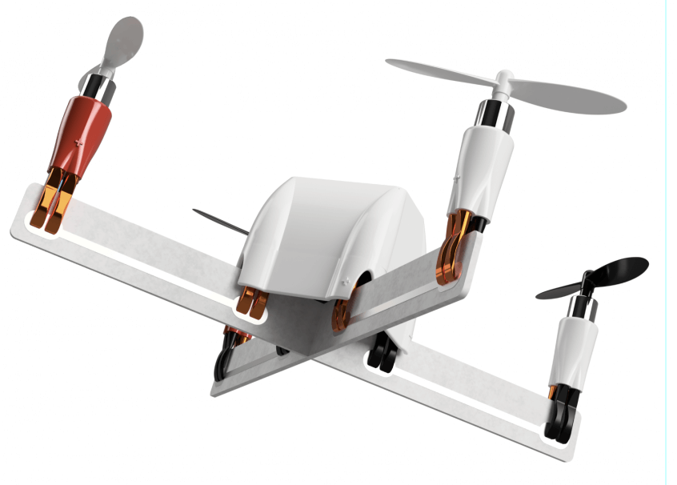
CONTENT
Introduction
Experiment
Method
Discussion

Slide 3
INTRODUCTION

Slide 4
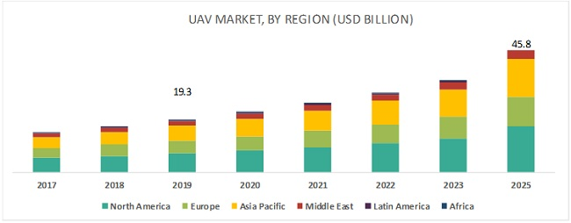
Why UAV ?
UAV is widely used.
UAV’s market is expected to reach $45.8 billion by 2025.
Military Reconnaissance
Inspection of Infrastructures
Smart Agriculture
Traffic Management
Border surveillance
Cargo delivery
1.4 trillion NTD

Slide 5
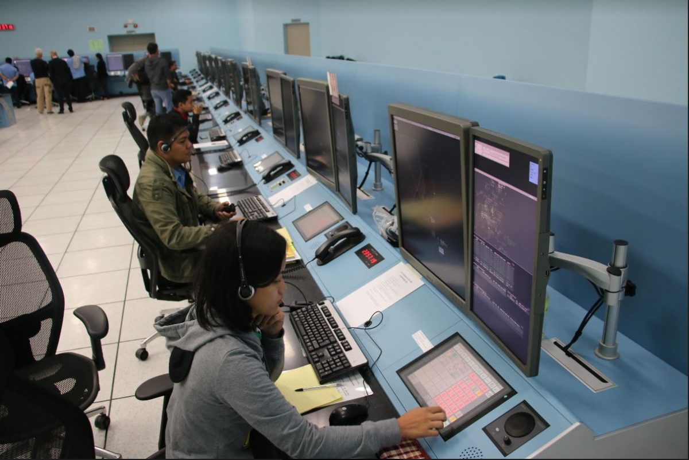
Air Traffic Management (ATM)
Each UAV is manually and individually operated (or use pre-define program).
In challenging environments, we must keep UAV stayed in Visual-Line-of-Sight of pilot.
Rely on voice communication between air traffic controllers and pilots.
That’s not designed to handle the expected high density of UAVs traffic.

Slide 6


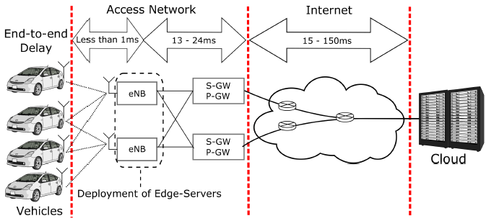
UAV Traffic Management (UTM)
Used to handle the high density of UAVs traffic.
Mitigate the risk of collision among small UAVs, flying in uncontrolled airspace.
A standard UTM must offer are the identification, the localization and the steering of UAVs.
Use cellular mobile networks to support the communication
between UTM service and UAVs.
Advantage：
Scalable
Secure
Ready-for-use
Fig. 5G Cellular-Connected Devices

Slide 7
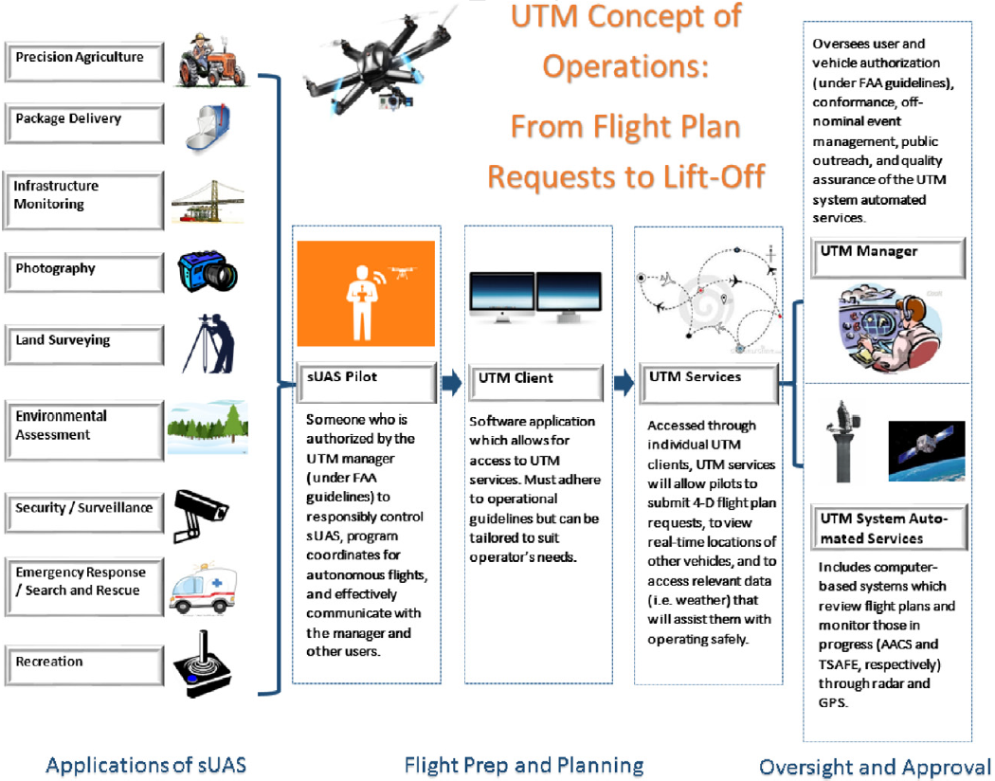
UAV Traffic Management (UTM)
The figure is an UTM system
concept of operations flow chart.

Slide 8
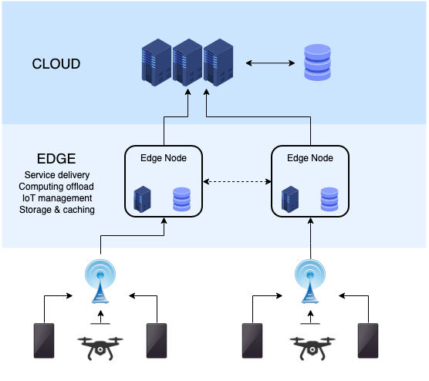
Multi-Access Edge Computing (MEC)
MEC push cloud-like services to the network edges.
This will reduce the latency and increase the reliability of
the communication.

Slide 9
EXPERIMENT

Slide 10
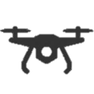
Experimentation Introduction
The management of UAVs’ traffic is mainly based on the dynamic definition of aerial geo-fences to specify the allowed and the restricted flight zones.
The UTM controls the flight plan of each UAV to ensure that it is flying inside an allowed geo-fences.
We had known that latency and packet loss will damage the reliability of communication, so we lever-
age this experimentation to test the impact of the two situations.
Allowed airspace
Latency ?
What’s the impact of
Packet Loss ?

Slide 11
Experimentation Methodology

Slide 12
Experimentation Setup

Slide 13
Result & Discussion

Slide 14
METHOD

Slide 15
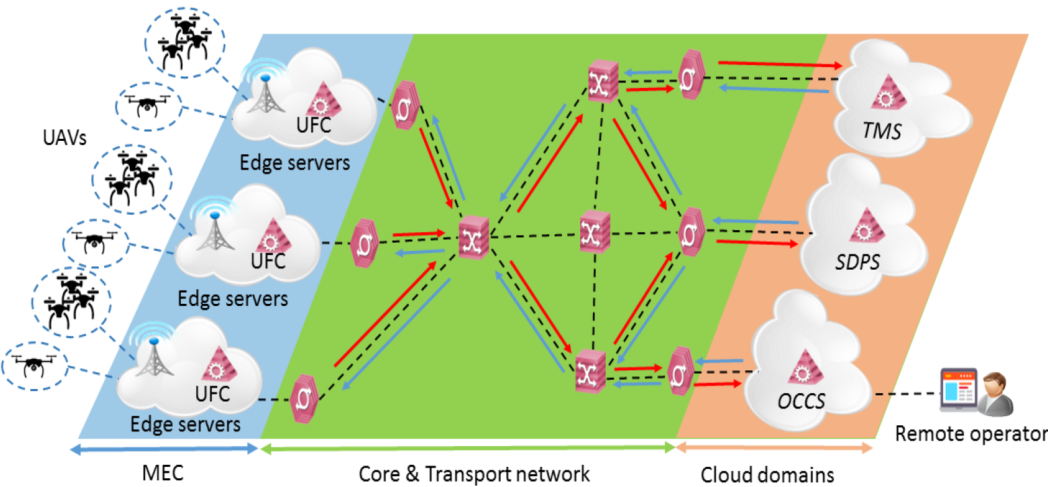
MEC-Based UAVs’ Traffic Management Framework

Slide 16
DISCUSSION

Slide 17

Q & A

Slide 18
Thank you for your attention

