Slide 1


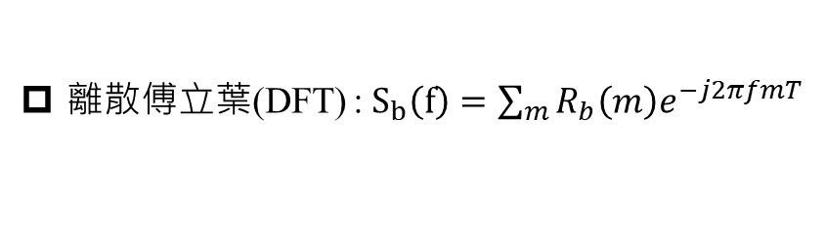

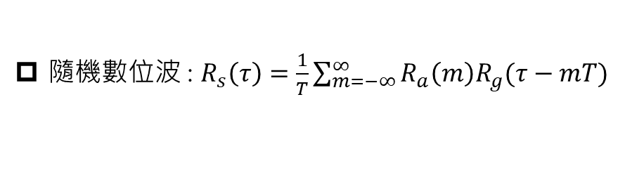

M-ary duo-binary signaling 錯誤率 : $P_{M}=2\left(1−\frac{1}{M^{2}}\right)Q\sqrt{{\left(\frac{π}{4}\right)}^{2}\frac{6}{M^{2}−1}\frac{E_{av}}{N_{o}}}$
Symbol rate : $R=\frac{1}{T}=\frac{Bit Rate}{Bits}$
Raised cosine bandwidth : $\frac{W}{2}=\frac{1}{2T}\left(1+β\right)$
隨機數位波 : $R_{s}\left(τ\right)=\frac{1}{T}\sum_{m=−∞}^{∞}{R_{a}\left(m\right)R_{g}(τ−mT)}$
尤拉公式 : $\sin\left(x\right)=\frac{e^{jx}−e^{−jx}}{2j}$ and $\cos\left(x\right)=\frac{e^{jx}+e^{−jx}}{2}$
離散傅立葉(DFT) : $S_{b}\left(f\right)=\sum_{m}{R_{b}\left(m\right)e^{−j2πfmT}}$
$CTFT : g\left(t\right)→G\left(f\right); g\left(−t\right)→G^{∗}\left(f\right)$
$M$odified duo-binary : $P_{n}=\left(D_{n}−P_{n−2}\right) mod 2 ; I_{n}=\left\{\begin{aligned} 1 ;P_{n}=1 \\ −1 ;P_{n}=0\end{aligned} ; B_{n}=I_{n}−I_{n−2} ;\hat{{ D}_{n}}=\left\{\begin{aligned}1 ;\left|B_{n}\right|>1 \\ 0 ;|B_{n}|<1\end{aligned}\right.\right.$
$M$-ary duo-binary : $P_{n}=\left(D_{n}−P_{n−1}\right) mod M ; I_{n}=\left[2P_{n}−\left(M−1\right)\right]d ;B_{n}=I_{n}+I_{n−1} ;\hat{{ D}_{n}}=$[$\frac{B_{n}}{2d}+(M−1)$] mod M

Slide 2
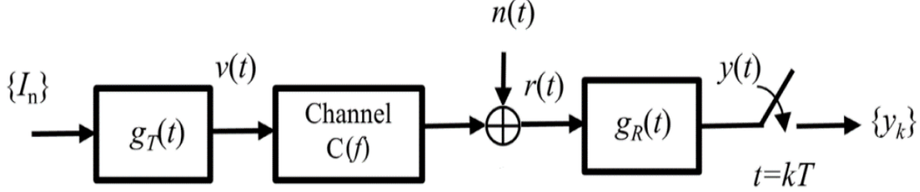
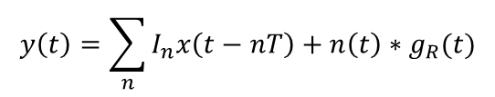
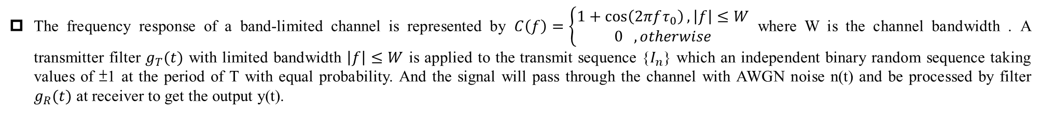
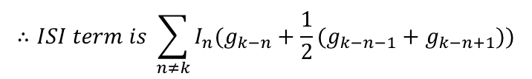
The frequency response of a band-limited channel is represented by $C\left(f\right)=\left\{\begin{aligned}1+\cos\left(2πfτ_{0}\right), \left|f\right|≤W \\ 0 , otherwise\end{aligned}\right.$ where W is the channel bandwidth . A transmitter filter $g_{T}(t)$ with limited bandwidth $\left|f\right|≤W$ is applied to the transmit sequence {$I_{n}$} which an independent binary random sequence taking values of ±1 at the period of T with equal probability. And the signal will pass through the channel with AWGN noise n(t) and be processed by filter $g_{R}(t)$ at receiver to get the output y(t).
(a) Let $x\left(t\right)=g_{T}\left(t\right)∗c\left(t\right)∗g_{R}(t)$, please write the equivalent discrete time
expression at the output of the sampler $y_{k}=x(kT)$ by $\left\{I_{n}\right\},\left\{x_{k}\right\}, \left\{n_{k}\right\} and \left\{g_{R,k}\right\}.$
(b) Let $τ_{0}=T$ and define $g_{k}=g_{T,k}∗g_{R,k}$,what is the ISI pattern in terms of $\{I_{n}\}$ and $\{g_{k}\}$ resulting from the channel?
(a)
$$y\left(t\right)=\sum_{n}{I_{n}x\left(t−nT\right)+n\left(t\right)∗g_{R}(t)}$$
$$y_{k}=\sum_{n}{I_{n}x\left(kT−nT\right)+n\left(kT\right)∗g_{R}(kT)}=\sum_{n}{I_{n}x_{k−n}+n_{k}∗g_{R,k}=\sum_{n}{I_{n}x_{k−n}+\sum_{n}{n_{n}g_{R,k−n}}}}$$
(b)
$$c\left(t\right)=δ\left(t\right)+\frac{1}{2}\left[δ\left(t−T\right)+δ\left(t+T\right)\right]→c_{k}=δ\left[k\right]+\frac{1}{2}(δ\left[k−1\right]+δ[k+1])$$
$$x_{k}=g_{k}∗c_{k}=g_{k}∗\left\{δ\left[k\right]+\frac{1}{2}\left(δ\left[k−1\right]+δ\left[k+1\right]\right)\right\}=g_{k}+\frac{1}{2}(g_{k−1}+g_{k+1})$$
$$∴ISI term is \sum_{n≠k}{I_{n}(g_{k−n}+\frac{1}{2}(g_{k−n−1}+g_{k−n+1}))}$$

Slide 3
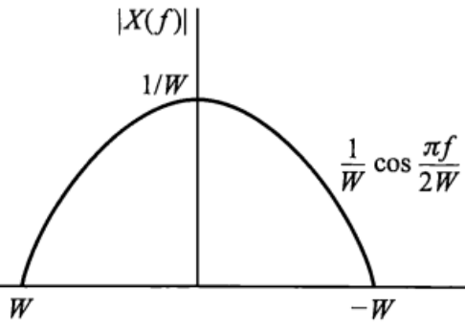
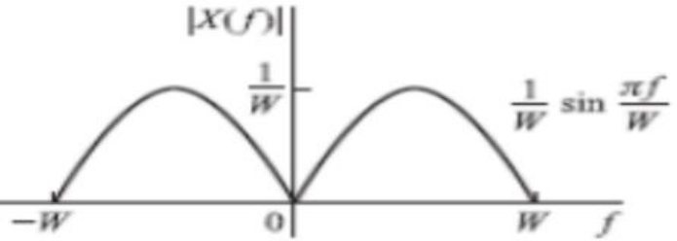
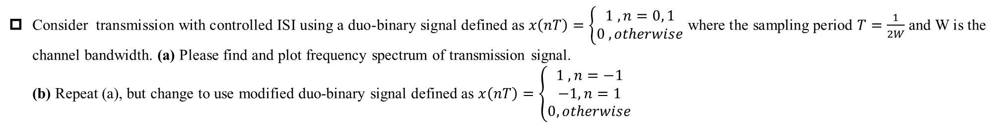
Consider transmission with controlled ISI using a duo-binary signal defined as $x\left(nT\right)=\left\{\begin{aligned}1 , n=0, 1 \\ 0 , otherwise\end{aligned}\right.$ where the sampling period $T=\frac{1}{2W}$ and W is the channel bandwidth. (a) Please find and plot frequency spectrum of transmission signal.
(b) Repeat (a), but change to use modified duo-binary signal defined as $x\left(nT\right)=\left\{\begin{aligned}1 , n=−1 \\ −1, n=1 \\ 0, otherwise\end{aligned}\right.$
(a)
$$X\left(f\right)=T+Te^{−j2πnfT}= \frac{1}{2W}e^{−jπf\frac{1}{2W}}\left(e^{jπf\frac{1}{2W}}+e^{−jπf\frac{1}{2W}}\right)=\frac{1}{W}e^{−jπf\frac{1}{2W}}\cos\left(\frac{πf}{2W}\right);\left|f\right|≤W$$
(b)
$$X\left(f\right)=Te^{j2πfT}−Te^{−j2πfT}=2jTsin\left(2πfT\right)=2j\frac{1}{2W}\sin\left(\frac{πf}{W}\right)=\frac{j}{W}\sin\left(\frac{πf}{W}\right);\left|f\right|≤W$$

