Slide 1


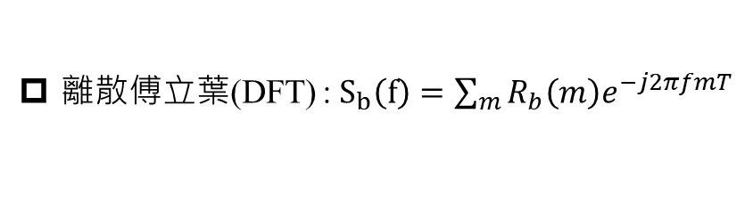


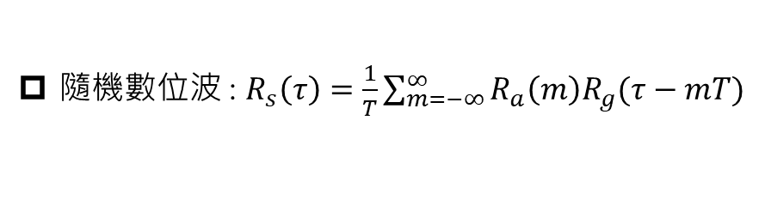

M-ary duo-binary signaling 錯誤率 : $P_{M}=2\left(1−\frac{1}{M^{2}}\right)Q\sqrt{{\left(\frac{π}{4}\right)}^{2}\frac{6}{M^{2}−1}\frac{E_{av}}{N_{o}}}$
Symbol rate : $R=\frac{1}{T}=\frac{Bit Rate}{Bits}$
Raised cosine bandwidth : $\frac{W}{2}=\frac{1}{2T}\left(1+β\right)$
隨機數位波 : $R_{s}\left(τ\right)=\frac{1}{T}\sum_{m=−∞}^{∞}{R_{a}\left(m\right)R_{g}(τ−mT)}$
尤拉公式 : $\sin\left(x\right)=\frac{e^{jx}−e^{−jx}}{2j}$ and $\cos\left(x\right)=\frac{e^{jx}+e^{−jx}}{2}$
離散傅立葉(DFT) : $S_{b}\left(f\right)=\sum_{m}{R_{b}\left(m\right)e^{−j2πfmT}}$
$CTFT : g\left(t\right)→G\left(f\right); g\left(−t\right)→G^{∗}\left(f\right)$
$M$odified duo-binary : $P_{n}=\left(D_{n}−P_{n−2}\right) mod 2 ; I_{n}=\left\{\begin{aligned} 1 ;P_{n}=1 \\ −1 ;P_{n}=0\end{aligned} ; B_{n}=I_{n}−I_{n−2} ;\hat{{ D}_{n}}=\left\{\begin{aligned}1 ;\left|B_{n}\right|>1 \\ 0 ;|B_{n}|<1\end{aligned}\right.\right.$
$M$-ary duo-binary : $P_{n}=\left(D_{n}−P_{n−1}\right) mod M ; I_{n}=\left[2P_{n}−\left(M−1\right)\right]d ;B_{n}=I_{n}+I_{n−1} ;\hat{{ D}_{n}}=$[$\frac{B_{n}}{2d}+(M−1)$] mod M
補償通道失真 : $X\left(f\right)=G_{T}\left(f\right)H\left(f\right)G_{R}\left(f\right)=T (constant)$
OFDM 功率限制 : $P=\sum_{n=1}^{N}{Δf_{n}P\left(f_{n}\right) ; 有 N 個 subcarrier}$
Max Peak-to-Average Power Ratio : $PAPR=\frac{P_{peak}}{P_{av}}=N$ (subcarrier 個數)
$Multicarrier system total capacity :C=\sum_{i=1}^{N}{Δf_{i}\log_{2}{[1+\frac{P\left(f_{i}\right){\left|H\left(f_{i}\right)\right|}^{2}}{σ_{i}^{2}}]}}$

Slide 2
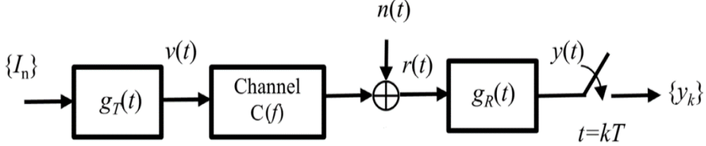
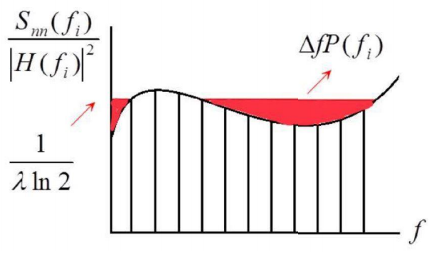
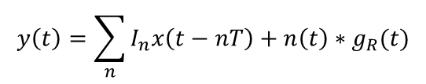
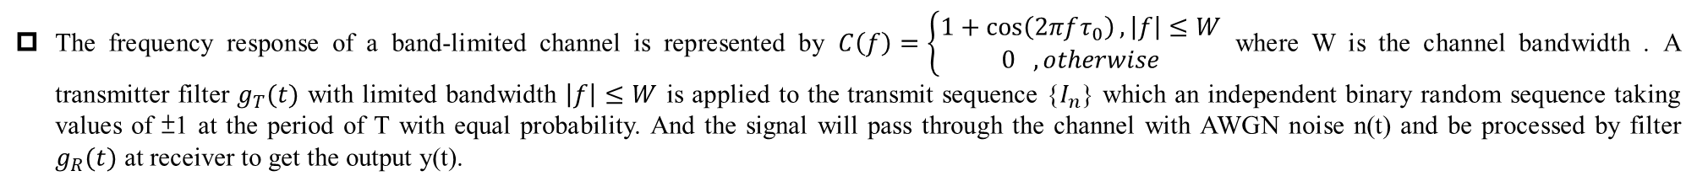
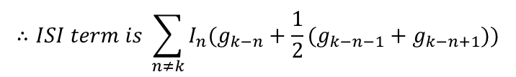
The frequency response of a band-limited channel is represented by $C\left(f\right)=\left\{\begin{aligned}1+\cos\left(2πfτ_{0}\right), \left|f\right|≤W \\ 0 , otherwise\end{aligned}\right.$ where W is the channel bandwidth . A transmitter filter $g_{T}(t)$ with limited bandwidth $\left|f\right|≤W$ is applied to the transmit sequence {$I_{n}$} which an independent binary random sequence taking values of ±1 at the period of T with equal probability. And the signal will pass through the channel with AWGN noise n(t) and be processed by filter $g_{R}(t)$ at receiver to get the output y(t).
(a) Let $x\left(t\right)=g_{T}\left(t\right)∗c\left(t\right)∗g_{R}(t)$, please write the equivalent discrete time
expression at the output of the sampler $y_{k}=x(kT)$ by $\left\{I_{n}\right\},\left\{x_{k}\right\}, \left\{n_{k}\right\} and \left\{g_{R,k}\right\}.$
(b) Let $τ_{0}=T$ and define $g_{k}=g_{T,k}∗g_{R,k}$,what is the ISI pattern in terms of $\{I_{n}\}$ and $\{g_{k}\}$ resulting from the channel?
(a)
$$y\left(t\right)=\sum_{n}{I_{n}x\left(t−nT\right)+n\left(t\right)∗g_{R}(t)}$$
$$y_{k}=\sum_{n}{I_{n}x\left(kT−nT\right)+n\left(kT\right)∗g_{R}(kT)}=\sum_{n}{I_{n}x_{k−n}+n_{k}∗g_{R,k}=\sum_{n}{I_{n}x_{k−n}+\sum_{n}{n_{n}g_{R,k−n}}}}$$
(b)
$$c\left(t\right)=δ\left(t\right)+\frac{1}{2}\left[δ\left(t−T\right)+δ\left(t+T\right)\right]→c_{k}=δ\left[k\right]+\frac{1}{2}(δ\left[k−1\right]+δ[k+1])$$
$$x_{k}=g_{k}∗c_{k}=g_{k}∗\left\{δ\left[k\right]+\frac{1}{2}\left(δ\left[k−1\right]+δ\left[k+1\right]\right)\right\}=g_{k}+\frac{1}{2}(g_{k−1}+g_{k+1})$$
$$∴ISI term is \sum_{n≠k}{I_{n}(g_{k−n}+\frac{1}{2}(g_{k−n−1}+g_{k−n+1}))}$$
Please explain why we use multicarrier system ?
Explain what water-filling algorithm is and why we use this algorithm. Try to draw a picture and explain it.
(SOL)
Advantage :
可減輕 multipath fading
強化對 ISI 的抵抗性
可讓每個 subcarrier 的 equalizer 簡化
對由 impulse noise 引起的干擾的敏感度較低。
(SOL)
紅色區域是要分配給每個 subchannel 的功率，y 軸為 channel quality 的倒數。因此 water-filling 的概念為給越好的 channel 分配越多的功率，給越差的 channel 分配越少的功率，以獲得最大的 total capacity。

Slide 3
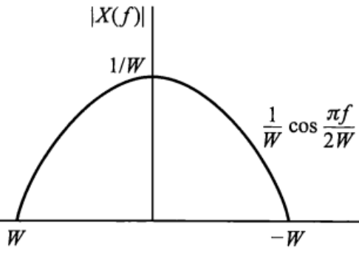
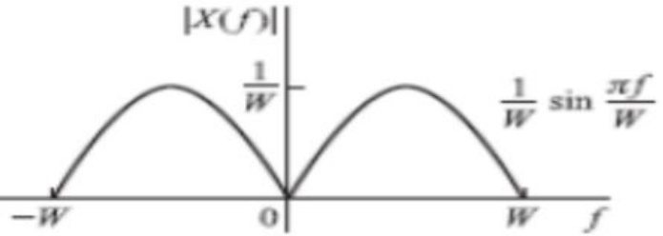
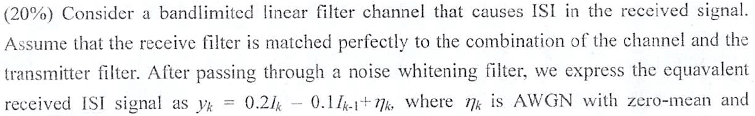
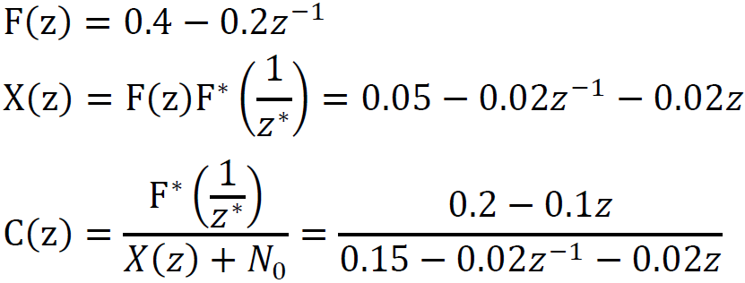
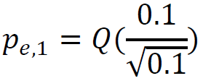

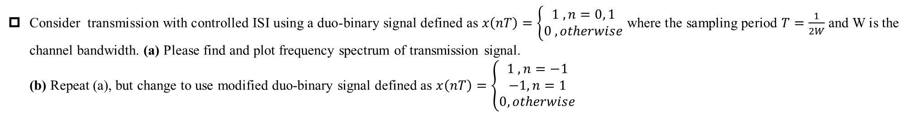
Consider transmission with controlled ISI using a duo-binary signal defined as $x\left(nT\right)=\left\{\begin{aligned}1 , n=0, 1 \\ 0 , otherwise\end{aligned}\right.$ where the sampling period $T=\frac{1}{2W}$ and W is the channel bandwidth. (a) Please find and plot frequency spectrum of transmission signal.
(b) Repeat (a), but change to use modified duo-binary signal defined as $x\left(nT\right)=\left\{\begin{aligned}1 , n=−1 \\ −1, n=1 \\ 0, otherwise\end{aligned}\right.$
(a)
$$X\left(f\right)=T+Te^{−j2πnfT}= \frac{1}{2W}e^{−jπf\frac{1}{2W}}\left(e^{jπf\frac{1}{2W}}+e^{−jπf\frac{1}{2W}}\right)=\frac{1}{W}e^{−jπf\frac{1}{2W}}\cos\left(\frac{πf}{2W}\right);\left|f\right|≤W$$
(b)
$$X\left(f\right)=Te^{j2πfT}−Te^{−j2πfT}=2jTsin\left(2πfT\right)=2j\frac{1}{2W}\sin\left(\frac{πf}{W}\right)=\frac{j}{W}\sin\left(\frac{πf}{W}\right);\left|f\right|≤W$$
(b)
(a)
$$→$$

Slide 4
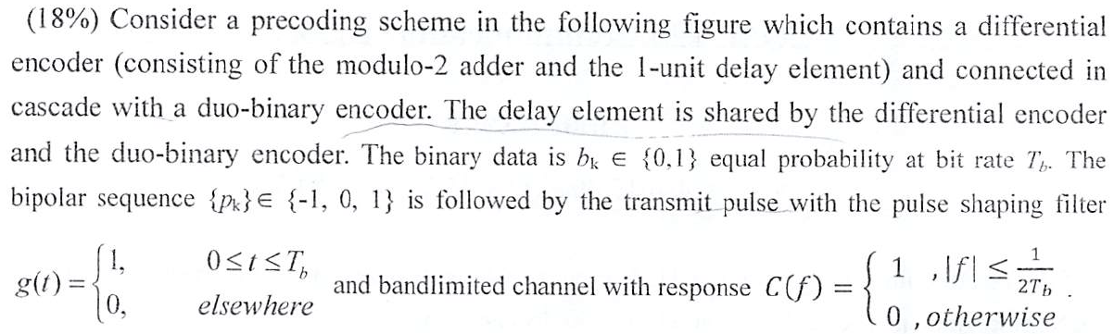

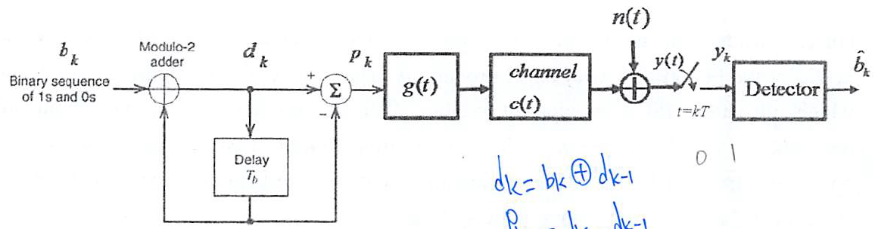


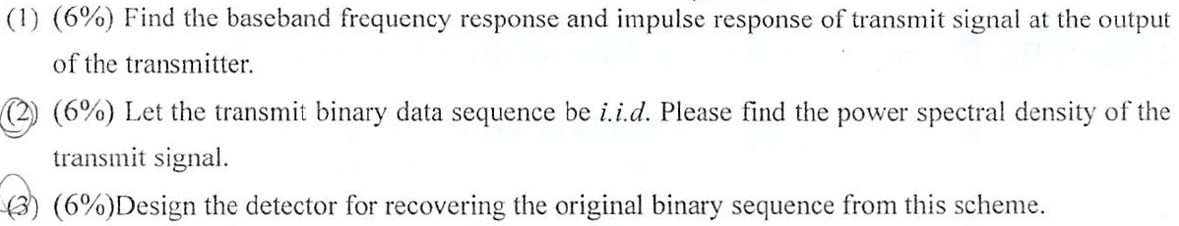
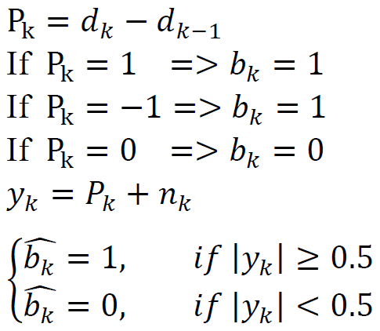
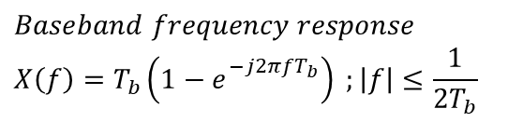
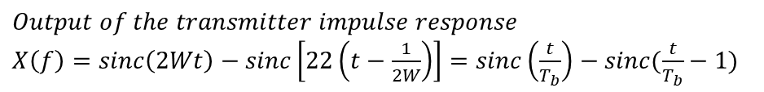
(b)
(c)
(a)
$$Output of the transmitter impulse response$$
$X\left(f\right)=sinc\left(2Wt\right)−sinc\left[22\left(t−\frac{1}{2W}\right)\right]=sinc\left(\frac{t}{T_{b}}\right)−sinc(\frac{t}{T_{b}}−1)$
$$Baseband frequency response$$
$$X\left(f\right)=T_{b}\left(1−e_{}^{−j2πfT_{b}}\right) ;\left|f\right|≤\frac{1}{2T_{b}}$$

Slide 5
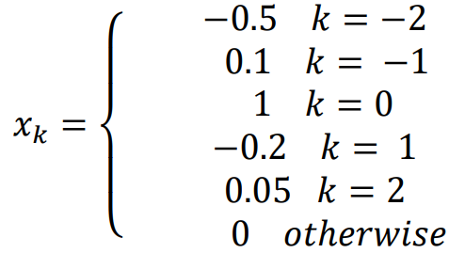
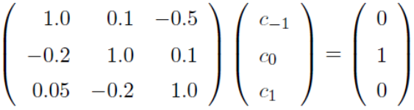
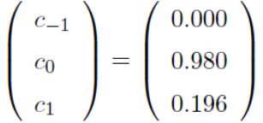
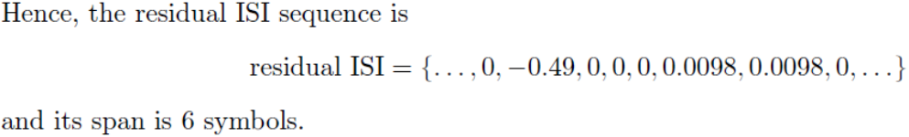
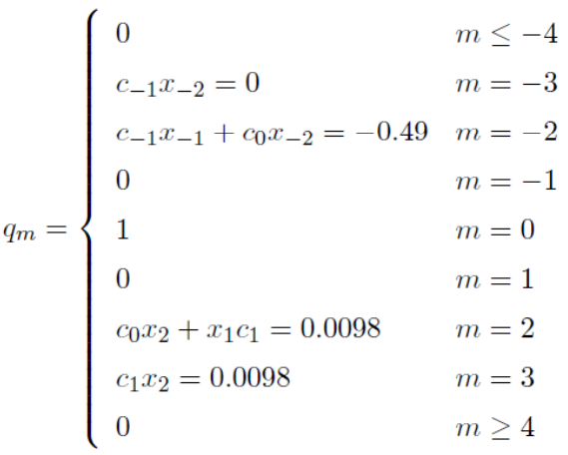

The transmission of a signal pulse with a raised cosine spectrum through a channel results in the following (noise-free) sampled output from the demodulator:
(a) Determine the tap coefficients of a three-tap linear equalizer based on the zero-forcing criterion.
(b) For the coefficients determined in (a), determine the output of the equalizer for the case of the isolated pulse. Thus, determine the residual ISI and its span in the time.
(a)
$$→$$
(b)
The output of the equalizer is :

Slide 6
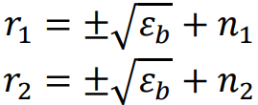
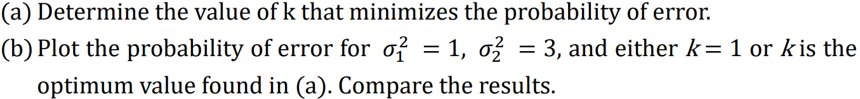



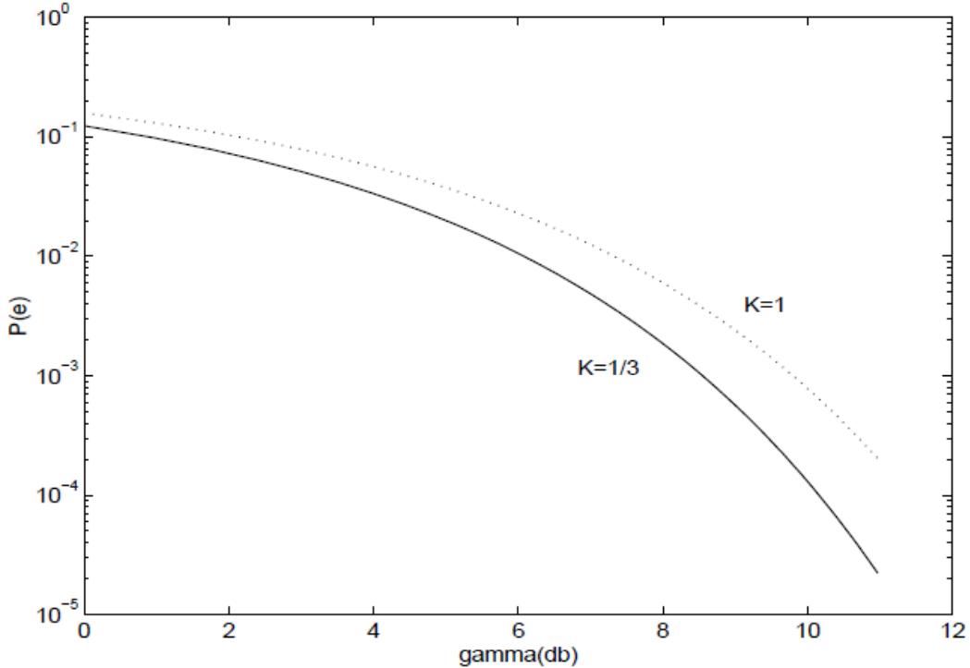




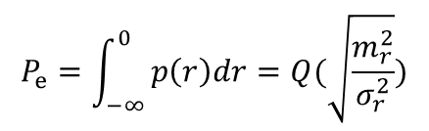
A binary communication system transmits the same information on two diversity channels. The two received signals are $r_{1} and r_{2},$ where $E\left(n_{1}\right)=E\left(n_{2}\right)=0, E\left(n_{1}^{2}\right)=σ_{1}^{2} and E\left(n_{2}^{2}\right)=σ_{2}^{2}, and n_{1} and n_{2}$ are uncorrelated Gaussian variables. The detector bases its decision on the linear combination of $r_{1} and r_{2}$, i.e., $r=r_{1}+kr_{2}$
(a)
$$R.V. r\sim Gauss\left(m_{r}, σ_{r}^{2}\right) ;m_{r}=\left(1+k\right)\sqrt{ε_{b}}, { σ}_{r}^{2}=σ_{1}^{2}+k^{2}σ_{2}^{2}$$
$$P_{e}=\int_{−∞}^{0}{p\left(r\right)dr=Q(\sqrt{\frac{m_{r}^{2}}{σ_{r}^{2}}})}$$
$$→$$
(b)

Slide 7
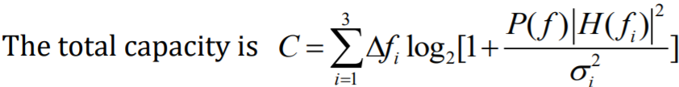
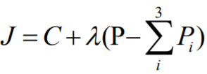
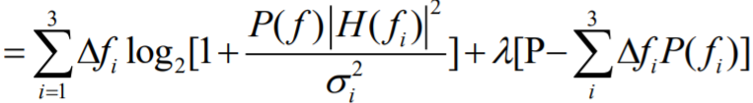
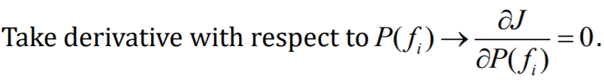
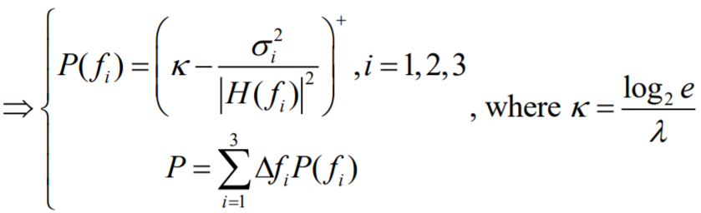
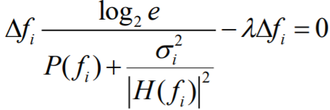
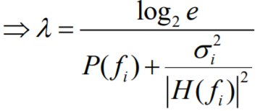






Consider a linear channel with bandwidth W . The channel is equally divided into three sub-channels which has squared magnitude response ${\left|H\left(f\right)\right|}^{2}$ in the piecewise-linear form with ${\left|H\left(f_{i}\right)\right|}^{2}=1, \frac{1}{3}, \frac{1}{5}$ for sub-channels $i=$1,2 and 3 respectively. Assume the system transmits data at the rate equal to the Shannon’s channel capacity and the noise variance $σ_{i}^{2}=1, \frac{1}{2}, \frac{1}{3}$ for subchannels $i=$1,2 and 3 respectively.
(a) Let the total transmit power be constrained such that $P_{1}+P_{2}+P_{3}=P$ is constant. Please derive the formulas for the optimum powers $P_{1}, P_{2} and P_{3}$ allocated to the three sub-channels of frequency bands such that the overall channel capacity of the entire system can be maximized.
(b) Given the total transmit power $P=2$, and subchannel bandwidth $Δf=2$, please calculate the corresponding values of $P_{1}, P_{2} and P_{3}.$
(a)
(b)

