Slide 1

UVAs Traffic Control based on Multi-Access Edge Computing
 | 2018 IEEE Global Communication Conference Authors : Oussama Bekkouche, Tarik Taleb and Miloud Bagaa Abu Dhabi, United Arab Emirates, 2018, pp. 1-6. doi: 10.1109/GLOCOM.2018.8647421
Date : 2019 / 12 /30
Name : 陳文遠
StudentID : 108064535

Slide 2
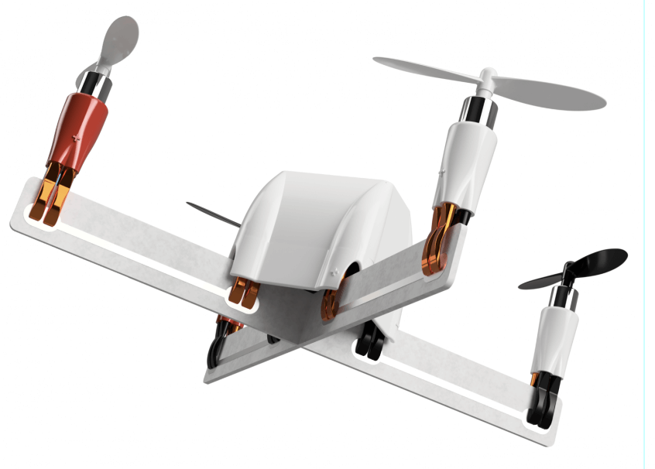
CONTENT
Introduction
Experiment
Method
Discussion

Slide 3
INTRODUCTION

Slide 4
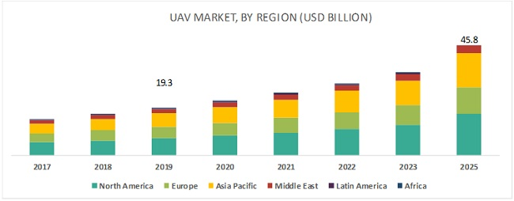
Why UAV ?
UAV is widely used.
UAV’s market is expected to reach $45.8 billion by 2025.
Military Reconnaissance
Inspection of Infrastructures
Smart Agriculture
Traffic Management
Border surveillance
Cargo delivery
1.4 trillion NTD

Slide 5
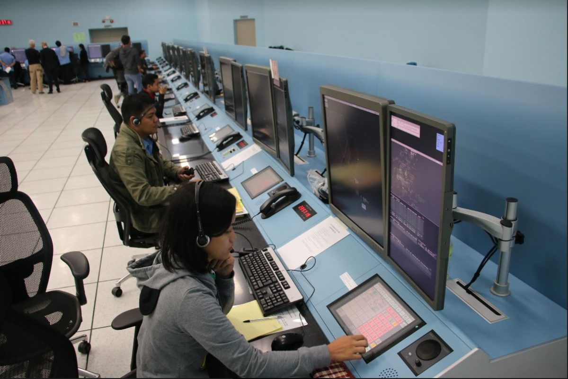
Air Traffic Management (ATM)
Each UAV is manually and individually operated (or use pre-define program).
In challenging environments, we must keep UAV stayed in Visual-Line-of-Sight of pilot.
Rely on voice communication between air traffic controllers and pilots.
That’s not designed to handle the expected high density of UAVs traffic.

Slide 6


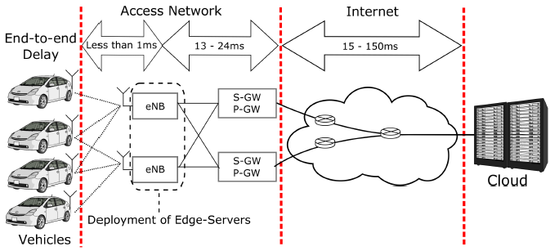
UAV Traffic Management (UTM)
Used to handle the high density of UAVs traffic.
Mitigate the risk of collision among small UAVs, flying in uncontrolled airspace.
A standard UTM must offer are the identification, the localization and the steering of UAVs.
Use cellular mobile networks to support the communication
between UTM service and UAVs.
Advantage：
Scalable
Secure
Ready-for-use
Fig. 5G Cellular-Connected Devices

Slide 7
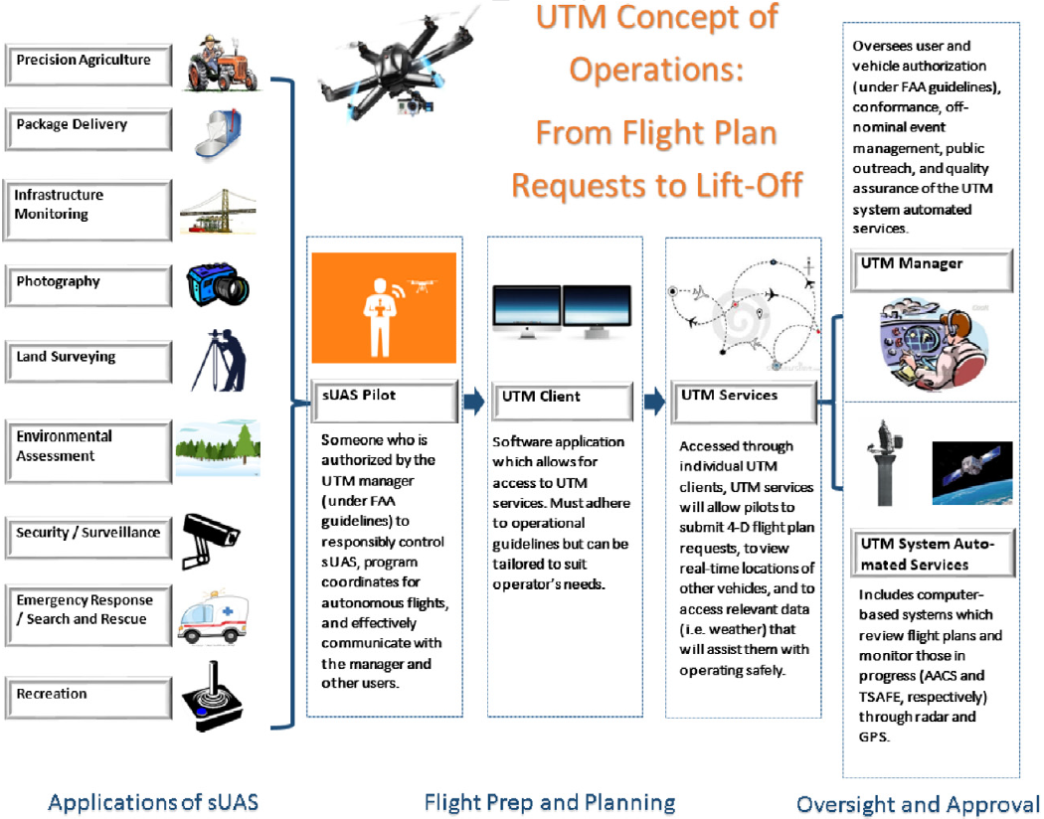
UAV Traffic Management (UTM)
The figure is an UTM system
concept of operations flow chart.

Slide 8
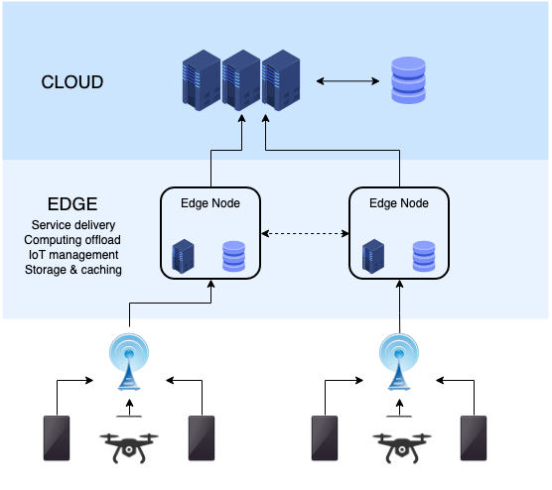
Multi-Access Edge Computing (MEC)
MEC push cloud-like services to the network edges.
This will reduce the latency and increase the reliability of
the communication.

Slide 9
EXPERIMENT

Slide 10
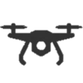
Experimentation Introduction
The management of UAVs’ traffic is mainly based on the dynamic definition of aerial geo-fences to specify the allowed and the restricted flight zones.
The UTM controls the flight plan of each UAV to ensure that it is flying inside an allowed geo-fences.
We had known that latency and packet loss will damage the reliability of communication, so we lever-
age this experimentation to test the impact of the two situations.
Allowed airspace
Latency ?
What’s the impact of
Packet Loss ?

Slide 11
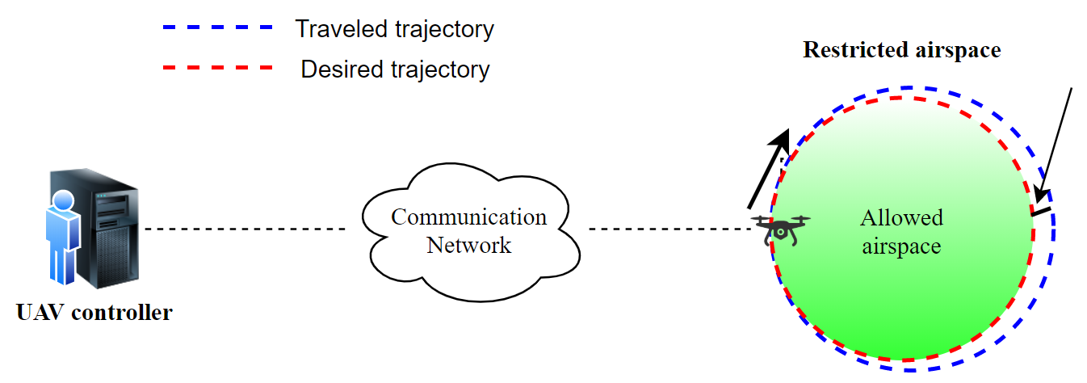

Experimentation Methodology
In order to investigate the impact of latency and packet loss to UAV control, the authors find a most challenging case.
The authors configure the following experimental scene. They want to keep the UAV flying on the border without crossing.
$$M_{i}$$

Slide 12

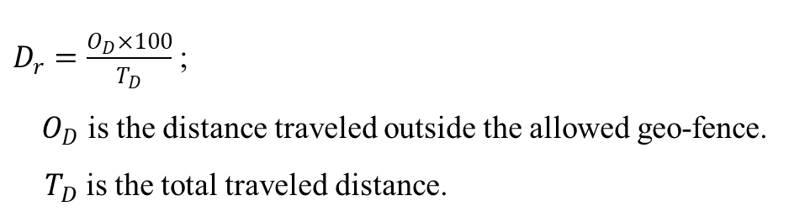

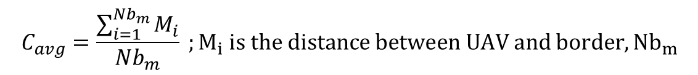

Experimentation Methodology
Then we will measure two arguments to evaluate flying stability.
1. The average of crossing distances $C_{avg}$
$$C_{avg}=\frac{\sum_{i=1}^{Nb_{m}}{M_{i}}}{Nb_{m}} ;M_{i} is the distance between UAV and border, {Nb}_{m}$$
2. The deviation ratio $D_{r}$
$$M_{i}$$
$D_{r}=\frac{O_{D}×100}{T_{D}}$ ;
$O_{D}$ is the distance traveled outside the allowed geo-fence.
$T_{D}$ is the total traveled distance.

Slide 13
Experimentation Setup
EXPERIMENT TOOL
UAV Controller (First VM) | UAV Controller is developed using the Python drone-kit API which is an implementation of the MAVLink protocol, used for the communication with drones.
Network (Second VM) | Through network emulator to simulate the communication between UAV Controller and UAV with latency and packet loss.
UAV operation (Third VM) | Using Software-In-the-Loop (SITL) emulator that allows running the open-source UAVs’ autopilot ArduCopter with the same behavior of a real UAV.

Slide 14
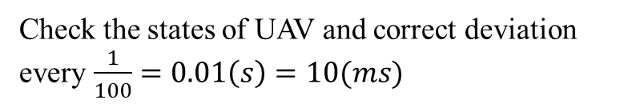
Experimentation Setup
The important configuration of UAV Controller.
Allowed airspace
Flying duration : 300 (s)
10 (m/s)
Frequency : 100 (Hz)
200 (m)
Check the states of UAV and correct deviation every $\frac{1}{100}=0.01\left(s\right)=10(ms)$

Slide 15
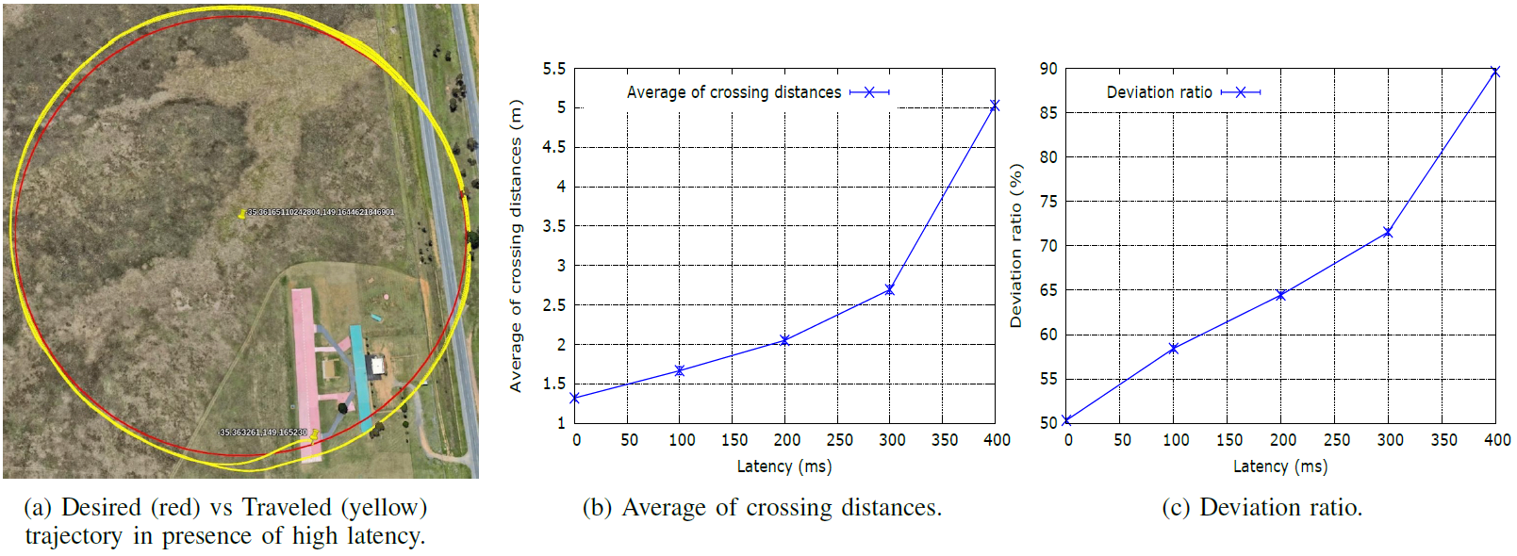


Result & Discussion
The following figure elaborate the effect of latency to UAV.
$$C_{avg}=\frac{\sum_{i=1}^{Nb_{m}}{M_{i}}}{Nb_{m}}$$
$$D_{r}=\frac{O_{D}×100}{T_{D}}$$

Slide 16
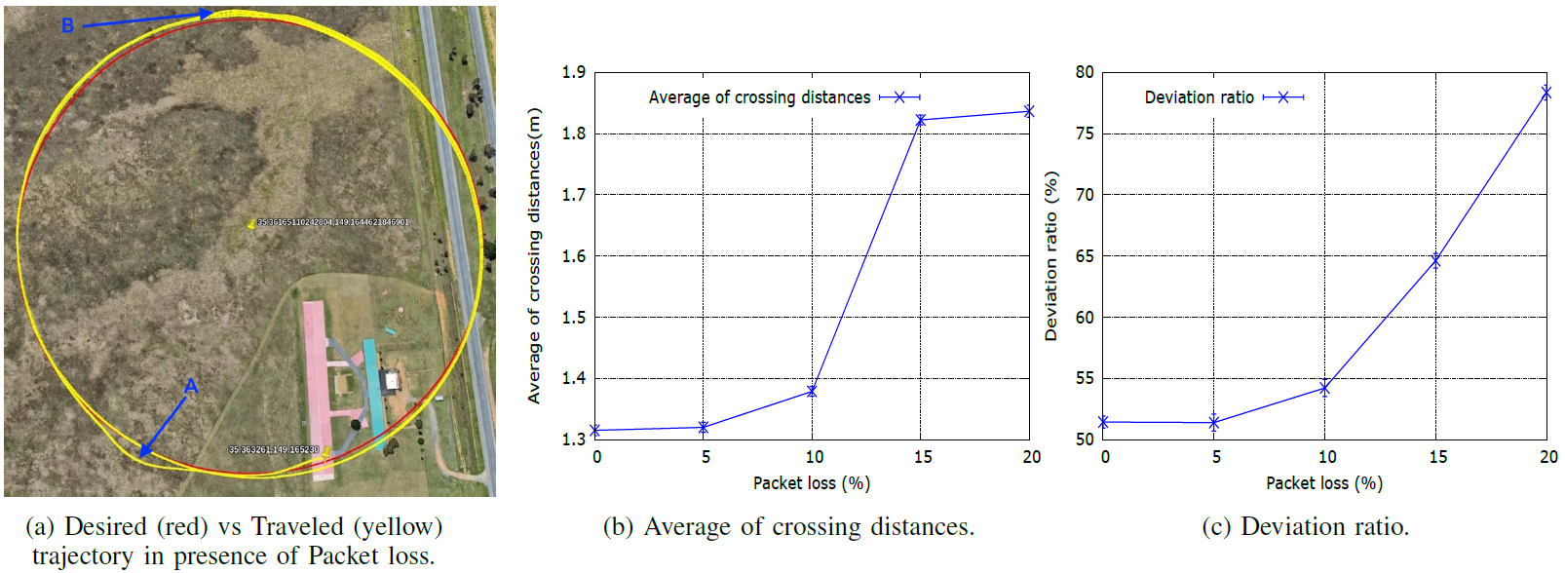


Result & Discussion
The following figure elaborate the effect of packet loss to UAV.
$$C_{avg}=\frac{\sum_{i=1}^{Nb_{m}}{M_{i}}}{Nb_{m}}$$
$$D_{r}=\frac{O_{D}×100}{T_{D}}$$

Slide 17
Result & Discussion
In this experiments, the authors measured the exact averages of crossing distances and
the deviation ratios for different values of network latency and packet loss.
When latency or packet loss rate increase, the averages of crossing distances and the deviation will increase as well.
On the other hand, this experimentation would help to choose the placement of the remote UAV controller according to the tolerated deviation.

Slide 18
METHOD

Slide 19
MEC-Based UAVs’ Traffic Management Framework
Based on the aforementioned results, the latency and packet loss have a dramatical impact
on the control of the UAVs’ flights.
For this reason, the authors propose a new framework that leverages MEC for ensuring that the UAVs stay within their defined geo-fences as much as possible.

Slide 20
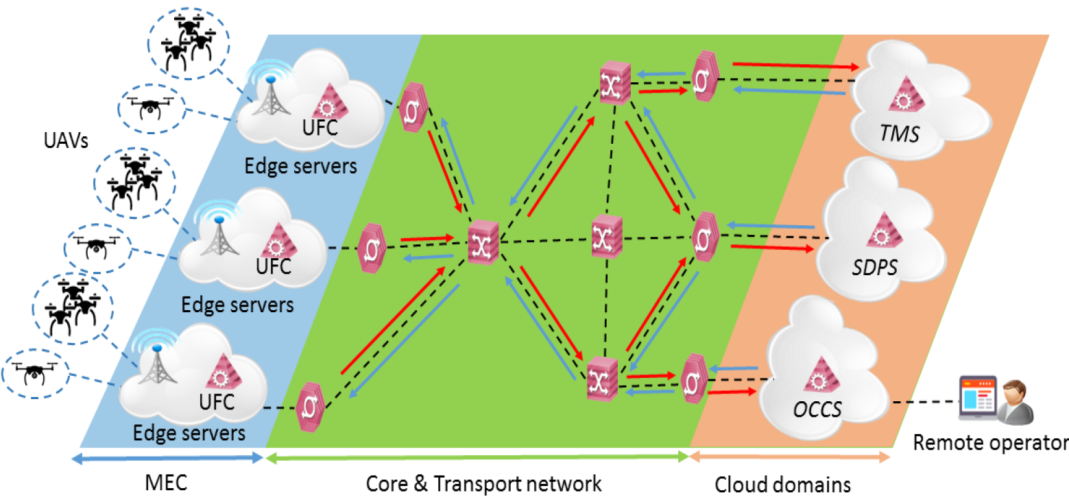
MEC-Based UAVs’ Traffic Management Framework
The following figure is the architecture of the proposed framework of this paper.
C
B
A
The proposed framework can be divided into three parts (A, B, C).

Slide 21
MEC-Based UAVs’ Traffic Management Framework
The proposed framework can be divided into three parts (A, B, C).
A. Cloud Domain :
The cloud domain hosts all the management services. Here, three principal services can be identified.
UAVs Traffic Management Service (UTMS) :
UTMS has all the information such as UAVs’ location, flight plan and airspace restriction. Also, this service is responsible for defining geo-fences.
Supplementary Data Provider Service (SDPS) :
SDPS provides some useful information for planning UAVs’ flights such as weather forecast and location of interest.
Operator Command and Control Service (OCCS) :
OCCS provides an interface for the remote operators to monitor and interact with UAVs in real time.

Slide 22
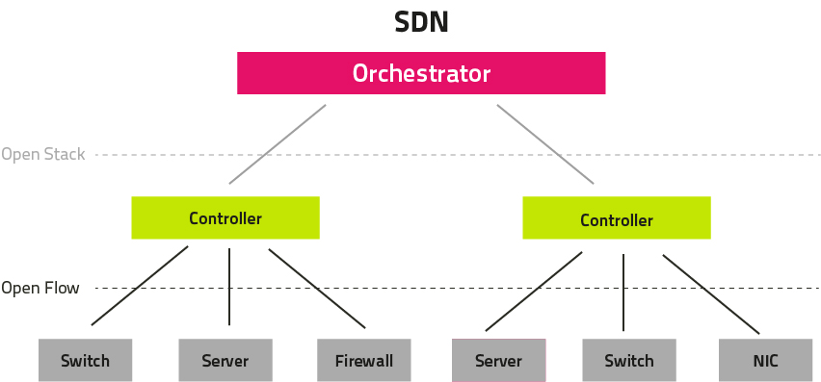
MEC-Based UAVs’ Traffic Management Framework
B. Core and transport network :
The core and transport networks ensure the transmission of communication traffic between MEC-hosted services and the previous Cloud-hosted services. Given that this communication belongs to ultra-reliable and low-latency Communication, the generated traffic must be treated with a high QoS. In this proposed framework, the core and transport networks are considered to be SDN-enabled networks.
SDN can be used to ensure a flexible QoS provisioning.

Slide 23
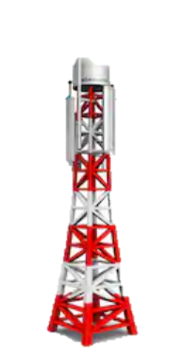


MEC-Based UAVs’ Traffic Management Framework
C. Mobile edge computing :
In this framework, MEC nodes are used to host UAVs Flight Controller service (UFC). The UFC is responsible for the monitoring and controlling the UAVs that connected to MEC nodes. Also, UFC collects information (i.e., geo-fences, weather forecasts and location of interest) and command from cloud-hosted services, and accordingly adapts UAVs’ flights.
BS
UFC
Edge Server
MEC

Slide 24
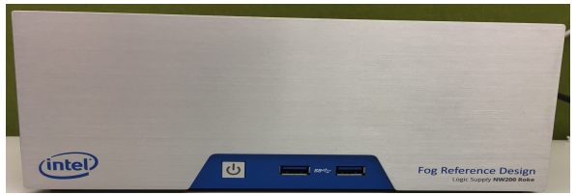
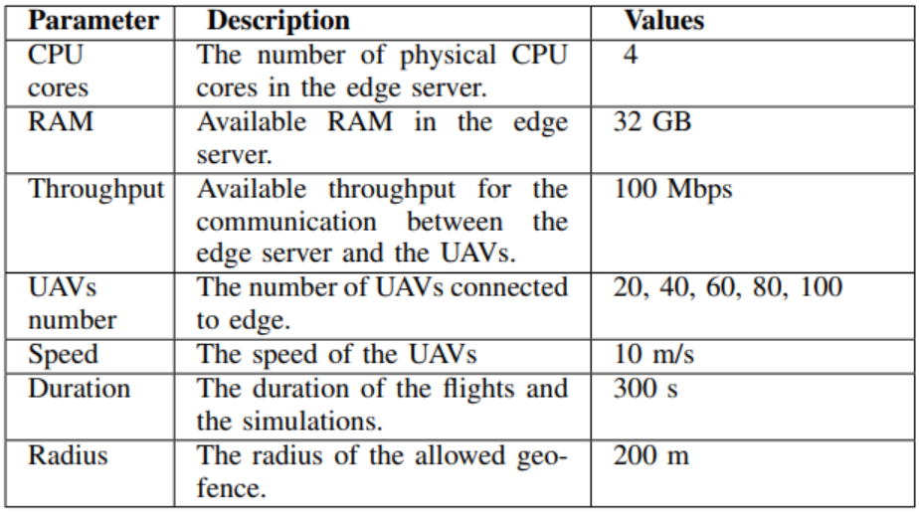
Experimentation Tools and Parameters
The edge server used in this testbed. It’s Intel Fog Reference Design.
The experimentation parameters.

Slide 25
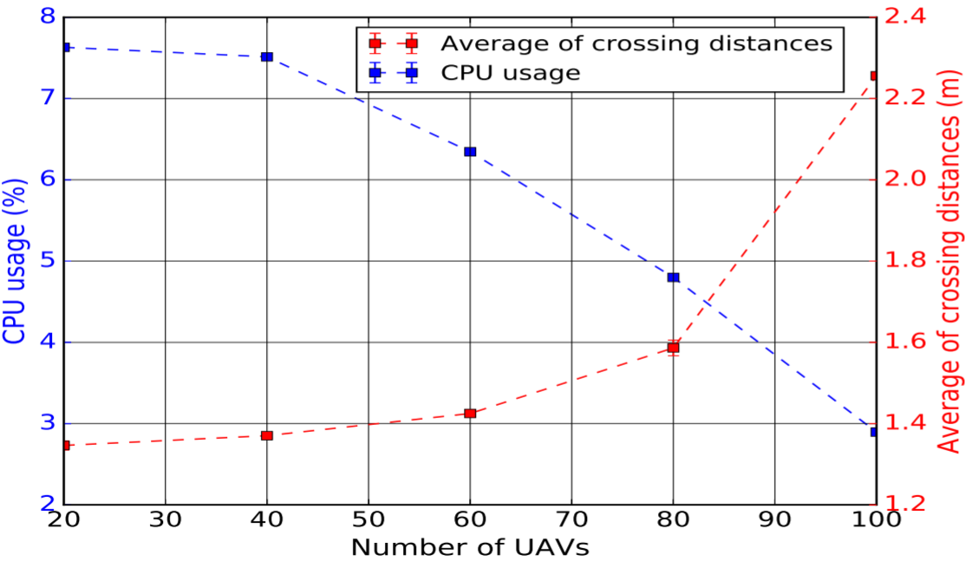
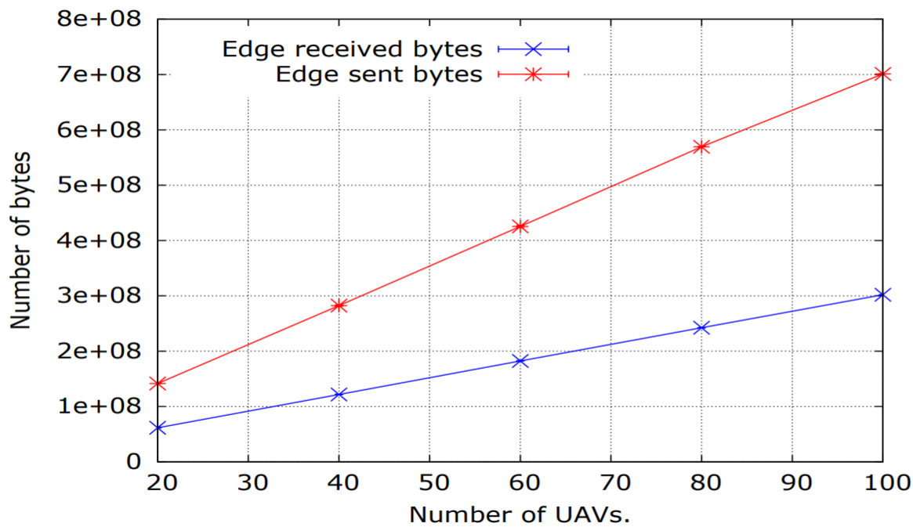
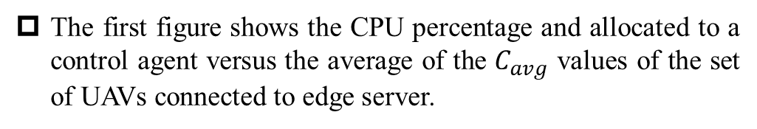
Experimentation Results
Communication latency and packet loss would approach to 0.
The first figure shows the CPU percentage and allocated to a control agent versus the average of the $C_{avg}$ values of the set of UAVs connected to edge server.
The second figure illustrates the evolution of the traffic exchanged between the edge servers and the connected UAVs as a function of the number of UAVs.
During the experimentation, each UAV produced 3028Kb of traffic, which corresponds to a rate of 10Kbps ; each UAV received 7152Kb of traffic, which corresponds to a rate of 24Kbps.

Slide 26
DISCUSSION

Slide 27
Conclusion
Air Traffic Management System
Along with the ever-increasing number of UAVs, the on-site control of UAVs, by pilot within VLOS, is becoming all but impossible.
UAV Traffic Management System
In general UTM system, communication latency and packet loss always have negative effect in controlling UAVs.
UAV Traffic Management System
with Multi-Access Edge Computing
Proposed framework

Slide 28
System Comparison
 | Air Traffic Management | UAV Traffic Management | UAV Traffic Management (MEC)
Application | That’s not designed to handle high density of UAVs’ traffic. | That’s designed to handle high density of UAVs’ traffic without high reliability. | That’s designed to handle high density of UAVs’ traffic with high reliability.
Latency and packet loss | With higher latency and packet loss. | With higher latency and packet loss. | Latency and packet loss would approach 0.
Cost | High (Labor cost) | Low | High (Deploy edge node)
Scope of application | Low | Middle | High

Slide 29

Q & A

Slide 30
Thank you for your attention

