Slide 1
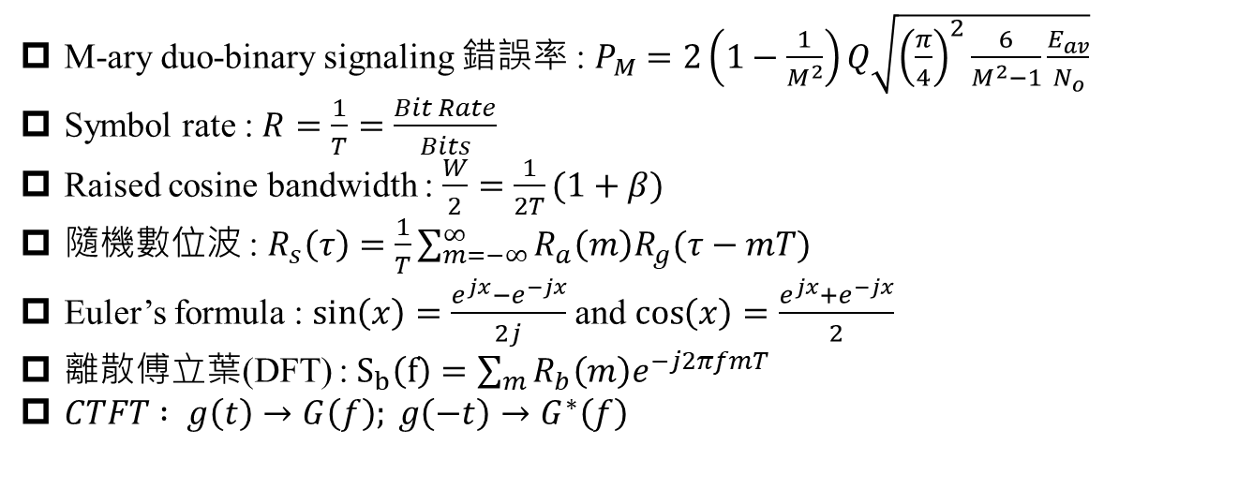
M-ary duo-binary signaling 錯誤率 : $P_{M}=2\left(1−\frac{1}{M^{2}}\right)Q\sqrt{{\left(\frac{π}{4}\right)}^{2}\frac{6}{M^{2}−1}\frac{E_{av}}{N_{o}}}$
Symbol rate : $R=\frac{1}{T}=\frac{Bit Rate}{Bits}$
Raised cosine bandwidth : $\frac{W}{2}=\frac{1}{2T}(1+β)$
隨機數位波 : $R_{s}\left(τ\right)=\frac{1}{T}\sum_{m=−∞}^{∞}{R_{a}\left(m\right)R_{g}(τ−mT)}$
Euler’s formula : $\sin\left(x\right)=\frac{e^{jx}−e^{−jx}}{2j}$ and $\cos\left(x\right)=\frac{e^{jx}+e^{−jx}}{2}$
離散傅立葉(DFT) : $S_{b}\left(f\right)=\sum_{m}{R_{b}\left(m\right)e^{−j2πfmT}}$
$CTFT : g\left(t\right)→G\left(f\right); g\left(−t\right)→G^{∗}\left(f\right)$

