Slide 1
REALTEK Interview Presentation
Interviewee : 陳文遠
Position : Audio系統設計工程師 (預聘_110年度應屆畢業)
Date : October 19, 2020

Slide 2
INTRODUCTION

Slide 3
ABOUT
EDUCATION
 | National Tsing Hua University (GPA 4.08) Institute of Communications Engineering (MS) | Hsinchu, Taiwan Sep. 2019 – Present
 | Feng Chia University Department of Communications Engineering (BS) | Taichung, Taiwan Sep. 2014 – Jan. 2019
ACADEMIC EXPERIENCE
2018 National University Competition of Python
2017 IMP 2017 Conference
2017 Independent Study Competition
Certified
Publish
Honorable Mention Award

Slide 4
SKILLS
WHAT I HAVE DONE
Skills |  | Tools
Website and Server Develop | Node.js(Server), HTML, Javascript, CSS
Computer Vision | C++(or Python) with OpenCV
Network Programming | C language
Embedded System Development | C(or Python) with Raspberry PI
Communication Simulation | Matlab
Blockchain Technology | Go lang with Hyperledger
Linux (UNIX) Operation | Basic operation

Slide 5
PROJECT

Slide 6
(1) VoIP Phone Call Monitoring Platform

Slide 7
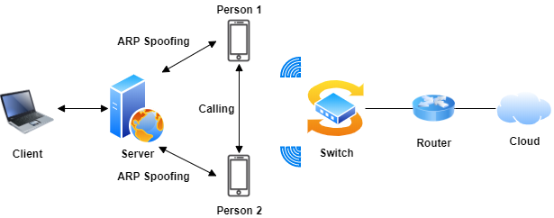
(1) VoIP Phone Call Monitoring Platform
PURPOSE
Provide VoIP phone call monitoring and management service to user.
ARCHITECTURE

Slide 8
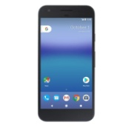
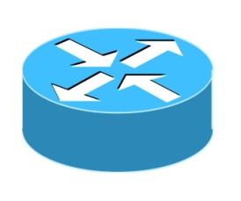


(1) VoIP Phone Call Monitoring Platform (Cont.)
METHOD
ARP Spoofing
IP：192.168.0.1
MAC：AAAA.AAAA.AAAA
192.168.0.2
corresponds to
BBBB.BBBB.BBBB
192.168.0.1
corresponds to
BBBB.BBBB.BBBB
IP：192.168.0.2
MAC：CCCC.CCCC.CCCC
IP：192.168.0.3
MAC：BBBB.BBBB.BBBB

Slide 9
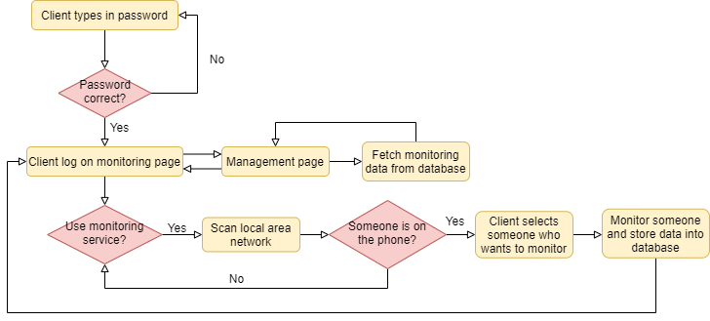
(1) VoIP Phone Call Monitoring Platform (Cont.)
FLOWCHART

Slide 10
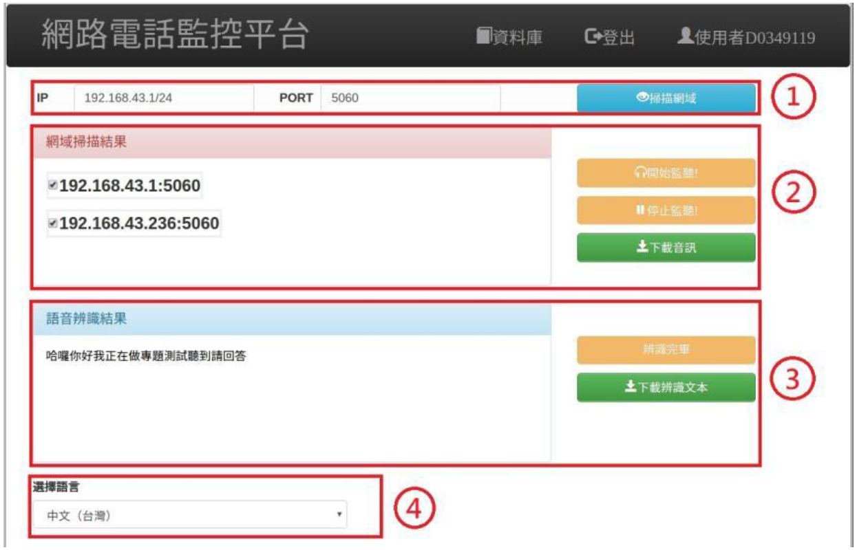
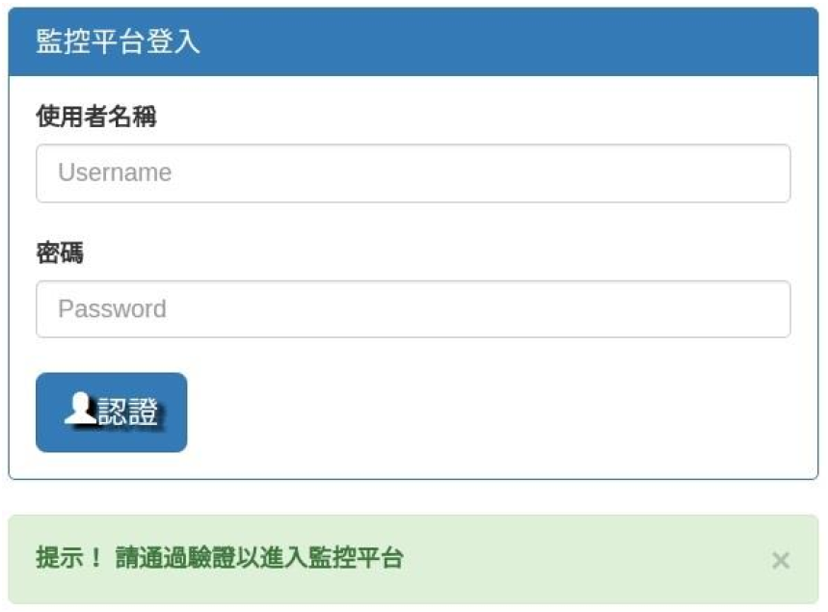
(1) VoIP Phone Call Monitoring Platform (Cont.)
RESULTS
Fig 1. Login page
Fig 2. Monitoring page

Slide 11
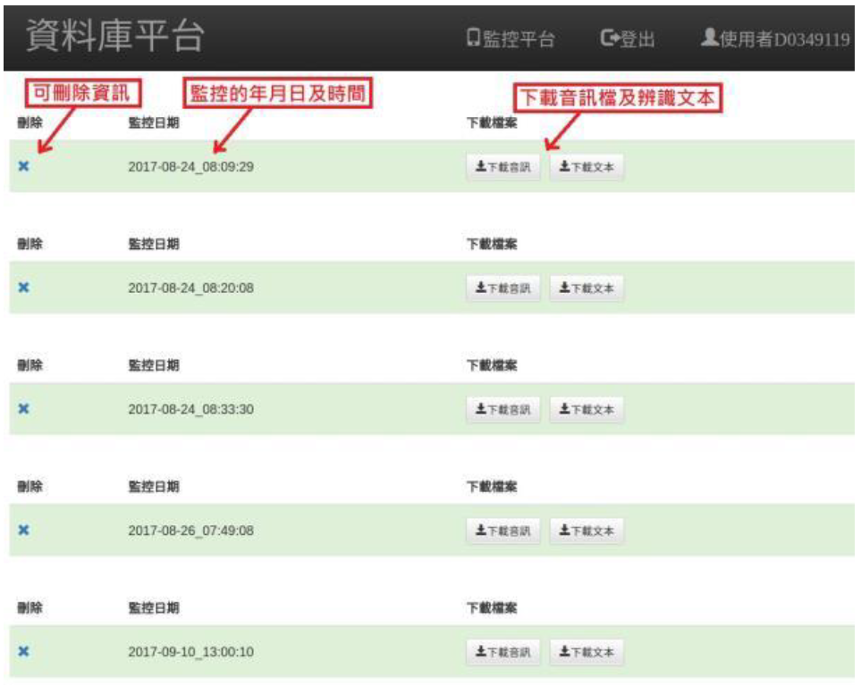
(1) VoIP Phone Call Monitoring Platform (Cont.)
RESULTS
Fig 3. Management page

Slide 12
(2) Blockchain Traceability System with HyperQL

Slide 13

(2) Blockchain Traceability System with HyperQL
What’s Blockchain?
Blockchain is a kind of decentralized database.
Advantage of blockchain technology :
Blockchain has immutable property that keep data secure.
Disadvantage of blockchain technology :
Query data from the blockchain ledger is complex and slow.
Blockchain Ledger
Query data

Slide 14
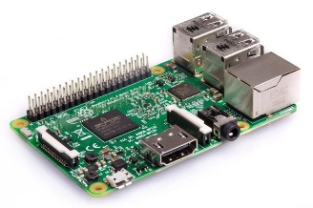
(2) Blockchain Traceability System with HyperQL
(2) Blockchain Traceability System with HyperQL (Cont.)
PURPOSE
Create a blockchain-based IoT system and propose an architecture, named “HyperQL”, to speed up the query speed.
ARCHITECTURE
Blockchain Ledger
Node
Collect data and submit to blockchain
IoT device

Slide 15
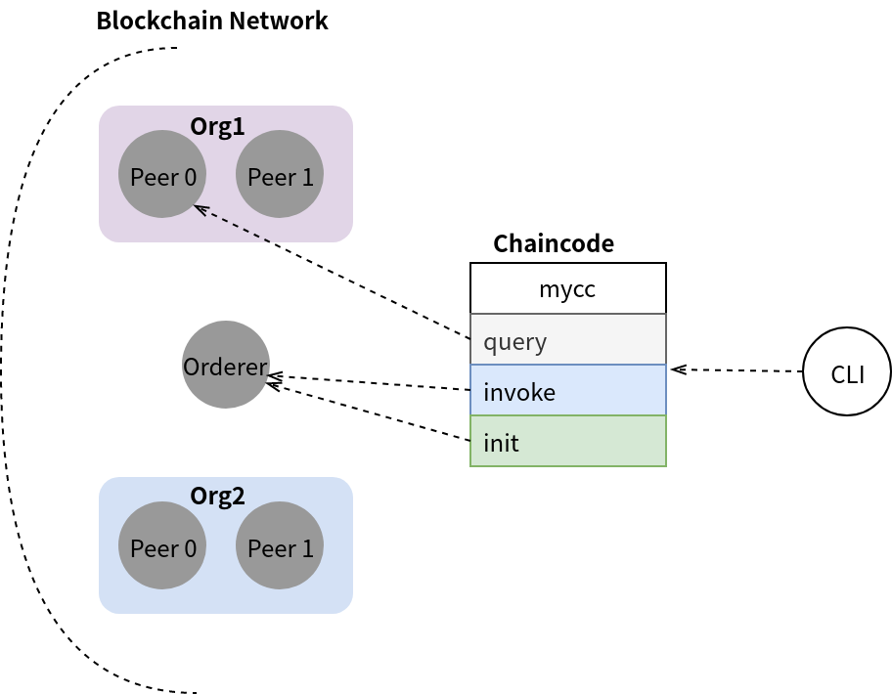
(2) Blockchain Traceability System with HyperQL (Cont.)
METHOD
Blockchain Ledger

Slide 16
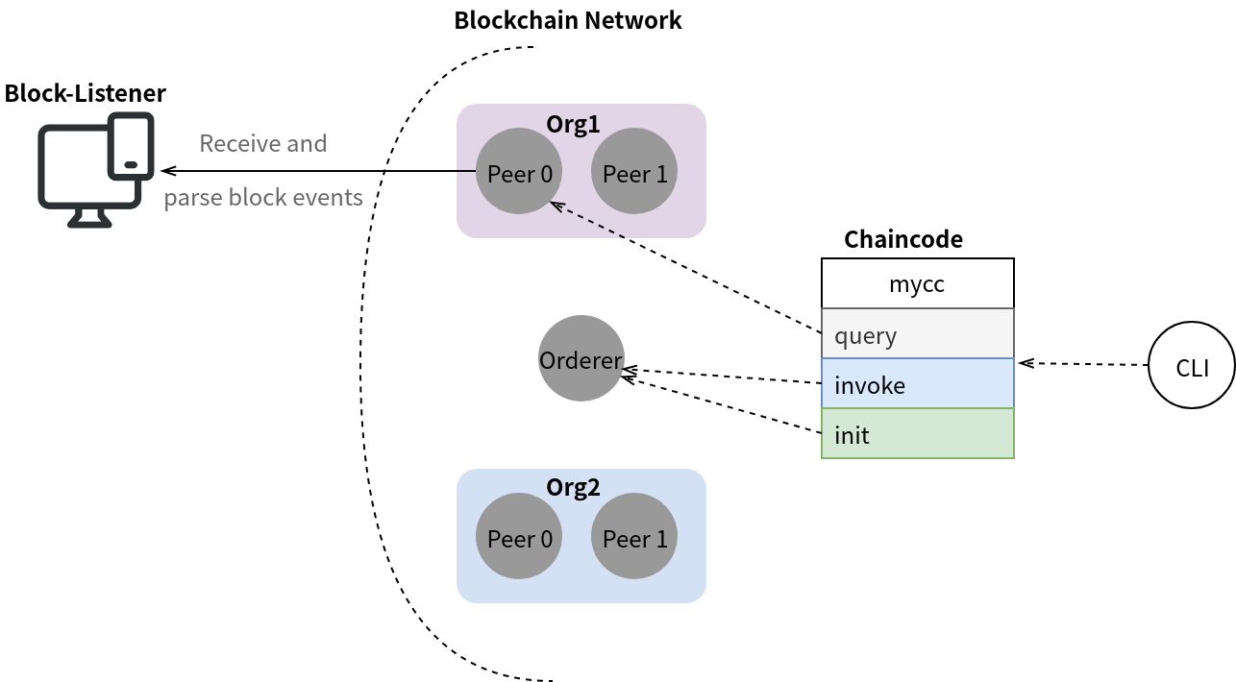
(2) Blockchain Traceability System with HyperQL (Cont.)
METHOD
Blockchain Ledger

Slide 17
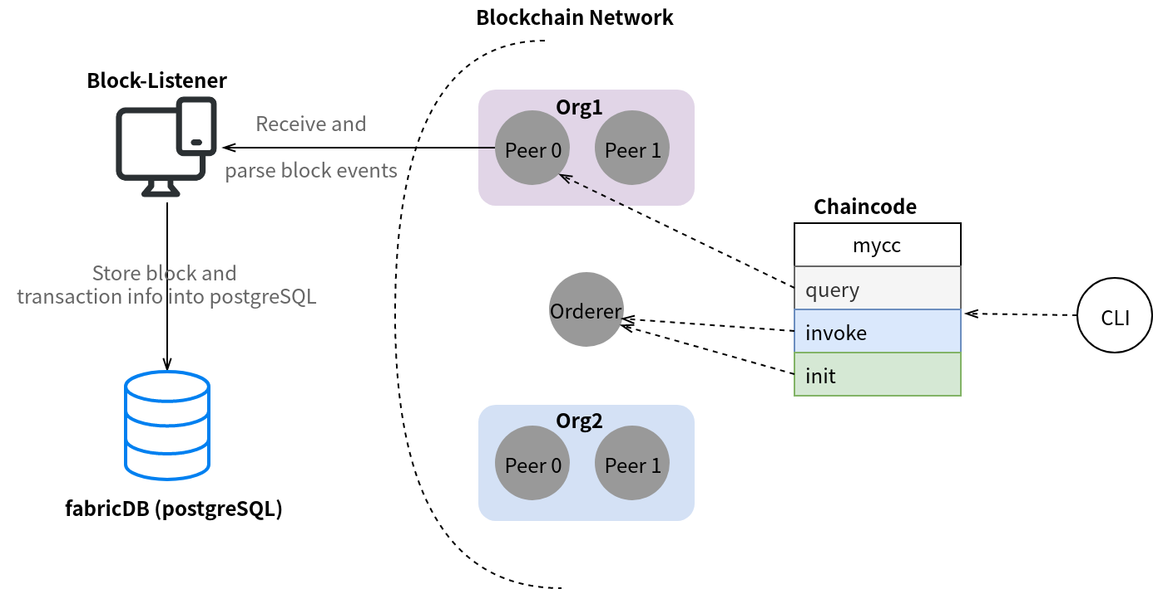
(2) Blockchain Traceability System with HyperQL (Cont.)
METHOD
Query data

Slide 18
(2) Blockchain Traceability System with HyperQL (Cont.)
ISSUES
Advantage :
Query data from the database is nearly 50 times faster than query from blockchain.
Disadvantage :
The data in the database is not immutable.
Future work :
Design an algorithm to efficiently synchronize the data in blockchain and database.
With this, we can keep the data secure while having faster query speed.

Slide 19
(3) Convex Hull Algorithm

Slide 20
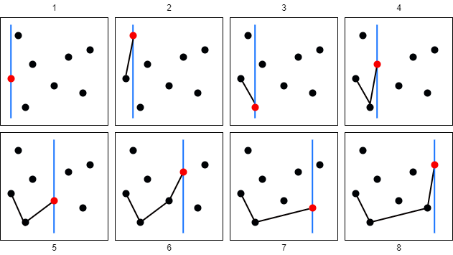
(3) Convex Hull Algorithm
PURPOSE
Can be applied to some fields such as image processing.
METHOD
My way of thinking :
Find the bottom-left point first.
Iterate the others from left to right to find the point that can form the smallest slope.
If the same slope occurs, take the longer one.
Do step 1 2 3 until reaching the far right
Then do the same thing from right to left.

Slide 21
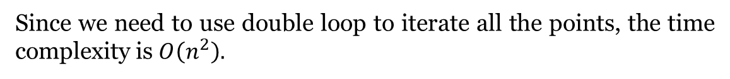
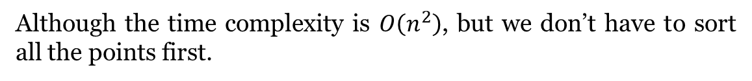
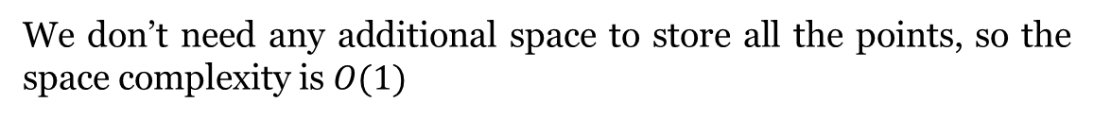
(3) Convex Hull Algorithm (Cont.)
ANALYZE
Time Complexity :
Since we need to use double loop to iterate all the points, the time complexity is $O\left(n^{2}\right).$
Space Complexity :
We don’t need any additional space to store all the points, so the space complexity is $O(1)$
Discuss :
Although the time complexity is $O\left(n^{2}\right)$, but we don’t have to sort all the points first.

Slide 22
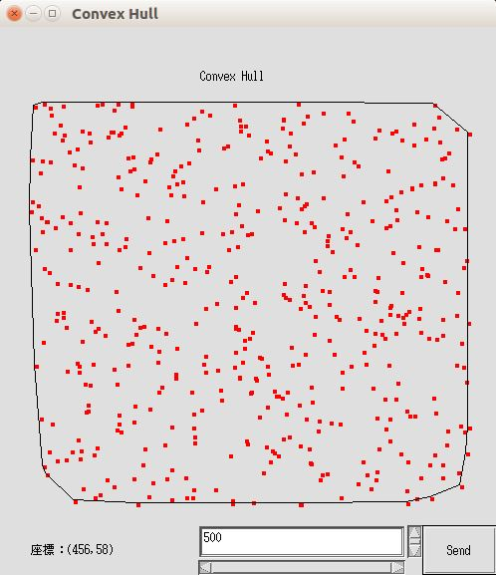
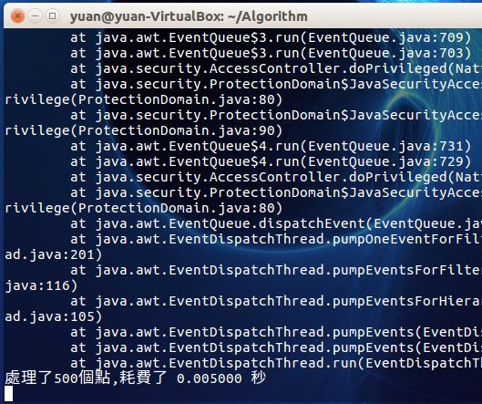
(3) Convex Hull Algorithm (Cont.)
RESULTS

Slide 23
(4) Simple TCP Communication (IPv4)

Slide 24
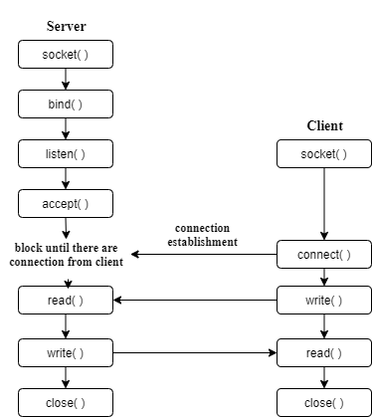
(4) Simple TCP Communication (IPv4)
PURPOSE
Implement TCP message communication using select( ) in C language.
ISSUES
Would be blocked
Would be blocked

Slide 25
(4) Simple TCP Communication (IPv4) (Cont.)
METHOD
Server uses select( ) function (Non-blocking):
select( ) function privileges you to monitor multiple file descriptors at the same time.
Client uses multi-thread (Non-blocking)
The thread is in charge of reading data which created by pthread_create( ). The main process is in charge of writing data.
Handle SIGPIPE signal
If a Client is disconnected, but the Server keeps sending data to the client, it will cause SIGPIPE signal produced.

Slide 26
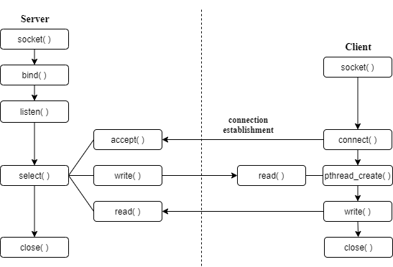
(4) Simple TCP Communication (IPv4) (Cont.)
ARCHITECTURE
Non-blocking
Non-blocking

Slide 27
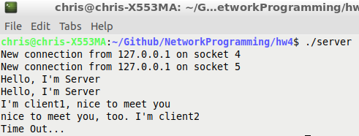
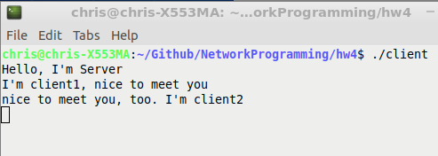
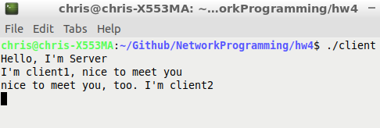
(4) Simple TCP Communication (IPv4) (Cont.)
RESULTS
Server :
Client 1 :
Client 2 :

Slide 28
(5) Simple LED Driver on RPI

Slide 29
(5) Simple LED Driver on RPI
PURPOSE
Create a simple device driver on RPI.
static struct miscdevice misc = { .minor = MISC_DYNAMIC_MINOR, .name = DEVICE_NAME, .fops = &fops, };
DRIVER
In first step, we have to initial the kernel module.
static struct file_operations fops = { .owner = THIS_MODULE, .read = device_read, .write = device_write, .open = device_open, .release = device_release, };
static int hello_init(void) { misc_register(&misc); printk(DEVICE_NAME" initialized\n"); return SUCCESS; }

Slide 30
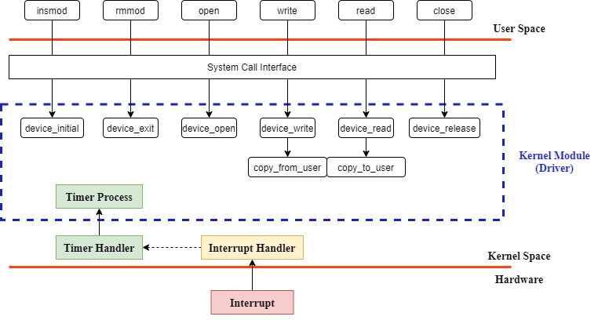
(5) Simple LED Driver on RPI (Cont.)
ARCHITECTURE

Slide 31
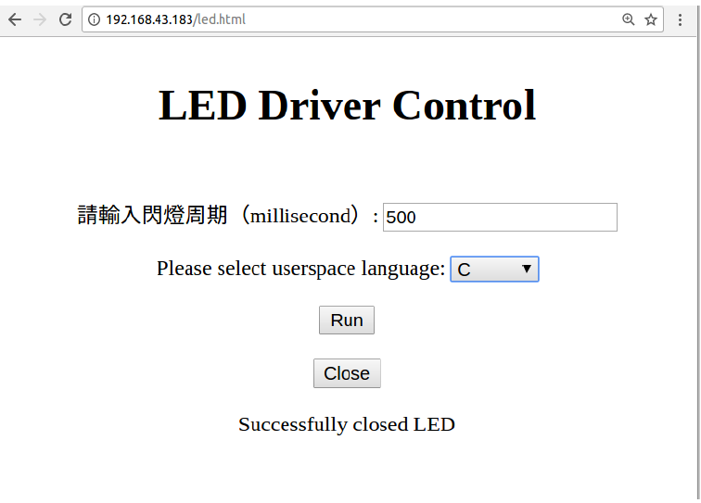
(5) Simple LED Driver on RPI (Cont.)
RESULTS

Slide 32
Thank you for your time!

