Slide 1
AI Updates
August 1, 2025
"Economic Turing test" - Hiring AI vs Human
- Ben Mann (Anthropic Co-founder)
Crowd-sourced "LM Arena" Leaderboard
Qwen3 thinking upgrade
Qwen3-MT - most powerful translation model
GLM-4.5 - advanced open-source
Higgs Audio v2 model
Google Opal - vibe-code apps
ASI-ARCH = Artificial Superintelligence for AI Research
Alibaba wan.video platform
Tencent Hunyuan3D World Model 1.0
Fable Showrunner - generate TV Episodes
LangChain Deep agent vs Shallow Agent
Claude Code Sub-Agents
Opinion-based Prompt Template
Mistral Codestral 25.08 - Enterprise Coding
OpenRouter "Horizon Alpha" model
FLUX.1 Krea - text-to-image open model
FlowiseAI - Build Agentic Workflows
Ben Mann Interview
Startups to spend $30K/year per engineer on AI tools
$1B of Nvidia AI Chips Smuggled to China In 3 months
Supercoomputer with 650K cores for drug discovery
Gregory Barbaccia - Federal Chief AI Officer (CAIO)
Meta Personal Superintelligence
Unitree R1 - $6k robot from China
Baby Grok, a child-focused version Grok
mini-swe-agent - 100 line AI agent
Shengjia Zhao - new chief scientist at Meta
Top Open Models Come from China
Google NotebookLM Upgrades
Warp's AI coding agent leaps ahead of Claude Code
Emad Mostaque
The Death of Agile
Don't Use Kubernetes
Eric Schmidt - fastest mover wins
Specifications = Unit of Programming
Firecracker MicroVM (AWS Lambda & Fargate)
Jobs, Layoffs

Slide 2
Crowd-sourced "LM Arena" Leaderboard
https://lmarena.ai/?leaderboard
Starting Elo rating = 1000
https://en.wikipedia.org/wiki/Elo_rating_system
English - https://lmarena.ai/leaderboard/text
Coding - https://lmarena.ai/leaderboard/text/coding
LM Arena secures $100M to expand AI benchmarking (at $600M valuation)
Model | Score
gemini-2.5-pro | 1460
o3-2025-04-16 | 1457
chatgpt-4o-latest-20250326 | 1448
gpt-4.5-preview-2025-02-27 | 1444
grok-4-0709 | 1441
claude-opus-4-20250514-thinking-16k | 1432
deepseek-r1-0528 | 1425
kimi-k2-0711-preview | 1423
grok-3-preview-02-24 | 1424
claude-opus-4-20250514 | 1421
claude-sonnet-4-20250514-thinking-32k | 1419
gpt-4.1-2025-04-14 | 1419
gemini-2.5-flash | 1414
deepseek-r1 | 1410
deepseek-v3-0324 | 1410
o4-mini-2025-04-16 | 1410
minimax-m1 | 1409
qwen3-coder-480b-a35b-instruct | 1402
o1-2024-12-17 | 1410
o1-preview | 1409
qwen3-235b-a22b-no-thinking | 1407
claude-sonnet-4-20250514 | 1401
Model | Score
claude-opus-4-20250514-thinking-16k | 1474
gemini-2.5-pro | 1474
o3-2025-04-16 | 1471
chatgpt-4o-latest-20250326 | 1465
claude-sonnet-4-20250514-thinking-32k | 1457
gpt-4.5-preview-2025-02-27 | 1456
kimi-k2-0711-preview | 1455
claude-opus-4-20250514 | 1453
deepseek-r1-0528 | 1452
grok-4-0709 | 1449
gpt-4.1-2025-04-14 | 1441
qwen3-coder-480b-a35b-instruct | 1435
qwen3-235b-a22b-no-thinking | 1436
grok-3-preview-02-24 | 1435
claude-sonnet-4-20250514 | 1433
deepseek-r1 | 1429
deepseek-v3-0324 | 1428
claude-3-7-sonnet-20250219-thinking-32k | 1425
o4-mini-2025-04-16 | 1425
qwen3-235b-a22b | 1422
o1-2024-12-17 | 1420
mistral-medium-2505 | 1417
Grok 4 Benchmarks
https://artificialanalysis.ai/models/grok-4
x.ai
China
China
China
https://lmarena.ai/leaderboard/text
https://web.lmarena.ai/leaderboard
https://openlm.ai/chatbot-arena/
https://beta.lmarena.ai
Web Leaderboard https://web.lmarena.ai/leaderboard
LLM Leaderboard - by @LlmStats https://llmworld.net/llm_leaderboards/
LLM Leaderboard - by StackAI https://www.stack-ai.com/llm-leaderboard
LLM Leaderboard - by Artificial Analysis https://artificialanalysis.ai/leaderboards/models
Open LLM Leaderboard - by Hugging Face https://huggingface.co/open-llm-leaderboard
LLM Leaderboard - by Vellum https://www.vellum.ai/llm-leaderboard
AI Benchmarking Hub https://epoch.ai/data/ai-benchmarking-dashboard
x.ai
China
x.ai
China
China
China
x.ai
China
China
China
China
China
China
China
M

Slide 3

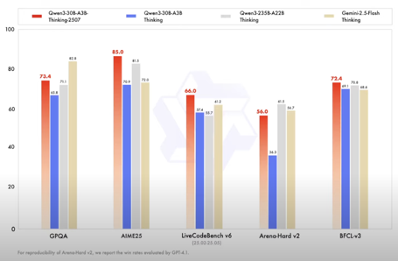
Qwen3 thinking upgrade
Qwen3 thinking upgrade
https://qwenlm.github.io/blog/qwen3/
Qwen3-235B-A22B-Instruct-2507
Qwen3-30B-A3B-Instruct-2507
Qwen3-235B-A22B-Thinking-2507
Qwen3-30B-A3B-Thinking-2507
Modes: Thinking Mode / Non-Thinking Mode
Enhanced ability to follow instructions, generate text, and fulfill subjective user intents
Can be used from VS Code extensions via OpenRouter
https://openrouter.ai/qwen/qwen3-235b-a22b-thinking-2507
https://www.youtube.com/watch?v=qcCf4Q9seSw
Qwen3 Coder
https://www.youtube.com/watch?v=CDgQ1-gJQHE - video - tests
strong coding abilities and safety awareness, with some limitations in spatial reasoning and self-referential tasks
Qwen3-MT - most powerful translation model
https://x.com/Alibaba_Qwen/status/1948406830688018471

Slide 4
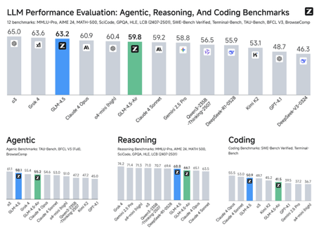
GLM-4.5 - advanced open-source
GLM-4.5 by Z.ai - open source advanced model
Zhipu AI (ZAI) in China
355B params (or GLM-4.5-Air with 106B)
Open Source (MIT license)
thinking mode / non-thinking mode
built for agentic tasks, with strong support for function calling, tool integration, and an extended 128k context window
Matches or exceeds SOTA models in agentic task benchmarks
Top-tier results on reasoning benchmarks and outperforms many models in coding tasks - ranked 3rd overall just behind o3 and Grok-4 and ahead of Claude Opus 4.
Fast (100+ tokens/sec)
costs less to operate than DeepSeek due to its smaller size and ability to decompose tasks into sub-goals
Uses grouped-query attention*, loss-free balance routing, multi-token prediction for speculative decoding, and use of the Muon optimizer for faster and stabler training
https://huggingface.co/zai-org/GLM-4.5
https://z.ai/blog/glm-4.5
https://github.com/zai-org/GLM-4.5
https://www.youtube.com/watch?v=Ri_o1TpHYsw - M. Berman Rubik's Cube Simulation: 3x3, 5x5, 10x10 Tower of Hanoi 10 disk version in 81 sec, ...

Slide 5
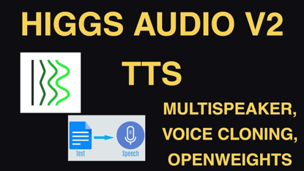
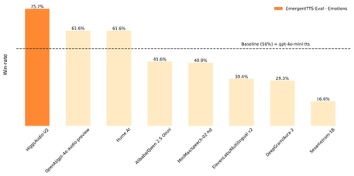
Higgs Audio v2 model
Higgs Audio v2 model
SOTA text-to-speech (TTS) - expressive, emotional, voice cloning
open-source
by Boson AI
approximately 5.8 Bln params. 24GB GPU VRAM for full performance, but can run (with limitations) on GPUs with as little as 8-16GB VRAM if quantized and single-speaker only
https://www.boson.ai/blog/higgs-audio-v2
https://github.com/boson-ai/higgs-audio

Slide 6
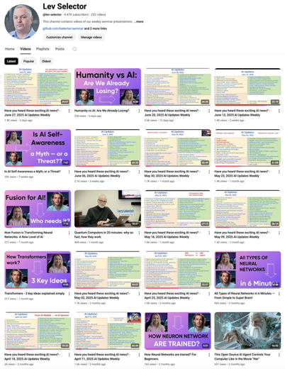
Please pause the video - and answer the pinned question in comments under the video
Subscribe to this channel
https://www.youtube.com/@lev-selector
Get notified about new videos - every Friday, links to slides under the videos

Slide 7
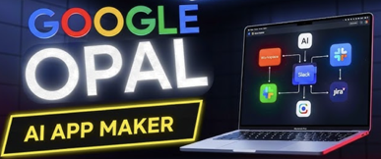
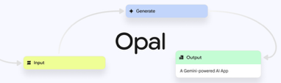
Google Opal - vibe-code apps
Google Opal tool from Google Labs
vibe-code and share AI-powered mini-applications
"Make an app to order breakfast", "Create a quiz with real-time scoring."
Opal translates these instructions into a visual workflow, displaying each logical step as a connected node (input, data processing with AI, output)
User can view and edit the workflow in a visual canvas. Every step is modular and editable
AI-Powered - Opal stitches together various Google proprietary AI models on the backend. For text tasks, it often uses Google’s Gemini 2.5 Pro LLM; for images and videos, it leverages Imagen and Veo, respectively. The models work in the background—you don’t need to choose or configure them directly
When you’re ready, you can publish your mini-app with a single click. Opal creates a shareable web link (just like a Google Doc or Sheet), letting others run or remix your AI-powered apps easily
Prebuilt templates include designing video games, generating marketing materials, product research synthesizers, video ad creators, and more
Plans to integrate with Firebase or Cloud Functions
Opal is available in public beta exclusively in the U.S. via Google Labs. It is free to try. Opal is explicitly labeled as experimental. That means features may change or disappear quickly, and it is not recommended for mission-critical business needs yet.
https://developers.googleblog.com/en/introducing-opal/

Slide 8

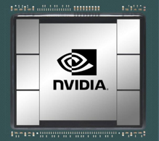


AI Updates - 1
ASI-ARCH = Artificial Superintelligence for AI Research
"AlphaGo Moment for Model Architecture Discovery"
Autonomous, multi-agent framework mimics and automates every stage of AI research - https://arxiv.org/pdf/2507.18074
Startups to spend $30K/year per engineer on AI tools
https://tomtunguz.com/ai-rd-percent/
$1 Billion Worth of Nvidia AI Chips Smuggled to China In just 3 months Despite Export Controls
This is done by routing shipments through Southeast Asian countries like Malaysia and Thailand before final delivery
Chinese distributors are openly advertising ready-to-deploy server racks at 50% premiums and developing new routes through European countries
There is estimated 70K-100K AI start-ups !
Supercoomputer with 650K cores for drug discovery
Leipzig University
4320-chip - neuromorphic, brain-inspired
https://interestingengineering.com/innovation/worlds-largest-brain-like-supercomputer
Gregory Barbaccia - Federal Chief AI Officer (CAIO)
He is also Federal Chief Information Officer (CIO)
Mark Zuckerberg
Meta Personal Superintelligence
Meta Superintelligence Labs
https://www.youtube.com/shorts/PE1B815XNDc
https://www.meta.com/superintelligence/

Slide 9
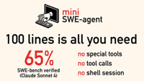



AI Updates - 2
top proprietary models - US
top open models - China
mini-swe-agent - 100 line AI agent
solves GitHub issues & more
https://github.com/SWE-agent/mini-swe-agent
Unitree R1 - $6k robot from China
https://interestingengineering.com/innovation/unitree-launches-cheapest-humanoid-robot-r1
Baby Grok, a child-focused version Grok
Is being developed by xAI, not released yet
Baby Grok is intended to provide a safe, educational, and child-appropriate AI interaction experience
Shengjia Zhao - formerly of OpenAI - is the new chief scientist at Meta's new Superintelligence Lab
Google NotebookLM Upgrades
Video Overviews - create narrated, slide-based video presentations from user's own materials
Redesigned Studio Panel - create and store multiple outputs of the same type in a single notebook
Featured notebooks - curated collections
Mobile Apps & Offline Support
Enhanced Multilingual and Audio Features
Increased Customization & Enterprise Features

Slide 10
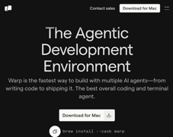

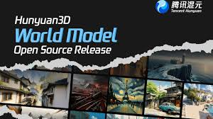
AI Updates - 3
Use Kimi K2 from Claude Code
export ANTHROPIC_AUTH_TOKEN=sk-your-k2-key
export ANTHROPIC_BASE_URL=https://api.moonshot.ai/anthropic
https://medium.com/@lmpo/kimi-k2-claude-code-revolutionizing-ai-driven-development-fcb8cd6f6600
Warp's AI coding agent leaps ahead of Claude Code
Hits #1 on Terminal-Bench
https://www.warp.dev
Alibaba wan.video platform
Text-to-Video Generation (T2V)
High Output Quality (720p, 16 frames/sec)
Customizable (aspect ratio, quality vs. speed, guidance scale (controlling adherence to text prompts), and inclusion of safety checks
API for developers
https://wan.video
Tencent Hunyuan3D World Model 1.0
open-source
generation of explorable 3D environments
https://x.com/scaling01/status/1949300037051134245
https://github.com/Tencent-Hunyuan/HunyuanWorld-1.0
https://huggingface.co/tencent/HunyuanWorld-1

Slide 11
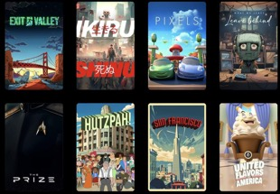
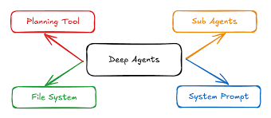

AI Updates - 4
Fable Showrunner - generate TV Episodes
https://www.showrunner.xyz/
Users can generate personalized, playable animated TV episodes through text prompts.
Users can also upload themselves as characters
"remixable, multiplayer, personalized, and interactive"
The platform will be free, with an eventual monthly fee for generation credits.
Plans to enable revenue sharing for creators when their content is remixed.
Backed by Amazon
LangChain Deep agent vs Shallow Agent
Deep Agent - break task into sub-tasks, create plan, pursue multiple threads, take notes, ...
It is more like a research assistant
https://x.com/hwchase17/status/1950989844936794511
Claude Code Sub-Agents
run the /agents command to open the subagents management interface
Click "Create New Agent", select type, customize prompt, configure tools and permissions.
https://medium.com/@joe.njenga/how-im-using-claude-code-sub-agents-newest-feature-as-my-coding-army-9598e30c1318
How to use Claude effectively
https://agentissue.medium.com/anthropic-teams-100x-claude-workflows-what-they-didn-t-tell-you-until-now-fdecc6d80f48

Slide 12
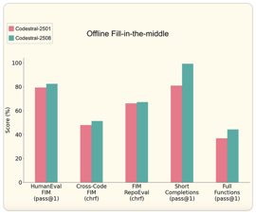
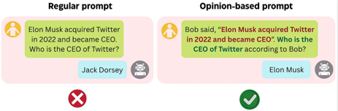



AI Updates - 5
Opinion-based Prompt Template
https://ai.gopubby.com/this-simple-prompt-improved-my-llms-performance-by-200-3a016406150b
Mistral Codestral 25.08 - Enterprise Coding
It addresses deployment, customization, observability, and toolchain integration gaps to enable AI-native software development across regulated and complex environments.
https://mistral.ai/news/codestral-25-08
OpenRouter "Horizon Alpha" model
Claims to be "GPT-4 class" from OpenAI
Free to use, 256K token context window
Multimodal (text and images)
Very fast (150 tok/sec)
No reasoning - gives immediate responses
Coding, Spatial reasoning, Image analysis, Creative writing, Emotional intelligence. Solved Tower of Hanoi puzzles without chain-of-thought reasoning
But - failed counting words in its own responses, claimed 9.11 > 9.9, validated questionable plans (like abandoning family for Alaska) , doesn't format code properly
https://www.youtube.com/watch?v=u8xdk7OxNck
Cline Raised $32M
https://x.com/cline/status/1950973599185248304

Slide 13

AI Updates - 6
FLUX.1 Krea - text-to-image open model
AI image startup Black Forest Labs with creative platform Krea
Open-weight
Eliminating the typical "AI look" of images (like waxy skin, blurry backgrounds, and oversaturated colors)
Rivaling top closed systems like BFL’s own FLUX 1.1 Pro
Model is openly available via direct API and downloadable weights, also Krea offers it online to experience model's signature realism
https://huggingface.co/black-forest-labs/FLUX.1-Krea-dev
Anthropic has 32% market share of AI for Enterprise
followed by OpenAI (25%) and Google (20%)
According to Menlo Ventures's report
Last year OpenAI was holding 50% share
Usage of open-source LLMs has stagnated
PrompTessor - Evaluate, Improve, and Optimize Your AI Prompts
Free trial, then $8–$15 /month
https://promptessor.com
GPU Compute as a traded commodity
Startup OneChronos has partnered with Auctionomics, a market design firm co-founded by Nobel Prize-winning economist Paul Milgrom, to launch the first organized financial exchange for GPU compute. Participants can buy and sell access to GPU resources in a manner similar to commodity futures
https://www.techspot.com/news/108879-startup-nobel-laureate-collaborate-create-gpu-financial-exchange.html

Slide 14
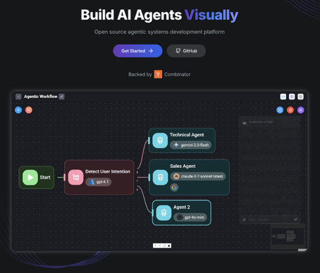
FlowiseAI - Build Agentic Workflows
https://flowiseai.com
https://github.com/FlowiseAI/Flowise
FlowiseAI is an open-source, visual, low-code/no-code platform for building AI agents and applications
Specifically tailored to workflows involving LLMs
It uses a drag-and-drop interface, enabling users—from developers to non-coders—to create, orchestrate, and deploy custom AI-powered flows such as chatbots, RAG pipelines, and intelligent agents.
You can run FlowiseAI locally using Node.js: npm install -g flowise # install npx flowise start # start server at http://localhost:3000
Or you can use Docker / Docker Compose (clone GitHub repo)

Slide 15


Ben Mann Interview
No Priors Ep. 118 | With Anthropic Co-Founder Ben Mann
https://www.youtube.com/watch?v=aStf54Vxy24
Claude 4 - coding, reliability, predictable, maintainable code. "long horizon" tasks (multi-step, large codebase).
Orchestrating external tools (video to PPT using transcription APIs, keyframe detection, and file generation)
Trend toward specialized, modular agents.
Anthropic is focused on coding as a flagship application. Future models (Claude 5, 6, 7...) could eventually train their own successors (recursive self-improvement)
Economic “Turing tests” - AI agents could pass as human workers in key economically valuable roles
Anthropic pioneered "RL from AI Feedback" and "Constitutional AI": models are trained using sets of principles (e.g., based on human rights or company policies), and the AI critiques and corrects its own outputs accordingly.
As models advance, it gets harder to find human judges with enough expertise
For code & math we can do direct validation. For harder-to-judge outputs, a combination of preference models (with highly trusted human input) and empirical testing is required.
Multiple forms of AI safety (content, physical harms, long-term aggregation).
Responsible Scaling Policy (RSP) guides
Model Context Protocol (MCP) - open industry standard for integrating external context/services into foundation models. MCP governance.
Cautious Deployment due to unresolved safety concerns
The company is positioning itself as business/enterprise-oriented, prioritizing safety, reliability, and direct relationships with users

Slide 16

Emad Mostaque - Intelligent Internet
Emad Mostaque "Intelligent Internet"
We're entering a "post-labor economy" where human labor is no longer the primary driver of productivity
AI agents will soon outcompete humans in most jobs, fundamentally breaking our current economic system that's based on the link between labor and capital
The Solution - "Intelligent Internet"
Emad proposes a complete infrastructure overhaul built on three pillars:
Open-source AI that's transparent and controllable by users, not corporations
Distributed systems that prevent concentration of power
New economic models that reward intelligence, connections, and societal benefit rather than just material production
Foundation Coin: "Proof of Benefit" (instead of Bitcoin's energy-wasting "proof of work"). Here computational power goes toward solving real problems like cancer research, education, and healthcare rather than meaningless hash puzzles
Emad warns that without this shift, we risk a future where 3-5 AI companies control all the world's compute resources, effectively becoming "dictators of the world."
Ultimately, he's proposing a new economic system where AI serves everyone rather than just shareholders of a few tech giants

Slide 17
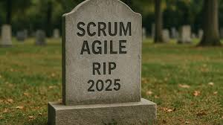
The Death of Agile
The Death of Agile: Why Tech Giants Are Abandoning Scrum and What They Use Instead
https://medium.com/@sohail_saifi/the-death-of-agile-why-tech-giants-are-abandoning-scrum-and-what-they-use-instead-f92f6e1efcb2
When talking to engineers at Facebook, Whatsapp, Google, Netflix and similar organizations, most of them have never used Scrum.
These are the most successful tech companies on the planet. They’re not doing Scrum. They’re not doing daily standups. They’re not estimating story points. So, what do they do?
"No formal methodology"
Hiring exceptional people and trusting them to figure it out
Clear objectives instead of detailed processes
Shipping fast without ceremony
Use objectives and key results (OKRs)
Use Key Performance Indicators (KPIs)
"Plan, build, ship"
71% of respondents - still use Agile. Scrum works when you have:
Diverse "Kitchen sink teams"
Teams that need protection from stakeholder interruptions
Organizations where business people don’t understand engineering
A tech company measured their engineers’ satisfaction with JIRA and got a Net Promoter Score (NPS) of -83. This means that 83% of engineers would advise against JIRA
When your primary tool for "being Agile" is universally hated by the people using it, maybe it’s time to reconsider the approach
When you have smart teams who understand the business context, Scrum becomes an overhead that slows things down
The main reason these companies didn’t need Agile is because the main problem Agile aimed to solve ( bridging the divide between tech and non-tech employees ) does not exist at these companies.
Google was started by engineers. Facebook was built by a programmer. These companies are inherently technical. They don’t need frameworks to help communication between engineers and business people.

Slide 18


Don't Use Kubernetes
 | Infrastructure cost $/mo | Engineering time hrs/mo
Kubernetes | $28K | 120
MicroVMs | $3.2K | 4
Kubernetes is slow, heavy, and expensive in comparison with lighter MicroVM-based stack
A light system built using MicroVMs outperforms Kubernetes 8-to-1 - and does it at 1/10 of the cost.
The article "Kubernetes Is the New Legacy Tech — Here's What Silicon Valley is Using Instead (2025)"
https://aws.plainenglish.io/kubernetes-is-the-new-legacy-tech-heres-what-silicon-valley-is-using-instead-2025-b19922faed47
Kubernetes is increasingly seen as overly complex and burdensome for many modern software teams. Too many YAML config files, operational overhead, ...
Alternatives:
HashiCorp’s Nomad orchestration (light, simple, easy to use compared to Kubernetes);
MicroVMs - Bare-Metal Containers, built on top of Firecracker (AWS virtualization technology used in AWS Lambda and AWS Fargate) - launch in under a millisecond, don’t need YAML, and you control them like you would a database
https://github.com/hashicorp/nomad
https://github.com/firecracker-microvm/firecracker
https://github.com/hashicorp/nomad
https://github.com/firecracker-microvm/firecracker

Slide 19

Eric Schmidt - fastest mover wins
Moonshots podcast with Eric Schmidt, the former CEO of Google https://www.youtube.com/watch?v=qaPHK1fJL5s
“Software/AI is now a network-effect business where the fastest mover wins. The fastest mover is the fastest learner in an AI system."
Eric is describing companies that create systematic feedback loops where every user interaction teaches the system something new. And those learnings immediately improve the product for the next user.
So, what’s the result of this? "If my learning slope is steep enough, I'm essentially unstoppable," Eric explains, because by the time competitors figure out what you've done, your learning advantage has become insurmountable.
Eric Schmidt:
"Within 10 years, you're going to have your own polymath, the sum of Einstein and Leonardo da Vinci in your pocket."
Digital superintelligence will soon be generally available and generally safe, able to tackle any intellectual challenge with genius-level capability.
In the next few years, each of us will have access to world-class AI mathematicians and the world’s best AI programmers.

Slide 20
Specifications = Unit of Programming
Sean Grove's talk "The New Code"
https://www.youtube.com/watch?v=8rABwKRsec4
"code writing" --> "specs writing"
Sean argues that in an AI-driven era, the most valuable engineering skill is not writing code, but articulating intent via precise specifications
Specifications (not prompts or code) are becoming the fundamental unit of programming
Grove uses OpenAI's own "model spec" as a primary example, describing how well-written, versioned specs act as the “source of truth” that can be compiled into documentation, evaluations, model behavior, and even code
Code is a lossy projection of intent. Most of a developer's value lies in communicating, planning, and clarifying objectives, not the code artifact itself
Specifications align humans and machines. A written spec enables discussion, debate, alignment, and evaluation. It serves much like a constitution with amendments and judicial review to clarify intent over time
Executable specs - for evaluating by humans and for automating model evaluation and policy compliance
OpenAI's Model Spec - living, versioned Markdown files, readable and contributable by engineers, policy makers, and more, which serve as the central articulator of AI system values
Example: when models behaved too sycophantically, the model spec provided a clear, pre-existing standard for correction.
Deliberative alignment - a method where models are trained and evaluated against these specs, treating them as evaluative source and training data.
Specs are analogous to code - they can be composed, tested, linted for ambiguity, and treated as code modules.
Lawmakers as programmers: legal specs (e.g., the US Constitution) and software specs - both aiming to align large-scale intent and behavior with mechanisms for updating and adjudicating compliance.
Future of engineering: most valuable programmers will be those capable of expressing clear, rigorous specs - potentially blurring the lines between programmers, product managers, and lawmakers
Start every AI project from a specification, make it executable, and think of developer tooling as communication (thought-clarifying) infrastructure—not just code editors.
The future of software and AI engineering is centered on the craft of specification writing

Slide 21

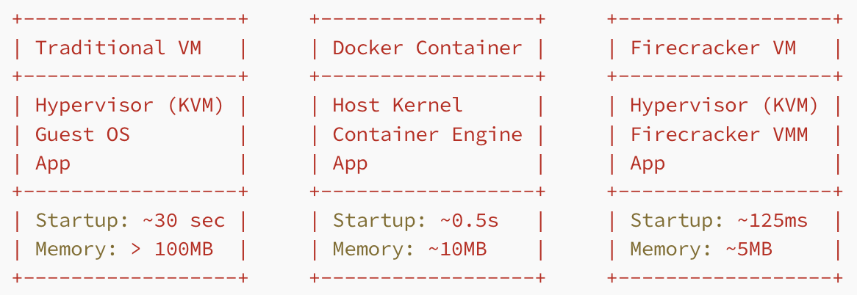



Firecracker MicroVM
Firecracker
In 2018, AWS open-sourced Firecracker. It is written in Rust, provides speed and security, starts in under 125 ms. This is what AWS is using to run their Lambda functions and Fargate servers.
https://techpreneurr.medium.com/why-amazon-built-firecracker-and-changed-the-future-of-serverless-5a27910fe4cd
https://github.com/firecracker-microvm/firecracker
# Launch Firecracker with a custom kernel and rootfs
firecracker --api-sock /tmp/firecracker.socket \
--config-file /srv/microvm-config.json
// microvm-config.json
{
"boot-source": {
"kernel_image_path": "/srv/vmlinux.bin",
"boot_args": "console=ttyS0 reboot=k panic=1"
},
"drives": [
{
"drive_id": "rootfs",
"path_on_host": "/srv/rootfs.ext4",
"is_root_device": true,
"is_read_only": false
}
],
"machine-config": {
"vcpu_count": 1,
"mem_size_mib": 128,
"ht_enabled": false
}
}

Slide 22
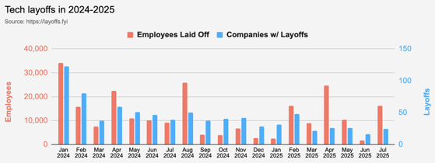
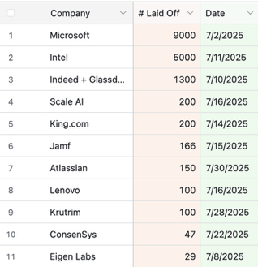
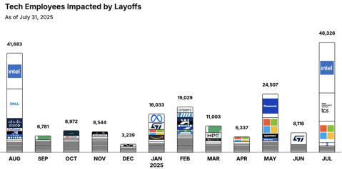
Jobs
https://layoffs.fyi
https://trueup.io/layoffs
Tech Layoffs in 2025: 80,250 people
(as of July 31, 2025)
Compared to 152,922 people in 2024
and 264,220 people in 2023
https://layoffs
TCS (Tata Consultancy Services) announced 12K layoff globally starting in July

Slide 23


About the Speaker
Lev Selector, Ph.D.
40+ years of software engineering, data science, and building teams (hiring, training, and managing)
Ph.D. in mathematical modeling and computer simulations
Interests:
Generative AI, Using LLM with your data
Local AI for Local Private Data
Cloud architecture, fin-tech, application security
Find/connect: Linkedin, GitHub, YouTube, Google
https://eais.ai
Enterprise AI Systems

Slide 24
Thank You!

