Slide 1
AI Updates
April 18, 2025
From AI Models -- to AI Systems
OLMoTrace from Allen Institute for AI (Ai2)
GPT for GSheets 7 GDocs - extension
Amazon Nova Sonic
GPT-4.1 & Llama-4 models on GitHub Models
MAI-DS-R1 in GitHub Models
Google rolls out AI video generator
Gemini Live: Gemini App sees your android screen
Affordable RAG re-ranking - One-Token Trick
Wikipedia offers its data as a dataset
Open AI uses Triton to write AI code
Seadream Tops the Image Leaderboard
n8n Workflow Automation
DISCIPL = Planner + Follower Reasoning
Ilya Sutskever's SSI valued at 32 Billion
Emmy Noether - Symmetries in Physics
OpenAI GPT-4.1
OpenAI o3 & o4-mini
Opera Agentic AI web browser experience
Cursor "Max Models"
NVIDIA - Native Python Support to CUDA
Scale AI - 25 Bln valuation preparing training data
NAS = Neural Architecture Search
Windsurf Cascade on JetBrains IDEs
Linearity Theorem - improve LLM Quantization
"Task Master" removes 90% Vibe coding errors
OpenRouter Quasar Alpha
MUSA SDK - alternative to Nvidia CUDA
OpenHands LLM 32B from All Hands
Dragontail model at LMArena
NVIDIA UltraLong-8B
Seaweed-7B Chinese AI model is better than Sora
Chinese Kling AI Creative Studio
Crowd-sourced "Arena" Leaderboard
"LM Arena" Search Tab and Other Tabs
Jobs

Slide 2
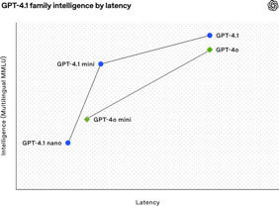
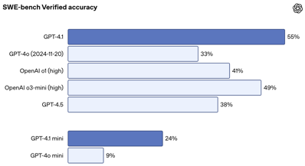
OpenAI GPT-4.1
GPT-4.1 (also "mini" and "nano"):
https://www.youtube.com/watch?v=AIHNqAxzhRk
https://openai.com/index/gpt-4-1/
improved instruction following and long context capabilities
outperforms GPT-4.0 (and even GPT-4.5 in some benchmark areas)
smaller cheaper "mini" and "nano" models released
pricing (per 1M tokens): $1.84 ($0.42 mini, $0.12 nano)
Prompt caching discount increased from 50% to 75%
coding - surpass o1-high and GPT-4.5
double the performance on the ADA polyglot benchmark
better visual design
better physics understanding
60% higher performance on Vince Cerf's internal coding benchmark
better code suggestions in 55% of cases
improved handling of XML, YAML, Markdown
better understanding of negative instructions
enhanced content requirements ranking
reduced overconfidence
Context length 1 Million tokens (up from 128,000 in GPT-4.0)
Excellent performance on "needle in the haystack" tests
More accurate for RAG, Intelligent information retrieval
Vision performance on par with GPT-4.5
GPT-4.1 mini outperforms GPT-4 mini for vision tasks
Improved video long context understanding

Slide 3
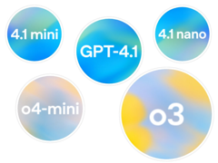
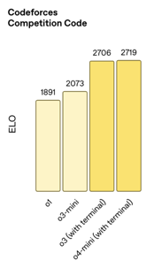
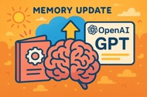
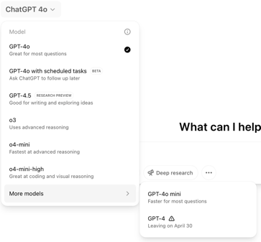

OpenAI o3 & o4-mini - AI Systems
OpenAI o3 & o4-mini
https://openai.com/index/introducing-o3-and-o4-mini/ - intro & charts
https://www.youtube.com/watch?v=sq8GBPUb3rk - video
"Flex" plan - a 50% discount for slower processing
OpenAI Codex-CLI - open-source local coding agent
https://github.com/openai/codex/tree/main/codex-cli
ChatGPT memory feature
AI can reference past conversations for more personalized interactions
Note: xAI’s Grok also gets memory feature
xAI's Grok Studio - create documents and apps
OpenAI considers launching a social network to rival Elon Musk’s X and Meta’s Instagram
GPT-5 delayed due to GPU shortages
OpenAI will soon retire GPT-4

Slide 4

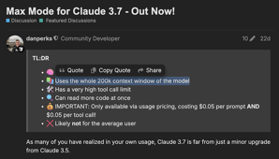


AI Updates 1
Opera Agentic AI web browser experience
An Opera AI agent called Browser Operator navigated the web on a user’s behalf in a science-fiction-like demonstration.
https://www.tomsguide.com/computing/internet/exclusive-i-just-tried-operas-ai-powered-browser-operator-for-the-first-time-this-puts-chatgpt-on-notice
Max Models in Cursor
Cursor's default behavior is to send only a pruned or summarized portion of your context. This context reduction lead to frustrating experiences where models provide wrong answers
The Solution - use Max Models in Cursor. "Max" models are the same models - but without Cursor's heavy-handed context pruning. Both Claude 3.7 Sonnet MAX and Gemini 2.5 Pro MAX modes are designed to give the AI access to the entire long context that the underlying models support. In other words, Max models remove the artificial truncation or summarization that standard Cursor applies.
https://www.vincentschmalbach.com/always-use-max-models-in-cursor-ide/
NVIDIA - Native Python Support to CUDA
https://thenewstack.io/nvidia-finally-adds-native-python-support-to-cuda/
Scale AI - 25 Bln valuation - preparing training data
Alexandr Wang
https://en.wikipedia.org/wiki/Scale_AI

Slide 5
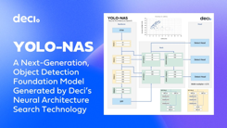
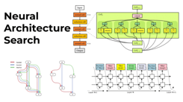
Neural Architecture Search - NAS
NAS = Neural Architecture Search
Came from deci.ai - Israeli startup
Nvidia bought it 2 years ago, so deci.ai redirects to Nvidia
Deci AI was co-founded in 2019 by Yonatan Geifman (CEO), Jonathan Elial (COO), and Ran El-Yaniv (Chief Scientist)
They had developed SOTA object detection (YOLO-NAS - You Only Look Once). They used NAS while building it.
NAS was used in Nvidia Llama 3.1 Nemotron Ultra 253B
This LLM was released on April 8, 2025
It is derived from Meta Llama-3.1-405B-Instruct
Open Source, accessible for commercial use
Better than Llama4 and Deepseek-R1
Runs on an 8x H100 GPU setup with high inference throughput
Cost-effective deployment compared to larger models, good for enterprise AI copilots, coding agents, scientific research assistants
Toggleable "Reasoning On/Off"
128Ktokens Context Length
https://build.nvidia.com/nvidia/llama-3_1-nemotron-ultra-253b-v1
https://huggingface.co/nvidia/Llama-3_1-Nemotron-Ultra-253B-v1
https://sebastian-petrus.medium.com/nvidias-llama-nemotron-ultra-253b-via-api-b503bf8a0a37
Neural Architecture Search (NAS) is the process of automating the design of artificial neural network architectures
How many layers should the network have? What type of layers should be used (e.g., convolutional, recurrent, dense)? How should these layers be connected? What hyperparameters (like learning rate, filter size) should be used within those layers? etc.
NAS uses algorithms to automatically search through a space of possible architectures and find one that performs well on a specific task.
NAS involves defining Search Space, selecting Search Strategy (Reinforcement Learning, Evolutionary Algorithms, Gradient-based Methods, Random Search), Performance Estimation Strategy for faster results (Training on smaller datasets or for fewer epochs, Using parameter sharing across child models, Predicting performance based on architectural properties)

Slide 6
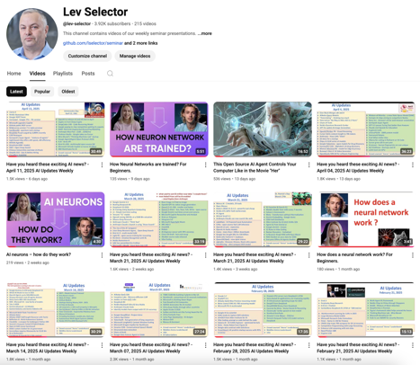
We post our AI Updates
Every Friday after 3pm EST
It is usually 25-30 min long
Links to slides are under the videos
Subscribe to our YouTube channel to get notified when new videos are posted
https://www.youtube.com/@lev-selector

Slide 7
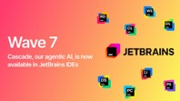
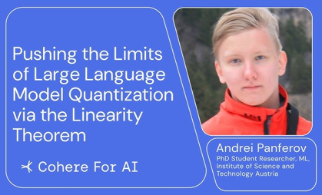
AI Updates 2
Windsurf Cascade on JetBrains IDEs
Agentic multi-step coding
https://windsurf.com/blog/windsurf-wave-7
Note: OpenAI in talks about acquiring Windsurf for $3 Bln
Linearity Theorem - improve LLM Quantization
https://arxiv.org/abs/2411.17525
https://www.youtube.com/watch?v=Jfc07PuEhYo
The "linearity theorem" helps to establish a direct relationship between the layer-wise ℓ2 reconstruction error and the model perplexity increase due to quantization. This enables:
a simple data-free LLM quantization method using Hadamard rotations and MSE-optimal grids, dubbed HIGGS (Hadamard Incoherence with Gaussian MSE-optimal GridS), which outperforms all prior data-free approaches such as the extremely popular NF4 quantized format
an optimal solution to the problem of finding non-uniform per-layer quantization levels which match a given compression constraint in the medium-bitwidth regime, obtained by reduction to dynamic programming.
We demonstrate improved accuracy-compression trade-offs on Llama-3.1, Llama-3.2, and on Qwen-family models
Further, we show that our method can be efficiently supported in terms of GPU kernels at various batch sizes, advancing both data-free and non-uniform quantization for LLMs.

Slide 8
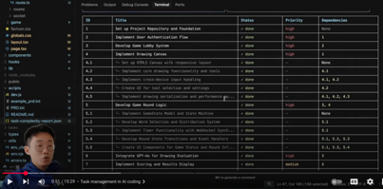
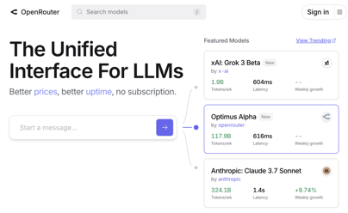
AI Updates 3
"Task Master" removes 90% Vibe coding errors
https://www.youtube.com/watch?v=1L509JK8p1I
Idea - implement task management to reduce errors
give AI coding agents a task management system that helps them understand the overall implementation plan and control the context for each step. Break down complex projects into small, manageable tasks; Track tasks' completion; Implement tasks in a logical order with dependencies mapped out
Cloud Taskmaster - A command-line tool, integrates with Cursor
Boomerang Task from Ruko Code - a similar tool with task management features
OpenRouter - a platform providing access to many LLMs (OpenAI, Anthropic, Google, and many others) - https://openrouter.ai
Quasar Alpha - one of the models on OpenRouter. https://medium.datadriveninvestor.com/i-used-openais-gpt-4-5-to-create-a-trading-strategy-it-returned-over-10x-the-broader-market-7ab2ccce8021

Slide 9
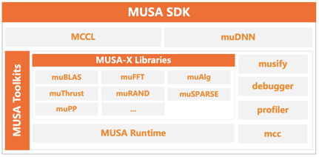

AI Updates 4
MUSA SDK - alternative to Nvidia CUDA
by Chinese firm Moore Threads
Supports Intel & ARM Processors along with their own GPUs
Allows easy code porting from NVIDIA's CUDA Stack
Allows parallel computing
https://wccftech.com/china-first-in-house-alternative-to-nvidias-cuda-emerges-online/

Slide 10

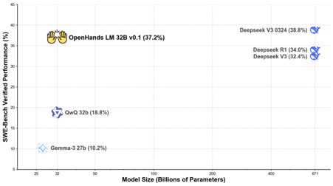

OpenHands LLM 32B
OpenHands LLM 32B from All Hands - https://www.all-hands.dev
Strong & Open Coding Agent Model, 128k context
built on top of Qwen Coder 2.5 Instruct 32B
Self-Generated Training Data + Reinforcement Learning (RL) with SWE-Gym (SWE = SoftWare Engineering)
SWE-Gym is the first environment designed specifically for training AI agents on real software engineering tasks. 2,438 Python tasks sourced from GitHub issues across 11 repositories like pandas ...; Executable environments (in terminal) with pre-configured dependencies and unit tests for each task; Test-driven verification to validate code solutions automatically
https://www.all-hands.dev/blog/introducing-openhands-lm-32b----a-strong-open-coding-agent-model
https://github.com/All-Hands-AI/OpenHands
https://app.all-hands.dev - try it live
ollama run huihui_ai/openhands-lm-abliterated
ollama run omercelik/openhands-lm # we use this in PyCharm
"All Hands" is based in the US (University of Illinois Urbana Champaign and Carnegie Mellon University, Pittsburgh, PA)
Founders: Robert Brennan (CEO), Xingyao Wang (Chief AI Officer), Graham Neubig (Chief Scientist)
Funding from U.S.-based venture capital firms such as Menlo Ventures and Pillar VC
300 Contributors on GitHub

Slide 11

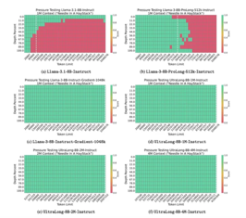
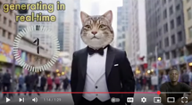

AI Updates 5
Dragontail model at LMArena (Google?)
on par with o3-mini-high and claude-3-7-sonnet-20250219-thinking-32k
consistently delivers the correct answers !
https://www.geeky-gadgets.com/google-dragontail-ai-2025/
https://www.youtube.com/watch?v=LbiEkzt7yhQ
NVIDIA UltraLong-8B
Ultra-Long Context LLMs (1M, 2M, and 4M tokens)
From Llama3.1-8B-Instruct 128K to 4M - https://arxiv.org/abs/2504.06214
https://huggingface.co/collections/nvidia/ultralong-67c773cfe53a9a518841fbbe
https://www.marktechpost.com/2025/04/12/nvidia-a-releases-introduce-ultralong-8b-a-series-of-ultra-long-context-language-models-designed-to-process-extensive-sequences-of-text-up-to-1m-2m-and-4m-tokens/
Seaweed-7B Chinese video generation better than Sora !
from Bytedance, competitive against much larger models like Kling 1.6, Google Veo, massively outperforming Sora and Wan 2.1
text-to-video, image-to-video, and audio-driven synthesis
output length up to 20 seconds.
Multi-shot storytelling, controlled camera movements, synchronized audio-visual generation, realistic human animation and lip syncing
Chinese models are crushing AI video leaderboards: Wan (Alibaba), Kling, and ByteDance’s Seaweed
https://www.youtube.com/watch?v=Gn2HlDfdCOA
https://arxiv.org/abs/2504.08685 - paper
Chinese Kling AI Creative Studio
Kling 2.0 Master - video
Kolors 2.0 - images
sequential actions and expressions; natural speed and fluid motions; styles, editing
https://www.klingai.com/global/

Slide 12
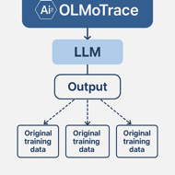

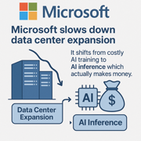
AI Updates 6
OLMoTrace from Allen Institute for AI (Ai2)
Tracing LLM Outputs Back to Trillions of Training Tokens
https://arxiv.org/abs/2504.07096
Harvard Business Review research indicates that therapy and companionship have become the top use cases for AI
Browser extension - GPT for Sheets™ and Docs™ brings ChatGPT, Gemini™, Claude, Perplexity and other AIs directly into Google Sheets™ and Google Docs™.
https://workspace.google.com/marketplace/app/gpt_for_sheets_and_docs/677318054654
Amazon Nova Sonic - speech generation on AWS Bedrock
Microsoft slows down data center expansion
It shifts from costly AI training to money making AI inference.
Moving towards a more balanced approach that prioritizes efficiency and cost-effectiveness.
There are also concerns about a potential oversupply of AI infrastructure, leading to a more cautious approach to data center investments

Slide 13

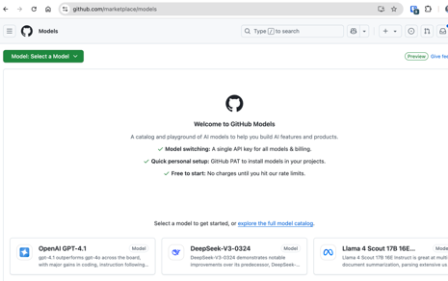
AI Updates 7
GPT-4.1 & Llama-4 models on GitHub Models
https://github.com/marketplace/models
Google rolls out AI video generator
to Gemini Advanced subscribers
Veo 2 text-to-video AI model
creating high-resolution clips with "cinematic realism"
Select Veo 2 from the Gemini model dropdown
Enter a prompt to generate an eight-second video in 720p
Whisk Animate tool is coming to Google One AI Premium users
https://www.theverge.com/news/648816/google-veo-2-ai-video-generation-gemini-advanced
Gemini Live - feature of Gemini app on Android allowing it to see and respond to what is on your screen
MAI-DS-R1 in GitHub Models
MAI-DS-R1 is an updated version of DeepSeek-R1
It is refined by Microsoft AI to handle complex queries, work across multiple languages, and provide access to previously restricted information
https://github.blog/changelog/2025-04-17-mai-ds-r1-is-now-generally-available-in-github-models/
Affordable RAG re-ranking - One-Token Trick
Ask LLM to tell if the text is relevant or not using 1 token response length - thus reducing the cost.
https://blog.getzep.com/the-one-token-trick/
US government now requires Nvidia to get a permit to sell its H-20 AI chips to China, fearing misuse in powerful computers.

Slide 14
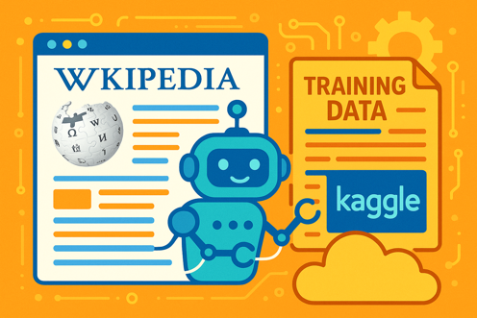
Wikipedia offers its data as a dataset
Wikipedia Offers AI-Ready Dataset to Ease Bot Surge
Wikipedia is being hit by overwhelming traffic from AI bots scraping its pages for training data
To reduce this traffic, Wikimedia Foundation has partnered with Kaggle (Google) to release an official, AI-friendly JSON formatted version of Wikipedia.
The datasets in English and French, stripped of links, citations, and markdown
Kaggle with host the dataset and help make it easily accessible to researchers and developers.

Slide 15

Open AI uses Triton to write AI code
import torch
import triton
import triton.language as tl
# -----------------------------------------------------------
@triton.jit
def add_kernel(x_ptr, y_ptr, output_ptr, n_elements,
BLOCK_SIZE: tl.constexpr):
pid = tl.program_id(axis=0)
block_start = pid * BLOCK_SIZE
offsets = block_start + tl.arange(0, BLOCK_SIZE)
mask = offsets < n_elements
x = tl.load(x_ptr + offsets, mask=mask)
y = tl.load(y_ptr + offsets, mask=mask)
output = x + y
tl.store(output_ptr + offsets, output, mask=mask)
# -----------------------------------------------------------
def add(x: torch.Tensor, y: torch.Tensor):
output = torch.empty_like(x)
assert x.is_cuda and y.is_cuda and output.is_cuda
n_elements = output.numel()
grid = lambda meta: (triton.cdiv(n_elements, meta['BLOCK_SIZE']), )
add_kernel[grid](x, y, output, n_elements, BLOCK_SIZE=1024)
return output
# -----------------------------------------------------------
# Example usage:
torch.manual_seed(0)
size = 98432
x = torch.rand(size, device='cuda')
y = torch.rand(size, device='cuda')
output_triton = add(x, y)
output_torch = x + y
print(f'The maximum difference between torch and triton is '
f'{torch.max(torch.abs(output_torch - output_triton))}')
Open AI uses Triton to write AI code
https://triton-lang.org/main/index.html
https://github.com/triton-lang/triton
https://triton-lang.org/main/python-api/triton.html
Triton is a language and compiler for parallel programming.
It is Python-based programming environment for writing custom Deep Neural Networks compute kernels.
Nvidia Triton Inference Server - completely separate project. Naming coincidence

Slide 16
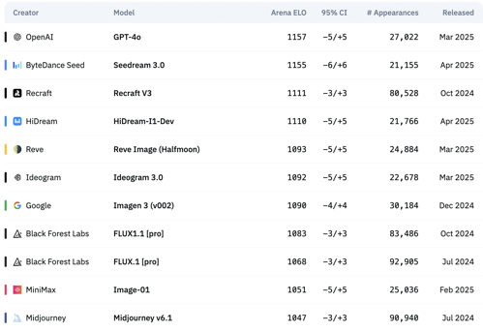
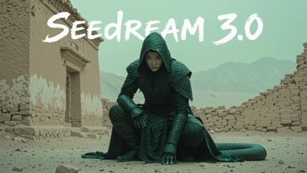
Seadream Tops the Image Leaderboard
ByteDance’s Seadream 3.0 (Mogao)
https://x.com/ArtificialAnlys/status/1912122278722379903
https://team.doubao.com/en/tech/seedream3_0
Seadream 3.0 - Hi-Res Text-to-Image Model
Artificial Analysis Image Arena Leaderboard https://artificialanalysis.ai/text-to-image/arena?tab=Leaderboard https://huggingface.co/spaces/ArtificialAnalysis/Text-to-Image-Leaderboard

Slide 17

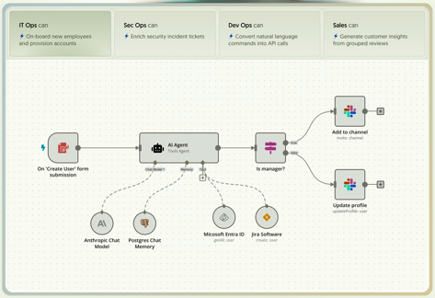
n8n Workflow Automation
n8n is an open-source workflow automation
https://n8n.io ( nodemation )
connect different apps, tools, and services—such as Slack, Google Sheets, databases, and APIs—using a visual, drag-and-drop interface
Supports over 400 native integrations and can connect to thousands of other apps via HTTP requests if they offer an API
Hybrid No-Code/Low-Code
Self-Hosting & Cloud Options
allows integration of AI tools and agents into workflows
Open Source & Community Driven
n8n is often chosen over competitors like Zapier or Make for its flexibility, open-source nature, and ability to self-host

Slide 18
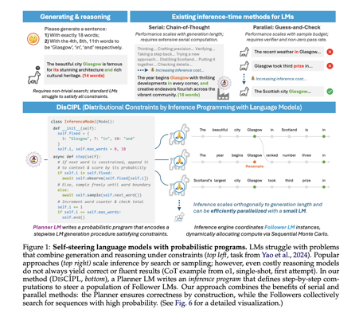
DISCIPL = Planner + Follower Reasoning
MIT Researchers Introduce DISCIPL.
It is a reasoning framework consisting of two steps - a "Planner" and "Follower".
A "Planner" language model generates a task-specific inference program in a python-based framework. This program is then executed by a population of "Follower" models to search for valid outputs.
These programs operate by iteratively proposing partial solutions and scoring them based on constraints.
The architecture supports multiple inference techniques, including importance sampling, Sequential Monte Carlo (SMC), and rejection sampling.
In performance evaluations, DISCIPL proved remarkably effective raising success from 4% to 87-88%, surpassing GPT-4o-mini in some instances.
https://arxiv.org/pdf/2504.07081 - paper
https://www.marktechpost.com/2025/04/16/mit-researchers-introduce-discipl-a-self-steering-framework-using-planner-and-follower-language-models-for-efficient-constrained-generation-and-reasoning/

Slide 19
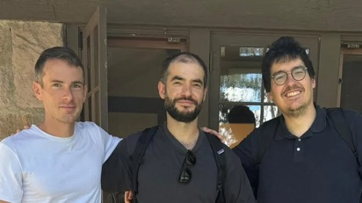
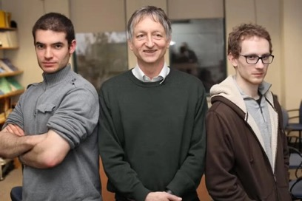
Ilya Sutskever's SSI valued at 32 Billion
Alphabet & Nvidia invest in OpenAI co-founder Ilya Sutskever's Startup SSI (Safe Super Intelligence)
SSI raised additional $2B at $32B valuation
SSI will use Google's TPU chips
AI developers have historically preferred Nvidia's GPUs which hold more than 80% of the AI chips market.
But SSI is so far primarily using TPUs rather than GPUs for its AI research and development
Amazon is building Trainium and Inferentia chips.
Anthropic continues to use TPUs for its AI development
Safe Super Intelligence Inc. (SSI):
Sole Focus and long term goal is building "safe superintelligence". This is their mission, name, and sole product
SSI considers this the most important technical problem of our time - creating AI vastly smarter than humans, while ensuring it remains aligned with human interests and values, preventing potential existential risks
Developing this superintelligence "safely"
Research-Oriented, intentionally insulate themselves from short-term commercial pressures, product cycles, and management overhead that might distract from their core mission
SSI has offices in Palo Alto, California, and Tel Aviv, Israel

Slide 20
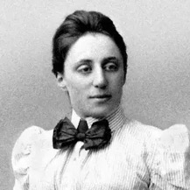
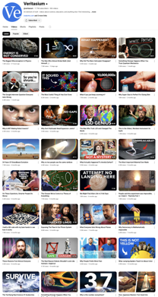


Emmy Noether - Symmetries in Physics
Symmetries in Physics According to Emmy Noether
Translation Symmetry in Space = position doesn't matter. This symmetry leads to conservation of momentum - when you throw an object in empty space, it continues moving at constant velocity.
Rotation Symmetry = The laws of physics remain unchanged when you rotate an experiment. This symmetry leads to conservation of angular momentum - a spinning object in empty space will continue spinning indefinitely.
Time Translation Symmetry = The laws of physics don't change over time; experiments done today or tomorrow yield the same results. This symmetry leads to conservation of energy - in a static universe, energy would be conserved.
Local Symmetries (General Covariance) = In general relativity, the laws of physics look the same regardless of your frame of reference, even for accelerating or rotating frames. However, these are local symmetries (applying to small regions) rather than global symmetries.
Gauge Symmetry = Electrons have a "phase" that can be offset by any amount simultaneously for all electrons without changing anything physically. This symmetry leads to conservation of electric charge.
https://www.youtube.com/watch?v=lcjdwSY2AzM
https://en.wikipedia.org/wiki/Emmy_Noether
Emmy Noether
1882-1935
Derek Muller

Slide 21
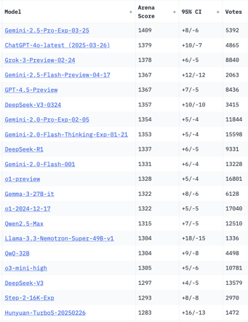
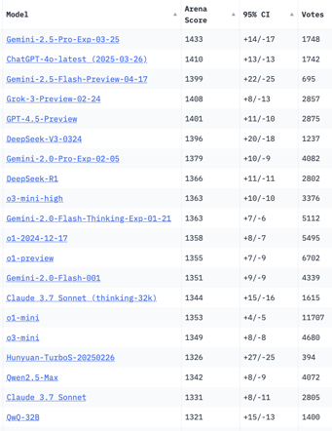
Crowd-sourced "LM Arena" Leaderboard
Starting Elo rating = 1000
95% CI = Confidence Interval
https://en.wikipedia.org/wiki/Elo_rating_system
Total #models: 225
Total #votes: 2,871,517
Last updated: 2025-04-16
https://chat.lmsys.org/?leaderboard
https://lmarena.ai/?leaderboard
https://openlm.ai/chatbot-arena/
https://beta.lmarena.ai
English-only queries
Coding
x.ai
x.ai
China
China
China
China
China
China
China
China
China
China
Llama-4-Maverick
is still on 30th place
China
China

Slide 22
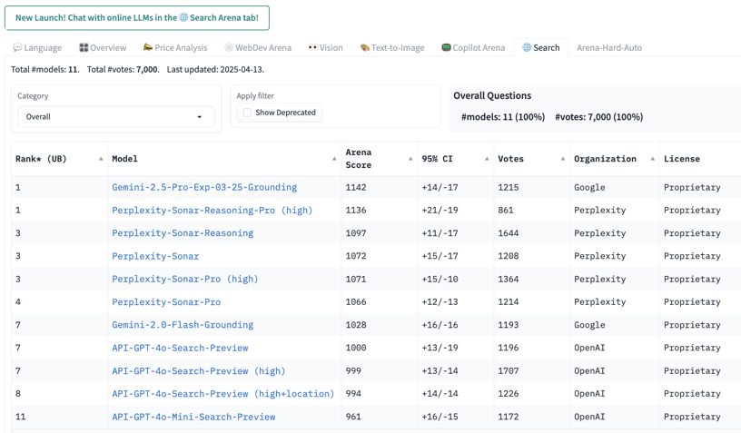
"LM Arena" Search Tab and Other Tabs

Slide 23

Jobs
AI Job Market Growth Despite Workforce Uncertainty
AI-related jobs are increasing after a slight dip
Global demand is up, especially in Singapore, Luxembourg, and Hong Kong
Some businesses expect AI to shrink their workforce, others predict growth.
Tools like GitHub Copilot might increase hiring but shift job skills toward more human-centered abilities
Python remains the most sought-after skill, but interest in generative AI is rising.
A gender imbalance persists in AI jobs,
High training costs are shifting advanced research from universities to companies.
More funding and collaboration are needed to support future AI workforce demands.

Slide 24


About the Speaker
Lev Selector, Ph.D.
40+ years of software engineering, data science, and building teams (hiring, training, and managing)
Ph.D. in mathematical modeling and computer simulations
Interests:
Generative AI, Using LLM with your data
Local AI for Local Private Data
Cloud architecture, fin-tech, application security
Find/connect: Linkedin, GitHub, YouTube, Google
https://eais.ai
Enterprise AI Systems

Slide 25
Thank You!

