Slide 1
AI Updates
February 07, 2025
Reasoning Models + Tools/Agents = AGI
DeepSeek Acceleration Effect
Multiple R Models - Cheap & Open Source
DeepSeek Self-Evolving
Restrictions on using DeepSeek in the US
DeepSeek Jailbreaking
Andrej Karpathy - Take LLM to School
Reflection-70B
Andrej Karpathy - Deep Dive into LLMs
Anthropic classifiers reduce jailbreaks
OpenAI ChatGPT Search - open without login
Microsoft "Think Deeper" in Copilot - free
Elicit.com - Automate research
ChatGPT Edu - OpenAI in Education
WARP: An Efficient Multi-Vector Retrieval Engine
Figure AI drops OpenAI - to use in-house models
Sam Altman says OpenAI is ‘on the wrong side of history
Microsoft Copilot with o1
Microsoft DeepSeek
OpenAI o3-mini
OpenAI Deep Research
Google Gemini 2.0 Flash & Pro
Deep Research - Open Source Alternatives
Crowd-sourced "Arena" Leaderboard
Jobs

Slide 2
Part 1 - DeepSeek
DeepSeek Acceleration Effect
Multiple R Models - Cheap & Open Source
DeepSeek Self-Evolving
Restrictions on using DeepSeek in the US
DeepSeek Jailbreaking
Andrej Karpathy - Take LLM to School
Reflection-70B
Andrej Karpathy - Deep Dive into LLMs
Anthropic classifiers reduce jailbreaks
OpenAI ChatGPT Search - open without login
Microsoft "Think Deeper" in Copilot - free
Elicit.com - Automate research
ChatGPT Edu - OpenAI in Education
WARP: An Efficient Multi-Vector Retrieval Engine
Figure AI drops OpenAI - to use in-house models
Sam Altman says OpenAI is ‘on the wrong side of history
Microsoft Copilot with o1
Microsoft DeepSeek
OpenAI o3-mini
OpenAI Deep Research
Google Gemini 2.0 Flash & Pro
Deep Research - Open Source Alternatives
Crowd-sourced "Arena" Leaderboard
Jobs

Slide 3
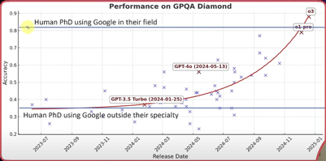
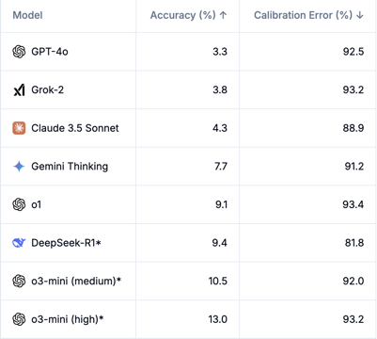
DeepSeek Acceleration Effect
Multiple new Reasoning models and services: Qwen, OpenAI, Google, Perplexity, ...
Microsoft Copilot with OpenAI o1 reasoning model https://www.theregister.com/2025/01/31/microsoft_open_ai_reasoning_copilot/
Microsoft offers DeepSeek on Copilot PCs https://www.pcworld.com/article/2593957/microsoft-ports-deepseeks-ai-to-copilot-pcs-and-their-npus.html
https://www.linkedin.com/posts/jonkeskitalo_the-gpqa-diamond-benchmark-is-a-test-of-448-activity-7293251958620987393-rr-v/
Humanity last exam: from 8.3% to 26.6% in just 10 days - https://agi.safe.ai https://www.youtube.com/watch?v=P4hGKsLaKfk https://www.techradar.com/computing/artificial-intelligence/openais-deep-research-smashes-records-for-the-worlds-hardest-ai-exam-with-chatgpt-o3-mini-and-deepseek-left-in-its-wake

Slide 4

Multiple R Models - Cheap & Open Source
DeepSeek R1 Cloned for $30?! (Berkeley) https://www.youtube.com/watch?v=e659KrxxN5w - video https://x.com/jiayi_pirate/status/1882839370505621655?s=46
Reproduced DeepSeek R1-Zero in the CountDown game
Using RL, 3B base LM develops self-verification and search abilities all on its own
http://github.com/Jiayi-Pan/TinyZero
https://github.com/volcengine/verl - Volcano Engine Reinforcement Learning for LLM
https://arxiv.org/abs/2409.19256v2
HybridFlow: A Flexible and Efficient RLHF Framework
Test-time compute ("giving an AI model extra time to think") is the most important breakthrough since Transformers changed the world in 2017
https://www.youtube.com/watch?v=KPOt8ekEanM - video
https://www.silamir.com/en/insight/test-time-compute-why-thinking-ai-models-are-shaping-the-future/
https://www.youtube.com/watch?v=kZWSiiMbua0 - Nvidia
s1: Simple test-time scaling (for $6)
https://arxiv.org/pdf/2501.19393 - We seek the simplest approach to achieve test-time scaling and strong reasoning performance.
https://github.com/simplescaling/s1
https://simonwillison.net/2025/Feb/5/s1-the-6-r1-competitor/ - inference-scaling model fine-tuned on top of Qwen2.5-32B-Instruct for just $6 - the cost for 26 minutes on 16 NVIDIA H100 GPUs.
They reduced dataset from 56K examples down to just the best 1K. They found that the core 1K is all that's needed to achieve o1-preview performance on a 32B model. The paper describes a technique called "Budget forcing": To enforce a minimum, we suppress the generation of the end-of-thinking token delimiter and optionally append the string “Wait” to the model’s current reasoning trace to encourage the model to reflect on its current generation
Fine-Tuning Your LLM to "Think" Like DeepSeek R1 https://kaitchup.substack.com/p/fine-tuning-your-llm-to-think-like-r1
Open source Reasoning implementation https://www.youtube.com/watch?v=QWoslkjR9W4 -
Speculations on Test-Time Scaling (o1) - https://www.youtube.com/watch?v=6PEJ96k1kiw
OpenAI o1's New Paradigm: Test-Time Compute Explained - https://www.youtube.com/watch?v=pi7LF-OpO6k
Scaling LLM Test-Time Compute Optimally - https://arxiv.org/abs/2408.03314 https://www.youtube.com/watch?v=AfAmwIP2ntY
R1-V - replicate reasoning of DeepSeek R1 model for just $3 - on a small 2 Bln params model and RL with verifiable rewards in STEM field.
https://github.com/Deep-Agent/R1-V
https://x.com/liangchen5518/status/1886171667522842856

Slide 5
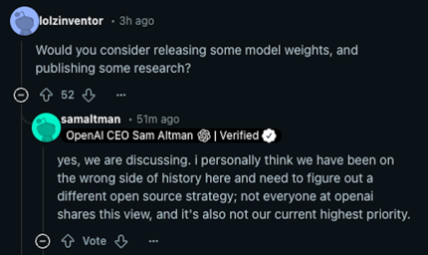
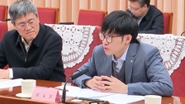
More around DeepSeek
DeepSeek R1 gave itself a x2 Speed Boost - Self-Evolving LLM
https://www.youtube.com/watch?v=ApvcIYDgXzg - video
https://simonwillison.net/2025/Jan/27/llamacpp-pr/ -
This was accomplished through a collaborative effort between a human prompter and the AI, where the prompter provided instructions and the AI iteratively improved the code based on feedback.
This demonstrates the potential for self-improving AI.
Sam Altman says OpenAI is ‘on the wrong side of history’ and needs a new open-source strategy after DeepSeek shock (Ask Me Anything session on Reddit) https://venturebeat.com/ai/sam-altman-admits-openai-was-on-the-wrong-side-of-history-in-open-source-debate/
Restrictions on using DeepSeek in the US:
Texas banned DeepSeek on government-issued devices
US Congressional offices have been warned against using DeepSeek on official devices due to security concerns.
US Navy has also banned DeepSeek for its members, citing "potential security and ethical concerns".
DeepSeek is easy to Jailbreak
https://fortune.com/2025/02/02/deepseek-ai-chatbot-security-jailbreak-attempts-openai-cisco/
DeepSeek founder Liang Wenfeng says China AI will stop following U.S.
He calls for support ecosystem for nation's AI industry

Slide 6


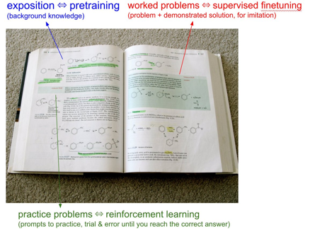
Andrej Karpathy - Take LLM to School
Andrej Karpathy tweeted: "We have to take the LLMs to school"
https://x.com/karpathy/status/1885026028428681698
When you open any textbook, you'll see three major types of information:
1. Background information / exposition. The meat of the textbook that explains concepts. As you attend over it, your brain is training on that data. This is equivalent to pretraining, where the model is reading the internet and accumulating background knowledge.
2. Worked problems with solutions. These are concrete examples of how an expert solves problems. They are demonstrations to be imitated. This is equivalent to supervised finetuning, where the model is finetuning on "ideal responses" for an Assistant, written by humans.
3. Practice problems. These are prompts to the student, usually without the solution, but always with the final answer. There are usually many, many of these at the end of each chapter. They are prompting the student to learn by trial & error - they have to try a bunch of stuff to get to the right answer. This is equivalent to reinforcement learning.
We've subjected LLMs to a ton of 1 and 2, but 3 is a nascent, emerging frontier. When we're creating datasets for LLMs, it's no different from writing textbooks for them, with these 3 types of data. They have to read, and they have to practice.

Slide 7





Reflection-70B
Matt Shumer & Sahil Chaudhary have fine-tuned Llama 3.1 70B and claimed (September 5th) to achieve amazing accuracy beating top models in just 3 weeks. They used a technique similar to the one described in 2023 paper "Reflection-Tuning: Recycling Data for Better Instruction-Tuning" - basically training the model to use "step-by-step" Chain of Thought approach. This is done by tuning on synthetic data showing examples of using <thinking> and <reflection> tags to remove hallucination and perform self-correction - and fine-tuned the model on these examples.
https://openreview.net/forum?id=xaqoZZqkPU
https://venturebeat.com/ai/meet-the-new-most-powerful-open-source-ai-model-in-the-world-hyperwrites-reflection-70b/
https://huggingface.co/mattshumer/Reflection-Llama-3.1-70B
But third party evaluations have failed to reproduce Reflection 70B’s impressive results, so Shumer was accused of fraud.
https://www.greenbot.com/hyperwrite-reflection-70B/
https://www.youtube.com/watch?v=Alzjn_0ne1Y
https://venturebeat.com/ai/reflection-70b-model-maker-breaks-silence-amid-fraud-accusations/
Matt Shumer
https://x.com/mattshumer_
https://www.hyperwriteai.com
Sahil Chaudhary
https://twitter.com/csahil28
https://glaive.ai
Matt Berman videos:
35 min interview with Matt & Sahil https://www.youtube.com/watch?v=5_m-kN64Exc
How This AI Model Achieves Insane Accuracy https://www.youtube.com/watch?v=-IBAg6lMfXA

Slide 8
Part 2 - OpenAI, Gemini, Microsoft
DeepSeek Acceleration Effect
Multiple R Models - Cheap & Open Source
DeepSeek Self-Evolving
Restrictions on using DeepSeek in the US
DeepSeek Jailbreaking
Andrej Karpathy - Take LLM to School
Reflection-70B
Andrej Karpathy - Deep Dive into LLMs
Anthropic classifiers reduce jailbreaks
OpenAI ChatGPT Search - open without login
Microsoft "Think Deeper" in Copilot - free
Elicit.com - Automate research
ChatGPT Edu - OpenAI in Education
WARP: An Efficient Multi-Vector Retrieval Engine
Figure AI drops OpenAI - to use in-house models
Sam Altman says OpenAI is ‘on the wrong side of history
Microsoft Copilot with o1
Microsoft DeepSeek
OpenAI o3-mini
OpenAI Deep Research
Google Gemini 2.0 Flash & Pro
Deep Research - Open Source Alternatives
Crowd-sourced "Arena" Leaderboard
Jobs

Slide 9
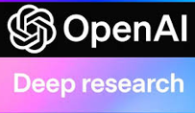


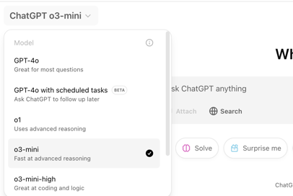

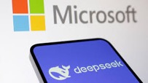
OpenAI o3-mini & Deep Research
o3-mini https://openai.com/index/openai-o3-mini/ https://www.youtube.com/watch?v=6HfGqW2dg2E
OpenAI Deep Research - (Pro users, later Plus and Teams users) https://openai.com/index/introducing-deep-research/ - https://www.youtube.com/watch?v=-1ZQHC3jxBE -
Microsoft Copilot with o1
DeepSeek R1 is now available on Azure AI Foundry and GitHub

Slide 10
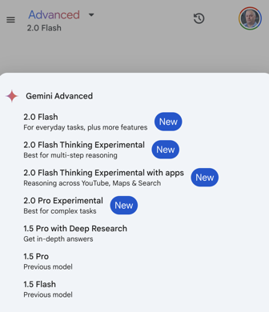
Google Gemini 2.0 Flash & Pro
Google Gemini 2.0 Flash & Pro
Gemini 2.0 is the next generation of Gemini
Improved performance across various tasks, such as writing different kinds of creative content, summarizing factual topics, and answering your questions in an informative way.
Context length 1 Mln tokens
Gemini 2.0 Flash Thinking Experimental with apps, which can use apps such as YouTube, Maps, and Search to solve complex multi-step problems for you. For example, it can help you do things like find and analyze multiple YouTube videos, research places and create routes using Maps, and find or compare detailed information online.

Slide 11
Deep Research - Open Source Alternatives
OpenAI Deep Research https://openai.com/index/introducing-deep-research/
Gemini Deep Research on Gemini 1.5 Pro (December 2024) - in "Advanced" subscription Gemini Deep Research on Gemini 2.0 Flash (February 2025) - in Google AI Studio and Vertex AI
Open Deep-research https://github.com/dzhng/deep-research
OpenDeepResearcher https://github.com/mshumer/OpenDeepResearcher
Open Deep Research by Firecrawl https://github.com/nickscamara/open-deep-research
DeepResearch by Jina AI https://github.com/jina-ai/node-DeepResearch
Summary: https://www.marktechpost.com/2025/02/05/4-open-source-alternatives-to-openais-200-month-deep-research-ai-agent/

Slide 12
Part 3 - Misc. AI Updates
DeepSeek Acceleration Effect
Multiple R Models - Cheap & Open Source
DeepSeek Self-Evolving
Restrictions on using DeepSeek in the US
DeepSeek Jailbreaking
Andrej Karpathy - Take LLM to School
Reflection-70B
Andrej Karpathy - Deep Dive into LLMs
Anthropic classifiers reduce jailbreaks
OpenAI ChatGPT Search - open without login
Microsoft "Think Deeper" in Copilot - free
Elicit.com - Automate research
ChatGPT Edu - OpenAI in Education
WARP: An Efficient Multi-Vector Retrieval Engine
Figure AI drops OpenAI - to use in-house models
Sam Altman says OpenAI is ‘on the wrong side of history
Microsoft Copilot with o1
Microsoft DeepSeek
OpenAI o3-mini
OpenAI Deep Research
Google Gemini 2.0 Flash & Pro
Deep Research - Open Source Alternatives
Crowd-sourced "Arena" Leaderboard
Jobs

Slide 13
AI Updates 1
Andrej Karpathy - Deep Dive into LLMs like ChatGPT - 3.5 h video
https://www.youtube.com/watch?v=7xTGNNLPyMI
Anthropic classifiers reduce jailbreaks
https://opentools.ai/news/anthropic-unleashes-revolutionary-constitutional-classifiers-to-slash-ai-jailbreaks
OpenAI ChatGPT Search - open without login
Microsoft "Think Deeper" in Copilot - free for all users https://www.seroundtable.com/chatgpt-search-open-38864.html
Figure AI drops OpenAI - to use in-house models
https://techcrunch.com/2025/02/04/figure-drops-openai-in-favor-of-in-house-models/
Elicit.com - Automate research - summarizing papers, extracting data, and synthesizing your findings - https://elicit.com/#Pricing
ChatGPT Edu - OpenAI in Education
OpenAI partnering with California State University
https://fortune.com/education/articles/chatgpt-access-for-california-state-university-system/
WARP: An Efficient Multi-Vector Retrieval Engine for Faster and Scalable Search - Stanford, UC Berkeley and ETH Zurich
https://www.marktechpost.com/2025/02/01/researchers-from-stanford-uc-berkeley-and-eth-zurich-introduces-warp-an-efficient-multi-vector-retrieval-engine-for-faster-and-scalable-search/

Slide 14
Part 4 - Leaderboard, Jobs
DeepSeek Acceleration Effect
Multiple R Models - Cheap & Open Source
DeepSeek Self-Evolving
Restrictions on using DeepSeek in the US
DeepSeek Jailbreaking
Andrej Karpathy - Take LLM to School
Reflection-70B
Andrej Karpathy - Deep Dive into LLMs
Anthropic classifiers reduce jailbreaks
OpenAI ChatGPT Search - open without login
Microsoft "Think Deeper" in Copilot - free
Elicit.com - Automate research
ChatGPT Edu - OpenAI in Education
WARP: An Efficient Multi-Vector Retrieval Engine
Figure AI drops OpenAI - to use in-house models
Sam Altman says OpenAI is ‘on the wrong side of history
Microsoft Copilot with o1
Microsoft DeepSeek
OpenAI o3-mini
OpenAI Deep Research
Google Gemini 2.0 Flash & Pro
Deep Research - Open Source Alternatives
Crowd-sourced "Arena" Leaderboard
Jobs

Slide 15
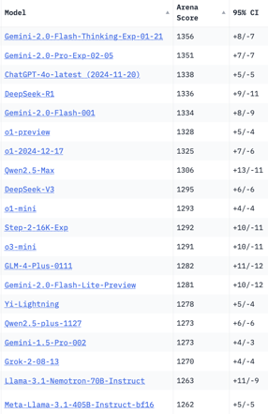
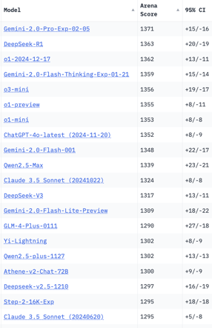
Crowd-sourced "Arena" Leaderboard
Total #models: 201
Total #votes: 2,621,136
Last updated: 2025-02-05
Starting Elo rating = 1000
95% CI = Confidence Interval
https://en.wikipedia.org/wiki/Elo_rating_system
https://chat.lmsys.org/?leaderboard
English-only queries
Coding
China
China
China
China
China
China
China
China
China
China
China
China
China
x.ai
China

Slide 16
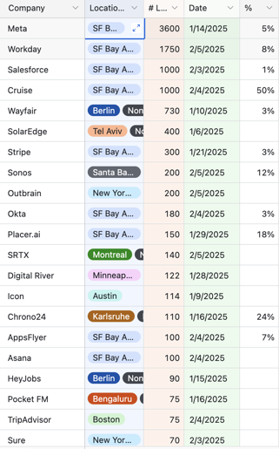
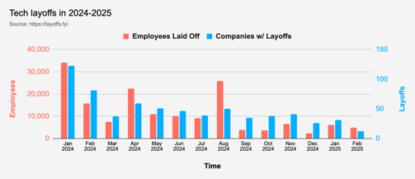
Jobs
Layoffs - https://layoffs.fyi
Google offers “voluntary exit” to all US platforms and devices employees
Microsoft has initiated performance-based job cuts, resulting in immediate termination of affected employees without severance pay.

Slide 17


About the Speaker
Lev Selector, Ph.D.
40+ years of software engineering, data science, and building teams (hiring, training, and managing)
Ph.D. in mathematical modeling and computer simulations
Interests:
Generative AI, Using LLM with your data
Local AI for Local Private Data
Cloud architecture, fin-tech, application security
Find/connect: Linkedin, GitHub, YouTube, Google
https://eais.ai
Enterprise AI Systems

Slide 18
Thank You!

