Slide 1
AI Updates
June 13, 2025
OpenAI o3-Pro
Gogle 2.5 Flash Thinking Budget
Mistral Magistral Reasoning Models
Crowd-sourced "Arena" Leaderboard
Claude Gov - models for US National Security
Alphabet keeps hiring engineers
Qwen3-Embedding & Qwen3-Reranker Models
OpenThinker3-7B
FastPlaid by LightOn
NVIDIA’s ProRL
Google's AI handling financial data
Holo1 Action Vision Language Model
ether0: a scientific reasoning model for chemistry
AMD MI350 AI chip line to rival Nvidia Blackwell
ByteDance Seedance 1.0 Video Generation
Cursor - 1 Mln queries per second, Tech Stack
DeepAgent from Abacus.ai
Apple Research - Illusion of Thinking
Ilya Sutskever - 10 min speech
AI Solving Math Problems
How to Use OpenAI Sora
Meta to invest +$10B into Scale AI
Salesforce CRMArena-Pro Benchmark
dots.llm1 by RedNote (Xiaohongshu)
ByteDance Detail Flow - doodles, sketches
Open Code - Free AI coding agent
Apple Unveils New AI Features at WWDC
Vibe Coding - MDC & PRD files
Jobs, Layoffs

Slide 2
Crowd-sourced "LM Arena" Leaderboard
Starting Elo rating = 1000
https://en.wikipedia.org/wiki/Elo_rating_system
Text - June 12
Webdev - June 5
LM Arena secures $100M to expand AI benchmarking (at $600M valuation)
Model | Score
gemini-2.5-pro-preview-06-05 | 1470
o3-2025-04-16 | 1447
gemini-2.5-pro-preview-05-06 | 1446
chatgpt-4o-latest-20250326 | 1436
gpt-4.5-preview-2025-02-27 | 1430
claude-opus-4-20250514 | 1420
gemini-2.5-flash-preview-05-20 | 1418
gpt-4.1-2025-04-14 | 1408
grok-3-preview-02-24 | 1404
gemini-2.5-flash-preview-04-17 | 1403
claude-sonnet-4-20250514 | 1395
o4-mini-2025-04-16 | 1395
deepseek-v3-0324 | 1394
o1-2024-12-17 | 1393
deepseek-r1 | 1388
o1-preview | 1376
mistral-medium-2505 | 1376
gpt-4.1-mini-2025-04-14 | 1370
hunyuan-turbos-20250416 | 1370
Model | Score
Gemini-2.5-Pro-Preview-06-05 | 1443
Claude Opus 4 (20250514) | 1412
Gemini-2.5-Pro-Preview-05-06 | 1408
Claude Sonnet 4 (20250514) | 1389
Claude 3.7 Sonnet (20250219) | 1357
Gemini-2.5-Flash-Preview-05-20 | 1312
GPT-4.1-2025-04-14 | 1256
Claude 3.5 Sonnet (20241022) | 1238
DeepSeek-V3-0324 | 1207
DeepSeek-R1 | 1198
o3-2025-04-16 | 1188
GPT-4.1-mini-2025-04-14 | 1187
Qwen3-235B-A22B | 1183
Mistral Medium 3 | 1167
Gemini-2.5-Flash-Preview-04-17 | 1144
o3-mini-high (20250131) | 1136
Claude 3.5 Haiku (20241022) | 1133
o4-mini-2025-04-16 | 1100
o3-mini (20250131) | 1092
https://lmarena.ai/?leaderboard
https://openlm.ai/chatbot-arena/
https://beta.lmarena.ai
https://legacy.lmarena.ai
Web Leaderboard https://web.lmarena.ai/leaderboard
LLM Leaderboard - by @LlmStats https://llmworld.net/llm_leaderboards/
LLM Leaderboard - by StackAI https://www.stack-ai.com/llm-leaderboard
LLM Leaderboard - by Artificial Analysis https://artificialanalysis.ai/leaderboards/models
Open LLM Leaderboard - by Hugging Face https://huggingface.co/open-llm-leaderboard
LLM Leaderboard - by Vellum https://www.vellum.ai/llm-leaderboard
x.ai
China
China
China
China
M
China
M
China

Slide 3
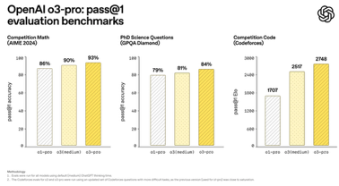

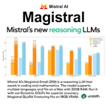
AI Updates 1
OpenAI o3-Pro released to replace o1-Pro
Available for Pro, Team, API. Enterprise and Edu - next week
Pricing (in/out) $20/$80 per million tokens
o3-pro is live in OpenAI’s developer API
It is a reasoning model. It is not a chat model, but rather a report generator. It is good at analyzing big context and at using tools. It "thinks" a lot.
https://techcrunch.com/2025/06/10/openai-releases-o3-pro-a-souped-up-version-of-its-o3-ai-reasoning-model/
https://help.openai.com/en/articles/6825453-chatgpt-release-notes
o3 input tokens price drop from $10 to $2 per Million
OpenAI hits $10B in ARR (Annual Recurring Revenue) - doubled from $5.5B last year
ChatGPT released major voice and translation update
OpenAI signed a massive deal to use Google Cloud
Gogle 2.5 Flash Thinking Budget
Input price: $0.15 per million tokens.
Output price (no reasoning/thinking off): $0.60 per million tokens.
Output price (reasoning/thinking on): $3.50 per million tokens
Mistral Magistral Small & Medium Reasoning Models
Magistral works through problems step-by-step for improved consistency and reliability across topics such as math and physics
Magistral Small 24B params open-source based on Mistral Small 3.1, 128K context (40k effective); It is very fast on Le Chat. But it is being outperformed by Qwen3-32B and Qwen3-30B-A3B @
Magistral Medium is a bigger model for Enterprise
https://mistral.ai/news/magistral
https://techcrunch.com/2025/06/10/mistral-releases-a-pair-of-ai-reasoning-models/

Slide 4


AI Updates 2
Claude Gov - models for US National Security
handle classified information and support intelligence operations
strategic planning, intelligence analysis, operational support, threat assessment, and cybersecurity data interpretation
Enhanced Language and Contextual Understanding
Access to Claude Gov is strictly limited to authorized personnel
Safety and Compliance, strict usage policies to prevent misuse for disinformation, weapon development, censorship, or malicious cyber activities, though contractual exceptions exist for certain government missions
Claude Gov is already deployed within agencies at the highest levels of U.S. national security
https://getcoai.com/news/anthropic-launches-claude-gov-for-us-classified-intelligence-operations/
Alphabet keeps hiring engineers
Alphabet CEO Sundar Pichai stated that
they will continue hiring engineers,
even as it invests heavily in AI
AI is not intended to replace human talent.
Balanced Approach - human oversight and creativity remain crucial

Slide 5
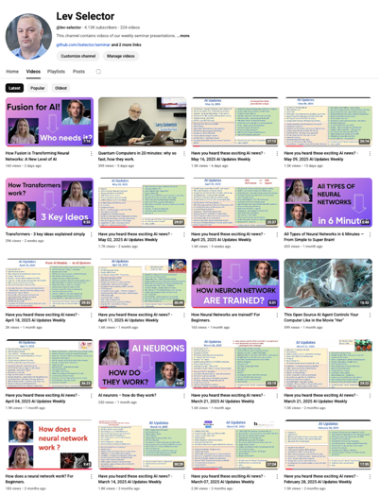
Subscribe to get notified
about new videos
https://www.youtube.com/@lev-selector
We post a video every Friday
It is usually 25-30 min long
Links to slides are under the videos

Slide 6


AI Updates 3
Qwen3-Embedding-8B and Qwen3-Reranker-8B Models
Open-weight , SOTA, free.
The model has taken the #1 rank on the MTEB multilingual leaderboard, outperforming even Gemini's experimental embedding model from March 2025.
The new models are supported by vLLM, with one user declaring, "Every RAG system on earth just got a free upgrade."
OpenThinker3-7B - top open reasoning model
A fine-tuned version of Qwen/Qwen2.5-7B-Instruct on the OpenThoughts3-1.2M dataset.
Better than previous OpenThinker models, outperforms several other strong reasoning 7B
https://huggingface.co/open-thoughts/OpenThinker3-7B
SOTA. Was trained on the newly released OpenThoughts3-1.2M dataset and improves over DeepSeek-R1-Distill-Qwen-7B by 33% on a key benchmark

Slide 7

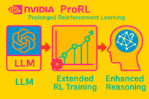


AI Updates 4
FastPlaid by LightOn - fast multi-vector search engine written in Rust, up to a 554% speedup for ColBERT models
NVIDIA’s ProRL (Prolonged Reinforcement Learning)
Novel framework designed to enhance the reasoning capabilities of LLMs through extended RL training
Demonstrates that prolonged training can unlock new reasoning strategies beyond a base model’s initial capabilities
Meta Platforms is paying $14.8 B cash for 49% stake in Scale AI.
Scale AI is valued at ~$28B
Scale AI’s CEO, Alexandr Wang will take a significant role within Meta as part of a new "Superintelligence" initiative
Scale AI also built Defense Llama, a LLM designed for military use, on top of Meta’s Llama 3
Meta’s V-JEPA 2 model teaches AI to understand its surroundings.
Meta on Wednesday unveiled its new V-JEPA 2 AI model, a “world model” that is designed to help AI agents understand the physical world around them.
Salesforce CRMArena-Pro Benchmark
CRMArena-Pro evaluates agents on 19 expert-validated tasks spanning sales, service, and CPQ, for both B2B and B2C contexts
Use case - Enterprise AI Assessment - rigorous, realistic, and scalable way for organizations to evaluate and optimize LLM agents for CRM, sales, and service automation

Slide 8

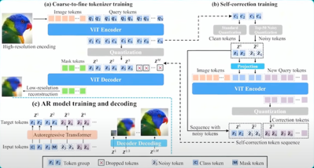
AI Updates 5
dots.llm1 by RedNote (Xiaohongshu)
SOTA open-source LLM
MoE architecture, strong multilingual capabilities, particularly in English and Chinese
142B params, 14B active params (top-6-of-128 experts+2 shared) and a 32K context window
Pretrained on 11.2T high-quality, non-synthetic tokens
Docker, HuggingFace, vLLM, sglang
Slightly surpasses Qwen3 235B on MMLU
ByteDance Detail Flow - doodles, sketches, ...
A 1D Coarse-to-Fine Autoregressive Framework for Faster, Token-Efficient Image Generation
arranges token sequences from global to fine detail using next-detail prediction merthod. Unlike traditional 2D raster-scan or scale-based techniques, DetailFlow employs a 1D tokenizer trained on progressively degraded images. This design allows the model to prioritize foundational image structures before refining visual details. By mapping tokens directly to resolution levels, DetailFlow significantly reduces token requirements, enabling images to be generated in a semantically ordered, coarse-to-fine manner.
https://www.youtube.com/watch?v=mBimGYuTZpg

Slide 9



AI Updates 6
Open Code - Free AI coding agent
Open-source, for use in Terminal, flexible, local-first alternative to proprietary tools like Cloud Code and ADR - https://www.youtube.com/watch?v=Z0HglpK20ec
Powerful, user-friendly terminal interface (built with Bubble Tea) for interacting with various AI models, enabling coding, debugging, and codebase management directly from the command line
Users can integrate multiple AI providers (e.g., OpenAI, Anthropic, OpenRouter), manage sessions, track file changes, ...
Apple Unveils New AI Features at WWDC
Messages, FaceTime, and Phone apps will offer real-time translation using on-device AI - a small (3B) foundation on-device model developed by Apple itself. Translations appear as captions or spoken aloud during calls, and messages auto-translate while typing https://www.youtube.com/shorts/nabzqpeH8mk
Genmoji and Image Playground now include ChatGPT for better image and emoji creation
A new system lets developers easily add AI features to their apps
The Shortcuts app gets AI-powered functions
Apple Wallet will automatically summarize delivery updates
https://www.engadget.com/ai/apple-intelligence-at-wwdc-everything-apple-announced-for-ios-macos-and-more-171133202.html
Google's AI handling financial data
Interactive charts, question answering about stocks and funds
https://blog.google/products/search/ai-mode-data-visualization
https://topmostads.com/google-ai-mode-financial-data-visualization

Slide 10



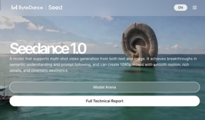
AI Updates 7
Holo1 Action Vision Language Model
https://huggingface.co/Hcompany/Holo1-7B
Developed by HCompany for use in the Surfer-H web agent system
Designed to interact with web interfaces like a human user.
Holo1 acts as a policy, localizer, or validator
Trained on a mix of open-access, synthetic, and self-generated data
SOTA performance on the WebVoyager benchmark (and other benchmarks)
ether0: a scientific reasoning model for chemistry
24B open-weights reasoning model
https://www.futurehouse.org/research-announcements/ether0-a-scientific-reasoning-model-for-chemistry
AMD MI350 AI chip line to rival Nvidia Blackwell
AMD says the processors offer 4x AI compute and a 35x increase in inferencing capabilities versus its prior-generation chips
https://finance.yahoo.com/news/amd-launches-mi350-ai-chip-line-to-rival-nvidias-blackwell-processors-debuts-ai-cloud-service-183046317.html
ByteDance Seedance 1.0 Video Generation
China, TikTok parent ByteDance tops leaderboards for both text-to-video and image-to-video tasks, beating Google's Veo 3 and OpenAI's Sora
Seedance generates 5 seconds of HD video in 41 seconds and natively supports multi-shot storytelling though it lacks audio generation.
https://seed.bytedance.com/en/seedance?utm_source=tldrai

Slide 11

Cursor Tech Stack
Cursor AI editor - 1 Mln queries per second
50 engineers working on Cursor
1M transactions per second, and higher at its peak
100x growth in users and load in 12 months
100M+ lines of enterprise code written per day with Cursor by enterprise clients. Almost 1B lines total (per day)
$500M+ ARR (annual revenue run rate). This was at $300M in early May, and $100M in January, after being zero a year prior
Hundreds of TBytes of embeddings in Cursor’s databases
Code: 25,000 files, 7 million lines of code
https://newsletter.pragmaticengineer.com/p/cursor
Tech stack. TypeScript (+Electron) and Rust, cloud providers (AWS, Azure), Turbopuffer (vector search), ...
The backend service is mostly a large monolith, deployed as one
Most of the CPU infra runs on AWS. They also operate tens of thousands of NVIDIA H100 GPUs (some on Azure)
Anyrun - orchestrator component, written fully in Rust (note - company name is Anysphere). Anyrun launches agents in the cloud using Amazon EC2 (Linux servers) and AWS Firecracker. Firecracker - secure, lightweight micro-virtual machines (microVMs) optimized for serverless and containerized workloads. It is written in Rust and leverages the Linux Kernel-based Virtual Machine (KVM)
Autocomplete is generated on GPUs using Cursor’s in-house LLM model
Cursor sends obfuscated filenames and encrypted code chunks to the server. The server decrypts the code, creates an embedding using OpenAI’s embedding models, or one of their own, and stores the embedding in their vector database, Turbopuffer (vector and full text search, very fast, affordable)
Cursor uses Merkle trees to search code using embeddings
A Merkle tree is a tree whose every leaf is the cryptographic hash of the underlying file (e.g. the hash for the file main.js). And every node is a combination of the hashes of its children.
Database - Turbopuffer for "code" search, Pinecone for documentation search. Also PostgresSQL.

Slide 12
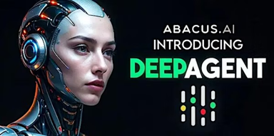
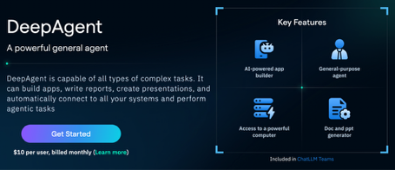
DeepAgent from Abacus.ai
DeepAgent - Autonomous AI Agent from Abacus.ai
https://deepagent.abacus.ai
https://www.youtube.com/watch?v=9hpsmdLdBPs
Discovering, learning, and using online tools in real time without any setup or coding
It connects to services like Twitter, Slack, Notion, Salesforce, and Jira, automating complex workflows across platforms with self-learning abilities
Integration with MCP servers, OpenAPI schemas, and secure credential management
Can build interactive mind maps, format reports, resolve access issues, and create workflows—all from a single prompt
Demos: Twitter Automation, Mind Map Creation, Workflow Automation, Jira Dashboard
Caching endpoint details and sample responses.
Security is robust: credentials are encrypted, stored temporarily, and revoked after use
The agent is transparent, offering logs of its reasoning and actions for compliance and auditing
DeepAgent is available for $10 per month, delivering enterprise-level automation at a fraction of the cost

Slide 13
Apple Research - Illusion of Thinking
Apple's research paper "The Illusion of Thinking: Understanding the Strengths and Limitations of Reasoning Models via the Lens of Problem Complexity"
https://ml-site.cdn-apple.com/papers/the-illusion-of-thinking.pdf
https://machinelearning.apple.com/research/illusion-of-thinking
https://9meters.com/technology/ai/apple-study-calls-out-reasoning-ai-as-overhyped-while-siri-struggles
https://pivot-to-ai.com/2025/06/08/apple-reasoning-ais-fail-hard-if-they-actually-have-to-think/
The study systematically tested reasoning models (including Claude-3.7-Sonnet-Thinking, DeepSeek-R1, and OpenAI's o3-mini) using puzzle environments like Tower of Hanoi and River Crossing.
Key finding - the models don't actually reason at all - they just memorize patterns really well
Instead of using standard math problems (which can be tainted), Apple’s team had models to solve classic puzzles:
Tower of Hanoi
River Crossing
Blocks World
They cranked up the difficulty and watched what happened.
Main conclusion: According to Apple's research, what we call AI "reasoning" today isn't reasoning at all. It's a sophisticated Illusion of Thinking. These models are incredible pattern-matchers, but they aren't yet capable of the generalizable, logical problem-solving we see in humans.
Here are the 5 shocking discoveries:
1. They (models) hit a wall. Beyond a certain complexity, every single model's accuracy collapsed. Not just a little bit. It dropped to ZERO.
2. They start “thinking” LESS when it gets harder. AI doesn't try harder. It actually spends fewer tokens thinking about it.
3. There are 3 clear performance zones:
Easy Puzzles: Regular LLMs are actually better and more efficient. The "thinking" models just overthink and waste time.
Medium Puzzles: This is the sweet spot where "thinking" models have a clear advantage.
Hard Puzzles: Everyone fails. The "thinking" just delays the inevitable collapse.
4. They can't follow simple instructions. Even when Apple gave the AI the exact algorithm to solve the puzzle, it still failed at the same complexity point. It shows they aren’t executing logical steps, but are still just predicting the next word.
5. Their "reasoning" is inconsistent. A model could solve a puzzle requiring over 100 correct moves (Tower of Hanoi), but then fail a different puzzle that only needed 5 correct moves (River Crossing). This suggests memorization, not a general ability to reason.

Slide 14

Ilya Sutskever - 10 min speech
Ilya Sutskever - receives honorary degree, speech
June 6, 2025 - University of Toronto
https://www.youtube.com/watch?v=zuZ2zaotrJs
Ilya has received his bachelor's degree from U of T exactly 20 years ago in the same hall. This would be his fourth degree from the university after spending 10 years there as both undergrad and graduate student.
He has studied under Jeff Hinton, which he describes as "one of life's great strokes of luck" allowing him to contribute to the most revolutionary AI research at the time
Main Advice: accept reality as it is, don't regret the past, and focus on the next best step forward. This mindset is difficult to maintain but makes everything work out better.
The unprecedented nature of our current moment due to AI:
AI has already significantly changed what it means to be a student
Current AI can converse, write code, and perform various tasks, though it still has limitations
AI will eventually be able to do everything humans can do, reasoning that since our brains are "biological computers," digital computers should eventually match our capabilities
This will lead to extremely rapid progress and fundamental changes to work and society
AI is "the greatest challenge of humanity ever". It is important to pay attention to AI developments rather than ignore them
By observing and understanding AI's capabilities, people will generate the energy needed to solve the massive challenges it will create
Successfully overcoming these challenges will bring "the greatest reward".
Everyone's life will be significantly affected by AI, making it crucial to stay engaged and prepared for the changes ahead.

Slide 15
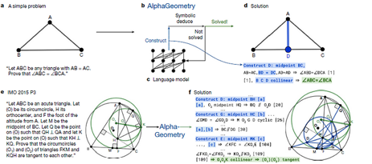
AI Solving Math Problems
AI systems solves complex math problems at the International Mathematical Olympiad (IMO) level
AlphaProof and AlphaGeometry-2 solved 4 out of 6 problems* at the 2024 IMO, achieving a silver medalist score of 28/42 points. This includes solving the competition's hardest problem, which only five human contestants completed.
The system combines: Neural language models for creative intuition; Symbolic deduction engines for rigorous proof verification; Reinforcement learning to improve through millions of self-generated proofs
The AI approaches geometric problems through a Neuro-symbolic reasoning blending pattern recognition and logical deduction. It automatically explores techniques using 100+ million synthetic training theorems, Hybrid models for hyperbolic/elliptic geometries, and subconscious-style search analogous to human problem-solving: (trying different proofs while reinforcing successful strategies). This process mirrors how mathematicians subconsciously test multiple approaches.
The systems currently outperform humans in geometric theorem proving while matching silver medalist capabilities in algebra/number theory. Researchers note the AI's solutions show human-like clarity rather than brute-force computation
https://www.livescience.com/technology/artificial-intelligence/math-olympics-has-a-new-contender-googles-ai-now-better-than-human-gold-medalists-at-solving-geometry-problems (February 2025)
https://arxiv.org/abs/2506.02690v1 (June 2025)
https://deepmind.google/discover/blog/ai-solves-imo-problems-at-silver-medal-level/ (July 2024)
https://www.nature.com/articles/s41586-023-06747-5 (January 2024)
https://deepmind.google/discover/blog/alphageometry-an-olympiad-level-ai-system-for-geometry/ (January 2024)
https://aicompetence.org/alphageometry-revolutionizing-ai-in-geometry/ (June 2024)
https://techstrong.ai/articles/thinking-fast-and-slow-how-genai-is-mastering-mathematical-reasoning/ (February 2024)

Slide 16
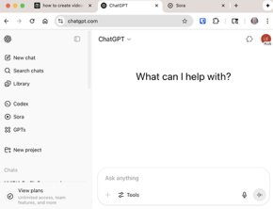
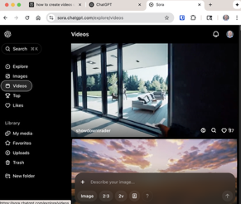
How to Use OpenAI Sora
OpenAI’s Sora - create Videos
Available for paid ChatGPT Plus, Team, or Pro accounts
Click on the link in your account - or visit Sora website and sign in with your OpenAI account.
Start a New Video Project, describe your video in text, upload an image, or even upload a video file for reference. Adjust settings such as aspect ratio (16:9, 1:1, 9:16), resolution (up to 1080p for Pro users), duration (up to 20 seconds for Pro users), and the number of variations you want to generate
Choose a style or theme (e.g., animated, professional, casual) to match your desired look and feel
Submit Your Prompt to generate the video. Monitor the status of your video’s generation on the dashboard
Hover over the video previews to watch all generated variations play back in real time. Click on a video to view it in a larger window for more detailed editing; Trim or extend sections of your video in a new timeline; Describe changes you want to make (e.g., change objects, weather, or backgrounds) and Sora will update the video accordingly; Combine elements from two different videos to create a new effect; Create a seamless loop of any part of your video
Use the Storyboard tool to create a sequence of scenes by adding text prompts for each action and adjusting the duration for each scene; Drag and drop cards on the timeline to space out actions and create smooth transitions
Watermark - may be removed only in Pro account
Download the mp4 - or share the link

Slide 17
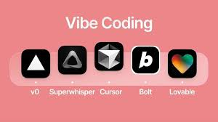
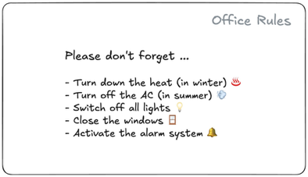
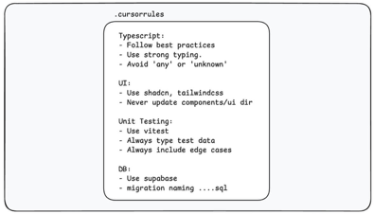
Vibe Coding - MDC & PRD files
Vibe coding - MDC rules files and PRD files
MDC = Markdown Documentation - rules for coding
PRD = Product Requirements Document requirements for project
https://github.com/lselector/ai/tree/master/vibecoding - examples
https://www.youtube.com/watch?v=ABozvKmctkc https://github.com/elie222/inbox-zero/tree/main/.cursor/rules
https://www.instructa.ai/blog/cursor-ai/everything-you-need-to-know-cursor-rules

Slide 18
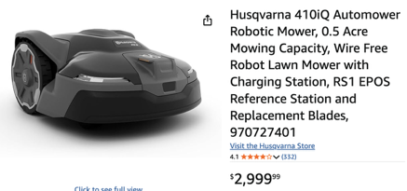
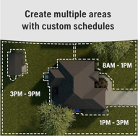


AI Robotic Grass Mowers
You can buy Robotic Grass Mowers on Amazon
Husqvarna - https://www.amazon.com/dp/B0DTV7TR6W - Husqvarna currently do NOT use AI, but planning to add it in 2026 (camera-based night vision and enhanced obstacle avoidance)
Anthbot - https://www.amazon.com/dp/B0F9WKNKLY -

Slide 19
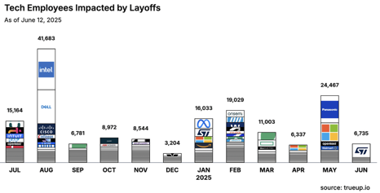
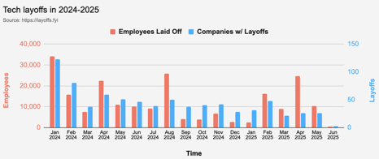
Jobs
https://layoffs.fyi
https://trueup.io/layoffs
'This A.I. Company Wants to Take Your Job' - The New York Times, June 11, 2025
Mechanize, a San Francisco start-up, is building artificial intelligence tools to automate white-collar jobs “as fast as possible.”
“Our goal is to fully automate work. We want to get to a fully automated economy, and make that happen as fast as possible.”
https://www.nytimes.com/2025/06/11/technology/ai-mechanize-jobs.html
Workers with AI skills command a 56% wage premium (up from 25% last year), suggesting the value these workers bring
https://www.pwc.com/gx/en/issues/artificial-intelligence/job-barometer/2025/report.pdf
New job postings from white-collar roles fell by 12.7% from 2024 to 2025, with demand for business analysts and developers dropping twice as fast
Anthropic’s CEO predicts that within the next 5 years, 50% of all entry-level jobs will be fully automated.
Elon’s launching Tesla self-driving cars in Austin and trucks operating autonomously on Texas highways
The only secure job is being an entrepreneur.
Curiosity and adaptability now outperform career pathing.
"Singularity Sprint" - now!
The coming years will feel chaotic, unpredictable, and downright scary at times

Slide 20


About the Speaker
Lev Selector, Ph.D.
40+ years of software engineering, data science, and building teams (hiring, training, and managing)
Ph.D. in mathematical modeling and computer simulations
Interests:
Generative AI, Using LLM with your data
Local AI for Local Private Data
Cloud architecture, fin-tech, application security
Find/connect: Linkedin, GitHub, YouTube, Google
https://eais.ai
Enterprise AI Systems

Slide 21
Thank You!

