Slide 1
AI Updates
December 13, 2024
Google Gemini 2.0
OpenAI Days - Sora, Canvas, Apple Intelligence
OpenAI Days - Live Conversations, Projects
AWS re:Invent Dec. 2-6
Copilot Arena Extension for VS Code
David Sacks - "AI & Crypto Chief"
Deepmind GraphCast Weather Forecasting
MinerU - PDF to markdown or JSON
Google Gemini exp-1121 & exp-1206
ClearerVoice-Studio
Grok is now FREE for all X users
Deepmind Project Astra
Deepmind Project Mariner
Devin AI coding assistant $500/mo
Grok image generation
Google Android XR
Llama 3.3 70B
Ollama v. 0.5 supports structured outputs
Generating Podcasts
Text to audio
Dialog to audio podcast
Create Video Podcast (audio+slides)
PydanticAI
5 AI Prompts to Create Content
25% of tasks can be outsourced to AI
Crowd-sourced "Arena" Leaderboard
Tech Layoffs in 2024

Slide 2
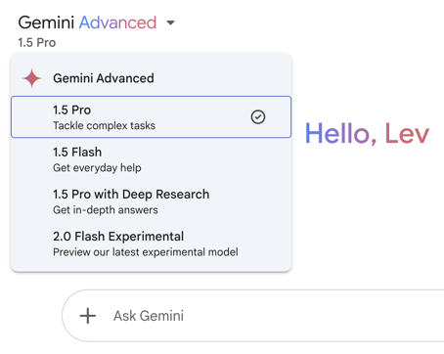
Google Gemini 2.0
Google Gemini 2.0
https://www.youtube.com/watch?v=LoVktJUS1zg
https://aistudio.google.com/prompts/new_chat
Gemini 2.0 is Google's latest most capable AI model.
Gemini 2.0 Flash is currently available for developers. It is smaller, twice faster, and outperforms the previous 1.5 Pro model. General availability - early 2025.
Designed for the "agentic era."
Multimodal Input and Output (text, images, audio).
Native Tool Use (Google Search and Maps, ...) - real time info.
Great at navigating user interfaces
Improved logical reasoning
Gemini 2.0 can even give video game tips and help you navigate virtual worlds

Slide 3
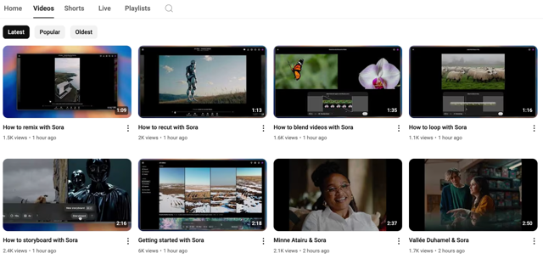
OpenAI Day 3 - Sora
Sora - with fast "Turbo" model:
up to 20-second outputs in various aspect ratios
Remix for scene editing, Storyboard for stitching multiple outputs together, Blend, Loop, Style presets, Sora’s web platform to organize and view generated videos
GPT Plus - up to 50 videos at 480p or fewer at 720p per month
GPT Pro - x10 times more, hire resolutions, longer durations.
Sora is NOT available in EU, UK, ... due to regulations
OpenAI is restricting content with real people, minors, or copyrighted material, with only a ‘subset’ of users allowed to upload real people as input initially
all Sora-generated videos include C2PA metadata and a watermark
https://www.youtube.com/@OpenAI/streams
https://www.youtube.com/@OpenAI/videos
Mon Dec 9 - Sora - text-to-video generation
https://www.youtube.com/watch?v=2jKVx2vyZOY
https://www.youtube.com/watch?v=98gEvnftQZg

Slide 4
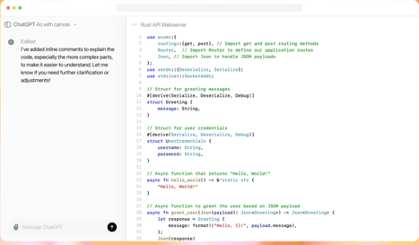
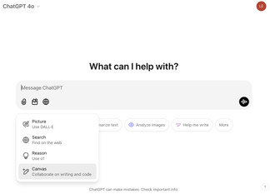
OpenAI Day 4 - Canvas
OpenAI day 4 of 12 - Canvas
https://www.youtube.com/watch?v=qZ0ImE41pVs
https://openai.com/index/introducing-canvas/
Select gpt-40 with Canvas, click on Tools - and select Canvas
Enter prompt. Canvas opens to the side of the chat
You can edit the canvas while ChatGPT is working on it
Canvas can be used for writing and for programming tasks
Canvas includes a code editor with syntax highlighting and autocomplete
Canvas allows you to run their code within it
Canvas can be integrated with custom GPTs

Slide 5
OpenAI Day 5 - Apple Intelligence
OpenAI Day 5 - ChatGPT in Apple Intelligence
Siri, Writing Tools, Camera control
https://www.youtube.com/watch?v=mBhkD0iFf4w
OpenAI Day 6 - live conversations
OpenAI Day 6 - live video and screen sharing conversations with ChatGPT - using 4o model, natural conversation pace, emotion, and tone in over 50 languages.
Users can talk to Santa - ask Santa questions, hear stories, and experience real-time responses in Santa's signature jolly voice.
Look for a snowflake icon on the home screen or select Santa in the ChatGPT settings page.
OpenAI Day 7 - Projects in chat GPT
OpenAI day 7 - Projects in chat GPT - allows users to organize conversations, upload files, and set custom instructions.
https://www.youtube.com/watch?v=FcB97h3vrzk

Slide 6

AWS re:Invent Dec. 2-6, 2024, Las Vegas
New foundation models on Bedrock, Nova (Micro, Light, Pro, Premier), Nova Canvas, Nova Real
https://aws.amazon.com/ai/generative-ai/nova/
Agents for Bedrock - create AI agents
Bedrock integrations (with other AWS services)
SageMaker Studio Notebooks - new features for gen. AI development (easier prompt engineering, model fine-tuning, and model evaluation).
SageMaker JumpStart - pre-built solutions and models for generative AI use cases
SageMaker Canvas - easier to build and deploy AI models
Amazon CodeWhisperer enhancements: Improved code generation, support for more programming languages. CodeWhisperer can now identify security vulnerabilities in code and suggest fixes
AI-powered services for Healthcare, including tools for medical imaging analysis, drug discovery, and clinical trial management
AI solutions for fraud detection, risk management, and personalized financial advice
AI-powered tools for manufacturing - predictive maintenance, quality control, and supply chain optimization
AWS Security AI Category - to find partners with expertise in securing AI environments
EC2 and S3 enhancements - New EC2 instance types optimized for high-performance workloads and S3 Iceberg compatibility for enhanced data management

Slide 7
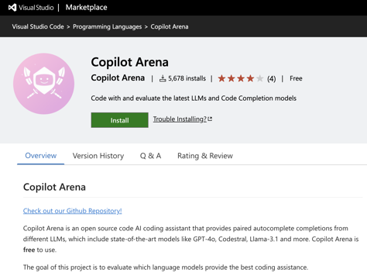
Copilot Arena Extension for VS Code
Copilot Arena is an open source code AI coding assistant that provides paired autocomplete completions from different LLMs, which include state-of-the-art models like GPT-4o, Codestral, Llama-3.1 and more. Copilot Arena is free to use.
The goal of this project is to evaluate which language models provide the best coding assistance.
https://marketplace.visualstudio.com/items?itemName=copilot-arena.copilot-arena
https://github.com/lmarena/copilot-arena

Slide 8

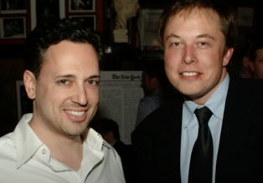
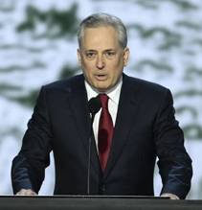
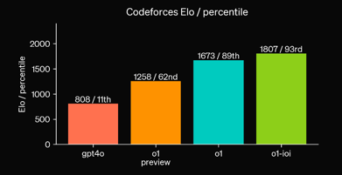
Trump names David Sacks as "AI & Crypto Csar"
Sam Altman's new $200 ChatGPT has a big Elon problem...
https://www.youtube.com/watch?v=Sf4WqHBCYSY
Trump names David Sacks as a White House’s artificial intelligence and cryptocurrency policy chief.
David Oliver Sacks is a South African-American entrepreneur, author, former PayPal COO, tech investor. He is a general partner of Craft Ventures, a venture capital fund he co-founded in late 2017 .. https://en.wikipedia.org/wiki/David_O._Sacks
.. https://www.wsj.com/tech/trumpplans-to-appoint-musk-confidant-david-sacks-as-ai-crypto-czar-9a9d400c
ioi = International Olympiad in Informatics
o1-ioi - a specialized version of OpenAI's o1 AI model specifically designed to excel at coding.
https://openai.com/index/learning-to-reason-with-llms/
https://textcortex.com/post/openai-o1-vs-gpt-4o
September 2024

Slide 9


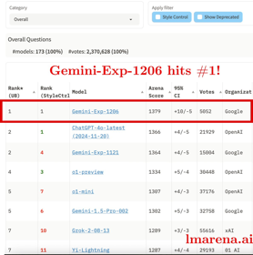

AI Updates 1
Deepmind GraphCast - AI model for fast and accurate global weather forecasting
10-day weather predictions in under one minute
https://deepmind.google/discover/blog/graphcast-ai-model-for-faster-and-more-accurate-global-weather-forecasting/
MinerU - tool to convert PDFs into machine-readable formats (e.g., markdown, JSON)
https://github.com/opendatalab/MinerU
Google Gemini-exp-1121 & exp-1206 models
high (top) ranking
2M context window
really good at coding
ClearerVoice-Studio - open-source, AI-powered speech processing toolkit - speech enhancement, speech separation, target speaker extraction, ...
https://github.com/modelscope/ClearerVoice-Studio

Slide 10
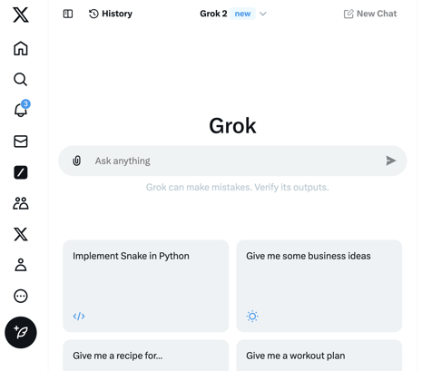
AI Updates 2
Deepmind Project Astra - allows AI to interact with the real world through your camera, providing information and assistance based on what it sees. https://deepmind.google/technologies/project-astra/
Deepmind Project Mariner (still in research stage) - enables agents to control a web browser and do tasks online https://deepmind.google/technologies/project-mariner/
Devin AI coding assistant is available at $500/month https://www.cognition.ai/blog/devin-generally-available
Grok image generation - high-quality images of people (including celebrities) and objects https://x.ai/blog/grok-image-generation-release
Grok is now FREE for all X users
https://x.com/i/grok
Google Android XR - platform for headsets and glasses
create immersive augmented reality (AR) experiences https://www.android.com/xr/
Uses Gemini AI model
The first device to launch with Android XR will be a headset developed in collaboration with Samsung, planned for release next year.
The headset can be used for both entertainment and productivity. YouTube, Google Photos, Google Maps, and even receive real-time assistance with tasks like cooking or home improvement.

Slide 11


Llama 3.3 70B
Ollama v. 0.5 now supports structured outputs - making it possible to constrain a model’s output to a specific format defined by a JSON schema.
You need to update Ollama and Python or JavaScript libraries (pip install -U ollama).
Pass in the schema as a JSON object to the format parameter as either dict or use Pydantic (recommended) to serialize the schema using model_json_schema()
https://github.com/ollama/ollama-python/blob/main/examples/structured-outputs.py
https://www.youtube.com/watch?v=7T7Nv5RMZqs
Llama 3.3 70B model is here
Open-source
Multilingual
70B, but comparable to 405B Llama 3.1
Available on Ollama: ollama run llama3.3
(4bit quantized file is ~43..44GB)
https://ollama.com/library/llama3.3
from ollama import chat
from pydantic import BaseModel
class FriendInfo(BaseModel): # Define the schema for the response
name: str
age: int
is_available: bool
class FriendList(BaseModel):
friends: list[FriendInfo]
response = chat(
model='llama3.1:8b',
messages=[{'role': 'user',
'content': '... Return a list of friends in JSON format'
}],
format=FriendList.model_json_schema(),# Use Pydantic to generate
# the schema or format=schema
options={'temperature': 0}, # Make responses more deterministic
)
# Use Pydantic to validate the response
friends_response = FriendList.model_validate_json(response.message.content)
print(friends_response)

Slide 12




Generating Podcasts
Google Illuminate - https://illuminate.google.com
NotebookLM - https://notebooklm.google
Elevenlabs GenFM - https://elevenlabs.io/genfm
Key leaders behind Google’s viral NotebookLM are leaving to create their own startup
https://techcrunch.com/2024/12/04/key-leaders-behind-googles-viral-notebooklm-are-leaving-to-create-their-own-startup/
Raiza Martin - https://www.linkedin.com/in/whatsaraiza/
Jason Spielman - https://www.linkedin.com/in/jason-spielman-creative/
Stephen Hughes - https://www.linkedin.com/in/stephen-hughes-44bb3497/

Slide 13
Text to audio
SpeechT5 (Hugging Face Transformers)
Can generate high-quality, expressive speech.
.. https://github.com/microsoft/SpeechT5
.. https://huggingface.co/microsoft/speecht5_tts
from transformers import SpeechT5Processor, SpeechT5ForTextToSpeech
from datasets import load_dataset
import torch
import soundfile as sf
processor = SpeechT5Processor.from_pretrained("microsoft/speecht5_tts")
model = SpeechT5ForTextToSpeech.from_pretrained("microsoft/speecht5_tts")
inputs = processor(text="This is some text I want to convert to speech.", return_tensors="pt")
with torch.no_grad():
speech = model.generate_speech(inputs["input_ids"], inputs["speaker_embeddings"])
sf.write("output.wav", speech.numpy(), samplerate=16000)
gTTS (Google Text-to-Speech) - Easy of Use, a simple interface to Google Translate's TTS API, produces natural-sounding speech, but requires an internet connection .. https://github.com/pndurette/gTTS
from gtts import gTTS
text = "Some text I want to convert to speech."
tts = gTTS(text=text, lang='en')
tts.save("output.mp3")
pyttsx3 - works offline, cross-platform, different voices - but slightly less natural-sounding speech compared to gTTS .. https://github.com/nateshmbhat/pyttsx3
import pyttsx3
engine = pyttsx3.init()
engine.say("This is some text I want to convert to speech.")
engine.runAndWait()
OpenAI's Text-to-Speech API - very natural and expressive, high-quality output, multiple voices and styles
.. https://platform.openai.com/docs/guides/text-to-speech
import openai
openai.api_key = "YOUR_API_KEY"
response = openai.Audio.speech.create(
model="tts-1",
voice="alloy",
input="This is some text I want to convert to speech."
)
response.stream_to_file("output.mp3")

Slide 14
Dialog to audio podcast
from gtts import gTTS
from moviepy.editor import *
def create_audio_from_text(text, speaker):
tts = gTTS(text=text, lang='en')
filename = f"{speaker}_{i}.mp3"
tts.save(filename)
return AudioFileClip(filename)
audio_clips = []
with open("podcast_script.txt", "r") as f:
for i, line in enumerate(f):
speaker, text = line.strip().split(": ", 1)
if speaker == "Man":
audio_clips.append(create_audio_from_text(text, "man"))
elif speaker == "Woman":
audio_clips.append(create_audio_from_text(text, "woman"))
podcast_audio = concatenate_audioclips(audio_clips)
podcast_audio.write_audiofile("podcast.mp3")
# may add (natural) pauses between voices
Script the Conversation - create a text file like this:
Man: Hey there, welcome back to our podcast!
Woman: It's great to be here. Today we're talking about...
Man: ...the amazing world of AI!
...
Convert the pieces for man and woman into audio pieces using one of TTS libraries (generate audio for each speaker). Save each line of dialog into a separate audio file.
Combine audio segments using MoviePy or pydub
concatenate_audioclips() # MoviePy
audio_segment_1 + audio_segment_2 # pydub

Slide 15
Create a list of timestamps where voices switch in podcast
Librosa - Excellent for audio analysis, feature extraction, and loading audio files - https://librosa.org/doc
PyAudioAnalysis - Provides tools for audio segmentation and feature extraction, which can be helpful for speaker diarization - https://github.com/tyiannak/pyAudioAnalysis
SpeechRecognition - A versatile library for interfacing with speech-to-text engines (like Google Speech Recognition) - https://github.com/Uberi/speech_recognition#readme
Kaldi (Advanced) - a powerful toolkit for speech recognition research, offering more advanced speaker diarization capabilities. .. https://github.com/kaldi-asr/kaldi .. https://github.com/pykaldi/pykaldi
from pyAudioAnalysis import audioBasicIO
from pyAudioAnalysis import audioSegmentation
[Fs, x] = audioBasicIO.readAudioFile("your_podcast_audio.wav")
segments = audioSegmentation.speakerDiarization(x, Fs, num_speakers=2)
timestamps = []
current_speaker = None
for i in range(len(segments)):
if segments[i] != current_speaker:
timestamps.append(i * 0.2) # Assuming each segment
# is 0.2 seconds
current_speaker = segments[i]
print(timestamps)
Extract relevant audio (voices) features (e.g., MFCCs - Mel-Frequency Cepstral Coefficients) using Librosa
Speaker Diarization:
Option 1 (simpler) - use PyAudioAnalysis's speaker diarization functionality. It might not be as accurate as Kaldi, but it's easier to set up
Option 2 (more robust) - use Kaldi. Steeper learning curve - but provides more advanced algorithms
Timestamp Extraction
If you have a very clean audio recording, you might even try using Google Speech Recognition to transcribe the audio and then analyze the text to identify speaker changes.

Slide 16
Create Video Podcast (audio+slides)
from moviepy.editor import *
audio = AudioFileClip("your_audio.mp3")
# set durations of clips in seconds
image_clips = [ ImageClip("image1.jpg").set_duration(3),
ImageClip("image2.png").set_duration(5),
ImageClip("image3.jpeg").set_duration(2)
]
video = concatenate_videoclips(image_clips, method="compose")
final_video = video.set_audio(audio)
final_video.write_videofile("output_video.mp4", fps=24)
MoviePy - https://zulko.github.io/moviepy/
FFmpeg - https://www.ffmpeg.org/
import ffmpeg
# Input files
input_images = ffmpeg.input('image%d.jpg',
pattern_type='sequence',
framerate=1)
input_audio = ffmpeg.input('audio.mp3')
# Combine and output
(
ffmpeg
.concat(input_images, input_audio, v=1, a=1)
.output('output_video.mp4')
.run()
)

Slide 17
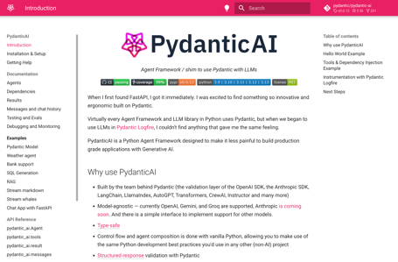
PydanticAI
PydanticAI Agent Framework for LLMs
https://ai.pydantic.dev/
https://github.com/pydantic/pydantic-ai
https://medium.com/data-science-in-your-pocket/pydanticai-pydantic-ai-agent-framework-for-llms-6c60c86e0e48
https://www.youtube.com/watch?v=vnBcowFaQyU
Pydantic is a Python library used to validate and parse data easily (JSON files, user data, or API responses). https://docs.pydantic.dev/latest/
It helps ensure your data is accurate and follows the expected structure. It can be used to validate Structured Responses (both static and streamed).
It is compatible with OpenAI, Gemini, and Groq models (other models can be integrated as well)
Developed by the creators of Pydantic framework
Currently in Beta stage
Workflow:
LLM generates structured response (JSON)
You pass this response to PydanticAI for validation (structure, data types)
If validation fails - PydanticAI will raise a ValidationError.
You can then ask LLM to retry (informing it about specifics of the error)
pip install 'pydantic-ai-slim[openai,vertexai,logfire]'

Slide 18
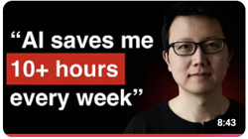
5 AI Prompts to Create Content
"5 AI Prompts that I Use to Create Content for 100K+ Readers"
- by Peter Yang - https://www.youtube.com/watch?v=xUN6udKi50E
Extract insights from long podcasts, YouTube videos, and articles
Turn raw transcripts into polished articles with my best interviews
Craft headlines and YouTube thumbnails using the best examples
Create viral posts using my best LinkedIn and X posts (1M+ impressions)
Edit newsletter articles using my best-performing articles

Slide 19
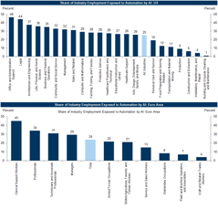
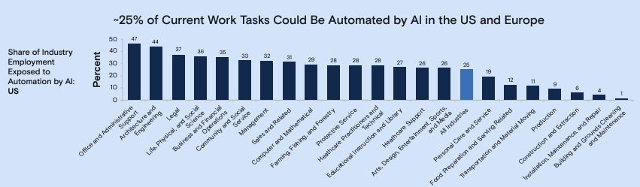
25% of tasks can be outsourced to AI
Approx 25% of current work tasks could be automated by AI in the US and Europe (across industries) - from the Goldman Sachs Global Investment Research team
https://www.gspublishing.com/content/research/en/reports/2023/03/27/d64e052b-0f6e-45d7-967b-d7be35fabd16.html

Slide 20
Education in US and Other Countries
Note: Education in the US used to be ranked #1, but ranking went down over the last 44 years since the creation of the US Department of Education in 1979.
Note: Current US Department of Education's budget for 2024 is $238 billion. This makes it the 6th highest-funded federal agency.
Top countries in Education:
South Korea, Denmark, Netherlands
Other countries frequently found in the top 10 include:
Belgium, Slovenia, Japan, Germany, Finland, Norway, Ireland
USA is at ~ 20th places.
For example, according to PISA (Programme for International Student Assessment) in 2022 the US ranked 28th in math and 12th in science among OECD countries (Organization for Economic Co-operation and Development).

Slide 21
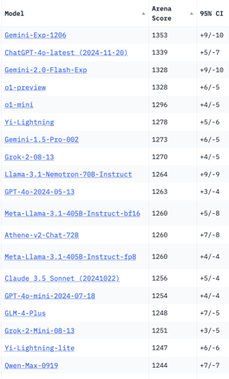
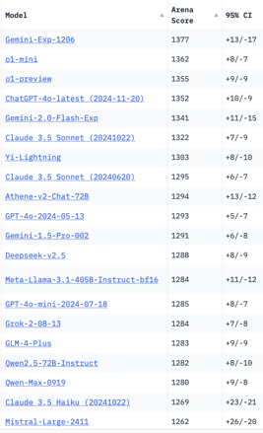
Crowd-sourced "Arena" Leaderboard
Total #models: 175.
Total #votes: 2,396,949.
Last updated: 2024-12-10.
Starting Elo rating = 1000
95% CI = Confidence Interval
https://chat.lmsys.org/?leaderboard
English-only queries
Coding
China
China
x.ai
x.ai
China
x.ai
China
China

Slide 22
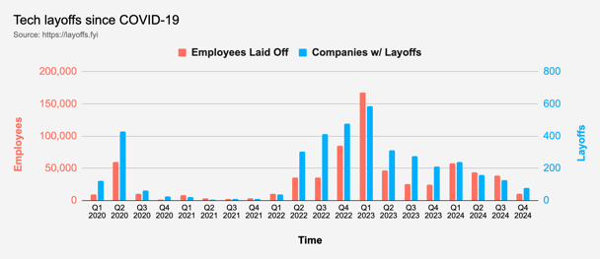
Tech Layoffs in 2024
Layoffs - https://layoffs.fyi
"Who is AI Replacing? The Impact of Generative AI on Online Freelancing Platforms" - paper October 2024
https://papers.ssrn.com/sol3/papers.cfm?abstract_id=4991774
The study found that AI tools have led to a decrease in demand for jobs in areas like writing and coding.
At the same time there is an increase in demand for individuals skilled in utilizing AI tools.
Legal: $8,000 work now can be done for only $3 in GPT credits.
Translation - mostly outsourced to AI
Phone Sales and Customer service
Job market for IT: much worse than before COVID.
IT has become a commodity. Lower salaries/rates ($100/hr => $75/hr).
Much more competition, hundreds of applications for each position

Slide 23
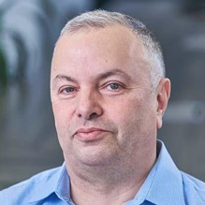

About the Speaker
Lev Selector, Ph.D.
40+ years of software engineering, data science, and building teams (hiring, training, and managing)
Ph.D. in mathematical modeling and computer simulations
Interests:
Generative AI, Using LLM with your data
Local AI for Local Private Data
Cloud architecture, fin-tech, application security
Find/connect: Linkedin, GitHub, YouTube, Google
https://eais.ai
Enterprise AI Systems

Slide 24
Thank You!

