Slide 1

AI Updates
January 03, 2024
2025 - Year of Snake
Large Concept Models - from Meta
o1 clone open-source from China
OpenAI "for-profit" transition
AI Inventions
Perplexity Pro, Storm, Google Deep Research
Anthropic on building effective AI agents
Google AgentSpace - early access
Run:ai acquired by Nvidia for $700 Mln
AI is used to decipher ancient texts
AI Teachers in schools in Arizona.
Cerebras Trillion Parameter Model Training
Alibaba's Qwen QVQ-72B-Preview
Deepseek Outpaces OpenAI in Reasoning
ByteDance 1.58-bit FLUX - 5x less memory
Sonus-1 - new model family from Rubik.ai
Crowd-sourced "Arena" Leaderboard
Growth in AI related jobs

Slide 2
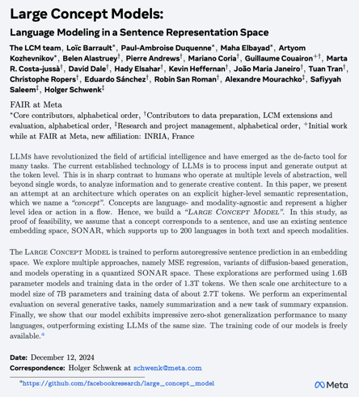
Large Concept Models - from Meta
Large Concept Models: Language Modeling in a Sentence Representation Space
https://ai.meta.com/research/publications/large-concept-models-language-modeling-in-a-sentence-representation-space/
https://arxiv.org/abs/2412.08821
https://arxiv.org/pdf/2412.08821
https://github.com/facebookresearch/large_concept_model
https://www.youtube.com/watch?v=1Z1vKdrmpj4
The Large Concept Model is trained to perform autoregressive sentence prediction in an embedding space. We explore multiple approaches, namely MSE regression, variants of diffusion-based generation, and models operating in a quantized SONAR space.
These explorations are performed using 1.6B parameter models and training data in the order of 1.3T tokens.
We then scale one architecture to a model size of 7B parameters and training data of about 2.7T tokens.
We perform an experimental evaluation on several generative tasks - summarization and a summary expansion.
Our model exhibits impressive zero-shot generalization performance to many languages, outperforming existing LLMs of the same size

Slide 3
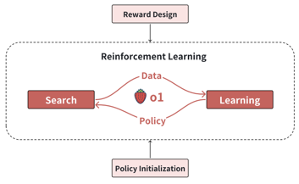
o1 clone open-source from China
The researchers discovered 4 critical elements to how test-time compute works: (1) policy initialization, (2) reward design, (3) search, (4) learning
o1 could drive two paradigm shifts in AI
SSL => RL (from self-supervised learning toward reinforcement learning)
scaling training => scaling training & inference compute
The researchers speculate as to how o1 does policy initialization, long text generation capabilities during inference, shaping humanlike reasoning behaviors logically, and self-reflection.
The researches also discuss different types of reward design, including outcome reward (OR) and process reward (PRM).
Additionally, they explore different search strategies, including tree search and sequential revisions
Finally, they discuss how to make an open-source thinking model and highlight a number of future directions for research.
Chinese researchers may have figured out the technology behind OpenAI’s latest reasoning models - and are making it open source: "Scaling of Search and Learning: A Roadmap to Reproduce o1 from the Perspective of Reinforcement Learning," - https://arxiv.org/abs/2412.14135 - Dec 2024 paper, 51 pages - published by researchers at Fudan University & Shanghai AI Lab
The paper proposes a roadmap for recreating OpenAI’s O1 model. The four key components of the roadmap are policy initialization, reward design, search, and learning.
This roadmap can be compared the to a 2022 paper from Stanford and Google Research, which proposed a similar approach to developing reasoning models.
The key to these "thinking" models (like o1) is test-time compute, which allows them to reach PhD-level mathematics and scientific research capabilities.
This research paper explains how to reproduce the thinking aspect of these models and aims to open-source it.
The irony of OpenAI’s shift from an open-source to a closed-source model. The progress is still being open-sourced, but not by OpenAI - but by Chinese researches.
https://www.youtube.com/watch?v=RAw3JJIht24 - video
https://www.youtube.com/watch?v=-haWhgmUheA - video

Slide 4
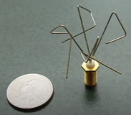

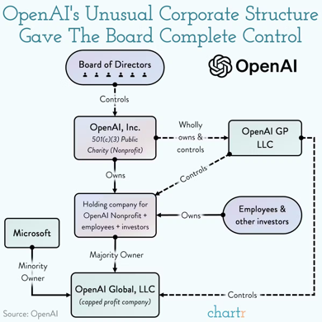

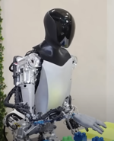
AI Updates 1
OpenAI will transition its for-profit arm into a Delaware Public Benefit Corporation (PBC)
The existing nonprofit will receive shares in the new PBC
This change allows OpenAI to raise capital more easily
AI Inventions
https://www.youtube.com/watch?v=IrLJEzUxIs0
2023

Slide 5
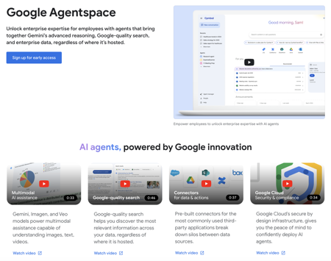
AI Updates - 2
AI research tools: Perplexity Pro, Storm, and Google Deep Research - https://www.youtube.com/watch?v=Rfyq3Mxeyio
Storm, a free tool developed by the Stanford team, outperforms both Perplexity Pro and Google Deep Research in coding related research. But Storm can't engage in conversations and answer follow-up questions
Google Deep Research is the best overall solution due to its comprehensive research, user-friendly interface, and ability to ask follow-up questions.
Perplexity Pro is placed in second place, particularly for its ability to provide fresh data quickly.
Google AgentSpace - early access: https://cloud.google.com/products/agentspace Gemini models, Agents, Notebook LM, multimodal, connectors, Google cloud, Google quality search, enterprise data - regardless of where it’s hosted.
Anthropic on building effective AI agents discussion bt Matthew Berman https://www.youtube.com/watch?v=0v7TQIh_kes
Workflows (predefined) vs Agents.
Agentic frameworks - Langchain, Bedrock, Rivet, and Vellum
Prompt chaining, (based on expertise, tools, and model type), parallelization (running tasks concurrently)
Orchestrator pattern, where a central LLM delegates tasks to worker LLMs
Evaluator optimizer pattern, where one LLM generates a response while another provides feedback in a loop

Slide 6


AI Updates - 3
Run:ai - https://www.run.ai - an Israeli software company was recently acquired by NVIDIA for $700 Mln. Run:ai has developed a platform to help organizations manage and optimize their AI workloads, especially those that rely heavily on GPUs (Graphics Processing Units)
AI is used to decipher ancient texts - burnt Roman scrolls, crumbling cuneiform tablets, etc. https://www.nature.com/articles/d41586-024-04161-z
AI Teachers in schools in Arizona.
An Arizona charter school will use AI instead of human teachers for two hours a day on academic lessons. The AI will customize lessons in real-time to match each student’s needs. The company has only tested this idea at private schools before but claims it hugely increases student academic success.
https://www.techradar.com/computing/artificial-intelligence/ai-educators-are-coming-to-this-school-and-its-part-of-a-trend
Alibaba's Qwen QVQ-72B-Preview - an experimental open-source AI model that combines step-by-step analytical capabilities with visual reasoning to solve complex problems in mathematics, physics, and science.
QVQ excels at step-by-step reasoning through complex visual problems, particularly in mathematics and physics
The model scored a 70.3 on the MMMU benchmark, approaching performance levels of leading closed-source competitors like Claude 3.5 Sonnet
It is built upon Qwen's existing VL model, QVQ also demonstrates enhanced capabilities in analyzing images and drawing sophisticated conclusions.
https://qwenlm.github.io/blog/qvq-72b-preview/
Cerebras Demonstrates Trillion Parameter Model Training on a Single CS-3 System (instead of thousands of GPUs).
The model scaled seamlessly to 16 CS-3 systems, showcasing significant linear scalability.
https://cerebras.ai/press-release/cerebras-demonstrates-trillion-parameter-model-training-on-a-single-cs-3-system

Slide 7
AI Updates - 4
Deepseek R1 model Outpaces OpenAI o1 in Reasoning, Ignites AI Price War
Deepseek, a Chinese AI firm, surpasses OpenAI in reasoning tests and sparks price competition with its cost-effective AI models.
Deepseek is an open-source focused company
Deepseek aims for AGI (Artificial General Intelligence)
https://www.chinatalk.media/p/deepseek-ceo-interview-with-chinas
Sonus-1 - new model family from Rubik.ai .. https://sonus.ai/blog/sonus-1 .. https://www.linkedin.com/company/rubiks-ai/
Mini (speed), Air (everyday use), Pro (complex tasks), and Reasoning (advanced problem-solving).
Sonus-1 Reasoning excels at math problem-solving, achieving 97% on the GSM-8k benchmark and 91.8% on advanced mathematics tests.
In general knowledge tests, the Pro version with Reasoning reaches 90.15% on MMLU, surpassing many leading competitors and nearly matching o1.
The system also integrates real-time search capabilities and Flux image generation, allowing for up-to-date info and visual creation within the platform.
ByteDance 1.58-bit FLUX - dramatically reduces the computational demands of state-of-the-art image generation while maintaining output quality. Instead of 8 bit values it uses 3 values (-1,0,+1). Reducing storage by 8x. Requires 5x less computer memory while producing faster generation speeds.
https://arxiv.org/html/2412.18653v1

Slide 8
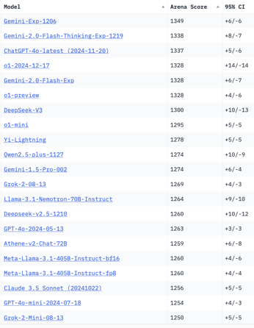
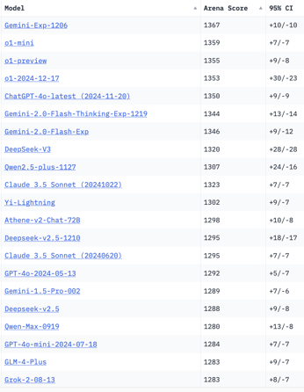
Crowd-sourced "Arena" Leaderboard
Total #models: 187
Total #votes: 2,488,392
Last updated: 2024-12-29
Starting Elo rating = 1000
95% CI = Confidence Interval
https://chat.lmsys.org/?leaderboard
English-only queries
Coding
China
China
China
China
China
China
x.ai
China
China
China
China
x.ai
x.ai

Slide 9
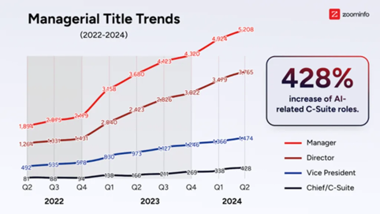
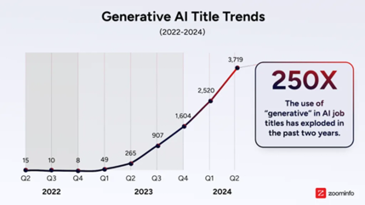
Growth in AI related jobs
Layoffs - https://layoffs.fyi
... dramatic increase in AI-related job titles since 2022. With a 200% increase in two years
AI impacts senior leadership roles. According to Linkedin, the most significant growth was seen in AI-related C-suite roles, which experienced a staggering 428% increase over two years. During the same period, AI-related VP titles increased by 199%, AI directors by 197%, and AI managers by 174%.
https://www.fastcompany.com/91248480/these-4-graphs-show-where-ai-is-already-impacting-jobs

Slide 10


About the Speaker
Lev Selector, Ph.D.
40+ years of software engineering, data science, and building teams (hiring, training, and managing)
Ph.D. in mathematical modeling and computer simulations
Interests:
Generative AI, Using LLM with your data
Local AI for Local Private Data
Cloud architecture, fin-tech, application security
Find/connect: Linkedin, GitHub, YouTube, Google
https://eais.ai
Enterprise AI Systems

Slide 11
Thank You!

