Slide 1
Web Sites and Apps
Using Python January 03, 2024
FastAPI & FastHTML
1994 - HTML, Browser
1995 - Javascript
1996 - Cascading Style Sheets (CSS)
Web Servers - Nginx, Apache, NodeJS
Serving Passive and Active Content
CGI , WSGI , ASGI protocols
Web- and API- Apps
Sticky Load Balancing
Managing multiple servers
FastAPI
FastHTML
Javascript
Cloud Solutions
Web Security

Slide 2
FastAPI - for Serving data (JSON) requests/responses
from fastapi import FastAPI
app = FastAPI()
...
FastHTML - for serving interactive websites / web applications
from fasthtml import FastHTML
app = FastHTML()
...

Slide 3

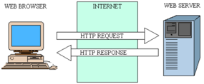




Basic Web Technologies
1995 – JavaScript - was developed by Brendan Eich for Netscape 2
<script type="text/javascript">
var rows = prompt("How many rows for your multiplication table?");
var cols = prompt("How many columns for your multiplication table?");
if(rows == "" || rows == null)
rows = 10;
if(cols== "" || cols== null)
cols = 10;
createTable(rows, cols);
function createTable(rows, cols)
{
var j=1;
var output = "<table border='1' width='500' cellspacing='0'cellpadding='5'>";
for(i=1;i<=rows;i++)
{
output = output + "<tr>";
while(j<=cols)
{
output = output + "<td>" + i*j + "</td>";
j = j+1;
}
output = output + "</tr>";
j = 1;
}
output = output + "</table>";
document.write(output);
}
</script>
1994 – web browser Netscape
HTML (HyperText Markup Language)
Tim Berners-Lee has created HTML, URL, and WorldWideWeb (Nexus) browser/editor in 1990 (worked only on NeXT station). The first widely used web browser was Mosaic Netscape, developed by Marc Andreessen and Eric Bina at the National Center for Supercomputing Applications (NCSA) in 1993-1994.
<!DOCTYPE html>
<html>
<head>
<meta charset="utf-8">
<title>My test page</title>
</head>
<body>
<p>Hello World!</p>
<img src="images/firefox-icon.png"
alt="My test image">
</body>
</html>
1996 – Cascading Style Sheets (CSS) - Håkon Wium Lie
<style>
BODY, TD, TH, P, DIV, blockquote, li, ul
{FONT-FAMILY: verdana, arial, geneva, helvetica; FONT-SIZE: 10pt;}
A:hover { COLOR: #FF0000; background: #FFA; TEXT-DECORATION: underline }
</style>

Slide 4
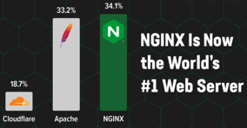
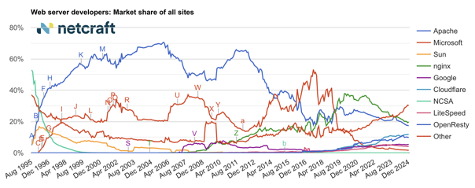
Web Servers
In 2021
In 2021 Nginx has become the most popular web server.
Apache moved to the 2nd place,
Microsoft IIS has very little popularity.
Dec 2024
nginx | 19.67%
Apache | 17.30%
Cloudflare | 11.89%
OpenResty | 9.79%

Slide 5
Serving Active Content
For active content you will need
an App. Server behind the Web Server.
Typically python app. servers use either WSGI or ASGI protocols.
CGI = Common Gateway Interface
WSGI = Web Server Gateway Interface (most common)
ASGI = Asynchronous Server Gateway Interface
Look at the list of different WSGI compatible app servers here:
- https://en.wikipedia.org/wiki/Web_Server_Gateway_Interface
Good for prototyping: uWSGI + Flask:
- https://en.wikipedia.org/wiki/UWSGI
- https://en.wikipedia.org/wiki/Flask_(web_framework)
Client
(Browser or mobile pps)
HTTP Web
Server
(Nginx)
Static content
HTML, CSS, JS, Images
Active content
Perl, PHP, .NET, Java, Python, etc.
CGI script (Perl)
#!/usr/bin/perl print "Content-type:text/html\n\n"; print "<html>Hello</html>\n";
1;
WSGI (Python, Gunicorn)
ASGI - FastHTML
Nginx – very light and fast proxy
Python:
Nginx + FastHTML
Nginx + Gunicorn + Flask
Nginx + Gunicorn + Uvicorn + FastAPI
Nginx Unit + FastAPI
Nginx + Django
Javascript:
Nginx – NodeJS
# myapp.py
# python gunicorn -c myconfig.cfg myapp:app
def app(environ, start_response):
data = b"Hello, World!\n"
start_response("200 OK", [
("Content-Type", "text/plain"),
("Content-Length", str(len(data)))
])
return iter([data])
from fasthtml import FastHTML
from fasthtml.common import *
app = FastHTML()
@app.get("/")
def home():
return "<h1>Hello, World</h1>"
serve()
# myconfig.cfg import multiprocessing bind = "127.0.0.1:8010"
workers = 4
reload = True

Slide 6

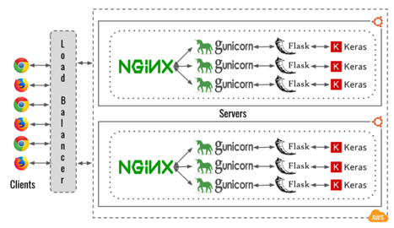
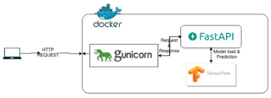


WebApps
Serving pages and APIs using Python
For active content you will need an App-Server
(usually behind a proxy (web) server, like Nginx).
Typically python app. servers use either WSGI or ASGI protocols.
CGI = Common Gateway Interface
WSGI = Web Server Gateway Interface (most common)
ASGI = Asynchronous Server Gateway Interface
Look at the list of different WSGI compatible app servers here:
- https://en.wikipedia.org/wiki/Web_Server_Gateway_Interface
Good for prototyping: uWSGI + Flask:
- https://en.wikipedia.org/wiki/UWSGI
- https://en.wikipedia.org/wiki/Flask_(web_framework)
FastAPI with Uvicorn server:
# Nginx - as Proxy
# gunicorn - to start multiple uvicorn servers/workers (non-sticky)
# uvicorn - async server, can keep multiple connections
# FastAPI - framework for Web API (or FastHTML for Web App)
import uvicorn
from fastapi import FastAPI
app = FastAPI()
# ... define routes ...
uvicorn.run("myscript:app", host='localhost', port=5001, reload=True)
Note:
Azure, AWS, and Google cloud
offer Load Balancing solutions
You can scale using multiple servers, or multiple docker containers managed by kubernetes
Using FastAPI with Nginx Unit

Slide 7

Sticky Load Balancing
If you want sticky load balancing,
you can NOT specify multiple workers
with gunicorn or uvicorn.
If you do something like this:
uvicorn --workers 4
gunicorn --workers 4
then you lose the "stickiness"
To get sticky sessions, you need a dedicated load balancer
(like HAProxy, NGINX, or a cloud load balancer)
sitting directly in front of your Uvicorn instances.
You start multiple uvicorn instances on different ports:
uvicorn main:app --host 0.0.0.0 --port 8000
uvicorn main:app --host 0.0.0.0 --port 8001
etc.
You do NOT need gunicorn.
The above is for both FastAPI and FastHTML
AWS Application Load Balancer
https://aws.amazon.com/elasticloadbalancing/application-load-balancer/
uvicorn FastHTML
uvicorn FastHTML
uvicorn FastHTML
uvicorn FastHTML
uvicorn FastHTML
uvicorn FastHTML

Slide 8
Managing multiple Uvicorn instances
#!/bin/bash
BASE_PORT=8000
APP_PATH="/path/to/your/app"
VENV_PATH="/path/to/venv"
for i in {1..10}; do
PORT=$((BASE_PORT + i - 1))
cat > /etc/systemd/system/uvicorn-${i}.service << EOF
[Unit]
Description=Uvicorn instance ${i}
After=network.target
[Service]
User=your_user
WorkingDirectory=${APP_PATH}
Environment="PATH=${VENV_PATH}/bin"
ExecStart=${VENV_PATH}/bin/uvicorn main:app --host 0.0.0.0 --port ${PORT}
Restart=always
RestartSec=3
# Health check
Type=notify
NotifyAccess=all
ExecStartPost=/bin/sh -c 'echo $MAINPID > /var/run/uvicorn-${i}.pid'
PIDFile=/var/run/uvicorn-${i}.pid
# Health monitoring
ExecStartPost=/bin/sleep 5
ExecStartPost=/usr/bin/curl -f http://localhost:${PORT}/health
TimeoutStartSec=30
# Periodic health check
ExecStartPost=/bin/systemd-notify --ready
ExecReload=/usr/bin/curl -f http://localhost:${PORT}/health \
|| /bin/systemctl restart uvicorn-${i}
WatchdogSec=30
[Install]
WantedBy=multi-user.target
EOF
systemctl enable uvicorn-${i}
systemctl start uvicorn-${i}
done
create and manage 10 uvicorn instances using systemd
# /usr/local/bin/create-uvicorn-services.sh
# chmod +x /usr/local/bin/create-uvicorn-services.sh
# Start/stop all instances
for i in {1..10}; do systemctl start uvicorn-${i}; done
for i in {1..10}; do systemctl stop uvicorn-${i}; done
# Check status
systemctl status 'uvicorn-*'
Systemd provides basic service monitoring and automatic restarting. By default, it will restart a service if it crashes. You can configure custom checks. For example, in your FastAPI app you an add this: from fastapi import FastAPI
app = FastAPI()
@app.get("/health")
async def health_check():
# check something ...
return {"status": "ok"}
Then in your systemd unit file you can add Health checks

Slide 9

FastAPI
fast web framework for building APIs with Python
Documentation: https://fastapi.tiangolo.com
Source Code: https://github.com/tiangolo/fastapi
Modern (since 2018) very high performance, on par with NodeJS and Go
Uses Pydantic for type hints checks - https://pydantic-docs.helpmanual.io
Uses Starlette (light ASGI - https://www.starlette.io )
Intuitive, Easy to use and learn, auto-completion, Fast to code & debug
Fewer bugs, reduce developer errors
Short: Minimize code duplication. Multiple features from each parameter declaration. Fewer bugs.
Robust: Get production-ready code. With automatic interactive documentation.
Standards-based: Based on OpenAPI (previously known as Swagger) and JSON Schema.
Uses Uvicorn - The lightning-fast ASGI server. - https://www.uvicorn.org
Implements ASGI (Asynchronous Server Gateway Interface) - https://asgi.readthedocs.io
Uses uvloops - fast, drop-in replacement of the built-in asyncio event loop. uvloop is implemented in Cython and uses libuv under the hood. - https://github.com/MagicStack/uvloop
Uses httptools - a Python binding for the nodejs HTTP parser. - https://github.com/MagicStack/httptools
Comparing with Flask
https://towardsdatascience.com/understanding-flask-vs-fastapi-web-framework-fe12bb58ee75
Flask (since 2010) is a micro web framework written in python.
minimal amount of coding required
easy setup, flexible, fast to deploy
built on WSGI (Python Web Server Gateway Interface) whereby the server will tie up a worker for each request.
FastAPI (since 2018) – similar to Flask, but:
faster than Flask because it is built on ASGI (Asynchronous Server Gateway Interface), supports concurrency / asynchronous code.
generates documentation (Swagger UI and ReDoc)
creates interactive GUI (Swagger UI) for testing

Slide 10
FastAPI Swagger
FastAPI's ReDoc (short for "Reference Documentation") is an alternative API documentation interface to Swagger UI.
ReDoc has a three-panel layout that many find more polished and readable. It shows the API structure in a left sidebar, The main content is in the middle, Examples and schemas appear on the right
ReDoc is more focused on reading/browsing documentation
Unlike Swagger UI, ReDoc doesn't allow you to make test API calls directly from the interface
ReDoc has better support for markdown in descriptions. It offers better search functionality. It provides a "sticky" navigation menu
The term "Swagger" actually predates FastAPI.
Swagger was originally created by Tony Tam in 2011 as a specification for describing REST APIs.
The name "Swagger" was chosen somewhat playfully - just as swagger means to move confidently or boastfully, the tool allowed APIs to "show off" their capabilities in a structured way.
Later, Swagger was donated to the Linux Foundation and was renamed to "OpenAPI Specification" (OAS) in 2016.
However, the term "Swagger" had become so popular in the developer community that many people still use it to refer to API documentation interfaces, including FastAPI's.
FastAPI uses Swagger UI (now part of OpenAPI) to generate its interactive API documentation.
When you access your FastAPI app's /docs endpoint, you're actually seeing the Swagger UI interface, which reads the OpenAPI specification that FastAPI automatically generates from your code.
So while technically the correct modern term would be "OpenAPI documentation," many developers still call it "Swagger docs" due to its historical name and widespread adoption in the industry.
Both Swagger ( /docs ) and ReDoc ( /redoc ) come with FastAPI.
from fastapi import FastAPI
app = FastAPI()
If you want to remove one of them you can do this:
app = FastAPI(docs_url=None) # Disables Swagger UI
# or
app = FastAPI(redoc_url=None) # Disables ReDoc

Slide 11
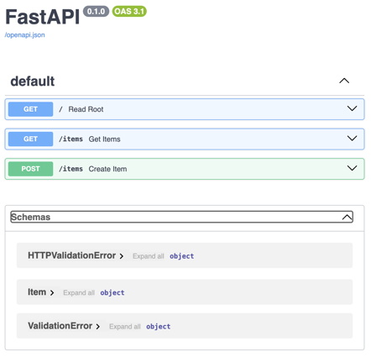
FastAPI Example
http://0.0.0.0:8000/docs
from fastapi import FastAPI
from pydantic import BaseModel
app = FastAPI()
# --------------------------------------
class Item(BaseModel):
name: str
price: float
items = []
# --------------------------------------
@app.get("/")
def read_root():
return {"message": "Hello World"}
# --------------------------------------
@app.get("/items")
def get_items():
return items
# --------------------------------------
@app.post("/items")
def create_item(item: Item):
items.append(item)
return item
# --------------------------------------
if __name__ == "__main__":
import uvicorn
uvicorn.run(app, host="0.0.0.0", port=8000)

Slide 12
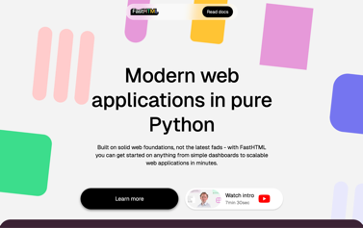

FastHTML
FastHTML - a python framework to create web apps.
It uses HTMX (Javascript library).
pip install python-fasthtml
https://fastht.ml
https://about.fastht.ml
https://docs.fastht.ml
https://docs.fastht.ml/tutorials/by_example.html
https://github.com/AnswerDotAI/fasthtml-tut
https://github.com/AnswerDotAI/fasthtml/tree/main/examples
https://www.youtube.com/watch?v=Auqrm7WFc0I
https://h2x.answer.ai - to convert HTML to FastHTML syntax
https://www.youtube.com/watch?v=evAb2x34Jqk - good short demo
uvicorn test01:app --reload
or serve() at the and of the .py file
or uvicorn.run("test01:app", host="localhost", port=8000, reload=True)
http://127.0.0.1:8000

Slide 13
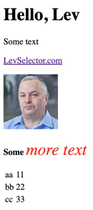
FastHTML : simple examples
from fasthtml import FastHTML
from fasthtml.common import *
app = FastHTML()
@app.get("/")
def home():
return "<h1>Hello, World</h1>"
serve()
""" uvicorn test02_common:app --reload """
from fasthtml import FastHTML
from fasthtml.common import *
app = FastHTML()
@app.get("/")
def home():
mypage = (
Title("Page Demo"),
Div(
H1('Hello, Lev'),
P('Some text'),
P(A( 'LevSelector.com', href='https://LevSelector.com')),
P(Img( src="https://eais.ai/img/Lev.jpg", width=100, height=100)),
P( Strong('Some'),
I('more text', style="color: #f00;font-size: 30px;")
),
Table(
Tr(Td("aa"),Td(11)), Tr(Td("bb"),Td(22)), Tr(Td("cc"),Td(33))
)
) # div
) # mypage
return mypage
from fasthtml.common import *
page = Html(
Head(Title('Some page')),
Body(
Div(
'Some text, ',
A('A link', href='https://example.com'),
Img(src="https://placehold.co/200"),
cls='myclass')
) # div
) # Html
print(to_xml(page)) # print HTML

Slide 14







Javascript
Links:
ajax - https://en.wikipedia.org/wiki/Ajax_(programming) -
jQuery - https://jquery.com -
node.js - https://nodejs.org -
AngularJS - https://en.wikipedia.org/wiki/AngularJS - https://angularjs.org
React - https://en.wikipedia.org/wiki/React_(JavaScript_library) - https://reactjs.org
npm - https://www.npmjs.com - https://en.wikipedia.org/wiki/Npm_(software)
Vue.js - https://en.wikipedia.org/wiki/Vue.js - https://vuejs.org - https://cli.vuejs.org -
Redux - https://en.wikipedia.org/wiki/Redux_(JavaScript_library)
Typescript - https://en.wikipedia.org/wiki/TypeScript
NativeScript - https://nativescript.org – mobile apps
More links:
Loopback.io - https://loopback.io/ - node.js + typescript
form.io - https://www.form.io/ - create forms and APIs, very good, uses mongo.db, opensource
heroku - https://www.heroku.com/ - container-based cloud platform
Swagger.io - https://swagger.io – build API, open source
expressJS - https://expressjs.com - Node Express
Yeoman.io - https://yeoman.io – tools for JS development
Mustache - https://github.com/mustache - templates
Joe Orr - https://kaleguy.github.io/ -
Fiddler – web debugger tool - https://en.wikipedia.org/wiki/Fiddler_(software) -
lodash JS library - https://en.wikipedia.org/wiki/Lodash
RxJS - reactive library - https://rxjs-dev.firebaseapp.com/ -
Svelte - https://en.wikipedia.org/wiki/Svelte – frontend
Vercel - https://vercel.com - platform for frontend frameworks
GitPod.io - https://www.gitpod.io - VS Code or JetBrains in browser
1996 – AJAX (Asynchronous JavaScript And XML)
2006 – jQuery
2009 – Node.js (server-side)
2010 – AngularJS (Google) JavaScript MVC framework
2013 – React (Facebook)
2014 – npm registry
repository for frontend packages
2014 – Vue.js
2014 – NativeScript (mobile apps)
2015 – Redux Library (manage state,
used with React or Angular)

Slide 15
Web Technologies – continued ...
Web Server Frameworks:
- Python-based (Django, Flask, gunicorn, FastAPI, etc.)
- node.js + TypeScript
- Google Flutter widgets https://en.wikipedia.org/wiki/Flutter_(software)
Load Balancers
In front of your web application you may have a load balancer.
All three major clouds provide load balancers:
AWS - https://docs.aws.amazon.com/AmazonECS/latest/developerguide/load-balancer-types.html
Azure - https://docs.microsoft.com/en-us/azure/load-balancer/load-balancer-overview
GCP - https://cloud.google.com/load-balancing
You may also use Nginx to route requests to application servers and to serve static html pages - https://en.wikipedia.org/wiki/Nginx
Django/Python provides authentication, sessions, and caching out-of-the-box:
- https://en.wikipedia.org/wiki/Django_(web_framework) -
- https://www.django-rest-framework.org -
Responsive HTML templates - top menu changes to hamburger for narrow screen)
You can google for something like this:
mobile compatible website template free download
mobile html templates
responsive website templates
shopify templates
Example of good template for Jekyll (static site generator):
- https://mademistakes.com/work/minimal-mistakes-jekyll-theme/
All major clouds provide tools for Authentication/Authorization
AWS Single Sign-On - https://docs.aws.amazon.com/singlesignon/latest/userguide/what-is.html -
Azure Active Directory SSO - https://docs.microsoft.com/en-us/azure/active-directory/hybrid/how-to-connect-sso -
Google: OpenID Connect - https://developers.google.com/identity/openid-connect/openid-connect -
Google Firebase - https://firebase.google.com/
Supabase is an open-source alternative to Firebase
- https://supabase.com

Slide 16
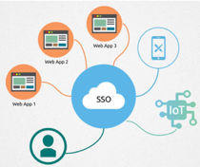

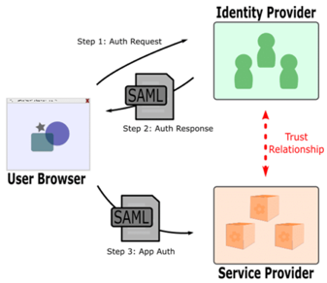
Web Security
SAML
Data security, Access
SSO = Single Sign-On
SAML (Security Assertion Markup Language (XML))
OAuth2 (Open Authorization) - open standard for access delegation, commonly used as a way for Internet users to grant websites or applications access to their information on other websites but without giving them the passwords
3-legged vs 2-legged OAuth. 3-legged OAuth flow involves three parties: - the end-user (or resource owner), - the client (the third-party application), - and the server (or authorization server). 2-legged is used to describe an OAuth-authenticated request without the end-user involved. Client credentials (identifier and secret) are used to calculate a request signature. 2-legged request don't include an access token or secret. These two values are basically empty strings.
Resources:
https://en.wikipedia.org/wiki/Single_sign-on
https://en.wikipedia.org/wiki/Security_Assertion_Markup_Language (SAML)
https://oauth.net/2/
https://stackoverflow.com/questions/13369516/why-is-there-3-legged-oauth2-when-2-legged-works-so-well

Slide 17


About the Speaker
Lev Selector, Ph.D.
40+ years of software engineering, data science, and building teams (hiring, training, and managing)
Ph.D. in mathematical modeling and computer simulations
Interests:
Generative AI, Using LLM with your data
Local AI for Local Private Data
Cloud architecture, fin-tech, application security
Find/connect: Linkedin, GitHub, YouTube, Google
https://eais.ai
Enterprise AI Systems

Slide 18
Thank You!

