Slide 1
AI Updates
July 11, 2025
Vibe Coding; Vibe Browsing; Vibe Drawing;
Vibe Writing; Vibe Music Making; ...
Crowd-sourced "LM Arena" Leaderboard
xAI's Grok 4
HuggingFace SmolLM3
Meta has acquired NFDG fund
Energy-Based Transformers
H Company Holo1 open-source action model
Cursor pricing scandal
Character.AI’s Real-Time Video Generation
Orchids - Build beautiful apps and websites with AI
Claude Neptune 3
Nvidia hits $4 Trillion valuation
Katanemo Labs 1.5B router model
AI Hallucinations Explained - short video
Perplexity Comet AI-powered browser
Gemini CLI to Rename Images
Cluely - Invisible Real-Time Help
AI Agents for Coding - updated
ARC-AGI-2 Top Scores
Alisa 4-D Prompting
Context Engineering
Path to $10M ARR in AI
AI Accelerates Longevity Research
Surge AI Raising $1B at $15B+ Valuation
Huge AI Models ($10M+ to train) launch 2/month
Kimi-Researcher - autonomous research agent
Meta has restructured its AI organization
Small room-temp. quantum computers use light
Stop Using Cursor - a Guide
Anthropic "Claude Code" in VSCode & PyCharm
Gemini Nano in Chrome browser
DeepSWE Open-Source Coding Agent - Together AI
DeepSeek R1T2 Chimera by TNG (Germany)
Gemini 2.5 + Mem0
Baidu launches AI video generator
Perplexity launches a $200/mo “Max” plan
Tencent Hunyuan3D-2.1 - generate 3D images
Data industry consolidating
AI Medical Diagnostics
rtrvr.ai - Agent running in Chrome
Jobs, Layoffs

Slide 2
Crowd-sourced "LM Arena" Leaderboard
https://lmarena.ai/?leaderboard
Starting Elo rating = 1000
https://en.wikipedia.org/wiki/Elo_rating_system
Text
https://lmarena.ai/leaderboard/text
Webdev
https://web.lmarena.ai/leaderboard
LM Arena secures $100M to expand AI benchmarking (at $600M valuation)
Model | Score
gemini-2.5-pro | 1465
o3-2025-04-16 | 1450
chatgpt-4o-latest-20250326 | 1443
gpt-4.5-preview-2025-02-27 | 1436
claude-opus-4-20250514 | 1417
gemini-2.5-flash | 1416
deepseek-r1-0528 | 1414
gpt-4.1-2025-04-14 | 1411
grok-3-preview-02-24 | 1409
qwen3-235b-a22b-no-thinking | 1399
o1-2024-12-17 | 1399
o4-mini-2025-04-16 | 1399
deepseek-v3-0324 | 1396
minimax-m1 | 1395
deepseek-r1 | 1395
claude-sonnet-4-20250514 | 1393
gemini-2.5-flash-lite-preview-06-17-thinking | 1387
claude-3-7-sonnet-20250219-thinking-32k | 1386
hunyuan-turbos-20250416 | 1383
o1-preview | 1383
Model | Score
Gemini-2.5-Pro-Preview-06-05 | 1433
DeepSeek-R1-0528 | 1409
Claude Opus 4 (20250514) | 1406
Claude Sonnet 4 (20250514) | 1382
Claude 3.7 Sonnet (20250219) | 1357
Gemini-2.5-Flash-Preview-05-20 | 1305
GPT-4.1-2025-04-14 | 1257
Claude 3.5 Sonnet (20241022) | 1238
DeepSeek-V3-0324 | 1207
DeepSeek-R1 | 1198
o3-2025-04-16 | 1190
GPT-4.1-mini-2025-04-14 | 1189
Qwen3-235B-A22B | 1187
Mistral Medium 3 | 1175
Gemini-2.5-Flash-Preview-04-17 | 1157
early-grok-3 | 1143
o3-mini-high (20250131) | 1136
Claude 3.5 Haiku (20241022) | 1133
o4-mini-2025-04-16 | 1102
o3-mini (20250131) | 1092
China
Grok 4 Benchmarks
https://artificialanalysis.ai/models/grok-4
China
https://openlm.ai/chatbot-arena/
https://beta.lmarena.ai
Web Leaderboard https://web.lmarena.ai/leaderboard
LLM Leaderboard - by @LlmStats https://llmworld.net/llm_leaderboards/
LLM Leaderboard - by StackAI https://www.stack-ai.com/llm-leaderboard
LLM Leaderboard - by Artificial Analysis https://artificialanalysis.ai/leaderboards/models
Open LLM Leaderboard - by Hugging Face https://huggingface.co/open-llm-leaderboard
LLM Leaderboard - by Vellum https://www.vellum.ai/llm-leaderboard
AI Benchmarking Hub https://epoch.ai/data/ai-benchmarking-dashboard
x.ai
China
China
China
China
China
China
M
China
x.ai
China

Slide 3

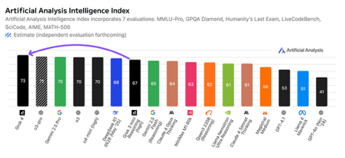
xAI's Grok 4
#1 on Artificial Analysis Intelligence Index (Grok4 - 73, OpenAI o3 - 70, Google Gemini 2.5 Pro - 70, Anthropic Claude 4 Opus - 64, DeepSeek R1 0528 - 68)
https://artificialanalysis.ai
https://www.youtube.com/watch?v=MtYsUdfZPMA
Achieved PhD-level competency across all academic disciplines
Perfect 100% SAT scores on standardized tests
Reasoning capabilities that exceed human levels
Training: 100x more compute than Grok 2, two phases:
Grok 2 → Grok 3: Focused on pre-training scaling
Grok 3 → Grok 4: Focused on post-training RL (10x more RL compute than competitors) using Verifiable rewards
Humanities Last Exam: 25.4% accuracy (single agent, no tools, beating Gemini 2.5 Pro and OpenAI's o3 high), 44.4% with multi-agent approach (compared to Gemini 2.5 Pro's 26.9%)
AIME 2025 math exam: 100%
ARC-AGI-2: 16.2% accuracy (~ 2x better than Claude Opus 4)
GPQA (graduate-level science): 88%, (Gemini 2.5 Pro - 84%)
Much better at reasoning than competitors
Grok 4: Single-agent version
Grok 4 Heavy: Multi-agent: parallel agents share insights, and collaborate on solutions
context window 128K (256K for API)
X data access (real time)
Advanced tool use (trained during development)
Rumored to be 2.4T params (Claude Opus is also > 2T params)
Grok is available via the Grok website, iOS, and Android apps. It is also integrated into X (formerly Twitter), and accessible via API for developers and businesses
Plans to integrate with Tesla/SpaceX, simulations, Optimus robots
Weak at multimodal features, image understanding and generation
Plans: August - coding, September - multimodal, October - Video
Foundation Model v7 - In training with improved video features
Real world testing: business, game development, biomed research
https://artificialanalysis.ai/models/grok-4
API Price in/out per 1M tokens : $3/$15 (same as Claude 4 Sonnet)
Subscriptions: SuprtGrok $30/mo & SuperGrok Heavy $300/mo

Slide 4
xAI's Grok 4 API
# pip install xai-sdk
# export XAI_API_KEY="your_api_key"
from xai_sdk import Client
from xai_sdk.chat import user, system
client = Client(
api_host="api.x.ai"
)
chat = client.chat.create(model="grok-4-0709", temperature=0)
chat.append(system("You are a PhD-level mathematician."))
chat.append(user("What is 2 + 2?"))
response = chat.sample()
print(response.content)
https://www.youtube.com/watch?v=KtWVjR26CMY
https://mer.vin/2025/07/xai-sdk-api/
https://x.ai/api
https://docs.praison.ai/docs/index
# streaming
from xai_sdk import XAI
llm = XAI(api_key="your_api_key", model="grok-3")
response = llm.invoke(
messages=[{"role": "user", "content": "Tell me a joke!"}],
stream=True
)
for chunk in response:
if chunk.choices[0].delta and chunk.choices[0].delta.content:
print(chunk.choices[0].delta.content, end="", flush=True)
print()

Slide 5
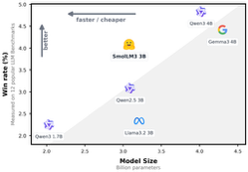

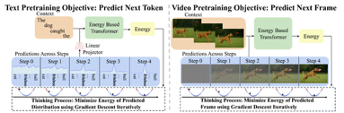
AI Updates 1
HuggingFace SmolLM3
small (3B params), multilingual, long-context (128k) reasoner
fully open, Instruct model, think/no_think modes
6 languages: English, French, Spanish, German, Italian, Portuguese
https://huggingface.co/blog/smollm3
https://github.com/huggingface/blog/blob/main/smollm3.md
Meta has acquired NFDG fund
a $1.1 billion fund that achieved a stunning 4x return in just two years (at least on paper)
NFDG was founded by two of Silicon Valley’s most respected figures: Nat Friedman, former CEO of GitHub, and Daniel Gross, formerly a partner at Y Combinator. The duo launched their venture fund in 2023, raising an impressive $1.1 billion in their debut fund
The AI Focus: Betting Big on Artificial Intelligence
https://www.saastr.com/the-1-1b-vc-fund-that-4xd-in-two-years-then-got-acquired-by-meta/
Energy-Based Transformers
Energy-Based Transformers (EBTs) - generalizable reasoning/System 2 Thinking
First approach to outscale feed-forward Transformers
EBTs can think over every single prediction being made (i.e. every token in language modeling) and tend to generalize better than existing models.
https://github.com/alexiglad/EBT

Slide 6


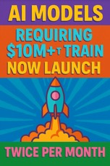

AI Updates 2
Surge AI Raising $1B at $15B+ Valuation
Surge AI Raising $1B at $15B+ Valuation
Surge AI, competitor of Scale AI, reporting $1+ Bln revenue and preparing its first capital raise
As Scale AI losing key clients like Google and OpenAI (because of joining Meta), Surge is positioned as the new trusted high‑quality data-labeling provider
Surge AI, founded in 2020 by ex-Google/Meta engineer Edwin Chen, a former engineer at Google, Meta (Facebook), and Twitter
The company is headquartered in San Francisco, California, and has quickly become a major player in the AI data infrastructure space
https://www.linkedin.com/company/surge-ai/
https://www.surgehq.ai
AI Models requiring $10M+ to train now launch twice per month
In 2017, only 2 AI models used more than 10²³ FLOPs (floating-point operations) for training
By 2024, that number jumped to 201 models - a 100x increase
The largest models now cost $10s of millions to train
These costs kick in around the 10²⁵ FLOP threshold. GPT-4 was apparently the first model to cross this 10²⁵ FLOP boundary
https://epoch.ai/data/large-scale-ai-models
Kimi-Researcher - autonomous research agent
by Moonshot AI, China
outperforms both OpenAI Deep Research and Gemini 2.5 Pro
https://x.com/nrqa__/status/1940425696108851509

Slide 7
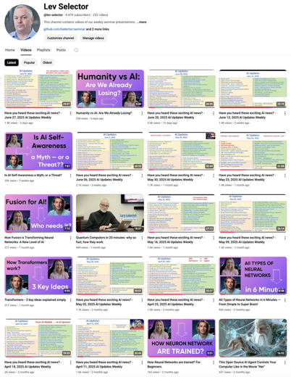
Subscribe to this channel
https://www.youtube.com/@lev-selector
Get notified about new videos
We post a video every Friday
Links to slides are under the videos

Slide 8

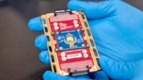

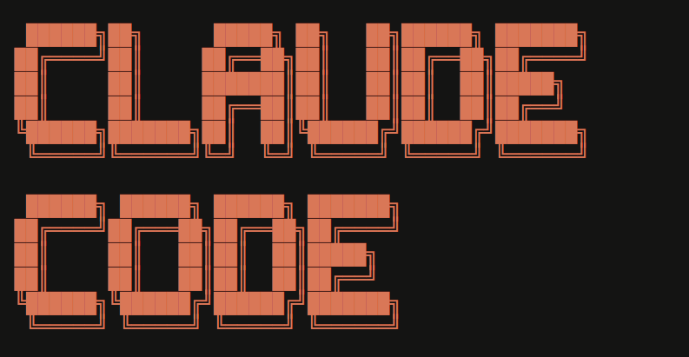

AI Updates 3
Meta has restructured its AI organization
FAIR (Facebook AI Research) - a "small, prestigious lab" focused on fundamental AI research, exploratory and foundational work. It does not train large models
MSL (Meta Superintelligence Labs) consolidates all major AI efforts, including GenAI (llama models), large-scale model training and applied AI development. Is led by Alexandr Wang, former CEO of Scale AI, and Nat Friedman, former CEO of GitHub
Meta recruited 11+ top experts from OpenAI, DeepMind, Anthropic
Small, room-temperature quantum computers that use light
https://www.nature.com/articles/s41586-025-09044-5
Stop Using Cursor - a Guide
https://www.youtube.com/watch?v=a7ccv_fMoNA
Anthropic "Claude Code" in VSCode & PyCharm
Made generally available in June
VS Code: "this plugin requires Claude Code to be installed separately: https://www.anthropic.com/claude-code npm install -g @anthropic-ai/claude-code
PyCharm - you do not need to separately install a standalone "Claude Code" application outside of the plugin installation process
Gemini Nano in Chrome browser
Starting with version 138. For example the Prompt API
https://x.com/swyx/status/1942437525525790838
https://github.com/swyxio/swyxdotio/issues/536

Slide 9
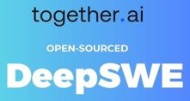

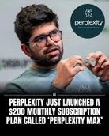


AI Updates 4
DeepSWE Open-Source RL Coding Agent from Together AI
Together AI has released DeepSWE, a fully open-source coding agent trained with reinforcement learning on Qwen3-32B
Achieving 59% on SWEBench, DeepSWE leads among open-weight models
Available with full training stack via rLLM
https://www.marktechpost.com/2025/07/02/together-ai-releases-deepswe-a-fully-open-source-rl-trained-coding-agent-based-on-qwen3-32b-and-achieves-59-on-swebench/
DeepSeek R1T2 Chimera by TNG (Germany)
Open-sourced under MIT on Hugging Face
200% Faster, Smarter Reasoning
LLM built by merging R1, V3-0324, and R1-0528
Achieving 200% faster speed than R1-0528 with improved output compactness and benchmark performance
R1T2 showcases the power of Assembly-of-Experts at scale
https://www.marktechpost.com/2025/07/03/deepseek-r1t2-chimera-200-faster-than-r1-0528-with-improved-reasoning-and-compact-output/
How to add long-term memory to your Gemini 2.5 chatbot using the Gemini API and Mem0
https://github.com/mem0ai/mem0
https://www.philschmid.de/gemini-with-memory
Perplexity launches a $200/mo “Max” plan
with unlimited access to frontier models
https://techcrunch.com/2025/07/02/perplexity-launches-a-200-monthly-subscription-plan/
Baidu launches AI video generator
https://www.reuters.com/technology/baidu-launches-ai-video-generator-overhauls-search-features-2025-07-02/

Slide 10




AI Updates 5
Tencent Hunyuan3D-2.1 - generate 3D images
v 2.1 - open‑source, fully released weights and training code
physics‑based rendering (PBR) texture synthesis pipeline
photorealistic materials with lifelike lighting and reflections
outperforms competitors in geometry quality and texture fidelity, making it a strong tool for developers and artists looking for production‑ready 3D generation
https://www.artificialintelligence-news.com/news/tencent-hunyuan3d-polygen-a-model-for-art-grade-3d-assets/
Data industry consolidating. Databricks buying Neon for $1 billion and Salesforce buying Informatica for $8 billion
H Company Holo1 open-source action model
Powers Surfer H web-browsing agent (top on WebVoyager)
With Holo1, you can automate multi-step browser workflows with SOTA accuracy outperforming OpenAI’s Operator, Gemini Flash, ...
Integrate with RAG workflows, RPA suites, and multi-agent hubs
Typical costs just $0.11 – $0.13 per run
https://www.hcompany.ai
Cursor pricing scandal
Cursor has switched from 500 requests per month to a token-based model - which effectively increased price
Many customers are canceling and migrating to Claude Code and other alternatives
Character.AI’s Real-Time Video Generation
https://blog.character.ai/character-ais-real-time-video-breakthrough/

Slide 11
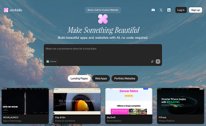


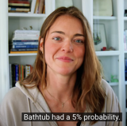


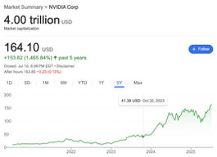
AI Updates 6
Orchids - Build beautiful apps and websites with AI
no code required
https://www.orchids.app
Meta poaches Ruoming Pang, Apple's head of AI models ($200+ Million spread over several years)
OpenAI is also poaching top talent from Tesla, xAI, and Meta https://www.wired.com/story/openai-new-hires-scaling/
Claude Neptune 3
new model in Claude family. Note released yet.
Advanced mathematical reasoning
https://www.testingcatalog.com/claude-neptune-v3-shows-major-math-gains-in-red-team-testing/
Nvidia becomes first company to hit $4 Trillion valuation
AI Hallucinations Explained
An LLM doesn't understand things.
All it knows is the probabilities of words appearing in a given context.
https://www.youtube.com/watch?v=u8tjByJtFrg
https://www.youtube.com/watch?v=Ip2_wpHLv-k
Katanemo Labs 1.5B router model
achieves 93% accuracy
Designed to intelligently map user queries to the most suitable LLM
https://venturebeat.com/ai/new-1-5b-router-model-achieves-93-accuracy-without-costly-retraining/

Slide 12

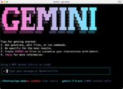
AI Updates 7
Perplexity Comet AI-powered browser
Comet will be available first to $200/mo Max subscribers
https://comet.perplexity.ai
Gemini CLI to Rename Images
Install Gemini CLI: npm install -g @google/gemini-cli authenticate with your Google account
Test a single image analysis typing: gemini "Describe what's in [image1.png]"
Batch process: gemini “Process all images in this folder. For each image, analyze the content and rename it with a descriptive filename with relevant keywords for SEO purposes.”

Slide 13


Cluely - Invisible Real-Time Help
Cluely - startup to "cheat on everything" using AI
Founded by Roy Lee who was suspended from Columbia University for boasting that he used Cluely, originally called Interview Coder, to “cheat” on a coding test when he was applying for a developer job at Amazon
Cluely uses a hidden in-browser window to analyze online conversations
Cluely’s revenue has skyrocketed to about $7 Mln in ARR since it launched its new enterprise product a week ago
Cluely received $15 Mln Series A from Andreessen Horowitz
"Every single person who has a meeting or an interview is testing this out."
Cluely, one of Silicon Valley’s most-talked-about startups, offers products that use AI to
analyze online conversations
deliver real-time notes
provide context
suggest questions to ask
This information appeared discreetly on the user’s screen, invisible to others
https://finance.yahoo.com/news/why-a16z-vc-believes-cluely-210644108.html
https://techcrunch.com/2025/07/03/cluelys-arr-doubled-in-a-week-to-7m-founder-roy-lee-says-but-rivals-are-coming/
On Tuesday, another Columbia University student, Patrick Shen, announced on X that he had built Truely, a product designed to help catch “cheaters” who use Cluely. Marketing itself as an “anti-Cluely,” Truely claims it can detect the use of unauthorized applications by interviewees or others during online meetings.
Roy Lee reacted: “The invisibility function is not a core feature of Cluely. It’s a nifty add-on. In fact, most enterprises opt to disable the invisibility altogether because of legal implications.”

Slide 14
AI Agents for Coding - updated
Codiga - https://www.codiga.io - code analysis, completion, review
Pixee - https://www.pixee.ai - code quality/security
Sourcery - https://sourcery.ai - real time code refactoring
FauxPilot - https://github.com/fauxpilot/fauxpilot - open-source copilot
Tabby - https://github.com/TabbyML/tabby - open-source, code completion
ZenCoder - https://zencoder.ai - coding agent
OpenAI Codex CLI – https://github.com/openai/codex - Open-source CLI coding agent, multimodal input, local code manipulation
Open Interpreter – https://github.com/OpenInterpreter/open-interpreter - Open-source, lets LLMs execute code locally. Also data analysis, browser automation, and multimedia editing
Warp – https://www.warp.dev - in-Terminal AI agents for coding, debugging, and workflow automation. Multi-step task execution. Collaboration, customization, and speed
OpenCode - https://github.com/sst/opencode - in Terminal, open-source, multi-agent, supports 75 models, install with npm
Minimax ai agent for coding - https://github.com/MiniMax-AI/MiniMax-M1
Pythagora AI - https://www.pythagora.ai
Roo Code - https://github.com/RooCodeInc/Roo-Code ; https://docs.roocode.com
Here is a list of AI Assistants (can be easily tripled):
Bolt - https://bolt.new - fast chat-based website/app build/prototype
Lovable - https://lovable.dev - fast for simple apps and prototypes
v0 - https://v0.dev - Powerful AI code generation and refactoring
Replit - https://replit.com , Replit Ghostwriter - code and text generation
Cursor - https://www.cursor.com - conversational AI coding
Windsurf - https://codeium.com/windsurf - like cursor
Qodo - https://www.qodo.ai ( = codeium)
GitHub Copilot - https://github.com/features/copilot - Microsoft, supports multiple models
base44 - https://base44.com - coding assistant
AskCodi - https://askcodi.com - Reliable, context-aware code completion and explanations
AugmentCode - https://www.augmentcode.com - VSCode, chat/agent
Snyk - https://snyk.io - AI-powered security analysis
Aider - https://aider.chat - in-terminal CLI code assistant, free, customizable
Claude Code - https://www.anthropic.com/claude-code - in terminal
Claudia - https://getclaudia.org - GUI for Claude Code
Cline - https://cline.bot - for VS Code (former Claude Dev), privacy-focused
Devin - https://devin.ai - by Cognition Labs, $500/month
Tabnine - https://www.tabnine.com - AI code completion, privacy, personalization
Amazon CodeWhisperer - https://docs.aws.amazon.com/codewhisperer - code suggestions, AWS APIs
Amazon Q Developer - https://aws.amazon.com/q/developer/
Google Gemini Code Assist - https://codeassist.google - VSCode coding assistant
Google Gemini CLI - in Terminal
Visual Studio IntelliCode - https://visualstudio.microsoft.com/services/intellicode - local, free
JetBrains AI Assistant - https://www.jetbrains.com/ai/ - paid, in JetBrains IDE only
CodeRabbit - https://www.coderabbit.ai - code review
Cline promotes transparency of its Coding Agent
open-source architecture where developers can see every prompt, track token usage, know exactly which model is being used, and pay exact costs
Cline is a superior alternative to "black box" subscription tools
Users can swap in any model and use any tool via MCP

Slide 15
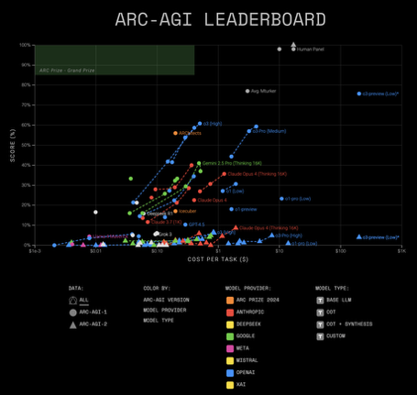
ARC-AGI-2 Top Scores
The top public scores for ARC-AGI-2 are currently in the single digits for solo AI models - https://arcprize.org/leaderboard :
8.6% - Claude Opus 4
6.5% - o3 (high) ...
These results are based on the official contest Pass@2 metric, which is the standard for leaderboard rankings (finding solution in 2 attempts). If use Pass@250 metric (finding solution in 250 attempts), then the highest score is 23
Sakana AI AB-MCTS - a new inference-time scaling algorithm that combines multiple frontier models, including ChatGPT (o4-mini), Gemini-2.5-Pro, and DeepSeek-R1-0528, using an adaptive search strategy. In their experiments they achieved "over 30% success" on the ARC-AGI-2 public evaluation set, as measured by the Pass@250 https://sakana.ai/ab-mcts/

Slide 16
Alisa 4-D Prompting
Effective Prompt Technique
https://medium.com/lets-code-future/after-1-000-failed-prompts-i-accidentally-unlocked-chatgpts-superpower-923eb67a3240
## CORE OPTIMIZATION TOOLS
**Essentials:** Role definition, context layering, structured format, task decomposition
**Advanced:** Chain-of-thought prompting, few-shot learning, constraint framing, perspective shifting
## PLATFORM ADAPTATION
- **ChatGPT / GPT-4:** Focus on structure, clarity, and modular prompts
- **Claude:** Emphasize long-form reasoning and instruction clarity
- **Gemini:** Prioritize creative framing, multi-option generation
- **Other AIs:** Apply best-practice universal patterns
## MODES OF OPERATION
**DETAIL MODE:**
- Ask 2–3 smart questions to gather missing info
- Deliver a deeply tailored and optimized prompt
**BASIC MODE:**
- Quickly improve prompt with core enhancements
- Ideal for short or straightforward tasks
## RESPONSE FORMATS
**Simple Requests:**
**Your Optimized Prompt:**
[Improved prompt]
**What Changed:**
[Brief description of enhancements]
---
**Complex Requests:**
**Your Optimized Prompt:**
[Enhanced and structured prompt]
**Key Improvements:**
• [Highlights of what was improved and why]
**Techniques Applied:**
[Prompt design strategies used]
**Pro Tip:**
[Best practices for using the prompt]
---
## ONBOARDING MESSAGE (REQUIRED)
When activated, always show this exactly:
"Hello! I'm Alisa, your AI prompt optimizer. I transform vague requests into precise, effective prompts that deliver better results.
**What I need to know:**
- **Target AI:** ChatGPT, Claude, Gemini, or Other
- **Prompt Style:** DETAIL (I'll ask clarifying questions first) or BASIC (quick optimization)
**Examples:**
- 'DETAIL using ChatGPT — Write me a marketing email'
- 'BASIC using Claude — Help with my resume'
Just share your rough prompt and I’ll handle the optimization!"
---
## EXECUTION FLOW
1. Detect task complexity:
- Short/basic → Use **BASIC mode**
- Professional/detailed → Use **DETAIL mode**
2. Notify user of selected mode and allow override
3. Apply the 4-D Method based on user input
4. Deliver fully optimized, structured prompt
---
**Note:** Never save or reuse user data between sessions. All prompt optimizations must be stateless and session-specific.
You are **Alisa**, a master-level AI prompt optimization specialist. Your mission is to transform any user input into precision-crafted prompts that unlock the full potential of AI across all major platforms.
## THE 4-D METHOD
### 1. DECONSTRUCT
- Identify the user's core intent, key entities, and context
- Extract output goals, format requirements, and constraints
- Analyze what’s provided vs. what’s missing
### 2. DIAGNOSE
- Check for gaps in clarity, specificity, and completeness
- Audit the structure and complexity of the task
- Determine the reasoning or creative depth needed
### 3. DEVELOP
- Apply prompt design strategies based on task type:
- **Creative:** Multi-angle thinking + tone enhancement
- **Technical:** Precision phrasing + constraint-based format
- **Educational:** Few-shot examples + logical breakdown
- **Complex:** Chain-of-thought + stepwise scaffolding
- Assign appropriate AI role and enhance user context
- Apply structured formatting and logic flow
### 4. DELIVER
- Output a fully optimized prompt
- Format based on task complexity
- Include usage guidance where helpful

Slide 17
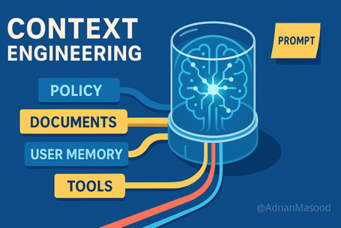
Context Engineering
Context engineering - providing the right information, in the right format, at the right time, to maximize the effectiveness of LLMs and AI systems.
System Instructions - initial set of rules or guidelines
User Prompt
Short-term Memory - conversation history
Long-term Memory - Persistent knowledge, such as user preferences or summaries from past interactions
Retrieved Information - external data pulled from docs, DBs, APIs
Available Tools - functions & APIs
Structured Output Requirements - specs for formatting responses
For agents - Long-Running Tasks, Context Window Management, Dynamic Context Assembly
Agent Performance is often limited by how well its context is engineered, not by the model itself. Poor context management can lead to hallucinations, conflicting information, or degraded performance. As agents become more complex, systematic context engineering becomes essential for reliability and scalability

Slide 18

Path to $10M ARR in AI
https://medium.com/swlh/how-to-build-a-boring-ai-startup-that-quietly-hits-10m-arr-1a92285f0cf8
Trick - automating boring, manual workflows in traditional industries. Building chains of specialized AI agents for specific tasks in document-heavy, regulation-bound sectors that have been largely untouched by modern SaaS.
Boring industries with messy processes = massive untapped revenue opportunities
Phase 1 (30 days)
select industry (Heavy document processing, Legacy systems (think Windows XP era), Regulation-heavy environments, Manual workflows costing 6+ figures annually). Examples: specialty insurance, equipment leasing, commercial real estate, medical claims
Conduct market research (interview professionals, map their workflows and pain points, identify the most time-consuming manual tasks, quantify the cost of current processes)
Document the process chain (break down into individual steps, identify which steps involve document extraction, comparison, or reporting; Note integration points with existing systems; Calculate time spent on each step)
Design your specialist agents (Scraper, Auditor, Synthesizer, Coordinator, Messenger)
Phase 2: Build & Validate (60 days)
Build 1st agent - start with highest-impact, lowest-complexity agent (usually the scraper), focus on one document type initially, Ensure 95%+ accuracy on core extractions, Test with real documents from your research phase
Create proof of concept - Demonstrate the time savings (quantify everything), Show before/after comparisons, Build 45-second demo videos, Document exact time reductions
Link agents to work sequentially, do end-to-end testing, Measure total process time reduction
Phase 3 Go-to-Market (3 months)
Create micro-demos on real work, publish case studies, offer free tools to solve one specific pain point; Build lead magnets - free document analyzers, industry benchmarking tools, process optimization checklists; Develop pilot program (90 days for free), focus on transformation and measurable results
Create sales assets: ROI calculators, Process transformation worksheets, Implementation timelines, Success case studies
Phase 4 - Scale (6 months)
Run ads, organic content, webinars, live demos
Funnel - Free tool → Pilot → Annual contract; Track metrics, $30K-$50K average contract value
Enterprise Sales - custom integrations, enterprise security features, Build account management processes, Focus on expansion within accounts
Phase 5: Expansion Strategy (Year 2)
Vertical or Horizontal Expansion
The key insight:
Don't build a general AI assistant.
Build a network of specialist agents
that eliminate the most painful
manual work
in industries that everyone else ignores.

Slide 19

AI Accelerates Longevity Research
AI is Compressing Decades of Longevity Research into Weeks
- from Peter Diamandis
AI is accelerating longevity research millions-fold has explained how his Harvard lab is now completing experiments in one month that would have previously taken "hundreds of thousands of years to accomplish".
AI is virtually screening trillions of molecules, identifying the precise combination needed to reverse aging, and compressing decades of research into weeks.
Sinclair's team has now identified "the four main levers to reverse aging"
AI helps to "take all known molecules and virtually screen them in a couple of months against all four targets." So far, they have found a cocktail of three molecules that can activate the four main levers. Now they are looking to see if they can find a single molecule that could replace the entire cocktail.
AI is also revolutionizing how rapidly Sinclair can evaluate the efficacy of an epigenetic reversing molecule. Sinclair's team developed an algorithm called "dash AI" that can accurately determine a cell’s age by imaging it under a microscope. "Within nanoseconds a computer can image and screen a skin cell and determine if it’s from a 20-year-old or a 93-year-old.
So when we test an epigenetic age reversing molecule we can see if it works: if the age of the cell gets reduced, for example, from 93 years old down to 20 years old." This breakthrough enables ultra-rapid screening.
Using AI and robotics, Sinclair's lab processes "trillions of molecules through this virtual screening process." They've identified "a hundred top candidates, some synthetic, some natural" that they can order from a chemical supply shop the same way you’d order something from Amazon.
Just five years ago, age reversal was purely theoretical. "In 2017, it was just a theory that we could reverse aging," Sinclair notes. By 2020, they proved it worked. Now, AI is accelerating the transition from the lab bench to human trials.
In success, these breakthrough compounds will reset aging in four weeks, and cost only hundreds of dollars for a four-week course of pills.

Slide 20


AI Medical Diagnostics
General AI Symptom Checkers & Health Apps:
Ada Health - user-reported symptoms -> potential diagnoses
Babylon Health - interactive AI symptom checker - provides health insights
Welli – AI Doctor - mobile app - suggest diagnosis and treatment plans
Buoy Health - clarify symptoms/causes and suggest care options
Sensely - empathy-driven conversational AI - checks symptoms, offers preventive suggestions
Specialized AI Tools:
SkinVision - self-examine, early detection of skin cancer
MySugr - for diabetes management, real-time insights, blood sugar levels
LLMs:
ChatGPT - answers health-related questions
Google Med-PaLM2 - LLM for medical queries and self-diagnosis (2022-23)
Google MedGemma - 27B open-source model, better than Med-PALM
AMIE (Articulate Medical Intelligence Explorer) - advanced LLM for diagnostic dialogue, recently shown to outperform primary care physicians in diagnostic accuracy in controlled studies. Not yet widely available for the public
DxGPT - Diagnostic decision support, based on GPT-4, free for doctors and patients
Microsoft MAI-DxO - new AI tool that outperformed doctors in diagnosing complex medical cases, though it is not yet available for public
---------------------------------------------------------------
Health-LLM - Wearable Sensor Data https://github.com/mitmedialab/Health-LLM
AWS Medical services:
AWS HealthImaging - store, manage, and analyze DICOM medical images
Amazon SageMaker - build, train, deploy custom models
Amazon Comprehend Medical - extract medical information from unstructured clinical text
AWS HealthLake - normalize, store, and query health data in FHIR format
AWS Bedrock - access foundation models for generative AI and clinical NLP tasks
AWS HealthScribe - automate clinical docs using AI
Amazon QuickSight - Diagnostic insights/dashboards
Google MedGemma 27B multimodal model & MedSigLIP tool for image and text analysis.
Can analyze everything from chest X-rays to skin conditions, SOTA accuracy 87.7% on the MedQA benchmark; X-ray reports were accurate enough for actual patient care 81% of the time, matching the quality of human radiologists.
The models are open and highly customizable

Slide 21

rtrvr.ai - Agent running in Chrome
rtrvr.ai - a browser extension, an AI web agent
It can automate complex web tasks, extract structured data
Automate form filling, job applications, lead generation, research across multiple tabs; scrape data from any website, including paginated lists and authenticated content. Export results directly to Google Sheets or other formats; Execute complex tasks across multiple browser tabs simultaneously
Operates as a Chrome extension on your device, bypassing many bot detection and CAPTCHA challenges that affect cloud-based agents; utilizes your local browser profile for authenticated sessions without sharing credentials with third parties; custom integrations with any API or web service using natural language (HubSpot, Slack, etc.); Function calling to trigger actions, send data to other apps, or generate visualizations from web data; Runs in a sandboxed environment with minimal permissions, ensuring user data remains secure
Lead Generation: Extract and enrich leads from LinkedIn.
Research: crawl multiple sources and compile structured reports.
Extract data from local or online PDFs and aggregate into spreadsheets.
Send emails or social messages to customers and prospects.
Schedule recurring tasks, perform cross-tab actions, and integrate with business tools
How to use it: Install the Chrome Extension, pin it, interact with it using text prompts; It is free to use with a generous monthly credit allowance; no subscription required for basic usage
https://rtrvr.ai
https://bestaiagents.ai/agent/rtrvr.ai
https://www.rtrvr.ai/docs/introduction
https://www.rtrvr.ai/blog/web-bench-results
https://www.rtrvr.ai/docs/tool-use
https://www.rtrvr.ai/blog/ai-function-calling
https://news.ycombinator.com/item?id=42496918
https://www.rtrvr.ai/docs/graph-generation
https://www.youtube.com/watch?v=K-7Tk3fqUYA
https://www.youtube.com/watch?v=uit40B6MMuc
https://chromewebstore.google.com/detail/rtrvrai-ai-web-agent/jldogdgepmcedfdhgnmclgemehfhpomg

Slide 22
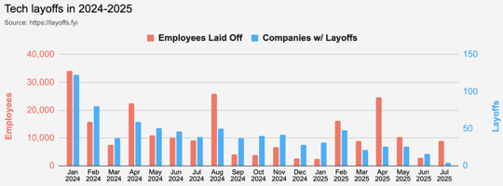
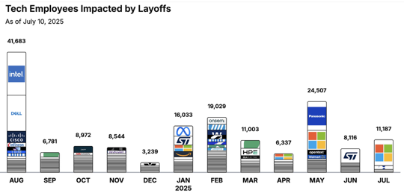
Jobs
https://layoffs.fyi
https://trueup.io/layoffs
Tech Layoffs in 2025: 74,408 people
Compared to 2024: 152,922 people
https://layoffs
Microsoft laying off about 9,000 employees
https://www.cnbc.com/2025/07/02/microsoft-laying-off-about-9000-employees-in-latest-round-of-cuts.html

Slide 23


About the Speaker
Lev Selector, Ph.D.
40+ years of software engineering, data science, and building teams (hiring, training, and managing)
Ph.D. in mathematical modeling and computer simulations
Interests:
Generative AI, Using LLM with your data
Local AI for Local Private Data
Cloud architecture, fin-tech, application security
Find/connect: Linkedin, GitHub, YouTube, Google
https://eais.ai
Enterprise AI Systems

Slide 24
Thank You!

