Slide 1
AI Updates
May 02, 2025
Meta launches AI app on iOS and Android
JetBrains Mellum-4b
Visa & Mastercard "Agent Pay"
Xiaomi MiMo-7B
IBM to invest $150 Bln in U.S. quantum computing
OpenMath-Nemotron-32B & -14B-Kaggle
TTRL: Test-Time Reinforcement Learning
Microsoft Phi-4 reasoning 14B params
Meta AI ReasonIR-8B - Retriever Optimized for RAG
Hyena Edge
Persona - AI Tools for Digital Id
Is the Dire Wolf Really Back?
Wasmer.io
Qwen3
Grok 3.5 to be released next week
Microsoft BitNet-b1.58-2B-4T
LLM Performance vs Cost
Parse Documents into text locally
Adobe Firefly-4 vs GPT-4o Images
AI That Thinks BEFORE You Ask?
AI in China
DeepSeek-Prover
Pleias - small reasoning models for RAG
Tiny Agents with MCP
DeepSeek R2 AI Model Rumors
NVIDIA Is Planning To Start Operations In China
Claude Desktop image and video generation
OpenAI Shopping, Citations, WhatsApp
Higgsfield.ai Turbo - video generation
Figure AI - robots to work at UPS
Crowd-sourced "Arena" Leaderboard
Can LM Arena be trusted?
Jobs, Layoffs

Slide 2



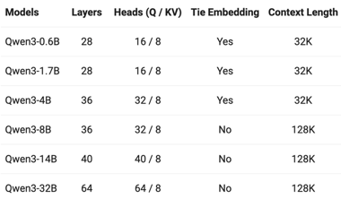

Qwen3
The word "Qwen" is primarily known as the name of LLMs developed by Alibaba Cloud. It is an acronym for "Quantum Wisdom Enhanced Network". Qwen also called Tongyi Qianwen, Chinese: 通义千问.
https://chat.qwen.ai
https://qwenlm.github.io
https://qwenlm.github.io/blog/qwen3/
https://github.com/QwenLM/Qwen3
https://ollama.com/library/qwen3/tags
Dense Models: 0.6B, 1.7B, 4B, 8B, 14B, 32B
MoE Qwen3-30B-A3B (30B total params, 3B activated) - small MoE, outcompetes QwQ-32B
MoE Qwen3-235B-A22B (235B total, 22B activated) - competes with DeepSeek-R1, o1, o3-mini, Grok-3, and Gemini-2.5-Pro
Qwen3-4B - tiny - but rivals Qwen2.5-72B-Instruct.
Available on Ollama, HuggingFace, ...
Hybrid Thinking Modes (Thinking On/Off)
Multilingual (119 languages and dialects)
Coding and agentic capabilities, MCP support
Not multimodal (only text, no image understanding)
Trained on 36 Trillion tokens. Four-stage training pipeline: (1) long chain-of-thought (CoT) cold start, (2) reasoning-based RL, (3) thinking mode fusion, (4) general RL
Dense
32b vs 30b: 32B is more accurate, 30B is faster (MoE)
MoE

Slide 3
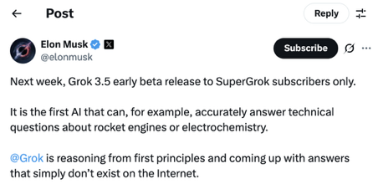
Grok 3.5 to be released next week
from Elon Musk @elonmusk April 29
Next week, Grok 3.5 early beta release to SuperGrok subscribers only.
It is the first AI that can, for example, accurately answer technical questions about rocket engines or electrochemistry.
@Grok is reasoning from first principles and coming up with answers that simply don’t exist on the Internet.
https://x.com/elonmusk/status/1917099777327829386

Slide 4
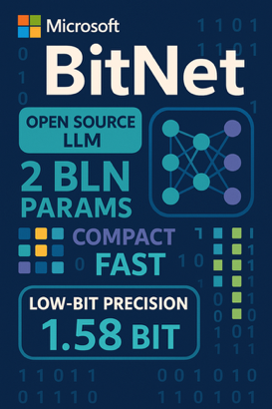
Microsoft BitNet-b1.58-2B-4T
Microsoft BitNet-b1.58-2B-4T - released April 16, 2025
open-source LLM (MIT license) on HuggingFace
1.58-bit Native Training (ternary: -1,0,+1 for weights), no biases
Weights: Ternary {-1, 0, +1} (1.58-bit)
Activations (values passed between layers) are int8
2 Bln params
trained on 4T-tokens (text, code, math), 3-step training
Transformer architecture with custom BitLinear layers
Uses squared ReLU (ReLU²) activation function
On par with full precision LLMs of similar number of params (Llama 3.2 1B, Gemma-3 1B, Qwen2.5 1.5B)
Uses approx 10-times less memory
Inference is approx 3 times faster, can be done on CPU
Energy consumption ~ 10 times less
bitnet.cpp - optimized inference for CPU
but ...
context length only 4K
supports only English
not tested enough for commercial use.
https://huggingface.co/microsoft/bitnet-b1.58-2B-4T
https://huggingface.co/papers/2504.12285

Slide 5
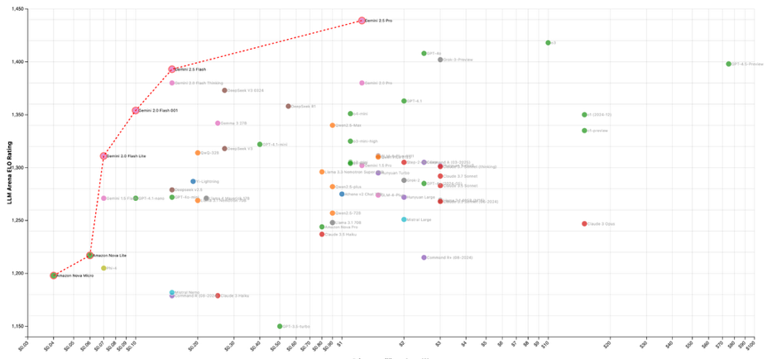
LLM Performance vs Cost (April 2025)
Gemini 2.5

Slide 6

Parse Documents into text locally
Parse Documents into text
Deploy an in-house Vision Language Model to parse millions of documents: say goodbye to Gemini and OpenAI
using local open-source models Qwen-2.5-VL (a vision language model from Alibaba) for document understanding and vLLM for efficient inference serving (PagedAttention mechanism)
This in-house solution processes documents more economically than third-party LLM providers while maintaining complete data privacy and control. For 10,000 documents, the cost would be approximately $10 and take about 12.5 hours using an EC2 g6.xlarge instance
https://pub.towardsai.net/deploy-an-in-house-vision-language-model-to-parse-millions-of-documents-say-goodbye-to-gemini-and-cdac6f77aff5
Generated using Adobe Firefly Web App https://firefly.adobe.com

Slide 7




Adobe Firefly-4 vs GPT-4o Images
Adobe’s new Firefly Image Model 4 to ChatGPT’s image generator
https://www.techradar.com/computing/artificial-intelligence/i-compared-adobes-new-firefly-image-model-4-to-chatgpts-image-generator-and-its-like-they-went-to-the-same-art-school

Slide 8
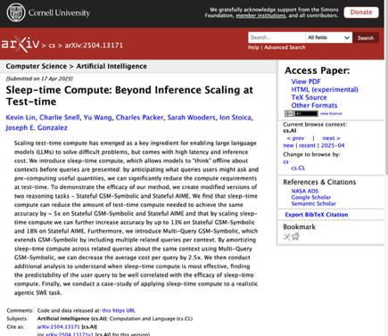
AI That Thinks BEFORE You Ask?
research paper about "Sleep-Time Compute" https://arxiv.org/abs/2504.13171
Sleep-Time Compute enables AI to "think" about context offline before queries are presented
Instead of processing the full context every time a query is made, Sleep-Time Compute pre-processes the context during idle "sleep time". The preprocessed context can then be used for future queries
This allows to reduce the latency of responses - and reduce the costs (sometmes 5-10 timeless expensive than Test-Time Compute).
Particularly effective for stateful applications where context is reused (code bases, document Q&A, chat)
It is less effective for unpredictable queries unrelated to the context
It is also less effective for extremely difficult problems
On average - improved results by 13-18% while reducing costs by 2.5x when amortized across multiple queries
Consistently outperformed parallel sampling approaches

Slide 9
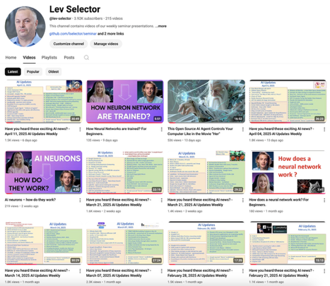
We post our AI Updates
Every Friday after 3pm EST
It is usually 25-30 min long
Links to slides are under the videos
Subscribe to our YouTube channel to get notified when new videos are posted
https://www.youtube.com/@lev-selector

Slide 10
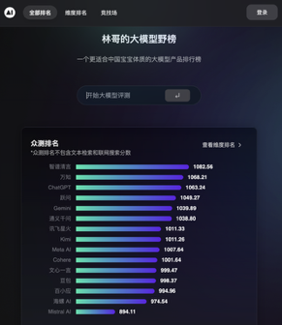

AI in China
AI in China
Baidu - ERNIE models
Alibaba - Qwen models
Tencent - Hunyuan models
Xiaomi - AI systems for humans, cars, home
Zhipu AI - GLM models (general, GocdeGeeX, CogView image, VisualGLM multimodal)
Moonshot AI - Kimi Chat model, long context
MiniMax - foundational models and consumer applications
Baichuan AI - Baichuan series of open-source models
01.AI - Yi series of models
DeepSeek - DeepSeek R1, V3
StepFun - multimodal (language, vision, video, and speech)
Shengshu Technology - Vidu model video generation
Leaderboards:
https://huggingface.co/collections/zh-ai-community/leaderboards-and-arenas-664b6913bfd9b93ba4ac242e
https://lyihub.com
Huawei Starts Delivering Its CloudMatrix 384 AI Clusters To Chinese Customers; It's performance is comparable to NVIDIA’s GB200 NVL72 System, but it is more expensive and consumes more electricity.
https://wccftech.com/huawei-starts-delivering-its-cloudmatrix-384-ai-clusters-to-chinese-customers/

Slide 11

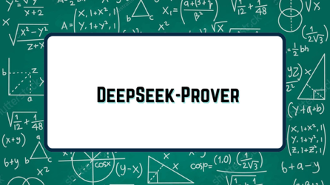
DeepSeek-Prover
DeepSeek Prover - Math Theorems' proving
Advanced open-source LLMs
Automates generating formal proofs for math theorems
DeepSeek-Prover-V1.5 was released on August 15, 2024.
DeepSeek-Prover-V2 (7B & 671B) - August 2025
DeepSeek-Prover-V2-671B - MoE, long context
DeepSeek-Prover-V2-7B - efficient, 32K context
Access via OpenRouter platform, also Hugging Face and GitHub
https://github.com/deepseek-ai/DeepSeek-Prover-V2
https://apidog.com/blog/deepseek-prover-v2-671b/

Slide 12
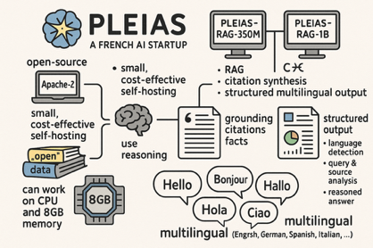
AI Updates - 1
Pleias - small reasoning models for RAG
Pleias is a French AI startup
Pleias-RAG-350M and Pleias-RAG-1B - new small models built for RAG, citation synthesis, and structured multilingual output.
open-source (Apache-2), built using "open" data only
models are small, cost-effective for self-hosting, use reasoning
Compete with 7..8B models, can work on CPU and 8GB memory
Focused on grounding, citations, and facts (literal quotes).
Structured output includes language detection, query and source analysis reports, and a reasoned answer
Multilingual (English, French, German, Spanish, Italian, ...)
https://venturebeat.com/ai/ethically-trained-ai-startup-pleias-releases-new-small-reasoning-models-optimized-for-rag-with-built-in-citations/
Tiny Agents with MCP
A tiny MCP-powered agent in 50 lines of code
https://huggingface.co/blog/tiny-agents
DeepSeek R2 AI Model Rumors
Low cost - $0.07/M in, $0.27/M out
Fully Trained on Huawei’s Ascend 910B Chips
1.2T param, 78B active, hybrid MoE
5.2PB training data. 89.7% on C-Eval2.0; 92.4% on COCO vision
NVIDIA Is Planning To Start Operations In China
https://wccftech.com/nvidia-is-planning-to-spin-off-its-chinese-operations-in-the-future/

Slide 13


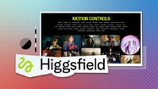

AI Updates - 2
Claude Desktop now supports image and video generation
via Luma integration
OpenAI upgrades ChatGPT Search - shopping, citations, WhatsApp
xx
https://openai.com/chatgpt/search-product-discovery/
higgsfield.ai Turbo - video generation
https://higgsfield.ai
rapid, high-quality, and cost-effective AI video creation for filmmakers, music video and social media creators
1.5 times faster than before
30% cheaper than standard model
dynamic and cinematic motion controls (e.g., dolly shots, crash zooms, overheads) and a wide range of motion presets
available exclusively to Pro and Ultimate plan users on Higgsfield.ai
Figure AI - robots to work at UPS
https://www.bloomberg.com/news/articles/2025-04-28/ups-in-talks-with-startup-figure-ai-to-deploy-humanoid-robots

Slide 14




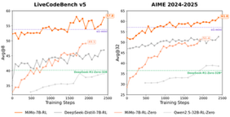
AI Updates - 3
Meta launches AI app on iOS and Android
https://about.fb.com/news/2025/04/introducing-meta-ai-app-new-way-access-ai-assistant/
JetBrains Mellum-4b
an "open" AI coding model (base & python)
4b params, 8K context window
https://huggingface.co/JetBrains/Mellum-4b-base
Visa & Mastercard "Agent Pay"
Visa "Intelligent Commerce" provides AI-ready cards with tokenized credentials and user-set preferences to let AI agents find and buy items without exposing card data enabling AI to shop and pay on consumers’ behalf
Mastercard "Agent Pay" to embed payments into AI conversations.
Xiaomi MiMo-7B
Open-source, reasoning,
Outperforms OpenAI o1-mini, Qwen-32B in math/code
https://github.com/XiaomiMiMo/MiMo
IBM to invest $150 Bln in U.S. quantum computing
https://newsroom.ibm.com/2025-04-28-ibm-unveils-150-billion-investment-in-america-to-accelerate-technology-opportunity

Slide 15
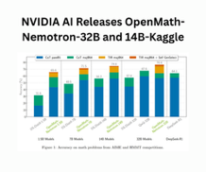
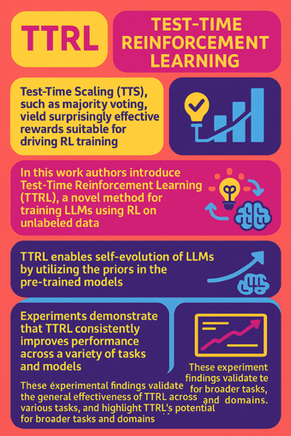
AI Updates - 3
OpenMath-Nemotron-32B & -14B-Kaggle
fine-tuned for Math from Qwen2.5-32B & -14B using OpenMathReasoning dataset
https://huggingface.co/nvidia/OpenMath-Nemotron-32B
https://huggingface.co/nvidia/OpenMath-Nemotron-14B-Kaggle
TTRL: Test-Time Reinforcement Learning
Test-Time Scaling (TTS), such as majority voting, yield surprisingly effective rewards suitable for driving RL training
In this work authors introduce Test-Time Reinforcement Learning (TTRL), a novel method for training LLMs using RL on unlabeled data
TTRL enables self-evolution of LLMs by utilizing the priors in the pre-trained models
Experiments demonstrate that TTRL consistently improves performance across a variety of tasks and models
TTRL has demonstrated performance to consistently surpass the upper limit of the initial model, and approach the performance of models trained directly on test data with ground-truth labels
These experimental findings validate the general effectiveness of TTRL across various tasks, and highlight TTRL's potential for broader tasks and domains.
https://www.arxiv.org/abs/2504.16084
https://github.com/PRIME-RL/TTRL

Slide 16
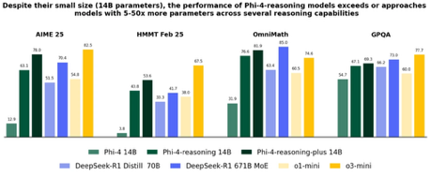
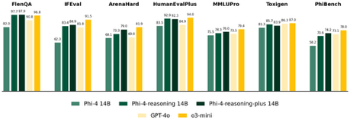
AI Updates - 4
Microsoft Phi-4 reasoning 14B params
Phi-4-reasoning Phi-4-reasoning-plus Phi-4-mini-reasoning
Microsoft's Phi-4 was released on Dec 12, 2024
https://azure.microsoft.com/en-us/blog/one-year-of-phi-small-language-models-making-big-leaps-in-ai/
Meta AI ReasonIR-8B - Retriever Optimized for RAG
https://huggingface.co/reasonir/ReasonIR-8B
https://github.com/facebookresearch/ReasonIR

Slide 17

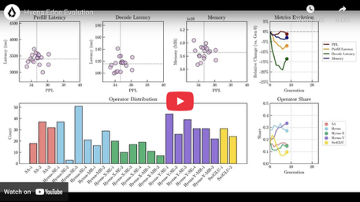
Hyena Edge
Hyena Edge - multi-hybrid model for smartphones and laptops
Developed by Liquid AI - https://www.liquid.ai
Convolution-Based Multi-Hybrid Architecture. Uses a combination of convolutional operators replacing about two-thirds of the grouped query attention (GQA) operations found in a typical Transformer. This reduces memory requirements
Architecture was optimized using STAR (Synthesizing Target Architectures) framework
The model uses a diverse set of convolutional operators (Hyena Full, Hyena-X, Hyena-Y) and other components like SwiGLU feedforward layers. STAR's search helped to find the best balance of speed, memory, and accuracy
Hyena Edge has up to 30% faster prefill and decode latencies compared to a parameter-matched Transformer++ baseline. Even better for longer sequences.
Memory usage is consistently smaller, and benchmarks scores are higher that of Transformer-based baselines.
By moving away from attention-heavy architectures and leveraging efficient convolutional operations, Hyena Edge enables faster, more private, and energy-efficient AI directly on consumer devices
Liquid AI plans to open-source Hyena Edge and related models
https://www.liquid.ai/research/convolutional-multi-hybrids-for-edge-devices
Liquid AI is a startup founded in 2023
Headquarted at Boston/Cambridge area of Massachusetts
Liquid AI has raised a total of $296.6 Mln
Model size probably ~ 2B params
Memory usage probably ~ 2GB
Context length 32K tokens

Slide 18



Persona - AI Tools for Digital Id
Persona - AI tools for digital Id verification
raised $200 million at a $2 billion valuation
Goal - distinguish between bots and humans
Used by OpenAI, LinkedIn, and Reddit, ...
Uses standard identity verification techniques and advanced machine learning & AI methods (text analysis, patterns, ...)
Persona's AI-driven solutions are crucial in distinguishing genuine users from sophisticated bots, addressing the growing challenge of automated online interactions.
https://withpersona.com/
World ID ( https://world.org/world-id )
vs. Persona ( https://withpersona.com )
World ID (co-founded by Sam Altman) is geared toward public, individual use for proving humanness, voting, or accessing digital services anonymously.
Persona is tailored for businesses to verify customers, prevent fraud, and automate compliance processes
World ID
Biometric Iris Scanning (Orb Technology)

Slide 19

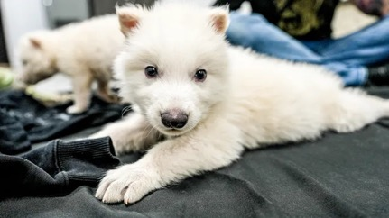
Is the Dire Wolf Really Back?
Is the Dire Wolf Really Back? | MOONSHOTS
https://www.youtube.com/watch?v=8qbmr4UpXAQ
Colossal Biosciences announced the birth of three pups (Romulus, Remus, and Khaleesi) in late 2024/early 2025, described as the world's first "de-extincted" animal, aiming to revive the dire wolf (Aenocyon dirus), which went extinct roughly 10,000-13,000 years ago.
Scientists have sequenced the dire wolf genome using ancient DNA extracted from fossils (including a 13,000-year-old tooth and a 72,000-year-old skull); Identified key genes associated with dire wolf traits; took blood cells (endothelial progenitor cells) from a living gray wolf; Used CRISPR gene-editing technology to modify roughly 14-20 specific sites in the gray wolf cells' DNA to match the desired dire wolf traits (e.g., larger size, stronger body, specific coat characteristics); No ancient dire wolf DNA was spliced in; existing gray wolf genes were rewritten; transferred the nucleus from the edited gray wolf cell into a denucleated egg cell from a domestic dog; implanted the resulting embryos into domestic dog surrogate mothers, leading to the birth of the pups.
Colossal Biosciences was co-founded in 2021 by tech entrepreneur Ben Lamm (CEO) and renowned geneticist Dr. George Church
Company is valued at $10 Bln and already received approx $450 Mln in funding. Has offices in TX and MA.
Note: Dinosaurs went extinct approx 65 Mln years ago. The oldest DNA is approx 1.2 Mln years old. There is no DNA older than that.

Slide 20


Wasmer.io
Wasmer Runtime - Run Wasm on any device
Run Wasm (WebAssembly) bytecode on desktops, servers, cloud, edge devices, and even browsers; mature, flexible, and easy-to-use
Lightweight Containers with near-instant startup times and strong security isolation; Run on any operating system or hardware
Supports both JIT (Just-In-Time) and AOT (Ahead-Of-Time) compilation, with multiple pluggable compilers
Use any programming languages that have Wasm support
Use cases: serverless functions and microservices with minimal overhead; Deploying cross-platform applications without recompiling for each target; Embedding Wasmer in applications to execute user-defined plugins or scripts safely; Running AI agents, games, or traditional web applications in a secure, virtualized environment
Supports WASI (WebAssembly System Interface) standard
Headless Mode - use compiled modules without compiler
open-source, widely used, and supports a vibrant ecosystem with templates for popular frameworks and languages https://github.com/wasmerio/wasmer - 20K stars
Wasmer was developed by Syrus Akbary, who is the founder and CEO of the company behind the project. The company, Wasmer Inc., was founded in 2019 and is based in San Francisco, California.
https://www.linkedin.com/in/syrusakbary/
https://www.linkedin.com/company/wasmerio/
https://wasmer.io
Syrus Akbary Nieto - Founder & CEO
Office: 25 Taylor Street, San Francisco, CA 94102
11 employees
Original funding $150K in 2021
Revenue ($M): 2023: 1.9; 2024: 2.9
Offers Wasmer Edge - a Managed Cloud Platform with free, pro, and enterprise pricing.
Offers open-source and value-added tools and services, licensing
List of many similar projects:
https://github.com/jcbhmr/awesome-webassembly-runtimes

Slide 21
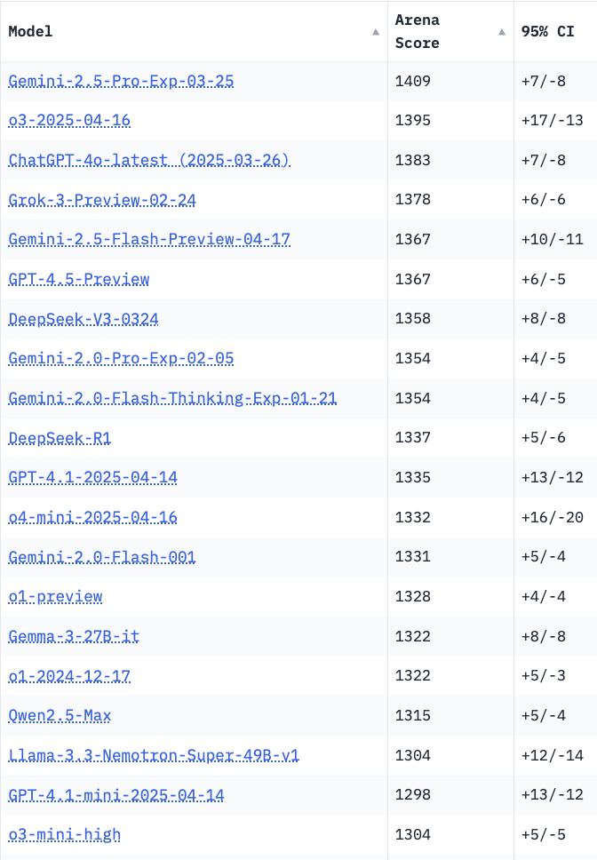
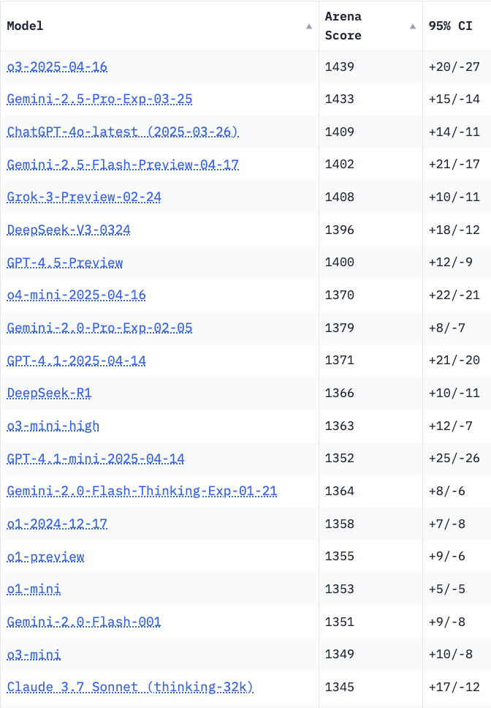
Crowd-sourced "LM Arena" Leaderboard
Starting Elo rating = 1000
95% CI = Confidence Interval
https://en.wikipedia.org/wiki/Elo_rating_system
Total #models: 229
Total #votes: 2,887,373
Last updated: 2025-04-22
https://chat.lmsys.org/?leaderboard
https://lmarena.ai/?leaderboard
https://openlm.ai/chatbot-arena/
https://beta.lmarena.ai
English-only queries
Coding
Chatbot Arena is now "Arena Intelligence Inc."
x.ai
LLM Leaderboard - by @LlmStats https://llmworld.net/llm_leaderboards/
LLM Leaderboard - by StackAI https://www.stack-ai.com/llm-leaderboard
LLM Leaderboard - by Artificial Analysis https://artificialanalysis.ai/leaderboards/models
Open LLM Leaderboard - by Hugging Face https://huggingface.co/open-llm-leaderboard
LLM Leaderboard - by Vellum https://www.vellum.ai/llm-leaderboard
Multiple Leaderboards: https://virtualizationreview.com/articles/2025/04/29/ais-heavy-hitters-best-models-for-every-task.aspx
x.ai
China
China
China
China
China
Llama-4-Maverick
is still on 30+ place

Slide 22
Can LM Arena be trusted?
LM Arena has a big problem
https://www.youtube.com/watch?v=4z-tYcFzWTA
https://arxiv.org/pdf/2504.20879 - paper
https://x.com/lmarena_ai/status/1917668731481907527 - response from LMArena
LM Arena is a ranking platform for LLMs. It has become the standard - and very influential - it affects venture capital investment decisions.
Providers upload models, platform provides pairs of model outputs that users rate through a Tinder-like interface. These "votes" determine the rankings.
Researchers from Cohere published a 69-page analysis of LM Arena.
They identified several issues with LM Arena's methodology:
1. sampling: the top 10 scoring models being sampled about three times more than others.
2. LM Arena unlists models without explanation
3. Most concerning, there are "private pools" that allow companies to game the system. For example, Meta published 27 variants of Llama 4 in March, learned the dynamics of the platform, and then silently deleted the poorly performing variants, keeping only the best ones. This manipulation allegedly boosted their score by about 100 points.
Cohere recommend to require that published models remain on the platform (no quiet deletions) and returning to the information gain-based sampling method
The Twitter community called the platform "flagrantly unscientific".
Andre Karpathy pointed to Open Router as a better alternative for ranking based on utility and cost-effectiveness.

Slide 23
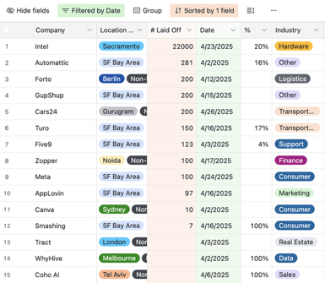
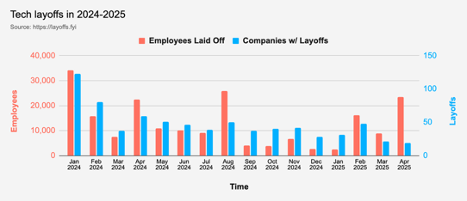
Jobs
https://layoffs.fyi
Intel is responsible for 22K out of 23K in April

Slide 24


About the Speaker
Lev Selector, Ph.D.
40+ years of software engineering, data science, and building teams (hiring, training, and managing)
Ph.D. in mathematical modeling and computer simulations
Interests:
Generative AI, Using LLM with your data
Local AI for Local Private Data
Cloud architecture, fin-tech, application security
Find/connect: Linkedin, GitHub, YouTube, Google
https://eais.ai
Enterprise AI Systems

Slide 25
Thank You!

