Slide 1
AI Updates
November 29, 2024
Qwen QwQ-32b from Alibaba - open source
Matrix from Alibaba - infinite video generation
Nvidia Sana-1.6B
Nvidia HyMBA
Self-Evolving LLM from Writer.com
Runner H from HCompany.ai
Uber doing data labeling service
daily.ai - generate newsletter using AI
Mistral is opening an office in Palo Alto
Runway "Frames" - AI Image Creation
Boosted.ai "Alfa" for investment professionals
Windsurf AI Editor by Codeium
Chat LLM for Teams by Abacus AI
Anthropic Claude Styles
White House AI czar - rumors
Anthropic Model Context Protocol (mCP)
AWS multi-agent orchestrator
Boltz.One AlphaFold 3 level accuracy
Llava 01 (11B, China) - VLM with reasoning
Open Canvas from langchain.ai
Google Gemini Live - an AI voice assistant
Ai2 OLMo-2 7B & 13B open source
OpenAI Sora Leaked
Andrej Karpathy - cognitive core can be small
Ollama Tool Calling
Democracy and Tech Revolution
Anthropic - 18 Months to Catastrophe
Working with Grok-2 API
Crowd-sourced "Arena" Leaderboard
Tech Layoffs in 2024

Slide 2
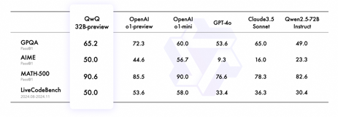
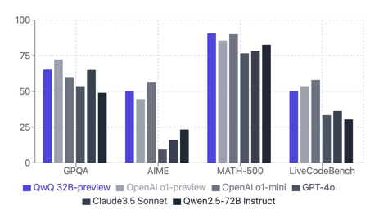
Qwen QwQ-32b from Alibaba
Qwen QwQ-32b is Alibaba's new LLM with 32 Bln parameters.
Open-source
Designed for advanced reasoning and self-reflection - competes with OpenAI's O1 mini reasoning model, outperforms GPT-3.5, Claude, and previous Qwen models.
QwQ excels in math and coding, demonstrates strong reasoning abilities in many tasks. Performs well in most programming tests, especially up to the "very hard" level.
Logical reasoning and safety tests show some limitations, with QwQ failing on questions involving nuanced understanding or potentially harmful instructions. Model has issues with with language mixing and code switching. Can sometimes go into recursive reasoning loops.
Overall very impressive.
GitHub: https://qwenlm.github.io/blog/qwq-32b-preview/
Tweet: https://x.com/Marktechpost/status/1861964229039071469
Try on hugginface:
https://huggingface.co/Qwen/QwQ-32B-Preview
https://huggingface.co/spaces/Qwen/QwQ-32B-preview
Testing video:
https://www.youtube.com/watch?v=QSA5tt-MVeA
https://www.youtube.com/watch?v=EWTWS1nghY0 - comparing with OpenAI o1-preview

Slide 3
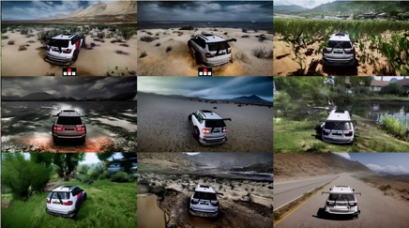
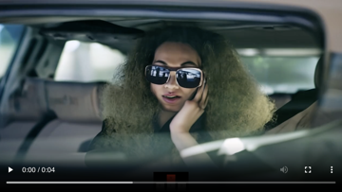
Matrix from Alibaba
The Matrix is a new AI model from Alibaba China that generates infinitely long, high-resolution, interactive video streams in real-time.
This is a significant breakthrough because previous models could only create short videos or struggled with interactivity.
Developed by researchers from Alibaba, the University of Hong Kong, and the University of Waterloo
The Matrix uses a video diffusion transformer and a novel method called shift window denoising process model (SDPM) to generate continuous video without limitations.
It incorporates an interactive module that allows users to control the simulation in real-time using inputs like keyboard commands.
The Matrix is trained on a massive dataset of both game footage (from games like Forza Horizon 5 and Cyberpunk 2077) and real-world videos.
Infinite video generation - creates continuous video streams without breaks or transitions
High resolution - generates 720p video at 8 to 16 frames/sec
Real-time interactivity - responds to user input instantly, allowing for dynamic control of the simulation
Domain generalization - can adapt to new environments and scenarios not seen in the training data
Open source - code, data, model checkpoints are publicly available
Use cases - Gaming, Autonomous vehicle testing, Virtual reality, Training and education
https://www.aibase.com/news/13389

Slide 4
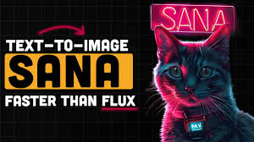
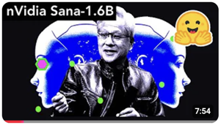
Nvidia Sana-1.6B
Nvidia Sana-1.6B: GenAI Model is 100X Faster than Flux AI!
Sana is significantly faster and smaller than existing models like Stable Diffusion XL
It's 20 times smaller and 100 times faster than Flux.
Can generate 4K images in seconds, even on laptop GPUs.
DCAE = Deep Compression Autoencoder - allows for 32x image compression, reducing memory usage
Open source, can be deployed locally
Several versions exist, including an ultra-compact 0.6 Bln params
Uses linear attention and a decoder-only text encoder for efficiency.
Requires only 9GB VRAM for the smallest model, and future quantizations will need even less
Hardware requirements are modest: 12GB VRAM recommended for the 1.6 billion parameter model Laptop with 16GB VRAM generated 1000x1000 images in under a second.
This new model could surpass Stability AI and Black Forest Labs in local generative AI, may lead to advancements in AI video generation on local GPUs

Slide 5
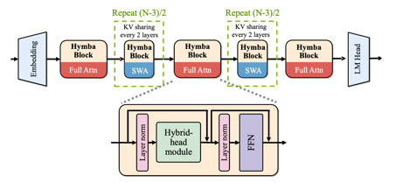
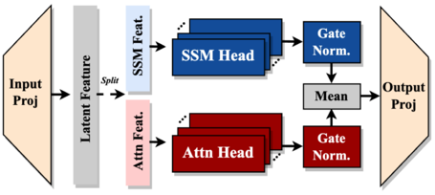
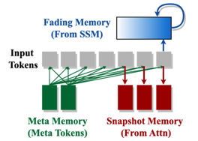
Nvidia HyMBA
HyMBA Model from Nvidia - for smaller devices, 8K context length, efficient and specialized. It utilizes "meta tokens" to provide task- or domain-specific knowledge to the model
Test-time algorithms, Adapter tuning, optimized for new NVIDIA chips that allow for parallel processing of Transformer and Mamba architectures.
Shared Key-Value Cache between attention heads and sliding window attention reduces memory usage needs
Mamba's Role - help process global context more efficiently, reducing memory needs for Transformer part
Attention Map Entropy: meta tokens help reduce attention map entropy, indicating stronger retrieval effects and better knowledge localization.
https://developer.nvidia.com/blog/hymba-hybrid-head-architecture-boosts-small-language-model-performance/

Slide 6



AI Updates 1
Self-Evolving LLM - by a startup called Writer.
These models can continuously learn and update their parameters, even after deployment.
Self-evolving LLMs have the potential to significantly reduce the costs as they don't require constant retraining
These models utilize a "memory pool" within their layers to store important information from past interactions.
Self-evolving LLMs show improved performance on benchmarks over time as they continue learning
Writer's self-evolving LLM is in beta testing with only two customers - workign on improving safety and performance
https://writer.com/engineering/self-evolving-models/
https://www.youtube.com/watch?v=B-4sW4RqboI
Runner H - an autonomous AI agent for robotics by a French Paris-based AI startup https://www.hcompany.ai founded by ex-Google employees, raised $220 Mln
2 Bln parameter LLM and a Visual language model (VLM)
Approach: compact, specialized models instead of large, generalist ones
Use cases: Robotic Process Automation (RPA), QA testing, automating workflows (like billing, ...)

Slide 7

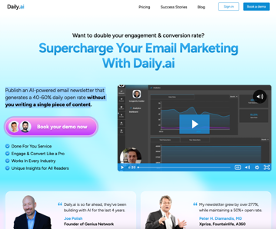
AI Updates 2
Uber Scaled Solutions - new division will hire workers to label data for AI models for Uber's own projects, and also for other companies like Aurora Innovation (self-driving cars) and Niantic (Pokémon Go) - https://www.uber.com/us/en/scaled-solutions/
daily.ai - https://daily.ai - Publish an AI-powered email newsletter that generates a 40-60% daily open rate without you writing a single piece of content
Mistral is opening an office in Palo Alto, California. The company is planning to hire U.S.-based engineers and scientists.
Runway "Frames" - AI Image Creation
Photorealistic quality and style control
Powered by Gen-3 Alpha and Runway's in-house API
Boosted.ai - AI assistant "Alfa" for investment professionals
Raised $15 Million
Alfa shrinks whole week of analyst work to about 20 minutes
Boosted.ai serves 300+ clients managing $3+ Trillion in assets

Slide 8

Windsurf AI Editor by Codeium
Windsurf AI Editor by Codeium - Cursor Alternative That's FREE & LOCAL (MCP, Image Support, Faster!) https://codeium.com/windsurf https://www.youtube.com/@codeiumdev
https://www.youtube.com/watch?v=_pFqyBoLGS0 - updates
AI-powered IDE (Integrated Development Environment) that helps you write code faster and more efficiently.
Uses a "context engine" to understand your codebase and provide relevant suggestions. Particularly good for complex projects with multiple files.
Built on "Cascade," an engine that combines AI with deep code understanding.
Offers features like terminal command integration, debugging, autocompletion, and multi-file editing.
More affordable than Cursor ($10/month vs. $20/month).
Image Upload - you can now upload images (like wireframes or mockups) directly into the IDE and Windsurf AI will generate code based on them. The video shows an example of creating a landing page from a simple sketch.
MCP = Model Context Protocol - Windsurf AI now uses Anthropic's MCP, an open standard that allows AI systems to connect with various data sources. This means the AI can access real-time data and provide even more relevant suggestions.
Unlimited access to Claude 3.5 !! Wow! Huge plus!
Note - there are multiple other free or paid AI editors:
VS Code with GitHub Copilot
VS Code many other extensions
Cursor (cursor.com) - stand alone app, fork of VS Code
idx.dev from Google
JetBrains IDEs with AI Assistant

Slide 9
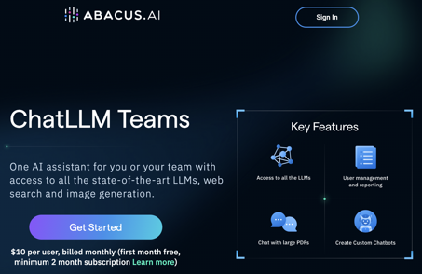
"Chat LLM for Teams" by Abacus AI
"Chat LLM for Teams" by Abacus AI - $10/user/month
https://chatllm.abacus.ai
https://www.youtube.com/watch?v=5CZQgl3zQXw
This SaaS AI tool helps to automate various GitHub tasks, including writing code, identifying and fixing errors, and creating pull requests, all within a browser.
Use the tool to connect with your GitHub account and select repositories and files for AI processing.
The AI can analyze your code, understand your instructions (e.g., "create a sidebar"), and generate or modify code accordingly.
The AI automatically creates pull requests with relevant titles, descriptions, and file changes, streamlining the code review process.
After review, you can merge the AI-generated changes into your main branch, effectively updating your live code.
This automation saves time and effort, especially for repetitive tasks.
Chat LLM for Teams offers other features like access to multiple LLMs, user management, chat with PDFs, custom chatbots, code editor, web search, image generation, and video generation.

Slide 10
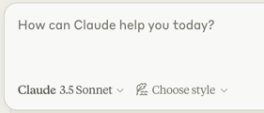
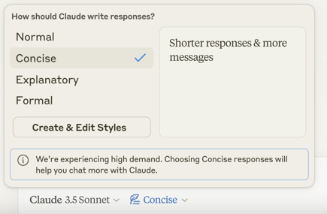
Anthropic Claude Updates
Anthropic Claude Preset Styles:
Normal, Formal, Concise, Explanatory
Users can also create custom styles
by uploading their own writing samples
to train Claude to mimic their specific style.
Anthropic announced that Claude can now read Google Docs
But this features doesn't work for me yet. Claude answers:
I cannot access Google Docs links. To help you, please copy and paste the document content directly into our conversation.

Slide 11
AI Updates 3
AWS multi-agent orchestrator - new open-source multi-agent AI framework (python & TypeScript) - https://github.com/awslabs/multi-agent-orchestrator
There are rumors that President-elect Trump is considering appointing a White House AI czar - a person who would be charged with focusing public and private resources to keep America at the AI forefront.
This role could be combined with a similar role for the crypto industry, but this is not certain.
The AI czar would not require Senate consent, allowing the person to get to work much more quickly.
One of the names thrown around for the role is Max Tegmark, an MIT professor and AI safety advocate.
Boltz.One - open-source model for biomolecular structure prediction achieves AlphaFold 3 level accuracy. Open and commercially available - https://blog.stackademic.com/boltz-1-open-source-biomolecular-interaction-modeling-with-python-and-r-code-tool-playground-77e1e660294b
Llava 01 (11B, China) - a new VLM (visual language model) with reasoning capabilities - https://arxiv.org/abs/2411.10440 - https://huggingface.co/blog/mikelabs/llava-o1-let-vision-language-models-reason It outperforms Gemini 1.5, GPT-4, and Llama 3 in reasoning
Senator Peter Welch has introduced a new bill aimed at making copyright enforcement easier when it comes to AI model training.
The bill would require AI developers to reveal training material to copyright holders if they have a good faith belief that their work was used to train the model.
Open Canvas https://github.com/langchain-ai/open-canvas offers an open-source UI for working with LLMs (like Llama3). It uses a reflection AI agent to store style rules and user insights, enhancing workflow integration and collaboration.
Google Gemini Live - an AI voice assistant that allows users to have natural conversations with Gemini
Anthropic tool for connecting AI assistants to external data sources called the Model Context Protocol (mCP). It is an open source standard for any model to draw data from business tools and software or content repositories. Anthropic has also shared pre-built mCP servers for Google Drive, Slack, and GitHub.
Ai2 (nonprofit AI research by Microsoft co-founder Paul Allen), released OLMo 2 ("open language model") - 7B & 13B - competitive with Meta Llama-3.1.
https://allenai.org/olmo
https://techcrunch.com/2024/11/26/ai2-releases-new-language-models-competitive-with-metas-llama/

Slide 12

OpenAI Sora Leaked
OpenAI’s Sora, a text-to-video AI model, has been leaked by a group of artists who were granted early access
The leaked version of Sora was temporarily available on a Hugging Face repository and several videos generated using the model were shared online before OpenAI shut it down
The leaked videos showcase Sora's ability to create highly realistic and creative videos, but also reveal some inconsistencies and areas for improvement.
OpenAI's Sora was originally released in February of 2024, but only a private release was made available. A public release has not been made at this time.
The artists, who were tasked with red teaming and providing feedback, released an open letter explaining their reasons for the leak. They objected to unpaid labor for a $150B company, have concerns about Sora's potential to replace artists without fair compensation, and having limited control over the creative process and use of generated content. They believed that the early access program was more about PR and less about genuine collaboration with artists
The leak has sparked discussions about artists' rights, fair compensation for use of their work in AI training data, and the ethics of AI development
The leakers encourage the use of open-source AI tools and artist-controlled datasets

Slide 13
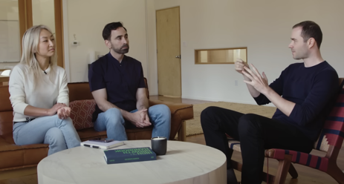
Andrej Karpathy
Andrej Karpathy on the importance of extremely smaller-sized distilled models
Cognitive core maybe small - even 1Bn param model should be good enough https://x.com/rohanpaul_ai/status/1846242281973486063
Original Video (Sep 5, 2024 ): No Priors: AI, Machine Learning, Tech, & Startups - https://www.youtube.com/watch?v=hM_h0UA7upI
Self-Driving cars can provide fully autonomous rides - transition is expected within the next few years
Karpathy believes Tesla is ahead of Waymo due to its focus on solving the software problem through massive data collection and end-to-end deep learning, while Waymo is hindered by its reliance on expensive hardware
Tesla is using expensive sensors like LiDAR at training time to distill information into a vision-only system for deployment
The transformer architecture, loss functions, datasets
Transformers exhibit impressive memorization capabilities, surpassing humans in certain cognitive aspects.
Karpathy believes that gradient-based optimization in transformers might be more efficient than learning mechanisms in the human brain.
AI Augmentation of Education is inevitable. Importance of STEM education (Science, Technology, Engineering, Math)
Eureka (Karpathy's AI Education Company) - first course aims to provide a deep understanding of AI concepts and is expected to launch early next year.

Slide 14
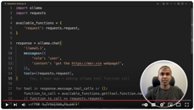
Ollama Tool Calling
import ollama
import yfinance as yf
from typing import Dict, Any, Callable
# ------------------------------------------------------
def get_stock_price(symbol: str) -> float:
# ...
return fast_info.last_price
raise Exception("Could not find valid price data")
# ------------------------------------------------------
get_stock_price_tool = { # tool definition
'type': 'function',
'function': {
'name': 'get_stock_price',
'description': 'Get the current stock price for any symbol',
'parameters': {'type':'object',
'required': ['symbol'],
'properties': {
'symbol': {'type': 'string',
'description': 'The stock symbol (e.g., AAPL, GOOGL)'},
},
},
},
}
# ------------------------------------------------------
prompt = 'What is the current stock price of Apple?'
print('Prompt:', prompt)
available_functions:Dict[str,Callable] = {'get_stock_price':get_stock_price,}
response = ollama.chat(
'llama3.2',
messages=[{'role': 'user', 'content': prompt}],
tools=[get_stock_price_tool],
)
if response.message.tool_calls:
for tool in response.message.tool_calls:
if function_to_call := available_functions.get(tool.function.name):
print('Calling function:', tool.function.name)
print('Arguments:', tool.function.arguments)
print('Function output:', function_to_call(**tool.function.arguments))
else:
print('Function', tool.function.name, 'not found')
In this video - https://www.youtube.com/watch?v=QzRPtorrZVo
Mervin Praison explains how to integrate Python functions with the Ollama LLM using a feature called "tool calling".
The code is here: https://mer.vin/2024/11/ollama-tools-call/
He starts by demonstrating how to create a custom tool to fetch stock prices using the Yahoo Finance library. He then shows how to register this tool with Ollama and use it to answer questions like "What is the stock price of Apple?".
Next, he explains how to use asynchronous tools for tasks like adding or subtracting numbers.
Finally, he demonstrates how to use existing Python functions, such as the requests library for making web requests, as tools in Ollama. He shows how to use this to fetch the HTML content of a web page.
Note: that all major vendors (OpenAI, Gemini, Claude) also offer function calling (tool calling, tool use, ...)
Function Calling
+/- numbers
Crawl URL

Slide 15


Democracy Might Not Survive the Tech Revolution
Peter H. Diamandis interviews Salim Ismail - a serial entrepreneur and technology strategist well known for his expertise in Exponential organizations. He is the Founding Executive Director of Singularity University, and the founder and chairman of ExO Works and OpenExO https://www.youtube.com/watch?v=u5wvklDW4mg
In a world of rapid technological advancement, our current democratic systems are struggling to keep up.
Traditional structures like nation-states are becoming obsolete, unable to effectively address global challenges such as climate change.
The rise of digital technology and abundance of information has made representative government less relevant.
The future of democracy may lie in decentralization and localized governance.
City-states and network states could offer more flexible and responsive alternatives to traditional nation-states.
These smaller entities would allow for greater self-determination and cater to the unique needs and values of their communities.
There are several ways to improve our current democratic systems without resorting to revolution.
Prioritizing local laws over federal ones would allow for greater flexibility and responsiveness to local needs.
Implementing "sunset clauses" for laws would prevent outdated regulations from remaining in effect.
Liquid democracy, where individuals can delegate their votes on specific issues to experts, could lead to more informed decision-making.
Disruption to traditional governance structures is inevitable, whether from within or outside existing systems.
Governments and companies must be willing to adapt and innovate to remain relevant in a rapidly changing world.
Virtual governments and network states may emerge as powerful alternatives to traditional governance models.
The abundance of information and technology available today necessitates a rethinking of our democratic processes.
Direct democracy, enabled by technology, could become a viable alternative to representative government.
New forms of governance may emerge that are better suited to the challenges and opportunities of the 21st century.

Slide 16
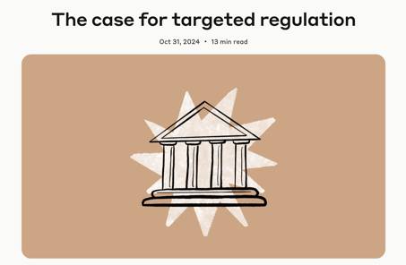
Anthropic - 18 Months to Catastrophe
Anthropic released an article warning that we have 18 months to implement AI safety regulations before catastrophic risks become a reality (October 31, 2024) https://www.anthropic.com/news/the-case-for-targeted-regulation
Exponential Growth of AI models capabilities creates potential for misuse (cybersecurity, bioweapons, ...)
Urgent government action required to implement AI regulations. "Responsible scaling policy" - continuous monitoring and adjustment of safety measures in proportion to AI capabilities.
The need for transparency from AI companies about their safety practices and the importance of independent verification to ensure compliance with safety standards.
Focus on empirically measured risks, regardless of whether a system is open source or closed source.
Balance Innovation and Safety - to ensure that regulations do not impose unnecessary burdens on AI development.

Slide 17
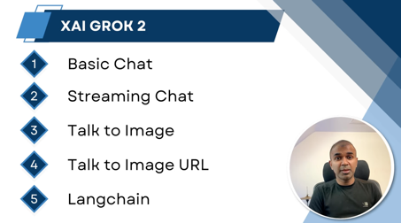
Working with Grok-2 API
# bash:
pip install -U openai langchain_xai chainlit
export XAI_API_KEY=XXXXXXXXXX
# python
client = OpenAI(
api_key=XAI_API_KEY,
base_url="https://api.x.ai/v1",
)
# 1. Basic Chat
response = client.chat.completions.create(
model="grok-beta",
messages=[
{"role": "system",
"content": "You are Grok, a helful chatbot."},
{"role": "user",
"content": "Give me a meal plan for me today"},
],
)
print(response.choices[0].message.content)
Grok 2 API - https://www.youtube.com/watch?v=T15R398-mUA
Code: https://mer.vin/2024/11/xai-grok-api-code/
Create API key: https://console.x.ai -

Slide 18
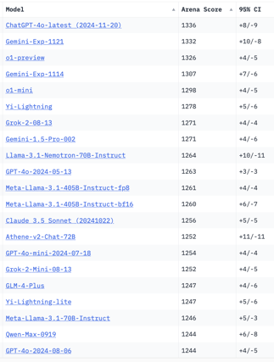
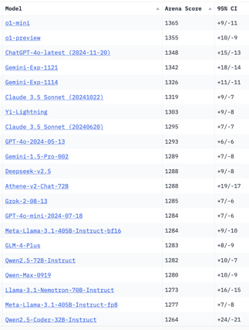
Crowd-sourced "Arena" Leaderboard
Total #models: 169.
Total #votes: 2,296,813.
Last updated: 2024-11-21.
Starting Elo rating = 1000
95% CI = Confidence Interval
https://chat.lmsys.org/?leaderboard
English-only queries
Coding
China
x.ai
China
x.ai
x.ai
China
China
China
China
China

Slide 19
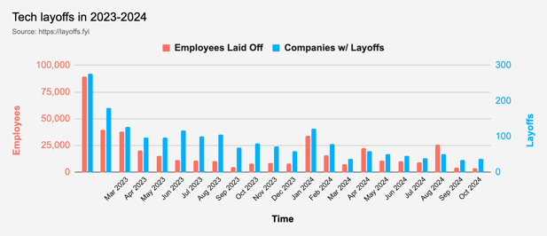
Tech Layoffs in 2024
Layoffs - https://layoffs.fyi
"Who is AI Replacing? The Impact of Generative AI on Online Freelancing Platforms" - paper October 2024
https://papers.ssrn.com/sol3/papers.cfm?abstract_id=4991774
The study found that AI tools have led to a decrease in demand for jobs in areas like writing and coding.
At the same time there is an increase in demand for individuals skilled in utilizing AI tools.
Job market for IT: much worse than before COVID.
IT has become a commodity. Lower salaries/rates ($100/hr => $75/hr).
Much more competition, hundreds of applications for each position
Legal: $8,000 work now can be done for only $3 in GPT credits.
Translation - mostly outsourced to AI
Phone Sales and Customer service

Slide 20
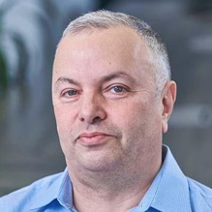

About the Speaker
Lev Selector, Ph.D.
40+ years of software engineering, data science, and building teams (hiring, training, and managing)
Ph.D. in mathematical modeling and computer simulations
Interests:
Generative AI, Using LLM with your data
Local AI for Local Private Data
Cloud architecture, fin-tech, application security
Find/connect: Linkedin, GitHub, YouTube, Google
https://eais.ai
Enterprise AI Systems

Slide 21
Thank You!

